Slide 1
Security Control Mapping
Firewalls • IDS/IPS • Segmentation • VPN • Traffic Monitoring | NIST CSF • ISO 27001 • CIS Controls • SOC 2
Team Members
• Poojan Patel
• Shilpa Soni
• Megha Sharma
• Vishnoo Rath
Sprint Review Presentation
Notes:
Poojan: Quick intro of team and what the project delivers (unified controls across 4 frameworks).

Slide 2
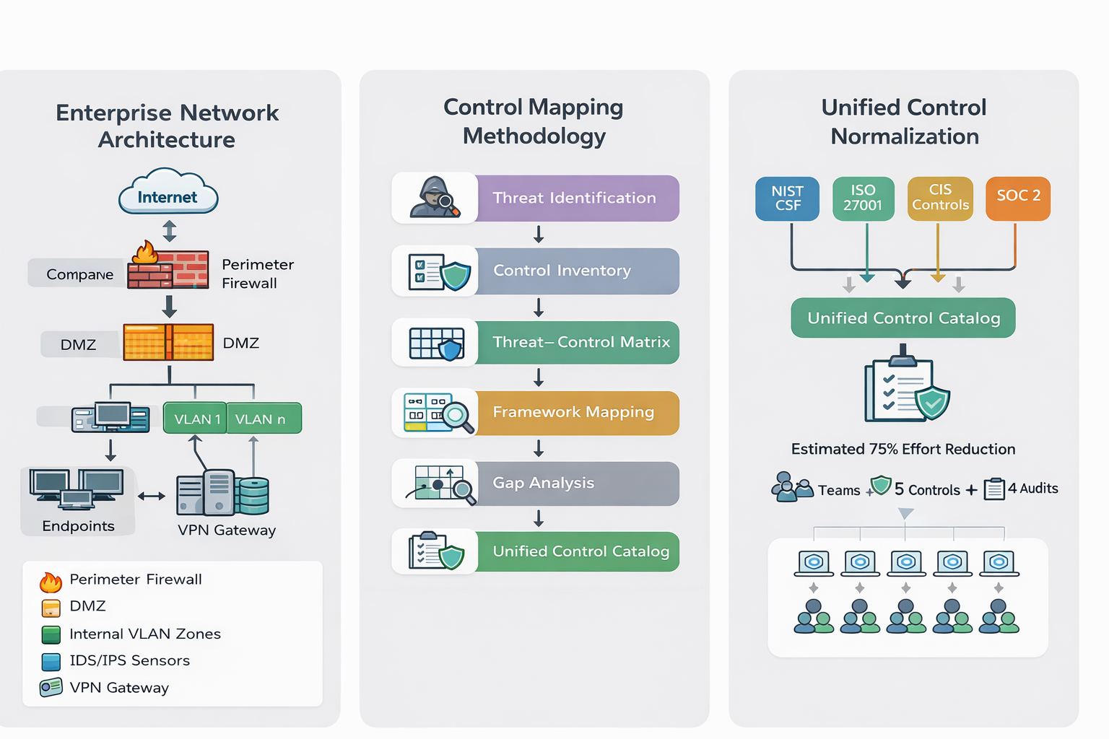
Agenda
What we will cover
Why control mapping matters (problem)
Framework analysis (NIST, ISO, CIS, SOC 2)
Mapping methodology (equivalence + gaps)
Unified control catalog (network controls)
Implementation guidance + evidence
Continuous compliance monitoring (KPIs)
Notes:
Poojan: Set expectations on flow and time.

Slide 3
The Problem: Compliance Duplication vs. Real Security
What organizations struggle with
Same control asked in different language across frameworks
Teams re-implement, re-document, and re-test for each audit
Evidence scattered across tools and owners
Gaps appear when controls aren’t mapped back to threats
Goal
Less duplication
More clarity + coverage
Approach
Build once
Implement & test once
Outcome
Reuse evidence
Across frameworks
Notes:
Shilpa: Explain the pain point in simple terms and why mapping saves time and improves consistency.

Slide 4
Framework Analysis: How They Differ (But Overlap)
Key lens
Common overlaps for network controls
• Boundary protection (firewalls)
• Secure access (VPN + auth)
• Detect anomalous traffic (IDS/IPS)
• Limit lateral movement (segmentation)
• Monitor & log (SIEM/telemetry)
NIST CSF: outcome & risk-based (flexible profiles)
ISO 27001: ISMS + audit-driven governance (PDCA)
CIS Controls: prescriptive technical safeguards (IG1–IG3)
SOC 2: assurance & evidence of operating effectiveness
Notes:
Megha: Compare frameworks quickly; emphasize overlap is objective-level but documentation/evidence depth varies.

Slide 5
Enterprise Network Architecture (Control Placement)
Key idea: place controls at boundaries + inside the network (east–west) and feed telemetry to a central monitoring layer.
Notes:
Vishnoo: Walk through where each control sits and why (perimeter vs internal).

Slide 6
Unified Control Catalog (One Set of Controls, Many Frameworks)
What we produced
A consolidated catalog of unified network controls (ID’d and normalized)
Each unified control maps to NIST, ISO, CIS and SOC 2 clauses
One implementation package → reusable evidence across audits
Catalog acts as input to gap remediation and continuous monitoring
Notes:
Shilpa: Explain normalization and why it reduces duplication; keep it practical.

Slide 7
Example Unified Control: Network Boundary Protection (Firewall)
What “good” looks like
Mapped requirements
• NIST CSF: PR.AC-5 (protect network traffic)
• ISO 27001: network controls (e.g., A.13/A.8.* controls)
• CIS Controls: secure network infrastructure (Control 12)
• SOC 2: logical access and network security (CC6.*)
Default deny + least privilege rules
Change approval + quarterly rule recertification
Central logging + alerting on anomalies
Evidence: config export, tickets, logs, review records
Validation: port scan + blocked traffic checks
Notes:
Megha: Use this example to show mapping + operational depth + evidence.

Slide 8
Implementation Guidance (Operational Depth)
Implementation model per unified control
Technical configuration (settings, baselines, integrations)
Governance process (approvals, reviews, segregation of duties)
Operational maintenance (patching, tuning, backups)
Evidence & artifacts (logs, configs, tickets, reports)
Validation tests (simulated attacks, control checks)
Evidence package (example)
• Config backup (monthly)
• Rule review records (quarterly)
• SIEM dashboards (weekly)
• Test reports (monthly/quarterly)
• Incident tickets (as needed)
Notes:
Vishnoo: Explain that implementation is not only technical; governance + evidence + testing matters.

Slide 9
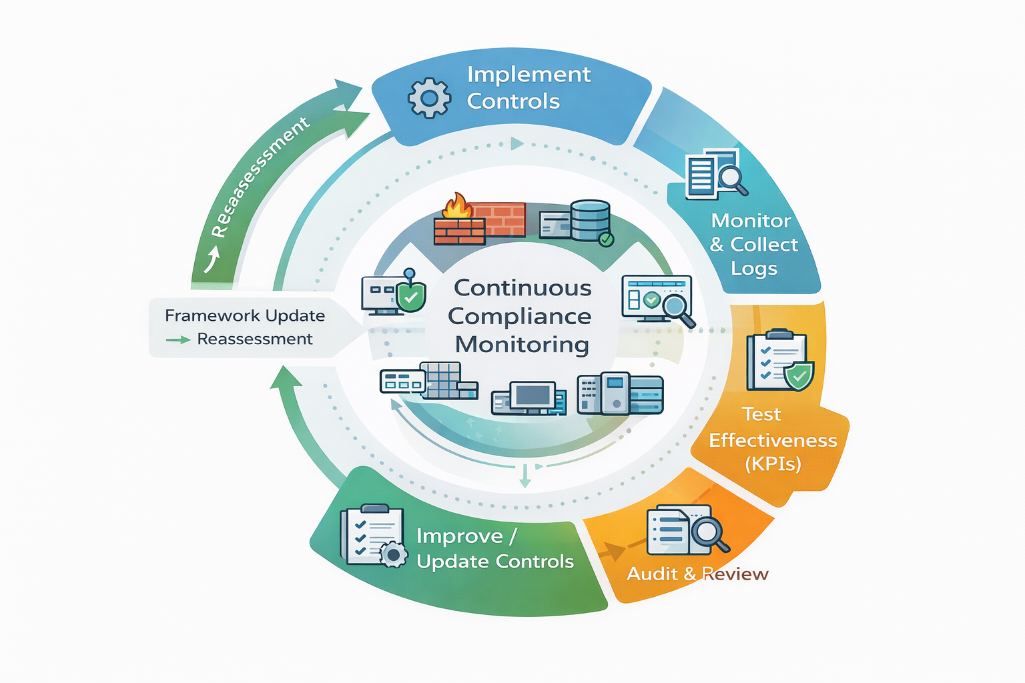
Continuous Compliance Monitoring (Keep Controls Effective)
Notes:
Poojan: Walk through the loop; emphasize KPIs, testing cadence, and reassessment when frameworks change.

Slide 10
AI Tools & Lessons Learned
How we used AI responsibly
Used AI to accelerate research and structure draft content
Cross-checked against framework docs and multiple sources
Captured prompts + validation notes in prompt logs
Refined outputs using equivalence criteria (Exact vs Partial)
Example prompts (short)
• “Map firewall controls across NIST/ISO/CIS/SOC2 with evidence artifacts.”
• “Define equivalence criteria for cross-framework control mapping.”
Notes:
Megha: Mention AI usage and how you validated outputs; point to prompt logs in repo.

Slide 11
Key Takeaways
1) Framework overlap creates duplication — mapping creates a common language.
2) Unified controls let teams implement once and reuse evidence across audits.
3) Operational depth + continuous monitoring keeps controls effective over time.
Q&A — We’re happy to answer questions
All members • Thank you
Notes:
All: Invite questions. Be ready for: framework choice, mapping criteria, AI validation, biggest gap found.

