Slide 1
Prayog Data Analytics
&
Information System
By Team Prayog

Slide 2
Objectives
To give a basic idea of the interface of the website
To understand the working of the dbms and its resource
To give a basic idea of working of data analysis and the tools required

Slide 3
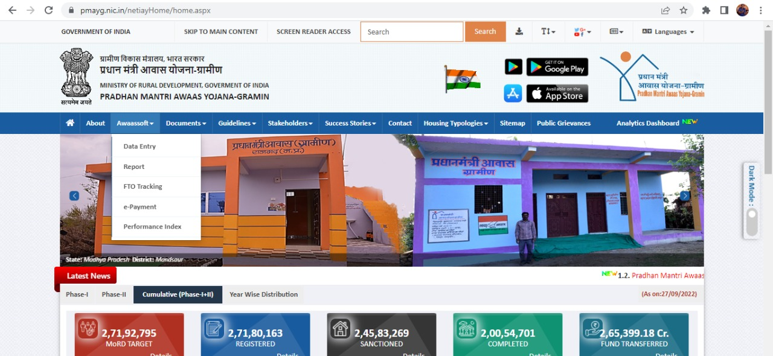
Features of our Interface
Various categories for the users to interact with the website
Drop down menu according to our requirement.

Slide 4
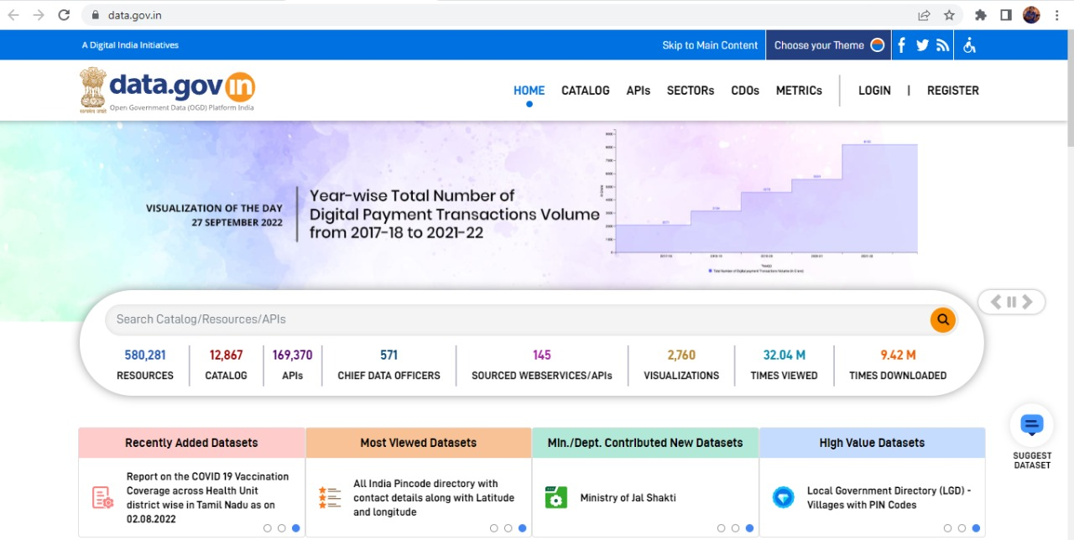
Slides showing most viewed datasets and recently added datasets.
Option for reporting bugs and taking feedback from the users.
User friendly and interactive.

Slide 5
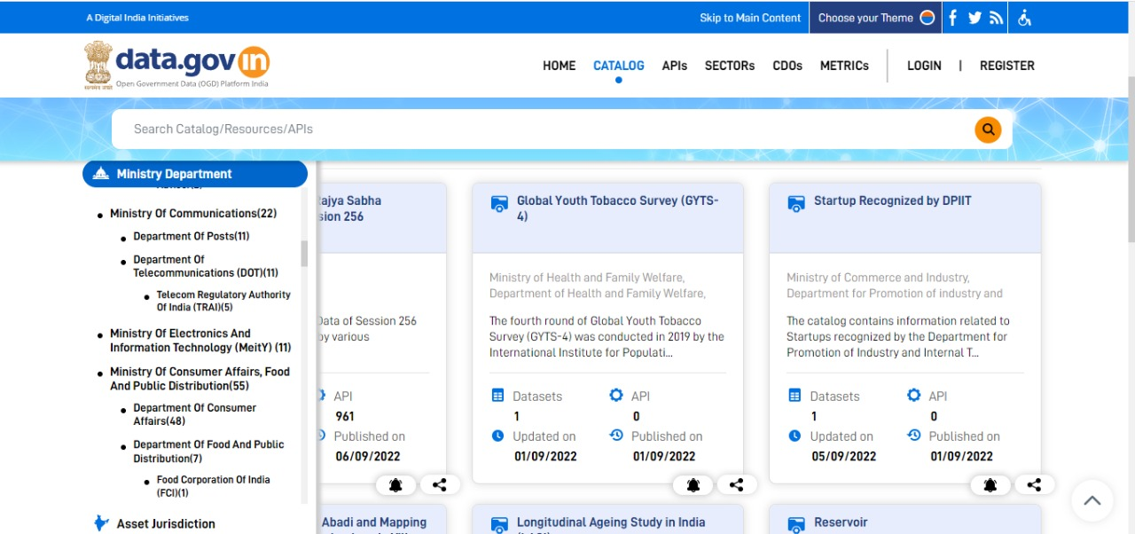
Schemes will be categorized according to its ministry.
After selecting a scheme the report for that scheme will be shown.

Slide 6
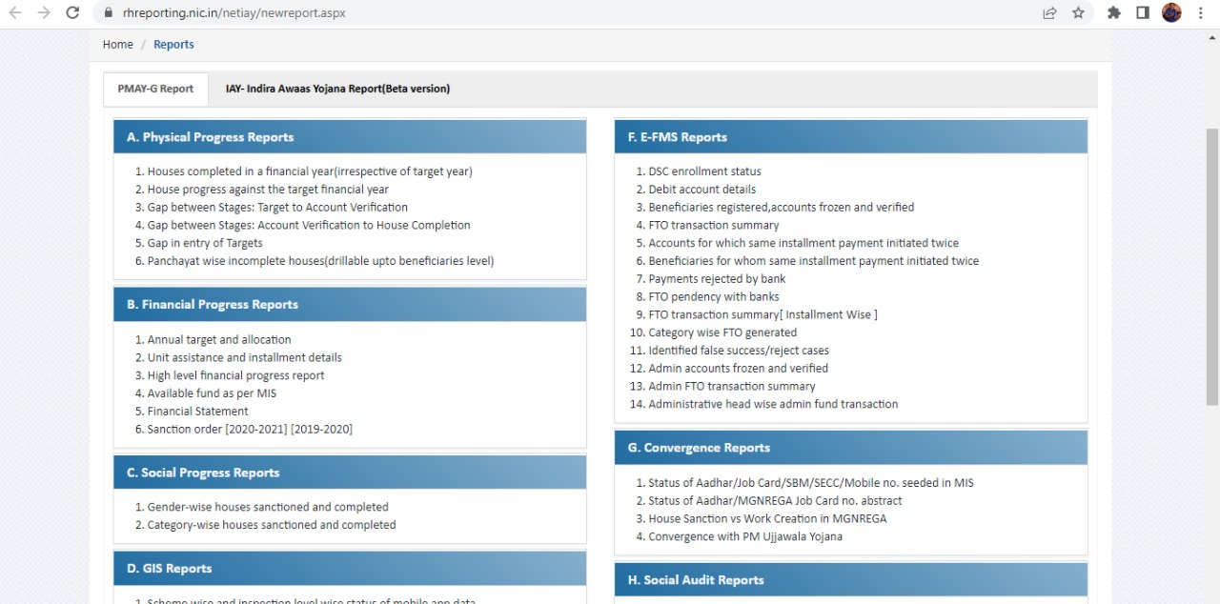
This is an example of how the reports will look.

Slide 7
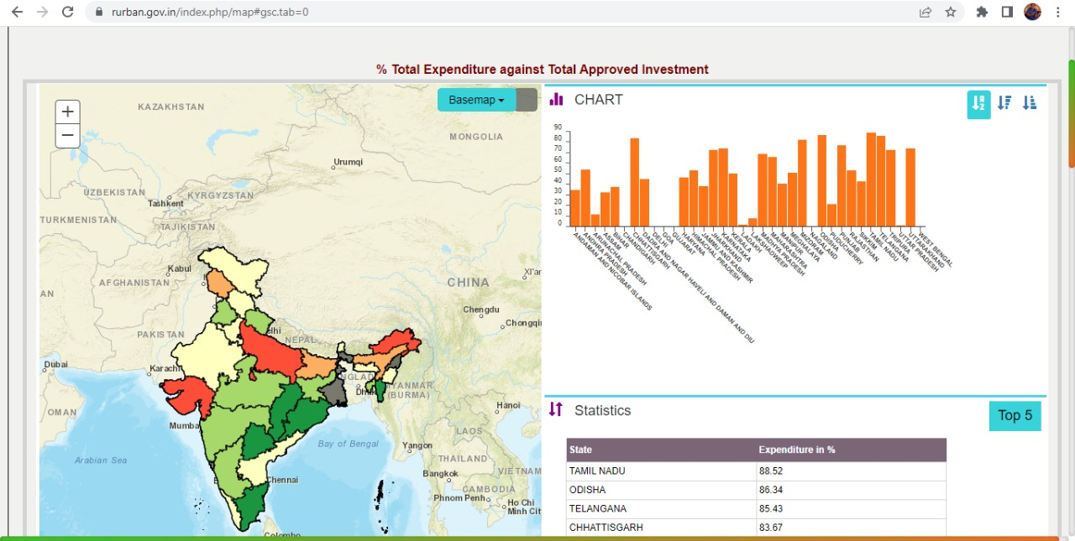
After clicking on a specific report it will show graphical data as well as tabular data of particular scheme.

Slide 8
DBMS
We will create a database that will be handled by the administrator.
The administrator will be able to do CRUD operations on the database.
To store the data regarding the reports in the database.
To host or send the graphs, maps and tabular data on the website when client sends a request after clicking on a report.

Slide 9
Data Visualization
Report and statistical data regarding the report would be stored in the database
When a client clicks on report which he/she wants to see for the data then after clicking on the report it will send a query to the database at the backend to send the data regarding the report to the website which would be shown on the website.

Slide 10
Literature review
https://data.gov.in/
https://rurban.gov.in/index.php/map#gsc.tab=0
https://rhreporting.nic.in/netiay/newreport.aspx

Slide 11
Conclusion

