Slide 1
Progress Presentation
By Team Prayog
Atharva Bhosale
Saklain Kazi
Nayaab Jindani

Slide 2
Introduction
This project is assigned to us by the officials of CTARA. The topic was finalised after having a discussion with our guide Dr Usha Raghavan and the CTARA officials. Also we added a new member to the group. The aim of the project is to develop prayog’s data analysis and information system which contains comprehensive government data analysis, insights, and reports of different government ministries.

Slide 3
Objectives
Creation of webpage
Back end development
Sample connection between the database and webpage

Slide 4
Front end development
We have started with the front-end development by creating a basic working home page of the website.
Along with it we have also created a feedback form for the user to give feedback, so that any bugs or issues on the website can be fixed.

Slide 5


Slide 6
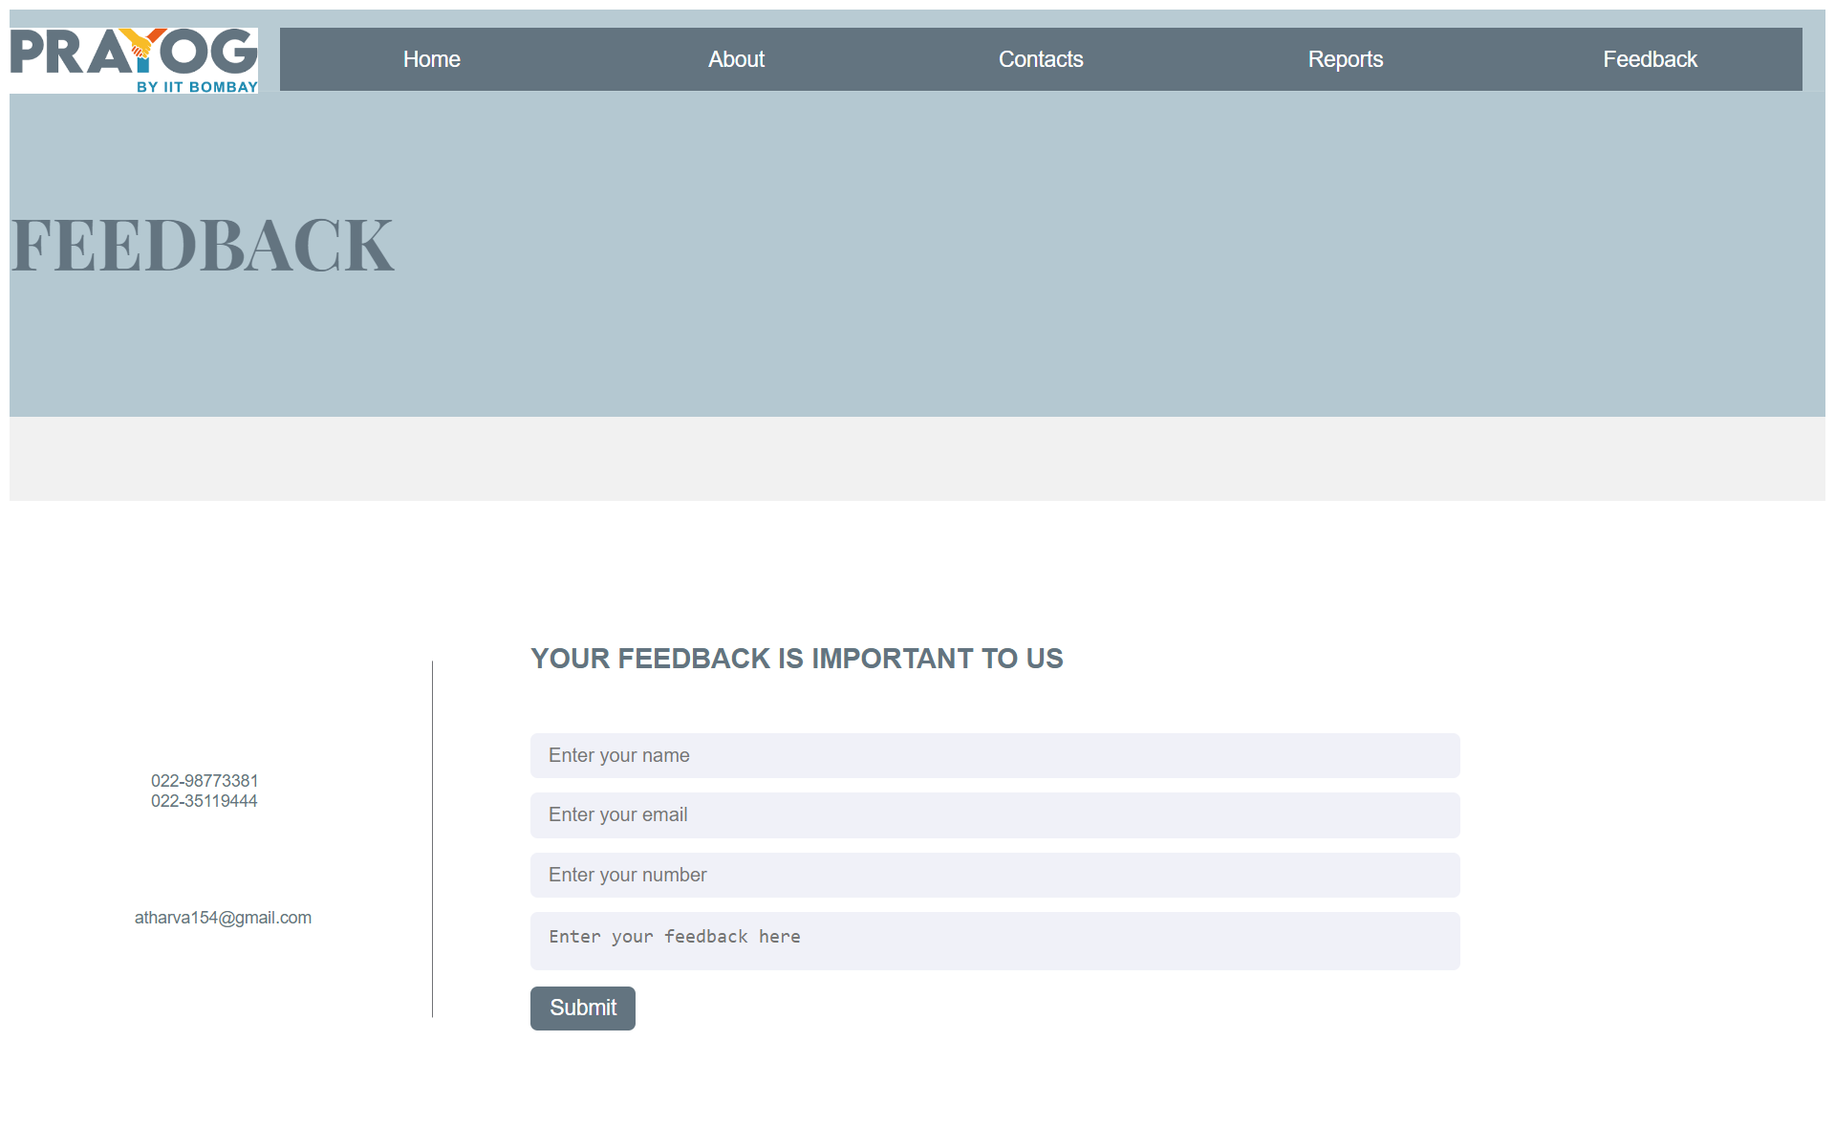

Slide 7
Back end development
For back end we will be creating a database for storing the reports and showing them on the website
For database we are using MySQL
For connecting the database with the website, we are using python language

Slide 8
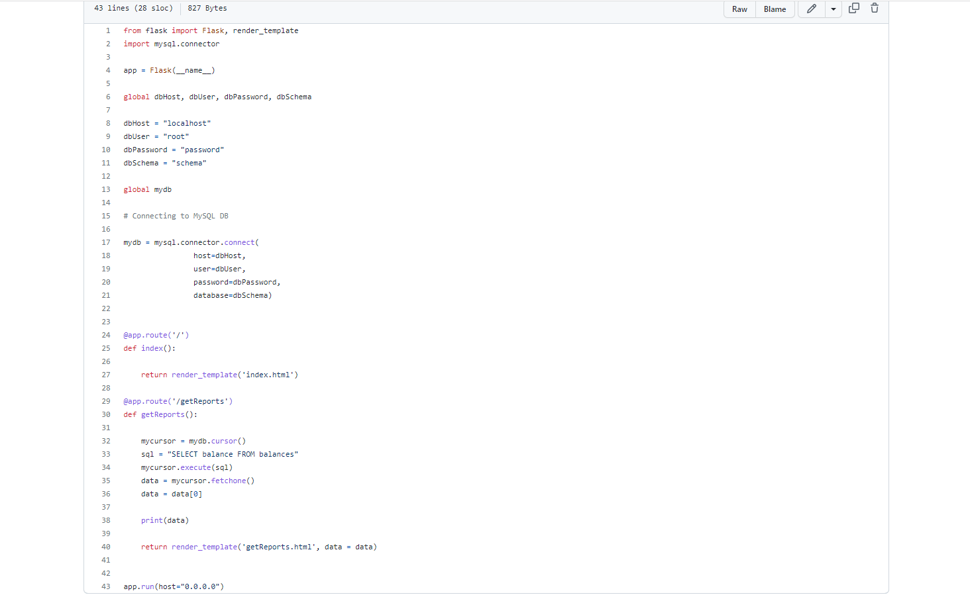
Sample code for connecting backend to the website.

Slide 9
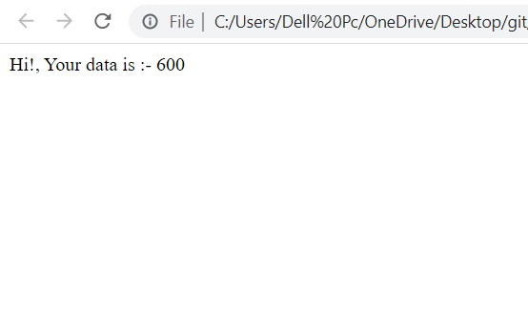

Slide 10
Future Goals
Further we are going to develop the different tabs of the website for showing the reports
We will be creating a proper structure and workflow for the database
Once connection between the database and the website will be established, we will work on the data analysis system.

Slide 11
Timeline
1st to 15th Nov
16th Nov to 5th Dec
6th DEC to 20th DEC
Development of working tabs & its functionalities
Data Visualization and it’s analysis.
Graphical Representation of data.
Creation of database structure &
its connection with webpage.

Slide 12
Conclusion
To summarize the work we have done until now-
Created a basic home page with an image slider and a feedback page.
Made a functional feedback tab.
Developed a sample connection between database and webpage.

Slide 13
THANKYOU

