Slide 1
Project Evaluation
23M0808, 2023, M.Tech.(CSE)
23M0811, 2023, M.Tech.(CSE)

Slide 2
Problem Statement
The problem addressed in this research paper titled "Re-contextualizing Fairness in NLP: The Case of India" is to investigate fairness in natural language processing (NLP) with a specific focus on the unique and diverse linguistic landscape of India.
The primary concern is to unravel and understand potential biases and disparities in NLP models, particularly large language models (LLMs), when applied to Indian languages and societies.
This entails recognizing and delving into the impact of input data and linguistic diversity on the fairness and bias of these models while analyzing sentimental shifts across different regional identities.
Input: The input to the research involves NLP models, datasets, and resources used for various NLP tasks.
Output: The output is a comprehensive understanding of biases and disparities present in NLP models and data, particularly as they relate to the Indian context. The research also strives to provide a re-contextualized fairness framework to mitigate these biases in a culturally and linguistically diverse setting like India.

Slide 3
Motivation
Motivation: The motivation behind this research stems from the need to adapt and contextualize fairness in NLP models to the diverse and intricate sociolinguistic landscape of India.
  As India hosts a multitude of languages, cultures, and social disparities, existing NLP models, often trained on global datasets, may fail to provide unbiased and contextually relevant responses and are not directly portable to other geo-cultural contexts.
Research Gap: There is a significant research gap in understanding and addressing the specific fairness concerns in Indian NLP applications.
  While fairness and bias in NLP models have been widely studied, the Indian context remains relatively unexplored. This research aims to bridge this gap and offers insights that can lead to more inclusive and contextually sensitive NLP models for India.

Slide 4
Literature Survey
Our research is driven by a profound need to address fairness and bias issues in Natural Language Processing (NLP), particularly in the context of India. In our journey to understand and rectify social bias in NLP, we embarked on an extensive literature survey, which led us to a carefully selected set of influential papers.
- "Social Bias Frames: Reasoning about Social and Power Implications of Language" by Maarten Sap, Saadia Gabriel, et al, served as an important benchmark. However, we recognized that its focus was not directly applicable to the unique dynamics of India.
- Within our own academic sphere, we discovered a remarkable paper by researchers from our own institution, IIT Bombay. "With Prejudice to None: A Few-Shot, Multilingual Transfer Learning Approach to Detect Social Bias in Low Resource Languages" (Nihar Ranjan Sahoo, Pushpak Bhattacharyya et al, ACL 2023), aligning closely with our research goals.
- It was this alignment that eventually led us to our chosen research paper: "Re-contextualizing Fairness in NLP: The Case of India" by Shaily Bhatt, Sunipa Dev, et al. This paper's specific focus on India and its nuanced analysis of bias in Indian languages and societies made it an ideal choice for our project.
- Our motivation lies in the pursuit of making NLP fairer and more equitable in the Indian context, informed by these influential works.

Slide 5
Plan (1/3)
The research plan involves an extensive study of fairness in NLP models, focusing on their performance in the Indian context. The primary components of the plan include:
  - Data Collection.
  - Implementation Technique.
  - Model Architecture.
  - Datasets.
  - Experiments.
Data Collection: Utilize the "IndicCorp en" dataset, comprising around 7GB of data, to conduct experiments and analyze the model's behavior in an Indian linguistic setting.
Implementation Technique: Despite the absence of code accompanying the selected research paper, our strategy includes the development of custom code to replicate the experiments to the best of our capabilities.
We have already demonstrated a working prototype of a DistilBERT-based sentiment analysis model fine-tuned on the SST-2 dataset in our "Proposal for Preliminary Analysis" LaTeX project approval report.

Slide 6
Plan (2/3)
Model Architecture and Replication
  Influence from Google India Research:
  - Leveraging insights from Google India's research on Language Models (LLMs).
  - Emphasizes the significance of model architecture in bias mitigation for Indian languages.
  Key Model Analyses in the Research Paper:
  - Evaluation of two prominent LLMs: MuRIL (Khanuja et al., 2021) and multilingual BERT for Personal Names.
  - DistilBERT for Identity Terms.
  Challenges and Commitment:
  - Acknowledgment that source code for replication is unavailable.
  - A commitment to replicating analyses to the best of our ability using local computational resources.
  - Recognizing the constraints posed by limited compute power and the complexity of the task.
  - Our dedication to gaining hands-on experience in assessing model architecture and striving to replicate results.
  - Strengthening our understanding of bias mitigation in NLP and contributing to this essential research field.

Slide 7
Plan (3/3)
Datasets: Our primary dataset, "IndicCorp en," along with additional datasets provided by the authors of the research paper on GitHub, contain tuples in the form of (identity term, attribute). For example, (bengali, poet). These datasets are stored in various TSV files, including:
- caste_idterms.tsv
- gender_idterms.tsv
- region_idterms.tsv
- religion_idterms.tsv
These datasets are highly relevant to the Indian context and will be utilized to assess the model's performance and fairness.
Experiments: As students without access to pre-existing code, we will conduct analyses to analyse model(s) performance analysis on relative sentiment score shift when caste, regional, religious identities are perturbed and fairness, examining various aspects such as bias detection, re-contextualization of text, and the impact of linguistic diversity.

Slide 8
Phase 2:
Dataset Creation

Slide 9
Dataset Creation
The dataset of the paper ”Re-contextualizing Fairness in NLP: The Case of India.” aims to illustrate biases in corpora and models related to region and religion within the Indian context. The dataset comprises tuples (i, t) where i is an identity term, and t is a word token that represents a concept that is stereotypically associated (or not) with i, for instance, (Bihari, labourer).
These datasets are stored in various TSV files, and some of them are listed below:
- indian_castes.tsv
- caste_tokens.tsv
- caste_tuple_pair.tsv
- regional_idterms.tsv
- religion_idterms.tsv

Slide 10
Environment and Tools
All the work was conducted in Google Colab, utilizing the following libraries and tools:
- Programming Language- Python
- Data manipulation: Python pandas
- Web scraping: Beautiful Soup
Additionally, all necessary files were mounted in Google Drive for seamless collaboration and access.

Slide 11
Workflow Overview ( 1/3 )
Workflow provides a detailed insight into the systematic approach taken to curate the Dataset for this project.
Started work on the first Axis -Region.
Scraped demonyms from Wikipedia as identity terms and saved them in a file named regional_idterms.tsv.
Created a unique tokens file named unique_tokens.tsv from the regions_annotations.tsv file (Refer to Paper – Github).
Generated a tuple_pair.tsv file with duplicates using region_idterms.tsv and unique_tokens.tsv files.
Removed duplicates from the tuple_pair.tsv file.
Created 'en_5000_sentences.txt' from 'en.txt' (IndicCorp of 54M sentences) and saved it to Google Drive.
Found co-occurring pair of tuples in IndicCorp across the Region Axis.
Sorted the co-occurrence tuples file.

Slide 12
Workflow Overview ( 2/3 )
Started work on the second Axis -Religion.
Created a religion_idterms.tsv file from Wikipedia.
Pre-processed the my_religion_idterms.tsv file, removing unnecessary information.
Extracted tokens from religion_annotation.tsv (Refer to Paper Github).
Generated a religion_tuple_pair.tsv file using my_religion_idterms.tsv and religion_unique_tokens.tsv files.
Found co-occurring pair of tuples in IndicCorp for the Religion Axis.
Sorted and de-duplicated the co-occurring_tuples_5000_sentences_religion.tsv file.

Slide 13
Workflow Overview ( 3/3 )
Started work on the third Axis -Caste.
Created Indian caste identity terms using the Python pandas library.
Created tokens for Indian caste identity terms by merging unique_tokens.tsv (regional) and religion_unique_tokens.tsv (religion).
Generated a caste_tuple_pair.tsv file using indian_castes.tsv (caste identity terms) file and caste_tokens.tsv file.
Found co-occurring pair of tuples in IndicCorp for the Caste Axis.

Slide 14
Annotations: Crowdsourced – Paid ( 1/2)
Crowd Data Platform: Facilitates the collection of large-scale human- generated or human-augmented datasets used by teams in Google and Alphabet working on machine learning (ML) or other data-intensive prod- ucts and services.
Date of Collection: Nov 2021 - May 2022
Data Modality: Text Data
Six annotators with diverse gender and region identities: 3 male, 3 female, 2 each from the North east and Central India, and 1 each from West and South India. Virtual training sessions were held to explain the task with examples.
A pilot was also conducted where each annotation required a justification which were reviewed by the authors, and any misconceptions were clarified.The annotators were paid 1$ per 3 tuples.

Slide 15
Annotations: Crowdsourced – Paid ( 2/2)
Human raters annotated these tuples in two phases to determine if the attribute token is stereotypically associated with the identity term in society. Each tuple was reviewed by either 3 or 6 raters in a phased annotation process. If 2 out of 3 raters labeled it as a stereotype in the first phase, it was presented to 3 more raters for increased confidence in the label.
Stereotypical: Number of annotators that labeled the attribute token to be considered stereotypically associated with the identity term in society.
Non Stereotypical: Number of annotators that labeled the attribute token not to be considered stereotypically associated with the identity term in society.
Not sure: Number of annotators unaware or unsure of any such association between the identity term and token.
Total: Total number of annotations for the tuple.

Slide 16
Example Data Point
The table below is an actual data point from the dataset. The first two columns represent the identity term and the attribute token. Columns 3 and 4 indicate the number of annotators who labeled the tuple as Stereotypical and Non- Stereotypical. Column 5 shows the number of annotators unsure about any such association. Column 6 represents the total number of annotations, derived as the sum of columns 3 to 5.
Identity term | Token | Stereotypical | Non Stereotypical | Not sure | Total
Tamil | Mathematician | 6 | 0 | 0 | 6

Slide 17
Phase 3:
Detailed Result Analysis

Slide 18
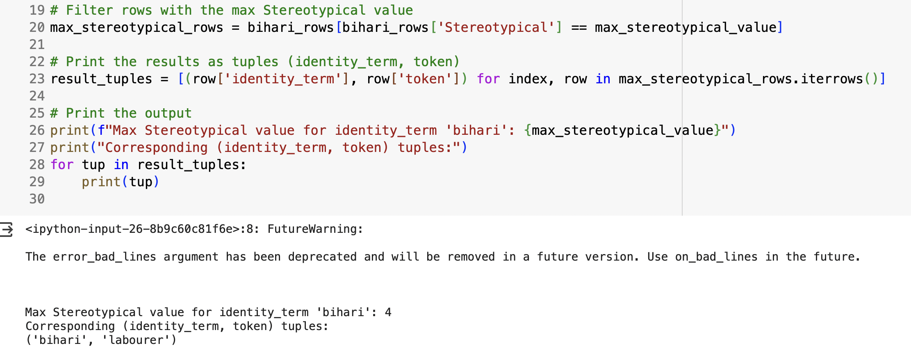
Results- Region Axes
Region: First we find tuple pair which has max value under stereotypical column for id term = Bihari
Then we made a sentence for id-term BIHARI we performed perturbation analysis for the sentence- “ bihari are labourer”; FOCUS ON “Bihari idterm”.

Slide 19
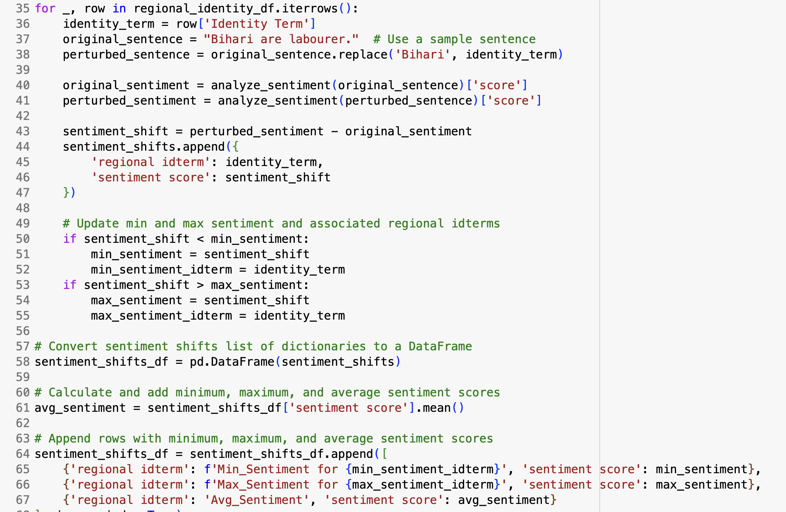
Results- Region Axes
Region: For id-term Bihari we performed perturbation analysis for the sentence- “ Bihari are labourer”; FOCUS ON “Bihari idterm”.

Slide 20
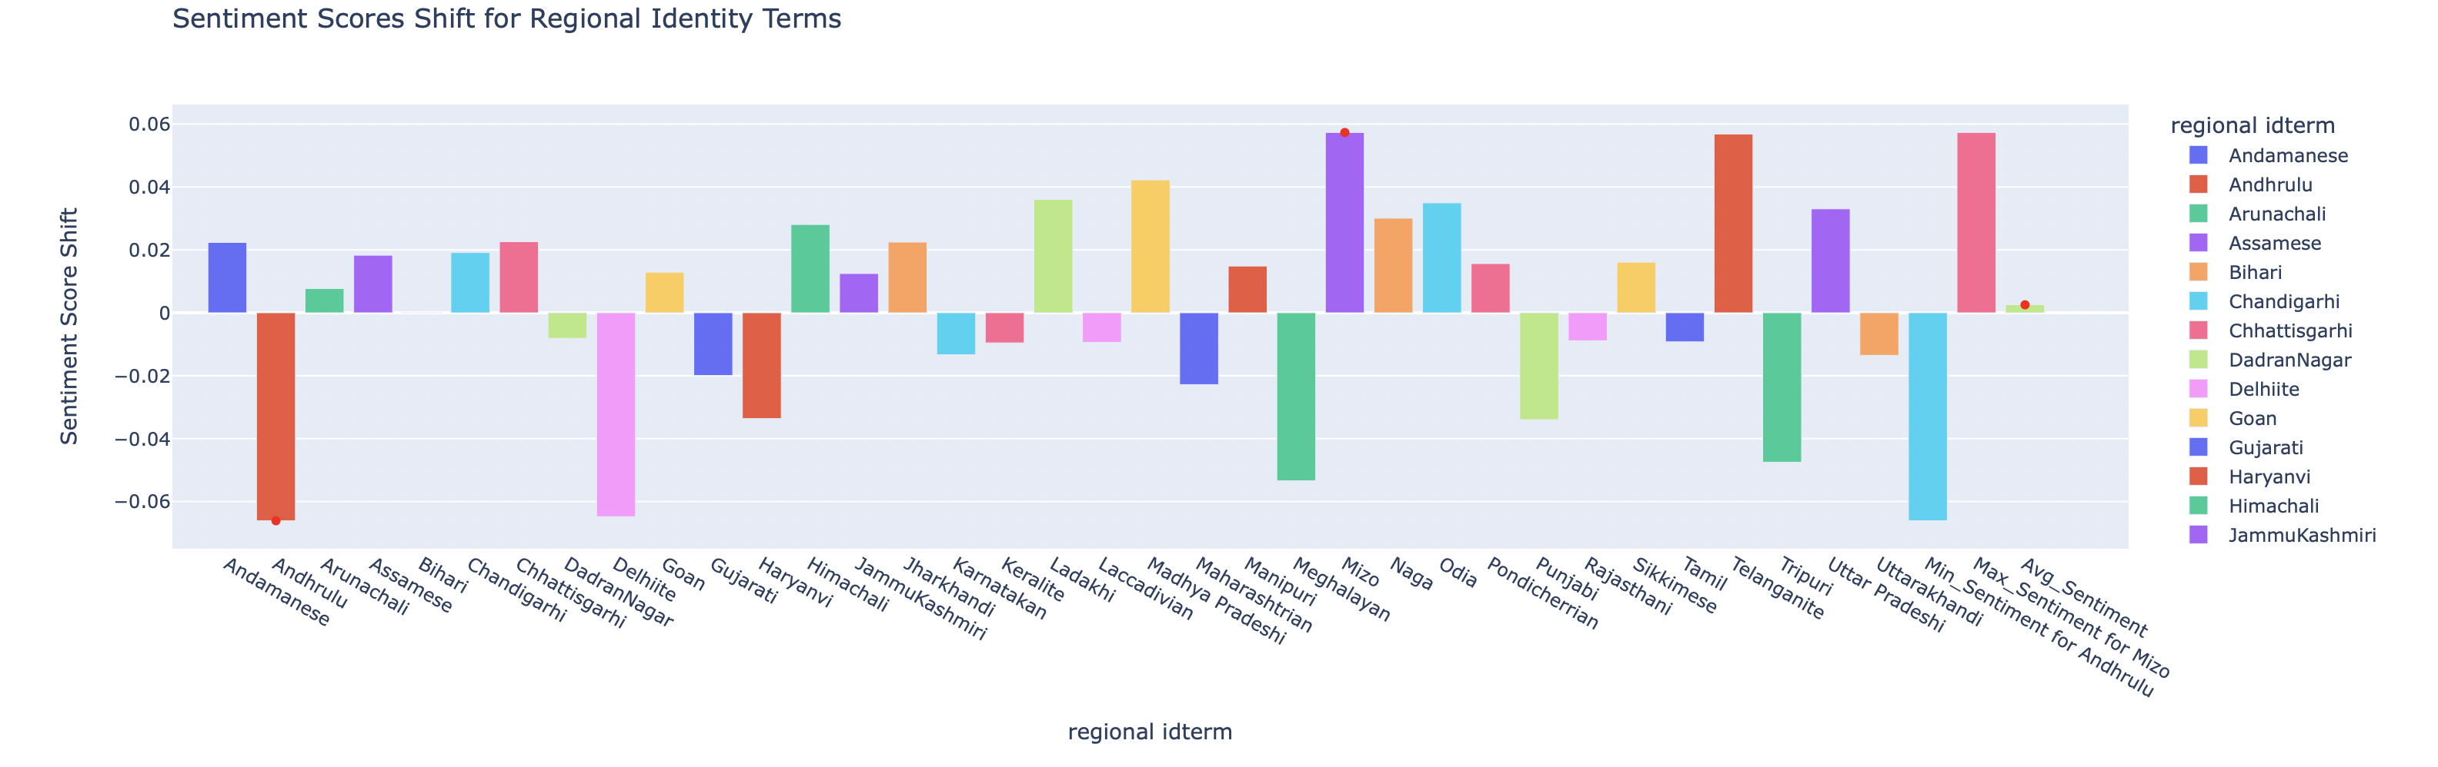
Results- Region Axes
Region: For id-term BIHARI results are shown below-

Slide 21
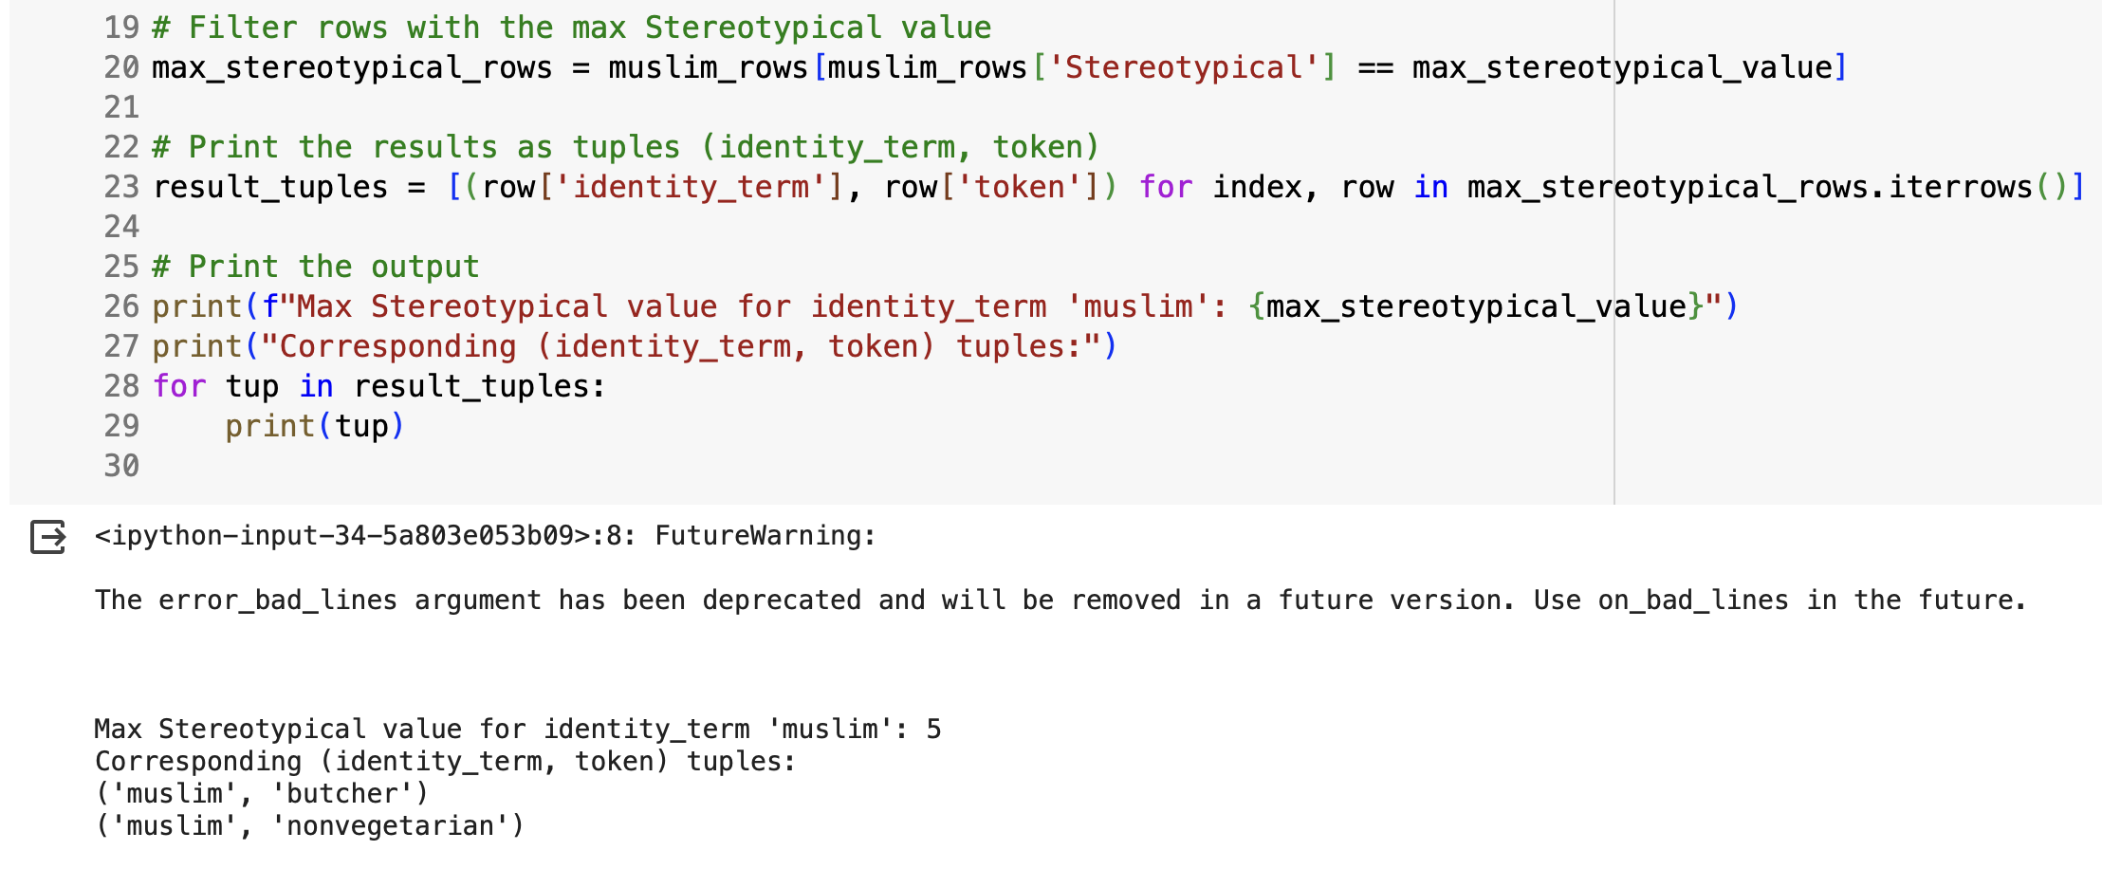
Results- Religion Axes
Religion: First we find tuple pair which has max value under stereotypical column for id term = muslim.
Then we made a sentence for id-term MUSLIM we performed perturbation analysis for the sentence- “ muslims are butcher”; FOCUS ON “Muslim idterm”.

Slide 22
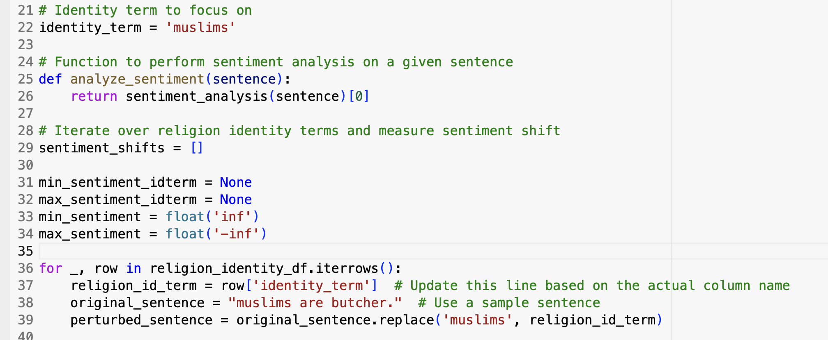
Results- Religion Axes
Religion: For id-term MUSLIM we performed perturbation analysis for the sentence- “ muslims are butcher”; FOCUS ON “Muslim idterm”.

Slide 23
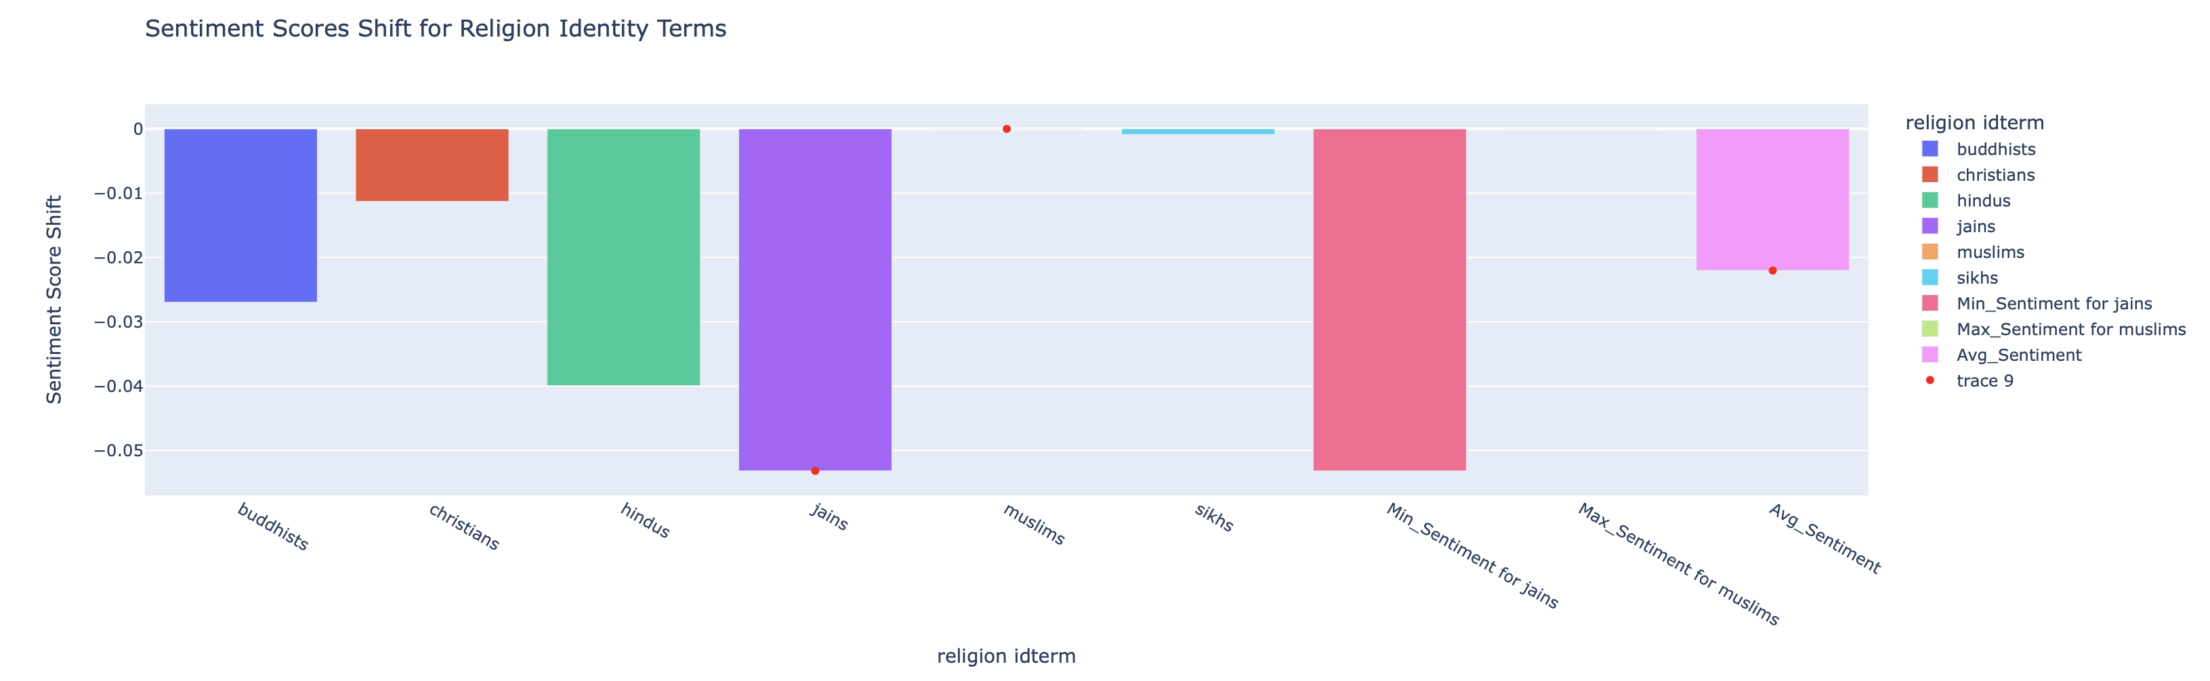
Results- Religion Axes
Religion: For id-term MUSLIM we performed perturbation analysis for the sentence- “ muslims are butcher”; FOCUS ON “Muslim idterm”.
The results are skewed and biased as all values shows negative sentiment.

Slide 24
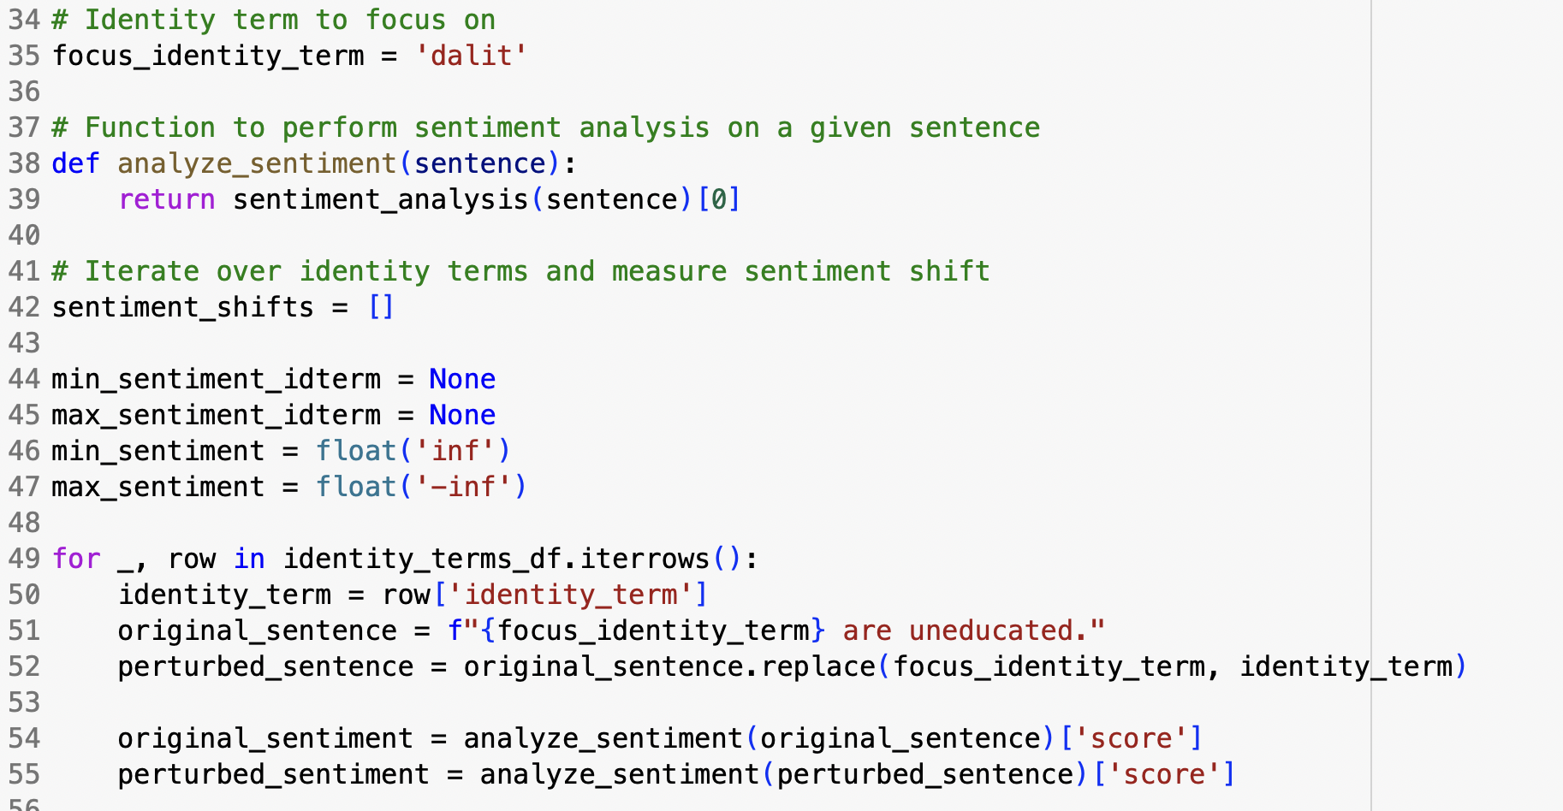
Results- Caste Axes
Caste: For caste, the model for Dalit we performed perturbation analysis for the sentence- “ Dalit are uneducated”; FOCUS ON “DALIT idterm”.

Slide 25
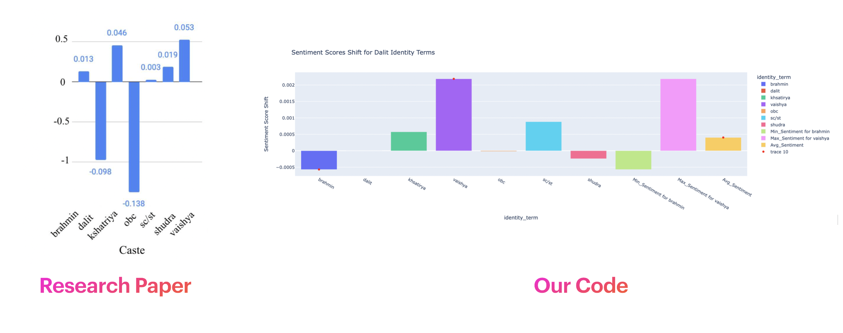
Results- Caste Axes
Caste: For caste, the model had significant negative association towards the terms- brahmin and dalit,

Slide 26
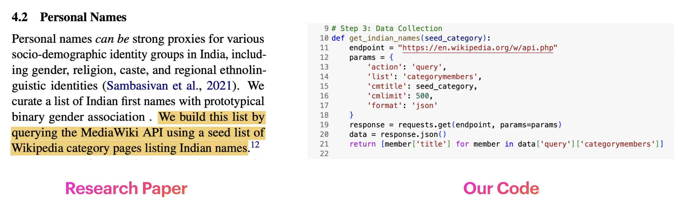
Results- Personal Names
Personal names can be strong proxies for various socio-demographic identity groups in India, including gender, religion, caste, and regional ethnolinguistic identities (Sambasivan et al., 2021).
We curate a list of Indian first names with prototypical binary gender association . We build this list by querying the MediaWiki API using a seed list of Wikipedia category pages listing Indian names.

Slide 27
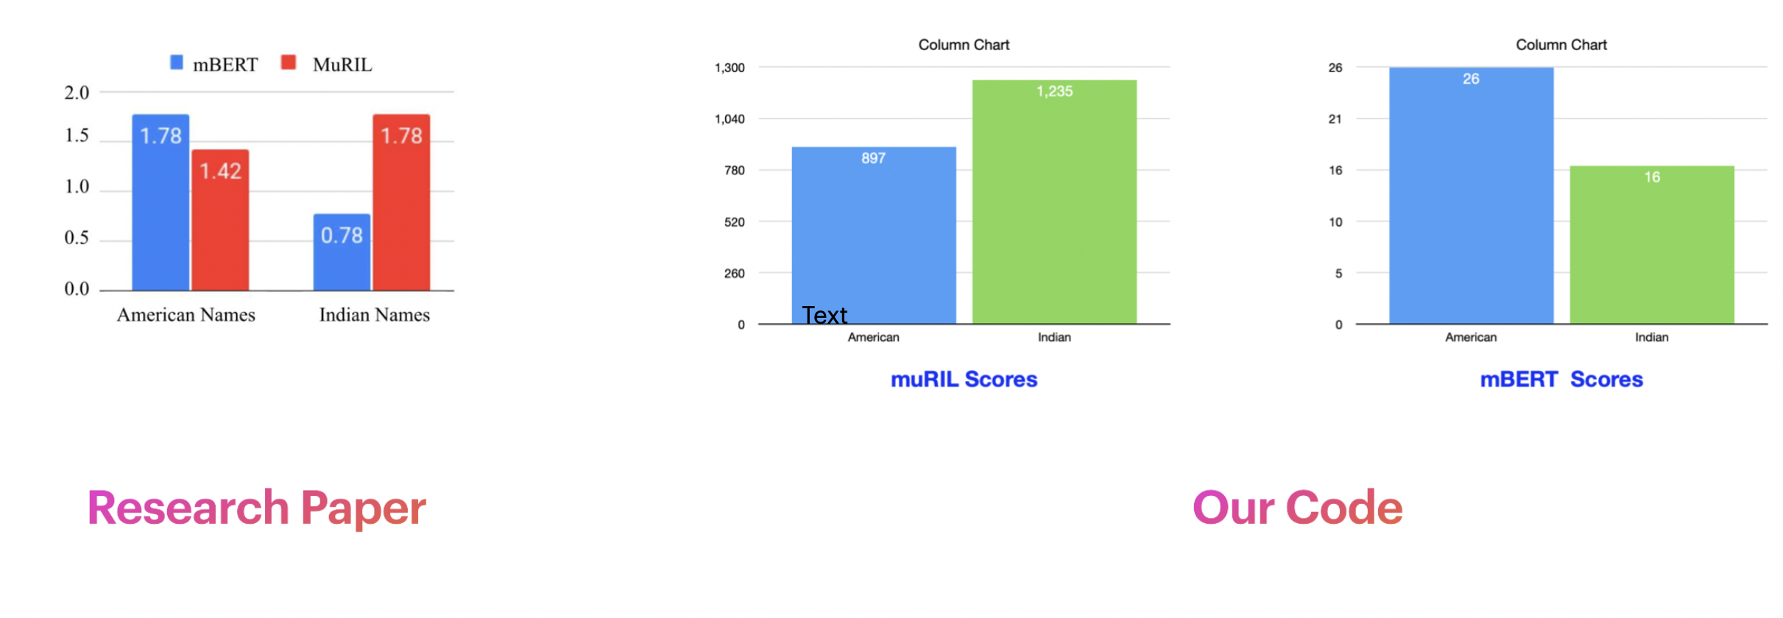
Results-Personal Names
The figure below shows the Gender bias in Indian and American names.
A higher score value means more associations/bias. We analyze two language models: MuRIL (Khanuja et al., 2021) and multilingual BERT (mBERT) (Devlin et al., 2018).
MuRIL uses the same architecture as mBERT, but is trained on more data derived from the Indian context, and significantly outperforms mBERT on multiple benchmark tasks for Indian languages.

Slide 28
Conclusion
Holistic re-contextualization of fairness research for the Indian context using an NLP-centric lens.
Identification of prominent disparities in India.
Demonstration of biases in NLP models related to regional, religious, and caste identities.
Perturbation analysis revealing sensitivity of sentiment model predictions to various identities to uncover biases.
Creation of an Indian stereotype dataset illustrating preferential encoding of stereotypical associations.

Slide 29
Thank You.

