Slide 1


Literature review of Challenges and Potential solutions associated with fast switching SiC devices
Presented by: Rajat Sankhla
Guided by : Prof. Sandeep Anand

Slide 2
Contents
Motivation of using SiC devices.
Advantages of SiC devices.
Challenges
Oscillations in the Gate Loop
Cross Talk Effect
Gate Impedance Regulation.
Gate Voltage Reduction.
Fault detection and protection.
High Frequency Magnetics Design.
Solutions for reducing dv/dt

Slide 3
Motivation of using SiC devices
High Efficiency
High Power Density
Reliability
PERFORMANCE
Notes:
With the ever rising energy demand and rising pollution levels, the need of efficient and clean energy has also increased. Extracting clean and cheap energy requires the usage of highly efficient conversion stages.

Slide 4
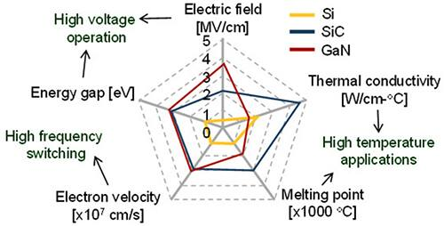
Advantages of Using SiC devices
https://www.google.com/url?sa=i&url=https%3A%2F%2Fwww.researchgate.net%2Ffigure%2FComparison-between-key-material-properties-SiC-vs-Si-vs-GaN_fig5_331397976&psig=AOvVaw2xBRjL2uOGU0EbV6GOXFvL&ust=1669362061580000&source=images&cd=vfe&ved=2ahUKEwi879y2qMb7AhUPi9gFHSQaCSYQr4kDegUIARDLAQ
Notes:
High temperature operation →High Energy gap→ Strong atomic Si-C bond provides a bandgap of 3.2eV against 1.1eV
High Voltage operation → Critical Electrical Field 2500kV/cm (9-10 times) allows formation of thinner layer and heavily doped layer that can block higher voltages.
High Thermal Conductivity→ Low thermal resistance and faster removal of heat.
High Frequency Operation→ 1.)Drift Velocity 2 times that of Si, allows faster removal of charges in depletion region.
2.)Smaller parasitic capacitors allows faster turn on and turn off enabling high frequency operation.
Lower Conduction losses→ Heavily doped layer reduces the on state resistance.

Slide 5
Challenges
Challenges
Ringing
Cross Talk
EMI
Fault detection and protection
High Frequency Magnetics Design
Notes:
All the previously discussed properties make SiC a superior and Powerful device as compared to Si.
So, As it is rightly said and I quote “With great power comes great challenges and great challenges provide great opportunities”
With that Lets look at the challenges first.

Slide 6
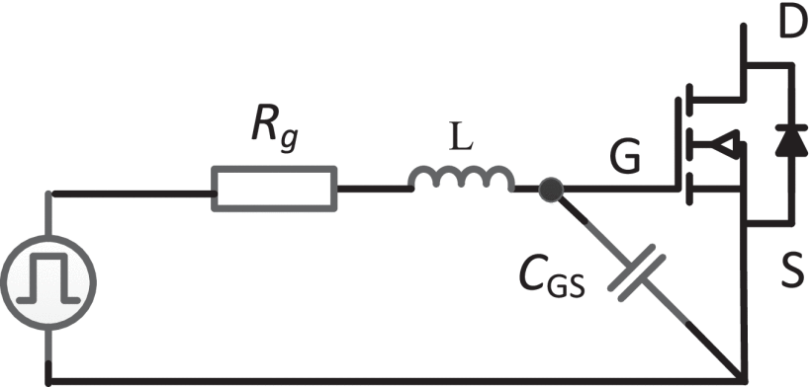
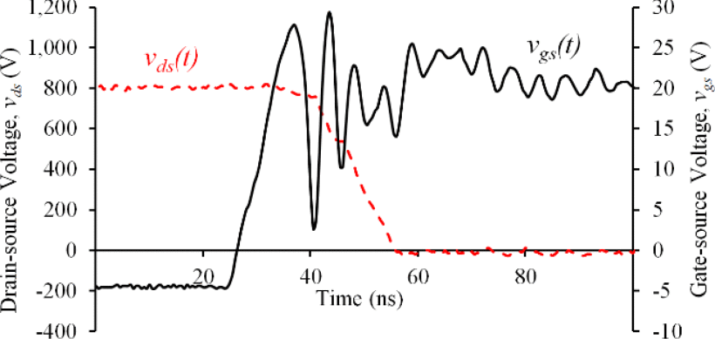
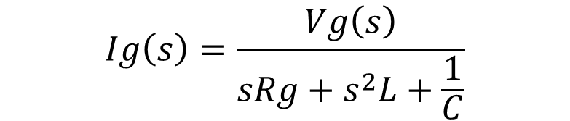
Ringing(Oscillations in the gate loop)
To achieve faster switching → Deliver gate charge quicky → Keep gate resistance small
$$Ig\left(s\right)=\frac{Vg\left(s\right)}{sRg+s^{2}L+\frac{1}{C}}$$
Why these oscillations are problematic from gate loop point of View?
Ig→
Vg
Peak of oscillations can cross the max allowable voltage ranges (+20, - 5)Volts
Gives rise to EMI
Interferes with the control and protection circuits → Unreliable operation
X. Yuan, I. Laird and S. Walder, "Opportunities, Challenges, and Potential Solutions in the Application of Fast-Switching SiC Power Devices and Converters," in IEEE Transactions on Power Electronics, vol. 36, no. 4, pp. 3925-3945, April 2021, doi: 10.1109/TPEL.2020.3024862.
Notes:
Poles of Ig equation moves away from imaginary axis and response is overdamped.

Slide 7
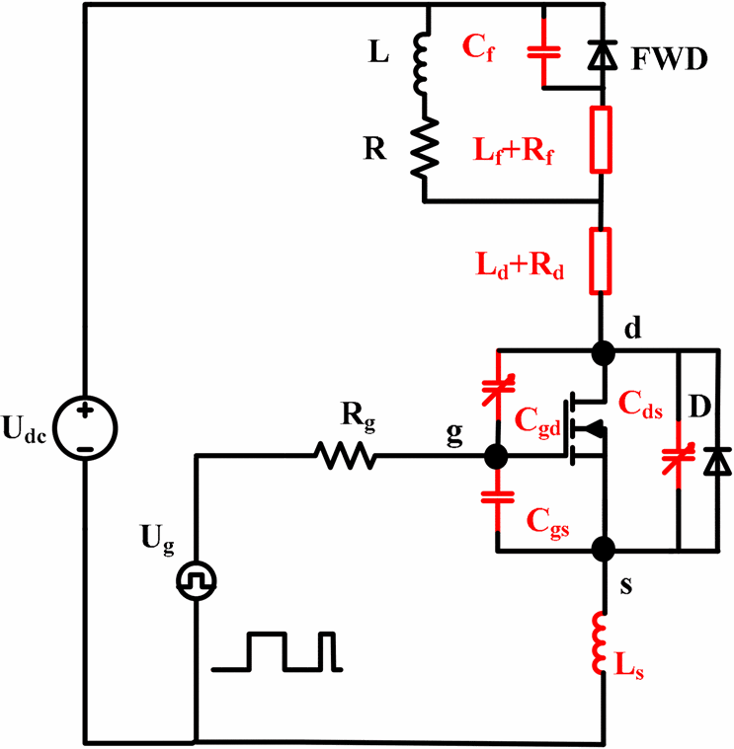




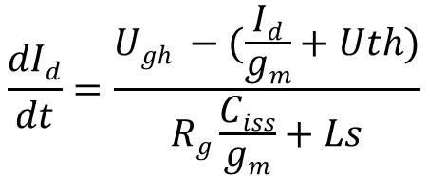
Oscillations in drain current
$$U_{gh}=R_{g}I_{g}+ U_{gs}+L_{s}\frac{{dI}_{d}}{dt}$$
$$Ig=Ciss\frac{dUgs}{dt}=(Cgs+Cgd)\frac{dUgs}{dt}$$
$$Id=gm(Ugs−Uth)$$
$$\frac{dId}{dt}=gm\frac{dUgs}{dt}$$
$$\frac{dId}{dt}=\frac{Ugh −(\frac{Id}{gm}+Uth)}{Rg\frac{Ciss}{gm}+Ls}$$
Haokai Huang, X. Yang, Yanhui Wen and Z. Long, "A switching ringing suppression scheme of SiC MOSFET by Active Gate Drive," 2016 IEEE 8th International Power Electronics and Motion Control Conference (IPEMC-ECCE Asia), 2016, pp. 285-291, doi: 10.1109/IPEMC.2016.7512300.
Notes:
Lets see how these gate loop oscillations can give rise to drain current oscillations.

Slide 8
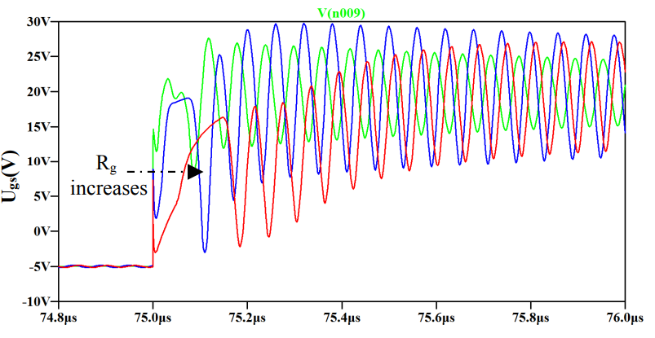
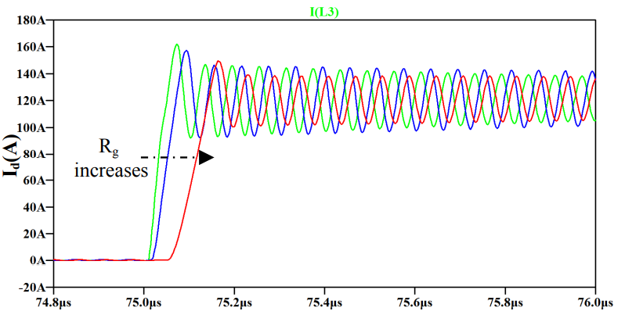
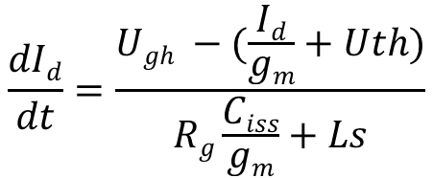
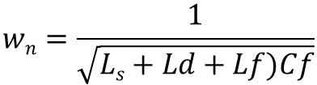
Oscillation in the drain current(Continued)
$$\frac{dId}{dt}=\frac{Ugh −(\frac{Id}{gm}+Uth)}{Rg\frac{Ciss}{gm}+Ls}$$
$$wn=\frac{1}{\sqrt{Ls+Ld+Lf)Cf}}$$
Ringing can be reduced by
Increasing R_{g}→ Slows down the turn on process.
Reducing U_{gh} during turn on phase.
Minimising Common inductance L_{s}.
Haokai Huang, X. Yang, Yanhui Wen and Z. Long, "A switching ringing suppression scheme of SiC MOSFET by Active Gate Drive," 2016 IEEE 8th International Power Electronics and Motion Control Conference (IPEMC-ECCE Asia), 2016, pp. 285-291, doi: 10.1109/IPEMC.2016.7512300.
Notes:
To reduce the Oscillations in the drain current → Reduce dI_{d}/dt→ Average energy getting stored in the inductor during oscillations reduces.
Explain the reduction in ringing amplitude with increase in Rg.
Also mention the increase in turn on time, red waveform settles to the steady state value very late.

Slide 9
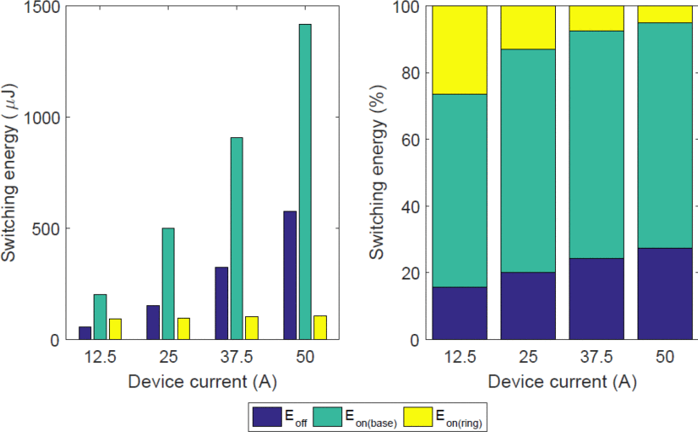
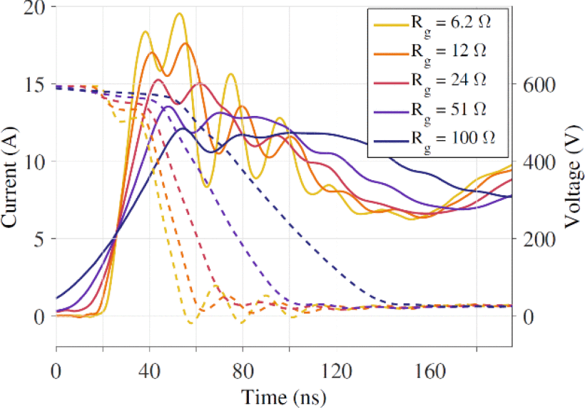
Problems due to Drain-Source current Overshoot during turn on
Turn on Losses increases.
Switching energy: turn-OFF energy (Eoff), turn-ON energy (base) (Eon(base)), turn-ON energy due to current overshoot/ringing (Eon(ring)).
X. Yuan, I. Laird and S. Walder, "Opportunities, Challenges, and Potential Solutions in the Application of Fast-Switching SiC Power Devices and Converters," in IEEE Transactions on Power Electronics, vol. 36, no. 4, pp. 3925-3945, April 2021, doi: 10.1109/TPEL.2020.3024862.
Notes:
1.) Clearly the turn on ringing has lead to some extra losses, which can be seen in the yellow bars.
2.) The turn on energy due to ringing is independent of the steady state drain current.→ Means overshoot is due to parasitic elements and therefore can be reduced without affecting the switching speeds.

Slide 10
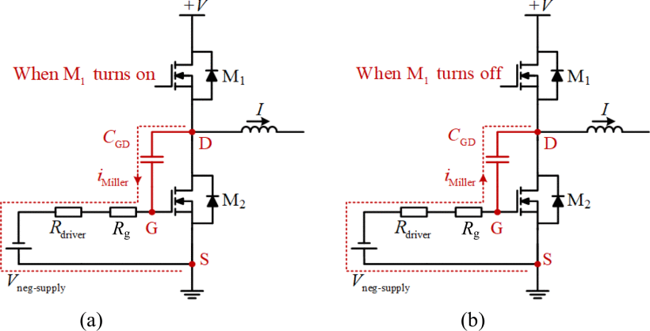
Cross talk Effect
SiC device switch at very high frequencies which means higher dv/dt at the switching node.
In a phase leg configuration switching transients of one device affects the switching performance of other device.
Increases the turn on switching loss in device undergoing turn on.
Can lead to shoot through failure.
Negative threshold of Vgs for SiC device is from -2 to -6 V→ Cross talk becomes a challenge in SiC device
0→V
V→0
X. Yuan, I. Laird and S. Walder, "Opportunities, Challenges, and Potential Solutions in the Application of Fast-Switching SiC Power Devices and Converters," in IEEE Transactions on Power Electronics, vol. 36, no. 4, pp. 3925-3945, April 2021, doi: 10.1109/TPEL.2020.3024862.

Slide 11
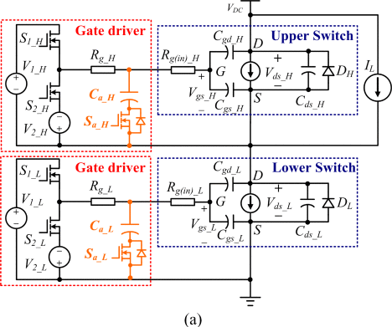
Cross talk mitigation strategies for SiC devices
Gate Impedance Regulation
Basic Idea
To reduce the magnitude of voltage appearing across the gate to source of the complementary MOSFET due to charge /discharge of Cgs by the current due to Miller capacitance (Cgd).
How this can be done?
Reduce the gate impedance of the mosfet undergoing interference during transition.
Z. Zhang, F.Wang, L.M. Tolbert, and B. J. Blalock, “Active gate driver for cross talk suppression of SiC power devices in a phase-leg configuration,” IEEE Trans. Power Electron., vol. 29, no. 4, pp. 1986–1997, Apr. 2014

Slide 12
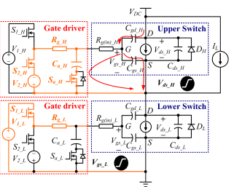
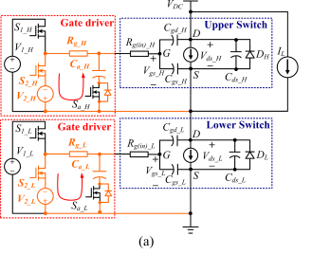
Cross talk mitigation strategies for SiC devices
Turn ON Crosstalk
Pre-charging of External Capacitors
Lower Device is Turning ON
Z. Zhang, F.Wang, L.M. Tolbert, and B. J. Blalock, “Active gate driver for cross talk suppression of SiC power devices in a phase-leg configuration,” IEEE Trans. Power Electron., vol. 29, no. 4, pp. 1986–1997, Apr. 2014
Notes:
The negative voltage applied during the turn off of the transistor will reduce the turn off cross-talk but it will impose a large negative voltage during turn off cross-talk.

Slide 13
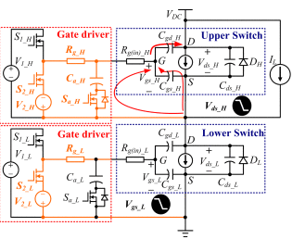
Turn OFF Crosstalk
Lower Device is Turning OFF
Negative gate voltage is reduced because impedance of C_aH is lower than Rg_H
Z. Zhang, F.Wang, L.M. Tolbert, and B. J. Blalock, “Active gate driver for cross talk suppression of SiC power devices in a phase-leg configuration,” IEEE Trans. Power Electron., vol. 29, no. 4, pp. 1986–1997, Apr. 2014

Slide 14
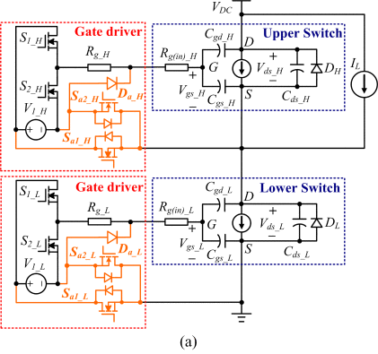
Gate Voltage Reduction
Basic Idea
Instead of using an external capacitor , Cgs of the capacitor undergoing interreference(Upper switch) is pre-charged to a negative value during the turn on transient of MOSFET.
Voltage appearing across Cgs of upper MOSFET due to miller discharge is cancelled by the pre-charged negative voltage.
During turn OFF transient, gate loop of the upper MOSFET is minimised.
Z. Zhang, F.Wang, L.M. Tolbert, and B. J. Blalock, “Active gate driver for cross talk suppression of SiC power devices in a phase-leg configuration,” IEEE Trans. Power Electron., vol. 29, no. 4, pp. 1986–1997, Apr. 2014
Notes:
Because we are directly reducing the gate voltage during the turn on transient.

Slide 15
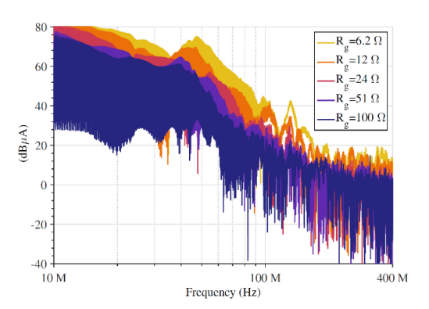
EMI issues
Smaller turn on and off time of SiC leads to sharp edges in the Vgs which leads to higher harmonic content in MHz + region.
High switching frequency escalates this further which means higher EMI in MHz+ region.
Higher the switching speed, higher the magnitude of EMI.
Need of additional and accurate EMI filters become crucial.
Spectrum of switching current at different switching time(Gate resistances)
Designing EMI filters to attenuate the high frequency harmonics can be challenging as the high-frequency components tend to go through the parasitic elements of the circuit rather than the main circuit.
X. Yuan, I. Laird and S. Walder, "Opportunities, Challenges, and Potential Solutions in the Application of Fast-Switching SiC Power Devices and Converters," in IEEE Transactions on Power Electronics, vol. 36, no. 4, pp. 3925-3945, April 2021, doi: 10.1109/TPEL.2020.3024862.

Slide 16
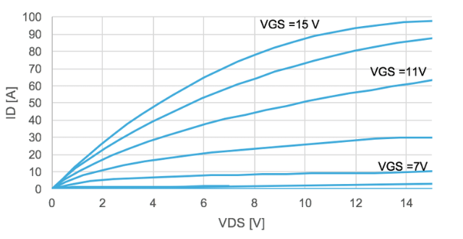
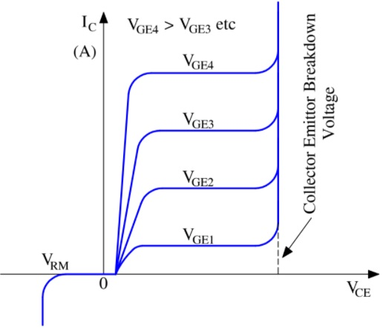
Fault detection and protection
ID2
ID1
I_{c2}
I_{c1}
VDS1
VDS2
I_{D1} at V_{GS} = 13 @ Linear Region
During SC ,I_{D1}→I_{D2}
Saturation point is far away
If we wait for detecting transition from linear to saturation→ Saturation region is far away at higher V_{DS}→ Device is damaged.
For SiC, change in current is too quick and die size is small→ Difficulty in heat dissipation.
V_{CE2}
V_{CE1}
I_{C1} at V_{GE2}
During SC, I_{C1}→I_{C2}
V_{CE} increases to V_{CE2}
Sharp transition from linear to Flat region be sensed.
Notes:
Lets see why detecting fault current is challenging in fast switching devices.

Slide 17
Fault detection and protection
Short circuit current withstand capability of SiC is between 2-8 Microseconds.
Requires higher bandwidth sensors for quick detection.
High bandwidth sensors also captures spooky noise signals, so fault detection is a challenge
Notes:
Find some connection between this and last slide

Slide 18
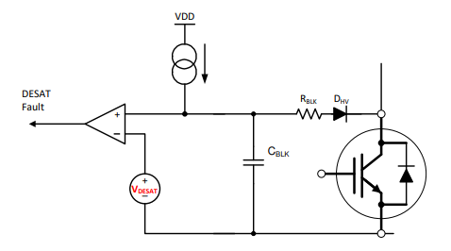

Short Circuit detection methods
DESAT Protection
During ON state voltage across blanking capacitor is device ON state voltage.
During fault current, voltage across blanking capacitor becomes greater than Vdsat→ Protection is enabled.
I_{CHG} is the charge current provide in the driver IC
V_{Dsat} is drain-source voltage set near the saturation point.
t _{BCAP} is time taken by capacitor to read V_{Dsat}.
TI-DOC-Understanding the Short Circuit Protection for Silicon Carbide MOSFETs

Slide 19
For SiC V_{Dsat} is very high→ t_{BCAP} is large and device protection becomes challenging.
If transient time becomes comparable to short circuit withstanding time of SiC.
Turn on noise magnitude becomes comparable to fault current due to transient than it can false trigger the protection system.
Conclusion
DESAT protection becomes difficult for SiC devices.
TI-DOC-Understanding the Short Circuit Protection for Silicon Carbide MOSFETs

Slide 20
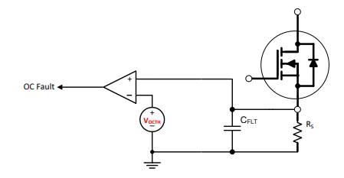
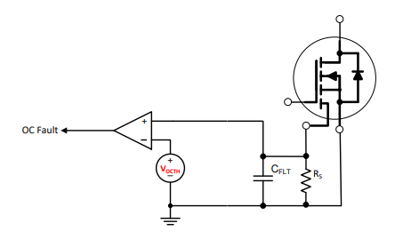
Shunt resistor scheme makes the system less efficient due to loss in resistor.
In SenseFET current sensing, scaled current is accurately measured using small resistor.
Incorporating separate pin in Power module increases the cost.
Shunt resistor current sensing scheme
SenseFET current sensing scheme
TI-DOC-Understanding the Short Circuit Protection for Silicon Carbide MOSFETs
Notes:
Few other methods are….

Slide 21
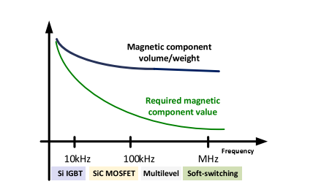
Design of High frequency Magnetics Components
Switching frequency increases, size of magnetics reduces ?
The reduction in size is not linear
Thermal Management becomes challenging, heat dissipation becomes a challenge.
Estimation of accurate high frequency core loss and winding loss is critical.
Variation of magnetic component value and volume/weight with (switching) frequency.
X. Yuan, I. Laird and S. Walder, "Opportunities, Challenges, and Potential Solutions in the Application of Fast-Switching SiC Power Devices and Converters," in IEEE Transactions on Power Electronics, vol. 36, no. 4, pp. 3925-3945, April 2021, doi: 10.1109/TPEL.2020.3024862.
21

Slide 22
Solutions for reducing the effects of high dv/dt
Snubbers→ Slows down dv/dt at the switching node there by reducing Voltage overshoots during turn off.
Ferrite Beads in series with gate resistance reduces ringing in gate loop.
Placement of Gate Driver to minimise the gate loop inductance.
Introducing Kelvin Source pins to minimise common parasitic inductance and reduce gate loop oscillations
Notes:
Ferrite bead is selected such that it works as low impedance at driving frequency and high impedance at noise frequency.

Slide 23
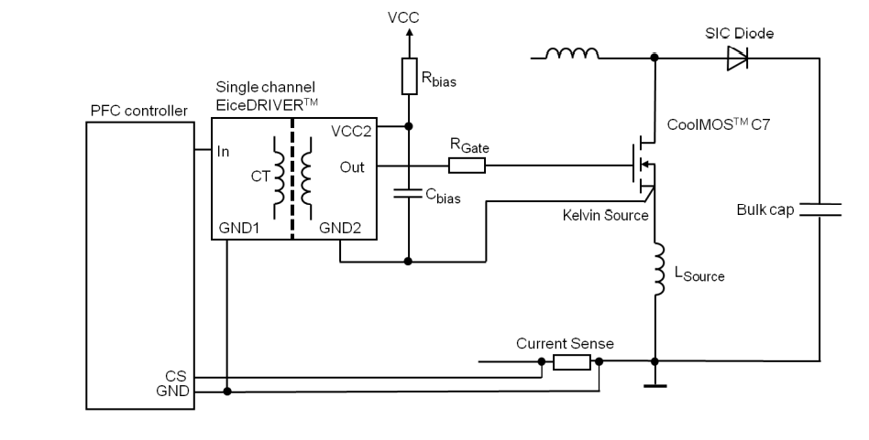
Kelvin Source pins to minimise common parasitic inductance and reduce gate loop oscillations
Kelvin source pin isolates source inductance from the gate loop which was responsible for increasing the turn on time and increasing the switching losses.
23

Slide 24
References
[1] J. Millan, P. Godignon, X. Perpina, A. Perez-Tomas, and J. Rebollo, “A survey of wide bandgap power semiconductor devices,” IEEE Trans. Power Electron., vol. 29, no. 5, pp. 2155–2163, May 2014.
[2] L. Zhang, X. Yuan, X. Wu, C. Shi, J. Zhang, and Y. Zhang, “Performance evaluation of high-power SiC MOSFET modules in comparison to Si IGBT modules,” IEEE Trans. Power Electron., vol. 34, no. 2, pp. 1181–1196, Feb. 2019.
[3] S.Debnath, J. Qin, B. Bahrani, M. Saeedifard, and P. Barbosa, “Operation, control and applications of the modular multilevel converter: A review,” IEEE Trans. Power Electron., vol. 20, no. 1, pp. 37–53, Jan. 2015.
[4] X. Yuan, I. Laird and S. Walder, ”Opportunities, Challenges, and Potential Solutions in the Application of Fast-Switching SiC Power Devices and Converters,” in IEEE Transactions on Power Electronics, vol. 36, no. 4, pp. 3925-3945, April 2021, doi: 10.1109/TPEL.2020.3024862.
[5] Haokai Huang, X. Yang, Yanhui Wen and Z. Long, ”A switching ringing suppression scheme of SiC MOSFET by Active Gate Drive,” 2016 IEEE 8th International Power Electronics and Motion Control Conference (IPEMC-ECCE Asia), 2016, pp. 285-291, doi: 10.1109/IPEMC.2016.7512300.

Slide 25
References
[6] Z. Zhang, F. Wang, L. M. Tolbert, B. J. Blalock and D. J. Costinett, ”Active gate driver for fast switching and cross-talk suppression of SiC devices in a phase-leg configuration,” 2015 IEEE Applied Power Electronics Conference and Exposition (APEC), 2015, pp. 774-781, DOI: 10.1109/APEC.2015.7104437.
[7] . L. Zhang, X. Yuan, J. Zhang, X. Wu, Y. Zhang and C. Wei, ”Modeling and implementation of optimal asymmetric variable dead-time setting for SiC MOSFET-based three-phase two-level inverters”, IEEE Trans. Power Electron., vol. 34, no. 12, pp. 11645-11660, Dec. 2019.
[8] S. Zhu, X. Yuan and P. Mellor, ”Reduction of the parasitic capacitance of a power inductor through conductor placement,” 2017 IEEE Energy Conversion Congress and Exposition (ECCE), 2017, pp. 3215-3221, DOI: 10.1109/ECCE.2017.8096583.
[9] https://www.ti.com/power-management/gate-drivers/overview.html [10] https://www.ti.com/lit/slua863 [11] E. Ayerbe, A. Barkley and J. Mookken, ”SiC MOSFETs in optimized packaging deliver a 3×reduction in switching losses enabling affordable high-efficiency EV battery chargers”, pp. 84-87, May 2017

Slide 26
Thank You

