Slide 1
AI in India
-By Kameng Hostel

Slide 2
Villages in India
“The soul of India lives in its villages”-Mahatma Gandhi.
According to the 2011 census of India, 68% of the Indian population lives in villages.
But it is quite evident that most of the talent in the music industry belongs to the urban population.
This is because in villages there are many constraints, and people have to travel to the cities to pursue their interest.
In music industry, vocal cord Hemorrhage is very common and begginners in music face it without proper guidance.

Slide 3
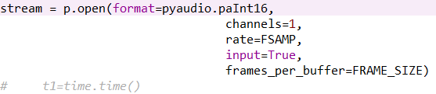
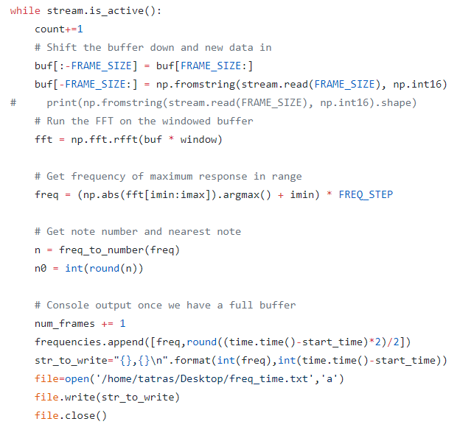
Live plotting of input audio
Taking voice input using some input device and live plot the frequency waveform of the voice.
The stream function initialises
the microphone and takes the
voice input
The function of the while loop is to keep
collecting the data and store it in text file

Slide 4
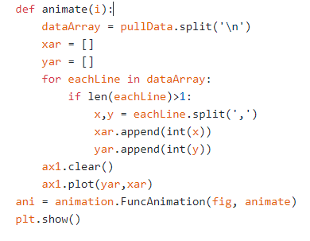
Live plotting of frequencies:
This function plots the frequency graph of the frequency stored in the text file.

Slide 5
Need for AI
It is required to classify the genre of the input music because each genre has a different width of frequencies .
So our AI model first classifies the input audio from which we obtain the range of frequency of input audio.
We use this range of frequencies in the code where we store the input audio into a text file storing frequencies.
This is important as this removes all the noise from various unnecessary frequencies.

Slide 6
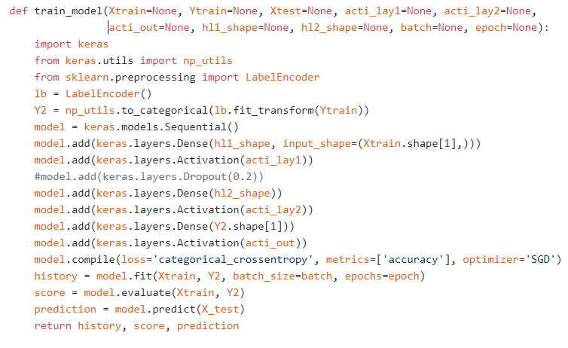
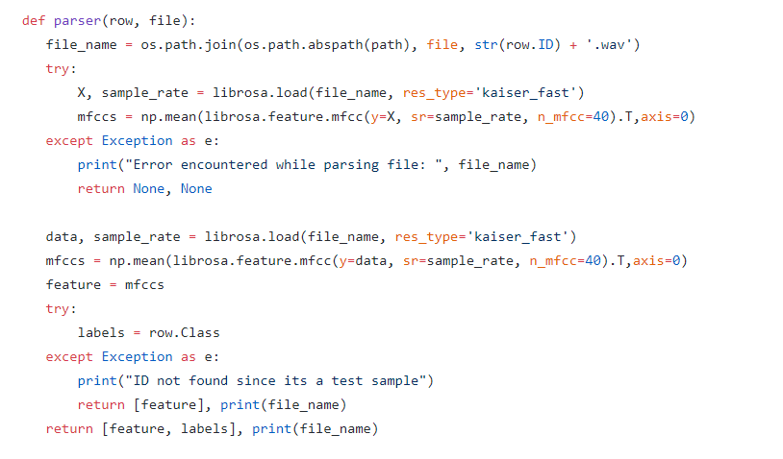
Extracting features and feeding them to Neural Network
We extract relevant features from the input audio and feed them into our own custom made neural network for classification.

Slide 7
Summing it up:
Our prototype gives a platform where aspiring musicians in the village can learn from their teachers, remotely.
First as the teacher sings, a life frequency plot is made. The student then tries to match his frequencies to the frequency of his master.
This will make sure that he sings correctly, and know where he is going wrong and correct himself.

