Slide 1
PolyScientist
August 20, 2019

Slide 2
Terminology
L1Reuse: #reuses that are exploitable in L1 cache
OptL1DataSetSize: Total number of bytes of data accessed from L1 cache for the reuses that are exploitable in L1 cache
Example: Reuse 1: N1 bytes < L1 size, Reuse 2: N2 bytes < L2. OptL1DataSetSize = N1 + N2
PessiL1DataSetSize: Total number of bytes of data accessed from L1 cache for the reuses that are exploitable in L1 cache up to L1 size
Example: Reuse 1: N1 bytes < L1 size, Reuse 2: N2 bytes < L2
Sort N1, N2 from smallest to highest: N1, N2
PessiDataSetSize = N1 + N2 if (N1 + N2) < L1 size, else N1

Slide 3
1_28_poly_perf.csv
Version | GFLOPS | L1Reuse | L2Reuse | L3Reuse | MemReuse | OptL1DataSetSize | OptL2DataSetSize | OptL3DataSetSize | OptMemDataSetSize | PessiL1DataSetSize | PessiL2DataSetSize | PessiL3DataSetSize | PessiMemDataSetSize
2 | 91.132 | 5 | 2 | 3 | 0 | 34592 | 89608 | 6475784 | 0 | 17144 | 89608 | 4853760 | 0
3 | 98.766 | 5 | 4 | 1 | 0 | 34592 | 333328 | 4007936 | 0 | 17144 | 288264 | 4007936 | 0
4 | 91.504 | 5 | 2 | 3 | 0 | 34592 | 89608 | 6475784 | 0 | 17144 | 89608 | 4853760 | 0
5 | 91.269 | 5 | 2 | 3 | 0 | 34592 | 89608 | 6475784 | 0 | 17144 | 89608 | 4853760 | 0
ActualRank | PolyRank | GFLOPS | Version | wins
1 | 1 | 98.766 | 3 | 3
2 | 2 | 91.504 | 4 | 2
3 | 3 | 91.269 | 5 | 1
4 | 4 | 91.132 | 2 | 0

Slide 4
4_28_poly_perf.csv
Version | GFLOPS | L1Reuse | L2Reuse | L3Reuse | MemReuse | OptL1DataSetSize | OptL2DataSetSize | OptL3DataSetSize | OptMemDataSetSize | PessiL1DataSetSize | PessiL2DataSetSize | PessiL3DataSetSize | PessiMemDataSetSize
2 | 2280.1 | 5 | 2 | 0 | 3 | 34592 | 89608 | 0 | 6475784 | 17144 | 89608 | 0 | 4853760
3 | 2292.5 | 5 | 4 | 0 | 1 | 34592 | 333328 | 0 | 4007936 | 17144 | 288264 | 0 | 4007936
4 | 2282.6 | 5 | 2 | 0 | 3 | 34592 | 89608 | 0 | 6475784 | 17144 | 89608 | 0 | 4853760
5 | 2283.2 | 5 | 2 | 0 | 3 | 34592 | 89608 | 0 | 6475784 | 17144 | 89608 | 0 | 4853760
ActualRank | PolyRank | GFLOPS | Version | wins
1 | 1 | 2292.5 | 3 | 3
2 | 2 | 2283.2 | 5 | 2
3 | 3 | 2282.6 | 4 | 1
4 | 4 | 2280.1 | 2 | 0

Slide 5
Ranking algorithm 1: Tournament based ranking
Each variant is played against all others
The variant that has the most “wins” is the overall winner
The Decision tree decides the winner between two variants

Slide 6
Decision Tree
If (v1-TotalDataSetSize < v2-TotalDataSetSize by a threshold 50%) {
v1 is the winner
} else if ( mirror condition) {
v2 is the winner
} else if (v1-MemDataSetSize < v2-MemDataSetSize by a threshold 5%) {
v1 is the winner
} else if (mirror condition) {v2 winner}
Else if (v1-L3DataSetSize < v2-L3DataSetSize by a threshold 5%) {
v1 is the winner
} else if (mirror condition) {v2 winner}
Else if (v1-L2DataSetSize < v2-L2DataSetSize by a threshold 5%) {
v1 is the winner
} else if (mirror condition) {v2 winner}
Else if (v1-L1DataSetSize < v2-L1DataSetSize by a threshold 5%) {
v1 is the winner
} else if (mirror condition) {v2 winner}
Input:
v1-L1DataSetSize
v1-L2DataSetSize
v1-L3DataSetSize
v1-MemDataSetSize
v1-TotalDataSetSize (sum of all of above)
v2-L1DataSetSize
v2-L2DataSetSize
v2-L3DataSetSize
v2-MemDataSetSize
v2-TotalDataSetSize (sum of all of above)

Slide 7
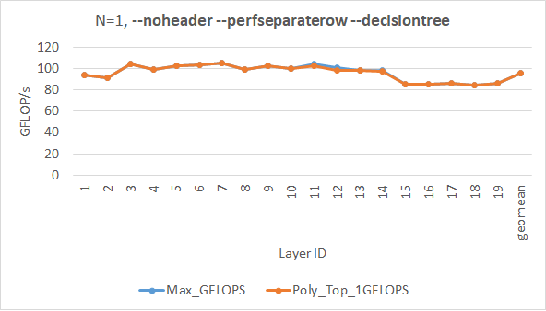
N = 1, Using Optimistic statistics

Slide 8
11_1_perf.csv
Version | GFLOPS | L1Reuse | L2Reuse | L3Reuse | MemReuse | OptL1DataSetSize | OptL2DataSetSize | OptL3DataSetSize | OptMemDataSetSize | PessiL1DataSetSize | PessiL2DataSetSize | PessiL3DataSetSize | PessiMemDataSetSize
2 | 102.68 | 7 | 5 | 0 | 0 | 81192 | 2270224 | 0 | 0 | 17144 | 648704 | 945152 | 0
3 | 104.62 | 7 | 4 | 1 | 0 | 81192 | 1306640 | 1083392 | 0 | 17144 | 599040 | 1083392 | 0
4 | 103.67 | 7 | 5 | 0 | 0 | 81192 | 2270224 | 0 | 0 | 17144 | 648704 | 945152 | 0
5 | 102.14 | 7 | 5 | 0 | 0 | 81192 | 1772560 | 0 | 0 | 17144 | 701448 | 1010688 | 0
ActualRank | PolyRank | GFLOPS | Version | wins
1 | 4 | 104.62 | 3 | 0
2 | 2 | 103.67 | 4 | 2
3 | 3 | 102.68 | 2 | 1
4 | 1 | 102.14 | 5 | 3

Slide 9
12_1_perf.csv
Version | GFLOPS | L1Reuse | L2Reuse | L3Reuse | MemReuse | OptL1DataSetSize | OptL2DataSetSize | OptL3DataSetSize | OptMemDataSetSize | PessiL1DataSetSize | PessiL2DataSetSize | PessiL3DataSetSize | PessiMemDataSetSize
2 | 98.286 | 9 | 10 | 1 | 0 | 127268 | 2700572 | 2182144 | 0 | 17144 | 825096 | 2871296 | 0
3 | 70.707 | 7 | 8 | 5 | 0 | 81192 | 2805780 | 10074116 | 0 | 17144 | 794624 | 6585344 | 0
4 | 100.96 | 7 | 12 | 1 | 0 | 81192 | 4765720 | 2182144 | 0 | 17144 | 997380 | 3723776 | 0
5 | 97.239 | 7 | 12 | 1 | 0 | 81192 | 4632344 | 2166784 | 0 | 17144 | 732928 | 3643904 | 0
ActualRank | PolyRank | GFLOPS | Version | wins
1 | 2 | 100.96 | 4 | 2
2 | 1 | 98.286 | 2 | 3
3 | 3 | 97.239 | 5 | 1
4 | 4 | 70.707 | 3 | 0

Slide 10
14_1_perf.csv
Version | GFLOPS | L1Reuse | L2Reuse | L3Reuse | MemReuse | OptL1DataSetSize | OptL2DataSetSize | OptL3DataSetSize | OptMemDataSetSize | PessiL1DataSetSize | PessiL2DataSetSize | PessiL3DataSetSize | PessiMemDataSetSize
2 | 97.812 | 7 | 3 | 2 | 0 | 81192 | 1274888 | 2854920 | 0 | 17144 | 249352 | 2788352 | 0
3 | 75.267 | 7 | 3 | 2 | 0 | 81192 | 1480712 | 3100680 | 0 | 17144 | 649224 | 2834944 | 0
4 | 98.328 | 7 | 3 | 2 | 0 | 81192 | 1274888 | 2854920 | 0 | 17144 | 249352 | 2788352 | 0
5 | 96.952 | 7 | 4 | 1 | 0 | 81192 | 761872 | 1936384 | 0 | 17144 | 701448 | 1936384 | 0
ActualRank | PolyRank | GFLOPS | Version | wins
1 | 2 | 98.328 | 4 | 2
2 | 3 | 97.812 | 2 | 1
3 | 1 | 96.952 | 5 | 3
4 | 4 | 75.267 | 3 | 0

Slide 11
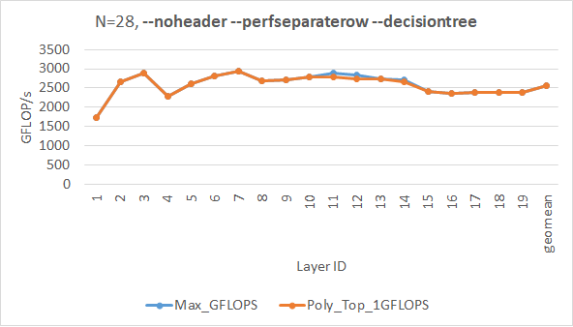
N = 28, Using Optimistic statistics

Slide 12
11_28_perf.csv
Version | GFLOPS | L1Reuse | L2Reuse | L3Reuse | MemReuse | OptL1DataSetSize | OptL2DataSetSize | OptL3DataSetSize | OptMemDataSetSize | PessiL1DataSetSize | PessiL2DataSetSize | PessiL3DataSetSize | PessiMemDataSetSize
2 | 2844 | 7 | 5 | 0 | 0 | 81192 | 2270224 | 0 | 0 | 17144 | 648704 | 945152 | 0
3 | 2882.3 | 7 | 4 | 1 | 0 | 81192 | 1306640 | 1083392 | 0 | 17144 | 599040 | 1083392 | 0
4 | 2855.8 | 7 | 5 | 0 | 0 | 81192 | 2270224 | 0 | 0 | 17144 | 648704 | 945152 | 0
5 | 2800.5 | 7 | 5 | 0 | 0 | 81192 | 1772560 | 0 | 0 | 17144 | 701448 | 1010688 | 0
ActualRank | PolyRank | GFLOPS | Version | wins
1 | 4 | 2882.3 | 3 | 0
2 | 2 | 2855.8 | 4 | 2
3 | 3 | 2844 | 2 | 1
4 | 1 | 2800.5 | 5 | 3

Slide 13
12_28_perf.csv
Version | GFLOPS | L1Reuse | L2Reuse | L3Reuse | MemReuse | OptL1DataSetSize | OptL2DataSetSize | OptL3DataSetSize | OptMemDataSetSize | PessiL1DataSetSize | PessiL2DataSetSize | PessiL3DataSetSize | PessiMemDataSetSize
2 | 2728.8 | 9 | 10 | 0 | 1 | 127268 | 2700572 | 0 | 2182144 | 17144 | 825096 | 689152 | 2182144
3 | 2248.9 | 7 | 8 | 0 | 5 | 81192 | 2805780 | 0 | 10074116 | 17144 | 794624 | 1371144 | 6031360
4 | 2828.7 | 7 | 12 | 0 | 1 | 81192 | 4765720 | 0 | 2182144 | 17144 | 997380 | 1328644 | 2871296
5 | 2701.5 | 7 | 12 | 0 | 1 | 81192 | 4632344 | 0 | 2166784 | 17144 | 732928 | 1276420 | 2822144
ActualRank | PolyRank | GFLOPS | Version | wins
1 | 2 | 2828.7 | 4 | 2
2 | 1 | 2728.8 | 2 | 3
3 | 3 | 2701.5 | 5 | 1
4 | 4 | 2248.9 | 3 | 0

Slide 14
14_28_perf.csv
Version | GFLOPS | L1Reuse | L2Reuse | L3Reuse | MemReuse | OptL1DataSetSize | OptL2DataSetSize | OptL3DataSetSize | OptMemDataSetSize | PessiL1DataSetSize | PessiL2DataSetSize | PessiL3DataSetSize | PessiMemDataSetSize
2 | 2707.4 | 7 | 3 | 1 | 1 | 81192 | 1274888 | 1115144 | 1739776 | 17144 | 249352 | 1048576 | 1739776
3 | 2279.4 | 7 | 3 | 1 | 1 | 81192 | 1480712 | 1120264 | 1980416 | 17144 | 649224 | 854528 | 1980416
4 | 2717.6 | 7 | 3 | 1 | 1 | 81192 | 1274888 | 1115144 | 1739776 | 17144 | 249352 | 1048576 | 1739776
5 | 2662.7 | 7 | 4 | 0 | 1 | 81192 | 761872 | 0 | 1936384 | 17144 | 701448 | 0 | 1936384
ActualRank | PolyRank | GFLOPS | Version | wins
1 | 2 | 2717.6 | 4 | 2
2 | 3 | 2707.4 | 2 | 1
3 | 1 | 2662.7 | 5 | 3
4 | 4 | 2279.4 | 3 | 0

Slide 15
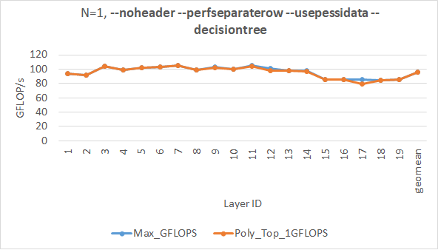
N = 1, Using Pessimistic statistics

Slide 16
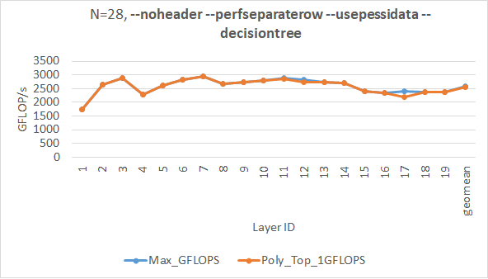
N = 28, Using Pessimistic statistics

Slide 17
Ranking algorithm 2: Modeling exec. time
#define L1Cost 4
#define L2Cost 14 // 26
#define L3Cost 60
#define MemCost 84
#define SecondaryL1Cost (1.0/192.0)
#define SecondaryL2Cost (1.0/96.0)
#define SecondaryL3Cost (1.0/16.0)
#define SecondaryMemCost (1.0/4.0)
programVariants->at(i)->userDefinedCost =
(programVariants->at(i)->L1DataSetSize) * L1Cost +
(programVariants->at(i)->L2DataSetSize) * L2Cost +
(programVariants->at(i)->L3DataSetSize) * L3Cost +
(programVariants->at(i)->MemDataSetSize) * MemCost;
programVariants->at(i)->secondaryCost =
(programVariants->at(i)->L1DataSetSize)
* SecondaryL1Cost +
(programVariants->at(i)->L2DataSetSize)
* SecondaryL2Cost +
(programVariants->at(i)->L3DataSetSize)
* SecondaryL3Cost +
(programVariants->at(i)->MemDataSetSize)
* SecondaryMemCost;

Slide 18
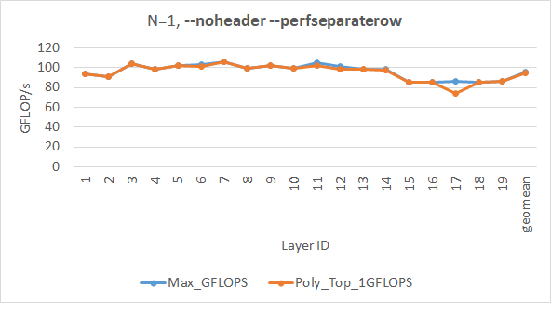
N = 1, Using Optimistic statistics

Slide 19
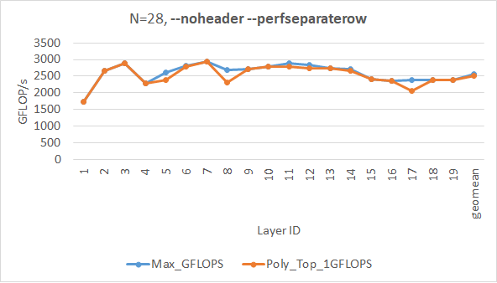
N = 28, Using Optimistic statistics

Slide 20
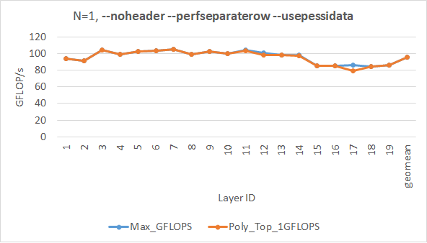
N = 1, Using Pessimistic statistics

Slide 21
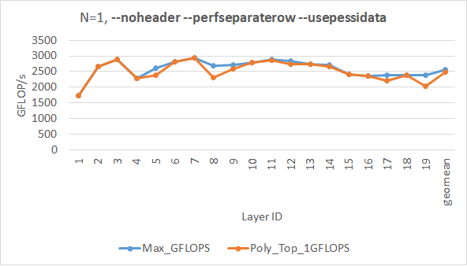
N = 28, Using Pessimistic statistics

Slide 22
Winner poly-ranking algorithm

Slide 23
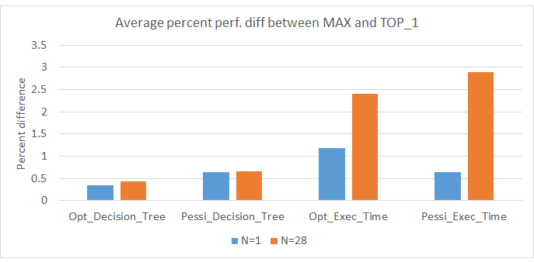
Winner: Decision tree using optimistic stats

Slide 24
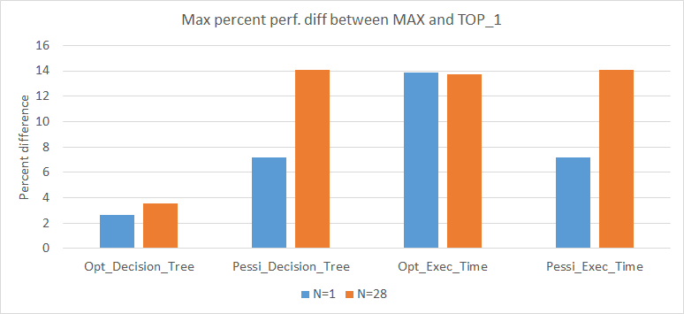
Winner: Decision tree using optimistic stats

