Slide 1
PolyScientist
August 28, 2019

Slide 2
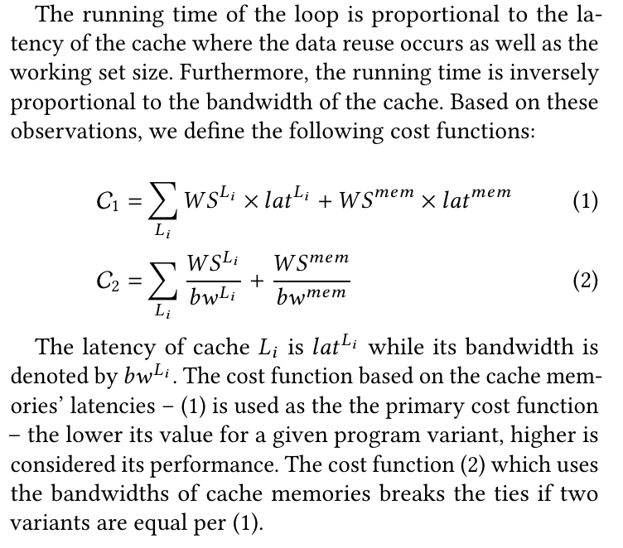
Poly-ranking heuristics. Preferred & best so far: Execution time modeling

Slide 3
Other poly-ranking approaches tried on 4 variants
 | Average percent perf. diff between MAX and TOP_1 |  |  | Max percent perf. diff between MAX and TOP_1
New Additions | N=1 | N=28 |  | N=1 | N=28
--noheader --perfseparaterow --usepessidata --decisiontree Default winner = -1, the threshold for total data set size is TOTALDATASETSIZE | 0.65 | 3.62 |  | 7.15 | 35.19
--noheader --perfseparaterow --usepessidata --decisiontree Default winner = 0, the threshold for total data set size is TOTALDATASETSIZE | 0.65 | 3.62 |  | 7.15 | 35.19
--noheader --perfseparaterow --decisiontree Default winner = -1, the threshold for total data set size is TOTALDATASETSIZE | 2.45 | 39.95 |  | 2.29 | 35.19
--noheader --perfseparaterow --usepessidata --decisiontree Default winner = -1, the threshold for total data set size is TOTALDATASETSIZE #define DATASETSIZETHRESHOLD 0.05 #define TOTALDATASETSIZETHRESHOLD 0.10 #define MEMDATASETSIZETHRESHOLD 0.05 | 0.65 | 2.47 |  | 7.15 | 14.09
--noheader --perfseparaterow --infogaindecisiontree | 1.06 | 5.71 |  | 12.93 | 35.96
--noheader --perfseparaterow --bwlat | 5.34 | 5.35 |  | 41.09 | 35.96
--noheader --perfseparaterow --usepessidata --bwlat | 0.65 | 2.9 |  | 7.15 | 14.09

Slide 4
Other poly-ranking heuristics tried
Decision tree with thresholds obtained using empirical performance data
Decision tree with normalized working set sizes (sum of various working set sizes equals 1)
Reverse decision tree, where higher L1 working set size, higher the performance assumed (as opposed to e.g., higher the L3 working set size, lower the performance)
EXECUTION TIME MODELING IS PREFERRED:
Ranking is better than or same as other heuristics
Easily portable to other architectures by updating the L1, L2, L3 latency and bandwidth parameters

Slide 5
Future Work – Improving the ranking function
Per-array analysis
The current approach calculates the aggregate working set sizes (for all arrays together) for various caches.
This may be over-estimating the working set sizes – because the LRU cache replacement policy will ensure that streaming data is evicted from cache and reused data is retained
Per-array based working set size calculation will be therefore more accurate
Distinguishing the Read and Write Array accesses
Currently, the reads and writes are considered together while calculating the working set sizes
Since the b/w of caches could be different and distinct for reads and writes, separate read and write working set analysis will be superior in projecting performance

