Slide 1
PolyScientist: Automatic Loop Transformations Combined with Microkernels for Optimization of Deep Learning Primitives
Sanket Tavarageri, Alexander Heinecke, Sasikanth Avancha,
Gagandeep Goyal (IIT-H), Ramakrishna Upadrasta (IIT-H), Bharat Kaul

Slide 2
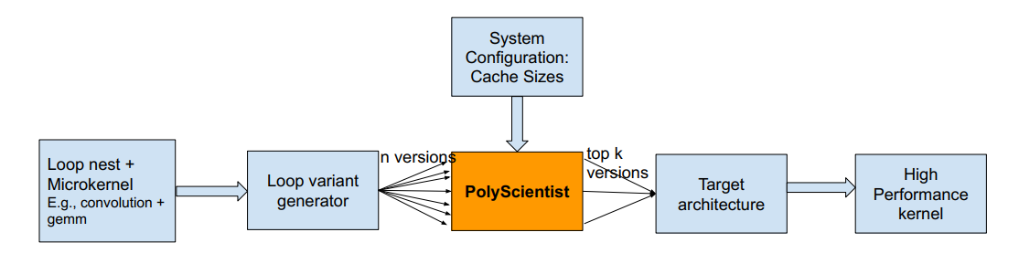
PolyScientist architecture

Slide 3
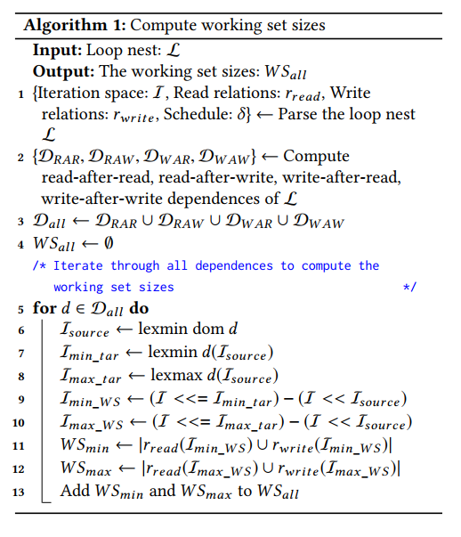
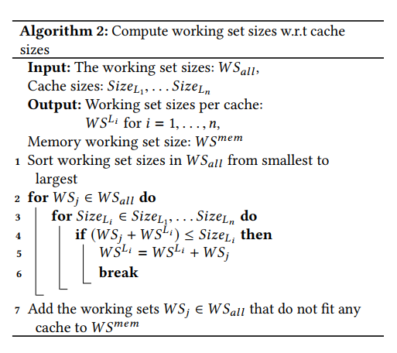
Cache Data Reuse algorithms

Slide 4
Resnet-50 Convolution (FWD), N = 28
Version | GFLOPS | L1Reuse | L2Reuse | L3Reuse | MemReuse | OptL1DataSetSize | OptL2DataSetSize | OptL3DataSetSize | OptMemDataSetSize | PessiL1DataSetSize | PessiL2DataSetSize | PessiL3DataSetSize | PessiMemDataSetSize
2 | 2280.1 | 5 | 2 | 0 | 3 | 34592 | 89608 | 0 | 6475784 | 17144 | 89608 | 0 | 4853760
3 | 2292.5 | 5 | 4 | 0 | 1 | 34592 | 333328 | 0 | 4007936 | 17144 | 288264 | 0 | 4007936
4 | 2282.6 | 5 | 2 | 0 | 3 | 34592 | 89608 | 0 | 6475784 | 17144 | 89608 | 0 | 4853760
5 | 2283.2 | 5 | 2 | 0 | 3 | 34592 | 89608 | 0 | 6475784 | 17144 | 89608 | 0 | 4853760
ActualRank | PolyRank | GFLOPS | Version | wins
1 | 1 | 2292.5 | 3 | 3
2 | 2 | 2283.2 | 5 | 2
3 | 3 | 2282.6 | 4 | 1
4 | 4 | 2280.1 | 2 | 0

Slide 5
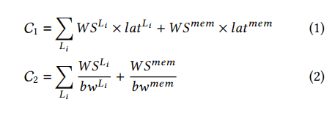
Poly-ranking heuristic

Slide 6
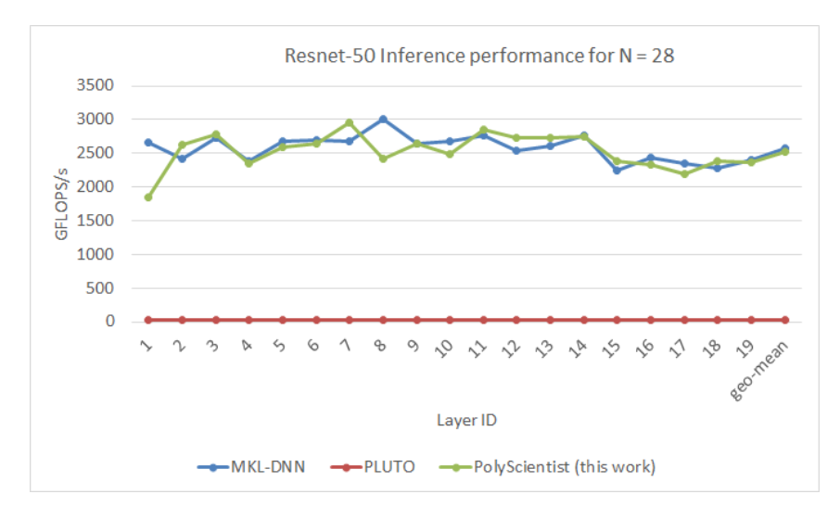
Resnet-50 inference 28-core performance on an Intel Cascade Lake server

Slide 7
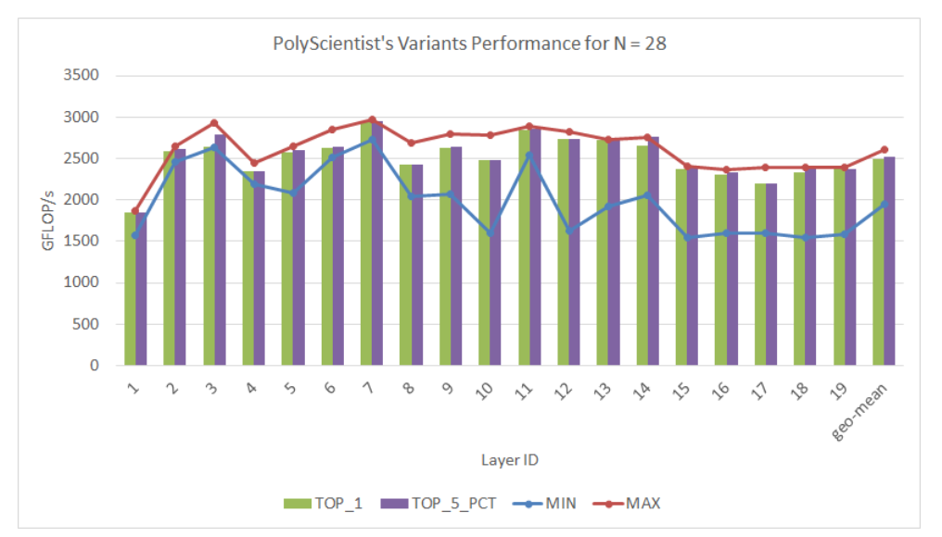
Comparison of PolyScientist picked variant 28-core performance with autotuning

Slide 8
Future Work – for PLDI

Slide 9
Direction for PLDI deadline in November 2019
Experimental evaluation on a broader range of convolutions (~300 convolutions) ~2 weeks
Focused on inference for vision applications
With GEMM microkernel and without GEMM microkernel
Making analysis more robust by performing per-array based analysis (in contrast to aggregate analysis as of today) ~ 2 weeks
Likely more accurate as the CPUs use hash-based addressing, therefore minimizing interference between arrays
Use of deep learning for ranking of code variants ~ 4 weeks
Reinforcement learning?

Slide 10
Future Work – Q1 2020

Slide 11
Q1 2020
Integration of PolyScientist with a deep learning compiler framework
Potentially with TensorFlow MLIR
Will be able to demonstrate end-to-end performance
FWD, BWD, WU passes
GNMT, BERT, LSTM, RNN etc

Slide 12
Work items (to discuss with Ramakrishna)
Additional kernels – LSTM
Code generator
Experimental evaluation tool chain – scripting
Use of deep learning for ranking of code variants
Reinforcement learning?

