Slide 1
Literature review on COMPUTING THE SHAPLEY VALUES OF FACTS IN QUERY ANSWERING
ROHITH REDDY BAIRI - A20526972
BRIJESHKUMARYADAV -A20528371
SHIRISHA VADDEGONI - A20553499
DEEKSHITHA TUMMALA - A20551936

Slide 2
Let’s decode the title first
What is a Shapley value?
What are Database facts?
Endogenous facts
Exogenous facts
What is a query?
Boolean query
What is the need for computing Shapley value of facts?

Slide 3
Problem statement:-
Theoretically Query evaluation over Relational databases helps us better understand the contribution of facts for the overall query output. Yet, there is no practical solution of computing Shapley values.
This paper aims at solving this by proposing two practical solutions
Computing Shapley values that adopts probability query evaluation tools to capture the dependence of query answers on input facts using Boolean expressions, then transform it via knowledge compilation to a circuit for which they devised an algorithm to compute the Shapley value.
Inexact approach to transform Boolean expressions to CNF and further compute the Shapley values.

Slide 4
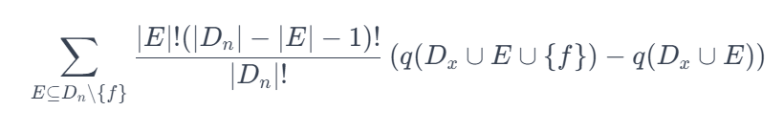
Understanding the Shapley Value of Facts
The Shapley Value in Databases
Shapley Value Computation
Shapley Value Formula
Shapley Value Computation Challenges
Enumerating all possible coalitions of facts, Evaluating the query for each coalition.
Exponential growth in coalitions with the number of facts, Computational infeasibility for large databases.
Practical Example
Flight Route Query
Shapley value can be solved in polynomial time, or q is not hierarchical and Shapley(q) is intractable.

Slide 5
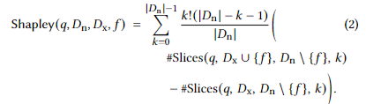
Computational Reductions and Efficiency
Reduction to PQE
Shapley and PQE Relationship
Shapley (q, Dn​, Dx​, f) = E⊆Dn​∖f∑​∣Dn​∣!∣E∣!(∣Dn​∣−∣E∣−1)!​(q(Dx​∪E∪f)−q(Dx​∪E))
Polynomial-Time Reductions
Knowledge Compilation Advantage
Boolean Functions and Circuits
Knowledge compilation classes
Decomposable circuit.
Deterministic circuit.
Decomposable & deterministic Boolean circuit.

Slide 6

Algorithm
This is a mathematical exposition related to Boolean circuits and a concept known as the Shapley value, It includes a formula for calculating the Shapley value in the context of Boolean circuits.
This formula is a summation that likely iterates over all possible coalitions of data points in ( D_n ) (a subset of the database representing endogenous facts), weighted by the factorial of the size of the coalition and the factorial of the size of its complement, normalized by the factorial of the total size of ( D_n ). The terms ( #SAT_k(C_1) ) and ( #SAT_k(C_2) ) refer to the number of satisfying assignments (solutions) for two circuits ( C_1 ) and ( C_2 ) with a particular number of variables set to true, indicated by ( k ).
also mentions a lemma (Lemma 4.5) that seems to provide a method for calculating the quantity ( #SAT_k(C) ) for a deterministic and decomposable Boolean circuit ( C ) and an integer ( k ), in polynomial time. The proof appears to involve preprocessing the circuit, handling gates with different fan-in sizes, and defining new terms for the satisfaction of different parts of the circuit.

Slide 7
Algorithm
Here’s a step-by-step explanation of what the algorithm is doing:
Complete the Circuit: Modify the given Boolean circuit so that the variables of the output gate correspond to a particular set, which is ( D_n ).
Compute Two Circuits: Create two circuits, ( C_1 ) and ( C_2 ), which are versions of the original circuit ( C ) with the fact ( f ) set to 1 and 0, respectively. This is to evaluate the circuit partially by setting ( f ) to 1 and to 0 to observe its effects on the outcome.
Compute All Satisfying Assignments: Calculate ( #SAT_k(C_1) ) and ( #SAT_k(C_2) ) for all possible numbers of variables ( k ) that can be set to true in the circuits ( C_1 ) and ( C_2 ). This is stored as an array.
Calculate Shapley Value: Use the formula from the previous steps to compute the Shapley value. This is a summation that involves factorials and the number of satisfying assignments calculated before.
Definition of Compute All #SAT_k(C): This step involves preprocessing the circuit to ensure that every gate has a fan-in of exactly 0 or 2, computing a set of variables for every gate, and then computing values for each gate using bottom-up induction on ( C ) with the inductive relations from the proof of Lemma 4.5.
Return Statement: Finally, return an array of ( #SAT ) values for the output gate ( g_{output} ), which essentially holds the number of satisfying assignments for each possible number of variables set to true.

Slide 8
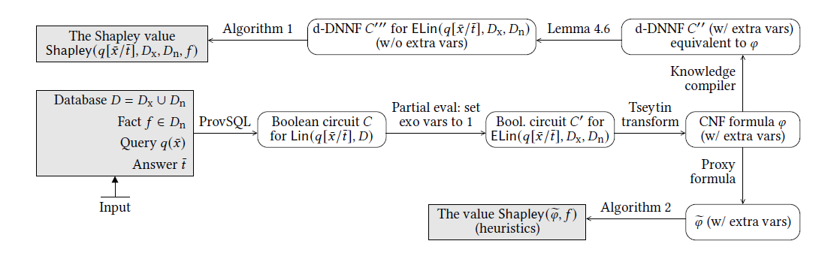
Architecture Implementation
The process begins with input data consisting of a database, a fact from the database, a query, and an answer. Here are the steps depicted in the flowchart:
1. ProvSQL
2. Tseytin Transformation
3. Knowledge Compiler
4. Lemma 4.6
5. Algorithm 1
6. Proxy Formula
7. Algorithm 2

Slide 9
EXPERIMENTS
The proposed approaches are put to the test through practical experiments on well-known benchmarks like TPC-H and IMDB. These experiments aim to check how well the solutions work in real-world situations, focusing on how effective, efficient, and accurate they are.
This system, developed using Python and PostgreSQL, operates on a sophisticated infrastructure with substantial memory resources. We employ specialized programs, namely ProvSQL and c2d, to facilitate data capture and comprehension.

Slide 10
Benchmark creation and exact computation
The curated benchmark consisting of 40 purposefully designed queries for TPC-H (1.4GB) and IMDB (1.2GB) databases allows us to assess the system's capabilities comprehensively. The exact Shapley computation delivers remarkable success rates, achieving an impressive 99.96% for IMDB queries and 84.43% for TPC-H queries.
A granular analysis of execution times, encompassing PostgreSQL, knowledge compilation, and Shapley computation, offers nuanced insights into computational efficiency, complete with detailed percentiles and a focused examination of outliers.

Slide 11
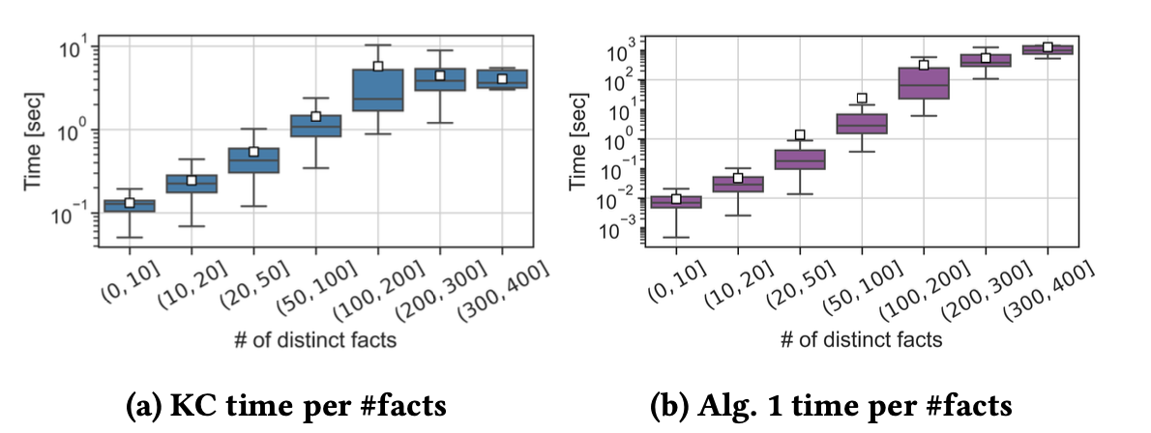
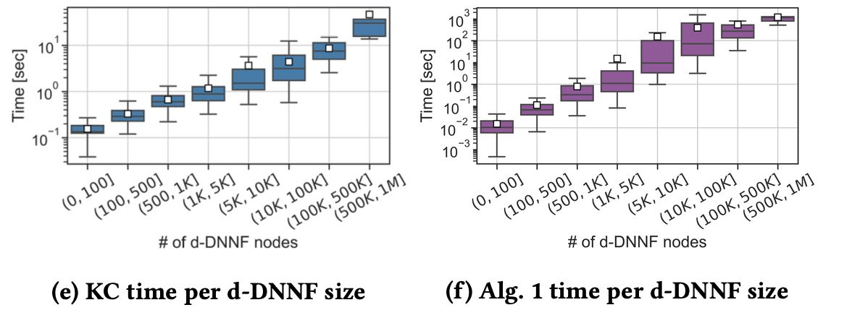
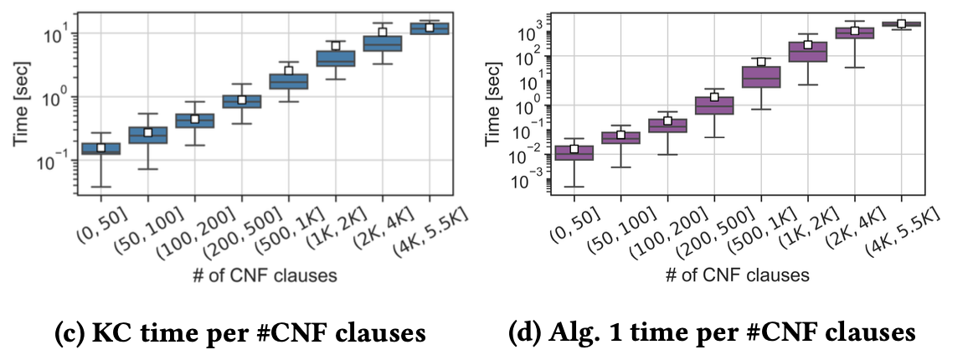
EXACT COMPUTATION RESULTS
From figures: Running times of knowledge compilation and computation of Shapley values from the d-DNNF as function of the number of distinct facts, CNF clauses, and d-DNNF size.
Success rate: We report here the rate of successful executions. The IMDB queries resulted in 95,636 output tuples; the KC step completed successfully for 95,599 out of them, where all 37 failures were the result of insufficient memory.

Slide 12
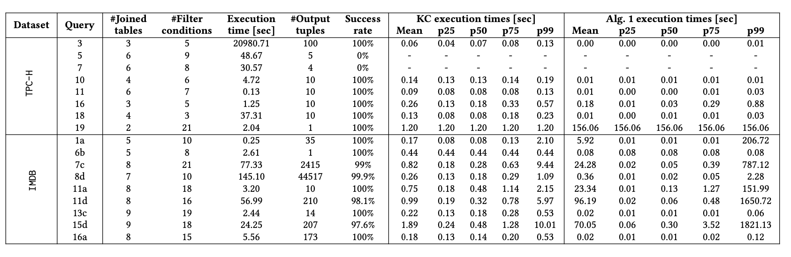
Table: Statistics on the exact computation of Shapley values for 16 representative queries

Slide 13
INEXACT COMPUTATION
This section delves into an exploration of alternative inexact computation algorithms, conducting a comparative analysis among three distinct methodologies: CNF Proxy, Monte Carlo, and Kernel SHAP.
Monte Carlo, a well-established sampling algorithm for Shapley value estimation, approximates the Shapley value of each fact by sampling permutations of input facts. Adapting Kernel SHAP to our context involves estimating Shapley values by assuming feature independence and utilizing a linear model trained on background data. CNF Proxy, a novel method introduced in this study, circumvents the need for sampling, offering a swift alternative for Shapley value computation.

Slide 14
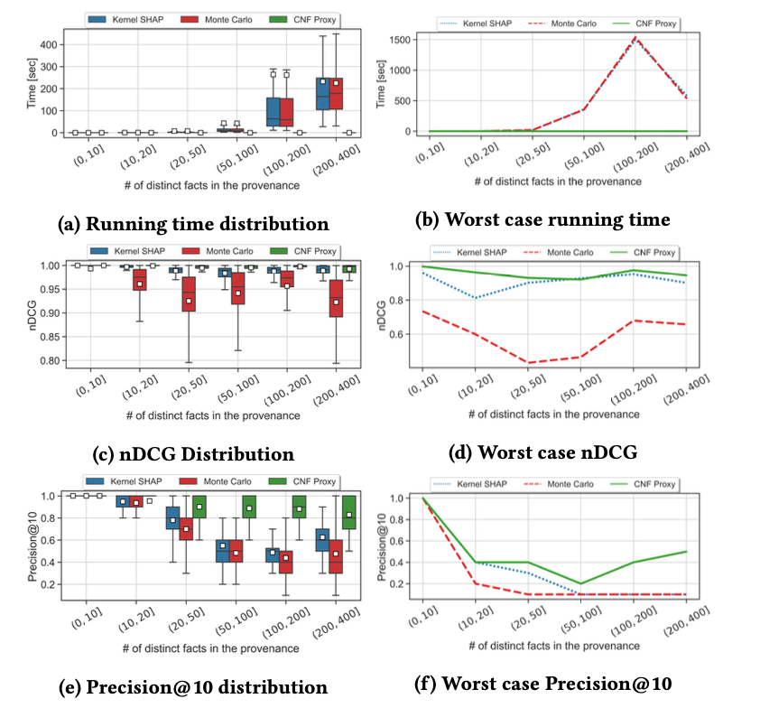
Figure: Comparing inexact methods as a function the number of distinct facts in the provenance (𝑛). Sampling methods (Kernel SHAP and Monte Carlo) presented with sampling budget of 𝑚 = 20𝑛; different budgets led to similar trends.

Slide 15
HYBRID COMPUTATION
They present a hybrid approach that combines the advantages of both methodologies. This hybrid method initiates with the precise computation, encompassing knowledge compilation and Algorithm 1. Should the exact computation conclude within a user-defined time threshold 𝑡 seconds, the outcomes are swiftly provided. Yet, in instances where the computation surpasses the set time limit, they smoothly conclude the exact computation and transition to the CNF Proxy method, providing a swift ranking of input tuples instead of their Shapley values.

Slide 16
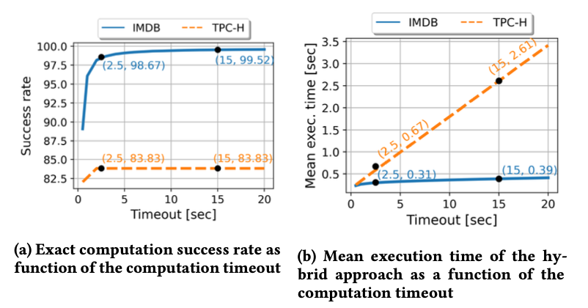
HYBRID APPROACH PERFORMANCE
For instance, with a timeout of 2.5 seconds, the mean hybrid execution time stands at 0.31 seconds for IMDB and 0.67 seconds for TPC-H.

Slide 17
BENEFITS AND LIMITATIONS
The research brings forth significant benefits by introducing an inventive application of the Shapley value in query answering, offering practical computational solutions, and establishing a meaningful connection with probabilistic query answering. The hybrid approaches, exemplified by the CNF Proxy method, contribute to a nuanced balance between efficiency and accuracy.
Its crucial to recognize the limitations, especially in the context of applying Shapley values to large-scale databases with complex queries. The computational complexity involved in certain scenarios poses challenges, necessitating further exploration of alternative methodologies and potential scalability concerns. Balancing the advantages with these limitations provides a comprehensive perspective for future advancements and research endeavors in this evolving domain.

Slide 18
CONCLUSION
This paper presents a pioneering method for evaluating the significance of individual database facts in the context of query responses, employing the Shapley value concept. We have developed a robust algorithm for precise computation of these contributions, as well as a more efficient heuristic for approximating Shapley values that prioritizes performance. Although currently tailored for SPJU queries within the ProvSQL environment, this work lays down a vital theoretical foundation for connecting Shapley value computation with probabilistic queries. The pathways for future research are numerous, including the investigation of additional SQL constructs and the possibility of adapting our framework to accommodate bag semantics, which would enable a more nuanced analysis of fact repetitions and their impact on query results.

