Slide 1
Divvy Biking Beyond Boundaries
Group 15:
Rohith Reddy Bairi, Brijeshkumaryadav Bandi, Deekshitha Tummala, Shirisha Vaddegoni

Slide 2
The story of Data
Divvy Bike Share's comprehensive dataset pulses with the life of Chicago, mapping the intricate ebbs and flows of the city's transit dynamics with detailed records of bike rides weaving through bustling neighborhoods, past iconic landmarks, and along the vibrant lakefront.
The datasets were downloaded from this divvy’s official website. A total of 12 csv files (1 file per month) were upload into Python as Pandas Dataframes. The files were combined into 1 file using .concat() method.
Featuring over 5.6 million of trips, the dataset captures rides from 633 unique stations, with data on ride duration, geographic coordinates, and user types—members and casual riders.
Lyft has provided a royalty-free, limited, perpetual license to access, reproduce, analyze, copy, modify, distribute in your product or service and use the Data for any lawful purpose.

Slide 3
From CSV to DataFrame: Structuring Divvy Bike Share Data
The Divvy Bike Share dataset is delivered in CSV format, encapsulating a wealth of information across numerous bike rides. Upon import, the raw data is transformed into a structured DataFrame, enabling advanced data manipulation and analysis.
Each ride is characterized by a series of attributes, including ride ID, bike type, timestamps of ride start and end, station information, geographical coordinates, and user type.
Header:
ride_id rideable_type started_at ended_at start_station_name start_station_id end_station_name end_station_id start_lat start_lng end_lat end_lng member_casual
Example Record:
322BD23D287743ED docked_bike 2020-08-20 18:08:14 2020-08-20 18:17:51 Lake Shore Dr & Diversey Pkwy 329 Clark St & Lincoln Ave 141 41.932588 -87.636427 41.915689 -87.6346 member

Slide 4
Data Processing
Data from 12 monthly CSV files was combined into a single DataFrame.
Corrected data types for started_at and ended_at columns.
Ensured ride_id values were unique and of correct length.
Standardized bike types by renaming 'docked_bike' to 'classic_bike'.
Identified and removed outliers in ride duration.
Handled missing station names specifically for classic bikes.
Managed missing values in station-related columns by marking them 'unknown'.
Conducted various data visualizations to analyze member vs. casual riders, ride durations, and day-wise patterns.
Performed time series analysis to observe ride duration trends over months.
Executed geospatial analysis using heatmaps to visualize bike ride distributions.

Slide 5
Data Processing & Why
To prepare a consistent, clean dataset for accurate analysis.
To ensure correct interpretation of time-based data.
To maintain data integrity and uniqueness.
To unify similar data under a consistent naming convention.
To focus the analysis on typical rides and exclude anomalies.
To preserve data integrity for trips where station information is crucial.
To retain records with valuable information despite missing some details.
To gain insights into rider behaviors, usage patterns, and operational aspects.
To identify seasonal or temporal trends in ride usage.
To understand spatial patterns in bike-sharing usage.

Slide 6
The Problem & solution
Missing Values:
We encountered missing values in this dataset. These gaps in the data might be due to errors during collection, system failures, or incomplete records.
Problem: Missing start or end station names for some classic bike rides.
Solution: Segregated these records into a separate DataFrame (`df_station_noise`), as these are critical for classic bike trips which require docking at stations.
Outliers:
Outliers are another challenge which we faced in this dataset. These anomalies, whether caused by errors or genuine extreme values, can significantly impact the statistical measures and the reliability of analytical models.
- Problem: Presence of extremely short (under 1 minute) and long (over 24 hours) rides, likely to be anomalies.
- Solution: Identified and removed these outliers, preserving them in a separate DataFrame (`df_duration_noise`) for potential future analysis.
This change has resulted in deleting 156036 rows

Slide 7
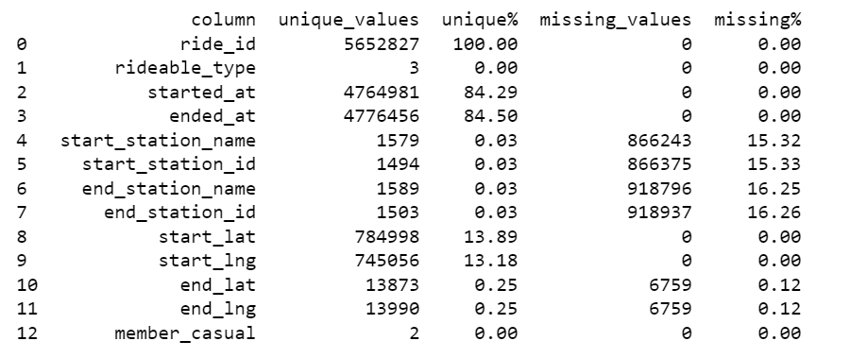

Slide 8
The Problem & solution
Duplicate Records:
Duplicate records are a common problem that needed to be addressed . These duplicates can arise from data entry errors or multiple sources providing the same information.
- Problem: Ensuring that the `ride_id` column, which serves as a unique identifier for each trip, contains unique values.
- Solution: Checked for duplicate `ride_id` values and verified the length of each `ride_id` to be exactly 16 characters.
Inaccurate Data:
Inaccuracies in data collection or entry were a concern. Large dataset as ours can sometimes contain errors that compromise the integrity of the information.
- Problem: Null values in `start_station_name`, `start_station_id`, `end_station_name`, and `end_station_id` columns.
- Solution: Instead of removing these records, missing values were filled with ‘unknown’ to acknowledge the flexibility of electric bikes which don’t always require docking at specific stations.
Data Type Transformation Challenges:
It was difficult to transform this dataset for analysis, and errors occurred during the process.
Problem: The `started_at` and `ended_at` columns were not in datetime format.
Solution: Converted these columns to datetime using Pandas `to_datetime()` method, essential for time-base analysis.

Slide 9
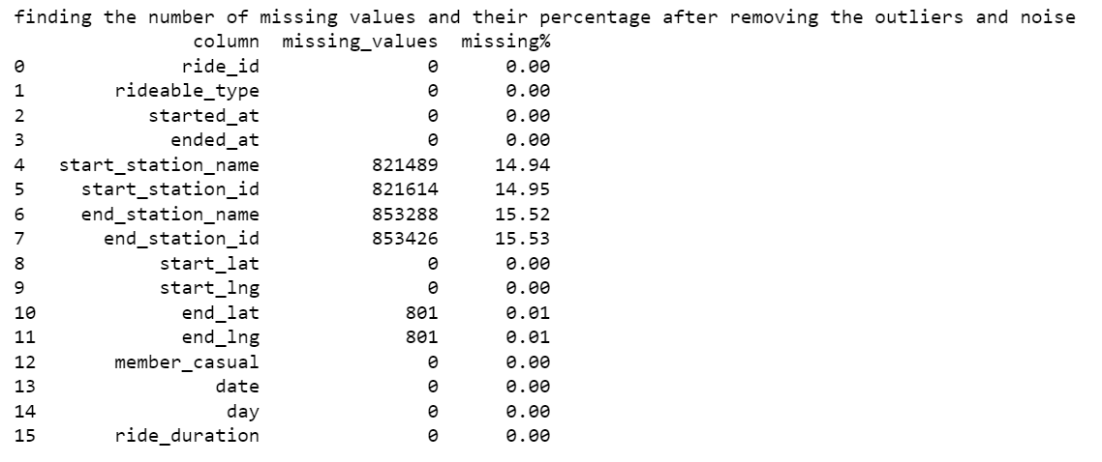
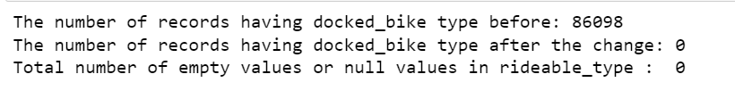

Slide 10
The Analysis and visulization
Data Visualization and Insights:
- Approach: Various visualizations were created to analyze rider behavior (members vs. casual), ride durations, and patterns based on days of the week.
- Tools Used: Matplotlib and Seaborn for visualizations, including pie charts, bar charts, and heatmaps.
Time Series Analysis:
- Objective: To observe trends in ride duration over time.
- Methodology: Grouped data by month and calculated the average ride duration, visualized using a line plot.
Geospatial Analysis:
- Objective: To visualize geographical distribution of bike rides.
- Methodology: Used Folium to create a heatmap based on the latitude and longitude of start locations.

Slide 11
Analysis and Data Visualization

Slide 12
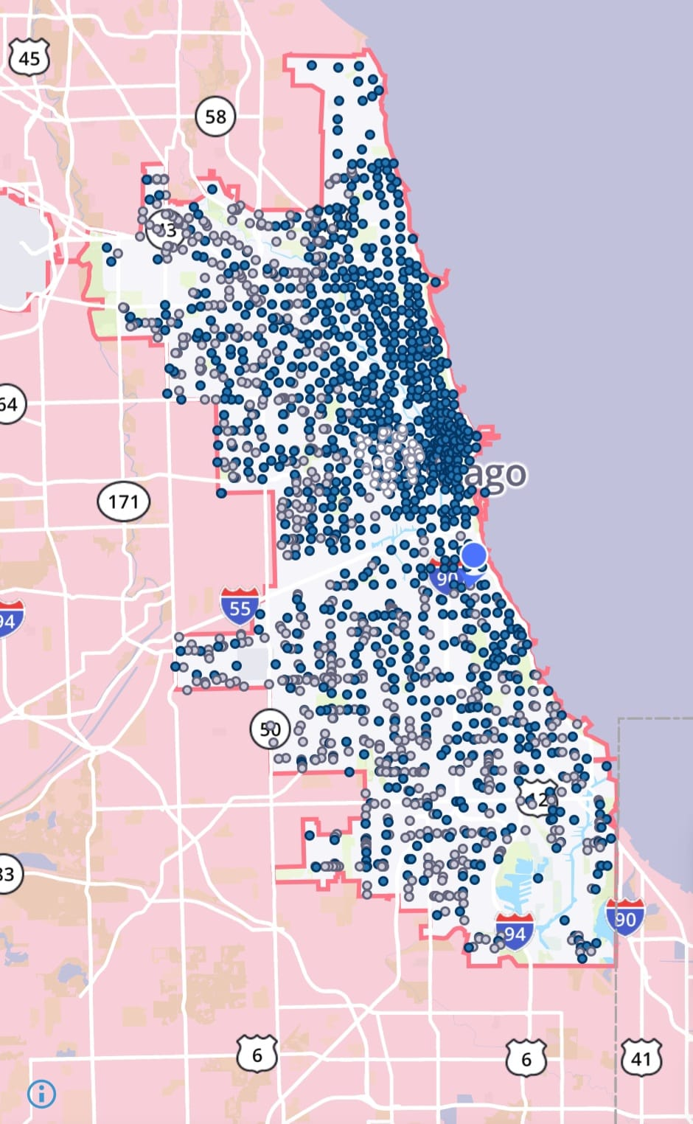
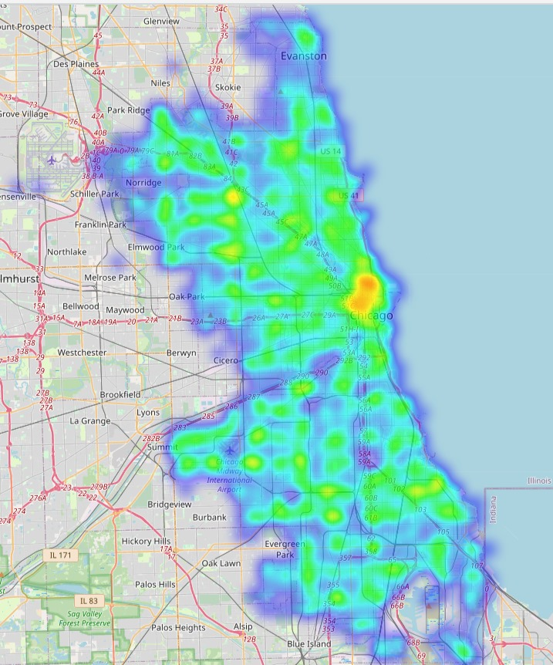
Location
Pickup locations are concentrated at the city center for casual riders.
Pickup locations are distributed throughout the city for annual members.
Divvy stations | Divvy usage heat map

Slide 13
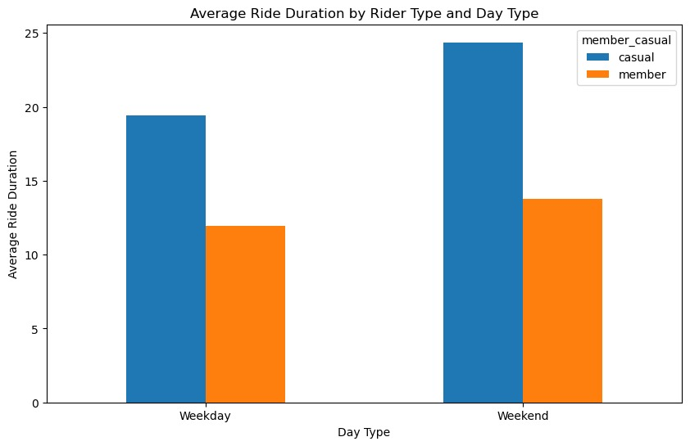
Average Ride Duration
For annual members, average ride durations are quite steady throughout the year and throughout the week.
For casual riders, average ride durations are significantly longer in spring and summer months
For casual riders, average ride durations are significantly longer in weekends.
Average ride durations are about twice as high for casual riders.

Slide 14
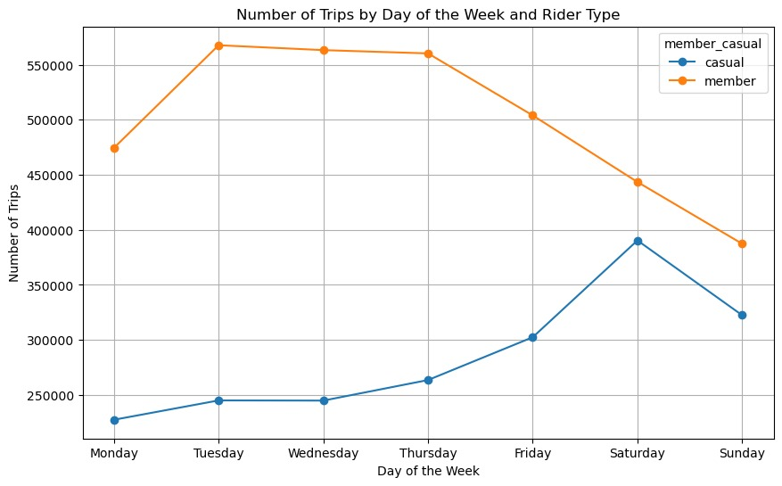
Trends in the data:
Casual Riders:
The number of trips by casual riders is higher than that of members on every day of the week. Casual ridership appears to peak midweek, with the highest number on Wednesday, and then gradually declines towards the weekend.
Member Riders:
The pattern for member riders is quite different. The number of trips starts low on Monday, increases significantly on Tuesday, remains relatively steady through Friday, and then spikes on Saturday. The number of trips for members drops on Sunday, indicating perhaps a lesser preference for using the service on that day compared to Saturday.
Overall Trends:
Casual riders seem to use the service more consistently across the week with a peak in the middle of the week. Members show a preference for using the service towards the end of the workweek and on Saturdays.

Slide 15
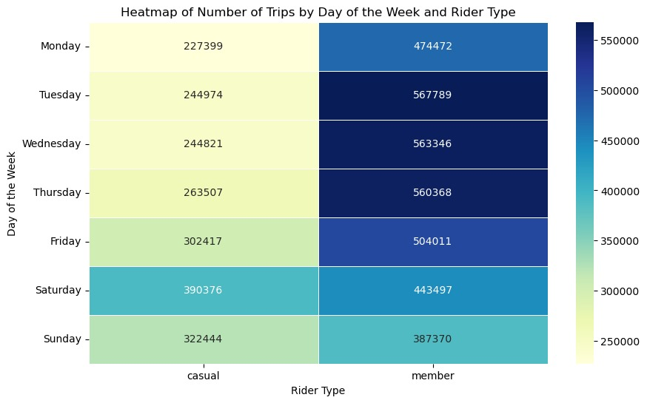
weekly Trends
The heatmap illustrates the distribution of Divvy bike-sharing trips across different days of the week for casual and member riders. Members show a consistent increase in trips as the week progresses, peaking on Tuesday, while casual riders’ trips peak on Saturdays. The heatmap’s color gradient indicates that members generally take more trips than casual riders on weekdays, with the highest volume on Tuesday.

Slide 16
The line graph depicts the average ride duration per month for Divvy bike-sharing from November 2022 to October 2023. There is a noticeable dip in ride durations in December 2022, after which there’s a steady increase, peaking in July 2023. Following this peak, there’s a sharp decline in August and September, with a slight recovery in October. This trend may suggest seasonal patterns in ride usage, with longer rides in the warmer months and shorter rides in the colder months.
The observed pattern likely reflects user behavior changes in response to weather conditions, with shorter rides during the cold winter months and longer rides during the warm summer months, indicating a preference for using bike-sharing services for longer periods when the weather is more favorable. The decline in late summer could be due to a return to school or work routines, suggesting a shift in the reasons for bike usage. The data could be vital for Divvy in planning resource allocation, and maintenance schedules to match these seasonal trends.

Slide 17
Thank You

