Slide 1
Data Curation Project
Dataset 1 – Hotel Demand Booking
Dataset 2 – Sales Data
GROUP 16:
Morareddy Rahul Reddy
Saurabh Rajput
Ganesh Maskuri

Slide 2
Introduction Dataset 1(Hotel Booking)
The dataset named "Hotel Booking Demand," which can be accessed via the above Kaggle link, includes data about hotel reservations. This is an extensive compilation of information showing reservations for two different types of hotels—one is a city hotel, while the other is a resort hotel. The collection contains details on bookings that were either cancelled or not, as well as other features of hotel reservations.
URL: https://www.kaggle.com/datasets/jessemostipak/hotel-booking-demand/data

Slide 3
Key Features
Booking Details: Includes information about bookings made at the hotels, such as reservation status, booking dates, and lead times.
Guest Information: Contains data about guests, including their demographics and the number of adults, children, and babies in the reservation.
Reservation Specifics: Comprises details like room type, meal options, special requests, and room rates.

Slide 4
Key Features
Cancellation Records: Contains information on bookings that were cancelled.
Market and Distribution Channels: Provides insights into how the reservations were made and through which channels.
Seasonality and Length of Stay: Data about the duration of stay, arrival dates, and booking trends over time.

Slide 5
Dimensions of Dataset
Dataset size: 16.86 MB
Number of Columns: 32 columns
* Integers- 17
* Strings- 13
* Decimal- 1
* Other- 1
Number of Rows: 119390 rows

Slide 6
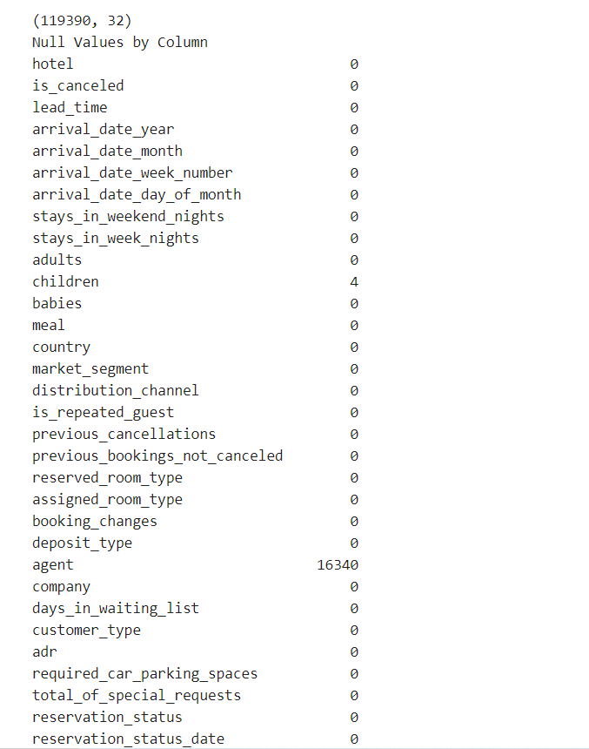
Column Names
Null Values by Column

Slide 7
Data Cleaning
Extracting the non-null values in every column and datatypes
Converting the object datatype
Creating a new column by combining three columns
Finding the number of missing values in every column
Finding the indexes of the missing value
Removing unwanted columns
Removing unwanted rows
Filling the missing values of the column

Slide 8
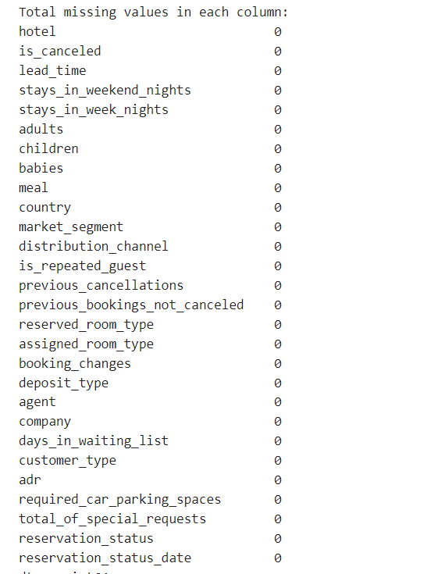
Null Values removed from the dataset

Slide 9
Dataset Details
Before data cleaning:
Columns -32
Rows -119390
After data cleaning:
Columns - 28
Rows - 103050

Slide 10
Introduction Dataset-2 (Sales Data)
Dataset comprises of sample sales data and has 25 columns and about 3000 unique records.
Includes columns representing order details, customer information, sales and shipping details, etc.
URL:https://www.kaggle.com/datasets/kyanyoga/sample-sales-data

Slide 11
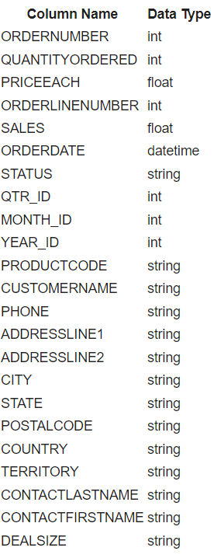
Dimensions of Dataset

Slide 12
Issues identified in the dataset
Identifying incorrect and irrelevant data from different columns of dataset and transforming it into a format.
1. ORDERDATE - The ORDERDATE column, along with the date, has a timestamp of 0:00 for all entries.
2. Phone - Customer’s phone numbers (PHONE) are in different formats.
3. STATE - STATE has missing values as well as different formats - Some fields have the entire state name spelled out vs some have the standard two syllable abbreviation used in most addresses.
4. ADDRESSLINE2 - ADDRESSLINE2 has missing values.

Slide 13
Methods used in the project
Normalizing the dataset
-Splitting into smaller tables
- Data Definition
- Data Type
- Constraints(Max, Min Values)
1
2
2
Filling missing values
Standardizing the formats
-such as country, address etc
3
3
4

Slide 14
Normalizing the dataset
Splitting data into smaller tables for query optimization
● There are a lot of fields in this table that belongs to one group, that can be broken down into smaller tables.
● For this Project, we are attempting to break down the dataset into 3 Components
○ Order Table
○ Customer Table
○ Product Table
● Even though there are specific columns such as Countries, and States that can have their own tables. Most of the columns fall under these categories, and using VizierDB's temp dataset, we can create these three tables, however, we will be providing the CREATE TABLE Script to go along with it as well

Slide 15
Standardizing Data
● Standardizing is process to convert the data in a generalized format
● Standardization helps to maintain data integrity, and are easily processed and accepted by applications without overhead transformation.

Slide 16
Data Imputation & Cleaning
● Data can be incomplete due to various reasons such as manual entry, data, etc. Data Imputation & Cleaning is required to streamline the data.
● For this dataset, we want to ensure all the fields are intact, and follow defined constraints.

Slide 17
Conclusion
● Sourced Dataset consisted of many columns that has to be broken down into multiple tables.
● The Dataset consisted information about Order Details, Product Details, and Customers.
● Standardizing Columns such as Phone Number and Country.
● Certain Dataset fields required to be defaulted on NULL, and certain fields can be calculated based on other fields such as Sales and Deal Size.
● The outcome of the exercise is a to produce well-curated dataset.

