Slide 1
Literature Review
Group 2

Slide 2
Outline
Introduction
Classification
Data Dependencies
Summary

Slide 3
Data Dependencies for Query Optimization: a Survey
By Kossmann et al.

Slide 4
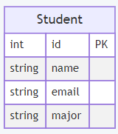
Unique Column Combination (UCCs)
Definition
Example
A set of attributes whose projection on some relational instance has no duplicate entry.
UCCs functionally determine all other attributes and, hence, are sometimes denoted as candidate keys
Any set of attributes that contains id is a UCC.

Slide 5
Functional dependencies (FDs)
Definition
Example
An FD is a statement X → Y , expressing that any two records in a relational instance r that have the same values in the attributes X ⊆ R also have the same values in the attributes Y ∈ R ; the attributes in X functionally determine the attributes in Y
Id functionally determines other attributes.

Slide 6

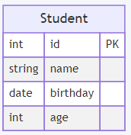

Order dependencies (ODs)
Definition
Example
An OD is a statement of the form X $↦$ Y specifying that ordering a relational instance r by the attribute list X ⊂ R also orders r by the attributes Y ⊂ R.
Order student by birthday also will order them by age

Slide 7
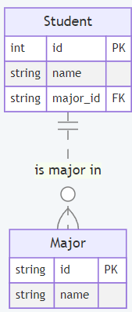
Inclusion dependencies (INDs)
Definition
Example
If all values in the projection of some attribute combination X also occur in the projection of some attribute combination Y (of the same or a different relation), then an inclusion dependency exists between X and Y.
Major.id over Student.major_id

Slide 8
Data dependency properties
Minimality
Completeness
Conditions
Null-semantics
State-of-the-art data profiling algorithms mine only minimal data dependencies.
Query optimizer might require non-minimal dependencies.
Complete set of minimal dependencies might be necessary to speed up query.
Data dependencies are sometimes tied to conditions that limit their scope.
The comparison of null values evaluates to unknown which is sometime effectively treated as true or false

Slide 9
Query Optimization
Cost-independent transformation
Cardinality and cost estimation
Cost-based transformation
The process of rewriting a query into a semantically equivalent but presumably more efficient query via static, rule-based transformation.
Query optimizer estimates the expected cost for a certain query plan and its individual operators based on cardinality information, logical operator specification, and hardware-specific costs.
The process of improving physical query plans via cost-driven transformations that depend on the database instance at hand.

Slide 10
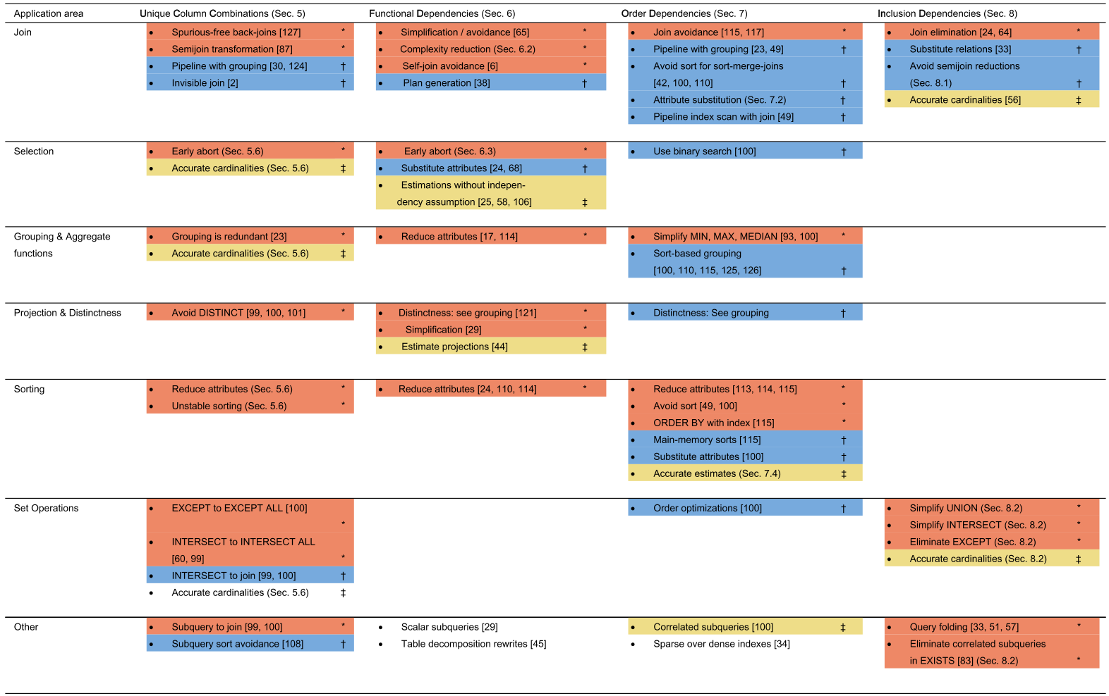
Classification of Dependency-driven Query Optimization Techniques
Cost-based plan transformations (†)
Cost-independent transformation (*)
Cardinality and cost estimation (‡)

Slide 11
UCCs and Join
Example
Optimization Technique
SELECT R.A, SUM(S.B) FROM R, S WHERE R.A = S.A GROUP BY R.A
Aggregations and asymmetrically implemented joins can be pipelined if the grouping attributes contain the primary key.

Slide 12
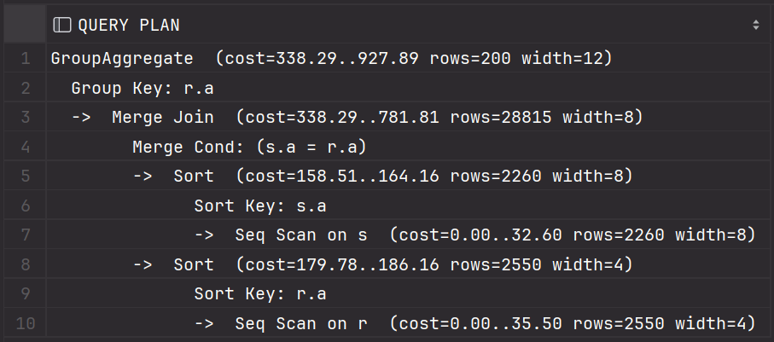
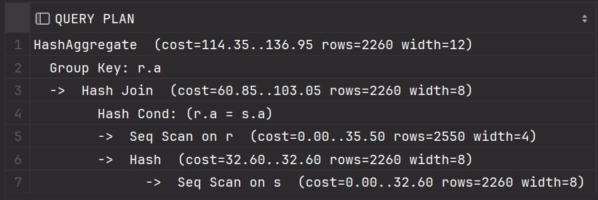
UCCs and Join
Example
SELECT R.A, SUM(S.B) FROM R, S WHERE R.A = S.A GROUP BY R.A

Slide 13
UCCs and Join
Example
Optimization Technique
SELECT R.A
FROM R
WHERE R.A in (SELECT S.A FROM S);
vs
SELECT R.A
FROM R inner join S on R.A = S.A;
An inner join of two relations R and S on the join attributes X can be executed by potentially more efﬁcient semijoin

Slide 14
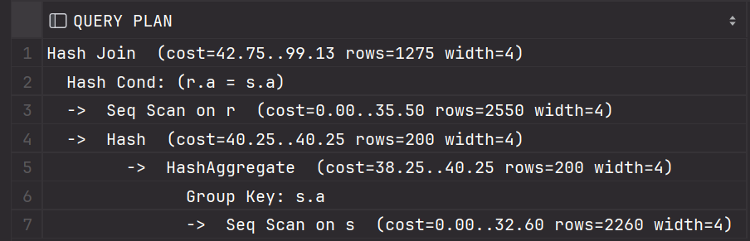
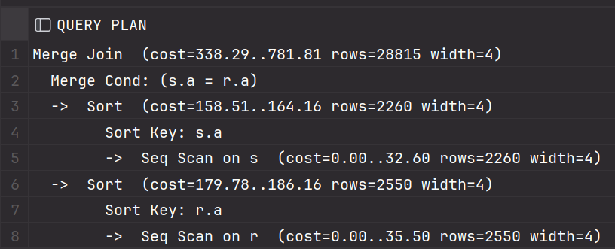
UCCs and Join
Inner join & semi-join
Inner join without UCC

Slide 15
UCCs and Subqueries
Example
Optimization Technique
SELECT R.A, R.B FROM R
WHERE EXISTS
(SELECT * FROM S WHERE S.A = R.A)
vs
SELECT R.A, R.B FROM R, S
WHERE S.A = R.A
Subqueries can be transformed into ordinary join queries

Slide 16
UCCs and Subqueries
Example
EXISTS & JOIN
SELECT R.A, R.B FROM R
WHERE EXISTS
(SELECT * FROM S WHERE S.A = R.A)
vs
SELECT R.A, R.B FROM R, S
WHERE S.A = R.A

Slide 17
FDs and Grouping
Optimizations
Example
Grouping operations can be simpliﬁed through query rewriting if functional dependencies are present.
SELECT C, SUM(D) FROM R WHERE B = 17 GROUP BY C, A
SELECT C, SUM(D) FROM R WHERE B = 17 GROUP BY C
(Special Case)
DISTINCT X, A reduces to DISTINCT X if X → A

Slide 18
FDs and Selections
Optimizations
Example
FDs can be used to reduce equality predicates
SELECT X, A FROM R
Where X = y and A = b
(FD: X → A)

Slide 19
FDs and Selections
Optimizations
Example
Selections can be shifted to another attribute that is less expensive to process
SELECT X, A FROM R
Where X = y and A = b
(FD: X → A)

Slide 20
ODs and Sortings
Optimizations
Example
OD can reduce number of sorting attributes and leads to fewer sort operations, which can potentially decrease the execution time.
If holds on a relation R,
ORDER BY X, Y
can be reduced to
ORDER BY X

Slide 21

ODs and Joins
Before
After
SELECT ... FROM sales s, date d WHERE s.sold_date_sk = d.date_sk AND
d.date BETWEEN ’20201104’ AND
’20201204’
SELECT ... FROM sales s,
(SELECT MIN(date_sk) min_d FROM date WHERE date >= ’20201104’) d1,
(SELECT MAX(date_sk) max_d FROM date WHERE date <= ’20201204’) d2
WHERE s.sold_date_sk BETWEEN d1.min_d AND d2.max_d

Slide 22
INDs and Joins
Optimizations
Example
No need for Semi Join Reduction
1
2

Slide 23


INDs and Joins
Optimizations
Example
Eliminate joins in the presence of INDs and foreign-key constraint
1 $→$ R
2 $→$
(iff

Slide 24
INDs and Further
Optimizations
Optimization
SELECT * FROM R WHERE EXISTS (SELECT * FROM S WHERE S.A = R.A)
->
SELECT * FROM R
SELECT A FROM R
UNION
SELECT A FROM S
SELECT DISTINCT A FROM R
SELECT A FROM R
EXCEPT
SELECT A FROM S
EMPTY

Slide 25
Summary
+ Classification of Query Optimization Techniques
+ Intuitive description
- missing real world cases
- comparing techniques applied between database

Slide 26
Thank you

