Slide 1

CS520 Group Project - Paper Review for ‘Computing Rule-Based Explanations by Leveraging Counterfactuals’
CS520 Group 23
Fatima Vahora(A20555359)
Haeun Suh(A20542585)
Prashant Ravic(A20499010)
Notes:
Good morning(afternoon), everyone! We are CS520 Group 23 who reviewed and going to give a presentation about the paper named 'Computing Rule-Based Explanations by Leveraging Counterfactuals'. As today’s presenter, my name is 000.

Slide 2

Index
Motivation: Why Data Provenance?
Terminology: Key concepts and background to know.
Algorithm: GeneticRule, GeneticCF, GreedyCF
Evaluation: Comparative evaluation through experiments.
Limitation: What improvement can be added?
Conclusion: Concluding remarks for the paper.
Notes:
The paper our group reviewed is related to 'Data Provenance', one of the topics we studied in class, and aims to introduce a new advanced explanation system that can be applied to sophisticated machine learning models used for high-stakes decisions. We will proceed with our presentation in the order of the index presented here in this slide. This order is similar to the way the paper is developed. It proceeds in the following order: motivation, which presents the need for the algorithm, terminology, which establishes the main concepts, algorithm, which introduces the algorithm, evaluation, which introduces the results of evaluating the algorithm, and limitation, which specifies the limitations of the paper. In the conclusion, we will briefly talk about our group's impressions and conclusions about the paper.

Slide 3
Motivation
Why Data Provenance?
Notes:
Before start off, let's talk about the concept 'Data Provenance’. Through the class, we learned that Data Provenance is a Metadata describing the origin and creation process of data. However, here we would like to explain Data Provenance as more straightforward through a slightly modified example from the example included in the paper we reviewed.

Slide 4

Mortgage loan application problem
Notes:
For example, let's assume that a customer named Jesse visits a bank to apply for a mortgage loan. Let's say the banker, Laura, takes over the relevant documents from her and enters them into the bank's computer system. The bank operates an automated loan screening system, so Laura only needs to check the screening results based on the information she entered. However, unfortunately, according to Laura's screening results, Jesse was found to be ineligible for the loan.

Slide 5
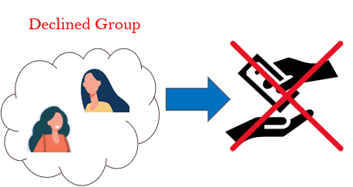
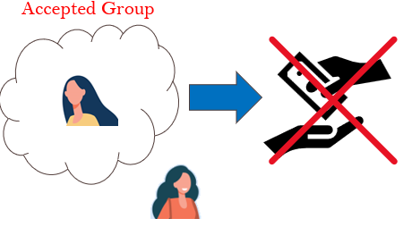

Mortgage Application problem
Notes:
Here, depending on the specific system the bank operates, you can think about how Laura would report the results. For example, Laura could explain that Jessie was rejected because she had features that put her in a group that did not allow her to apply for a mortgage loan. In another case, Jessie was rejected because she does not have the group's features to be approved, and Laura might reply that she could be approved for mortgage loan if she achieved those features.

Slide 6

Mortgage Application problem
Notes:
However, in any case, Laura or the bank must be able to explain that the loan reviews in our system were conducted in a reasonable and fair manner. For example, in the first case, the customer's interest is in getting approved for a mortgage loan, so the reason for the rejection may not be very important. On the other hand, in the second case, Jesse can question the system because her friend Paul had the same features as her and was approved for a mortgage loan. The bank's customers, including Jesse, are not interested in how overly complex or limited-access electronic screening systems work. We are only interested in ensuring that the system operates in a reasonable and fair manner. Non-IT employees, including banker Laura, are also not interested in the system's algorithms; they only want to know on what basis the system works. This is because the system is already so complex and processing so much data that individuals cannot control it.

Slide 7
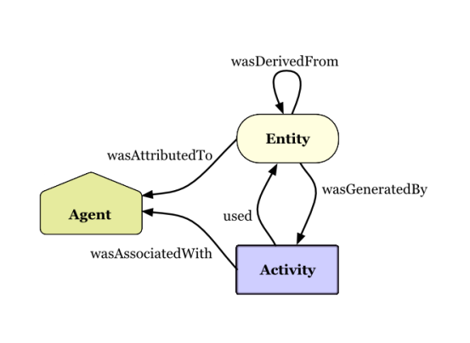
Data Provenance
“Metadata describing the origin and creation process of data”
Notes:
Let us recall once again the definition of data provenance mentioned earlier. When considered in relation to the case, we can now guess that a rational algorithm is needed that encompasses the origins and application logic of a system that applies complex machine learning, such as a loan screening system. With this goal in mind, the authors of the paper we reviewed developed a more efficient and at the same time persuasive algorithm and introduced it in the paper.
In summary, this paper is a method of mixing rule-based explanations and counterfactual explanations in a way that can improve the efficiency of the rule-based explanation system while overcoming the incompleteness of the counterfactual explanation system under the premise that the duality theorem is established. We are introducing a new algorithm.

Slide 8
Terminology
Key concepts and background to know.
Notes:
We found that there were several concepts in the paper that were relatively unfamiliar or needed to be clarified in the development of the paper. Representative examples include duality theorem, Rule-Based Explanation, and Counterfactual explanation. Before proceeding with the explanation of the algorithm, we will briefly explain these concepts.

Slide 9
Rule-Based Explanation VS Counterfactual Explanation.
Notes:
Before we begin the explanation, let's recall the example we looked at in the last step. We have seen that a bank can have two types of explanation systems.

Slide 10
Rule-Based Explanation VS Counterfactual Explanation.
The Rule-Based Explanation
The Rule-Based Explanation system is conjunctions of predicates on features consistently leading to certain outcomes and descriptively provide core reasons for decisions.
Notes:
In the first case, the system extracts the most common (i.e., minimum number of) features from customers who have already been rejected for a loan and checks whether the loan applicant meets the conditions. Although it doesn't confirm how customers get approved for a loan, the reasons for being rejected are clear and logical. This system judges the value of new data based on a set of the most common rules. Such a system can be said to be a Rule-Based Explanation system.

Slide 11
Rule-Based Explanation VS Counterfactual Explanation.
The Rule-Based Explanation
An arbitrary instance: 𝑥
A Prediction by classifier for 𝑥: C(𝑥)
A predicate of x by rule R: R(𝑥)
A set of all instances that satisfy rule R:
INST𝑅 = {𝑥|𝑥 ∈ INST𝑅, R(𝑥) = 1}
A database with m instance 𝑥: D = {𝑥1, …, 𝑥m}
An input instance: 𝑥i
Relevance: 𝑥i ∈ INST𝑅
Global Consistency: ∀𝑥 ∈ INST𝑅, 𝐶(𝑥) ≤ 0.5
Interpretability: min(|INST𝑅|)
Data Consistency: ∀𝑥k ∈ D ∩ INST𝑅, 𝐶(𝑥) ≤ 0.5
Notes:
According to the Rule-Based Explanation system, when the three properties of Relevance, Global Consistency, and Interpretability are satisfied for a specific instance, it becomes a system that can explain that instance. Relevance means that the instance must be relevant to the rule, which means that the rule must already contain the same value as the instance. Global Consistency means that all instances corresponding to the rule must be consistent. For example, in a loan review system, this means that all instances included in the rule must have been rejected for loans. Finally, Interpretability states that rules should be the most common and simple, and therefore have small cardinality. In other words, the redundant rule should be excluded as much as possible.
One more concept that should be mentioned is data consistency. In general, because it is realistically difficult to check all characteristics, the scope of consistency checking in the paper is limited to the database, and this property is referred to as data consistency.

Slide 12
Rule-Based Explanation VS Counterfactual Explanation.
The Counterfactual Explanation
The Counterfactual Explanation system is an explanation system with a more purposeful nature, aiming to identify the counterfactual features(or instances) that can change the predicate result from ‘undesired’ to ‘desired’.
Notes:
On the other hand, the Counterfactual Explanation system is an explanation system with a more purposeful nature. Like the second case in the previous example, through counterexamples, i.e. cases where the screening was passed, you can specify the features that a specific customer needs to change in order to pass the screening next time. The main purpose of the counterfactual explanation system is to identify counterfactual instances by checking whether the judgment result changes when the value of the instance included in the existing rule is changed. Therefore, a customer may be judged as unable to pass the loan screening unless he or she has an exception value for that feature, that is, a counterfactual instance.

Slide 13
Rule-Based Explanation VS Counterfactual Explanation.
Values ​​are different for a good reason
An arbitrary instance: 𝑥
A counterfactual instance of 𝑥 : 𝑥cf
A Prediction by classifier for 𝑥: C(𝑥)
Φi is a predicate over the features over the 𝑥i and 𝑥cf
A predicate PLAF: P(𝑥cf)
P(𝑥cf) = Φ1 ∧ · · · ∧ Φ𝑚 ⇒ Φ0
A distance function on INST: dist(𝑥, 𝑥’)
Rank 𝑥cf by the degree of change from 𝑥i
The Counterfactual Explanation
Feasibility: incomeCF ≤ $1M
i.e., income of 𝑥cf should be within feasible range as given.
Plausibility: genderCF = genderi
i.e., the feature gender should not be change.
education𝐶𝐹 > education𝑖 ⇒ age𝐶𝐹 ≥ age𝑖+4
i.e., Features ​​are different for a good reason.
PLAF constraints ranked by dist(𝑥, 𝑥’) from 𝑥i
Notes:
In order to be the counterfactual instance, it is necessary to satisfy two properties. First, the instance must be feasible and plausible with respect to the original instance value. Feasibility imposes constraints on the new values while plausibility imposes constraints on how the new values in the counterfactual instance differs from the target instance. The authors propose to express these two features as PLAF predicates, which are composed of a conjunction of predicates for each feature of an instance. Second, using function that calculates the difference from old value to new value of each feature respect to the target instance, PLAF constrains are scored and ranked by their distance from the target instance.

Slide 14
Duality and Duality Theorem

Slide 15
Algorithm
GeneticRule, GeneticCF, GreedyCF

Slide 16
Evaluation
Comparative evaluation through experiments.

Slide 17
Limitation
What improvement can be added?

Slide 18
Conclusion
Concluding remarks for the paper.

Slide 19
Thank you for your listening☺

