Slide 1

JEDI: These aren't the JSON documents you're looking for...
MEMBERS:
- NIRBHAY TIBADIYA
- TIRUMALA LAXMI
-SINGH NITIN

Slide 2
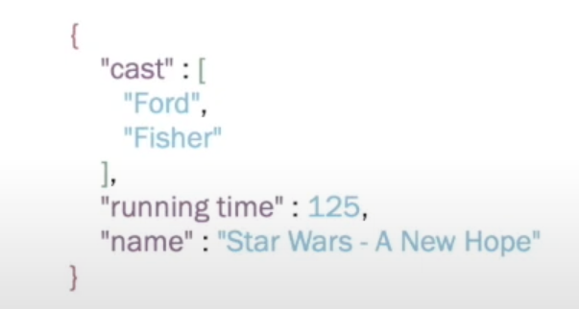
JSON Data Format
Applications:
Common format for datasets.
Data-interchange format in mobile and web applications.
Semi-structured data in document stores.
Definitions:
Objects: unordered collection of key-value pairs.
Arrays: ordered list of values.
Values: literals (e.g., string), arrays, and objects
JSON document 1:

Slide 3
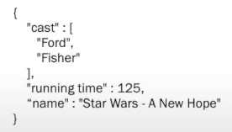
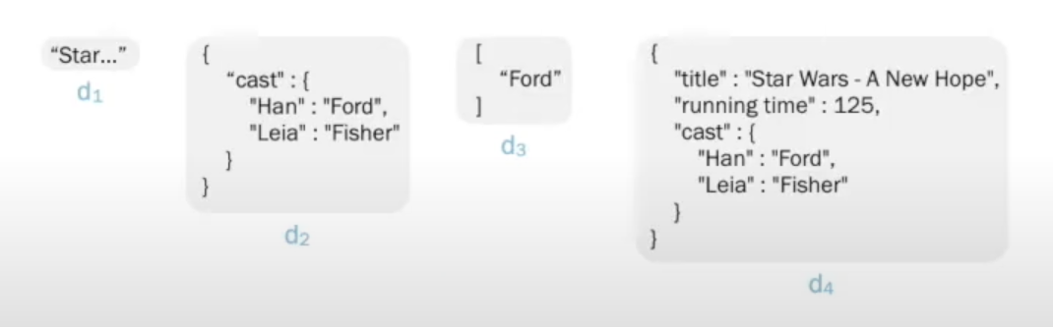
JSON Similarity Lookup
Definition: Given: distance function δ, user-defined threshold T, and a query JSON document dq.
Goal: retrieve all JSON documents di from a database D that are similar to dq, i.e., δ(dq,di) ≤T
Query Document dq
Database D

Slide 4
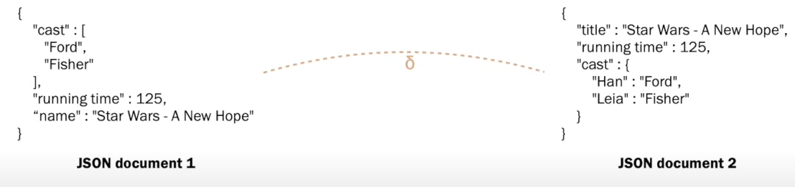
Distance Functions of JSON
Goal: find a distance function δ for JSON documents
Existing solutions:
Ignore the structure (eg. line based approach)
No quality guarantees ( eg. distance not minimal)

Slide 5
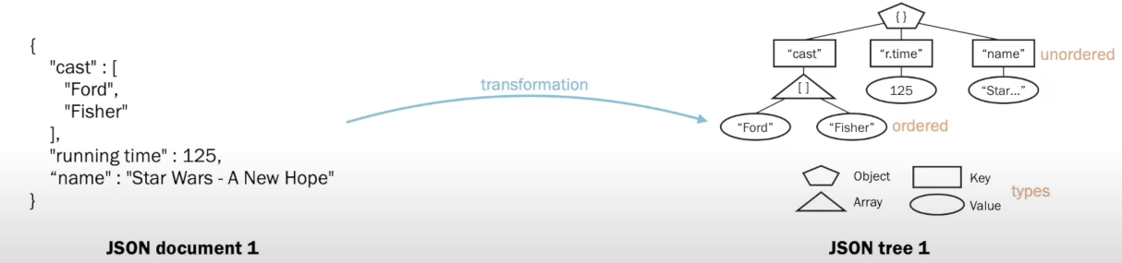
JSON Representation
Goal: Develop a lossless representation of JSON documents
JSON trees:

Slide 6
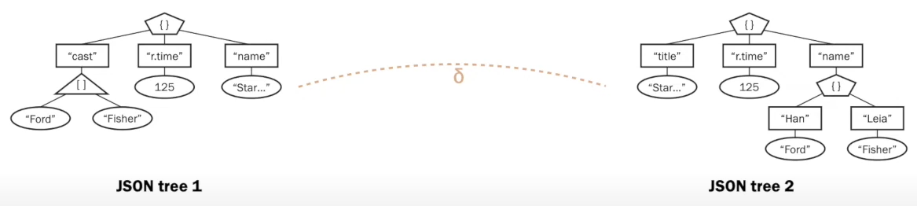
Distance Functions of JSON
Goal: develop a distance functions δ for JSON trees.

Slide 7
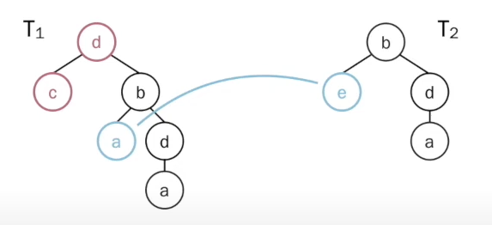
Tree Edit Distance (TED)
Example: trees T1 and T2 with TED(T1, T2) =3
Complexity:
O(n^3) time for ordered trees.
NP-hard for unordered trees.

Slide 8
Distance Functions of JSON
Goal: find a distance function δ for JSON documents
Existing solutions:
TED is NP-complete for JSON trees.

Slide 9
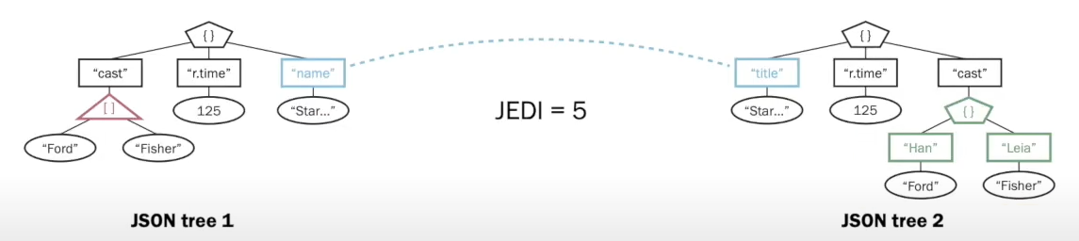
JSON Edit Distance (JEDI)
Definition: the minimum number of node edit operations (insert, delete, and rename) that transform one tree to another satisfying the document-preserving constraint
and uses
The resulting algorithm runs in O(n^2 d log(d)) time and uses O(n^2) space, where n is the tree size and d the maximum degree of the tree.

Slide 10
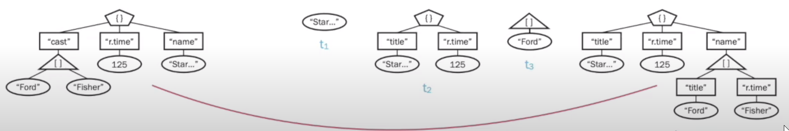



JSON Similarity Lookup
Definition: Given: distance function JEDI, user-defined threshold T, and a query JSON tree tq.
Goal: retrieve all JSON trees ti from a database D that are similar to tq, i.e., JEDI(tq,ti) ≤T

Slide 11
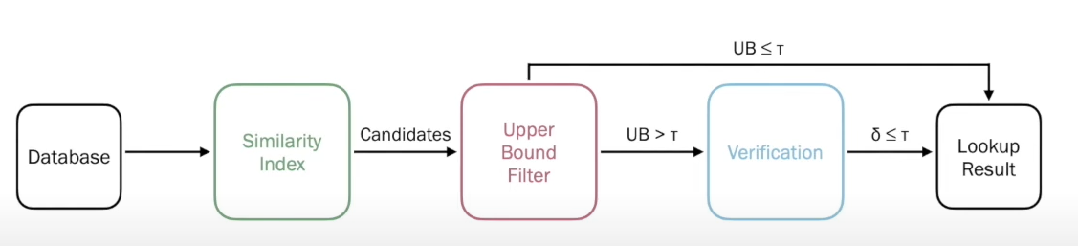
Filter and Verification Framework
Overview:

Slide 12
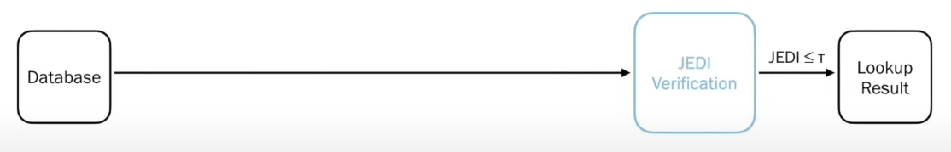
Filter and Verification Framework
Efficient Framework: QuickJEDI reduces the runtime by up to one order magnitude.

Slide 13
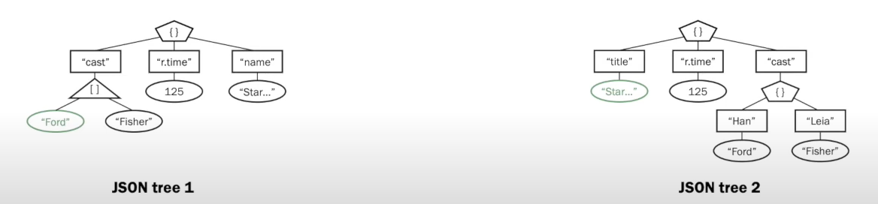
JEDI Baseline Algorithm
Dynamic Programing Algorithm:
Process all node pair in bottom-up manner
Compute the subtree distance for each node pair

Slide 14
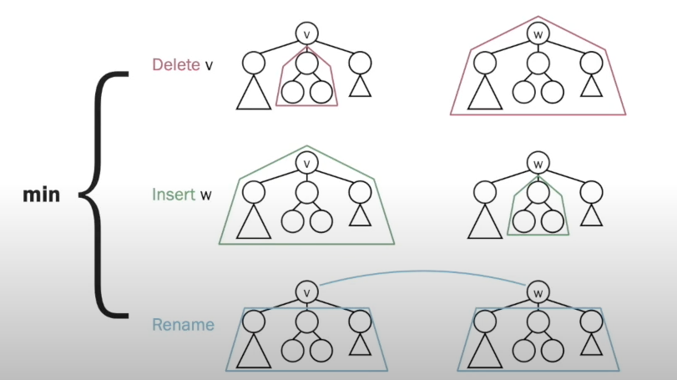
JEDI Baseline Algorithm
Subtree Distance Computation:
Consider the edit operation with minimum distance.

Slide 15
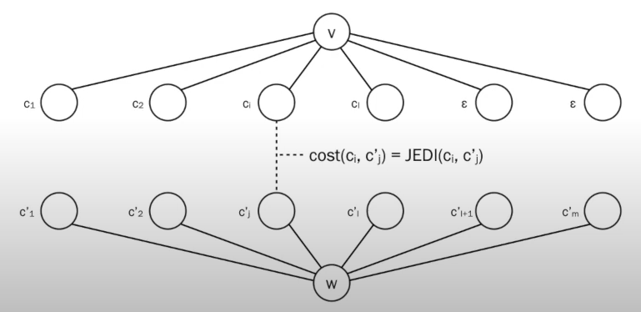
JEDI Baseline Algorithm
Cost of children matching:
v and w are arrays: sequence edit distance (quadratic runtime)
Otherwise: minimum bipartite-graph matching (cubic runtime)

Slide 16
Skipping the Children Matching
Bound the subtree distance and skip if lower bound exceeds upper bound
Insertion and deletion provide an upper bound.

Slide 17
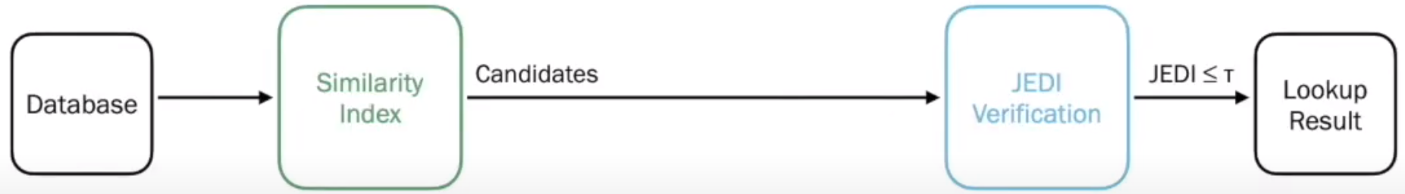
Filter and Verification Framework
Process large datasets: JSIM is the first JSON similarity index

Slide 18
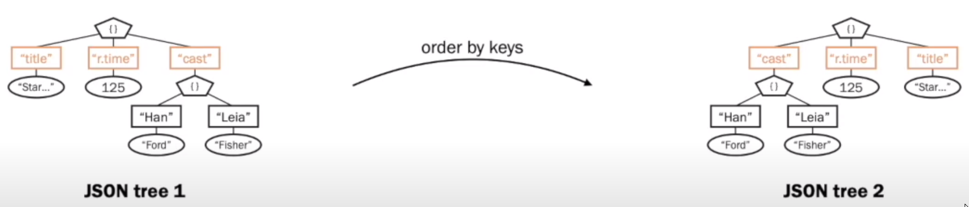
JOFilter Upper Bound
Send Candidates to the result set without verification

Slide 19
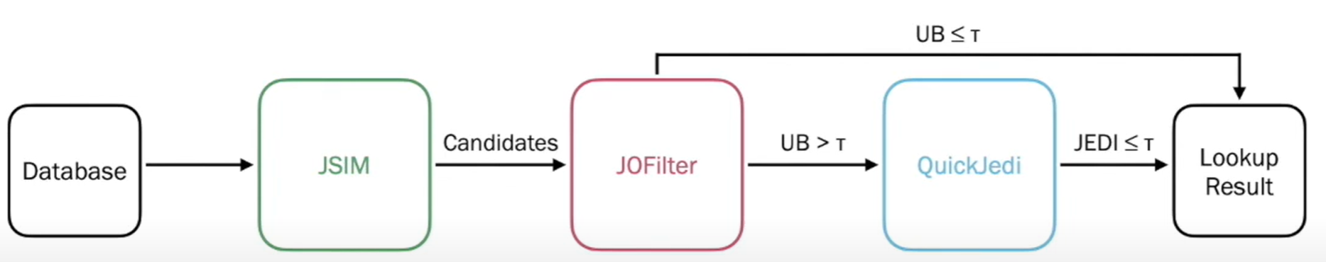
Filter and Verification Framework
JSON Similarity Lookup

