Slide 1
Data Curation Project
Ahmad Bacha, Tianyi Hao, Xinyi Yue
Group 10

Slide 2
Overview
Introduce Dataset
Identify Data Quality Problems
Clean Data

Slide 3
Dataset
The dataset is a full list of buildings required to comply with the Chicago
Energy Benchmarking Ordinance. It includes all commercial, institutional, and
residential buildings larger than 50,000 square feet. The information in this
dataset is used by building owners or other building representatives to
determine if their properties need to comply with the Chicago Energy
Benchmarking Ordinance.

Slide 4
Why
Buildings larger than 50,000 square feet are less than 1% of Chicago’s buildings, but they account for approximately 20% of total energy used by all buildings. Therefore, the Chicago Energy Benchmarking Ordinance requires buildings larger than 50,000 square feet to report their energy use to the City annually and verify data accuracy every three years.

Slide 5
Dataset
Source: Chicago Data Portal (https://data.cityofchicago.org)
Data Owner: City of Chicago Sustainability Program
Date Created: March 9, 2016
Data Last Updated: February 10, 2022
Rows: 3606 (Each row is a building)
Columns: 12

Slide 6
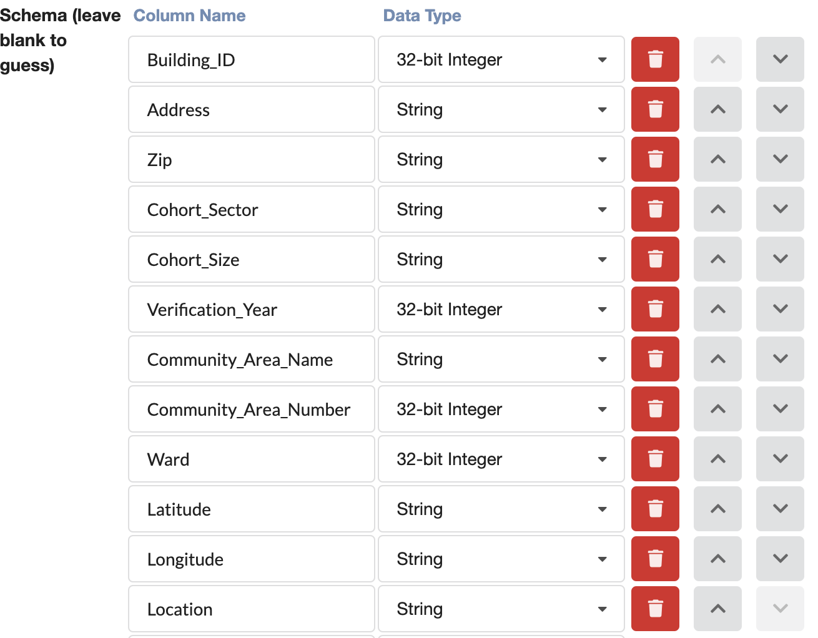
Tool
Vizier
Load Dataset
Assign Data Type

Slide 7
Data Quality
Five Characteristics of Quality Data
Validity
Accuracy.
Completeness
Consistency
Uniformity

Slide 8
Identify Data Quality Problems
Attempt to Identify
Irrelevant Columns
Duplicates
Structural Errors
Missing Values
Invalid Values

Slide 9
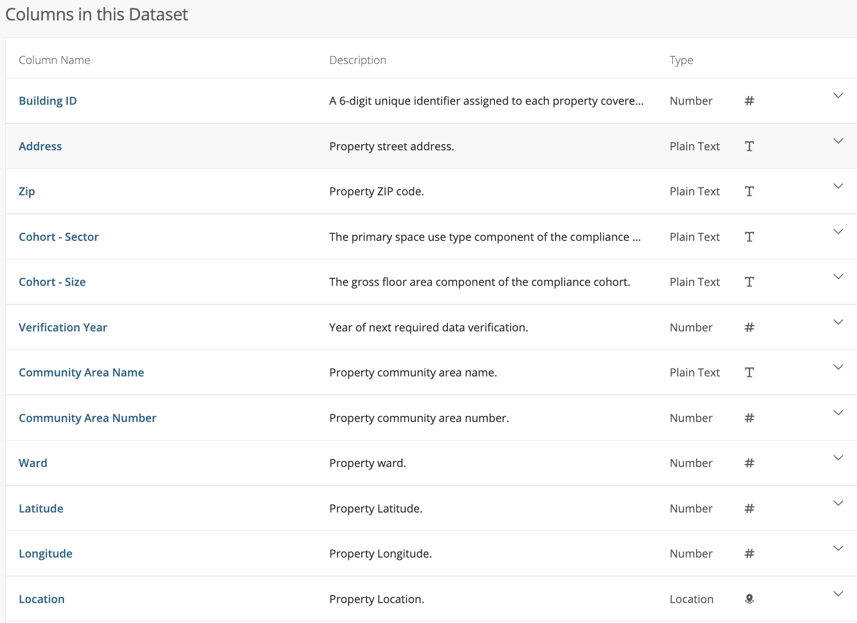
Identify Irrelevant Columns
Primary Key
All columns are useful No need to drop any column.

Slide 10
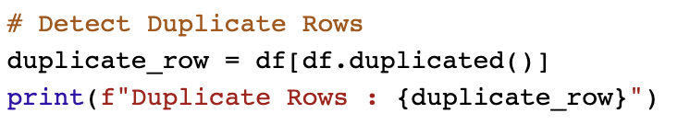

Identify Duplicate Rows
Code
Output

Slide 11
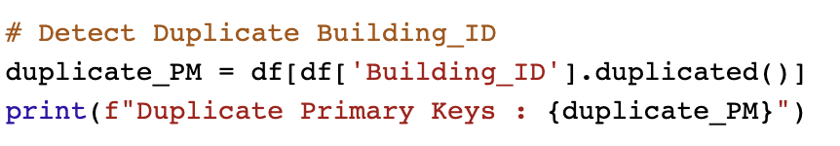
Identify Duplicate Primary Key
Code
Output

Slide 12
Identify Structural Errors
Are data types correct?
Yes, we assigned the data type at the beginning.

Slide 13
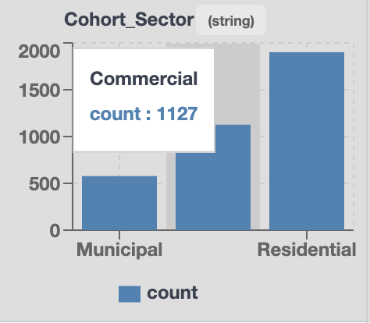
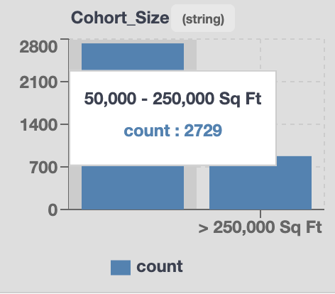
Identify Structural Errors
Are categorical values correct/should we convert category to number
Sector: Municipal, Commercial, Residential
Size: 50,000 – 250,000 Sq Ft, > 250,000 Sq Ft
Vizier Detail View

Slide 14
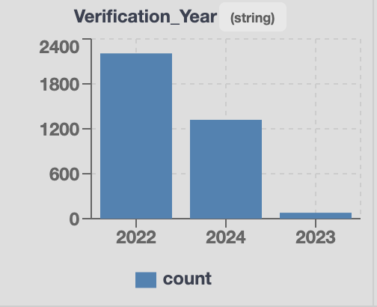
Identify Structural Errors
Valid Numerical Columns?
Verification Year: Verify information every three years

Slide 15
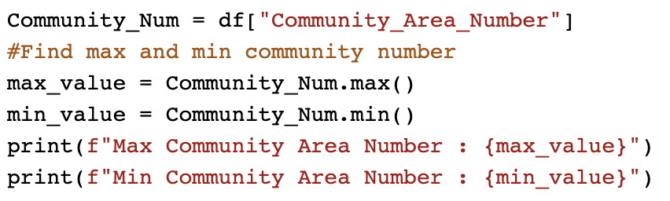
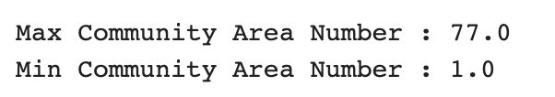
Identify Structural Errors
Valid Numerical Columns?
Community Number: The city of Chicago is divided into 77 community areas for statistical and planning purposes (Cited From Wiki)
Output

Slide 16
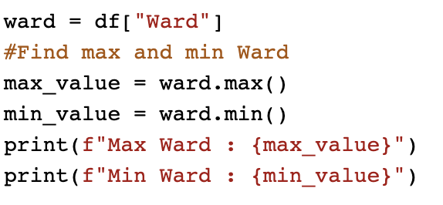
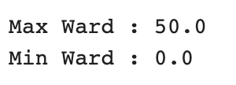
Identify Structural Errors
Valid Numerical Columns?
Ward: The city of Chicago is divided into 50 Ward (1-50)
Output

Slide 17


Identify Structural Errors
Valid Longitude and Latitude?
Longitude
Latitude

Slide 18
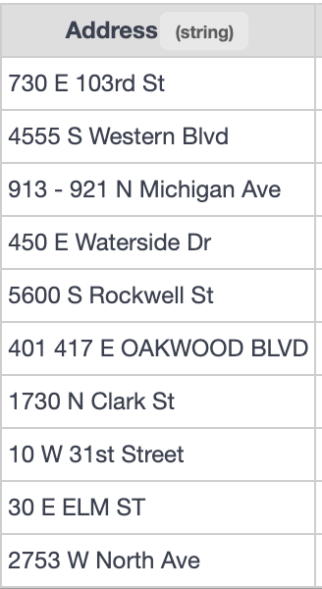
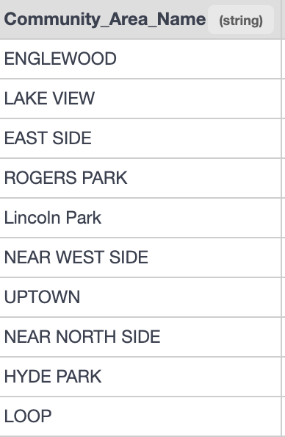
Identify Structural Errors
Good and uniform naming convention?
Some street numbers are range
Lower and upper case
Some use street abbreviation

Slide 19
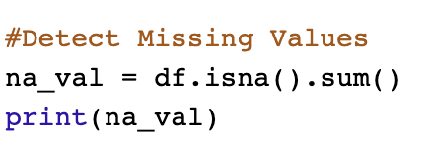
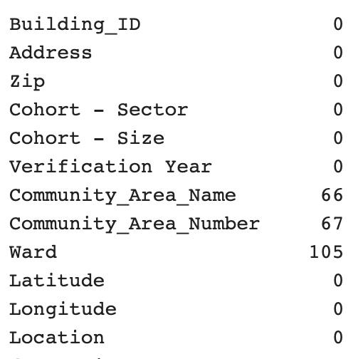
Detect Missing Values
Code Output

Slide 20
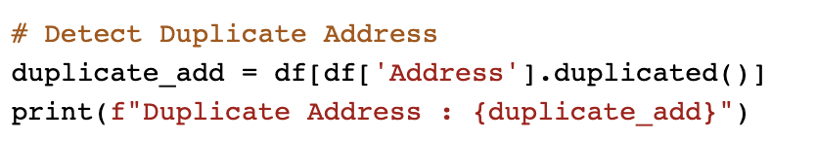
Identify Invalid Values
Each building should have a unique address, so there should be no duplicate address
Output

Slide 21
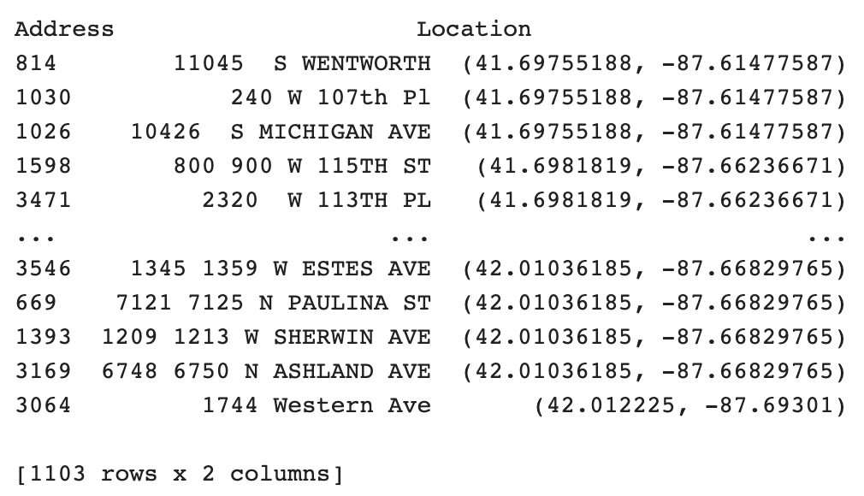
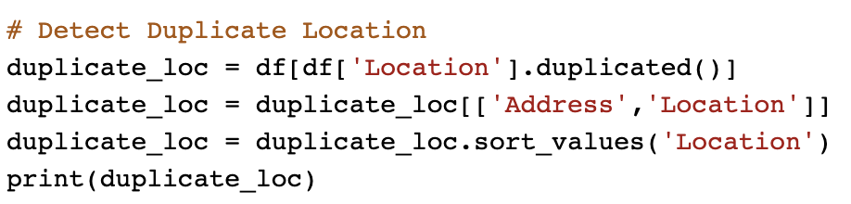
Identify Invalid Values
Each building has a unique address, so there should be no duplicate location or small number of duplicate locations
Output

Slide 22
Quality Problem Summary
Invalid Ward (Ward 0)
Missing Value : Ward, Community Area, Community Number
Too many duplicate locations/ Multiple address share one location

Slide 23
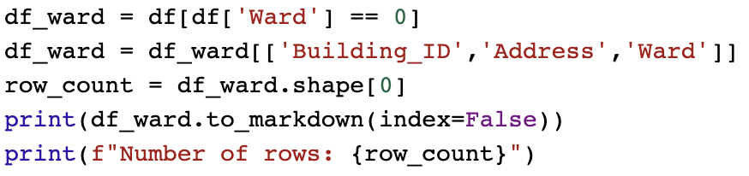
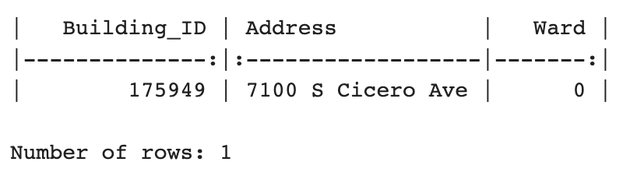
Data Clean
Invalid Ward (Ward 0)
How many rows with Ward 0 ?
Find correct ward by address from https://www.chicago.gov

Slide 24
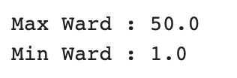
Data Clean
Invalid Ward (Ward 0)
Verify

Slide 25
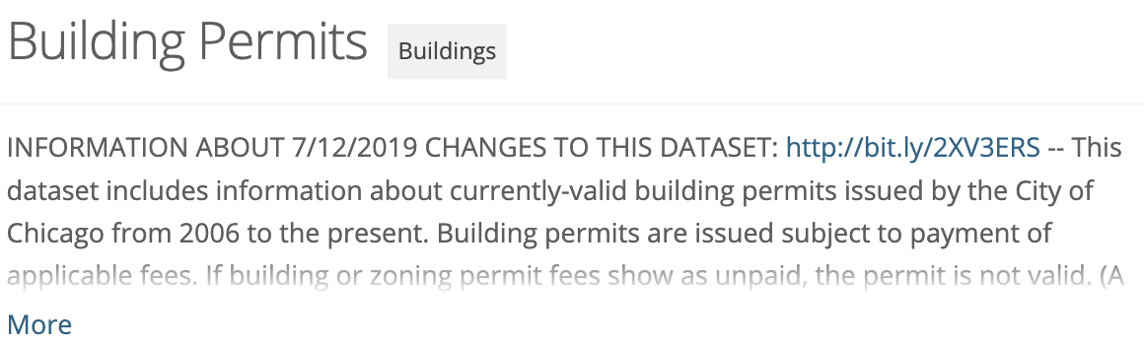
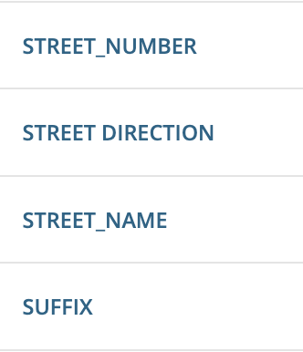
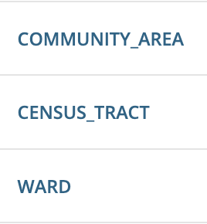
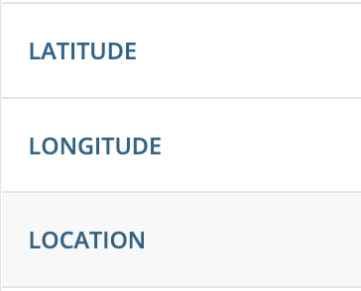
Data Clean
Fill Missing Values
We can find the missing values with the unique address
Auxiliary Dataset: Building Permits
From Chicago Data Portal
Includes information about currently-valid building permits issued by the City of Chicago
119 Columns
Useful Info – Address, Ward, Community, Location

Slide 26
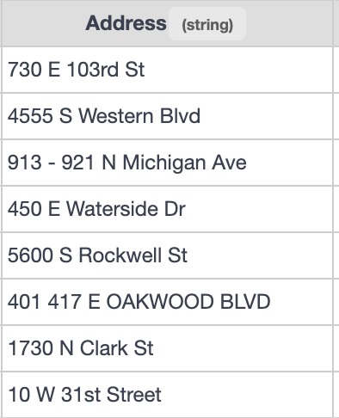
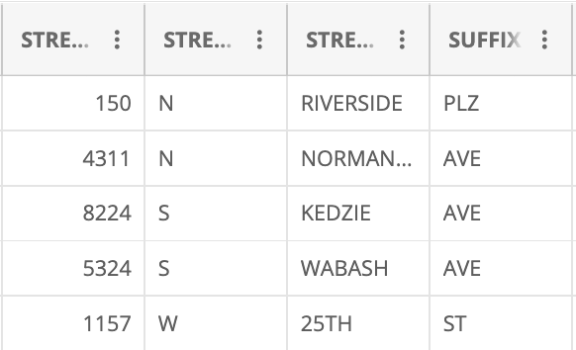
Data Clean
Fill Missing Values
Address Format Inconsistent
Parse Address
Split the Address to Street Number,
Street Direction, Street Name and Suffix
Keep only one Street Number
All Capital Letter
Street suffix abbreviations
Address of Our Dataset
Address of Building Permits

Slide 27
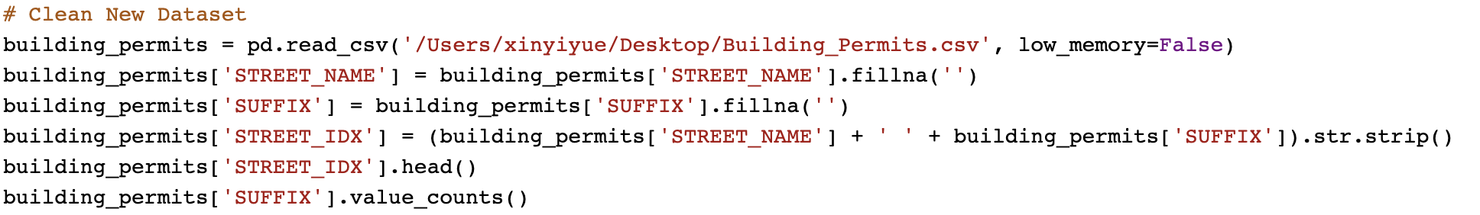
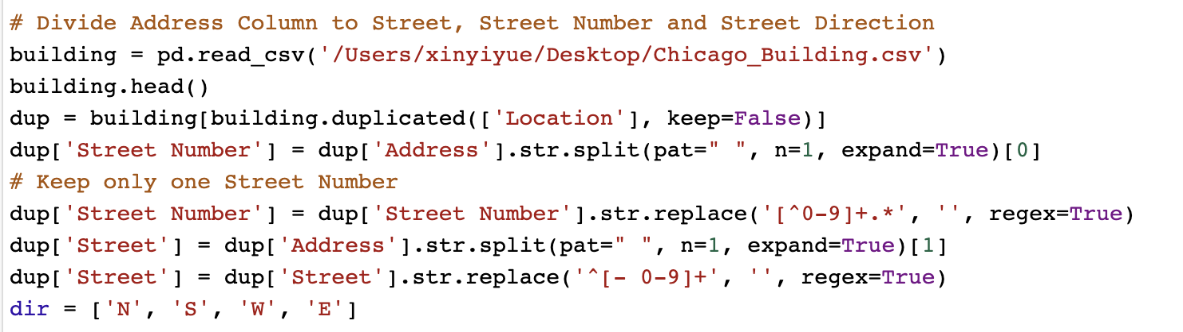
Data Clean
Trim string
Split the address and keep only one street number (Use Regex)

Slide 28
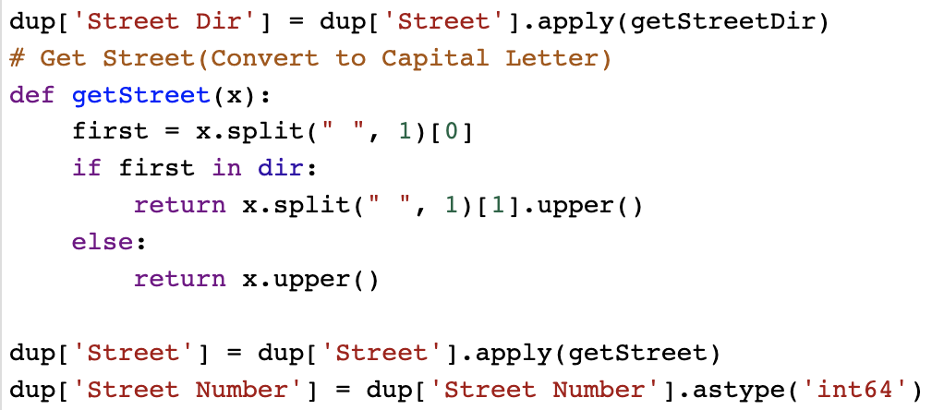
Data Clean
Convert to capital letter

Slide 29
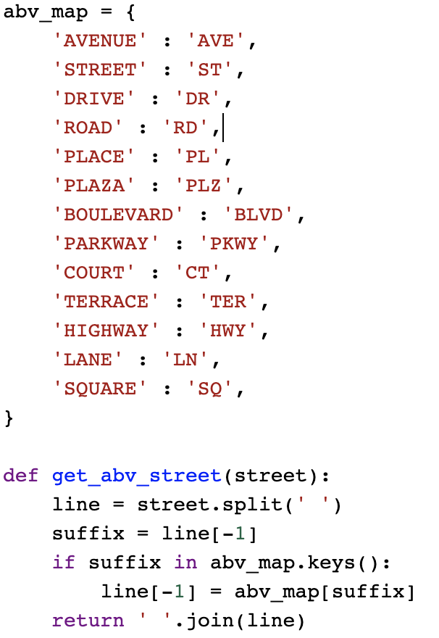
Data Clean
Obtain street suffix abbreviations

Slide 30
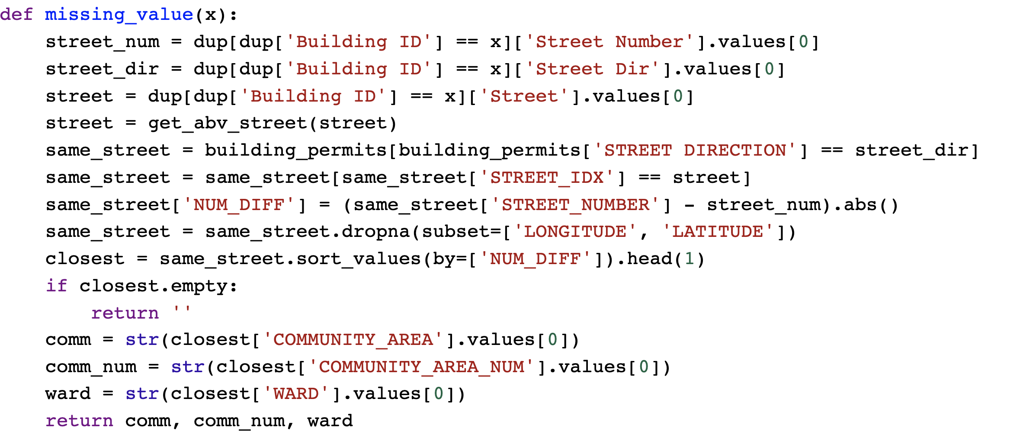
Data Clean
Join two tables to obtain the missing values
Join Rule 1: Same street and same street number
Join Rule 2: If identical address not found, same street and closest street number

Slide 31
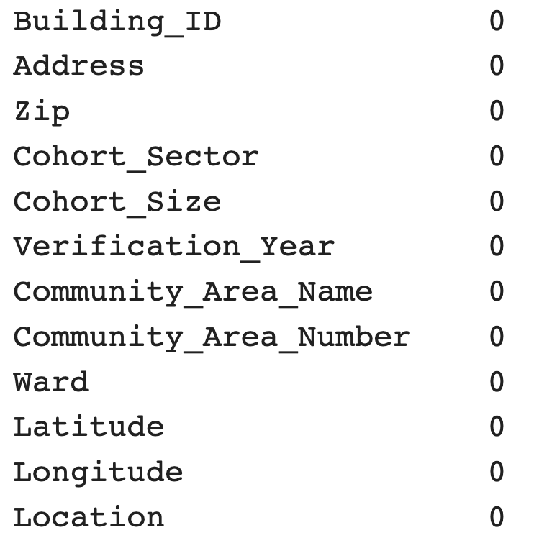
Data Clean
Verify

Slide 32
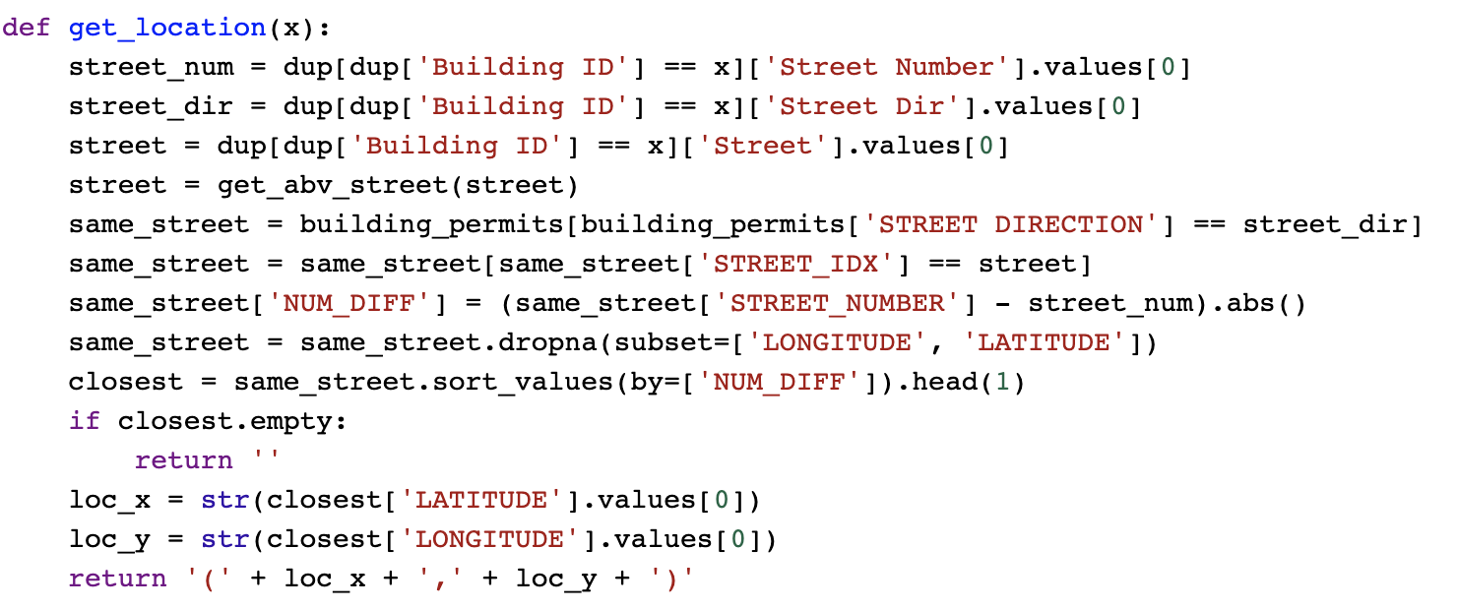
Data Clean
Invalid Location
Using address to find the location from auxiliary dataset

Slide 33
Data Clean
Verify

