Slide 1
Literature Review - BEER: Blocking for Effective Entity Resolution
Group 10: Ahmad Bacha ,Tianyi Hao, Xinyi Yue

Slide 2
Introduction
Blocking: is a key component of Entity resolution that aims to improve efficiency by pruning(remove) out non matching records.
Entity Resolution: task of identify groups of records that refer to same entity.
Also know as de-duplication, entity linkage, records linkage

Slide 3
Uses of ER
Knowledge graph construction
Better web and e-commerce search
Health care registers etc

Slide 4
Drawbacks of Existing System
Too aggressive they lose of some matching data.
Too permissive which add more un-matching records.

Slide 5
New Model
New model which is called BEER
Block Building :
Takes the records as input and returns a collection of blocks, by assigning each record to multiple blocks.
To ensure effectiveness, BEER constructs an intersection block hierarchy comprising of multiple levels of blocks, contain matching record pairs than parents

Slide 6
New Model
Block cleaning
is a process that sets a score for each block and cuts back the blocks with the lower scores.
There are various criteria for assigning scores. Common technologies such as TF-IDF determine scores regarding the block size but do not consider the block quality. BEER develops a block scoring method that forms informative blocks according to their ability to obtain records from a cluster.

Slide 7
New Model
Comparison Cleaning:
creates a graph for the input records, ensuring each pair of records in the same block is connected by an edge.
Also, every edge must be assigned a weight representing the possibility of matching pair of records
All lightweight edges are removed from the block

Slide 8
New Model
Pair Matching and Clustering:
Progressive ER techniques, which prioritize record pairs corresponding to entities that contain a large number of records, there by boosting the progressiveness of the ER procedure.

Slide 9
New Model
Feedback:
When the matching result of the pipeline achieves 1% of the new blocked pairs, the feedback of the matching result is sent back to blocking so that blocking can use the feedback to update its blocking scores and revise the structure of blocked pairs.

Slide 10
Performance
The authors propose a new methodology of progressive blocking that enables both efficient and effective ER and works across different entity cluster size distributions without manual fine tuning. In this paper we demonstrate BEER: Blocking for Effective Entity Resolution), the first end-to-end system that leverages intermediate ER output in a feedback loop to refine the blocking result in a data-driven fashion and thereby enabling effective entity resolution.

Slide 11
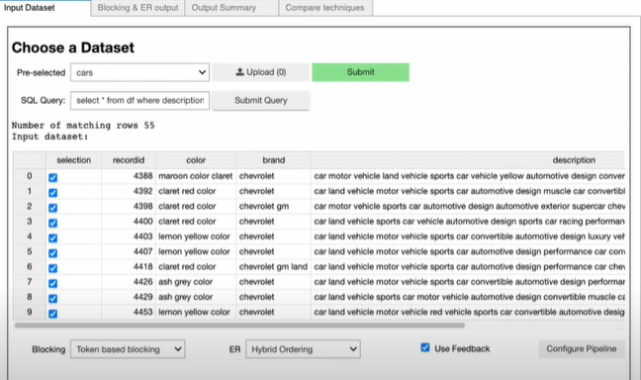
In this article, the author presents BEER with a car image as an example.

Slide 12
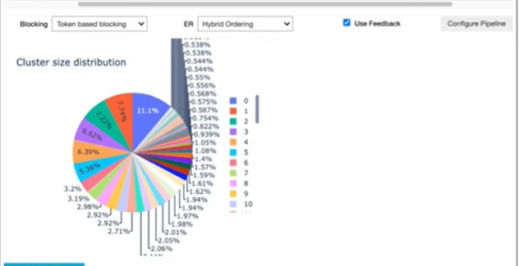
This figure shows the result of the analyze for the input dataset.

Slide 13
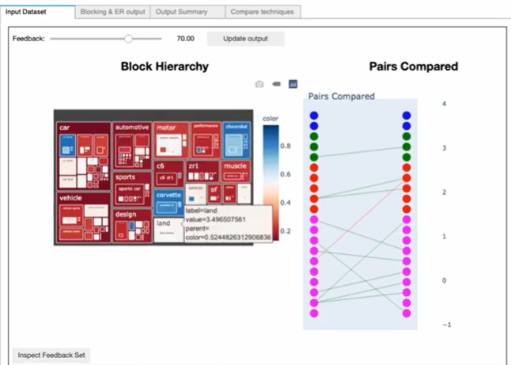
This shows block hierarchy(left) and the number of pairs compared(right).

Slide 14
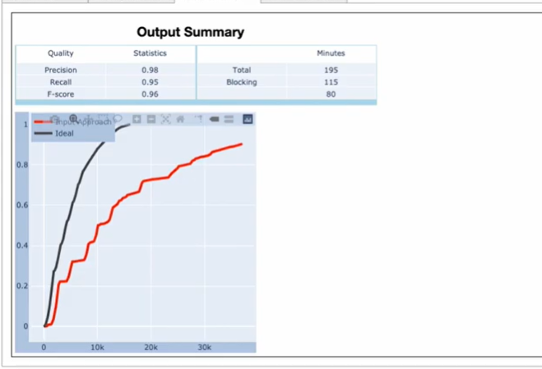
At last out put, the figure demonstrates the performance of the BEER and compare the result to the ideal situation.

Slide 15
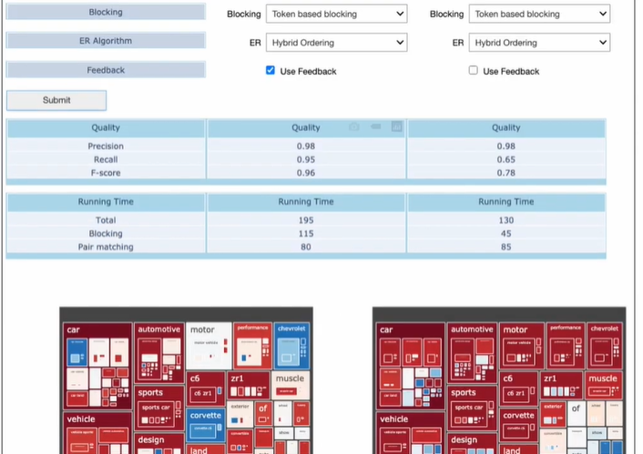
comparison
The author tested the performance of BEER on the dataset by presenting a comparative test and setting different parameters as shown in Figure Technique 1 uses feedback whereas Technique 2 does not.

Slide 16
The result shows that Technique 1 has a higher recall and F-score than Technique 2 does. The F-score is a measure of a model’s accuracy on a dataset in statistical analysis. It is calculated by combining the precision and recall of the test. The precision is calculated by the number of true positive results divided by the number of all positive results. The recall is the number of true positive results divided by the number of all records that should have been recognized as positive. BEER using feedback has better quality.

Slide 17
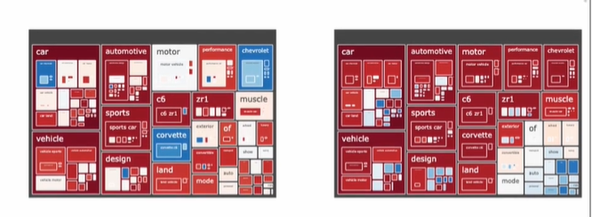

Slide 18
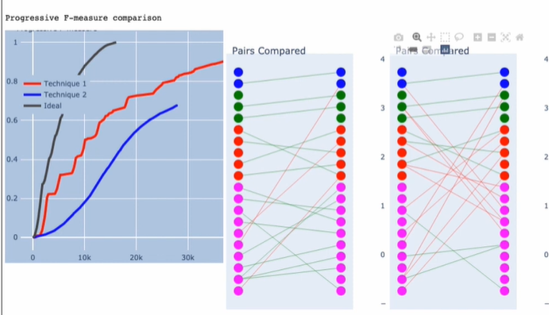
Demonstrates the number of pairs compared during the blocking process. It is obvious that Technique 1 with feedback triggers a smaller number of record comparisons than Technique 2 without feedback.

