Slide 1
Data Curation Project
Group 12
Presenters: Khiem Truong, Geongu Park

Slide 2
What is the Dataset?
311 Service Request received by the City of Chicago.
ex) aircraft noise complaint, tree removal request, etc
This dataset includes requests created after the launch of the new 311 system on 12/18/2018 and some records from the previous system.

Slide 3
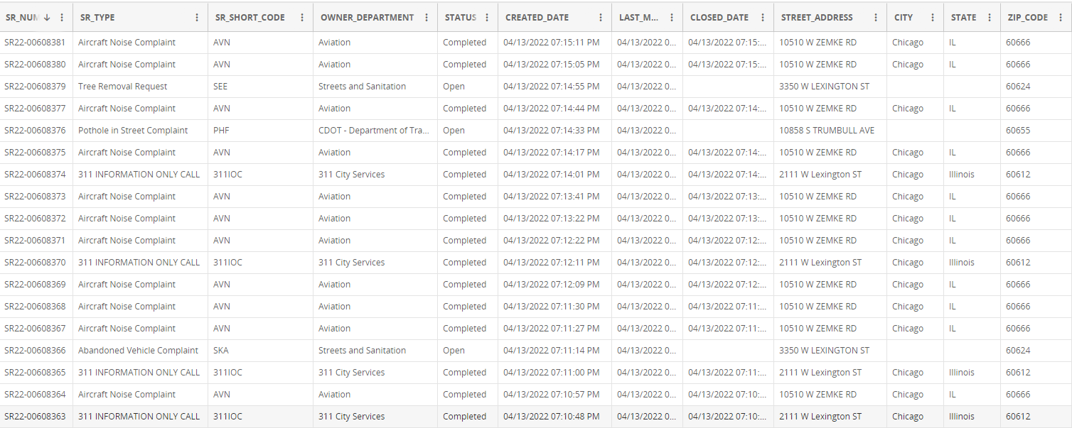
Dataset Overview
Dataset Size: 2GB
58.4M rows, each representing a service request
37 columns

Slide 4
Data Quality Problems
Multiple columns with no description
e.g: WARD, Electrical district, electricity grid, sanitation division days,…
Multiple columns can be integrated or separated
e.g. Created date, Created Month, Created Hour, Created Day of Week
e.g. Street Address, street number, street direction, street name, street type,
Inconsistent casing and naming schemes
e.g. IL vs Illinois

Slide 5
Solutions
Normalize streets’ name
Make sure to have a consistency
ex) Convert mix of IL and Illinois to IL
Fill in the blank if possible
ex) Fill in missing “City” and “State” using “zipcode”
Basic sanity check
“Create Date” has to be before “Closed Date”
Ensure if Parent_SR_Number is not empty, Duplicate, and/or Legacy_Record and Legacy_SR_Number are appropriately filled.

