Slide 1
311 SERVICE REQUESTS
DATA CURATION PROJECT
Susmitha Marripalapu (A20489531)
Pranava Brunda Manuguri (A20472679)
Yogith Reddy Venkanagari (A20493317)

Slide 2
UNDERSTANDING DATA
311 Service Requests received by the City of Chicago. This dataset includes requests created after the launch of the new 311 system on 12/18/2018 and some records from the previous system, indicated in the LEGACY_RECORD column.
CHARACTERISTICS:
36 columns in total.
SR-NUMBER , Service request number is primary key.
Dataset: link
MOTIVATION
Information of the service request - From which location, Which type of service, Nearest service center available.
Explore geo data and APIs available for curation.

Slide 3
UNDERSTANDING DATA
SAMPLE DATA
SR_NUMBER | SR_TYPE | SR_SHORT_CODE | OWNER_DEPARTMENT | STATUS | CREATED_DATE | LAST_MODIFIED_DATE | CLOSED_DATE | STREET_ADDRESS | CITY | STATE | ZIP_CODE
SR22-00502004 | Graffiti Removal Request | GRAF | Streets and Sanitation | Open | 03/28/2022 1:15:08 PM | 03/28/2022 1:15:09 PM |  | 3800 S STEWART AVE | CHICAGO | ILLINOIS | 60609
STREET_NUMBER | STREET_DIRECTION | STREET_NAME | STREET_TYPE
3800 | S | STEWART | AVE
X_COORDINATE | Y_COORDINATE | LATITUDE | LONGITUDE | LOCATION
1174263.624 | 1879703.957 | 41.82531728 | -87.63618378 | (41.82531727715132°, -87.63618377989255°)
DUPLICATE | LEGACY_RECORD | COMMUNITY_AREA | WARD | ELECTRICAL_DISTRICT | ELECTRICITY_GRID | POLICE_SECTOR | POLICE_DISTRICT | POLICE_BEAT | PRECINCT
FALSE | FALSE | 60 | 11 |  | O030 | 1 | 9 | 915 | 29

Slide 4
CHALLENGES
IDENTIFYING THE ISSUES:
Using visualization tool in city of chicago portal.
Python code for basic null values check.
Using geopy libraries to check the correctness of addresses.
EXAMPLE: 2711 S 31 AVE => 2711 S 31st AVE
CHALLENGES IN DATA CURATION:
Obtain the valid location data.
Getting valid street addresses.
Identifying datasets to fill gaps in police, electricity, community area and ward data.
Decoding MULTIPOLYGON Location border data.

Slide 5
PROBLEMS IN DATA ADDRESS
No Values
VALID:
10510 W ZEMKE RD
1142 N KENNEDY EXPRESS RL
INVALID:
0 Don’t know, 0, 1
STREET_TYPE having NULL values.
STREET_ADDRESS
STREET_NUMBER
STREET_DIRECTION
STREET_NAME
STREET_TYPE

Slide 6
ISSUES IN DATA
CITY: CHICAGO, Chicago, chicago, No value
STATE: No Value, Illinois and IL
ZIP_CODE: No Value
COMMUNITY_AREA: 12,223 are empty
WARD: 11,907 are empty
ELECTRICAL_DISTRICT, ELECTRICITY_GRID : Almost all records are empty
POLICE_SECTOR, POLICE_DISTRICT, POLICE_BEAT: 11,928 are empty
X_COORDINATE, Y_COORDINATE, LATITUDE, LONGITUDE, LOCATION:
Missing data

Slide 7
SOLUTION
CITY: Make it consistent - CHICAGO
STATE: Make it consistent - ILLINOIS
ZIP_CODE: Take the zip code from geopy address.
STREET_ADDRESS:
if
STREET_ADDRESS==NULL
if
LATITUDE AND LONGITUDE!=NULL
Get street address from geopy.geocoders
TRUE
TRUE
FALSE
FALSE
Check if it is valid address
Drop row
UPDATE STREET_ADDRESS

Slide 8
SOLUTION
LOCATION, LATITUDE, LONGITUDE: Using python, from geopy.geocoders import Nominatim
X_COORDINATE, Y_COORDINATE:
Get x and y coordinates from latitude and longitude
import utm
utm.from_latlon(LATITUDE, LONGITUDE)
The Universal Transverse Mercator (UTM) is a map projection system for assigning coordinates to locations on the surface of the Earth.
X_COORDINATE
Import utm
Y_COORDINATE
Import utm
Geopy is used to locate the coordinates of addresses, cities, countries, and landmarks across the globe using third-party geocoders
LOCATION
LATITUDE
LONGITUDE
STREET_ADDRESS + CITY +STATE
geopy.geocoders

Slide 9
SOLUTION
Derive using Community_area dataset from City of Chicago Data portal - Link
Derive using WARD dataset from City of Chicago Data portal - Link
Police data can be derived using dataset from City of Chicago Data portal - Link
Example of csv file used in code : Link
PRECINCT
POLICE_SECTOR
WARD
POLICE_BEAT
COMMUNITY_AREA
POLICE_DISTRICT
LOCATION

Slide 10
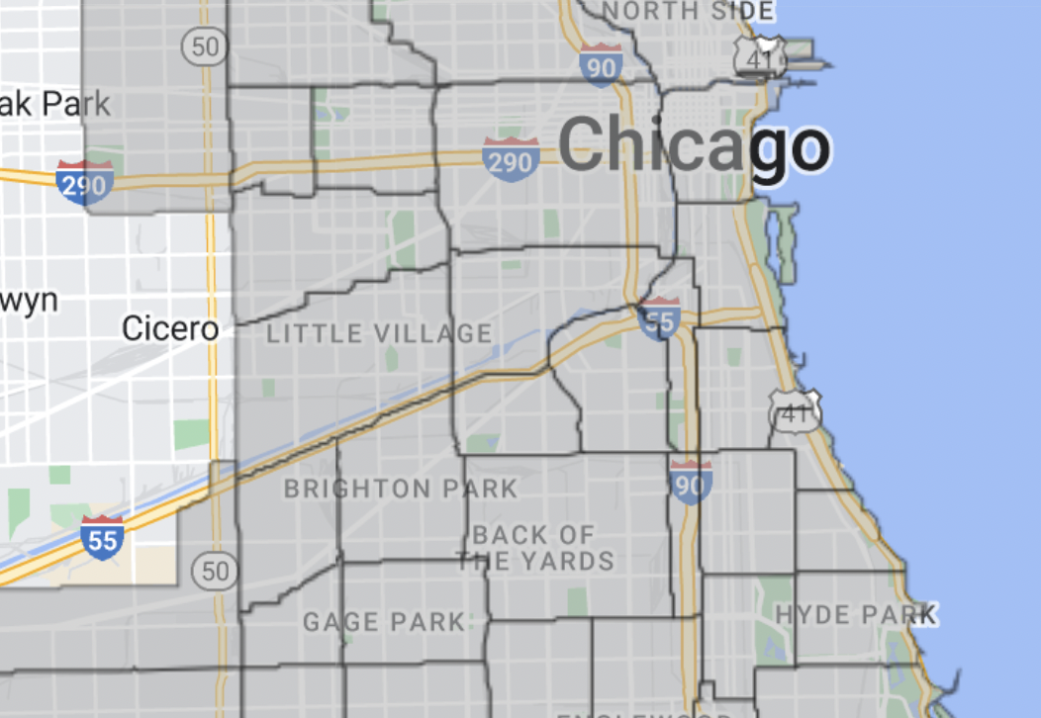

SOLUTION
Using boundary data, MULTIPOLYGON GEO DATA to get the COMMUNITY_AREA, WARD, POLICE_SECTOR, POLICE_DISTRICT, POLICE_BEATS and PRICINCTS
Use geopandas, geoseries to get if a location (point) is within the borders.

Slide 11


VALIDATIONS
Check for the missing values in columns
If Legacy_Record = False & Legacy_SR_Number != NULL
Curated Data
Validation report
If STREET_ADDRESS.splt(‘ ‘)[0] != STREET_NUMBER
If status == open & closed date is not null
if Duplicate=True and Legacy_Record=False and parent_sr_number is null
TRUE
If STREET_ADDRESS.splt(‘ ‘)[1] != STREET_DIRECTION
If STREET_ADDRESS.splt(‘ ‘)[1:] != STREET_NAME
If STREET_ADDRESS.splt(‘ ‘)[-1] != STREET_TYPE

Slide 12
EVALUATION
Minimized number of records in validation report.
Current invalid records for the 2021 service requests is zero after curation.
This solution works for the existing data problems.
FUTURE WORKS:
Time taken for address check using geopy libraries for 1 million records is larger than expected which can be improved.

