Slide 1
AI GAME PLAYING: MINIMAX VS ALPHA-BETA PRUNING IN SLIME VOLLEYBALL
ARTIFICIAL INTELLIGENCE
ASSIGNMENT 3
TEAM MEMBERS: TEJAS MESHRAM [CS24M108] GOWLIKAR AJITESH [CS24M118]

Slide 2
ALGORITHM OVERVIEW:
Minimax:
- Simulates all possible future moves
- Assumes opponent plays optimally.
Alpha-Beta Pruning:
- Optimized version of Minimax
- Skips unnecessary branches
- Improves efficiency significantly

Slide 3
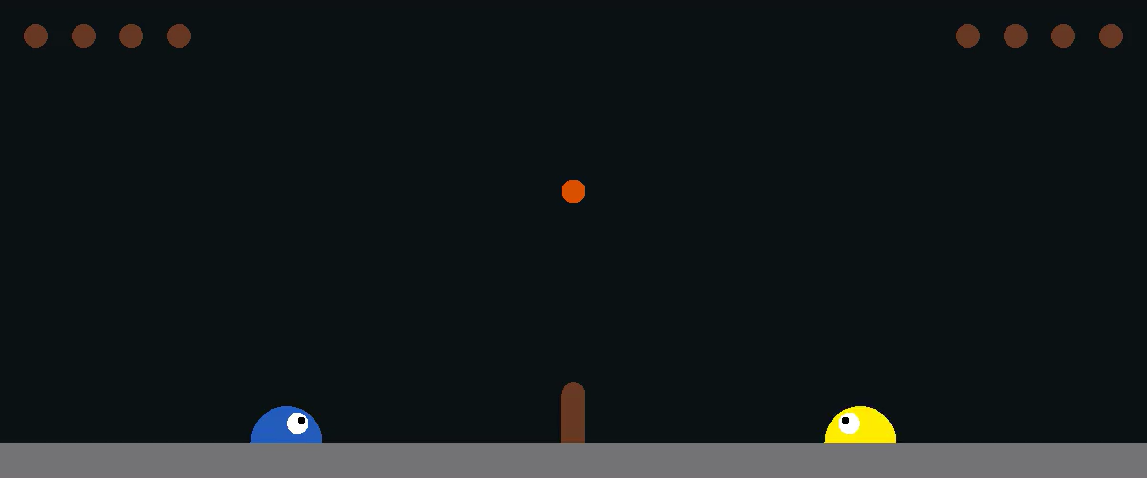

EVALUATION FUNCTION
Environment: Slime Volleyball
Heuristic Used: D = ∣ x agent​ − x ball​ ∣
- Encourages proximity to the ball
- Penalizes opponent advantage
- Enables aggressive strategy
ALPHA – BETA ALGORITHM
MIN-MAX ALGORITHM

Slide 4
RESULTS & PERFORMANCE
Metric | Minimax | Alpha-Beta
Avg Time per Move | ~500 ms | ~200 ms
Max Depth Reached | 4 | 6
Win Rate (vs Random) | 60% | 75%
Observations:
- Alpha-Beta is faster and explores deeper
- Both outperform random policy
- Evaluation function critically impacts strategy

Slide 5
CHALLENGES & LEARNINGS
Challenges:
- Extracting game state accurately
- Designing a good evaluation function
- Managing real-time decision-making
Learnings:
- Alpha-Beta improves efficiency
- Evaluation design impacts gameplay
- Practical AI requires iterative tuning
GITHUB: https://github.com/IITcseTejas/ai-assignment-slimevolley/tree/main

Slide 6
THANK YOU

