Slide 1

Natural Language Processing(NLP) Classification of personality of Human by their Social Media Post
Presented By: Sourav Saha
Enrollment Number: 23572014
Date: 23rd April, 2024
Supervisor Name: Prof. Millie Pant
Department of Applied Mathematics and Scientific Computing, IIT Roorkee, Saharanpur Campus

Slide 2
Natural Language Processing(NLP) Classification of personality of Human by their Social Media Post
What is Natural Language Processing(NLP)?
Natural Language Processing (NLP) is a subfield of artificial intelligence that deals with the interaction between computers and humans in natural language. It involves the use of computational techniques to process and analyze natural language data, such as text and speech, with the goal of understanding the meaning behind the language.
What are the applications of NLP?
Chatbots, Autocomplete in Search Engines, Voice Assistants, Sentiment Analysis, Text Translator etc.
Examples of Product:
Alexa by Amazon, Siri by Apple etc.

Slide 3

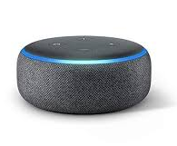

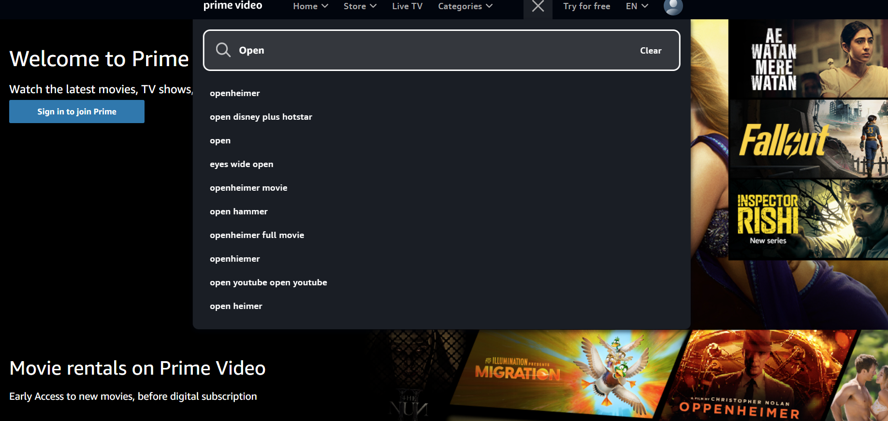
Natural Language Processing(NLP) Classification of personality of Human by their Social Media Post
What are the applications of NLP?
Alexa

Slide 4
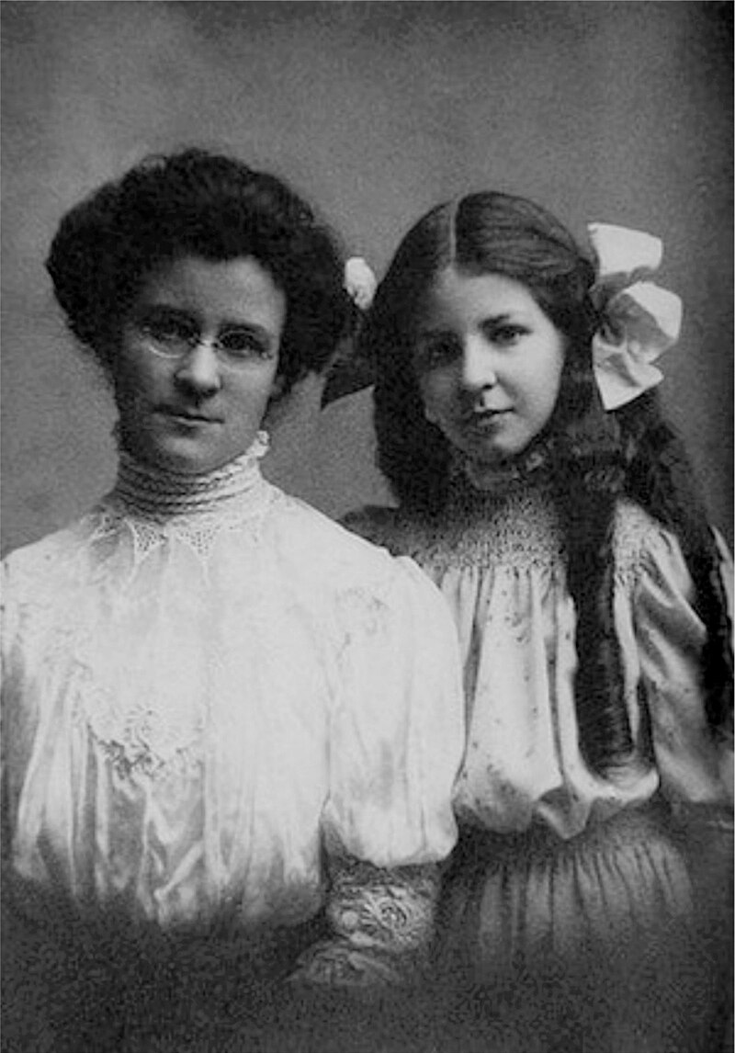
How to analysis someone’s personality?
I’m using MBTI scaling method by reading someone’s social media post with maintain privacy.
The Myers–Briggs Type Indicator (MBTI) is a pseudoscientific^{[1][2]} self-report questionnaire that claims to indicate differing "psychological types" (often commonly called "personality types"). The test attempts to assign a binary value to each of four categories: introversion or extraversion, sensing or intuition, thinking or feeling, and judging or perceiving. One letter from each category is taken to produce a four-letter test result representing one of sixteen possible types, such as "INFP" or "ESTJ"
The MBTI was constructed by two Americans: Katharine Cook Briggs and her daughter Isabel Briggs Myers, who were inspired by the book Psychological Types by Swiss psychiatrist Carl Jung.
This page refer to Wikipedia, for more information click here.

Slide 5
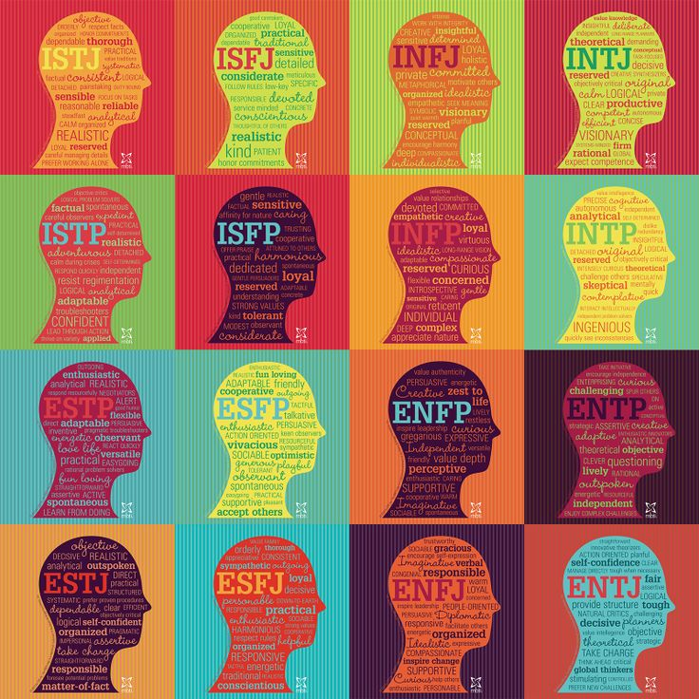
How to analysis someone’s personality?
I’m using MBTI scaling method by reading someone’s social media post with maintain privacy.
Scaling Parameters
Extraversion (E) – Introversion (I)
Sensing (S) – Intuition (N)
Thinking (T) – Feeling (F)
Judging (J) – Perceiving (P)

Slide 6
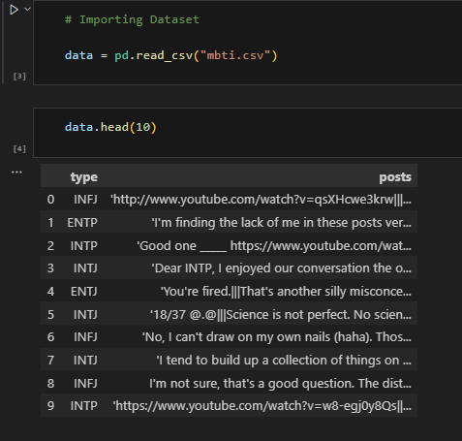
Introduction to Data Set
How to analysis someone’s personality?
I’m using MBTI scaling method by reading someone’s social media post with maintain privacy.
Motivation
Extraversion (E) – Introversion (I)
Sensing (S) – Intuition (N)
Thinking (T) – Feeling (F)
Judging (J) – Perceiving (P)
My main motive to pre process the data for further application of Machine Learning models, Deep Learning Models like RNN ,LSTM and Transformers. It’s a very important task as we know for any kind of ML and DL algorithm a good input always ensure a good output in generally.
Outline of presentation:
Introduction to Data Set.
Pre-Process of Data.
Apply few basic Machine Learning Algorithms.
This Dataset is known as MBTI Dataset, available over Kaggel and many other platforms in csv(Comma Separated Values) file.
By using Python Pandas library importing Dataset for further task.
On right side the visualization is for top 10 documents for the MBTI Dataset, where each single row is called a single document.
This Dataset contains 2 columns namely ‘type’ and ‘posts’.
The Dataset contains 8675 documents(rows).
The Dataset contains no null values as we as no duplicate columns.
There are total 16 unique types as per MBTI types in type column.

Slide 7
Introduction to Data Set
This Dataset is known as MBTI Dataset, available over Kaggel and many other platforms in csv(Comma Separated Values) file.
By using Python Pandas library importing Dataset for further task.
On right side the visualization is for top 10 documents for the MBTI Dataset, where each single row is called a single document.
This Dataset contains 2 columns namely ‘type’ and ‘posts’.
The Dataset contains 8675 documents(rows).
The Dataset contains no null values as we as no duplicate columns.
There are total 16 unique types as per MBTI types in type column.

Slide 8
Introduction to Data Set
For applying Machine Learning Model to this textual data we have to preprocess the as per necessary, this is one kind of sequential step to clean your data to get a better performance by any kind of algorithm.
What is pre-processing for textual data?
Remove quotes.
Remove URL’s from dataset.
Remove punctuation from dataset.
Lowercasing all words.
Contractions of English words.
Chat words to Normal text.
Lemmatization
Text to Vectorization

Slide 9
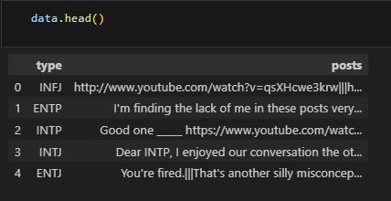

Remove Quotes from all Text
Remove all the quotes from the text, its make simple the data for further pre-processing.

Slide 10
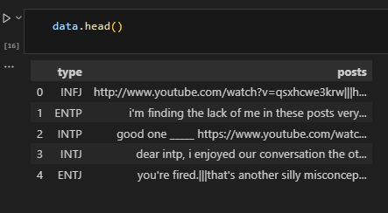
Lowercasing all Text
We are making all capital letters to small one such that its will not make any difference in between ‘Good’ and ‘good’, as python is case sensitive language.

Slide 11
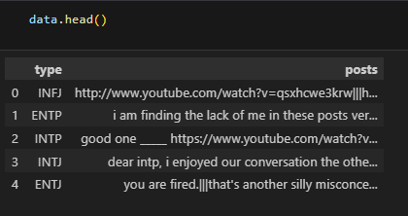
Contractions of english words
We are making all capital letters to small one such that its will not make any difference in between ‘Good’ and ‘good’, as python is case sensitive language.
By contraction we are making more understandable a particular word to proper word like “i’m” will “i am”, refer to document no 1, for this change we are using a dictionary of 117 words.

Slide 12
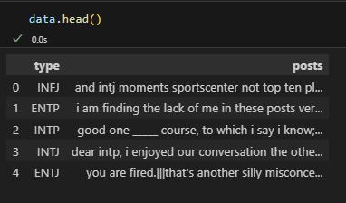
Remove URL’s form Text
By contraction we are making more understandable a particular word to proper word like “i’m” will “i am”, refer to document no 1, for this change we are using a dictionary of 117 words.
We are removing URL’s from text like we can see in document number 1 initially we have a link, which does not contributing any meaning for the text, its better to remove the URL’s to make a text more meaningful.

Slide 13
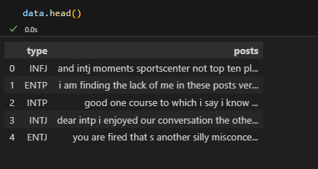
Remove punctuation’s form Text
We all know that punctuation are important for English sentence to explain feelings of a sentence, but In general for machine it does not provide a semantic meaning, moreover its create complexity for algorithms.

Slide 14
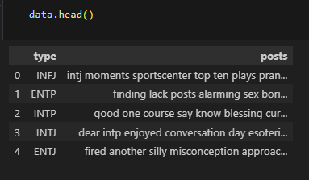
Remove stop words form Text
What are Stop words?
Stop words are a set of commonly used words in a language. Examples of stop words in English are “a,” “the,” “is,” “are,” etc. Stop words are commonly used in Text Mining and Natural Language Processing (NLP) to eliminate words that are so widely used that they carry very little useful information.
We all know that punctuation are important for English sentence to explain feelings of a sentence, but In general for machine it does not provide a semantic meaning, moreover its create complexity for algorithms.
We are able to see all stop words from text. Check the document number 1 and 4.

Slide 15
Lemmatization of Text
What is lemmatization?
Lemmatization is the process of grouping together different inflected forms of the same word. It's used in computational linguistics, natural language processing (NLP) and chatbots. Lemmatization links similar meaning words as one word, making tools such as chatbots and search engine queries more effective and accurate.
likes
enjoyed
playing
went
runs
like
enjoy
play
go
run

Slide 16
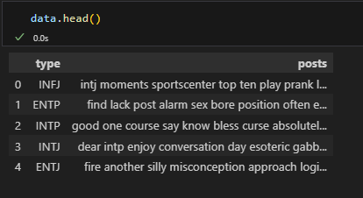
Lemmatization of Text
What is lemmatization?
Lemmatization is the process of grouping together different inflected forms of the same word. It's used in computational linguistics, natural language processing (NLP) and chatbots. Lemmatization links similar meaning words as one word, making tools such as chatbots and search engine queries more effective and accurate.

Slide 17
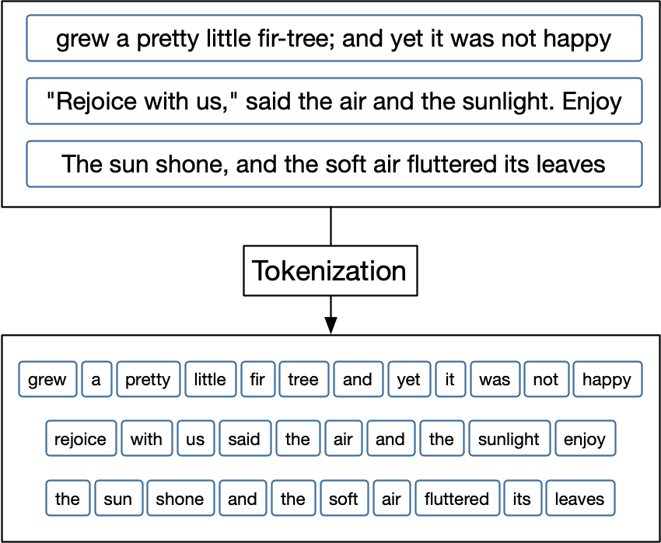
Word Tokenization of Text

Slide 18
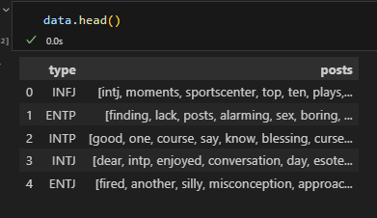
Word Tokenization of Text
What is word tokenize?
Word tokenization is the most common version of tokenization. It takes natural breaks, like pauses in speech or spaces in text, and splits the data into its respective words using delimiters
Before tokenization
After tokenization
Example

Slide 19
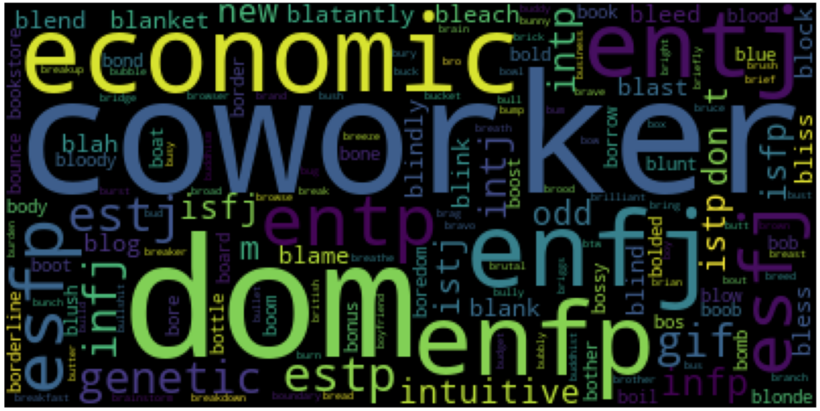
Word Cloud form
Get insight into the most popular concepts or to reveal sentiment. It provides instant analysis & visualization of word data and feedback. It engages & sparks excitement among participants.
Word clouds or tag clouds are graphical representations of word frequency that give greater prominence to words that appear more frequently in a source text.

Slide 20
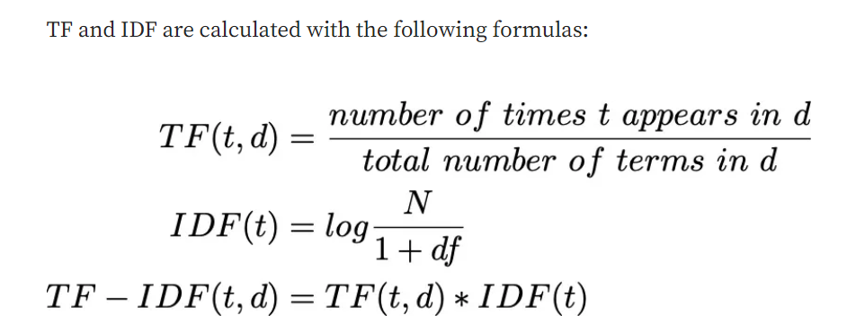
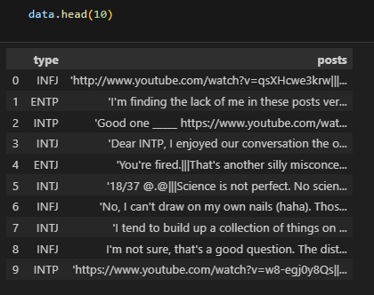
Word Cloud form
Finally, all kind of necessary pre-processing for the textual data we have done. Now, its time to explore the column ‘types’ of dataset which is also a categorical column.
There are total 16 types for personality, which is target column for Machine Learning Algorithm.
Kindly, check the distribution of data of particular types.
Machine also unable to understand text, so I prefer to do Label Encoding for that column and that keep our dataset leaser complex.
TF-IDF Vectorizer of word:
Get insight into the most popular concepts or to reveal sentiment. It provides instant analysis & visualization of word data and feedback. It engages & sparks excitement among participants.
Word clouds or tag clouds are graphical representations of word frequency that give greater prominence to words that appear more frequently in a source text.

Slide 21
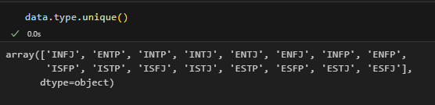
Finally, all kind of necessary pre-processing for the textual data we have done. Now, its time to explore the column ‘types’ of dataset which is also a categorical column.
There are total 16 types for personality, which is target column for Machine Learning Algorithm.
Kindly, check the distribution of data of particular types.
Machine also unable to understand text, so I prefer to do Label Encoding for that column and that keep our dataset leaser complex.
Get insight into the most popular concepts or to reveal sentiment. It provides instant analysis & visualization of word data and feedback. It engages & sparks excitement among participants.
Word clouds or tag clouds are graphical representations of word frequency that give greater prominence to words that appear more frequently in a source text.

Slide 22
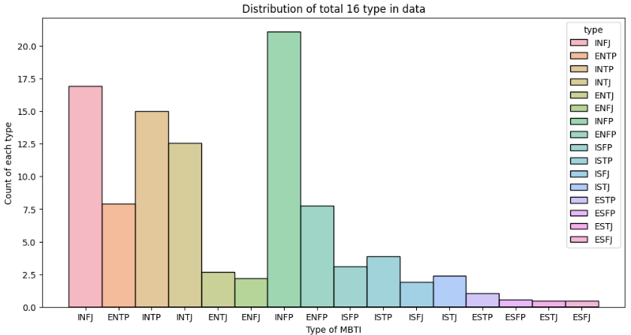
Finally, all kind of necessary pre-processing for the textual data we have done. Now, its time to explore the column ‘types’ of dataset which is also a categorical column.
There are total 16 types for personality, which is target column for Machine Learning Algorithm.
Kindly, check the distribution of data of particular types.
Machine also unable to understand text, so I prefer to do Label Encoding for that column and that keep our dataset leaser complex.

Slide 23
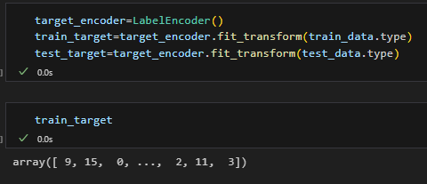
Finally, all kind of necessary pre-processing for the textual data we have done. Now, its time to explore the column ‘types’ of dataset which is also a categorical column.
There are total 16 types for personality, which is target column for Machine Learning Algorithm.
Kindly, check the distribution of data of particular types.
Machine also unable to understand text, so I prefer to do Label Encoding for that column and that keep our dataset leaser complex.

Slide 24
Finally, all kind of necessary pre-processing for the textual data we have done. Now, its time to explore the column ‘types’ of dataset which is also a categorical column.
There are total 16 types for personality, which is target column for Machine Learning Algorithm.
Kindly, check the distribution of data of particular types.
Machine also unable to understand text, so I prefer to do Label Encoding for that column and that keep our dataset leaser complex.

Slide 25
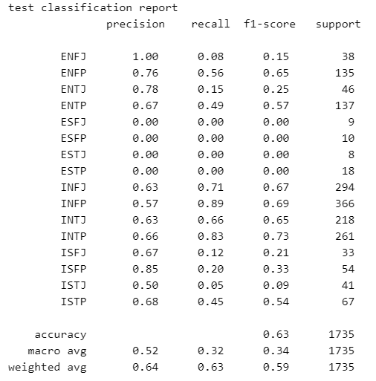
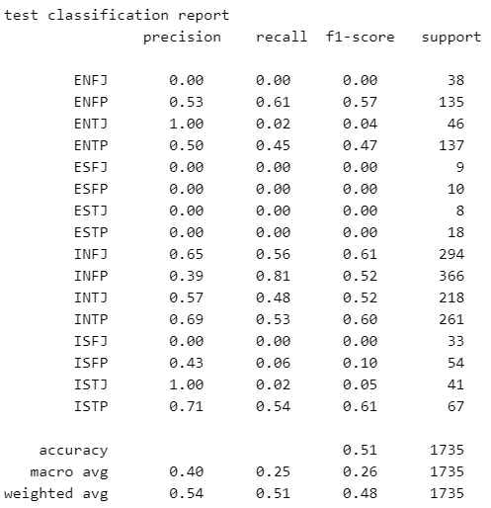
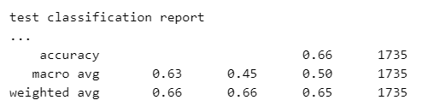
Machine Learning Algorithm and Their Results
Logistic Regression
Decision Tree
XGBoost Classifier
After apply Logistic regression with maximum iteration 3000, we are getting accuracy of model is 0.630548
After apply Decision Tree classifier with maximum depth 14, we are getting accuracy of model is 0.537176

Slide 26
References
Kaggel - Kaggle is a data science competition platform and online community of data scientists and machine learning practitioners under Google LLC.
CampusX – YouTube channel by Nitish Singh.
16Personalities - https://www.16personalities.com/free-personality-test
Wikipedia - https://en.wikipedia.org/wiki/Myers%E2%80%93Briggs_Type_Indicator

Slide 27
References
Kaggel - Kaggle is a data science competition platform and online community of data scientists and machine learning practitioners under Google LLC.
CampusX – YouTube channel by Nitish Singh.
16Personalities - https://www.16personalities.com/free-personality-test
Wikipedia - https://en.wikipedia.org/wiki/Myers%E2%80%93Briggs_Type_Indicator
Thank You for your patience and if you have any doubt you can ask to me.

