Slide 1
0.008
R² = 0.10
R² = 0.16
0.247*
R² = 0.10
Δ Range occupancy
Δ Range area
Population trend
0.040**
0.477*
-2.279**
-0.090
-0.900
0.486
0.003
0.067
-0.040
Habitat niche breadth
Climate niche breadth
Diet niche breadth

Slide 2
A. Concavity = 1
0.008
R² = 0.09
R² = 0.15
0.209*
R² = 0.10
Δ Range occupancy
Δ Range area
Population trend
0.040**
0.489**
-2.279**
-0.016
-0.925
0.486
0.004
0.067
-0.040
Habitat niche breadth
Climate niche breadth
Diet niche breadth

Slide 3
B. Concavity = 3
0.008
R² = 0.10
R² = 0.13
0.248***
R² = 0.10
Δ Range occupancy
Δ Range area
Population trend
0.040**
0.339**
-2.279**
-0.085
-0.34
0.486
0.003
0.067
-0.040
Habitat niche breadth
Climate niche breadth
Diet niche breadth

Slide 4
Response:
Population trend
Migratory distance
Diet niche breadth
-0.002
0.010
-0.010
-0.001
0.003
-0.001
Body size
-0.012
Total R² = 0.03
Notes:
Venn diagram of variance partitioning

Slide 5
Response:
Δ Range area
Migratory distance
Climate niche breadth
0.026
0.005
0.046
-0.001
-0.002
-0.008
Body size
-0.002
Total R² = 0.10
Notes:
Venn diagram of variance partitioning

Slide 6
Response:
Δ Range occupancy
Migratory distance
-0.006
Habitat niche breadth
0.033
0.001
0.034
0.004
0.003
Body size
-0.011
Total R² = 0.09
Notes:
Venn diagram of variance partitioning

Slide 7
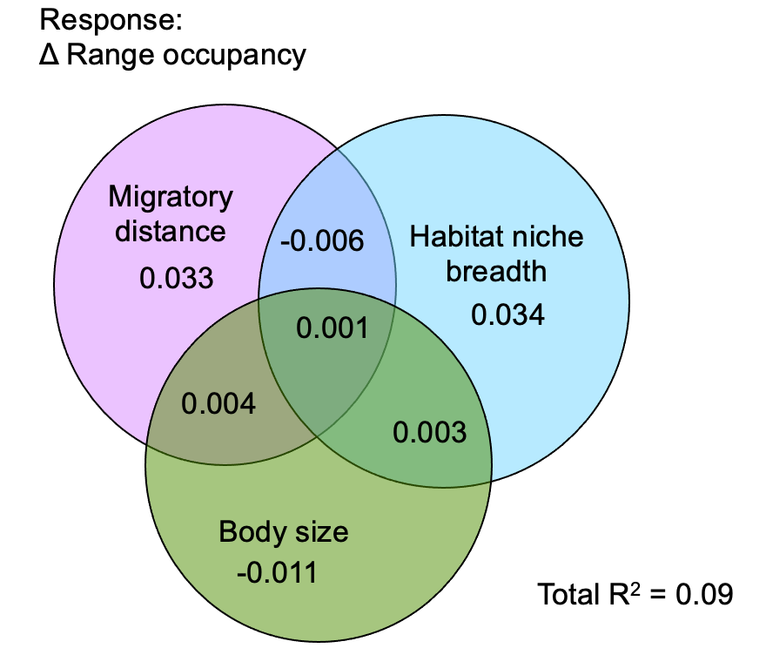
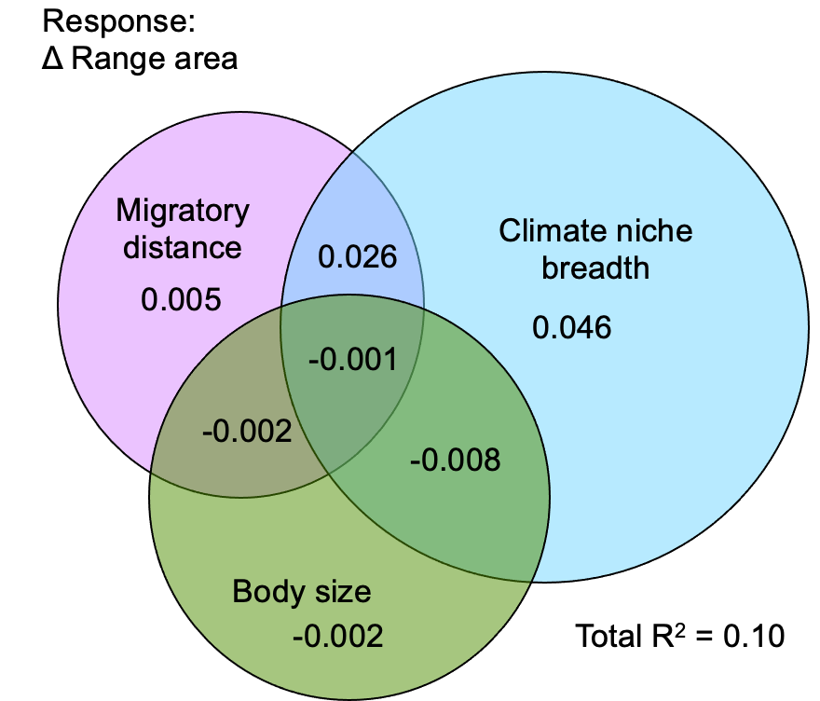
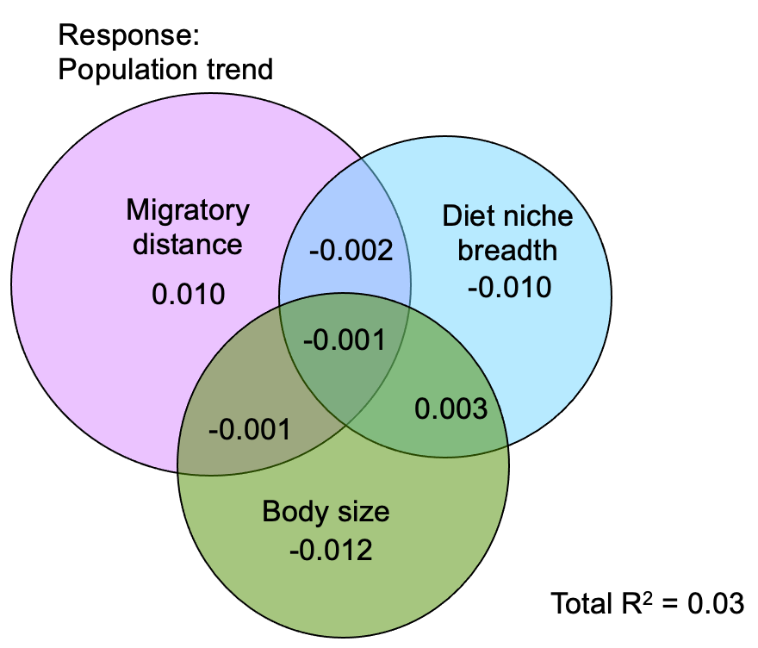

Slide 8
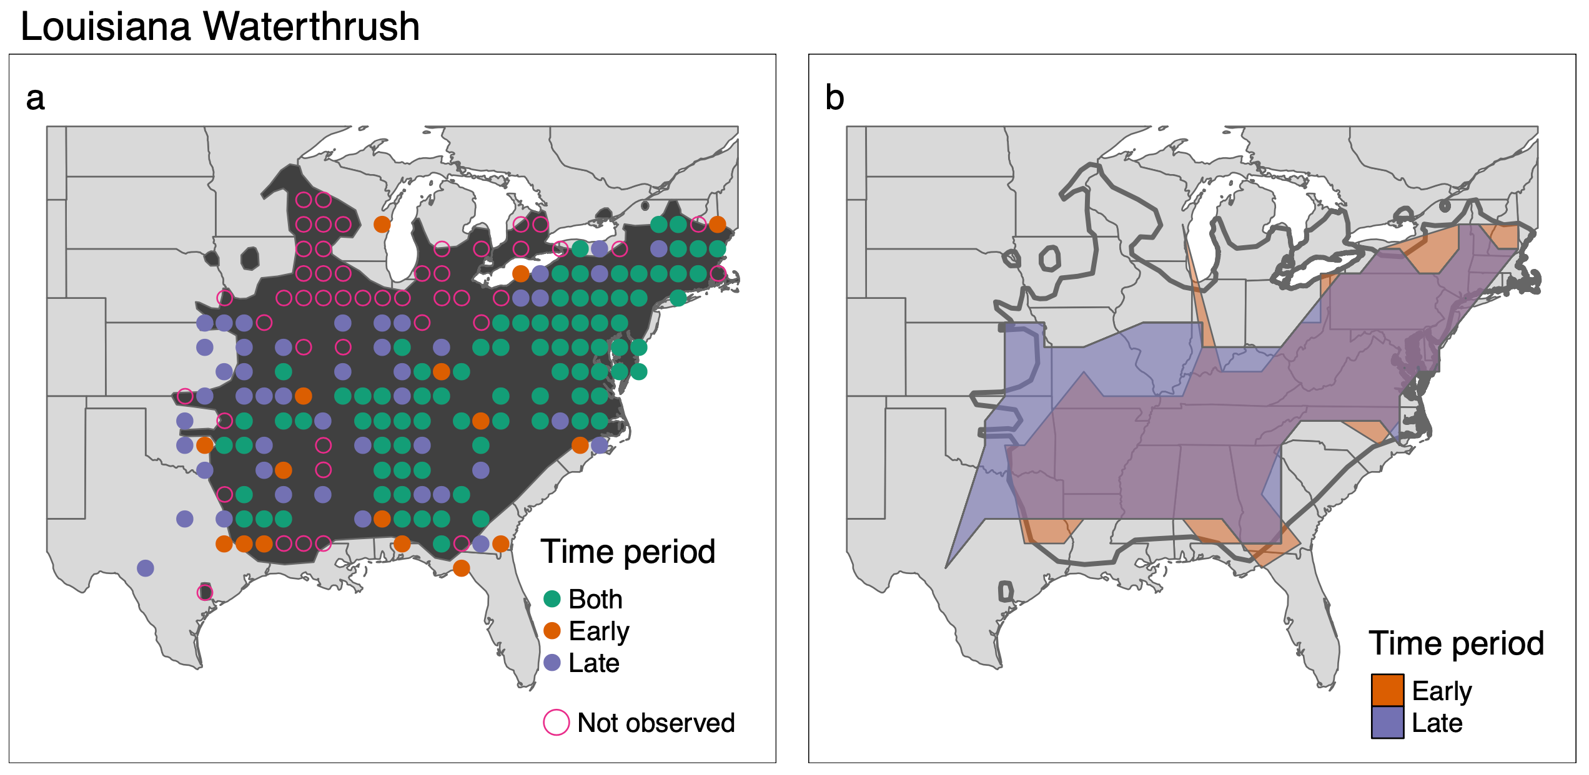
Range occupancy
Range area
Early
Late
Early
Late
13.8x10⁶ km²
17.3x10⁶ km²
122/226 = 0.54
160/226 = 0.71
Δ Range occupancy = 0.71-0.54 = 0.17
Δ Range area = (17.3x10⁶ -13.8x10⁶)/13.8x10⁶ = 0.25

