Slide 1
0.037***
R² = 0.36
R² = 0.23
0.396***
R² = 0.19
Δ Range occupancy
Δ Range area
Population trend
0.370*
-3.66***
0.036
0.149
0.872
0.470
-0.014
0.041
0.098
Habitat niche breadth
Climate niche breadth
Diet niche breadth

Slide 2
A. Concavity = 1
0.042***
R² = 0.39
R² = 0.34
-0.031
R² = 0.23
Δ Range occupancy
Δ Range area
Population trend
0.142*
1.126***
0.001
-4.268***
-0.206
2.047
0.435
-0.030
0.295
Habitat niche breadth
Climate niche breadth
Diet niche breadth

Slide 3
B. Concavity = 3
0.036**
R² = 0.35
R² = 0.33
0.559***
R² = 0.19
Δ Range occupancy
Δ Range area
Population trend
0.268
-3.657***
0.037
0.420
0.633
0.469
-0.013
0.041
0.094
Habitat niche breadth
Climate niche breadth
Diet niche breadth

Slide 4
Response:
Population trend
Migratory distance
Diet niche breadth
-0.002
0.010
-0.010
-0.001
0.003
-0.001
Body size
-0.012
Total R² = 0.03
Notes:
Venn diagram of variance partitioning

Slide 5
Response:
Δ Range area
Migratory distance
Climate niche breadth
0.026
0.005
0.046
-0.001
-0.002
-0.008
Body size
-0.002
Total R² = 0.10
Notes:
Venn diagram of variance partitioning

Slide 6
Response:
Δ Range occupancy
Migratory distance
-0.006
Habitat niche breadth
0.033
0.001
0.034
0.004
0.003
Body size
-0.011
Total R² = 0.09
Notes:
Venn diagram of variance partitioning

Slide 7
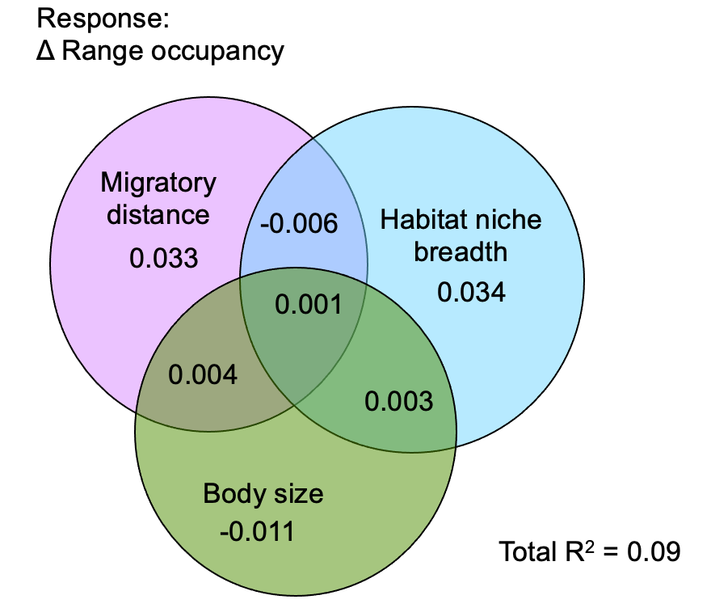
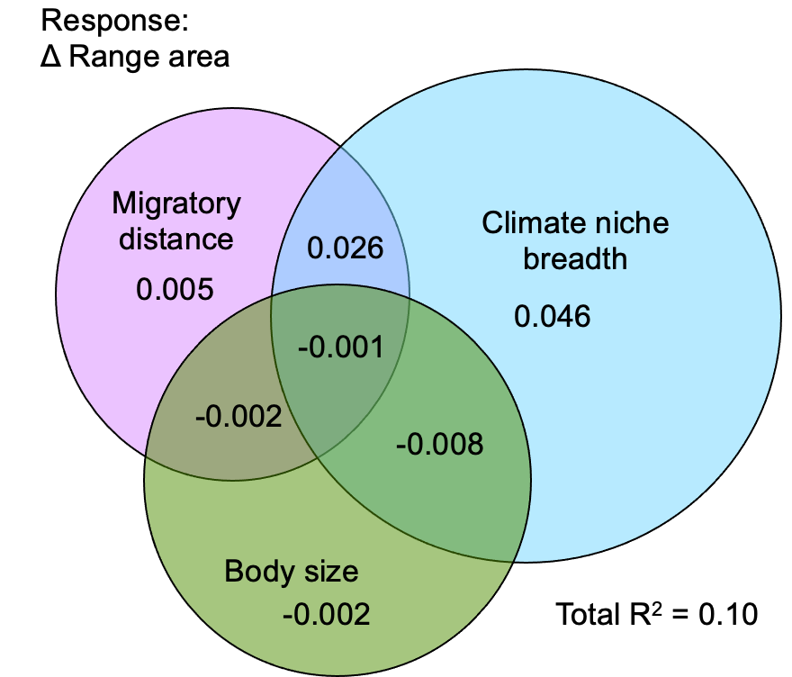
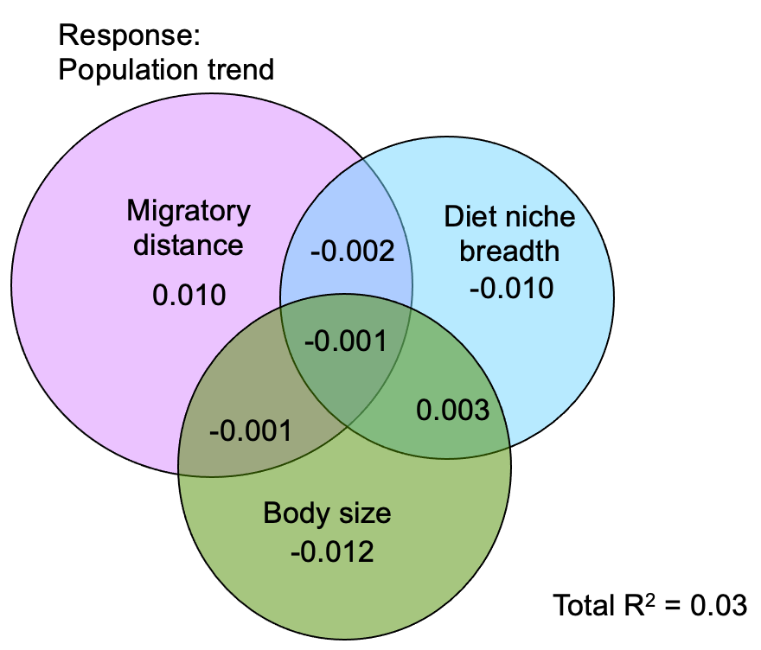

Slide 8
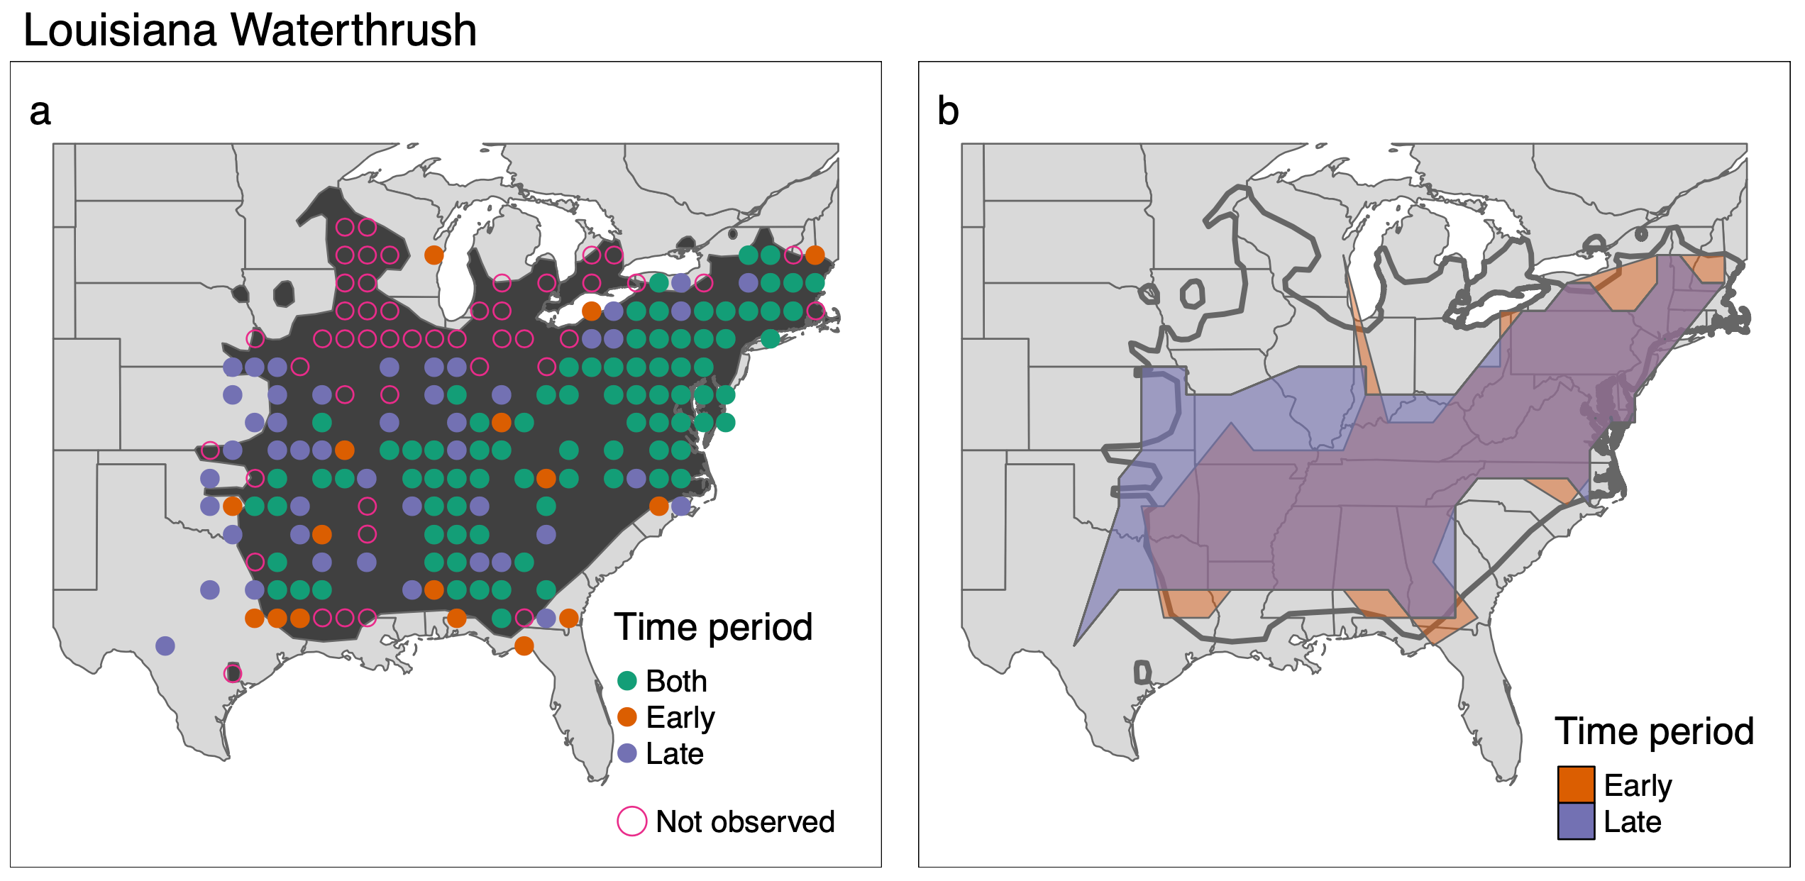
Range occupancy
Range area
Early
Late
Early
Late
13.8x10⁶ km²
17.3x10⁶ km²
122/226 = 0.54
160/226 = 0.71
Δ Range occupancy = 0.71-0.54 = 0.17
Δ Range area = (17.3x10⁶ -13.8x10⁶)/13.8x10⁶ = 0.25

