Slide 1
0.032**
R² = 0.33
R² = 0.22
0.353***
R² = 0.19
Δ Range occupancy
Δ Range area
Population trend
0.389*
-3.58***
0.043
0.190
0.960
0.522
-0.008
0.128
0.080
Habitat niche breadth
Climate niche breadth
Diet niche breadth

Slide 2
A. Concavity = 1
0.040***
R² = 0.39
R² = 0.31
-0.025
R² = 0.23
Δ Range occupancy
Δ Range area
Population trend
0.143*
1.013***
0.019
-4.226***
-0.133
1.983
0.301
-0.024
0.349
Habitat niche breadth
Climate niche breadth
Diet niche breadth

Slide 3
B. Concavity = 1.5
0.036***
R² = 0.35
R² = 0.38
0.192*
R² = 0.25
Δ Range occupancy
Δ Range area
Population trend
0.093
1.032***
0.011
-4.444***
0.660
-1.037
0.585
-0.033
0.185
Habitat niche breadth
Climate niche breadth
Diet niche breadth

Slide 4
C. Concavity = 2.5
0.032**
R² = 0.33
R² = 0.24
0.339***
R² = 0.19
Δ Range occupancy
Δ Range area
Population trend
0.590***
-3.581***
0.041
0.114
-0.521
0.522
-0.004
0.128
0.086
Habitat niche breadth
Climate niche breadth
Diet niche breadth

Slide 5
D. Concavity = 3
0.032**
R² = 0.32
R² = 0.32
0.505***
R² = 0.19
Δ Range occupancy
Δ Range area
Population trend
0.283
-3.581***
0.044
0.429
0.759
0.522
-0.006
0.128
0.080
Habitat niche breadth
Climate niche breadth
Diet niche breadth

Slide 6
Response:
Population trend
Migratory distance
Diet niche breadth
-0.002
0.010
-0.010
-0.001
0.003
-0.001
Body size
-0.012
Total R² = 0.03
Notes:
Venn diagram of variance partitioning

Slide 7
Response:
Δ Range area
Migratory distance
Climate niche breadth
0.026
0.005
0.046
-0.001
-0.002
-0.008
Body size
-0.002
Total R² = 0.10
Notes:
Venn diagram of variance partitioning

Slide 8
Response:
Δ Range occupancy
Migratory distance
-0.006
Habitat niche breadth
0.033
0.001
0.034
0.004
0.003
Body size
-0.011
Total R² = 0.09
Notes:
Venn diagram of variance partitioning

Slide 9
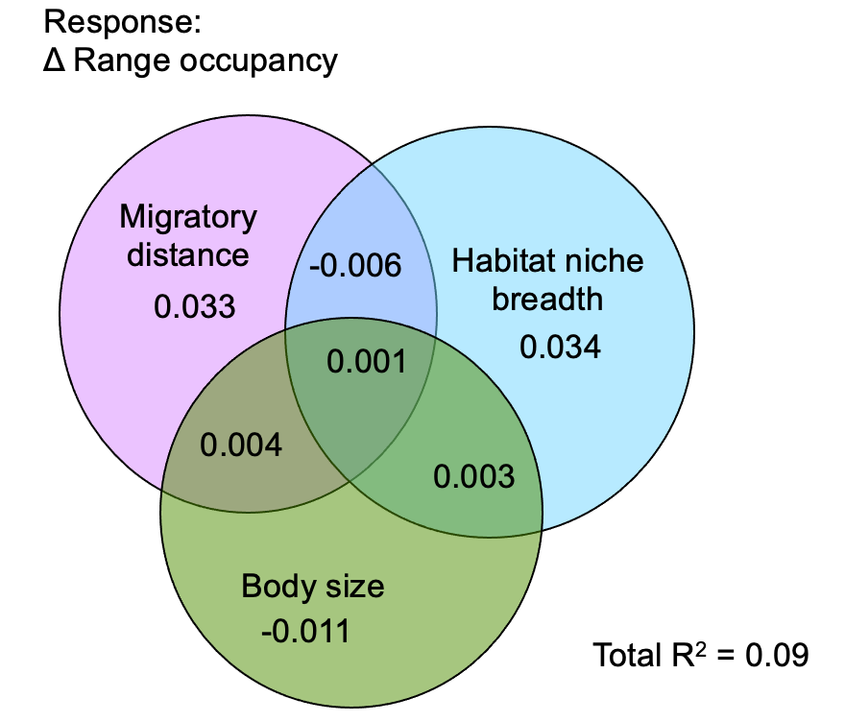
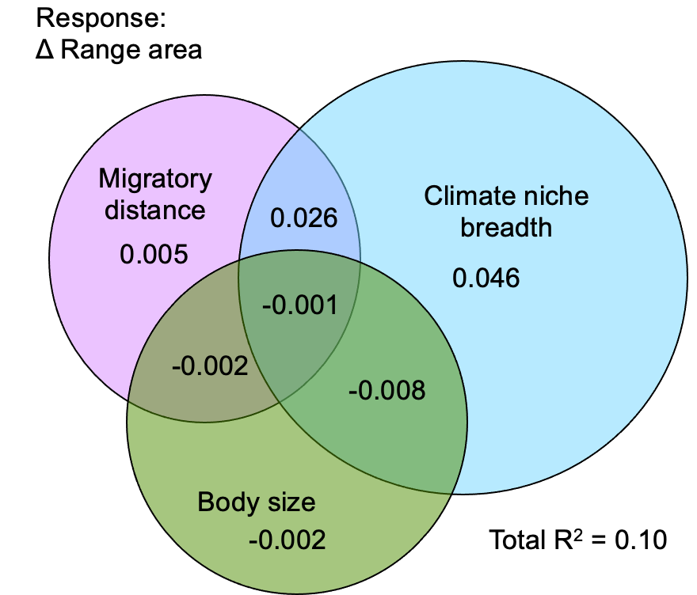
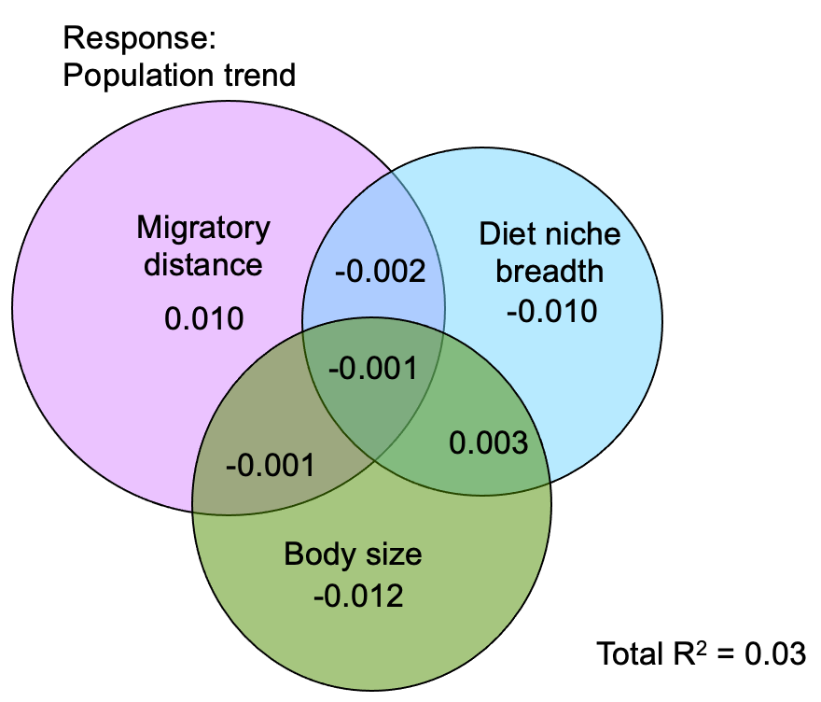

Slide 10
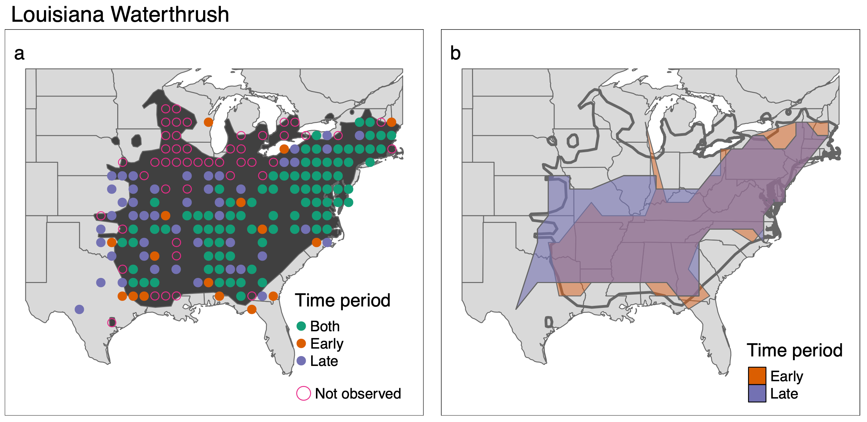
Range occupancy
Range area
Early
Late
Early
Late
13.8x10⁶ km²
17.3x10⁶ km²
122/226 = 0.54
160/226 = 0.71
Δ Range occupancy = 0.71-0.54 = 0.17
Δ Range area = (17.3x10⁶ -13.8x10⁶)/13.8x10⁶ = 0.25

