Slide 1
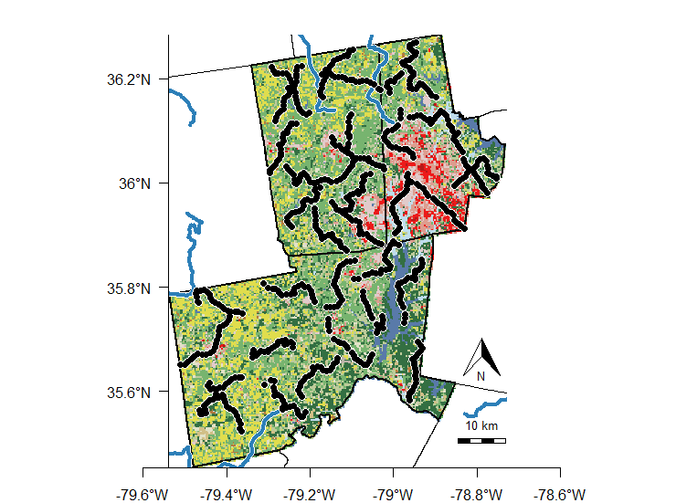
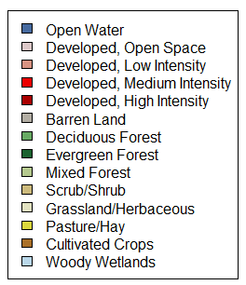
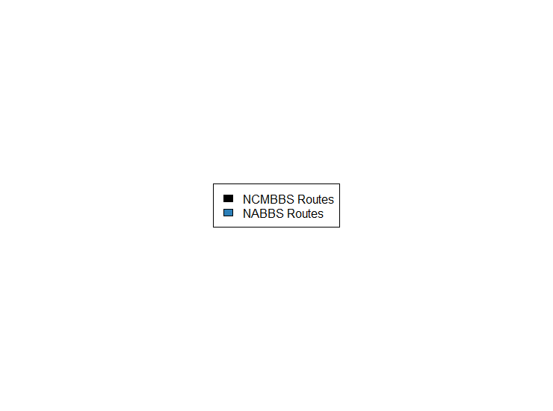

Slide 2
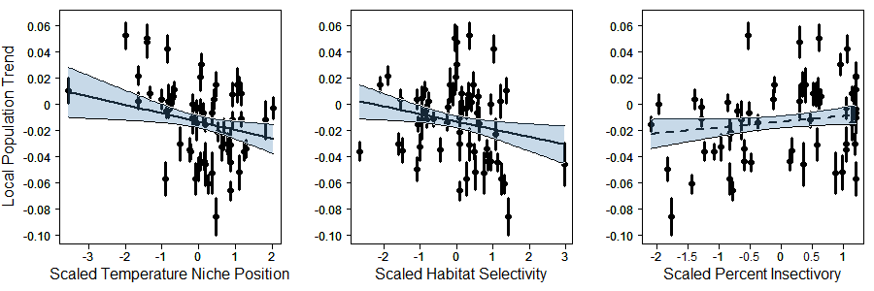
F3
All
Black
A
B
C

Slide 3
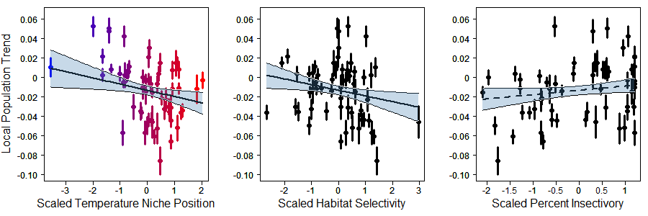
F3
Partial Color
A
B
C

Slide 4
F3
All
Color (this one isn’t as good imo)
A
B
C

Slide 5
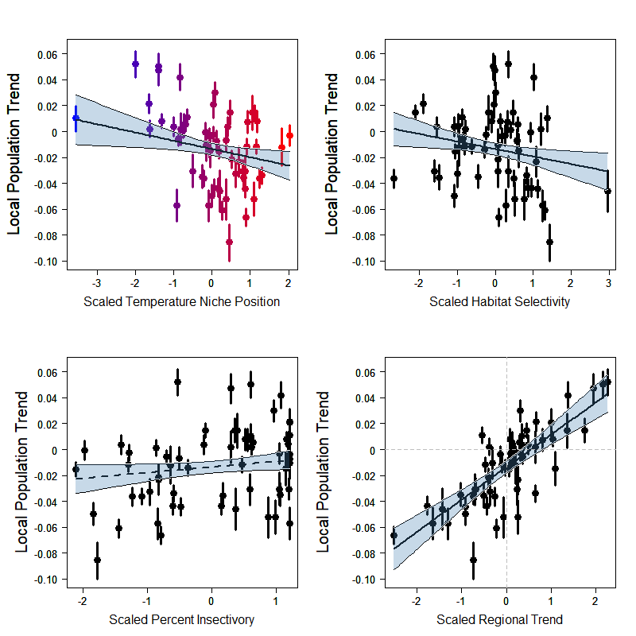

SF1
Show Scaled Regional Trend

Slide 6
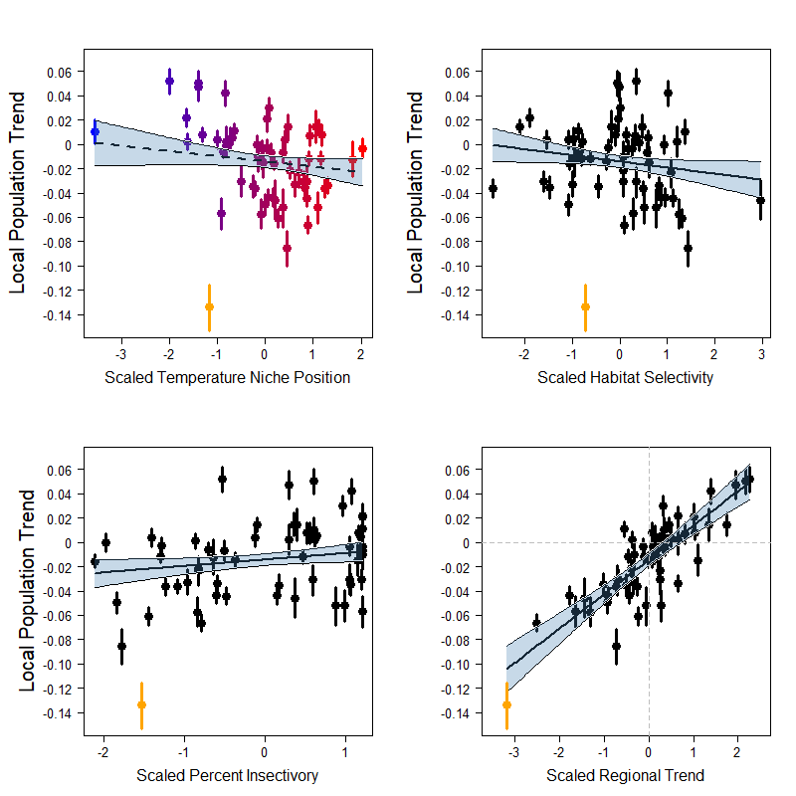
SF3
Bobwhite
Model
Run

Slide 7
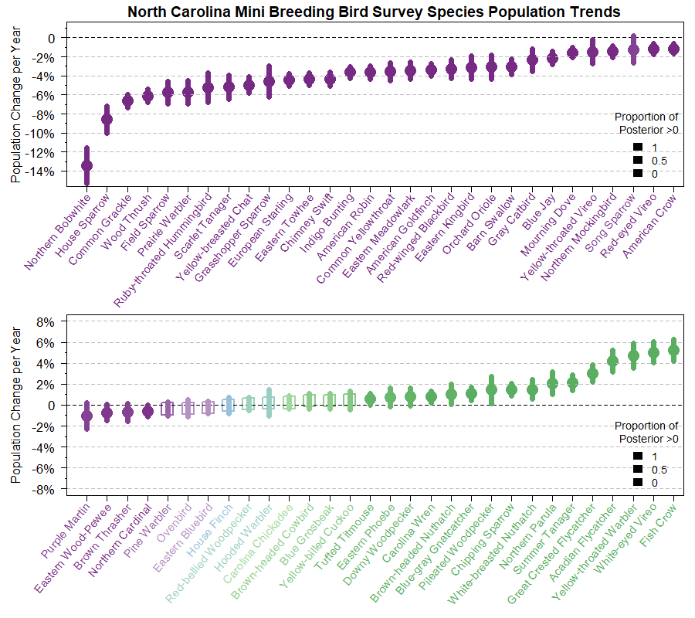
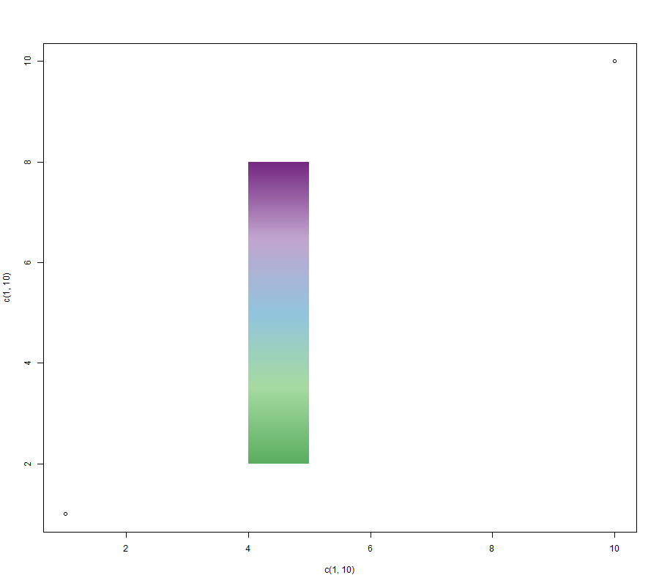
F1 Colorful Labels

Slide 8
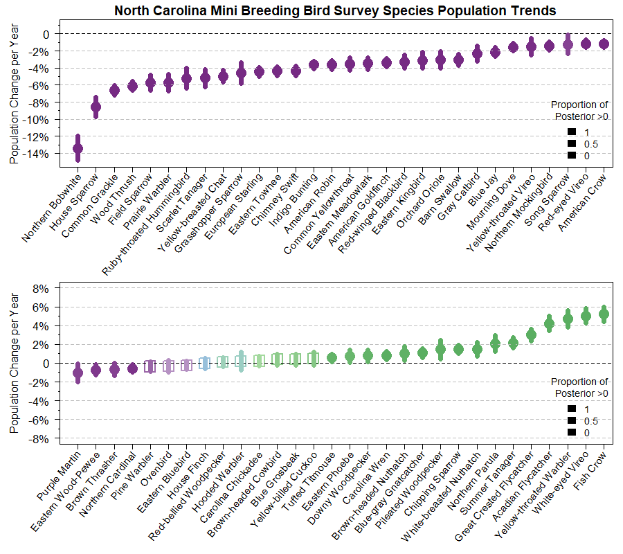
F1
Black Labels

