Slide 1
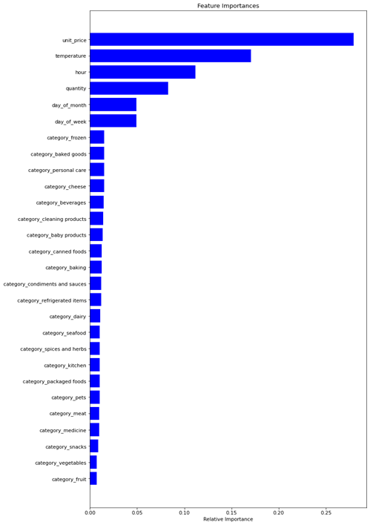
Cognizant
Problem Statement: To predict customer churn in a telecommunications company.
This machine learning model is very accurate at predicting customer churn. This means that the company can use the model to identify customers who are at risk of churning and take proactive steps to retain them. For example, the company could offer these customers special discounts or promotions.
Benefits to the Business:
Increased customer satisfaction
Reduced churn rates
Improved bottom line

