Slide 1

Communication Systems
Date : 25.05.2020
Prepared By:
Indrajit Solanki
Guided By:
Prof. Dr.-Ing. habil. Andreas Ahrens

Slide 2
Task 1 : Given are the random signals n₁(t) and n₂(t). Determine the mean value and the variance of the signals n₁(t) and n₂(t).
Signal | Mean Value | Variance
n1 (t) | 0.0909 | 0.0045
n2 (t) | 0.0909 | 0.0046
n1=[0.0130, 0.0280, 0.0640, 0.1310, 0.1810, 0.2020, 0.1680, 0.1060, 0.0650, 0.0300, 0.012]
sum(n1) = 1
length(n1) = 11
Mean Value = sum(n1)/11 = 0.0909
Power = sum(n1.^2)/11 = 0.0128
Variance = sum ((n1-m).^2)/11 = 0.0045
n2=[0.002, 0.008, 0.033, 0.072, 0.117, 0.166, 0.201, 0.179, 0.131, 0.06, 0.031]
sum(n2) = 1
length(n2) = 11
Mean Value = sum(n2)/11 = 0.0909
Power = sum(n2.^2)/11 = 0.0129
Variance = sum ((n2-m).^2)/11 = 0.0046

Slide 3
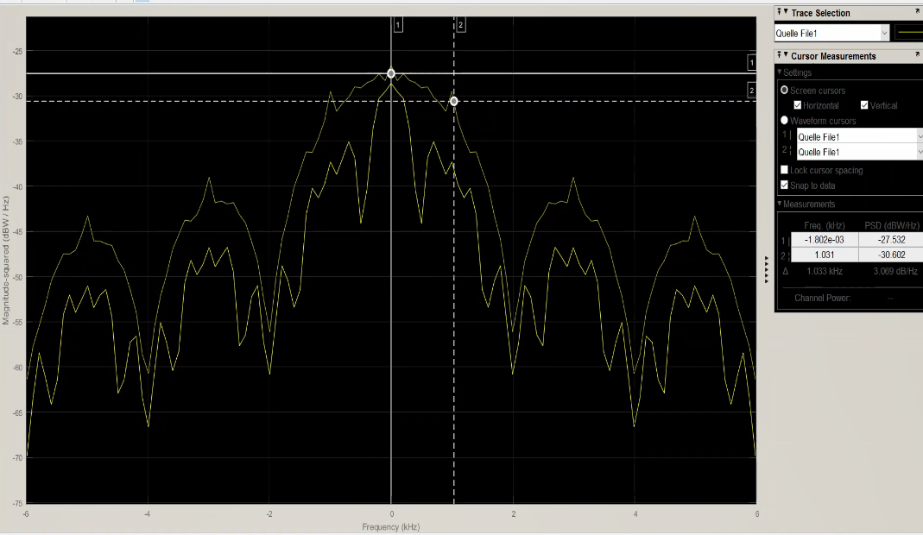
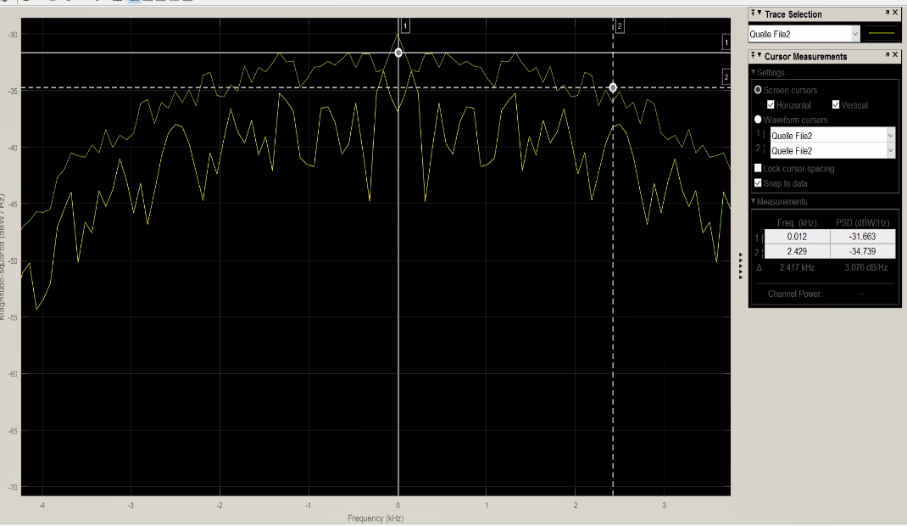
Task 2: Determine the bandwidth and the data rate of the recorded baseband signals!
 | Data Rate | Bandwidth (6dB, estimated)
File 1 | 2000 symbol / s | 1 kHz
File 2 | 5000 Symbol / s | 2.5 kHz
Required bandwidth for a transmission of 1000 symbols/s :
For, baseband signal,
Bandwidth = ½ * Symbol rate
= ½ * 1000
= 500 Hz.

Slide 4
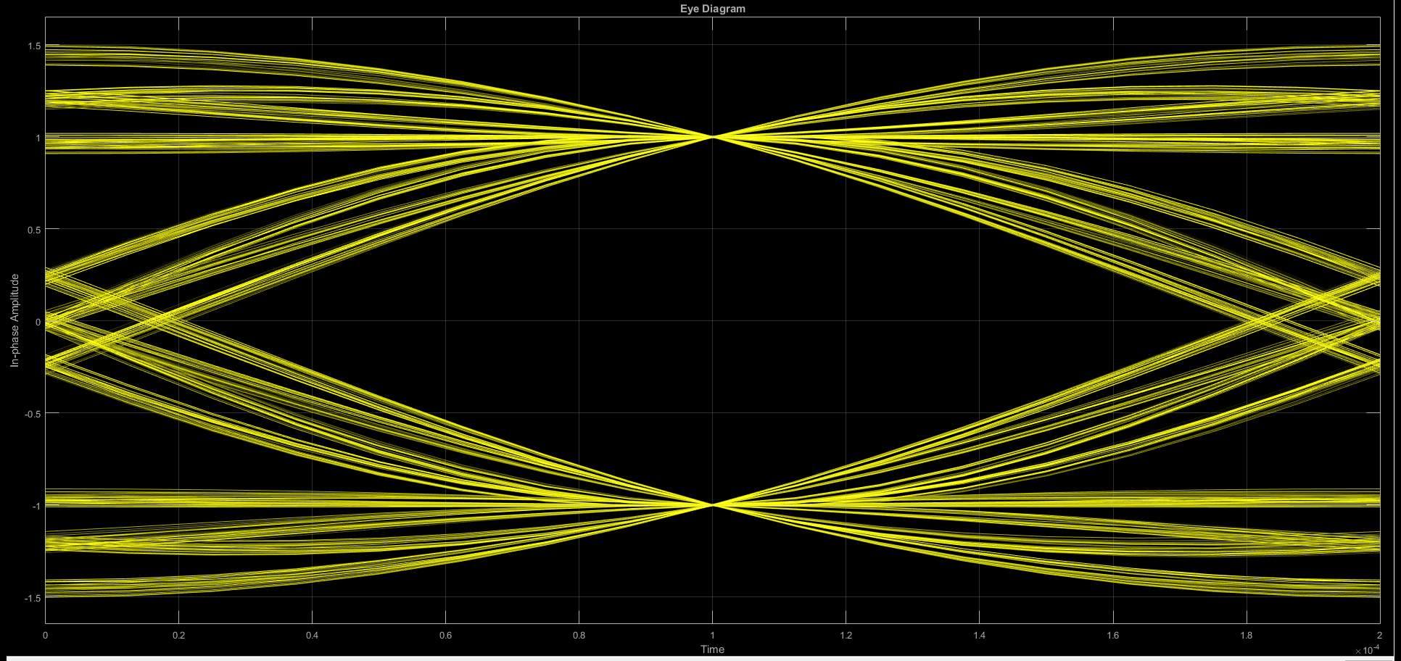
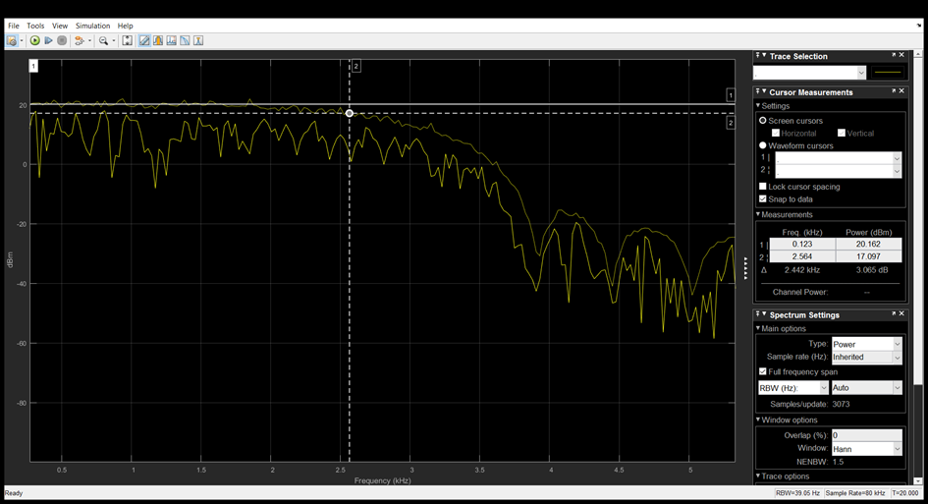
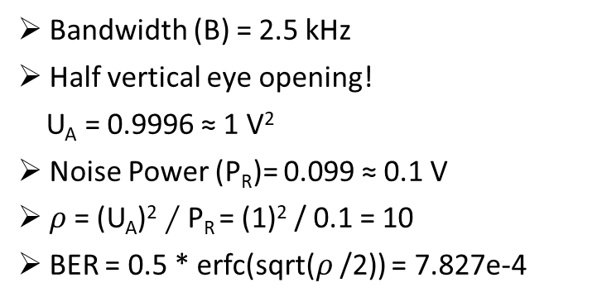
Task – 3: Transmit and receive filters are designed as square-root raised-cosine filters with a roll-off factor of r = 0.5. As modulation format, a two-level bipolar transmission ( i.e. s = 2) is selected. The data transmission speed is 5000 bit/s.
Bandwidth (B) = 2.5 kHz
Half vertical eye opening!
U_{A} = 0.9996 ≈ 1 V²
Noise Power (P_{R})= 0.099 ≈ 0.1 V
$ρ$ = (U_{A})² $∕$ P_{R} = (1)² / 0.1 = 10
BER = 0.5 * erfc(sqrt($ρ$/2)) = 7.827e-4

Slide 5
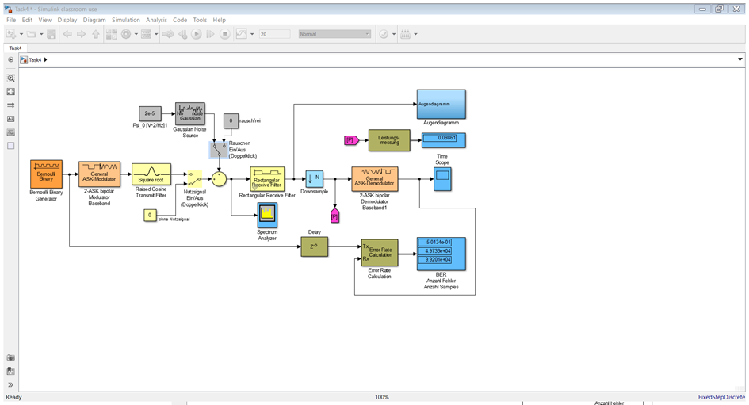
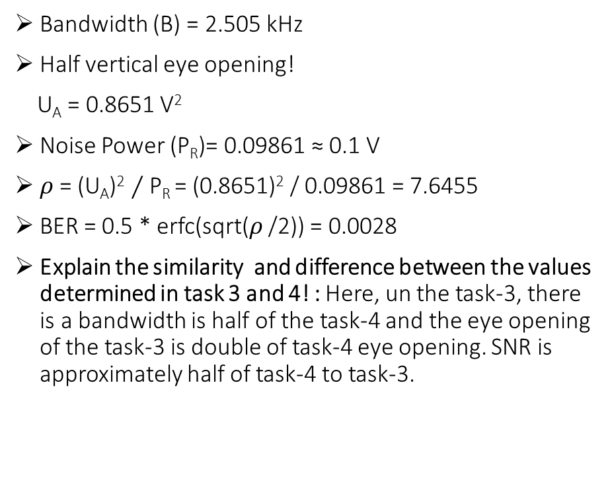
Task – 4: In addition to Task 3 a filter with the impulse response in fig. 3 is now used as the receive filter.
Bandwidth (B) = 2.505 kHz
Half vertical eye opening!
U_{A} = 0.8651 V²
Noise Power (P_{R})= 0.09861 ≈ 0.1 V
$ρ$ = (U_{A})² $∕$ P_{R} = (0.8651)² / 0.09861 = 7.6455
BER = 0.5 * erfc(sqrt($ρ$/2)) = 0.0028
Explain the similarity and difference between the values determined in task 3 and 4! : Here, un the task-3, there is a bandwidth is half of the task-4 and the eye opening of the task-3 is double of task-4 eye opening. SNR is approximately half of task-4 to task-3.

Slide 6
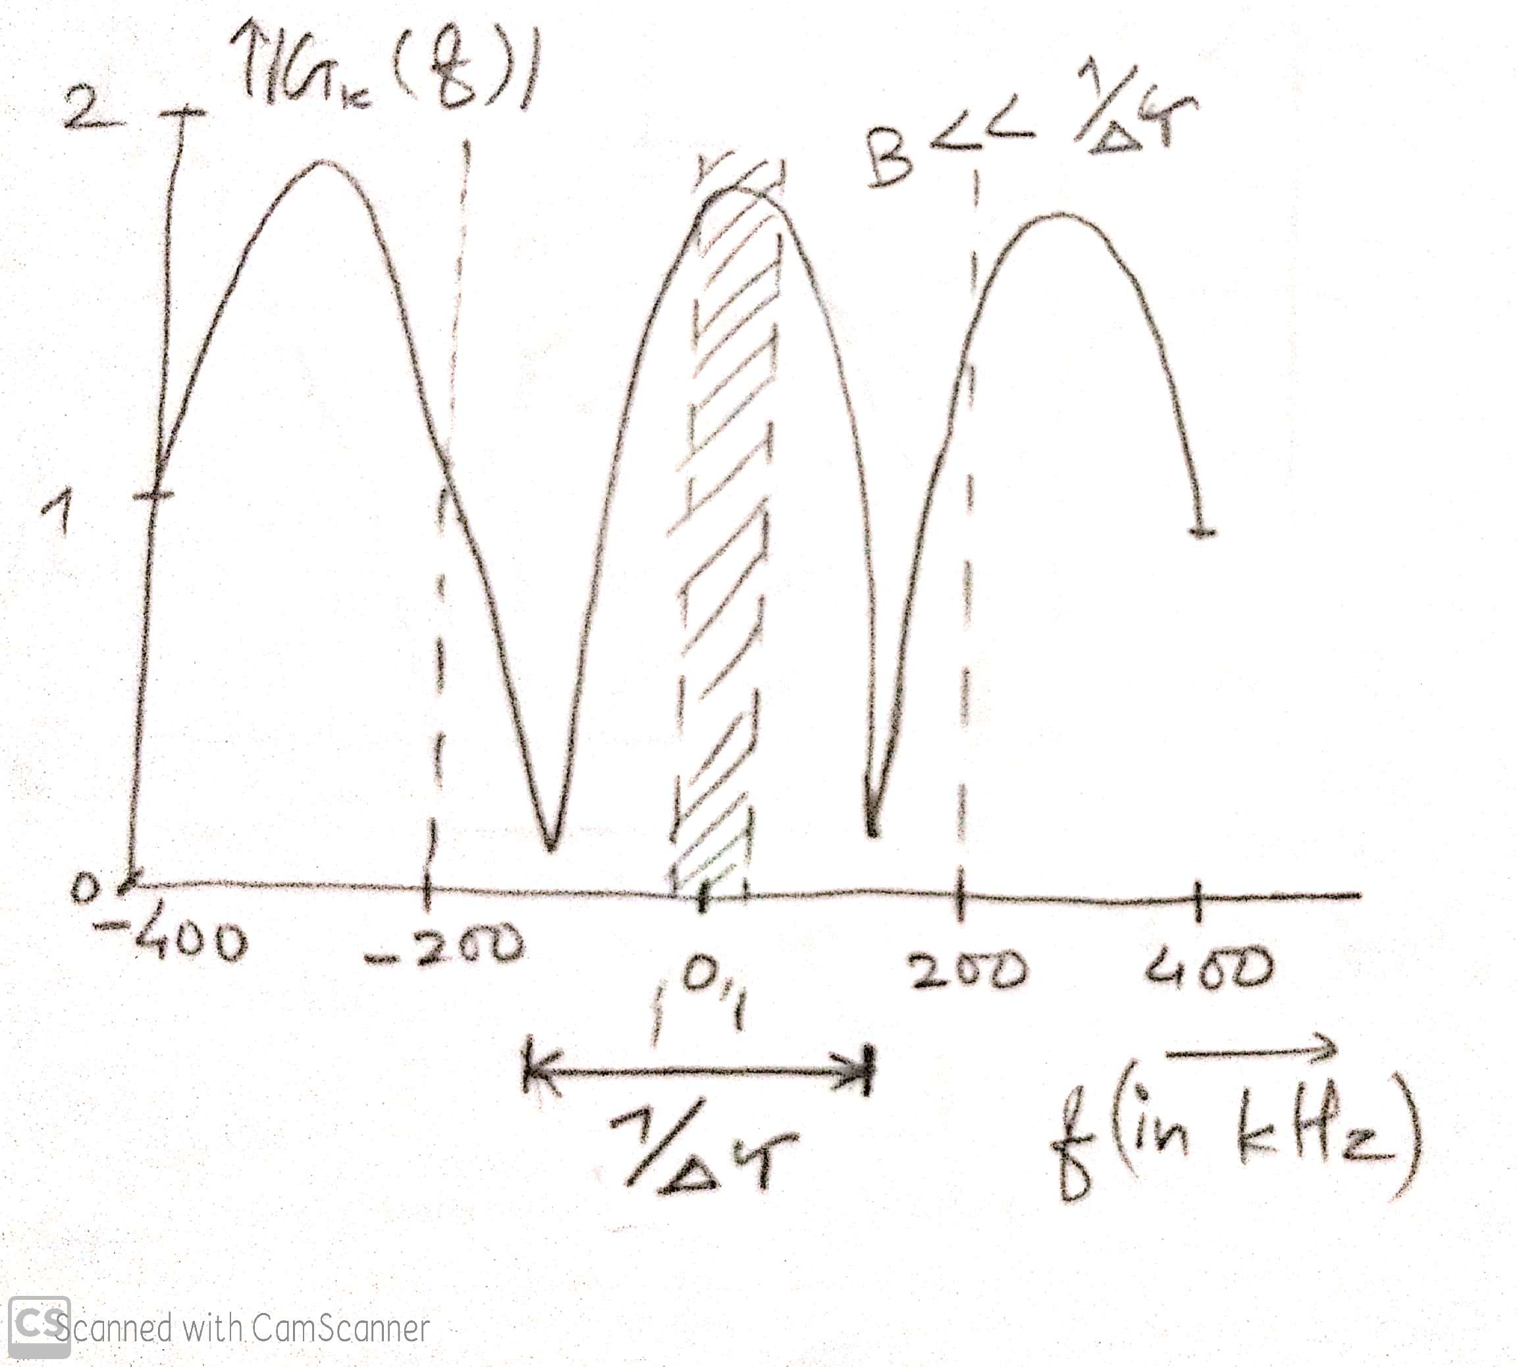
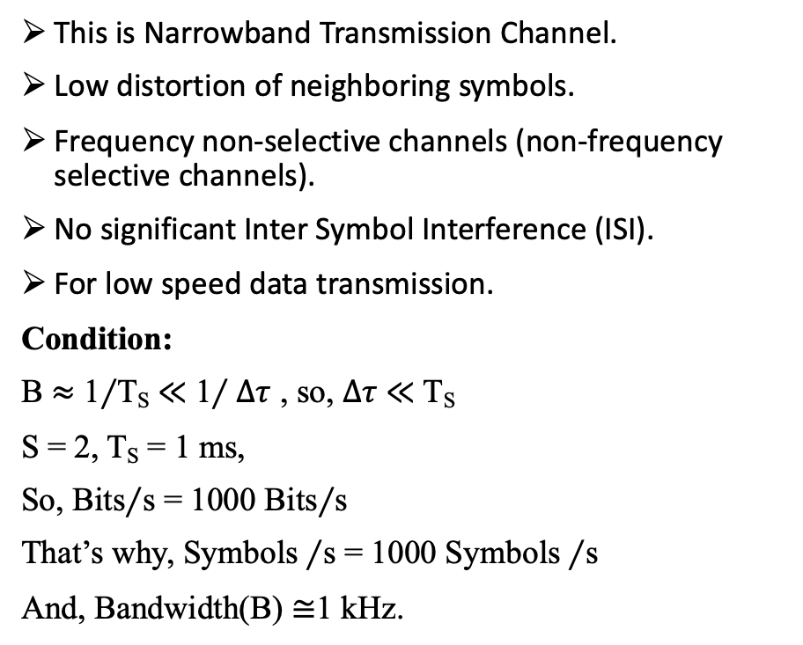
Task – 5: Determine approximately the bandwidth of the transmitted signal so that non- frequency selective (flat) channel conditions exist at the receiver. Explain (plot with an explanation) whether the use of an equalizer is necessary in this case. Estimate an approximate symbol rate that you consider to be appropriate!
This is Narrowband Transmission Channel.
Low distortion of neighboring symbols.
Frequency non-selective channels (non-frequency selective channels).
No significant Inter Symbol Interference (ISI).
For low speed data transmission.
Condition:
B $≈$ 1$∕$T_{S} $≪$ 1$∕∆τ$ , so, $∆τ$ $≪$ T_{S}
S = 2, T_{S} = 1 ms,
So, Bits$∕$s = 1000 Bits$∕$s
That’s why, Symbols $∕$s = 1000 Symbols $∕$s
And, Bandwidth(B) $≅$1 kHz.

Slide 7
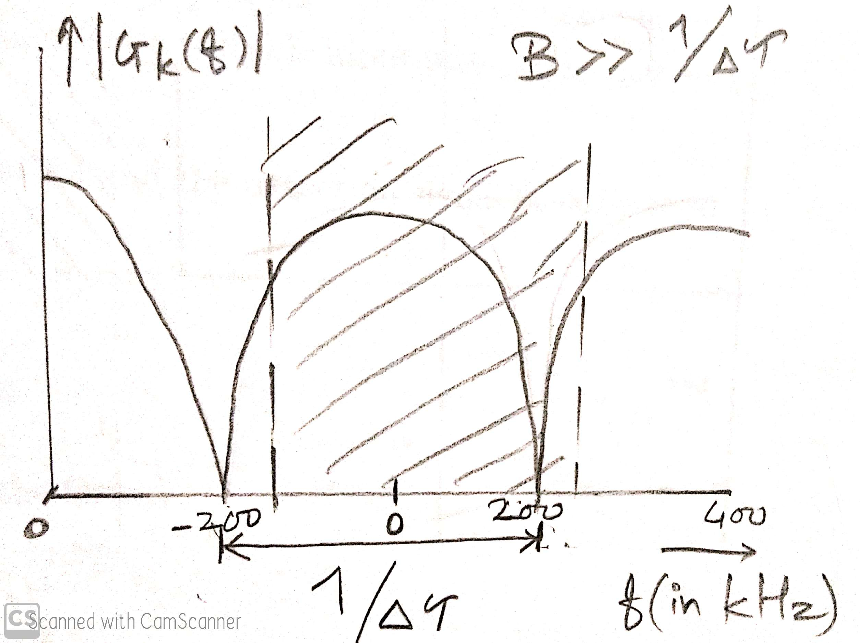
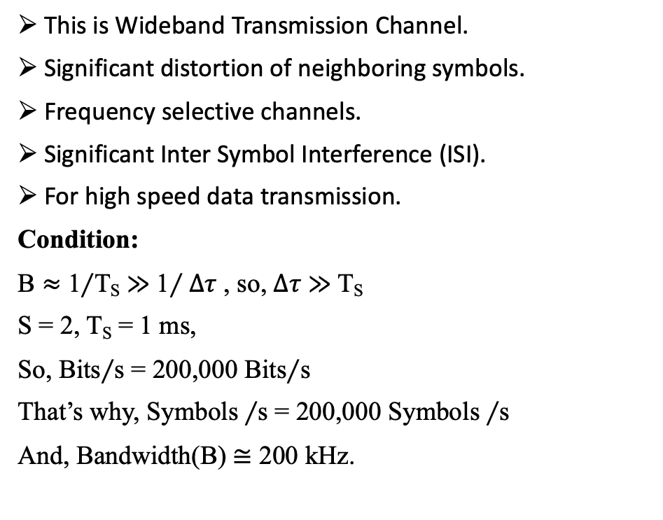
Task – 6: Determine approximately the bandwidth of the transmitted signal so that frequency selective (flat) channel conditions exist at the receiver. Explain (plot with an explanation) whether the use of an equalizer is necessary in this case. Estimate an approximate symbol rate that you consider to be appropriate!
This is Wideband Transmission Channel.
Significant distortion of neighboring symbols.
Frequency selective channels.
Significant Inter Symbol Interference (ISI).
For high speed data transmission.
Condition:
B $≈$ 1$∕$T_{S} $≫$ 1$∕∆τ$ , so, $∆τ$ $≫$T_{S}
S = 2, T_{S} = 1 ms,
So, Bits$∕$s = 200,000 Bits$∕$s
That’s why, Symbols $∕$s = 200,000 Symbols $∕$s
And, Bandwidth(B) $≅$ 200 kHz.

Slide 8
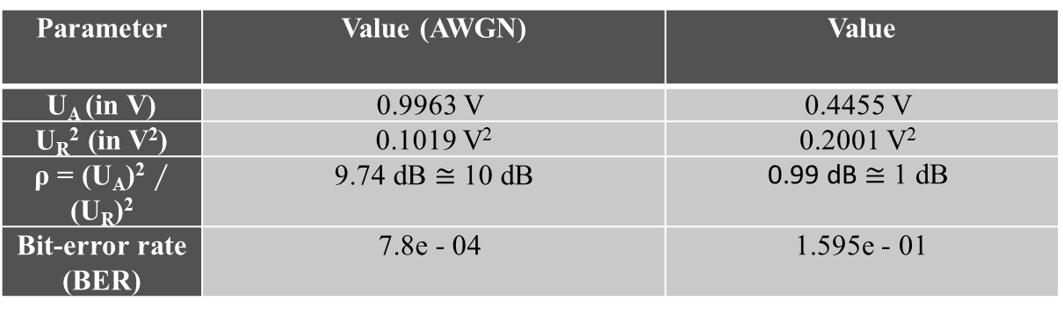
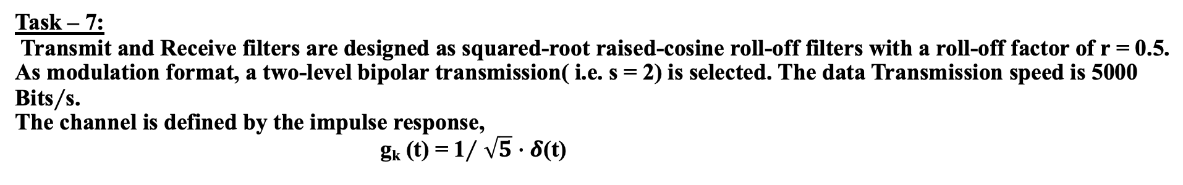
Task – 7: Transmit and Receive filters are designed as squared-root raised-cosine roll-off filters with a roll-off factor of r = 0.5. As modulation format, a two-level bipolar transmission( i.e. s = 2) is selected. The data Transmission speed is 5000 Bits$∕$s. The channel is defined by the impulse response, g_{k} (t) = 1$∕$ $\sqrt{5}$ $∙δ$(t)
Parameter | Value (AWGN) | Value
U_{A} (in V) | 0.9963 V | 0.4455 V
U_{R}² (in V²) | 0.1019 V² | 0.2001 V²
ρ = (U_{A})² $∕$ (U_{R})² | 9.74 dB $≅$ 10 dB | 0.99 dB $≅$ 1 dB
Bit-error rate (BER) | 7.8e - 04 | 1.595e - 01
Please decide wheather the specified channel g_{k} (t) is frequency selective or non-frequency selective?
g_{k} (t) is frequency Non-selective Channel.

Slide 9
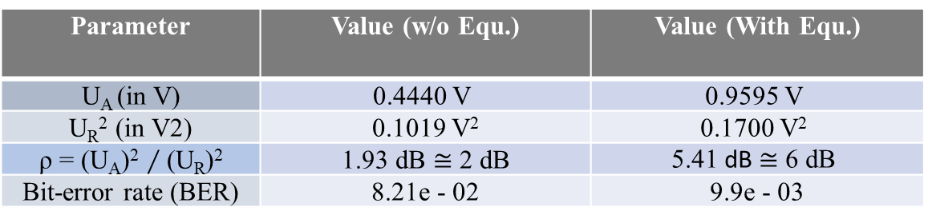
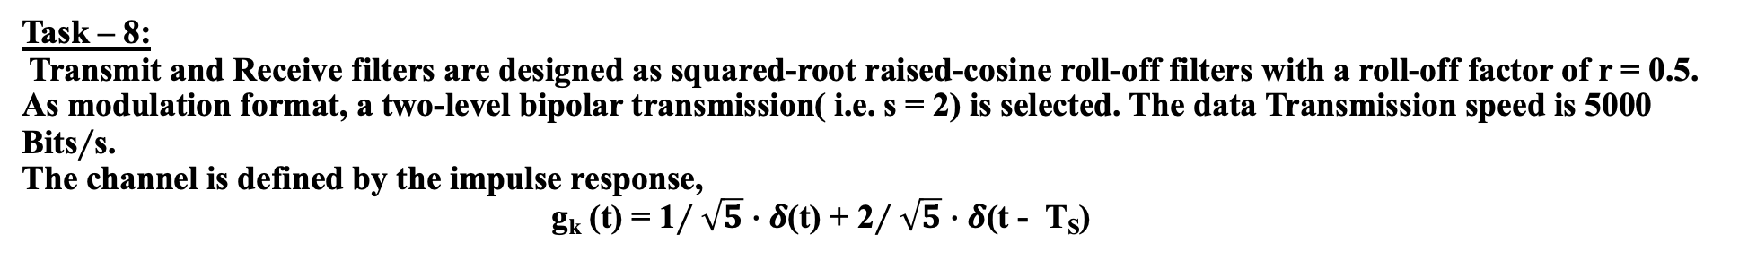
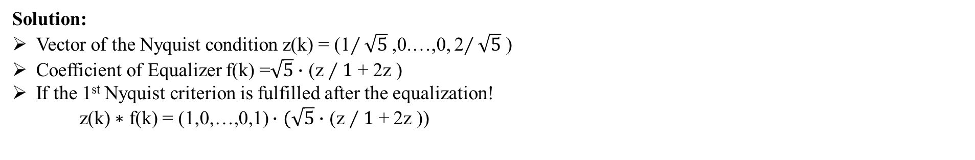
Task – 8: Transmit and Receive filters are designed as squared-root raised-cosine roll-off filters with a roll-off factor of r = 0.5. As modulation format, a two-level bipolar transmission( i.e. s = 2) is selected. The data Transmission speed is 5000 Bits$∕$s. The channel is defined by the impulse response, g_{k} (t) = 1$∕\sqrt{5}$ $∙δ$(t) + 2$∕\sqrt{5}$ $∙δ$(t - T_{S})
Parameter | Value (w/o Equ.) | Value (With Equ.)
U_{A} (in V) | 0.4440 V | 0.9595 V
U_{R}² (in V2) | 0.1019 V² | 0.1700 V²
ρ = (U_{A})² $∕$ (U_{R})² | 1.93 dB $≅$ 2 dB | 5.41 dB $≅$ 6 dB
Bit-error rate (BER) | 8.21e - 02 | 9.9e - 03
Solution:
Vector of the Nyquist condition z(k) = (1$∕\sqrt{5}$ ,0.…,0, 2$∕\sqrt{5}$ )
Coefficient of Equalizer f(k) =$\sqrt{5}$ $∙$ (z $∕1$ + 2z )
If the 1st Nyquist criterion is fulfilled after the equalization!
z(k) $∗$ f(k) = (1,0,…,0,1) $∙$ $(\sqrt{5}$ $∙$ (z $∕1$ + 2z ))
Please decide wheather the specified channel g_{k} (t) is frequency selective or non-frequency selective?
g_{k} (t) is frequency Selective Channel.

Slide 10
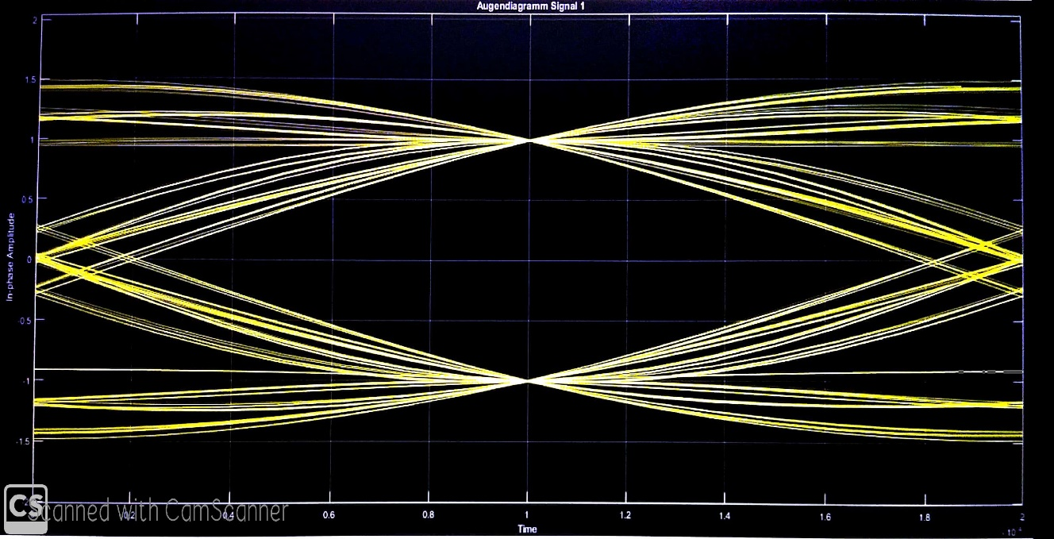
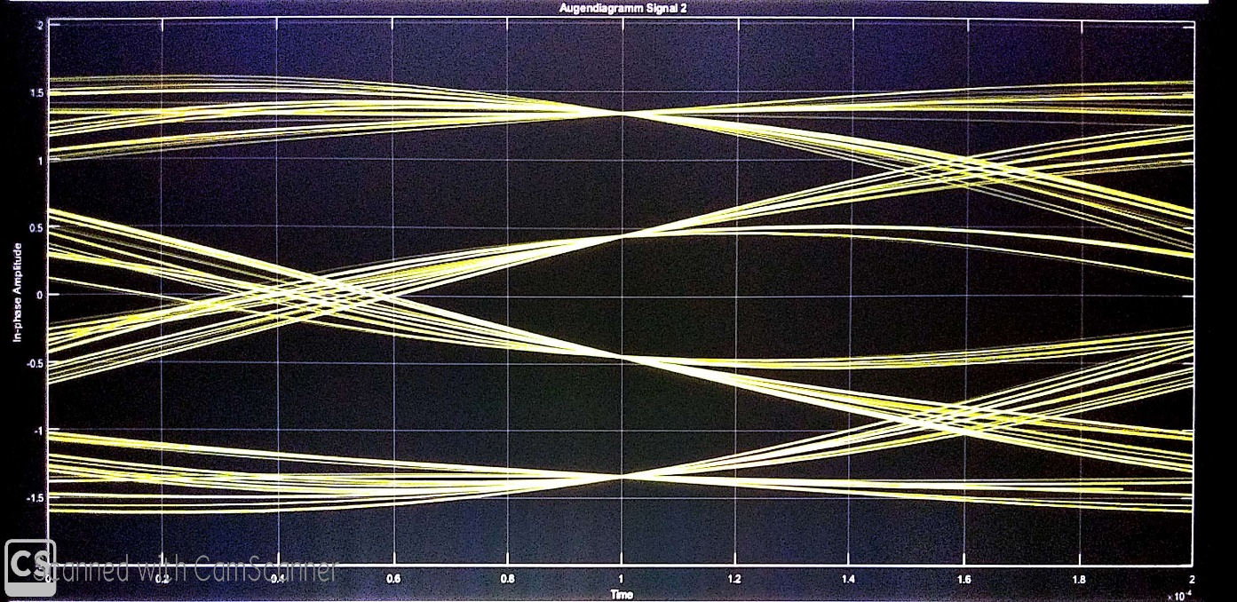
Task – 9: Analyse the given eye diagrams and identify possible interferences with regard to the transmission channel.
Eye Diagram I:
2-ASK with 2 constellation points with 1 bit/symbol.
Half vertical eye opening is large.
High amplitude.
No signal distortion and Inter Symbol Interference(ISI).
Eye Diagram II:
4- ASK with 4 constellation points with 2 bits/symbol.
Signal distortion and Inter Symbol Interference (ISI).
Half vertical eye opening is small.
Low amplitude.

Slide 11
Thank You

