Slide 1

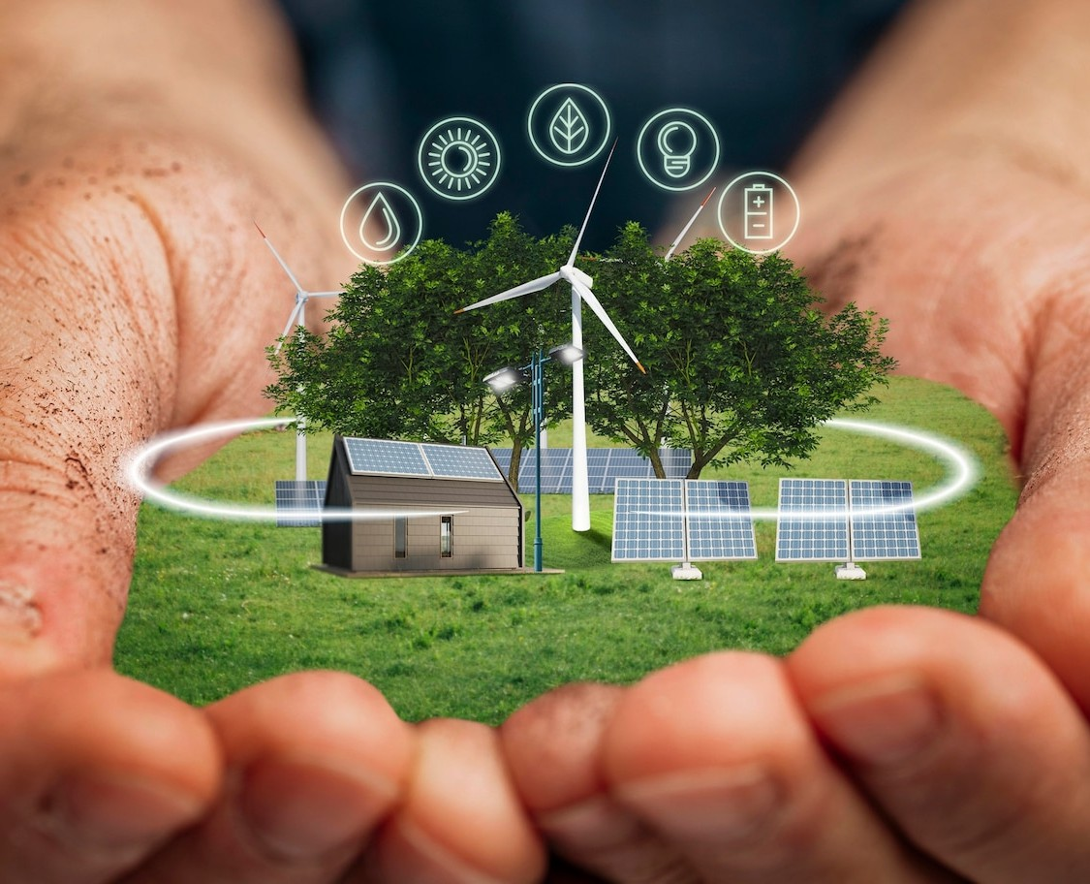
Efficient Scheduling of Smart Home Appliances Using Aquila Optimization Algorithm and Energy Monitoring using ThingSpeak
SAIKUMAR IKA
Paper id-137
ICSSCT-2k25

Slide 2
Introduction / Motivation
The rapid rise in automation has led to increased electricity consumption in modern households. Traditional home systems lack the intelligence and flexibility to optimize appliance usage and reduce energy waste.
The depletion of fossil fuels and rising energy costs have made efficient energy management a pressing concern. Smart Home Energy Management Systems (SHEMS), powered by IoT, can monitor, control, and optimize power usage in real time.
By combining manual switches, and mobile app control, we aim to provide a versatile and user-friendly solution for managing both smart and non-smart home devices. Our system also works smoothly with your current home setup, making it easy to upgrade.Plus, we’ll keep improving the system with updates to stay current with new technology and your changing needs
This paper aims to design a cost-effective, scalable, and intelligent system using:
ESP32 microcontroller
ThingSpeak for energy monitoring
Node-RED for control interface

Slide 3
Problem Statement
Traditional household energy systems are inefficient, lacking smart control and
real-time monitoring capabilities.
Manual operation of appliances leads to unnecessary energy consumption,
especially during peak load hours.
Existing solutions:
Often require costly smart appliances
Lack support for scheduling and optimization
Fail to leverage energy usage analytics
There is a critical need for a smart, scalable, and cost-effective solution that:
Supports both smart and non-smart appliances
Enables remote monitoring and control
Optimizes appliance usage based on energy consumption patterns

Slide 4
Objectives
Real Time Energy Monitoring:
Real-time tracking of power usage and energy consumption for enhanced energy efficiency.
Automation and Control:
Designing the system to control traditional non-smart appliances using IoT technology.
Data Logging and Visualization:
Uploading energy data and appliance states to ThingSpeak for analytics. Providing an intuitive LCD interface for instant feedback.
Ensure Seamless Integration Across Platforms:
Develop a unified system architecture that allows seamless communication and control across various platforms

Slide 5
Background / Literature Review:
Paper | Features and System | Limitations
Netinant, P.; Utsanok, T.; Rukhiran, M.; Klongdee, S. Development and Assessment of Internet of Things-Driven Smart Home Security and Automation with Voice Commands. IoT 2024, 5, 79-99. https://doi.org/10.3390/iot5010005 | Voice Command Integration, PIR Sensor-Based Intrusion Detection, Mobile Application Control | Dependence on Wireless Network Connectivity, Voice Recognition Authenticity
N. Prathima, P. Sai Kumar, SK. Lal Ahmed and G. Chakradhar,, “Voice Recognition Based Home Automation System for Paralyzed People”, International Journal for Modern Trends in Science and Technology, Vol. 03, Special Issue 02, 2017, pp. 101-106. | Voice-Controlled Home Automation wheel chair Control via Voice Commands Design Messaging System, Assistive Technology for Independence | Limited Functionality in Power Outages, Limited Device Compatibility, Initial Setup Complexity
S. Das, S. Ganguly, S. Ghosh, R. Sarker and D. Sengupta, "A bluetooth based sophisticated home automation system using smartphone," 2016 International Conference on Intelligent Control Power and Instrumentation (ICICPI), 2016, pp. 236-240, doi: 10.1109/ICICPI.2016.7859709. | Smart Home Automation, Arduino-Based, Android App Control, Device Control Bluetooth, Communication | Dependency on Cell Phone, Compatibility issues, Limited Processing Power, Prototype Limitation, Memory Constraints
M. S. Mahamud, M. S. R. Zishan, S. I. Ahmad, A. R. Rahman, M. Hasan and M. L. Rahman, "Domicile - An IoT Based Smart Home Automation System," 2019 International Conference on Robotics,Electrical and Signal Processing Techniques (ICREST), Dhaka, Bangladesh, 2019, pp. 493-497, doi: 10.1109/ICREST.2019.8644349. | Arduino UNO-Based System,Wi-Fi Connectivity via ESP32 Module, Edge and Fog Computing Architecture, Simulation and Hardware Prototyping | Limited Processing Power of Arduino UNO, Complex Setup for Edge and Fog Computing, Memory Constraints

Slide 6
Background / Literature Review:
Paper | Features and System | Limitations
Intelligent Scheduling of Smart Home Appliances Based on Demand Response Considering the Cost and Peak-to-Average Ratio in Residential Homes Nedim Tutkun 1 , Alessandro Burgio 2 , Michal Jasinski 3,* , Zbigniew Leonowicz 3 and Elzbieta Jasinska 4 | Smart Grid Integration, Metaheuristic Techniques, Feasibility for Wide-Range Applications, Repeated Execution | Complexity of Multi-Objective Optimization, Feasibility for Wide-Range Applications, Repeated Execution Requirement
Energy Prediction and Optimization for Smart Homes with Weather Metric-Weight Coefficients Asif Mehmood 1 , Kyu-Tae Lee 1,* and Do-Hyeun Kim 2 | Voice-Controlled Home Automation wheel chair Control via Voice Commands Design Messaging System, Assistive Technology for Independence | Limited Functionality in Power Outages, Limited Device Compatibility, Initial Setup Complexity
S. Das, S. Ganguly, S. Ghosh, R. Sarker and D. Sengupta, "A bluetooth based sophisticated home automation system using smartphone," 2016 International Conference on Intelligent Control Power and Instrumentation (ICICPI), 2016, pp. 236-240, doi: 10.1109/ICICPI.2016.7859709. | Hybrid Optimization Approach, Proactive Energy Optimization, Optimized Indoor Setting, Inclusion of Additional Weather Metrics | Complex Optimization Trade-offs, Hybrid Approach Complexity, Seasonal and Monthly Variations, User Adaptability
M. S. Mahamud, M. S. R. Zishan, S. I. Ahmad, A. R. Rahman, M. Hasan and M. L. Rahman, "Domicile - An IoT Based Smart Home Automation System," 2019 International Conference on Robotics,Electrical and Signal Processing Techniques (ICREST), Dhaka, Bangladesh, 2019, pp. 493-497, doi: 10.1109/ICREST.2019.8644349. | Edge and Fog Computing Architecture, Arduino UNO-Based System,Wi-Fi Connectivity via ESP32 Module, Simulation and Hardware Prototyping | Complex Setup for Edge and Fog Computing, Memory Constraints, Limited Processing Power of Arduino UNO,

Slide 7
Methodology / Approach:
1. Dual Operational Modes
Manual Mode: Appliances operated using physical switches
.Automated Mode: Appliances controlled using ESP32 and relay modules.
2. IoT-Based Automation
ESP32 acts as the central controller for appliance management
.Node-RED UI provides web-based remote control.
ThingSpeak logs and visualizes real-time energy consumption data.
3. Energy Monitoring
Sensors (ACS712 & ZMPT101B) measure:
Voltage
Current
Power & Energy Consumption
Data sent to ThingSpeak every few seconds for analysis.
4. Optimization using AO (Aquila Optimization Algorithm)
Categorizes appliances into: Shiftable,Non Shiftable and Controllable

Slide 8
Implementation:
1. Hardware Setup
ESP32 Microcontroller: Central hub for communication and control.
Relay Module: Controls appliances like:
Light 1 (120V)
Light 2 (240V)
Fan
Motor
Sensors:
ACS712 – Current sensor
ZMPT101B – Voltage sensor
LCD Display: Shows real-time voltage, current, and energy consumption.
Manual Switches: Allow local override of appliance control.

Slide 9
Implementation:
2. Software Components
Arduino IDE: Firmware development for ESP32.
Node-RED: Web-based control interface.
ThingSpeak: Cloud platform for real-time data logging and analytics.
MQTT Protocol (HiveMQ): Enables fast, lightweight communication.
FreeRTOS: Manages task scheduling on ESP32.
3. Functional Modules
WiFi Setup using WiFiManager (auto-connect or fallback to AP mode).
MQTT Communication with topics to control each relay.
Energy Monitoring using EmonLib for real-time power calculation.
ThingSpeak Logging: Publishes energy data every 20 seconds.
LCD Updates: Voltage, current, energy in kWh displayed every second.

Slide 10
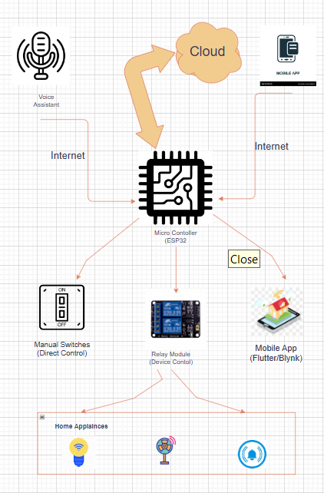
System Architecture

Slide 11
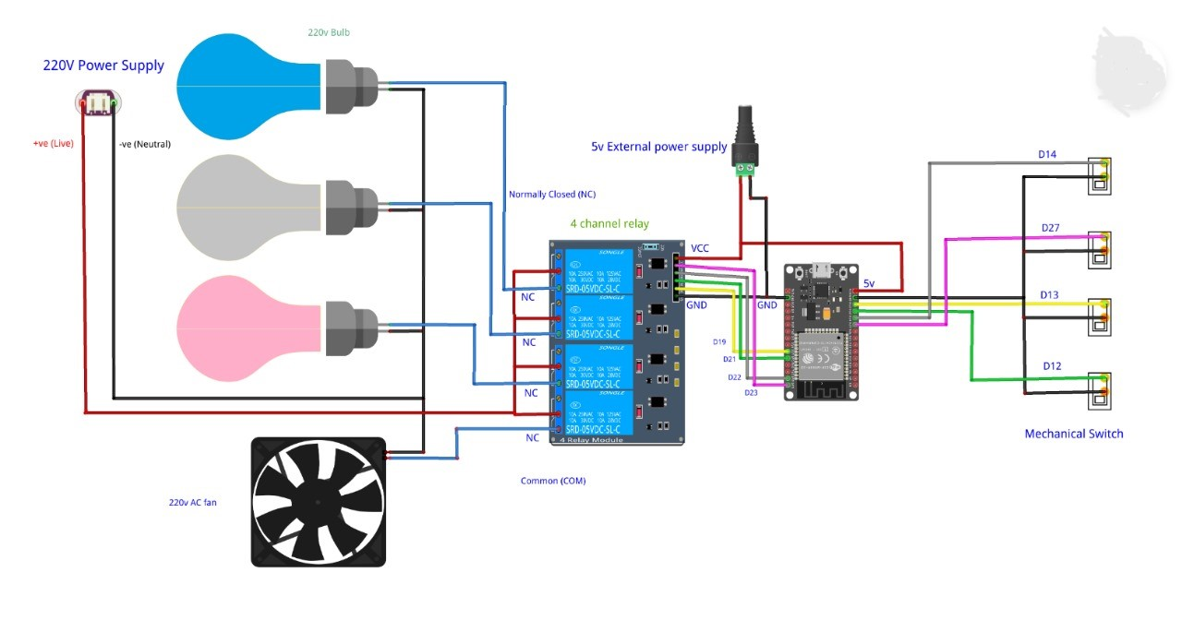
Circuit Diagram

Slide 12
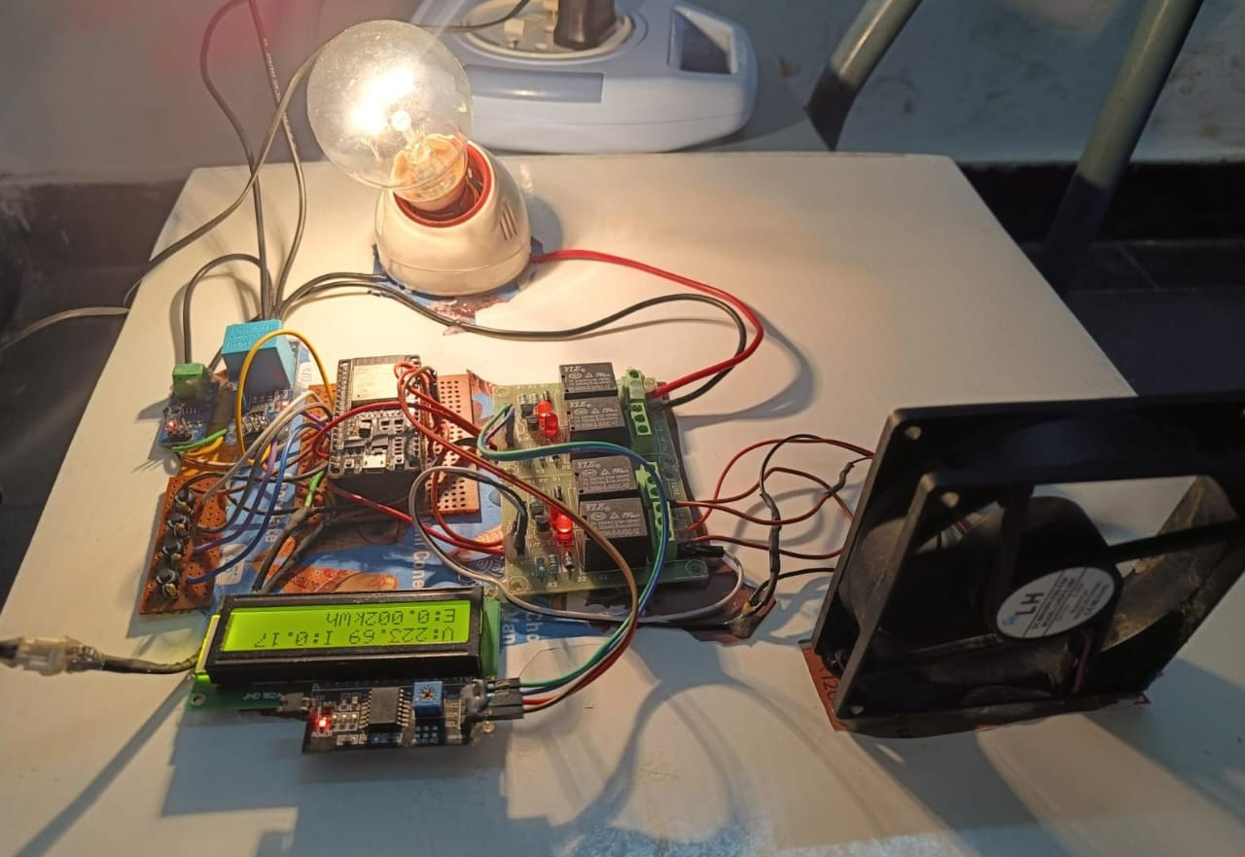
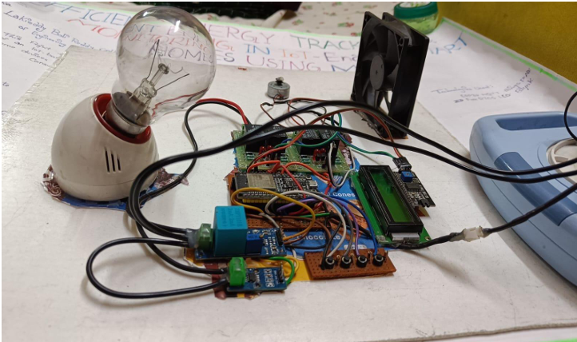
Implementation:

Slide 13
Implementation Flow:
System Initialization
Connectivity Setup
Task Scheduling (FreeRTOS)
ESP32 powers up
LCD initialized
WiFiManager launches → connects to local network
ESP32 connects to:
WiFi Network
HiveMQ MQTT Broker (broker.hivemq.com)
ThingSpeak Channel
Multitasking begins with:
mqttTask() → Listens for MQTT commands
energyMonitoringTask() → Calculates power
thingSpeakTask() → Publishes data every 20s

Slide 14
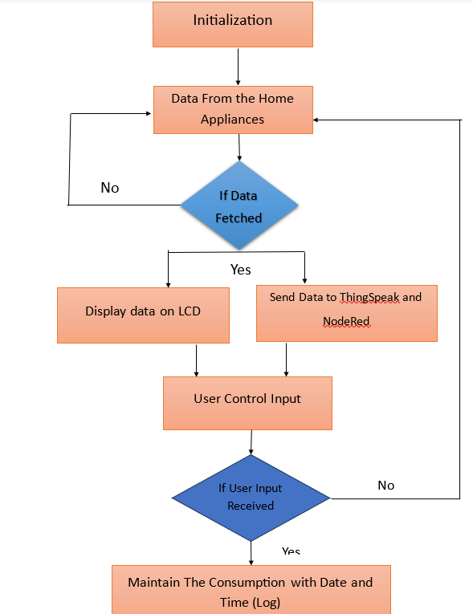
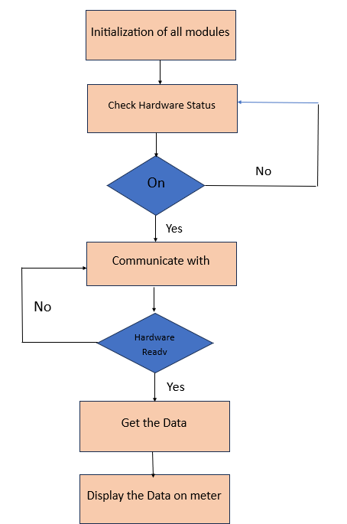
Process of Project:

Slide 15
Process of Project:
1. Initialization - The system initializes by setting up required parameters, including Wi-Fi, MQTT, and sensor conFigureureurations.
2. Data Collection from Appliances Network - The ESP32 collects real-time data from connected appliances.
3. Data Verification - If data is received, it is processed further; otherwise, the system waits for new data.
4. Display Data on LCD - The collected data is displayed on the LCD screen for local monitoring.
5. Data Transmission to EMS - The data is sent to the Energy Management System (EMS) for logging and analysis.
.

Slide 16
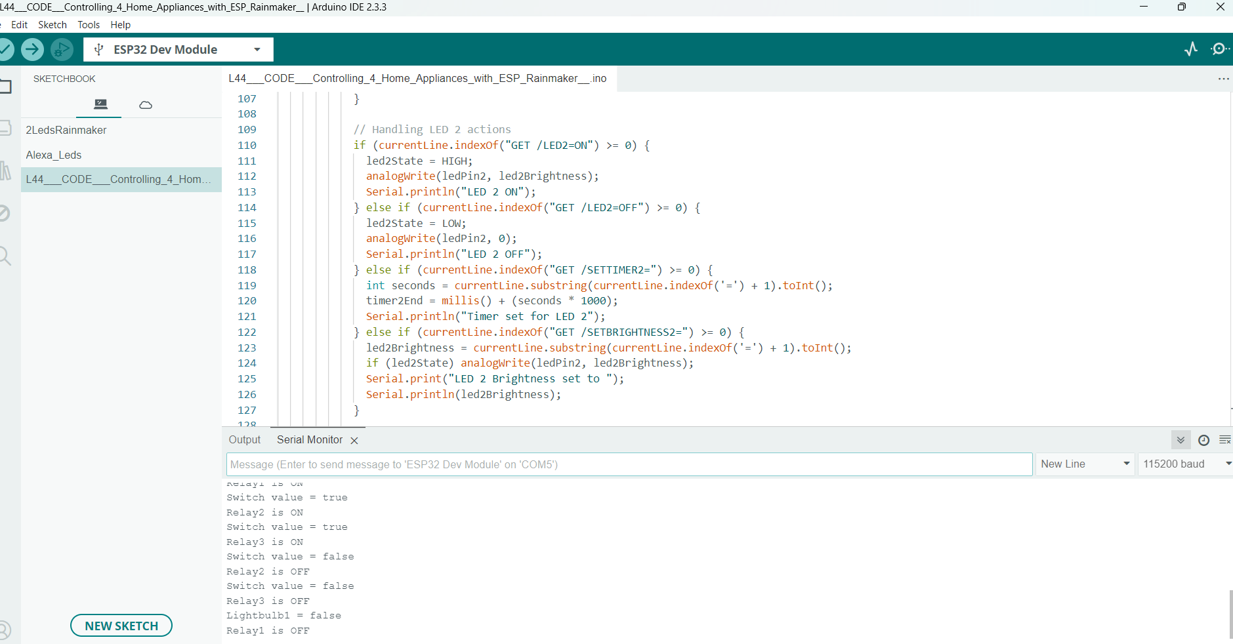
Arduino Uno Platform:

Slide 17
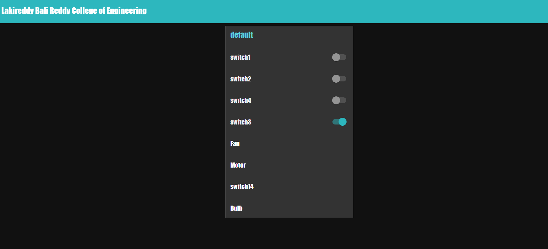
Node-red Interface:
The user interface for the smart home automation system was developed using Node- RED, enabling seamless control and monitoring of connected devices. The dashboard provides real-time status updates, allowing users to toggle appliances on/off, visualize power consumption trends, and analyze the relationship between date, time, and energy usage through integrated ThingSpeak charts and graphs. Additionally, it supports multiple control mechanisms, including voice commands via Google Assistant, manual switches, and mobile-based toggles. The UI enhances user experience with automated alerts, ensuring efficient energy management while maintaining ease of access and control from any device.

Slide 18
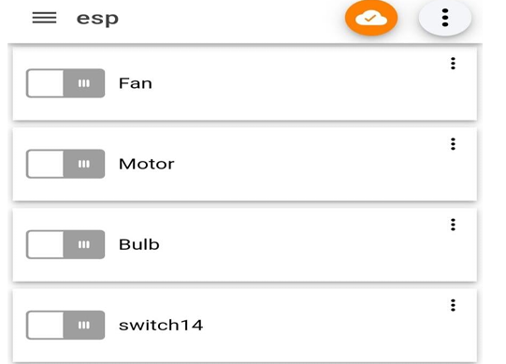
Process of Project:
7. User Input Verification - If user input is detected, the corresponding action is executed; otherwise, the system continues monitoring.
8. Data Logging - The system maintains logs of user interactions and energy data with date and time stamps for historical analysis.
.
Mobile app with Internet Connection

Slide 19
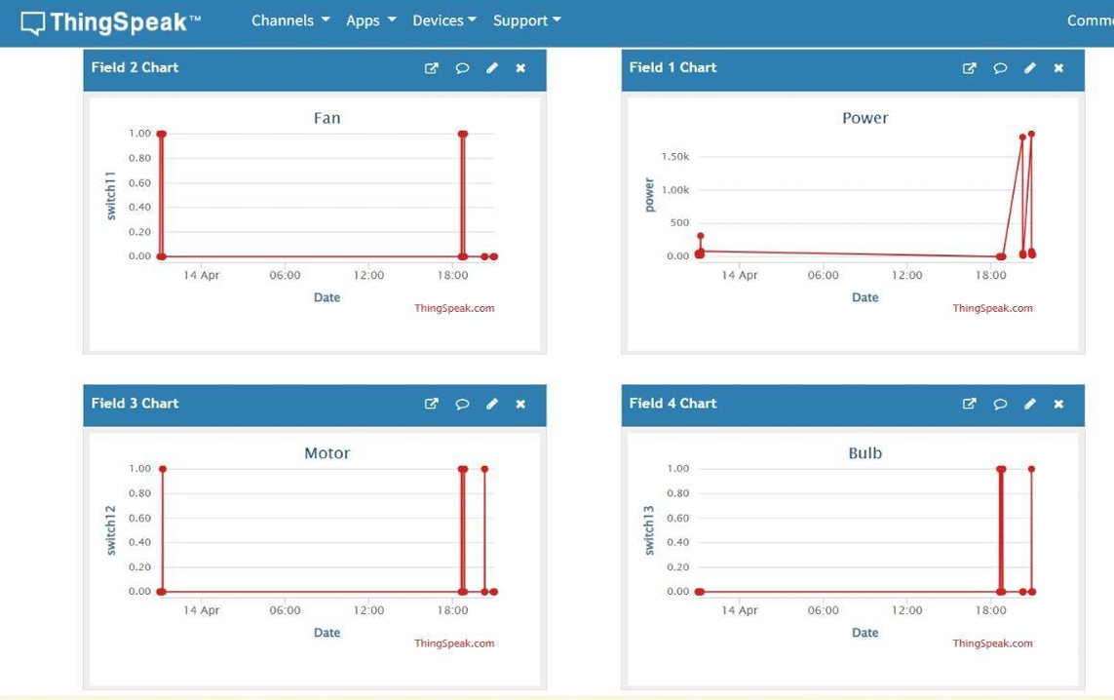
Charts and Visualizations
To analyze the power consumption pattern over time, the system logs real-time energy data to ThingSpeak, where it is visualized through various charts and graphs. The key observations from the collected data indicate the relationship between power consumption and date/time.
Time-Based Power Consumption Trends
Daily Power Usage Fluctuations

Slide 20
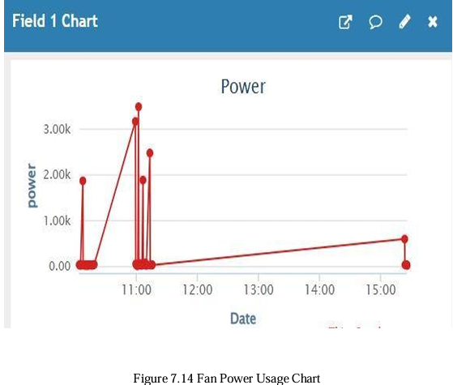
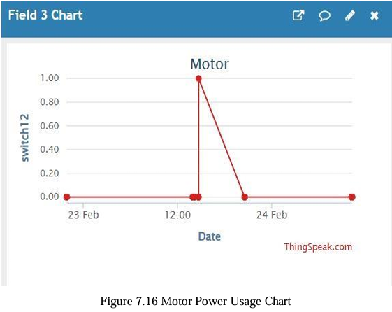
Energy Tracking:

Slide 21
Results And Discussion:
Insightful Energy Analytics: Real-time monitoring via ThingSpeak enabled users to track, analyze, and visualize energy usage patterns, helping identify inefficiencies and optimize appliance behavior over time.
Seamless Remote Control with MQTT: Integration with the HiveMQ MQTT broker enabled instantaneous (<1s) response times for remote appliance control through the web dashboard or mobile interface, ensuring a lag-free experience.
Reliable Manual Override: Even in the absence of internet connectivity, manual push-button control remained functional—ensuring continuous usability and flexibility in all scenarios.
Cost-Effective & User-Centric Design: The system strikes an ideal balance between energy efficiency and user convenience, enabling automation for non-smart devices without the need for expensive upgrades.

Slide 22
Conclusion:
The IoT-based smart home automation system offers a flexible, scalable, and energy-efficient solution for modern home management. By integrating manual and automated controls, real-time energy monitoring, and cloud-based analytics, it empowers users to optimize energy consumption and appliance usage. Built using the ESP32 microcontroller, Node-RED interface, and Aquila Optimization algorithm, the system demonstrated significant energy savings of up to 20% compared to manual operation. Features like remote control, real-time monitoring, and intelligent optimization enhance efficiency, convenience, and security. This system effectively addresses challenges related to peak load management and sustainable energy usage.

Slide 23
Future Work:
To enhance system capabilities and meet evolving smart home standards, the following improvements are proposed:
AI-Based Predictive Automation: Integration of machine learning algorithms to forecast usage patterns and automate control accordingly. Smart appliance learning based on user habits
Enhanced Security Features: Incorporating MQTT over TLS/SSL for encrypted communication. User authentication and access control for web/mobile dashboards.
Mobile Notifications: Push alerts for abnormal energy usage, connectivity issues, or device malfunctions.
Renewable Energy Integration: Adding support for solar panels or battery storage systems to optimize renewable energy consumption.

Slide 24
Acknowledgments:
I would like to express my sincere gratitude to the following individuals and institutions whose support was instrumental in completing this project:
Faculty Advisors and Project Mentors For their continuous guidance, technical insights, and encouragement throughout the development process.
Lakireddy Bali Reddy College of Engineering For providing the infrastructure, resources, and a collaborative environment essential for hands-on experimentation and innovation.
Open-source Communities and Developers Whose tools and libraries—especially Arduino Uno, Node-red, and ThingSpeak , documentations—played a vital role in implementation.

Slide 25
Thank You!
SAIKUMAR IKA
Email: ika.saikumar111@gmail.com
Paper ID: 137
Questions and discussions welcome!

