Slide 1
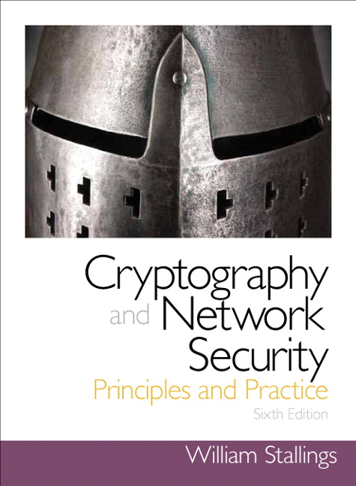
Chapter 13
第13章 数字签名
Digital Signatures
Notes:
The most important development from the work on public-key cryptography is the
digital signature. The digital signature provides a set of security capabilities that would
be difficult to implement in any other way.

Slide 2
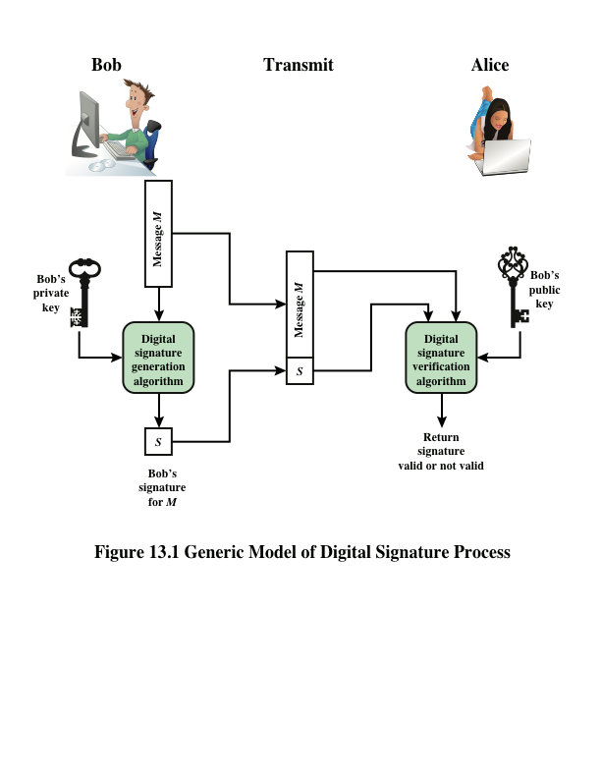
Notes:
Figure 13.1 is a generic model of the process of making and using digital signatures.
Bob can sign a message using a digital signature generation algorithm. The
inputs to the algorithm are the message and Bob’s private key. Any other user, say
Alice, can verify the signature using a verification algorithm, whose inputs are the
message, the signature, and Bob’s public key.

Slide 3
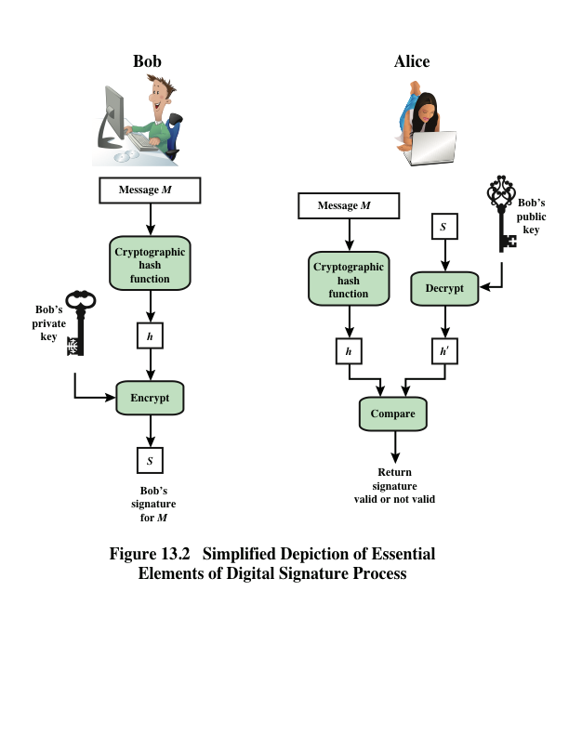
Notes:
In simplified terms, the essence of the
digital signature mechanism is shown in Figure 13.2. This repeats the logic shown in
Figure 11.4. A worked-out example, using RSA, is available at this book’s Premium
Content Web site.

Slide 4
Digital Signature Properties
It must verify the author and the date and time of the signature
It must authenticate the contents at the time of the signature
It must be verifiable by third parties, to resolve disputes
Notes:
Message authentication protects two parties who exchange messages from any third
party. However, it does not protect the two parties against each other. Several forms
of dispute between the two are possible.
In situations where there is not complete trust between sender and receiver,
something more than authentication is needed. The most attractive solution to
this problem is the digital signature. The digital signature must have the following
properties:
• It must verify the author and the date and time of the signature.
• It must authenticate the contents at the time of the signature.
• It must be verifiable by third parties, to resolve disputes.
Thus, the digital signature function includes the authentication function.

Slide 5
Attacks
Key-only attack
C only knows A’s public key
Known message attack
C is given access to a set of messages and their signatures
Generic chosen message attack
C chooses a list of messages before attempting to break A’s signature scheme, independent of A’s public key; C then obtains from A valid signatures for the chosen messages
Directed chosen message attack
Similar to the generic attack, except that the list of messages to be signed is chosen after C knows A’s public key but before any signatures are seen
Adaptive chosen message attack
C may request from A signatures of messages that depend on previously obtained message-signature pairs
Notes:
[GOLD88] lists the following types of attacks, in order of increasing severity. Here
A denotes the user whose signature method is being attacked, and C denotes the
attacker.
• Key-only attack: C only knows A’s public key.
• Known message attack: C is given access to a set of messages and their
signatures.
• Generic chosen message attack: C chooses a list of messages before attempting
to breaks A’s signature scheme, independent of A’s public key. C then
obtains from A valid signatures for the chosen messages. The attack is generic,
because it does not depend on A’s public key; the same attack is used against
everyone.
• Directed chosen message attack: Similar to the generic attack, except that the
list of messages to be signed is chosen after C knows A’s public key but before
any signatures are seen.
• Adaptive chosen message attack: C is allowed to use A as an “oracle.” This
means that C may request from A signatures of messages that depend on previously
obtained message-signature pairs.

Slide 6
Forgeries
Total break
C determines A’s private key
Universal forgery
C finds an efficient signing algorithm that provides an equivalent way of constructing signatures on arbitrary messages
Selective forgery
C forges a signature for a particular message chosen by C
Existential forgery
C forges a signature for at least one message; C has no control over the message
Notes:
[GOLD88] then defines success at breaking a signature scheme as an outcome
in which C can do any of the following with a non-negligible probability:
• Total break: C determines A’s private key.
• Universal forgery: C finds an efficient signing algorithm that provides an
equivalent way of constructing signatures on arbitrary messages.
• Selective forgery: C forges a signature for a particular message chosen by C.
• Existential forgery: C forges a signature for at least one message. C has no
control over the message. Consequently, this forgery may only be a minor nuisance
to A.

Slide 7
Digital Signature Requirements
The signature must be a bit pattern that depends on the message being signed
The signature must use some information unique to the sender to prevent both forgery and denial
It must be relatively easy to produce the digital signature
It must be relatively easy to recognize and verify the digital signature
It must be computationally infeasible to forge a digital signature, either by constructing a new message for an existing digital signature or by constructing a fraudulent digital signature for a given message
It must be practical to retain a copy of the digital signature in storage
Notes:
On the basis of the properties and attacks just discussed, we can formulate the following
requirements for a digital signature.
• The signature must be a bit pattern that depends on the message being signed.
• The signature must use some information unique to the sender to prevent
both forgery and denial.
• It must be relatively easy to produce the digital signature.
• It must be relatively easy to recognize and verify the digital signature.
• It must be computationally infeasible to forge a digital signature, either by
constructing a new message for an existing digital signature or by constructing
a fraudulent digital signature for a given message.
• It must be practical to retain a copy of the digital signature in storage.
A secure hash function, embedded in a scheme such as that of Figure 13.2, provides
a basis for satisfying these requirements. However, care must be taken in the design
of the details of the scheme.

Slide 8
Direct Digital Signature
Refers to a digital signature scheme that involves only the communicating parties
It is assumed that the destination knows the public key of the source
Confidentiality can be provided by encrypting the entire message plus signature with a shared secret key
It is important to perform the signature function first and then an outer confidentiality function
In case of dispute some third party must view the message and its signature
The validity of the scheme depends on the security of the sender’s private key
If a sender later wishes to deny sending a particular message, the sender can claim that the private key was lost or stolen and that someone else forged his or her signature
One way to thwart or at least weaken this ploy is to require every signed message to include a timestamp and to require prompt reporting of compromised keys to a central authority
Notes:
The term direct digital signature refers to a digital signature scheme that involves
only the communicating parties (source, destination). It is assumed that the destination
knows the public key of the source.
Confidentiality can be provided by encrypting the entire message plus signature
with a shared secret key (symmetric encryption). Note that it is important to
perform the signature function first and then an outer confidentiality function. In
case of dispute, some third party must view the message and its signature. If the signature
is calculated on an encrypted message, then the third party also needs access
to the decryption key to read the original message. However, if the signature is the
inner operation, then the recipient can store the plaintext message and its signature
for later use in dispute resolution.
The validity of the scheme just described depends on the security of the sender’s
private key. If a sender later wishes to deny sending a particular message, the sender
can claim that the private key was lost or stolen and that someone else forged his or her
signature. Administrative controls relating to the security of private keys can be employed
to thwart or at least weaken this ploy, but the threat is still there, at least to some
degree. One example is to require every signed message to include a timestamp (date
and time) and to require prompt reporting of compromised keys to a central authority.
Another threat is that some private key might actually be stolen from X
at time T. The opponent can then send a message signed with X’s signature and
stamped with a time before or equal to T.
The universally accepted technique for dealing with these threats is the use
of a digital certificate and certificate authorities. We defer a discussion of this topic
until Chapter 14, and focus in this chapter on digital signature algorithms.

Slide 9
ElGamal Digital Signature
Scheme involves the use of the private key for encryption and the public key for decryption
Global elements are a prime number q and a, which is a primitive root of q
Use private key for encryption (signing)
Uses public key for decryption (verification)
Each user generates their key
Chooses a secret key (number): 1 < x_{A} < q-1
Compute their public key: y_{A} = a^{xA} mod q
Notes:
Before examining the NIST Digital Signature Algorithm, it will be helpful to understand
the Elgamal and Schnorr signature schemes . Recall from Chapter 10, that
the Elgamal encryption scheme is designed to enable encryption by a user’s public
key with decryption by the user’s private key. The Elgamal signature scheme involves
the use of the private key for encryption and the public key for decryption
[ELGA84, ELGA85].
As with Elgamal encryption, the global elements of Elgamal digital signature
are a prime number q and a, which is a primitive root of q .

Slide 10
Schnorr Digital Signature
Scheme is based on discrete logarithms
Minimizes the message-dependent amount of computation required to generate a signature
Multiplying a 2n-bit integer with an n-bit integer
Main work can be done during the idle time of the processor
Based on using a prime modulus p, with p – 1 having a prime factor q of appropriate size
Typically p is a 1024-bit number, and q is a 160-bit number
Notes:
As with the ElGamal digital signature scheme, the Schnorr signature scheme is based on discrete logarithms [SCHN89, SCHN91]. The Schnorr scheme minimizes the message dependent amount of computation required to generate a signature. The main work for signature generation does not depend on the message and can be done during the idle time of the processor. The message dependent part of the signature generation requires multiplying a 2n-bit integer with an n-bit integer. The scheme is based on using a prime modulus p, with p – 1 having a prime factor q of appropriate size; that is p – 1 = 1 (mod q). Typically, we use p approx 2¹⁰²⁴ and q approx 2¹⁶⁰. Thus, p is a 1024-bit number and q is a 160-bit number, which is also the length of the SHA-1 hash value.

Slide 11
NIST Digital Signature Algorithm
Published by NIST as Federal Information Processing Standard FIPS 186
Makes use of the Secure Hash Algorithm (SHA)
The latest version, FIPS 186-3, also incorporates digital signature algorithms based on RSA and on elliptic curve cryptography
Notes:
The National Institute of Standards and Technology (NIST) has published
Federal Information Processing Standard FIPS 186, known as the Digital
Signature Algorithm (DSA). The DSA makes use of the Secure Hash
Algorithm (SHA) described in Chapter 12. The DSA was originally proposed
in 1991 and revised in 1993 in response to public feedback concerning the security
of the scheme. There was a further minor revision in 1996. In 2000, an
expanded version of the standard was issued as FIPS 186-2, subsequently updated
to FIPS 186-3 in 2009. This latest version also incorporates digital signature
algorithms based on RSA and on elliptic curve cryptography. In this
section, we discuss DSA.

Slide 12
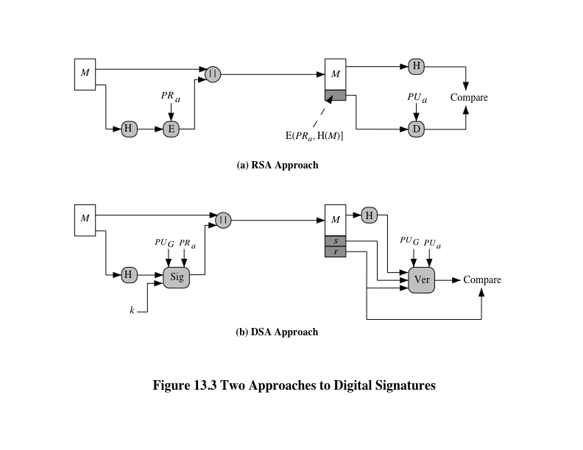
Notes:
The DSA uses an algorithm that is designed to provide only the digital signature
function. Unlike RSA, it cannot be used for encryption or key exchange.
Nevertheless, it is a public-key technique.
Figure 13.3 contrasts the DSA approach for generating digital signatures to
that used with RSA. In the RSA approach, the message to be signed is input to a
hash function that produces a secure hash code of fixed length. This hash code is
then encrypted using the sender’s private key to form the signature. Both the message
and the signature are then transmitted. The recipient takes the message and
produces a hash code. The recipient also decrypts the signature using the sender’s
public key. If the calculated hash code matches the decrypted signature, the signature
is accepted as valid. Because only the sender knows the private key, only the
sender could have produced a valid signature.
The DSA approach also makes use of a hash function. The hash code is provided
as input to a signature function along with a random number k generated
for this particular signature. The signature function also depends on the sender’s
private key (PR_{a} ) and a set of parameters known to a group of communicating principals.
We can consider this set to constitute a global public key (PU_{G} ). The result
is a signature consisting of two components, labeled s and r .
At the receiving end, the hash code of the incoming message is generated. This
plus the signature is input to a verification function. The verification function also
depends on the global public key as well as the sender’s public key (PU_{a} ), which
is paired with the sender’s private key. The output of the verification function is a
value that is equal to the signature component r if the signature is valid. The signature
function is such that only the sender, with knowledge of the private key, could
have produced the valid signature.

Slide 13
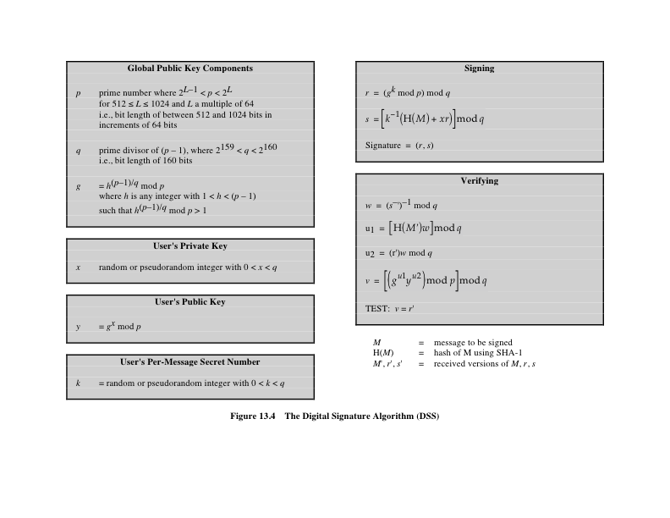
Notes:
The DSA is based on the difficulty of computing discrete logarithms (see Chapter 8)
and is based on schemes originally presented by Elgamal [ELGA85] and Schnorr
[SCHN91].
Figure 13.4 summarizes the algorithm.

Slide 14
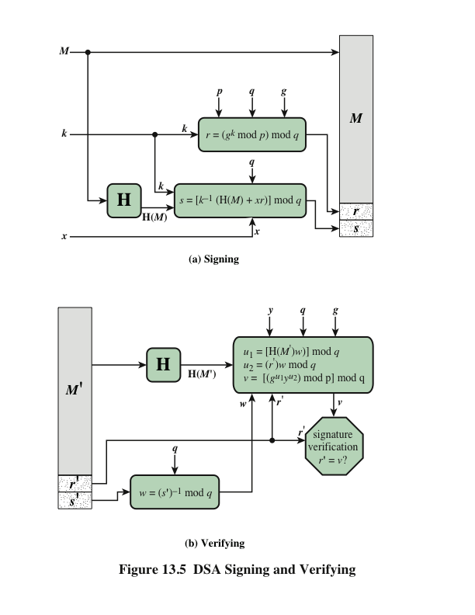
DSA Signing and Verifying
Notes:
Figure 13.5 depicts the functions of signing and verifying.
The structure of the algorithm, as revealed in Figure 13.5, is quite interesting.
Note that the test at the end is on the value r , which does not depend on the message
at all. Instead, r is a function of k and the three global public-key components. The
multiplicative inverse of k (mod q ) is passed to a function that also has as inputs
the message hash code and the user’s private key. The structure of this function is
such that the receiver can recover r using the incoming message and signature, the
public key of the user, and the global public key. It is certainly not obvious from
Figure 13.4 or Figure 13.5 that such a scheme would work. A proof is provided in
Appendix K.

Slide 15
Elliptic Curve Digital Signature Algorithm (ECDSA)
Four elements are involved:
All those participating in the digital signature scheme use the same global domain parameters, which define an elliptic curve and a point of origin on the curve
A signer must first generate a public, private key pair
A hash value is generated for the message to be signed; using the private key, the domain parameters, and the hash value, a signature is generated
To verify the signature, the verifier uses as input the signer’s public key, the domain parameters, and the integer s; the output is a value v that is compared to r ; the signature is verified if the v = r
Notes:
As was mentioned, the 2009 version of FIPS 186 includes a new digital signature
technique based on elliptic curve cryptography, known as the Elliptic Curve Digital
Signature Algorithm (ECDSA). ECDSA is enjoying increasing acceptance due to
the efficiency advantage of elliptic curve cryptography, which yields security comparable
to that of other schemes with a smaller key bit length.
First we give a brief overview of the process involved in ECDSA. In essence,
four elements are involved.
1. All those participating in the digital signature scheme use the same global domain
parameters, which define an elliptic curve and a point of origin on the curve.
2. A signer must first generate a public, private key pair. For the private key, the
signer selects a random or pseudorandom number. Using that random number
and the point of origin, the signer computes another point on the elliptic curve.
This is the signer’s public key.
3. A hash value is generated for the message to be signed. Using the private key,
the domain parameters, and the hash value, a signature is generated. The signature
consists of two integers, r and s.
4. To verify the signature, the verifier uses as input the signer’s public key, the
domain parameters, and the integer s. The output is a value v that is compared
to r. The signature is verified if the v = r.

Slide 16
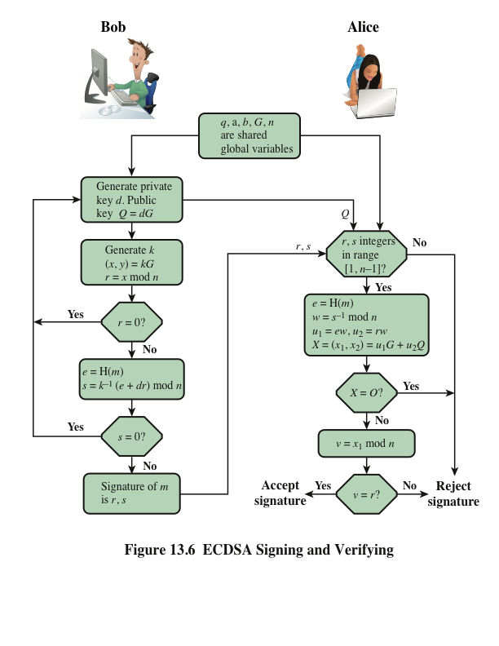
Notes:
Figure 13.6 illustrates the signature authentication process.

Slide 17
RSA-PSS
RSA Probabilistic Signature Scheme
Included in the 2009 version of FIPS 186
Latest of the RSA schemes and the one that RSA Laboratories recommends as the most secure of the RSA schemes
For all schemes developed prior to PSS is has not been possible to develop a mathematical proof that the signature scheme is as secure as the underlying RSA encryption/decryption primitive
The PSS approach was first proposed by Bellare and Rogaway
This approach, unlike the other RSA-based schemes, introduces a randomization process that enables the security of the method to be shown to be closely related to the security of the RSA algorithm itself
Notes:
In addition to the NIST Digital Signature Algorithm and ECDSA, the 2009 version
of FIPS 186 also includes several techniques based on RSA, all of which were
developed by RSA Laboratories and are in wide use. In this section, we discuss the
RSA Probabilistic Signature Scheme (RSA-PSS), which is the latest of the RSA
schemes and the one that RSA Laboratories recommends as the most secure of the
RSA schemes.
Because the RSA-based schemes are widely deployed in many applications,
including financial applications, there has been great interest in demonstrating that
such schemes are secure. The three main RSA signature schemes differ mainly in
the padding format the signature generation operation employs to embed the hash
value into a message representative, and in how the signature verification operation
determines that the hash value and the message representative are consistent.
For all of the schemes developed prior to PSS, it has not been possible to develop
a mathematical proof that the signature scheme is as secure as the underlying RSA
encryption/decryption primitive [KALI01]. The PSS approach was first proposed
by Bellare and Rogaway [BELL96c, BELL98]. This approach, unlike the other
RSA-based schemes, introduces a randomization process that enables the security
of the method to be shown to be closely related to the security of the RSA algorithm
itself. This makes RSA-PSS more desirable as the choice for RSA-based digital signature
applications.

Slide 18
Mask Generation Function (MGF)
Typically based on a secure cryptographic hash function such as SHA-1
Is intended to be a cryptographically secure way of generating a message digest, or hash, of variable length based on an underlying cryptographic hash function that produces a fixed-length output
Notes:
Before explaining the RSA-PSS operation, we need to describe the mask generation
function (MGF) used as a building block. MGF(X , maskLen ) is a pseudorandom
function that has as input parameters a bit string X of any length and the desired
length L in octets of the output. MGFs are typically based on a secure cryptographic
hash function such as SHA-1. An MGF based on a hash function is intended to be
a cryptographically secure way of generating a message digest, or hash, of variable
length based on an underlying cryptographic hash function that produces a fixed-length
output.

Slide 19
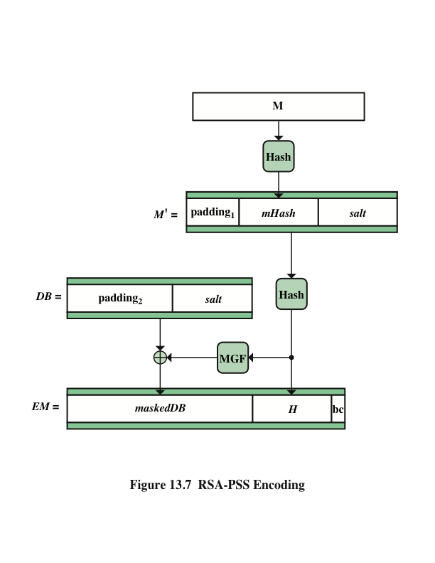
Notes:
The first stage in generating an RSA-PSS signature of a message
M is to generate from M a fixed-length message digest, called an encoded message
(EM ). Figure 13.7 illustrates this process.
We make several comments about the complex nature of this message digest
algorithm. All of the RSA-based standardized digital signature schemes involve appending
one or more constants (e.g., padding₁ and padding₂ ) in the process of forming
the message digest. The objective is to make it more difficult for an adversary to
find another message that maps to the same message digest as a given message or to
find two messages that map to the same message digest. RSA-PSS also incorporates
a pseudorandom number, namely the salt. Because the salt changes with every use,
signing the same message twice using the same private key will yield two different
signatures. This is an added measure of security.

Slide 20
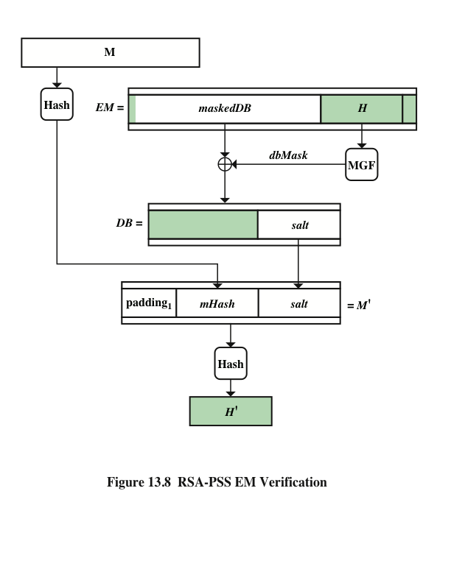
Notes:
Figure 13.8 RSA-PSS EM Verification

Slide 21
Summary
Digital signatures
Properties
Attacks and forgeries
Digital signature requirements
Direct digital signature
Elgamal digital signature scheme
RSA-PSS
Mask generation function
The signing operation
Signature verification
NIST digital signature algorithm
The DSA approach
Elliptic curve digital signature algorithm
Global domain parameters
Key generation
Digital signature generation and authentication
Schnorr digital signature scheme
Notes:
Chapter 13 summary.

Slide 23
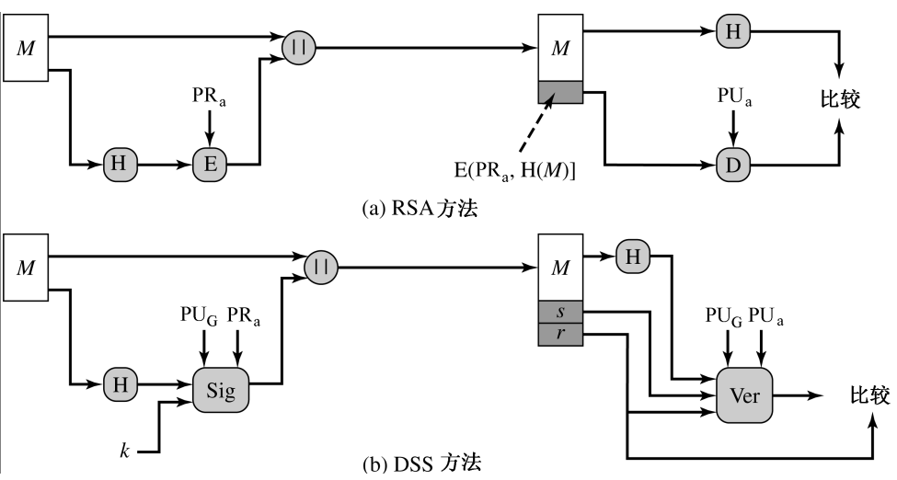
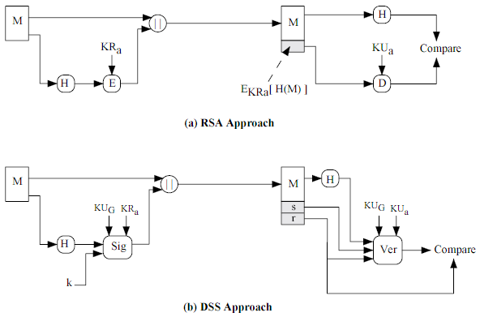
图示 RSA vs. DSS

Slide 24
DSA
准备
素数p，约512＋比特；
素数q，约160比特，要求是p-1的因子
选择g＝h^(p-1/q) mod p
密钥
用户私钥x，x<q
公钥y，y＝g^x mod p
签名，对报文M
产生随机数k
r＝(g^k mod p) mod q
s= k⁻¹ (H(M)+xr) mod q
(r，s)即是签名，连同明文的M
验证，测试是否v＝r’，其中
v＝g^u1×y^u2 mod p mod q
u1＝H(M’) ×s’⁻¹ mod q
u2＝r’×s’⁻¹ mod q

Slide 25
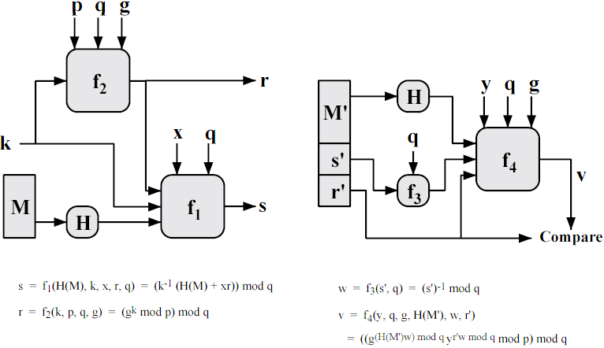
DSA Figure

Slide 26
练习：DSA算法 in OpenSSL
OpenSSL支持DSA签名算法
请练习给出使用DSA签名的例子程序，演示：
DSA密钥产生
对文件签名
验证
Notes:
OpenSLL

