Slide 1

Cryptography and Network Security
Sixth Edition
by William Stallings
Notes:
Lecture slides prepared for “Cryptography and Network Security”, 6/e, by William Stallings, Chapter 4 – “Basic Concepts in Number Theory and Finite Fields”.

Slide 2
Chapter 4
Basic Concepts in Number Theory and Finite Fields
Notes:
Finite fields have become increasingly important in cryptography. A number of cryptographic
algorithms rely heavily on properties of finite fields, notably the Advanced
Encryption Standard (AES) and elliptic curve cryptography. Other examples include
the message authentication code CMAC and the authenticated encryption
scheme GCM.
This chapter provides the reader with sufficient background on the concepts of
finite fields to be able to understand the design of AES and other cryptographic algorithms
that use finite fields. The first three sections introduce basic concepts from number
theory that are needed in the remainder of the chapter; these include divisibility,
the Euclidian algorithm, and modular arithmetic. Next comes a brief overview of the
concepts of group, ring, and field. This section is somewhat abstract; the reader may
prefer to quickly skim this section on a first reading. We are then ready to discuss finite
fields of the form GF(p ), where p is a prime number. Next, we need some additional
background, this time in polynomial arithmetic. The chapter concludes with a discussion
of finite fields of the form GF(2^{n} ), where n is a positive integer.

Slide 3
“Mathematics has long been known in the printing trade as difficult, or penalty, copy because it is slower, more difficult, and more expensive to set in type than any other kind of copy.”
—Chicago Manual of Style,
14th Edition
Notes:
The concepts and techniques of number theory are quite abstract, and it is
often difficult to grasp them intuitively without examples. Accordingly, this chapter
and Chapter 8 include a number of examples, each of which is highlighted in a
shaded box.

Slide 4
Divisibility
We say that a nonzero b divides a if a = mb for some m, where a, b, and m are integers
b divides a if there is no remainder on division
The notation b | a is commonly used to mean b divides a
If b | a we say that b is a divisor of a
The positive divisors of 24 are 1, 2, 3, 4, 6, 8, 12, and 24
13 | 182; - 5 | 30; 17 | 289; - 3 | 33; 17 | 0
Notes:
We say that a nonzero b divides a if a=mb for some m, where a, b, and m are integers. That is, b divides a if there is no remainder on division.
The notation b | a is commonly used to mean b divides a . Also, if b | a , we say that b is a divisor of a .

Slide 5
Properties of Divisibility
If a | 1, then a = ±1
If a | b and b | a, then a = ±b
Any b ≠ 0 divides 0
If a | b and b | c, then a | c
If b | g and b | h, then b | (mg + nh) for arbitrary integers m and n
11 | 66 and 66 | 198 = 11 | 198
Notes:
Subsequently, we will need some simple properties of divisibility for integers, which are as follows:
• If a|1, then a = ±1.
• If a|b and b|a, then a = ±b.
• Any b ≠ 0 divides 0.
• If a | b and b | c, then a | c
• If b|g and b|h, then b|(mg + nh) for arbitrary integers m and n.

Slide 6
Properties of Divisibility
To see this last point, note that:
If b | g , then g is of the form g = b * g₁ for some integer g₁
If b | h , then h is of the form h = b * h₁ for some integer h₁
So:
mg + nh = mbg₁ + nbh₁ = b * (mg₁ + nh₁ )
and therefore b divides mg + nh
b = 7; g = 14; h = 63; m = 3; n = 2
7 | 14 and 7 | 63.
To show 7 (3 * 14 + 2 * 63),
we have (3 * 14 + 2 * 63) = 7(3 * 2 + 2 * 9),
and it is obvious that 7 | (7(3 * 2 + 2 * 9)).
Notes:
To see this last point, note that
• If b | g , then g is of the form g = b * g₁ for some integer g₁ .
• If b | h , then h is of the form h = b * h₁ for some integer h₁ .
So
mg + nh = mbg₁ + nbh₁ = b * (mg₁ + nh₁ )
and therefore b divides mg + nh .

Slide 7
Division Algorithm
Given any positive integer n and any nonnegative integer a, if we divide a by n we get an integer quotient q and an integer remainder r that obey the following relationship:
a = qn + r 0 ≤ r < n; q = [a/n]
Notes:
Given any positive integer n and any nonnegative integer a, if we divide a by n, we get an integer quotient q and an integer remainder r that obey the following relationship:
a = qn + r, 0 ≤ r < n; q = [a/n] which is referred to as the division algorithm.

Slide 8
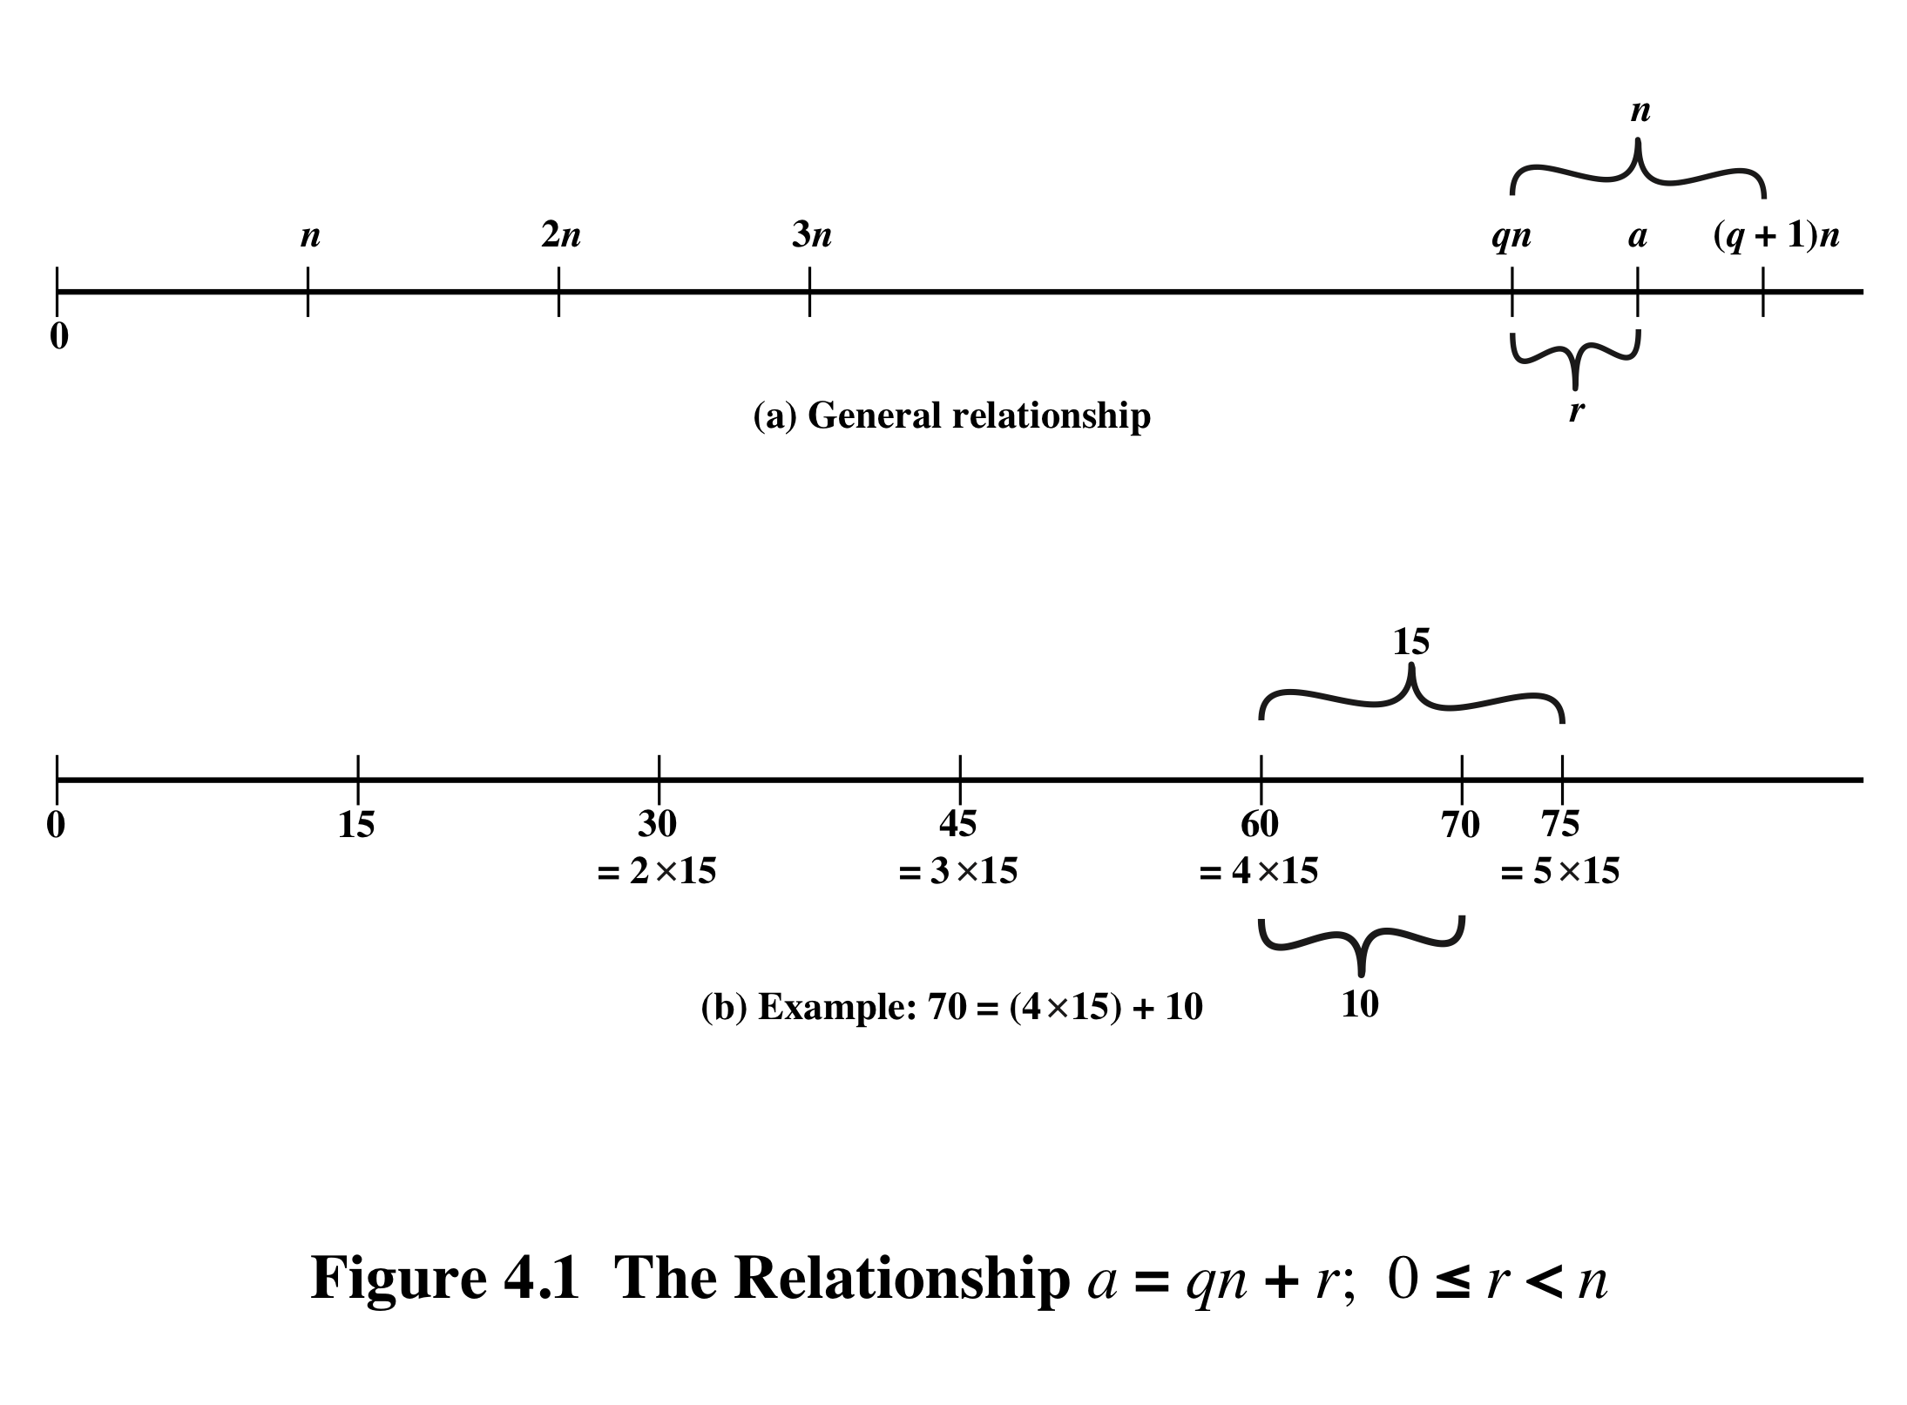
Notes:
Figure 4.1a demonstrates that, given a and positive n, it is always possible to find q and r that satisfy the preceding relationship. Represent the integers on the number line; a will fall somewhere on that line (positive a is shown, a similar demonstration can be made for negative a). Starting at 0, proceed to n, 2n, up to qn such that qn ≤ a and (q + 1)n > a. The distance from qn to a is r, and we have found the unique values of q and r. The remainder r is often referred to as a residue .
For example:
a = 11; n = 7; 11 = 1 x 7 + 4; r = 4 q = 1
a = –11; n = 7; –11 = (–2) x 7 + 3; r = 3 q = –2
Figure 4.1b provides another example.

Slide 9
Euclidean Algorithm
One of the basic techniques of number theory
Procedure for determining the greatest common divisor of two positive integers
Two integers are relatively prime if their only common positive integer factor is 1
Notes:
One of the basic techniques of number theory is the Euclidean algorithm, which
is a simple procedure for determining the greatest common divisor of two positive
integers. First, we need a simple definition: Two integers are relatively prime if their
only common positive integer factor is 1.

Slide 10
Greatest Common Divisor (GCD)
The greatest common divisor of a and b is the largest integer that divides both a and b
We can use the notation gcd(a,b) to mean the greatest common divisor of a and b
We also define gcd(0,0) = 0
Positive integer c is said to be the gcd of a and b if:
c is a divisor of a and b
Any divisor of a and b is a divisor of c
An equivalent definition is:
gcd(a,b) = max[k, such that k | a and k | b]
Notes:
Recall that nonzero b is defined to be a divisor of a if a = mb for some m , where a , b , and
m are integers. We will use the notation gcd(a , b ) to mean the greatest common divisor
of a and b . The greatest common divisor of a and b is the largest integer that divides
both a and b . We also define gcd(0, 0) = 0.
More formally, the positive integer c is said to be the greatest common divisor
of a and b if
1. c is a divisor of a and of b .
2. Any divisor of a and b is a divisor of c .
An equivalent definition is the following:
gcd(a , b ) = max[k , such that k | a and k | b ]

Slide 11
GCD
Because we require that the greatest common divisor be positive, gcd(a,b) = gcd(a,-b) = gcd(-a,b) = gcd(-a,-b)
In general, gcd(a,b) = gcd(| a |, | b |)
Also, because all nonzero integers divide 0, we have gcd(a,0) = | a |
We stated that two integers a and b are relatively prime if their only common positive integer factor is 1; this is equivalent to saying that a and b are relatively prime if gcd(a,b) = 1
gcd(60, 24) = gcd(60, - 24) = 12
8 and 15 are relatively prime because the positive divisors of 8 are 1, 2, 4, and 8, and the positive divisors of 15 are 1, 3, 5, and 15. So 1 is the only integer on both lists.
Notes:
Because we require that the greatest common divisor be positive, gcd(a , b ) =
gcd(a , -b ) = gcd(-a , b ) = gcd(-a ,-b ). In general, gcd(a , b ) = gcd( | a | , | b | ).
Also, because all nonzero integers divide 0, we have gcd(a , 0) = a .
We stated that two integers a and b are relatively prime if their only common
positive integer factor is 1. This is equivalent to saying that a and b are relatively
prime if gcd(a , b ) = 1.

Slide 12
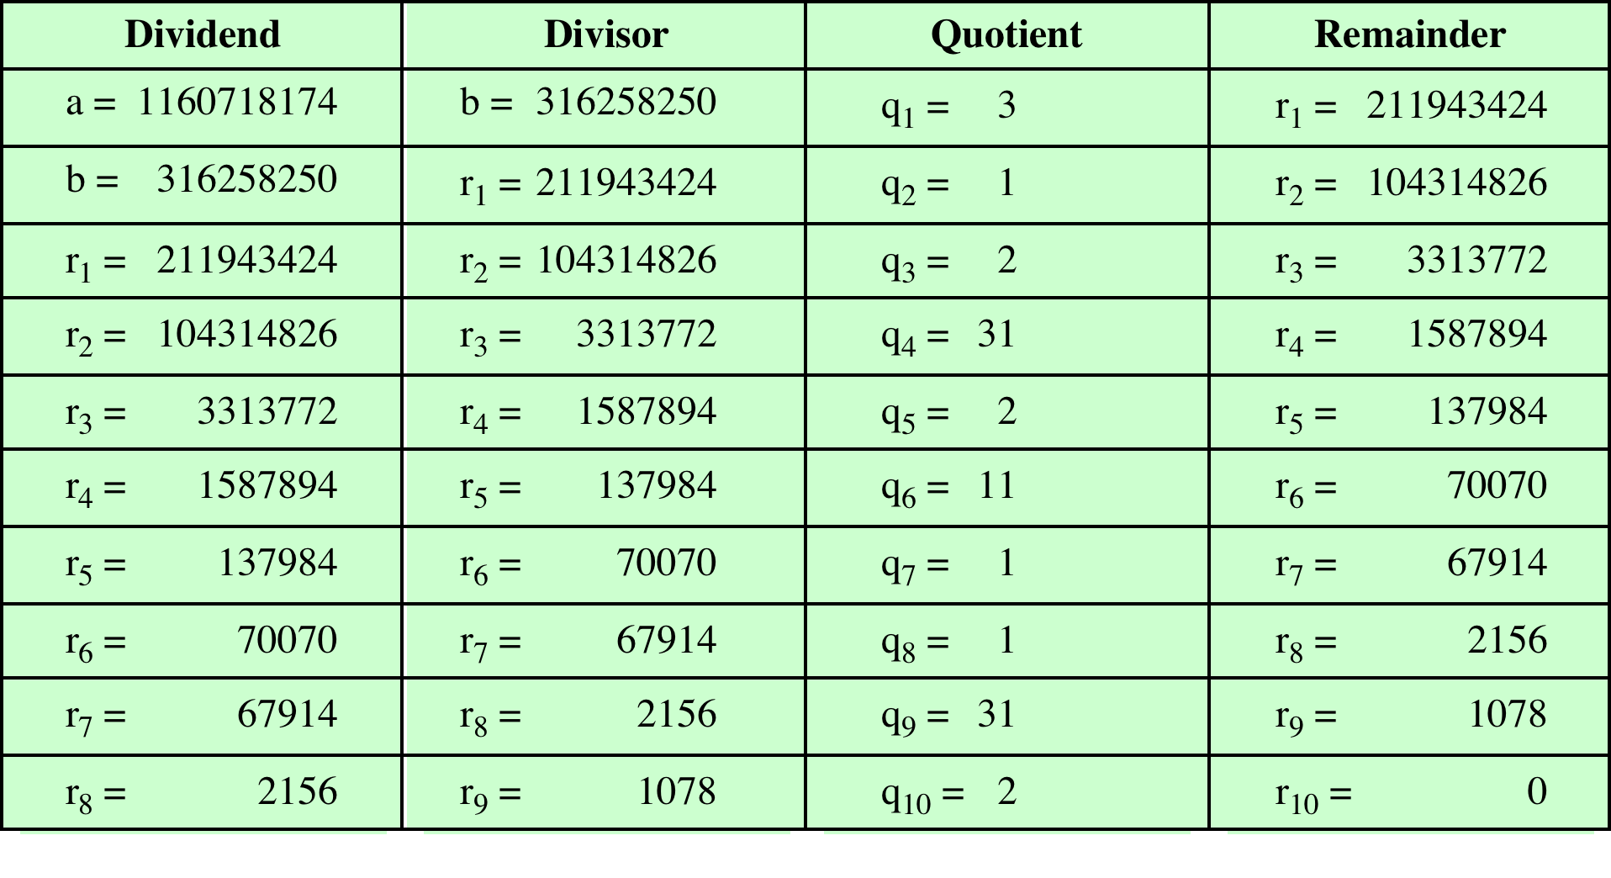
Table 4.1 Euclidean Algorithm Example
(This table can be found on page 91 in the textbook)
Notes:
In this example, we begin by dividing 1160718174 by 316258250, which gives 3
with a remainder of 211943424. Next we take 316258250 and divide it by 211943424.
The process continues until we get a remainder of 0, yielding a result of 1078.

Slide 13
Modular Arithmetic
The modulus
If a is an integer and n is a positive integer, we define a mod n to be the remainder when a is divided by n; the integer n is called the modulus
thus, for any integer a:
a = qn + r 0 ≤ r < n; q = [a/ n]
a = [a/ n] * n + ( a mod n)
11 mod 7 = 4; - 11 mod 7 = 3
Notes:
If a is an integer and n is a positive integer, we define a mod n to be the remainder
when a is divided by n . The integer n is called the modulus . Thus, for any integer a:
a = qn + r 0 ≤ r < n; q = [ a/ n]
a = [a/ n] * n + ( a mod n)

Slide 14
Modular Arithmetic
Congruent modulo n
Two integers a and b are said to be congruent modulo n if (a mod n) = (b mod n)
This is written as a = b(mod n)²
Note that if a = 0(mod n), then n | a
73 = 4 (mod 23); 21 = - 9 (mod 10)
Notes:
Two integers a and b are said to be congruent modulo n , if (a mod n ) =
(b mod n ). This is written as a K b (mod n ).²
Note that if a = 0 (mod n ), then n | a .

Slide 15
Properties of Congruences
Congruences have the following properties:
1. a = b (mod n) if n (a – b)
2. a = b (mod n) implies b = a (mod n)
3. a = b (mod n) and b = c (mod n) imply a = c (mod n)
To demonstrate the first point, if n (a - b), then (a - b) = kn for some k
So we can write a = b + kn
Therefore, (a mod n) = (remainder when b + kn is divided by n) = (remainder when b is divided by n) = (b mod n)
23 = 8 (mod 5) because 23 - 8 = 15 = 5 * 3
- 11 = 5 (mod 8) because - 11 - 5 = - 16 = 8 * (- 2)
81 = 0 (mod 27) because 81 - 0 = 81 = 27 * 3
Notes:
Congruences have the following properties:
1. a = b (mod n) if n (a – b)
2. a = b (mod n) implies b = a (mod n)
3. a = b (mod n) and b = c (mod n) imply a = c (mod n)
To demonstrate the first point, if n (a - b), then (a - b) = kn for some k
So we can write a = b + kn
Therefore, (a mod n) = (remainder when b + kn is divided by n) = (remainder when b is divided by n) = (b mod n)

Slide 16
Modular Arithmetic
Modular arithmetic exhibits the following properties:
1. [(a mod n) + (b mod n)] mod n = (a + b) mod n
2. [(a mod n) - (b mod n)] mod n = (a - b) mod n
3. [(a mod n) * (b mod n)] mod n = (a * b) mod n
We demonstrate the first property:
Define (a mod n) = r_{a} and (b mod n) = r_{b}. Then we can write a = r_{a} + jn for some integer j and b = r_{b} + kn for some integer k
Then:
(a + b) mod n = (ra + jn + rb + kn) mod n
= (ra + rb + (k + j)n) mod n
= (ra + rb) mod n
= [(a mod n) + (b mod n)] mod n
Notes:
Modular arithmetic exhibits the following properties:
1. [(a mod n) + (b mod n)] mod n = (a + b) mod n
2. [(a mod n) - (b mod n)] mod n = (a - b) mod n
3. [(a mod n) * (b mod n)] mod n = (a * b) mod n
We demonstrate the first property:
Define (a mod n) = r_{a} and (b mod n) = r_{b}. Then we can write a = r_{a} + jn for some integer j and b = r_{b} + kn for some integer k.
Then:
(a + b) mod n = (ra + jn + rb + kn) mod n
= (ra + rb + (k + j)n) mod n
= (ra + rb) mod n
= [(a mod n) + (b mod n)] mod n

Slide 17
Remaining Properties:
Examples of the three remaining properties:
11 mod 8 = 3; 15 mod 8 = 7
[(11 mod 8) + (15 mod 8)] mod 8 = 10 mod 8 = 2
(11 + 15) mod 8 = 26 mod 8 = 2
[(11 mod 8) - (15 mod 8)] mod 8 = - 4 mod 8 = 4
(11 - 15) mod 8 = - 4 mod 8 = 4
[(11 mod 8) * (15 mod 8)] mod 8 = 21 mod 8 = 5
(11 * 15) mod 8 = 165 mod 8 = 5
Notes:
The remaining properties are proven as easily. Here are examples of the three
Properties.

Slide 18
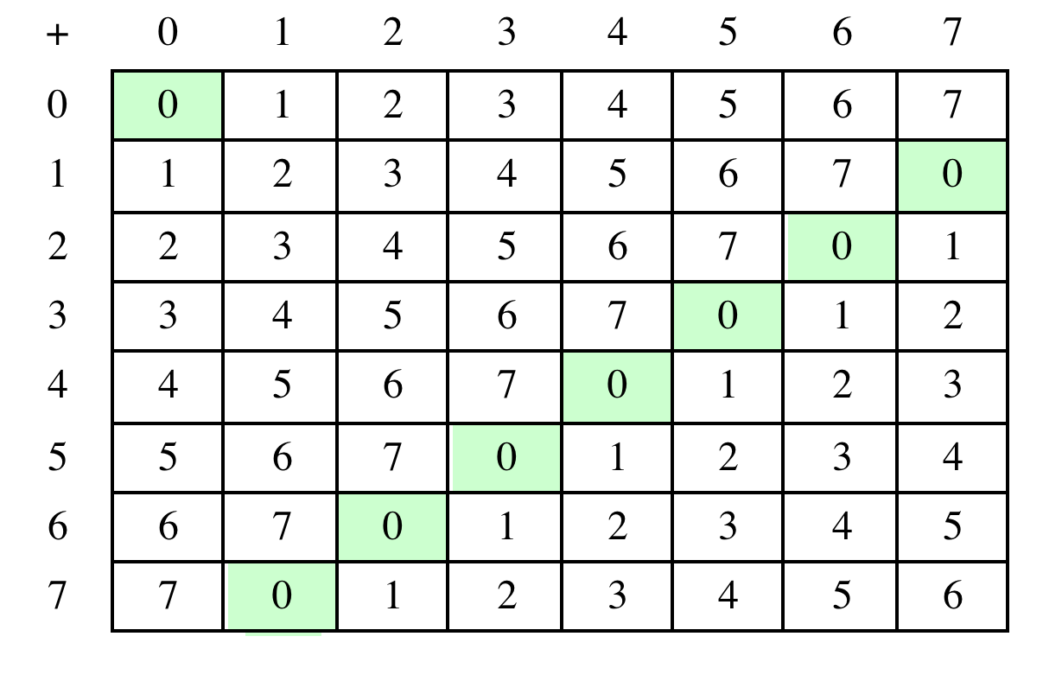
Table 4.2(a) Arithmetic Modulo 8
Notes:
Table 4.2 provides an illustration of modular addition and multiplication
modulo 8. Looking at addition, the results are straightforward, and there is a regular
pattern to the matrix. Both matrices are symmetric about the main diagonal
in conformance to the commutative property of addition and multiplication.

Slide 19
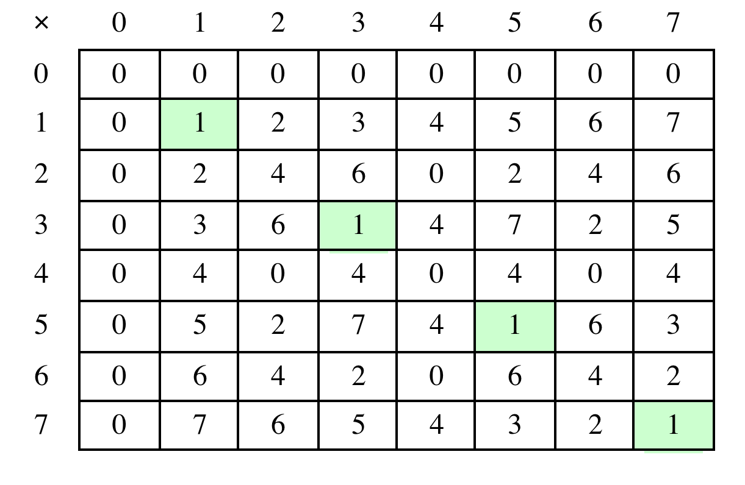
Table 4.2(b) Multiplication Modulo 8
Notes:
Similarly, the entries in the multiplication table are straightforward. In ordinary
arithmetic, there is a multiplicative inverse, or reciprocal, to each integer. In modular
arithmetic mod 8, the multiplicative inverse of x is the integer y such that
(x * y ) mod 8 = 1 mod 8. Now, to find the multiplicative inverse of an integer
from the multiplication table, scan across the matrix in the row for that integer to
find the value 1; the integer at the top of that column is the multiplicative inverse;
thus, (3 * 3) mod 8 = 1. Note that not all integers mod 8 have a multiplicative
inverse; more about that later.

Slide 20
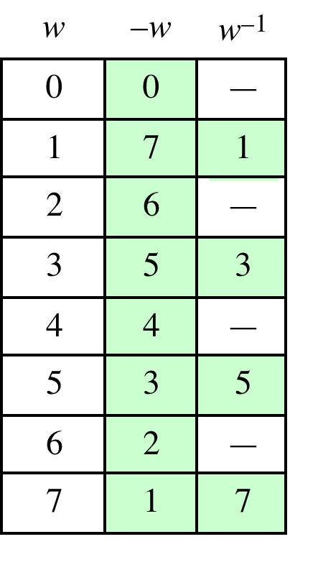
Table 4.2(c) Additive and Multiplicative Inverses Modulo 8
Notes:
As in ordinary addition, there is an additive inverse, or negative, to each integer in
modular arithmetic. In this case, the negative of an integer x is the integer y such
that (x + y ) mod 8 = 0. To find the additive inverse of an integer in the left-hand
column, scan across the corresponding row of the matrix to find the value 0; the
integer at the top of that column is the additive inverse; thus, (2 + 6) mod 8 = 0.

Slide 21
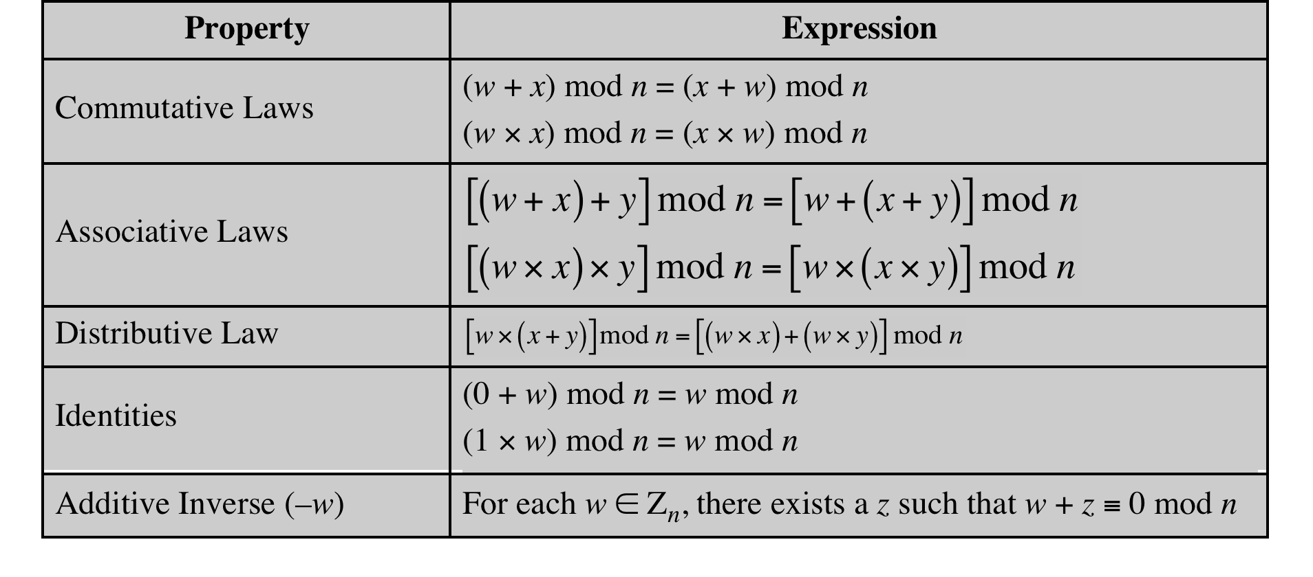
Table 4.3 Properties of Modular Arithmetic for Integers in Z_{n}
Notes:
If we perform modular arithmetic within Z_{n}, the properties shown in Table 4.3 hold for integers in Z_{n} We show in the next section that this implies that Z_{n} is a commutative ring with a multiplicative identity element. Note that unlike ordinary arithmetic, the following statement is true only with the attached condition:
if (a x b) = (a x c) (mod n) then b = c (mod n) if a is relatively prime to n
In general, an integer has a multiplicative inverse in Z_{n} if that integer is relatively prime to n. Table 4.2 cin the text shows that the integers 1, 3, 5, and 7 have a multiplicative inverse in Z 8, but 2, 4, and 6 do not.

Slide 22
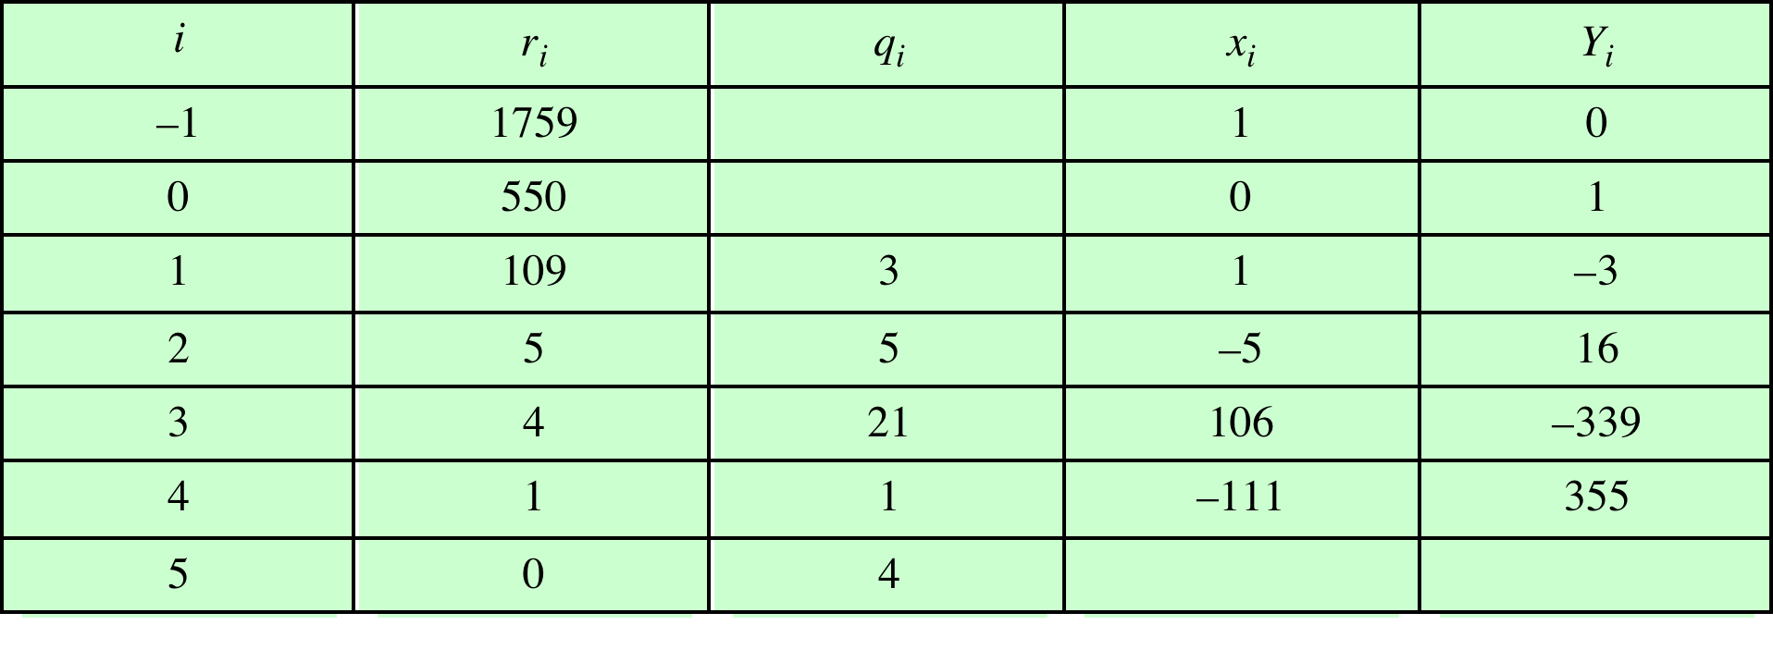
Table 4.4 Extended Euclidean Algorithm Example
Result: d = 1; x = –111; y = 355
Notes:
Example of the Extended Euclidean Algorithm. (See pages 97 – 99 in textbook for details.)

Slide 23
Groups
A set of elements with a binary operation denoted by • that associates to each ordered pair (a,b) of elements in G an element (a • b ) in G , such that the following axioms are obeyed:
(A1) Closure:
If a and b belong to G, then a • b is also in G
(A2) Associative:
a • (b • c) = (a • b) • c for all a, b, c in G
(A3) Identity element:
There is an element e in G such that a • e = e • a = a for all a in G
(A4) Inverse element:
For each a in G, there is an element a in G such that a•a = a • a = e
(A5) Commutative:
a • b = b • a for all a, b in G
Notes:
Groups, rings, and fields are the fundamental elements of a branch of mathematics
known as abstract algebra, or modern algebra. In abstract algebra, we are concerned
with sets on whose elements we can operate algebraically; that is, we can combine
two elements of the set, perhaps in several ways, to obtain a third element of the set.
These operations are subject to specific rules, which define the nature of the set. By
convention, the notation for the two principal classes of operations
on set elements is usually the same as the notation for addition and multiplication on ordinary numbers.
However, it is important to note that, in abstract algebra, we are not limited to
ordinary arithmetical operations. All this should become clear as we proceed.
A group G , sometimes denoted by {G , * }, is a set of elements with a binary operation
denoted by * that associates to each ordered pair (a, b ) of elements in G an element
(a ~ b ) in G , such that the following axioms are obeyed:
(A1) Closure:
If a and b belong to G, then a * b is also in G
(A2) Associative:
a * (b * c) = (a * b) * c for all a, b, c in G
(A3) Identity element:
There is an element e in G such that a * e = e * a = a for all a in G
(A4) Inverse element:
For each a in G, there is an element a in G such that a*a = a * a = e
(A5) Commutative:
a * b = b * a for all a, b in G

Slide 24
Cyclic Group
Exponentiation is defined within a group as a repeated application of the group operator, so that a³ = a•a•a
We define a⁰ = e as the identity element, and a^{-n} = (a’)^{n} , where a’ is the inverse element of a within the group
A group G is cyclic if every element of G is a power a^{k} (k is an integer) of a fixed element
The element a is said to generate the group G or to be a generator of G
A cyclic group is always abelian and may be finite or infinite
Notes:
Define exponentiation in a group as the repeated use of the group operator. Note that we are most familiar with it being applied to multiplication, but it is more general than that. If the repeated use of the operator on some value a in the group results in every possible value being created, then the group is said to be cyclic, and a is a generator of (or generates) the group G.

Slide 25
Rings
A ring R , sometimes denoted by {R , + , * }, is a set of elements with two binary operations, called addition and multiplication, such that for all a , b , c in R the following axioms are obeyed:
(A1–A5)
R is an abelian group with respect to addition; that is, R satisfies axioms A1 through A5. For the case of an additive group, we denote the identity element as 0 and the inverse of a as –a
(M1) Closure under multiplication:
If a and b belong to R , then ab is also in R
(M2) Associativity of multiplication:
a (bc ) = (ab)c for all a , b , c in R
(M3) Distributive laws:
a (b + c ) = ab + ac for all a , b , c in R
(a + b )c = ac + bc for all a , b , c in R
In essence, a ring is a set in which we can do addition, subtraction [a - b = a + (-b )], and multiplication without leaving the set
Notes:
A ring R , sometimes denoted by {R , + , * }, is a set of elements with two binary operations, called addition and multiplication, such that for all a , b , c in R the following axioms are obeyed:
(A1–A5)
R is an abelian group with respect to addition; that is, R satisfies axioms A1 through A5. For the case of an additive group, we denote the identity element as 0 and the inverse of a as –a
(M1) Closure under multiplication:
If a and b belong to R , then ab is also in R
(M2) Associativity of multiplication:
a (bc ) = (ab)c for all a , b , c in R
(M3) Distributive laws:
a (b + c ) = ab + ac for all a , b , c in R
(a + b )c = ac + bc for all a , b , c in R
In essence, a ring is a set in which we can do addition, subtraction [a - b = a + (-b )], and multiplication without leaving the set

Slide 26
Rings (cont.)
A ring is said to be commutative if it satisfies the following additional condition:
(M4) Commutativity of multiplication:
ab = ba for all a, b in R
An integral domain is a commutative ring that obeys the following axioms.
(M5) Multiplicative identity:
There is an element 1 in R such that a 1 = 1a = a for all a in R
(M6) No zero divisors:
If a , b in R and ab = 0, then either a = 0 or b = 0
Notes:
A ring is said to be commutative if it satisfies the following additional condition:
(M4) Commutativity of multiplication:
ab = ba for all a, b in R
An integral domain is a commutative ring that obeys the following axioms.
(M5) Multiplicative identity:
There is an element 1 in R such that a 1 = 1a = a for all a in R
(M6) No zero divisors:
If a , b in R and ab = 0, then either a = 0 or b = 0

Slide 27
Fields
A field F , sometimes denoted by {F, +,* }, is a set of elements with two binary operations, called addition and multiplication, such that for all a, b, c in F the following axioms are obeyed:
(A1–M6)
F is an integral domain; that is, F satisfies axioms A1 through A5 and M1
through M6
(M7) Multiplicative inverse:
For each a in F, except 0, there is an element a⁻¹ in F such that aa⁻¹ = (a⁻¹ )a = 1
In essence, a field is a set in which we can do addition, subtraction, multiplication, and division without leaving the set. Division is defined with the following rule: a /b = a (b⁻¹ )
Familiar examples of fields are the rational numbers, the real numbers, and the complex numbers. Note that the set of all integers is not a field, because not every element of the set has a multiplicative inverse.
Notes:
A field F , sometimes denoted by {F , + , * }, is a set of elements with two binary operations,
called addition and multiplication , such that for all a , b , c in F the following
axioms are obeyed.
(A1–M6) F is an integral domain; that is, F satisfies axioms A1 through A5 and
M1 through M6.
(M7) Multiplicative inverse: For each a in F , except 0, there is an element
a⁻¹ in F such that aa⁻¹ = (a⁻¹ )a = 1.
In essence, a field is a set in which we can do addition, subtraction, multiplication,
and division without leaving the set. Division is defined with the following rule:a /b = a (b⁻¹ ).

Slide 28
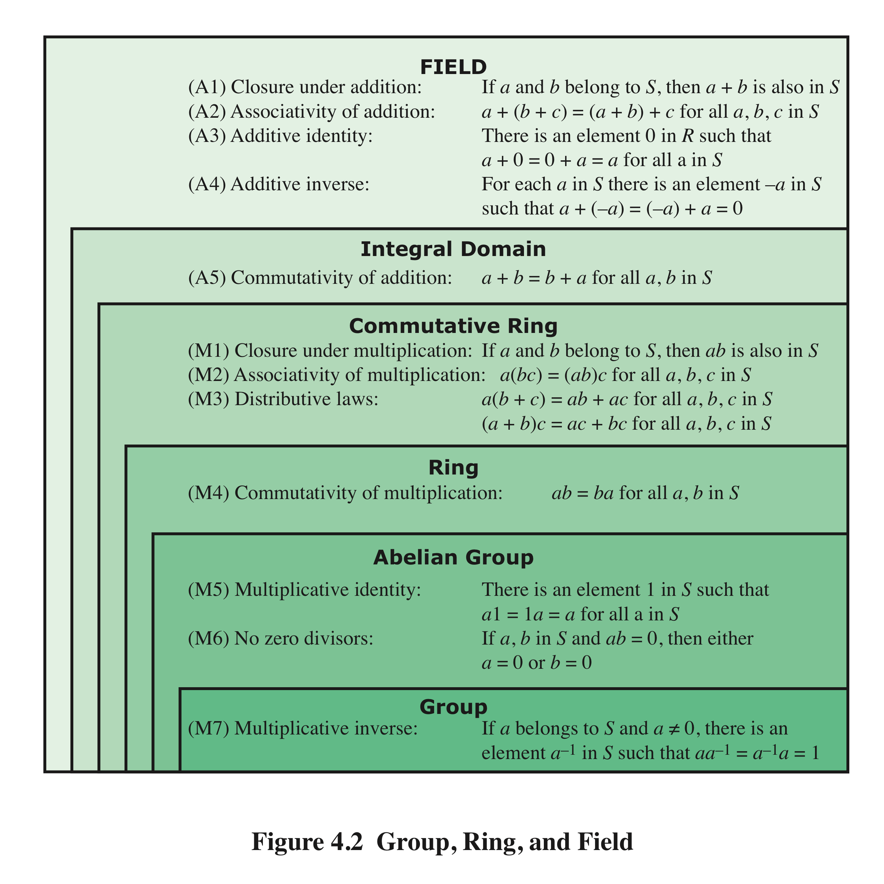
Group, Ring, and Field
Notes:
Figure 4.2 summarizes the axioms that define groups, rings, and fields.

Slide 29
Finite Fields of the Form GF(p)
Finite fields play a crucial role in many cryptographic algorithms
It can be shown that the order of a finite field must be a power of a prime p^{n}, where n is a positive integer
The only positive integers that are divisors of p are p and 1
The finite field of order p^{n} is generally written GF(p^{n} )
GF stands for Galois field, in honor of the mathematician who first studied finite fields
Notes:
In Section 4.4, we defined a field as a set that obeys all of the axioms of Figure 4.2
and gave some examples of infinite fields. Infinite fields are not of particular interest
in the context of cryptography. However, finite fields play a crucial role in many
cryptographic algorithms. It can be shown that the order of a finite field (number of
elements in the field) must be a power of a prime p^{n} , where n is a positive integer.
We discuss prime numbers in detail in Chapter 8. Here, we need only say that a
prime number is an integer whose only positive integer factors are itself and 1. That
is, the only positive integers that are divisors of p are p and 1.
The finite field of order p^{n} is generally written GF(p^{n}); GF stands for Galois
field, in honor of the mathematician who first studied finite fields. Two special cases
are of interest for our purposes. For n = 1, we have the finite field GF(p); this finite
field has a different structure than that for finite fields with n > 1 and is studied in
this section. In Section 4.7, we look at finite fields of the form GF(2^{n}).

Slide 30
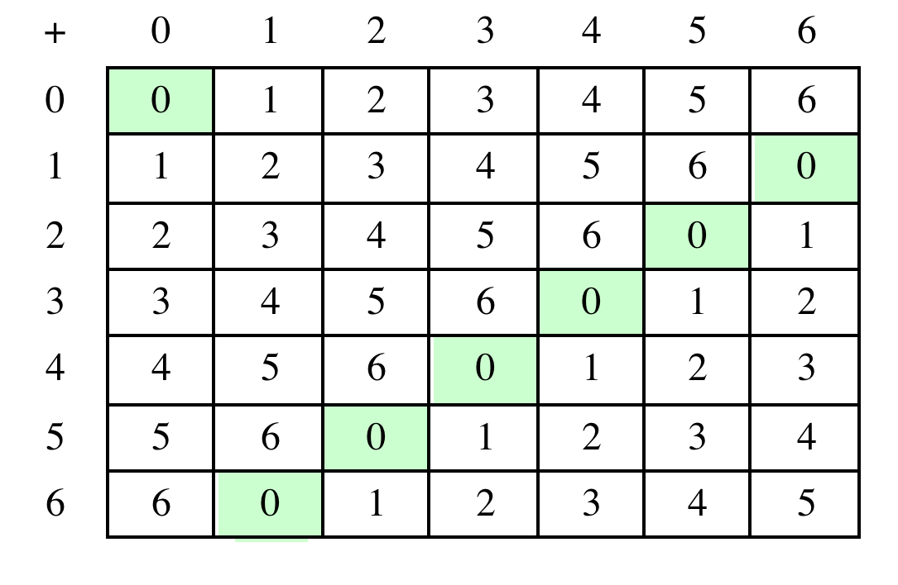
Table 4.5(a) Arithmetic in GF(7)
(a) Addition modulo 7
Notes:
Table 4.5 shows arithmetic operations in GF(7). This is a field of order 7 using
modular arithmetic modulo 7. As can be seen, it satisfies all of the properties required
of a field (Figure 4.2). Compare this table with Table 4.2. In the latter case,
we see that the set Z₈ , using modular arithmetic modulo 8, is not a field. Later in
this chapter, we show how to define addition and multiplication operations on Z₈
in such a way as to form a finite field.

Slide 31
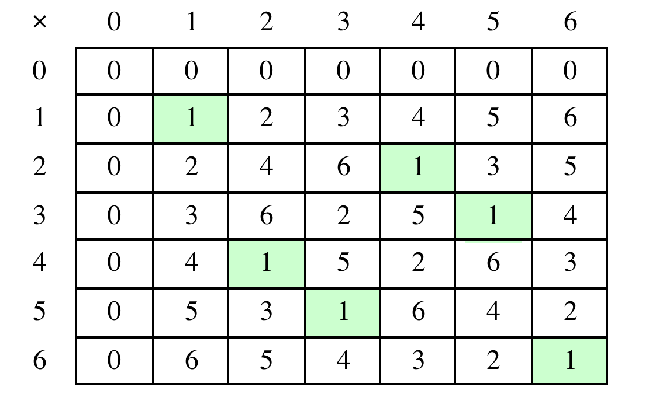
Table 4.5(b) Arithmetic in GF(7)
(b) Multiplication modulo 7
Notes:
Table 4.5 shows arithmetic operations in GF(7).

Slide 32
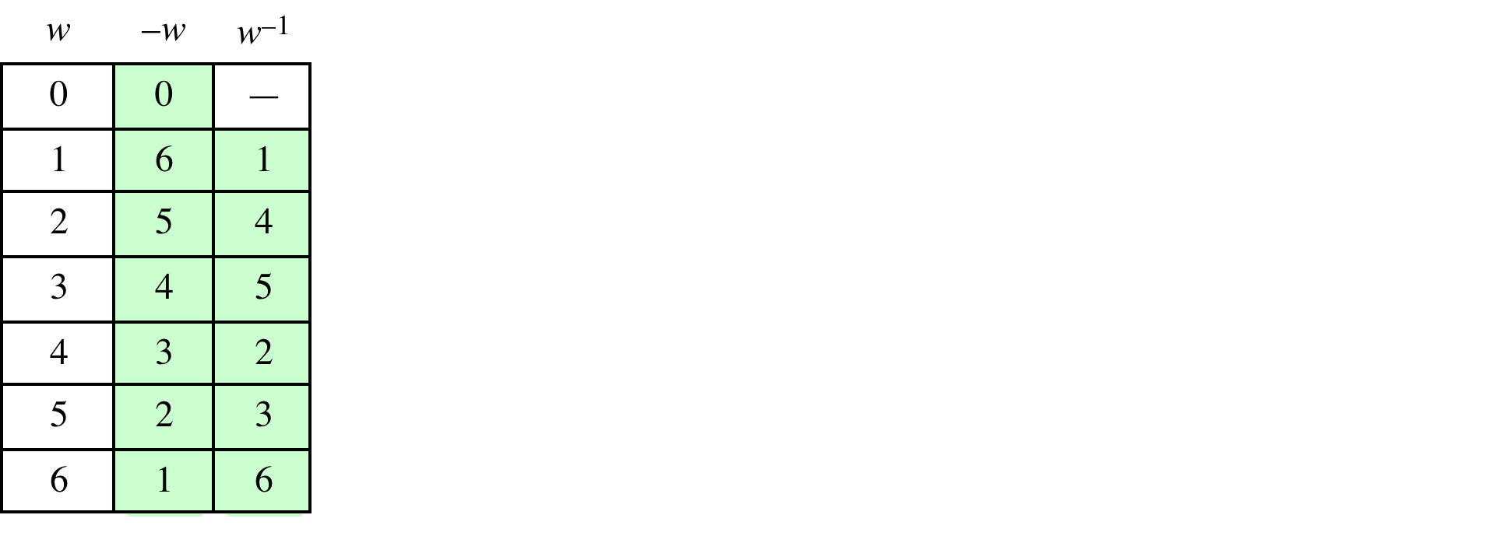
Table 4.5(c) Arithmetic in GF(7)
(c) Additive and multiplicative inverses modulo 7
Notes:
Table 4.5 shows arithmetic operations in GF(7).

Slide 33
In this section, we have shown how to construct a finite field of order p, where p is prime. GF(p) is defined with the following properties:
1. GF(p) consists of p elements
2. The binary operations + and * are defined over the set. The operations of addition, subtraction, multiplication, and division can be performed without leaving the set. Each element of the set other than 0 has a multiplicative inverse
We have shown that the elements of GF(p) are the integers {0, 1, . . . , p – 1} and that the arithmetic operations are addition and multiplication mod p
Notes:
In this section, we have shown how to construct a finite field of order p, where p is prime. GF(p) is defined with the following properties:
GF(p) consists of p elements
2. The binary operations + and * are defined over the set. The operations of addition, subtraction, multiplication, and division can be performed without leaving the set. Each element of the set other than 0 has a multiplicative inverse
We have shown that the elements of GF(p) are the integers {0, 1, . . . , p – 1} and that the arithmetic operations are addition and multiplication mod p

Slide 34
Polynomial Arithmetic
We can distinguish three classes of polynomial arithmetic:
• Ordinary polynomial arithmetic, using the basic rules of algebra
• Polynomial arithmetic in which the arithmetic on the coefficients is performed modulo p; that is, the coefficients are in GF(p )
• Polynomial arithmetic in which the coefficients are in GF(p ), and the polynomials are defined modulo a polynomial m (x ) whose highest power is some integer n
Notes:
Before continuing our discussion of finite fields, we need to introduce the interesting
subject of polynomial arithmetic. We are concerned with polynomials in a single
variable x , and we can distinguish three classes of polynomial arithmetic.
• Ordinary polynomial arithmetic, using the basic rules of algebra.
• Polynomial arithmetic in which the arithmetic on the coefficients is performed
modulo p ; that is, the coefficients are in GF(p ).
• Polynomial arithmetic in which the coefficients are in GF(p ), and the polynomials
are defined modulo a polynomial m (x ) whose highest power is some integer n .

Slide 35
Ordinary Polynomial Arithmetic Example
As an example:
let f(x) = x³ + x² + 2 and g(x) = x² - x + 1, where S is the set of integers
Then:
f(x) + g(x) = x³ + 2x² - x + 3
f(x) - g(x) = x³ + x + 1
f(x) * g(x) = x⁵ + 3x² - 2x + 2
Figures 4.3a through 4.3c show the manual calculations
Notes:
Polynomial arithmetic includes the operations of addition, subtraction, and multiplication, defined in the usual way, ie add or subtract corresponding coefficients, or multiply all terms by each other.

Slide 36
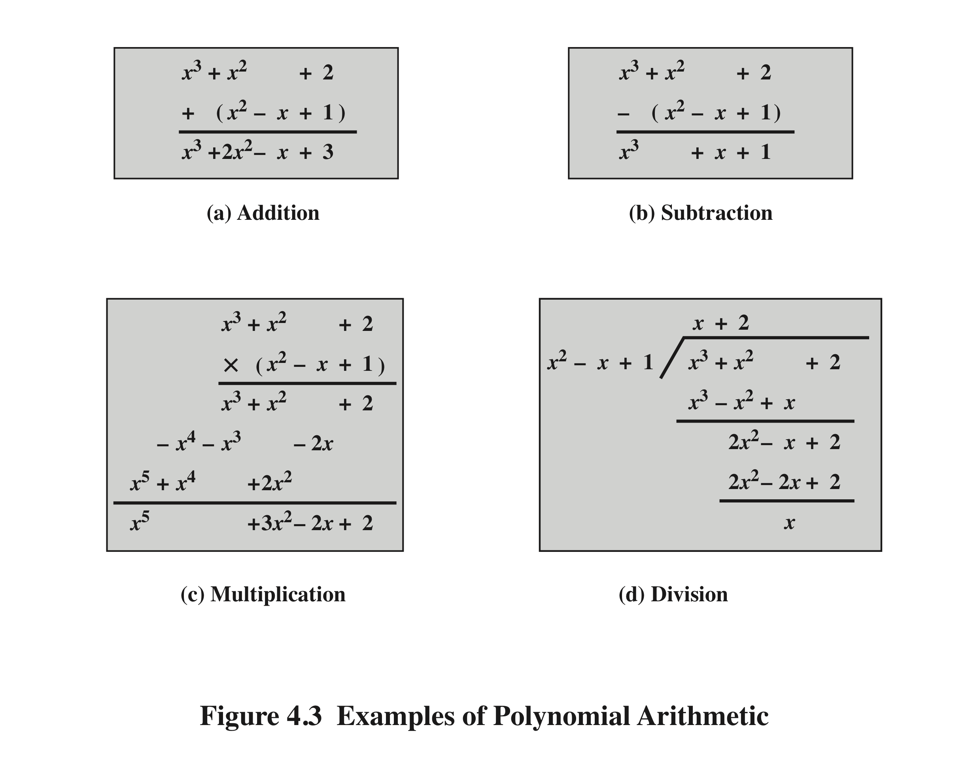
Notes:
Examples of Polynomial Arithmetic

Slide 37
Polynomial Arithmetic With Coefficients in Z_{p}
If each distinct polynomial is considered to be an element of the set, then that set is a ring
When polynomial arithmetic is performed on polynomials over a field, then division is possible
Note: this does not mean that exact division is possible
If we attempt to perform polynomial division over a coefficient set that is not a field, we find that division is not always defined
Even if the coefficient set is a field, polynomial division is not necessarily exact
With the understanding that remainders are allowed, we can say that polynomial division is possible if the coefficient set is a field
Notes:
Let us now consider polynomials in which the coefficients are elements of some
field F; we refer to this as a polynomial over the field F. In that case, it is easy to
show that the set of such polynomials is a ring, referred to as a polynomial ring .
That is, if we consider each distinct polynomial to be an element of the set, then
that set is a ring.
When polynomial arithmetic is performed on polynomials over a field, then
division is possible. Note that this does not mean that exact division is possible.
Let us clarify this distinction. Within a field, given two elements a and b , the
quotient a /b is also an element of the field. However, given a ring R that is not a
field, in general, division will result in both a quotient and a remainder; this is not
exact division.
Now, if we attempt to perform polynomial division over a coefficient set that
is not a field, we find that division is not always defined.
However, as we demonstrate presently, even if the coefficient set is a field,
polynomial division is not necessarily exact. In general, division will produce a quotient
and a remainder.
With the understanding that remainders are allowed, we can say that polynomial
division is possible if the coefficient set is a field.

Slide 38
Polynomial Division
We can write any polynomial in the form:
f(x) = q(x) g(x) + r(x)
r(x) can be interpreted as being a remainder
So r(x) = f(x) mod g(x)
If there is no remainder we can say g(x) divides f(x)
Written as g(x) | f(x)
We can say that g(x) is a factor of f(x)
Or g(x) is a divisor of f(x)
A polynomial f(x) over a field F is called irreducible if and only if f(x) cannot be expressed as a product of two polynomials, both over F, and both of degree lower than that of f(x)
An irreducible polynomial is also called a prime polynomial
Notes:
Note that we can write any polynomial in the form of f(x) = q(x) g(x) + r(x), where division of f(x) by g(x) results in a quotient q(x) and remainder r(x). Can then extend the concept of divisors from the integer case, and show that the Euclidean algorithm can be extended to find the greatest common divisor of two polynomials whose coefficients are elements of a field.
Define an irreducible (or prime) polynomial as one with no divisors other than itself & 1. If compute polynomial arithmetic modulo an irreducible polynomial, this forms a finite field, and the GCD & Inverse algorithms can be adapted for it.

Slide 39
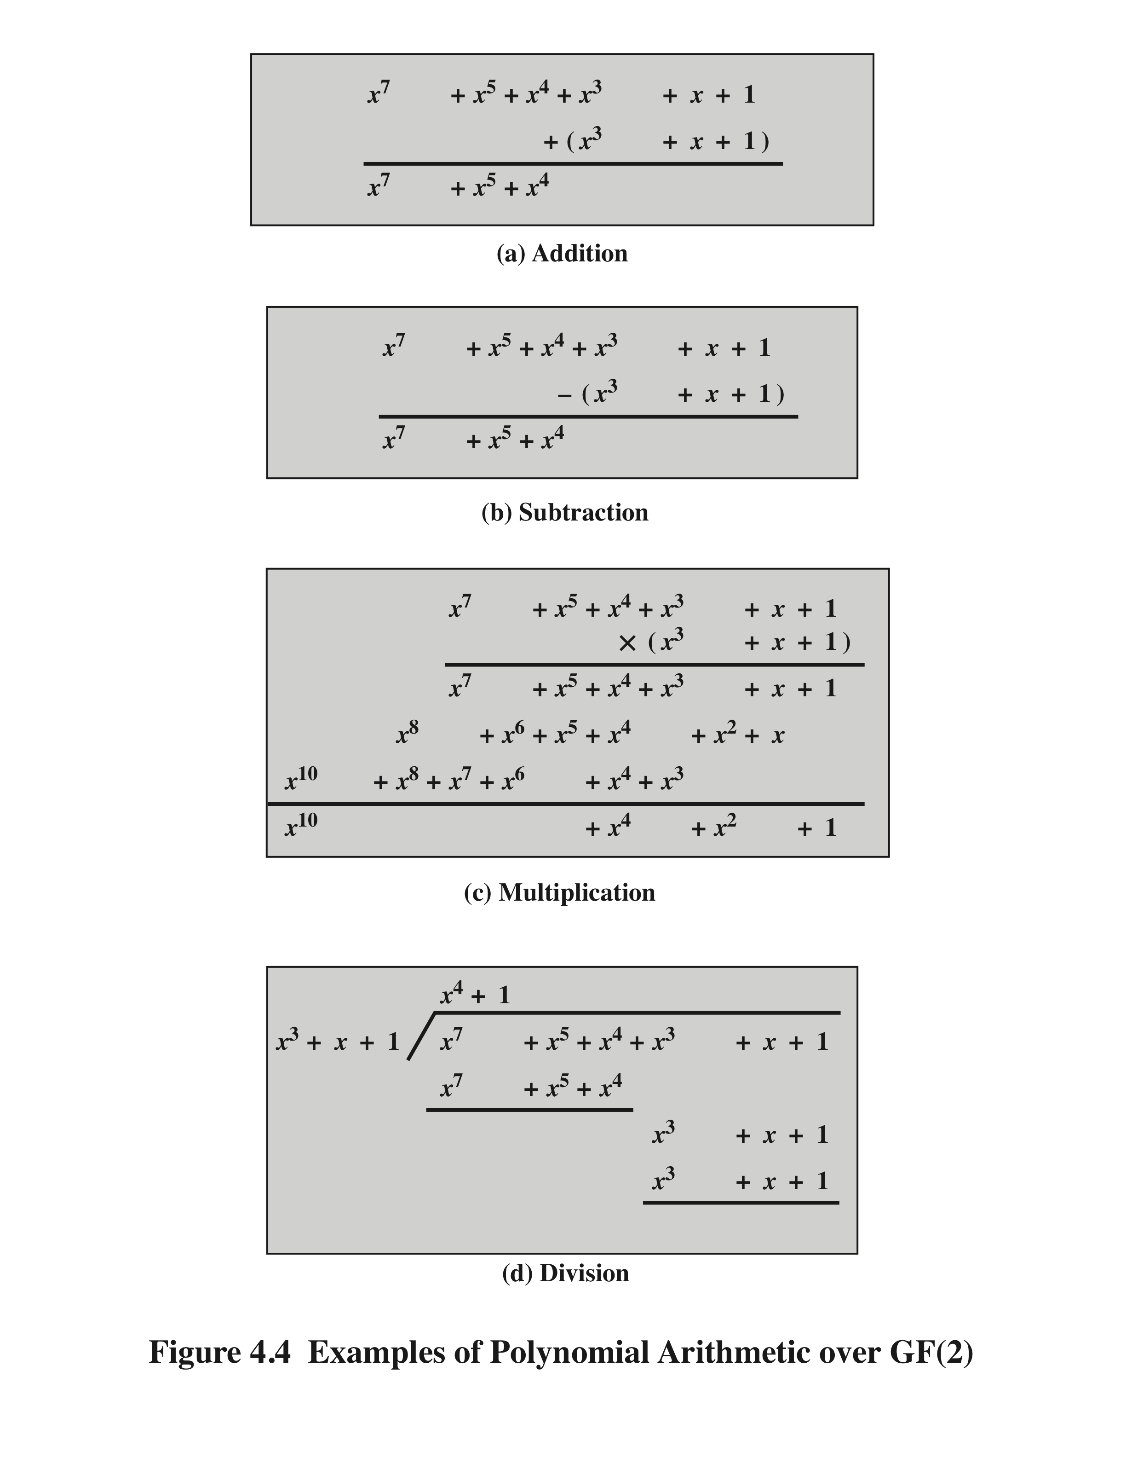
Example of Polynomial Arithmetic Over GF(2)
(Figure 4.4 can be found on page 110 in the textbook)
Notes:
Figure 4.4 shows an example of polynomial arithmetic over GF(2).

Slide 40
Polynomial GCD
The polynomial c(x) is said to be the greatest common divisor of a(x) and b(x) if the following are true:
c(x) divides both a(x) and b(x)
Any divisor of a(x) and b(x) is a divisor of c(x)
An equivalent definition is:
gcd[a(x), b(x)] is the polynomial of maximum degree that divides both a(x) and b(x)
The Euclidean algorithm can be extended to find the greatest common divisor of two polynomials whose coefficients are elements of a field
Notes:
We can extend the analogy between polynomial arithmetic over a field and integer
arithmetic by defining the greatest common divisor as follows. The polynomial c(x)
is said to be the greatest common divisor of a(x) and b(x) if the following are true.
1. c(x) divides both a(x) and b(x).
2. Any divisor of a(x) and b(x) is a divisor of c(x).
An equivalent definition is the following: gcd[a (x ), b (x )] is the polynomial of
maximum degree that divides both a (x ) and b (x ).
We can adapt the Euclidean algorithm to compute the greatest common
Divisor of two polynomials.

Slide 41
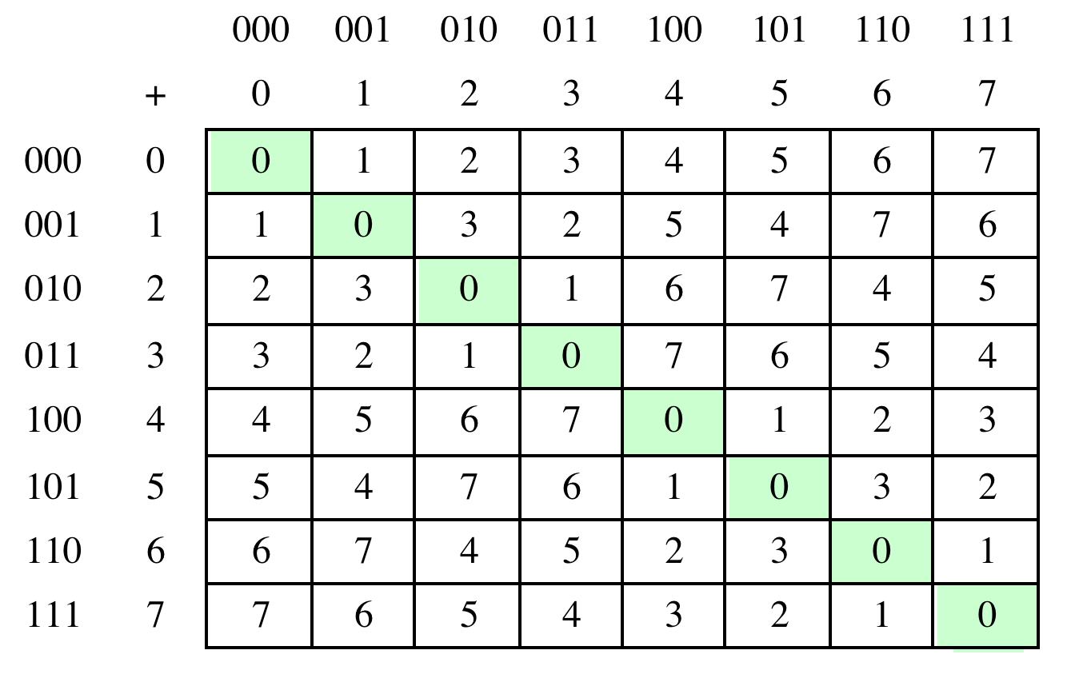
Table 4.6(a) Arithmetic in GF(2³)
(a) Addition
Notes:
Table 4.6 Arithmetic in GF(23)

Slide 42
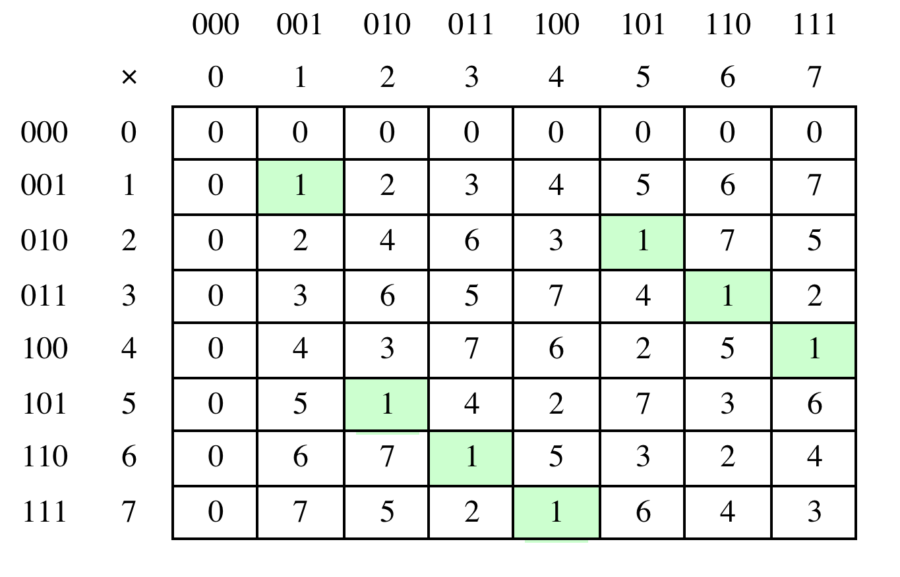
Table 4.6(b) Arithmetic in GF(2³)
(b) Multiplication
Notes:
Table 4.6 Arithmetic in GF(23)

Slide 43
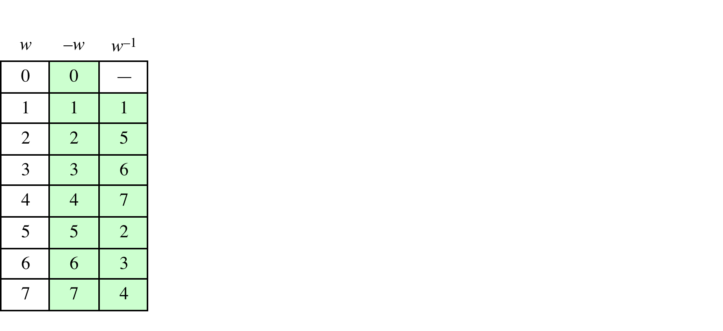
Table 4.6(c) Arithmetic in GF(2³)
(c) Additive and multiplicative inverses
Notes:
Table 4.6 Arithmetic in GF(23)

Slide 44
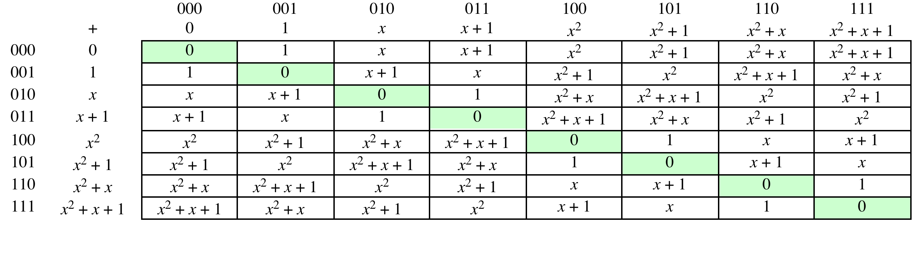
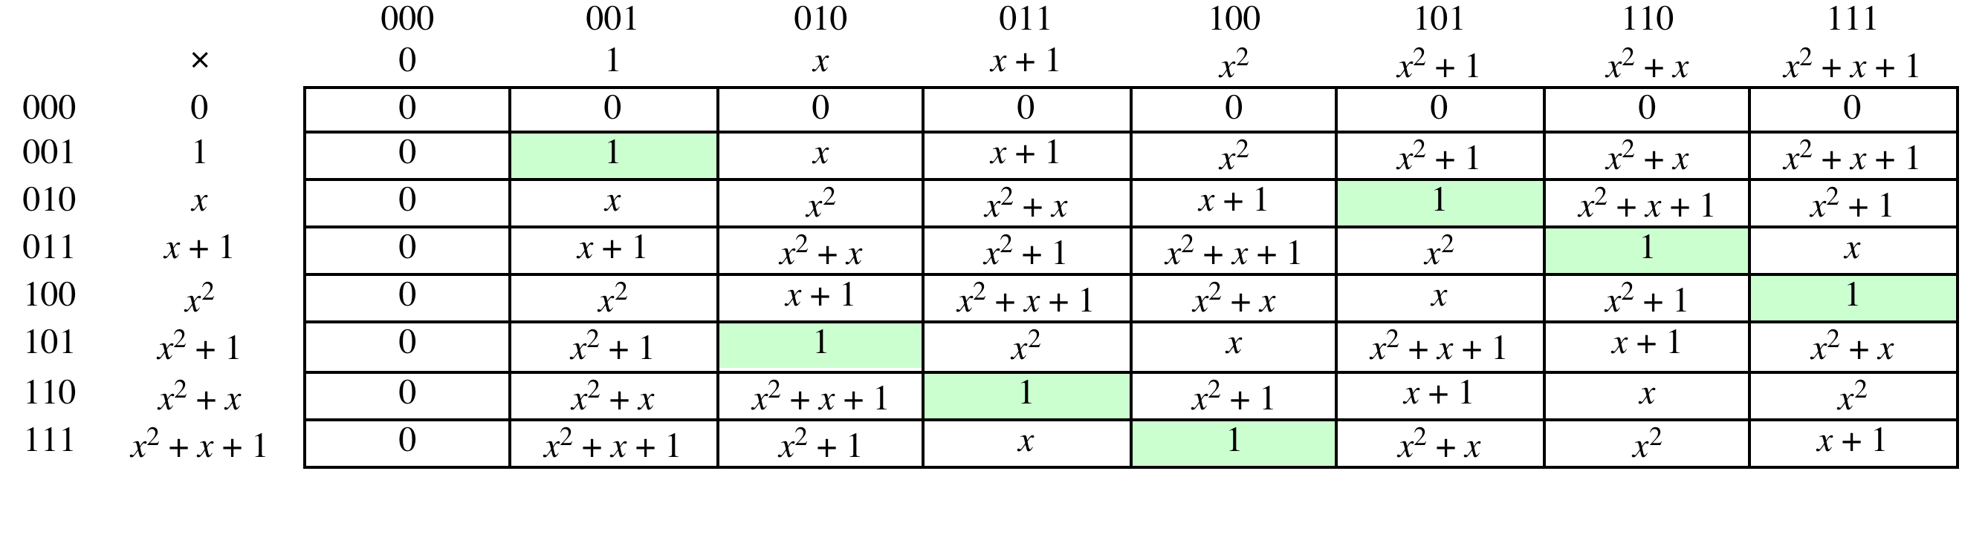
Table 4.7 (page 117 in textbook)
Polynomial Arithmetic Modulo (x³ + x + 1)
(a) Addition
(b) Multiplication
Notes:
Example shows addition & multiplication in GF(2³) modulo (x³+x+1)

Slide 45
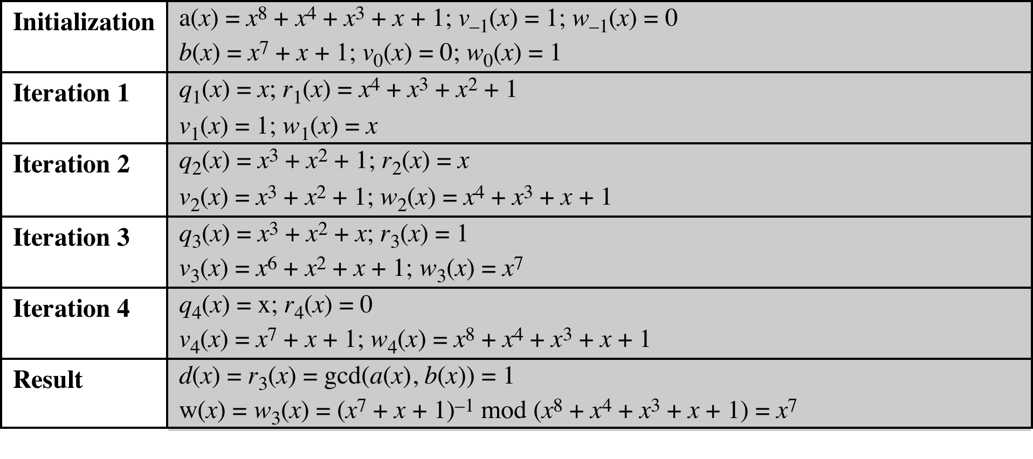
Table 4.8
Extended Euclid [(x⁸ + x⁴ + x³ + x + 1), (x⁷ + x + 1)]
(Table 4.8 can be found on page 118 in textbook)
Notes:
Table 4.8 Extended Euclid [(x8 + x4 + x3 + x + 1), (x7 + x + 1)]

Slide 46
Computational Considerations
Since coefficients are 0 or 1, they can represent any such polynomial as a bit string
Addition becomes XOR of these bit strings
Multiplication is shift and XOR
cf long-hand multiplication
Modulo reduction is done by repeatedly substituting highest power with remainder of irreducible polynomial (also shift and XOR)
Notes:
A key motivation for using polynomial arithmetic in GF(2^{n}) is that the polynomials can be represented as a bit string, using all possible bit values, and the calculations only use simple common machine instructions - addition is just XOR, and multiplication is shifts & XOR’s. See text for additional discussion. The shortcut for polynomial reduction comes from the observation that if in GF(2^{n}) then irreducible poly g(x) has highest term x^{n} , and if compute x^{n} mod g(x) answer is g(x)- x^{n}

Slide 47
Using a Generator
A generator g of a finite field F of order q (contains q elements) is an element whose first q-1 powers generate all the nonzero elements of F
The elements of F consist of 0, g⁰, g¹, . . . ., g^{q-2}
Consider a field F defined by a polynomial fx
An element b contained in F is called a root of the polynomial if f(b) = 0
Finally, it can be shown that a root g of an irreducible polynomial is a generator of the finite field defined on that polynomial
Notes:
An equivalent technique for defining a finite field of the form GF(2^{n} ), using the
same irreducible polynomial, is sometimes more convenient. To begin, we need two
definitions: A generator g of a finite field F of order q (contains q elements) is an
element whose first q - 1 powers generate all the nonzero elements of F. That is, the
elements of F consist of 0, g⁰ , g¹ , c , g^{q-2} . Consider a field F defined by a polynomial
f (x ). An element b contained in F is called a root of the polynomial if f (b ) = 0.
Finally, it can be shown that a root g of an irreducible polynomial is a generator of the
finite field defined on that polynomial.

Slide 48
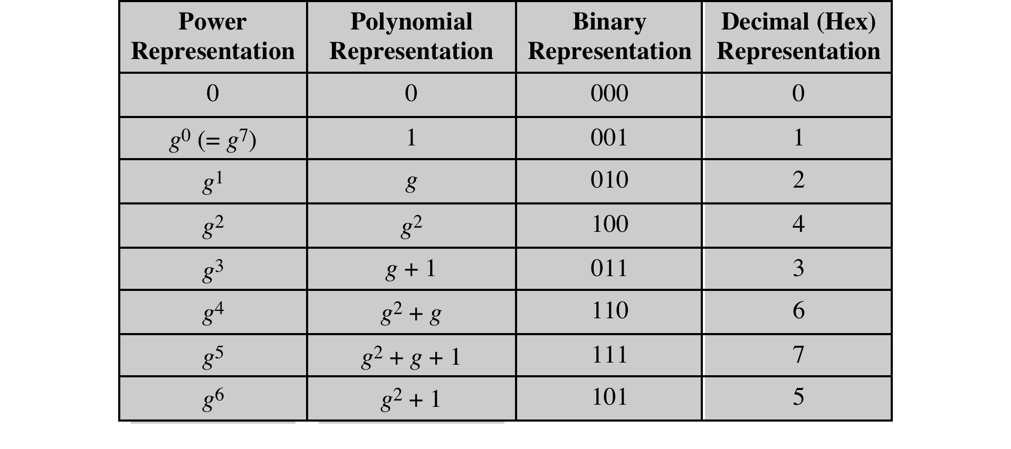
Table 4.9 Generator for GF(2³) using x³ + x + 1
Notes:
Table 4.9 Generator for GF(2³) using x³ + x + 1

Slide 49
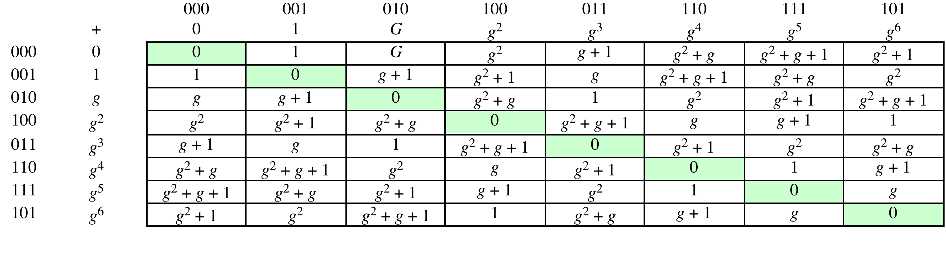
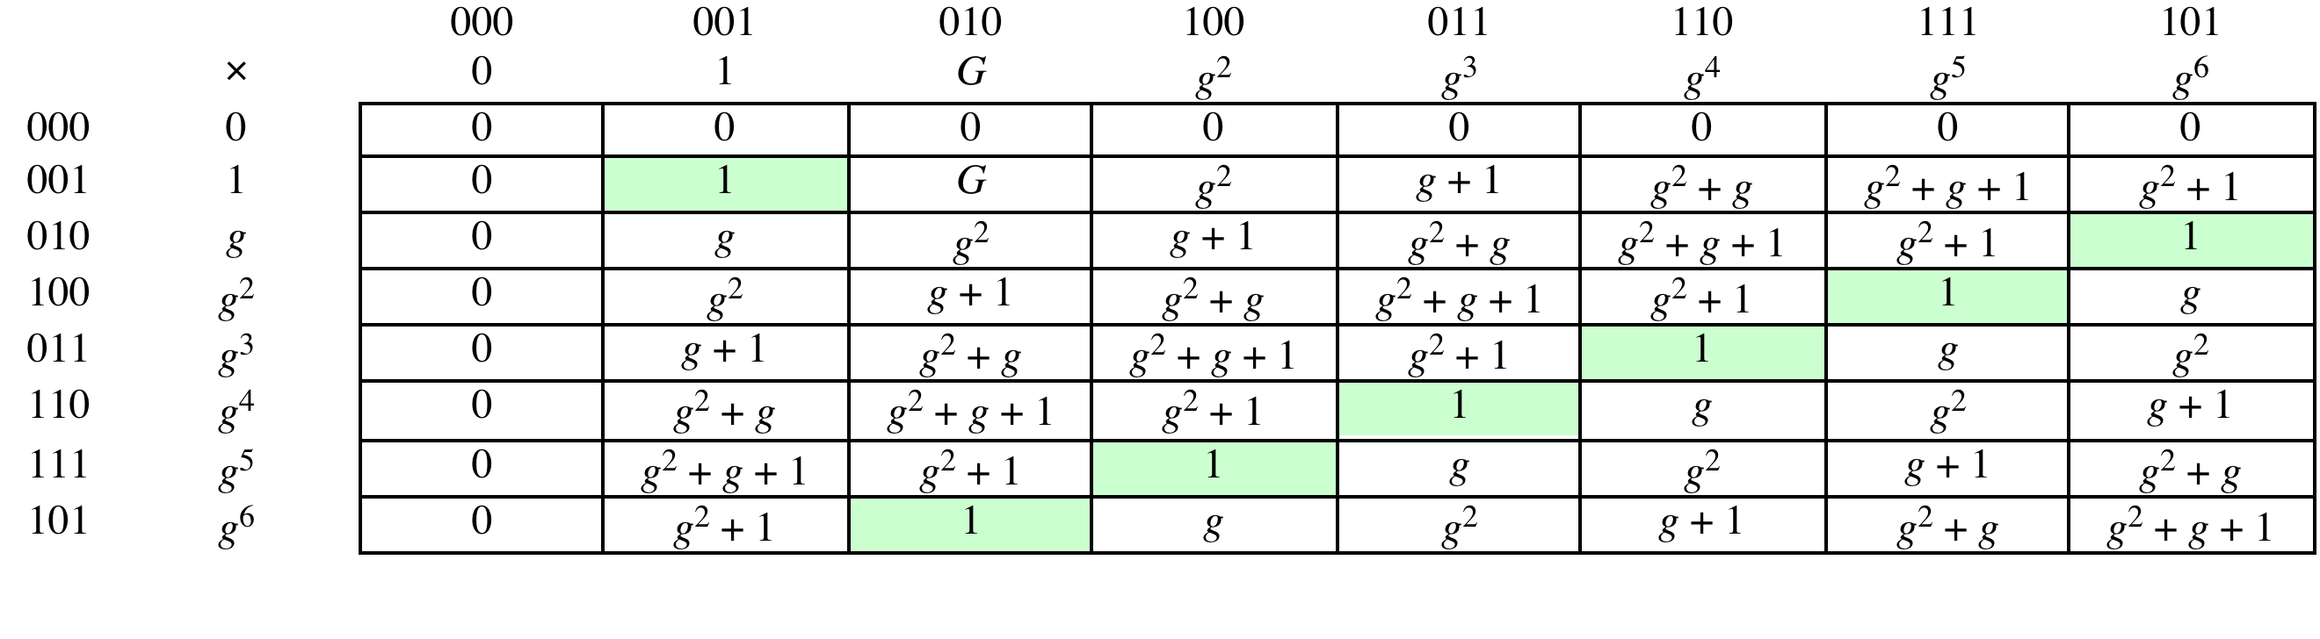
Table 4.10 (page 123 in textbook)
GF(2³) Arithmetic Using Generator for the Polynomial (x³ + x + 1)
(a) Addition
(b) Multiplication
Notes:
Table 4.10 GF(2³) Arithmetic Using Generator for the Polynomial (x³ + x + 1)

Slide 50
Summary
Divisibility and the division algorithm
The Euclidean algorithm
Modular arithmetic
Groups, rings, and fields
Finite fields of the form GF(p)
Polynomial arithmetic
Finite fields of the form GF(2^{n})
Notes:
Chapter 4 summary.

