Slide 1
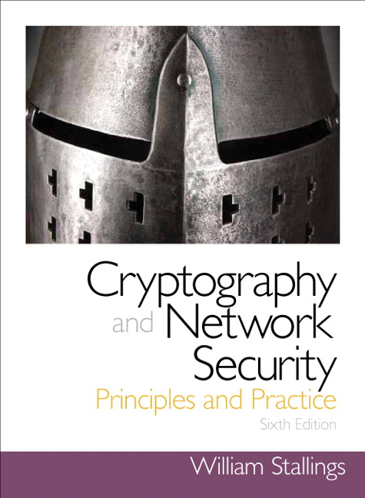
Chapter 11
第11章密码学Hash函数
Cryptographic Hash Functions
Notes:
This chapter begins with a discussion of the wide variety of applications for cryptographic
hash functions. Next, we look at the security requirements for such functions.
Then we look at the use of cipher block chaining to implement a cryptographic hash
function. The remainder of the chapter is devoted to the most important and widely
used family of cryptographic hash functions, the Secure Hash Algorithm (SHA) family.

Slide 2
Hash Functions
A hash function H accepts a variable-length block of data M as input and produces a fixed-size hash value
h = H(M)
Principal object is data integrity
Cryptographic hash function
An algorithm for which it is computationally infeasible to find either:
(a) a data object that maps to a pre-specified hash result (the one-way property)
(b) two data objects that map to the same hash result (the collision-free property)
Notes:
A hash function H accepts a variable-length block of data M as input and produces
a fixed-size hash value h = H(M ). A “good” hash function has the property that the
results of applying the function to a large set of inputs will produce outputs that are
evenly distributed and apparently random. In general terms, the principal object of a
hash function is data integrity. A change to any bit or bits in M results, with high probability,
in a change to the hash code.
The kind of hash function needed for security applications is referred to as a
cryptographic hash function . A cryptographic hash function is an algorithm for which
it is computationally infeasible (because no attack is significantly more efficient than
brute force) to find either (a) a data object that maps to a pre-specified hash result
(the one-way property) or (b) two data objects that map to the same hash result (the
collision-free property). Because of these characteristics, hash functions are often used
to determine whether or not data has changed.

Slide 3
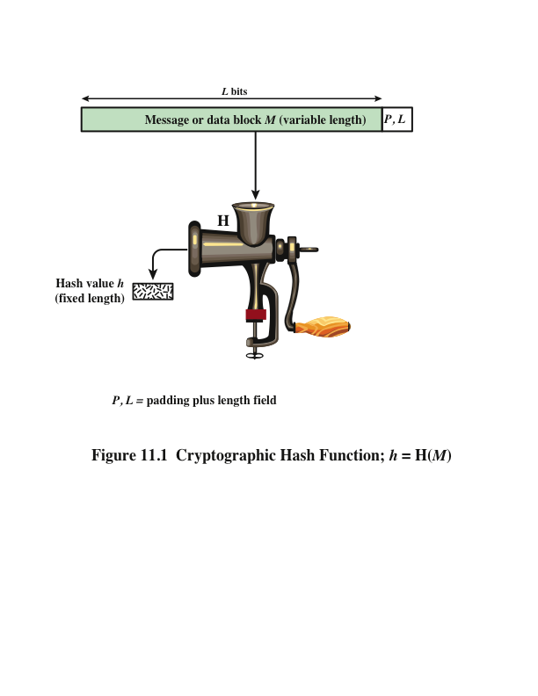
Notes:
Figure 11.1 depicts the general operation of a cryptographic hash function.
Typically, the input is padded out to an integer multiple of some fixed length
(e.g., 1024 bits), and the padding includes the value of the length of the original message
in bits. The length field is a security measure to increase the difficulty for an
attacker to produce an alternative message with the same hash value.

Slide 4
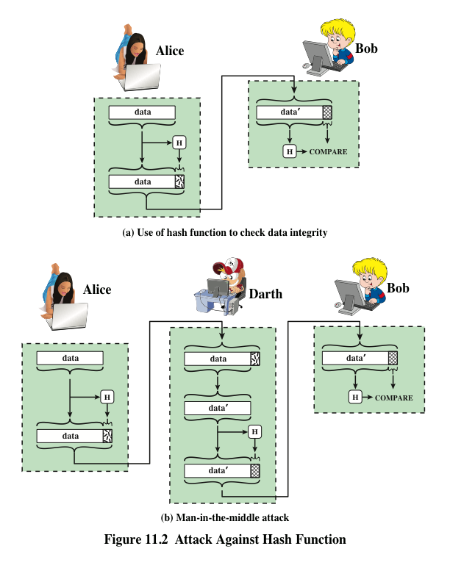
Notes:
Message authentication is a mechanism or service used to verify the integrity of
a message. Message authentication assures that data received are exactly as sent
(i.e., contain no modification, insertion, deletion, or replay). In many cases, there is
a requirement that the authentication mechanism assures that purported identity of
the sender is valid. When a hash function is used to provide message authentication,
the hash function value is often referred to as a message digest .
The essence of the use of a hash function for message authentication is as
follows. The sender computes a hash value as a function of the bits in the message
and transmits both the hash value and the message. The receiver performs the same
hash calculation on the message bits and compares this value with the incoming
hash value. If there is a mismatch, the receiver knows that the message (or possibly
the hash value) has been altered (Figure 11.2a).
The hash function must be transmitted in a secure fashion. That is, the hash
function must be protected so that if an adversary alters or replaces the message,
it is not feasible for adversary to also alter the hash value to fool the receiver. This
type of attack is shown in Figure 11.2b. In this example, Alice transmits a data block
and attaches a hash value. Darth intercepts the message, alters or replaces the data
block, and calculates and attaches a new hash value. Bob receives the altered data
with the new hash value and does not detect the change. To prevent this attack, the
hash value generated by Alice must be protected.

Slide 5
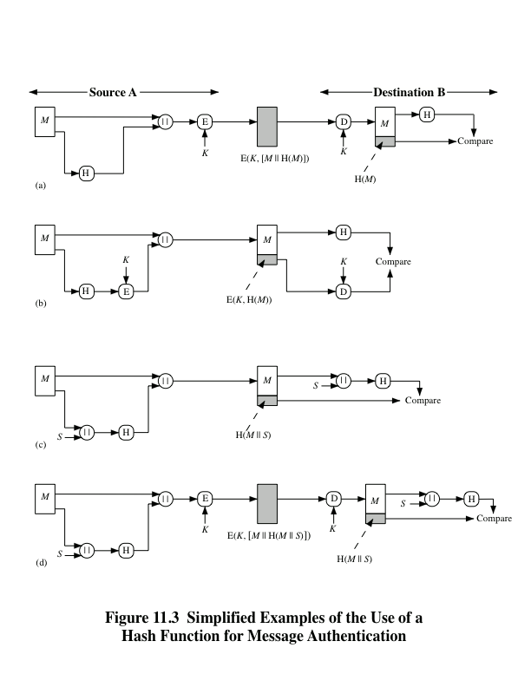
Notes:
Figure 11.3 illustrates a variety of ways in which a hash code can be used to
provide message authentication, as follows:
a. The message plus concatenated hash code is encrypted using symmetric
encryption. Because only A and B share the secret key, the message must
have come from A and has not been altered. The hash code provides the structure
or redundancy required to achieve authentication. Because encryption is
applied to the entire message plus hash code, confidentiality is also provided.
b. Only the hash code is encrypted, using symmetric encryption. This reduces the
processing burden for those applications that do not require confidentiality.
c. It is possible to use a hash function but no encryption for message authentication.
The technique assumes that the two communicating parties share a common secret
value S. A computes the hash value over the concatenation of M and S and
appends the resulting hash value to M. Because B possesses S, it can recompute
the hash value to verify. Because the secret value itself is not sent, an opponent
cannot modify an intercepted message and cannot generate a false message.
d. Confidentiality can be added to the approach of method (c) by encrypting the
entire message plus the hash code.
When confidentiality is not required, method (b) has an advantage over
methods (a) and (d), which encrypts the entire message, in that less computation
is required. Nevertheless, there has been growing interest in techniques that
avoid encryption (Figure 11.3c). Several reasons for this interest are pointed out in
[TSUD92].
• Encryption software is relatively slow. Even though the amount of data to be
encrypted per message is small, there may be a steady stream of messages into
and out of a system.
• Encryption hardware costs are not negligible. Low-cost chip implementations
of DES are available, but the cost adds up if all nodes in a network must have
this capability.
• Encryption hardware is optimized toward large data sizes. For small blocks
of data, a high proportion of the time is spent in initialization/invocation
overhead.
• Encryption algorithms may be covered by patents, and there is a cost associated
with licensing their use.

Slide 6
Message Authentication Code (MAC)
Also known as a keyed hash function
Typically used between two parties that share a secret key to authenticate information exchanged between those parties
Takes as input a secret key and a data block and produces a hash value (MAC) which is associated with the protected message
If the integrity of the message needs to be checked, the MAC function can be applied to the message and the result compared with the associated MAC value
An attacker who alters the message will be unable to alter the associated MAC value without knowledge of the secret key
Notes:
More commonly, message authentication is achieved using a message authentication
code (MAC ), also known as a keyed hash function . Typically, MACs are
used between two parties that share a secret key to authenticate information exchanged
between those parties. A MAC function takes as input a secret key and a
data block and produces a hash value, referred to as the MAC, which is associated
with the protected message. If the integrity of the message needs to be checked, the
MAC function can be applied to the message and the result compared with the associated
MAC value. An attacker who alters the message will be unable to alter the
associated MAC value without knowledge of the secret key. Note that the verifying
party also knows who the sending party is because no one else knows the secret key.
Note that the combination of hashing and encryption results in an overall
function that is, in fact, a MAC (Figure 11.3b). That is, E(K , H(M )) is a function of
a variable-length message M and a secret key K , and it produces a fixed-size output
that is secure against an opponent who does not know the secret key. In practice,
specific MAC algorithms are designed that are generally more efficient than an encryption
algorithm.

Slide 7
Digital Signature
Operation is similar to that of the MAC
The hash value of a message is encrypted with a user’s private key
Anyone who knows the user’s public key can verify the integrity of the message
An attacker who wishes to alter the message would need to know the user’s private key
Implications of digital signatures go beyond just message authentication
Notes:
Another important application, which is similar to the message authentication
Application, is the digital signature . The operation of the digital signature is similar
to that of the MAC. In the case of the digital signature, the hash value of a message
is encrypted with a user’s private key. Anyone who knows the user’s public key
can verify the integrity of the message that is associated with the digital signature.
In this case, an attacker who wishes to alter the message would need to know the
user’s private key. As we shall see in Chapter 14, the implications of digital signatures
go beyond just message authentication.

Slide 8
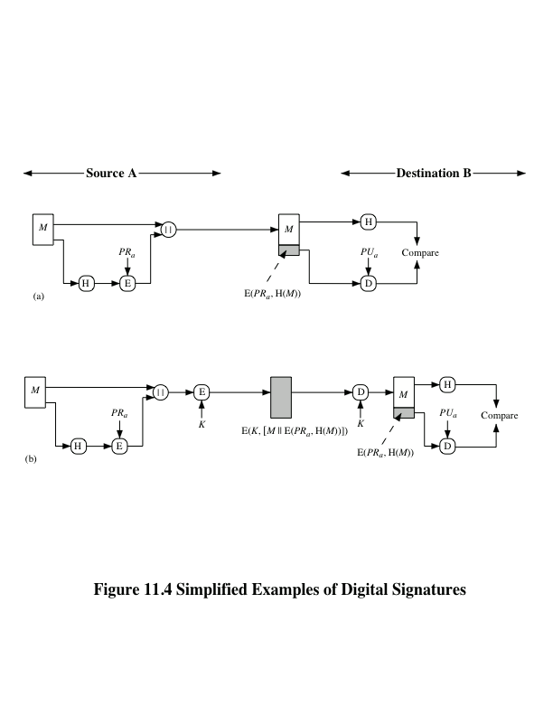
Notes:
Figure 11.4 illustrates, in a simplified fashion, how a hash code is used to provide
a digital signature.
a. The hash code is encrypted, using public-key encryption with the sender’s private
key. As with Figure 11.3b, this provides authentication. It also provides a
digital signature, because only the sender could have produced the encrypted
hash code. In fact, this is the essence of the digital signature technique.
b. If confidentiality as well as a digital signature is desired, then the message
plus the private-key-encrypted hash code can be encrypted using a symmetric
secret key. This is a common technique.

Slide 9
Other Hash Function Uses
Commonly used to create a one-way password file
When a user enters a password, the hash of that password is compared to the stored hash value for verification
This approach to password protection is used by most operating systems
Can be used for intrusion and virus detection
Store H(F) for each file on a system and secure the hash values
One can later determine if a file has been modified by recomputing H(F)
An intruder would need to change F without changing H(F)
Can be used to construct a pseudorandom function (PRF) or a pseudorandom number generator (PRNG)
A common application for a hash-based PRF is for the generation of symmetric keys
Notes:
Hash functions are commonly used to create a one-way password file . Chapter 21
explains a scheme in which a hash of a password is stored by an operating system
rather than the password itself. Thus, the actual password is not retrievable by
a hacker who gains access to the password file. In simple terms, when a user enters
a password, the hash of that password is compared to the stored hash value
for verification. This approach to password protection is used by most operating
systems.
Hash functions can be used for intrusion detection and virus detection . Store
H(F) for each file on a system and secure the hash values (e.g., on a CD-R that is
kept secure). One can later determine if a file has been modified by recomputing
H(F). An intruder would need to change F without changing H(F).
A cryptographic hash function can be used to construct a pseudorandom
function (PRF) or a pseudorandom number generator (PRNG) . A common application
for a hash-based PRF is for the generation of symmetric keys. We discuss this
application in Chapter 12.

Slide 10
Two Simple Hash Functions
Consider two simple insecure hash functions that operate using the following general principles:
The input is viewed as a sequence of n-bit blocks
The input is processed one block at a time in an iterative fashion to produce an n-bit hash function
Bit-by-bit exclusive-OR (XOR) of every block
C_{i} = b_{i1} xor b_{i2} xor . . . xor b_{im}
Produces a simple parity for each bit position and is known as a longitudinal redundancy check
Reasonably effective for random data as a data integrity check
Perform a one-bit circular shift on the hash value after each block is processed
Has the effect of randomizing the input more completely and overcoming any regularities that appear in the input
Notes:
To get some feel for the security considerations involved in cryptographic hash functions, we present two simple, insecure hash functions in this section. One of the simplest hash functions is the bit-by-bit exclusive-OR (XOR) of every block, which can be expressed as shown. This operation produces a simple parity for each bit position and is known as a longitudinal redundancy check. It is reasonably effective for random data as a data integrity check. Each n-bit hash value is equally likely. Thus, the probability that a data error will result in an unchanged hash value is 2^{–n}. With more predictably formatted data, the function is less effective. For example, in most normal text files, the high-order bit of each octet is always zero. So if a 128-bit hash value is used, instead of an effectiveness of 2^{–128}, the hash function on this type of data has an effectiveness of 2^{–112}.
A simple way to improve matters is to perform a one-bit circular shift, or rotation, on the hash value after each block is processed. Although this second procedure provides a good measure of data integrity, it is virtually useless for data security when an encrypted hash code is used with a plaintext message. Given a message, it is an easy matter to produce a new message that yields that hash code: Simply prepare the desired alternate message and then append an n-bit block that forces the new message plus block to yield the desired hash code.

Slide 11
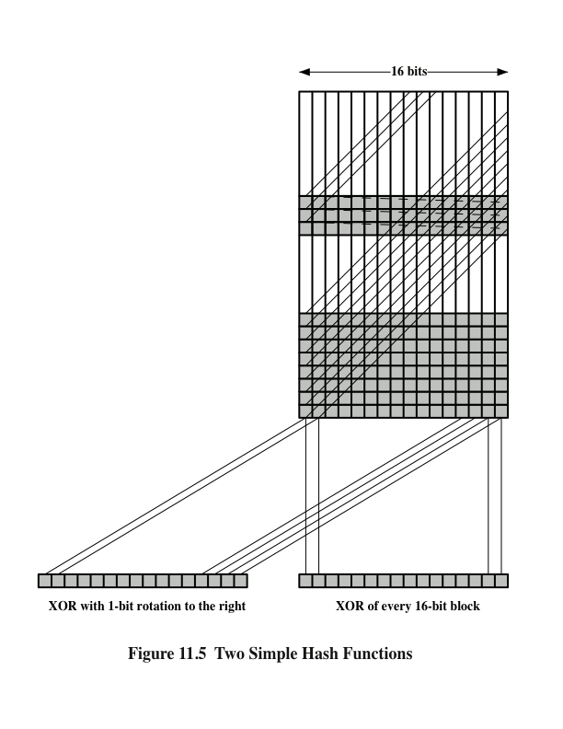
Two
Simple
Hash Functions
Notes:
Figure 11.5 illustrates these two types of hash functions for 16-bit hash values.
Although the second procedure provides a good measure of data integrity,
it is virtually useless for data security when an encrypted hash code is used with a
plaintext message, as in Figures 11.3b and 11.4a. Given a message, it is an easy matter
to produce a new message that yields that hash code: Simply prepare the desired
alternate message and then append an n -bit block that forces the new message plus
block to yield the desired hash code.
Although a simple XOR or rotated XOR (RXOR) is insufficient if only the
hash code is encrypted, you may still feel that such a simple function could be useful
when the message together with the hash code is encrypted (Figure 11.3a). But
you must be careful.

Slide 12
Requirements and Security
Preimage
Collision
x is the preimage of h for a hash value h = H(x)
Is a data block whose hash function, using the function H, is h
Because H is a many-to-one mapping, for any given hash value h, there will in general be multiple preimages
Occurs if we have x ≠ y and H(x) = H(y)
Because we are using hash functions for data integrity, collisions are clearly undesirable
Notes:
Before proceeding, we need to define two terms. For a hash value h = H(x ), we say
that x is the preimage of h . That is, x is a data block whose hash function, using the
function H, is h . Because H is a many-to-one mapping, for any given hash value h ,
there will in general be multiple preimages. A collision occurs if we have x ≠ y and
H(x ) = H(y ). Because we are using hash functions for data integrity, collisions are
clearly undesirable.

Slide 13
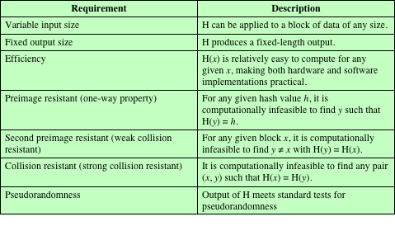
Table 11.1 Requirements for a Cryptographic Hash Function H
(Table can be found on page 323 in textbook.)
Notes:
Table 11.1 lists the generally accepted requirements for a cryptographic hash function.
The first three properties are requirements for the practical application of a
hash function.
The fourth property, preimage resistant , is the one-way property: it is easy
to generate a code given a message, but virtually impossible to generate a message
given a code. This property is important if the authentication technique involves the
use of a secret value (Figure 11.3c). The secret value itself is not sent.
The fifth property, second preimage resistant , guarantees that it is impossible
to find an alternative message with the same hash value as a given message. This
prevents forgery when an encrypted hash code is used (Figures 11.3b and 11.4a). If
this property were not true, an attacker would be capable of the following sequence:
First, observe or intercept a message plus its encrypted hash code; second, generate
an unencrypted hash code from the message; third, generate an alternate message
with the same hash code.
A hash function that satisfies the first five properties in Table 11.1 is referred
to as a weak hash function. If the sixth property, collision resistant , is also satisfied,
then it is referred to as a strong hash function. A strong hash function protects
against an attack in which one party generates a message for another party to sign.
For example, suppose Bob writes an IOU message, sends it to Alice, and she signs
it. Bob finds two messages with the same hash, one of which requires Alice to pay a
small amount and one that requires a large payment. Alice signs the first message,
and Bob is then able to claim that the second message is authentic
The final requirement in Table 11.1, pseudorandomness , has not traditionally
been listed as a requirement of cryptographic hash functions but is more or less implied.
[JOHN05] points out that cryptographic hash functions are commonly used
for key derivation and pseudorandom number generation, and that in message integrity
applications, the three resistant properties depend on the output of the hash
function appearing to be random. Thus, it makes sense to verify that in fact a given
hash function produces pseudorandom output..

Slide 14
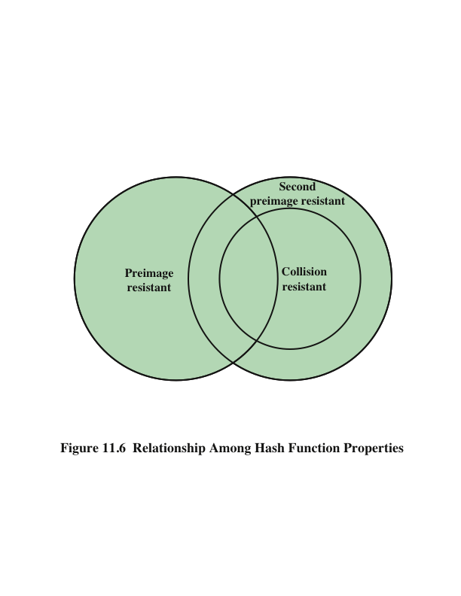
Notes:
Figure 11.6 shows the relationships among the three resistant properties.
A function that is collision resistant is also second preimage resistant, but the
reverse is not necessarily true. A function can be collision resistant but not preimage
resistant and vice versa. A function can be preimage resistant but not second
preimage resistant and vice versa. See [MENE97] for a discussion.

Slide 15
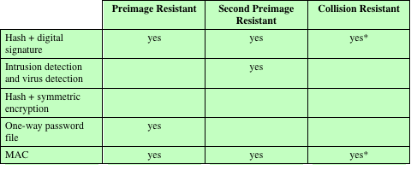
Table 11.2 Hash Function Resistance Properties Required for Various Data Integrity Applications
* Resistance required if attacker is able to mount a chosen message attack
Notes:
Table 11.2 shows the resistant properties required for various hash function
applications.

Slide 16
Attacks on Hash Functions
Brute-Force Attacks
Cryptanalysis
Does not depend on the specific algorithm, only depends on bit length
In the case of a hash function, attack depends only on the bit length of the hash value
Method is to pick values at random and try each one until a collision occurs
An attack based on weaknesses in a particular cryptographic algorithm
Seek to exploit some property of the algorithm to perform some attack other than an exhaustive search
Notes:
As with encryption algorithms, there are two categories of attacks on hash
functions: brute-force attacks and cryptanalysis. A brute-force attack does not depend
on the specific algorithm but depends only on bit length. In the case of a hash
function, a brute-force attack depends only on the bit length of the hash value. A
cryptanalysis, in contrast, is an attack based on weaknesses in a particular cryptographic
algorithm.

Slide 17
Birthday Attacks
For a collision resistant attack, an adversary wishes to find two messages or data blocks that yield the same hash function
The effort required is explained by a mathematical result referred to as the birthday paradox
How the birthday attack works:
The source (A) is prepared to sign a legitimate message x by appending the appropriate m-bit hash code and encrypting that hash code with A’s private key
Opponent generates 2^{m/2} variations x’ of x, all with essentially the same meaning, and stores the messages and their hash values
Opponent generates a fraudulent message y for which A’s signature is desired
Two sets of messages are compared to find a pair with the same hash
The opponent offers the valid variation to A for signature which can then be attached to the fraudulent variation for transmission to the intended recipient
Because the two variations have the same hash code, they will produce the same signature and the opponent is assured of success even though the encryption key is not known
Notes:
The Birthday Attack exploits the birthday paradox – the chance that in a group of people two will share the same birthday – only 23 people are needed for a Pr>0.5 of this. Can generalize the problem to one wanting a matching pair from any two sets, and show need 2^{m/2} in each to get a matching m-bit hash.
Yuval proposed the strategy shown to exploit the birthday paradox in a collision resistant attack. Note that creating many message variants is relatively easy, either by rewording or just varying the amount of white-space in the message. All of which indicates that larger MACs/Hashes are needed.

Slide 18
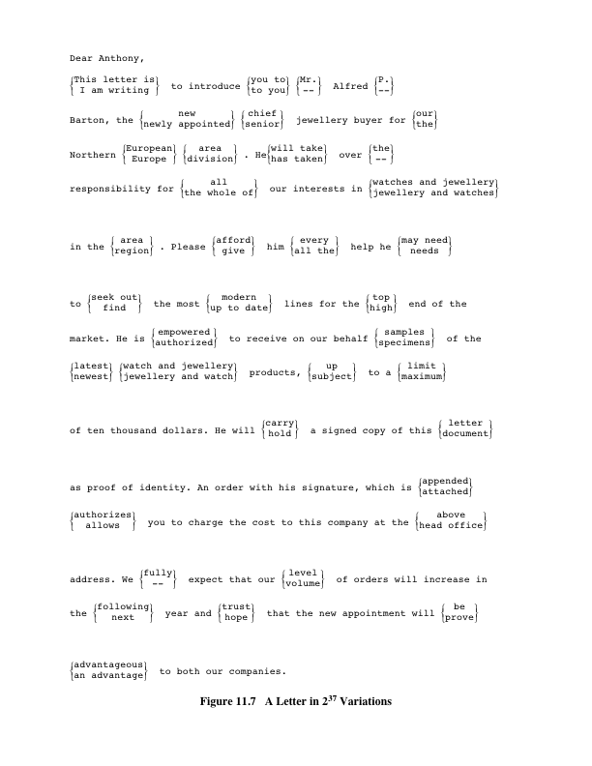
A Letter in 2³⁷ Variation
(Letter is located on page 326 in textbook)
Notes:
The generation of many variations that convey the same meaning is not difficult.
For example, the opponent could insert a number of “space-space-backspace”
character pairs between words throughout the document. Variations could then
be generated by substituting “space-backspace-space” in selected instances.
Alternatively, the opponent could simply reword the message but retain the meaning.
Figure 11.7 [DAVI89] provides an example.

Slide 19
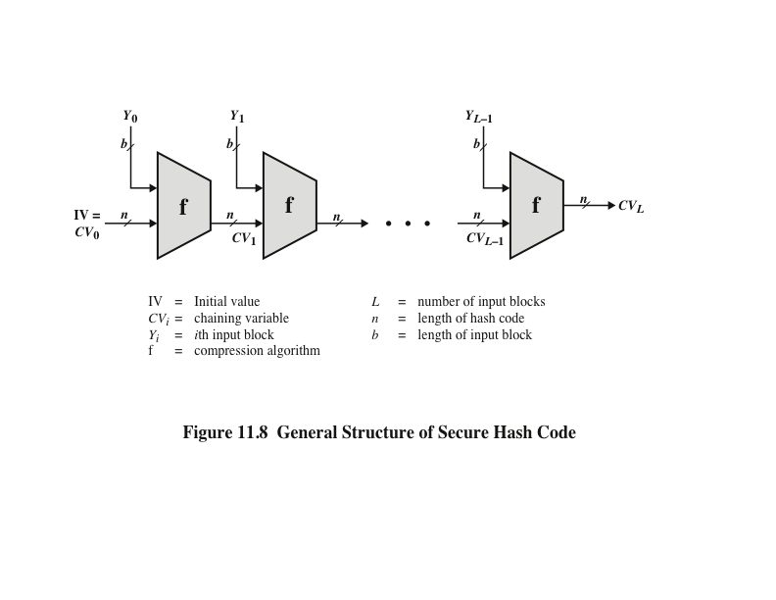
Notes:
In recent years, there has been considerable effort, and some successes,
in developing cryptanalytic attacks on hash functions. To understand these, we
need to look at the overall structure of a typical secure hash function, indicated in
Figure 11.8. This structure, referred to as an iterated hash function, was proposed
by Merkle [MERK79, MERK89] and is the structure of most hash functions in use
today, including SHA, which is discussed later in this chapter. The hash function
takes an input message and partitions it into L fixed-sized blocks of b bits each.
If necessary, the final block is padded to b bits. The final block also includes the
value of the total length of the input to the hash function. The inclusion of the
length makes the job of the opponent more difficult. Either the opponent must
find two messages of equal length that hash to the same value or two messages of
differing lengths that, together with their length values, hash to the same value.
The hash algorithm involves repeated use of a compression function , f, that
takes two inputs (an n -bit input from the previous step, called the chaining variable ,
and a b -bit block) and produces an n -bit output. At the start of hashing, the chaining
variable has an initial value that is specified as part of the algorithm. The final
value of the chaining variable is the hash value.

Slide 20
Hash Functions Based on Cipher Block Chaining
Can use block ciphers as hash functions
Using H₀=0 and zero-pad of final block
Compute: H_{i} = E(M_{i} H_{i-1})
Use final block as the hash value
Similar to CBC but without a key
Resulting hash is too small (64-bit)
Both due to direct birthday attack
And “meet-in-the-middle” attack
Other variants also susceptible to attack
Notes:
A number of proposals have been made for hash functions based on using a cipher block chaining technique, but without the secret key (instead using the message blocks as keys). One of the first such proposals was that of Rabin, which divided a message M into fixed-size blocks, and usde a symmetric encryption system such as DES to compute the hash code G as shown. This is similar to the CBC technique, but in this case there is no secret key. As with any hash code, this scheme is subject to the birthday attack, and if the encryption algorithm is DES and only a 64-bit hash code is produced, then the system is vulnerable. Furthermore, another version of the birthday attack can be used even if the opponent has access to only one message and its valid signature and cannot obtain multiple signings, known as a “meet-in-the-middle” attack (see text). It can be shown that some form of birthday attack will succeed against any hash scheme involving the use of cipher block chaining without a secret key provided that either the resulting hash code is small enough (e.g., 64 bits or less) or that a larger hash code can be decomposed into independent subcodes. Thus, attention has been directed at finding other approaches to hashing.

Slide 21
Secure Hash Algorithm (SHA)
SHA was originally designed by the National Institute of Standards and Technology (NIST) and published as a federal information processing standard (FIPS 180) in 1993
Was revised in 1995 as SHA-1
Based on the hash function MD4 and its design closely models MD4
Produces 160-bit hash values
In 2002 NIST produced a revised version of the standard that defined three new versions of SHA with hash value lengths of 256, 384, and 512
Collectively known as SHA-2
Notes:
In recent years, the most widely used hash function has been the Secure Hash
Algorithm (SHA). Indeed, because virtually every other widely used hash function
had been found to have substantial cryptanalytic weaknesses, SHA was more or
less the last remaining standardized hash algorithm by 2005. SHA was developed
by the National Institute of Standards and Technology (NIST) and published as a
federal information processing standard (FIPS 180) in 1993. When weaknesses were
discovered in SHA, now known as SHA-0 , a revised version was issued as FIPS
180-1 in 1995 and is referred to as SHA-1 . The actual standards document is entitled
“Secure Hash Standard.” SHA is based on the hash function MD4, and its design
closely models MD4.
SHA-1 produces a hash value of 160 bits. In 2002, NIST produced a revised
version of the standard, FIPS 180-2, that defined three new versions of SHA, with
hash value lengths of 256, 384, and 512 bits, known as SHA-256, SHA-384, and
SHA-512, respectively. Collectively, these hash algorithms are known as SHA-2 .
These new versions have the same underlying structure and use the same types of
modular arithmetic and logical binary operations as SHA-1.

Slide 22
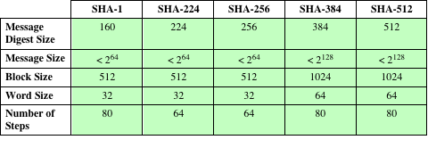
Table 11.3 Comparison of SHA Parameters
Note: All sizes are measured in bits.
Notes:
A revised document
was issued as FIP PUB 180-3 in 2008, which added a 224-bit version (Table 11.3).
SHA-1 and SHA-2 are also specified in RFC 6234, which essentially duplicates the
material in FIPS 180-3 but adds a C code implementation.
In 2005, NIST announced the intention to phase out approval of SHA-1
and move to a reliance on SHA-2 by 2010. Shortly thereafter, a research team described
an attack in which two separate messages could be found that deliver the
same SHA-1 hash using 2⁶⁹ operations, far fewer than the 2⁸⁰ operations previously
thought needed to find a collision with an SHA-1 hash [WANG05]. This result
should hasten the transition to SHA-2.

Slide 23
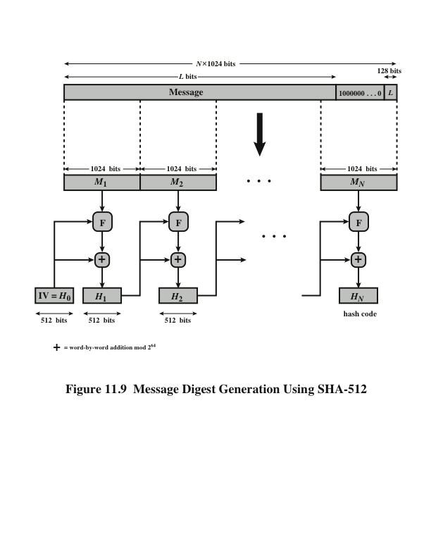
Notes:
The algorithm takes as input a message with a maximum length of less than 2¹²⁸ bits
and produces as output a 512-bit message digest. The input is processed in 1024-bit
blocks. Figure 11.9 depicts the overall processing of a message to produce a digest.
This follows the general structure depicted in Figure 11.8. The processing consists
of the following steps.
Step 1 Append padding bits. The message is padded so that its length is congruent
to 896 modulo 1024 [length = 896(mod 1024)]. Padding is always added,
even if the message is already of the desired length. Thus, the number of
padding bits is in the range of 1 to 1024. The padding consists of a single 1
bit followed by the necessary number of 0 bits.
Step 2 Append length. A block of 128 bits is appended to the message. This block
is treated as an unsigned 128-bit integer (most significant byte first) and
contains the length of the original message (before the padding).
The outcome of the first two steps yields a message that is an integer
multiple of 1024 bits in length. In Figure 11.9, the expanded message is
represented as the sequence of 1024-bit blocks M₁ , M₂ , . . . , M_{N} , so that the
total length of the expanded message is N * 1024 bits.
Step 3 Initialize hash buffer. A 512-bit buffer is used to hold intermediate
and final results of the hash function. The buffer can be represented as eight 64-bit
registers (a, b, c, d, e, f, g, h).
Step 4 Process message in 1024-bit (128-word) blocks. The heart of the algorithm
is a module that consists of 80 rounds; this module is labeled F in Figure 11.9.
The logic is illustrated in Figure 11.10.
Step 5 Output. After all N 1024-bit blocks have been processed, the output from
the Nth stage is the 512-bit message digest.

Slide 24
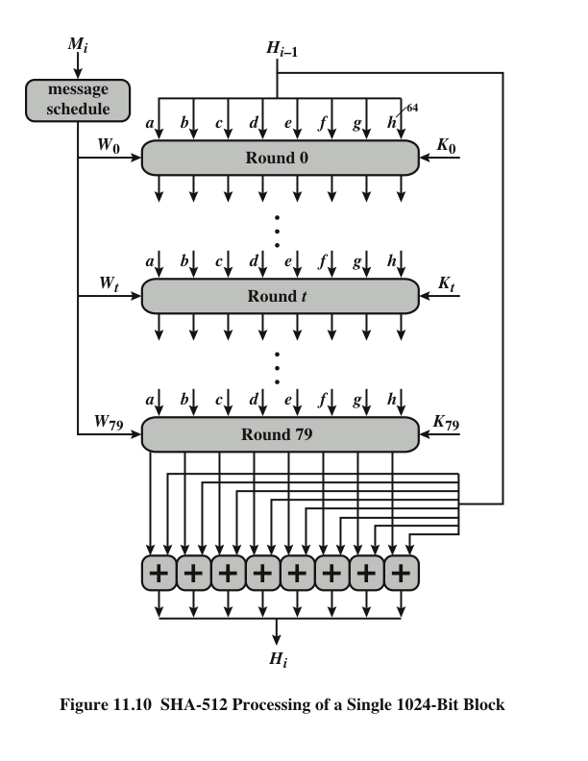
Notes:
The heart of the algorithm
is a module that consists of 80 rounds; this module is labeled F in Figure 11.9.
The logic is illustrated in Figure 11.10.

Slide 25
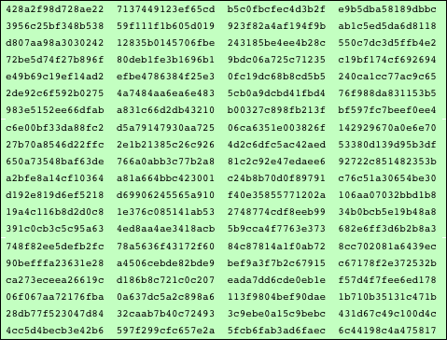
Table 11.4
SHA-512 Constants
(Table can be found on page 333 in textbook)
Notes:
The constants provide a “randomized” set of 64-bit patterns, which should
eliminate any regularities in the input data. Table 11.4 shows these constants
in hexadecimal format (from left to right).

Slide 26
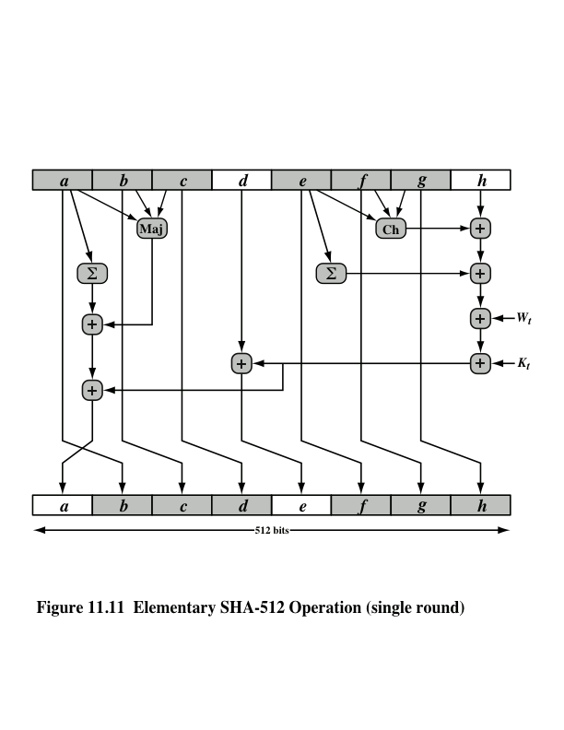
Notes:
Let us look in more detail at the logic in each of the 80 steps of the processing
of one 512-bit block (Figure 11.11).

Slide 27
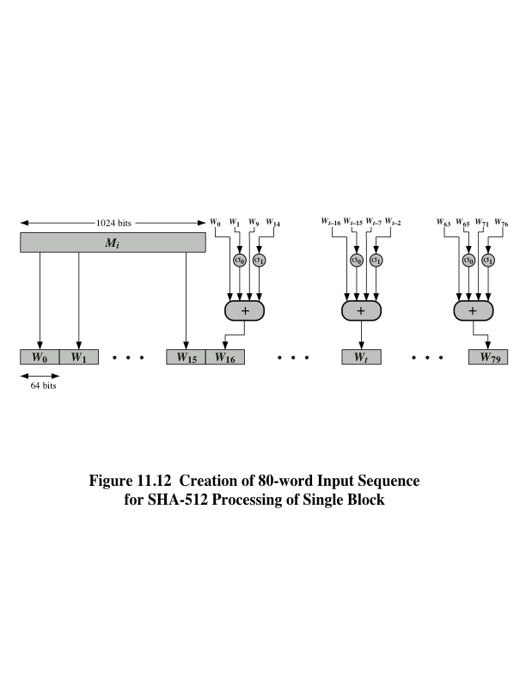
Notes:
Figure 11.12 Creation of 80-word Input Sequence for SHA-512 Processing of Single Block

Slide 28
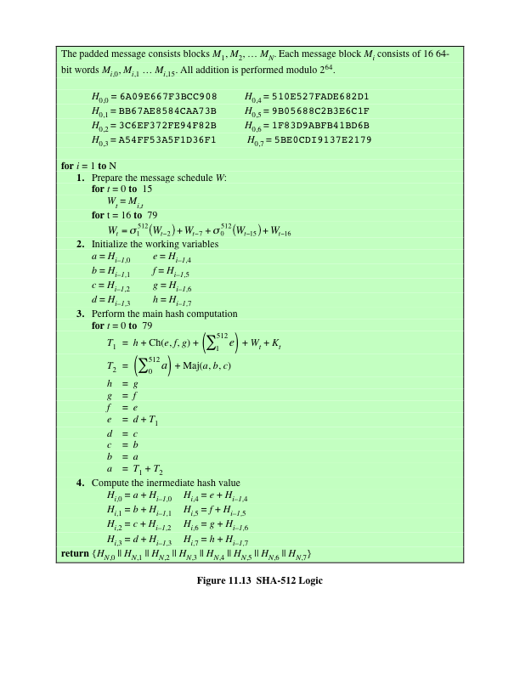
SHA-512
Logic
(Figure can be found on
page 337 in textbook)
Notes:
Figure 11.13 summarizes the SHA-512 logic.
The SHA-512 algorithm has the property that every bit of the hash code is a
function of every bit of the input. The complex repetition of the basic function F
produces results that are well mixed; that is, it is unlikely that two messages chosen
at random, even if they exhibit similar regularities, will have the same hash code.
Unless there is some hidden weakness in SHA-512, which has not so far been published,
the difficulty of coming up with two messages having the same message digest
is on the order of 2²⁵⁶ operations, while the difficulty of finding a message with
a given digest is on the order of 2⁵¹² operations.

Slide 29
SHA-3
SHA-1 has not yet been "broken”
No one has demonstrated a technique for producing collisions in a practical amount of time
Considered to be insecure and has been phased out for SHA-2
SHA-2 shares the same structure and mathematical operations as its predecessors so this is a cause for concern
Because it will take years to find a suitable replacement for SHA-2 should it become vulnerable, NIST decided to begin the process of developing a new hash standard
NIST announced in 2007 a competition for the SHA-3 next generation NIST hash function
Winning design was announced by NIST in October 2012
SHA-3 is a cryptographic hash function that is intended to complement SHA-2 as the approved standard for a wide range of applications
Notes:
As of this writing, the Secure Hash Algorithm (SHA-1) has not yet been “broken.”
That is, no one has demonstrated a technique for producing collisions in a practical
amount of time. However, because SHA-1 is very similar, in structure and in the
basic mathematical operations used, to MD5 and SHA-0, both of which have been
broken, SHA-1 is considered insecure and has been phased out for SHA-2.
SHA-2, particularly the 512-bit version, would appear to provide unassailable
security. However, SHA-2 shares the same structure and mathematical operations
as its predecessors, and this is a cause for concern. Because it will take years to find
a suitable replacement for SHA-2, should it become vulnerable, NIST decided to
begin the process of developing a new hash standard.
Accordingly, NIST announced in 2007 a competition to produce the next generation
NIST hash function, to be called SHA-3. The winning design for SHA-3
was announced by NIST in October 2012. SHA-3 is a cryptographic hash function
that is intended to complement SHA-2 as the approved standard for a wide range
of applications.
Appendix V looks at the evaluation criteria used by NIST to select from
among the candidates for AES, plus the rationale for picking Keccak, which was
the winning candidate. This material is useful in understanding not just the SHA-3
design but also the criteria by which to judge any cryptographic hash algorithm.

Slide 30
The Sponge Construction
Underlying structure of SHA-3 is a scheme referred to by its designers as a sponge construction
Takes an input message and partitions it into fixed-size blocks
Each block is processed in turn with the output of each iteration fed into the next iteration, finally producing an output block
The sponge function is defined by three parameters:
f = the internal function used to process each input block
r = the size in bits of the input blocks, called the bitrate
pad = the padding algorithm
Notes:
The underlying structure of SHA-3 is a scheme referred to by its designers as a
sponge construction [BERT07, BERT11]. The sponge construction has the same
general structure as other iterated hash functions (Figure 11.8). The sponge function
takes an input message and partitions it into fixed-size blocks. Each block is
processed in turn with the output of each iteration fed into the next iteration, finally
producing an output block.
The sponge function is defined by three parameters:
f = the internal function used to process each input block
r = the size in bits of the input blocks, called the bitrate
pad = the padding algorithm

Slide 31
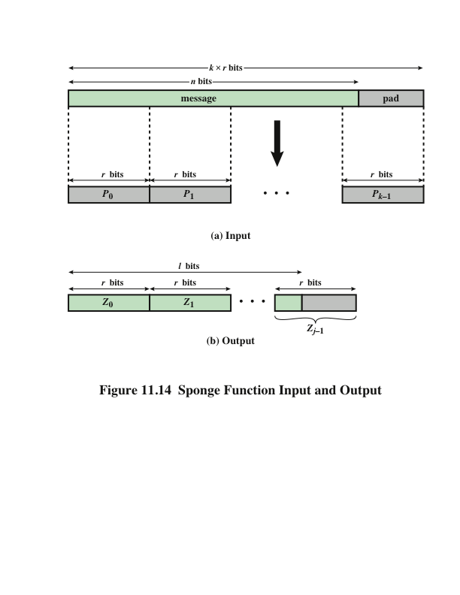
Notes:
A sponge function allows both variable length input and output, making it a
flexible structure that can be used for a hash function (fixed-length output), a pseudorandom
number generator (fixed-length input), and other cryptographic functions.
Figure 11.14 illustrates this point.
The sponge specification proposes [BERT11] proposes
two padding schemes:
• Simple padding: Denoted by pad10*, appends a single bit 1 followed by the
minimum number of bits 0 such that the length of the result is a multiple of the
block length.
• Multirate padding: Denoted by pad10*1, appends a single bit 1 followed by
the minimum number of bits 0 followed by a single bit 1 such that the length of
the result is a multiple of the block length. This is the simplest padding scheme
that allows secure use of the same f with different rates r .

Slide 32
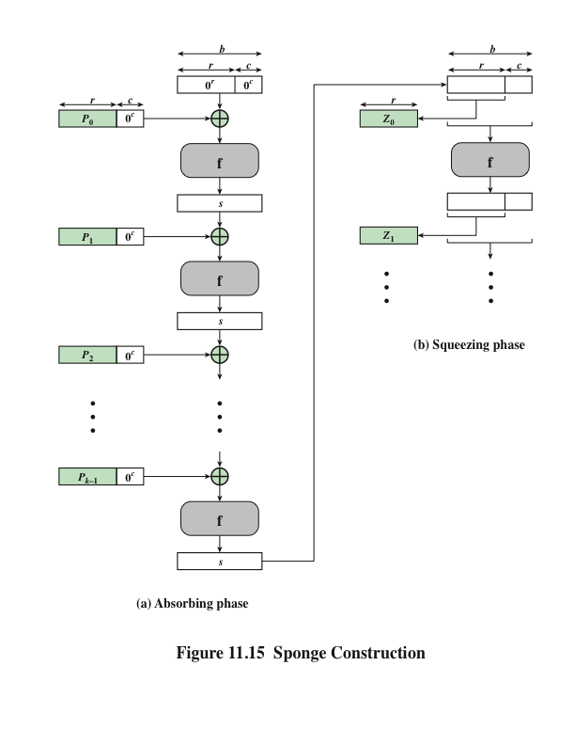
Notes:
Figure 11.15 shows the iterated structure of the sponge function. The sponge
construction operates on a state variable s of b = r + c bits, which is initialized to all
zeros and modified at each iteration. The value r is called the bitrate. This value is
the block size used to partition the input message. The term bitrate reflects the fact
that r is the number of bits processed at each iteration: the larger the value of r , the
greater the rate at which message bits are processed by the sponge construction.
The value c is referred to as the capacity . A discussion of the security implications of
the capacity is beyond our scope. In essence, the capacity is a measure of the achievable
complexity of the sponge construction and therefore the achievable level of
security. A given implementation can trade claimed security for speed by increasing
the capacity c and decreasing the bitrate r accordingly, or vice versa. The default
values for Keccak are c = 1024 bits, r = 576 bits, and therefore b = 1600 bits.

Slide 33
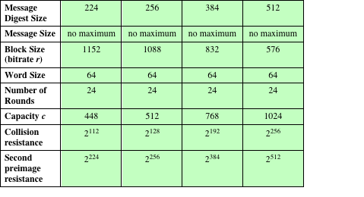
Table 11.5
SHA-3 Parameters
Notes:
Table 11.5 shows
the supported values of r and c . As Table 11.5 shows, the hash function security associated
with the sponge construction is a function of the capacity c .

Slide 34
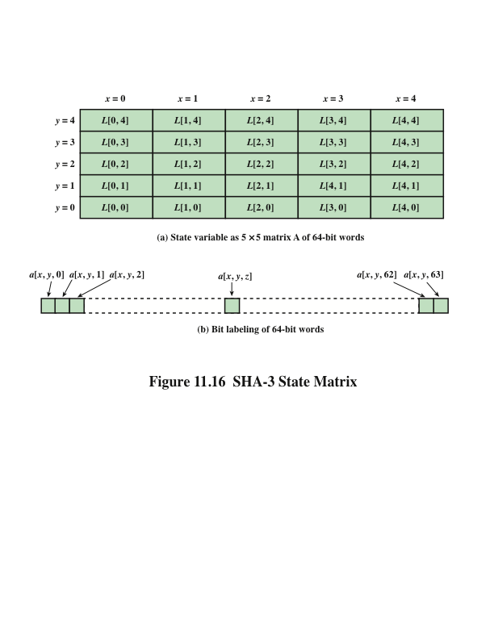
Notes:
We now examine the iteration function Keccak-f used to process each successive
block of the input message. Recall that f takes as input a 1600-bit variable s consisting
of r bits, corresponding to the message block size followed by c bits, referred to as the
capacity. For internal processing within f , the input state variable s is organized as a
5 * 5 * 64 array a . The 64-bit units are referred to as lanes . For our purposes, we generally
use the notation a [x , y , z ] to refer to an individual bit with the state array. When
we are more concerned with operations that affect entire lanes, we designate the
5 * 5 matrix as L [x , y ], where each entry in L is a 64-bit lane. The use of indices
within this matrix is shown in Figure 11.16. Thus, the columns are labeled x = 0
through x = 4, the rows are labeled y = 0 through y = 4, and the individual bits
within a lane are labeled z = 0 through z = 63.
The mapping between the bits of s
and those of a is
s [64(5y + x ) + z ] = a [x , y , z ]
We can visualize this with respect to the matrix in Figure 11.16. When treating
the state as a matrix of lanes, the first lane in the lower left corner, L [0, 0], corresponds
to the first 64 bits of s . The lane in the second column, lowest row, L [1, 0],
corresponds to the next 64 bits of s . Thus, the array a is filled with the bits of s starting
with row y = 0 and proceeding row by row.

Slide 35
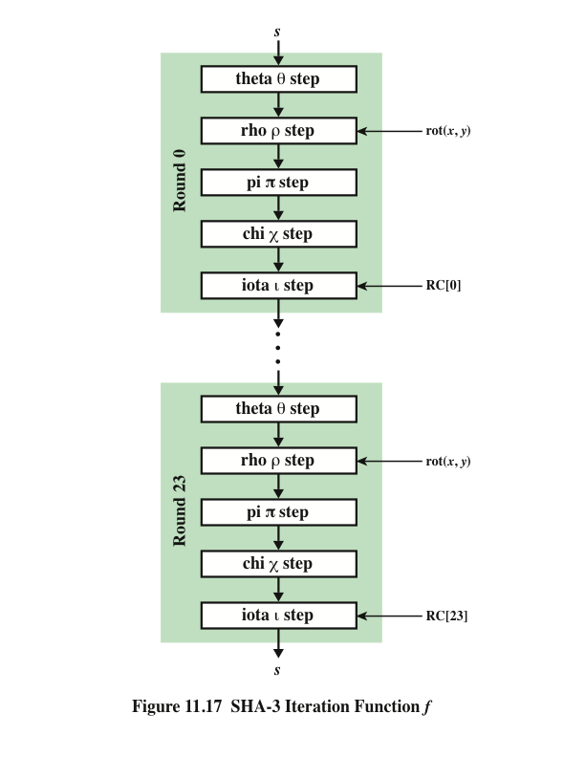
SHA-3 Iteration Function f
Notes:
The function f is executed once for each input block of the message
to be hashed. The function takes as input the 1600-bit state variable and converts
it into a 5 * 5 matrix of 64-bit lanes. This matrix then passes through 24 rounds of
processing. Each round consists of five steps, and each step updates the state matrix
by permutation or substitution operations. As shown in Figure 11.17, the rounds are
identical with the exception of the final step in each round, which is modified by a
round constant that differs for each round.

Slide 36
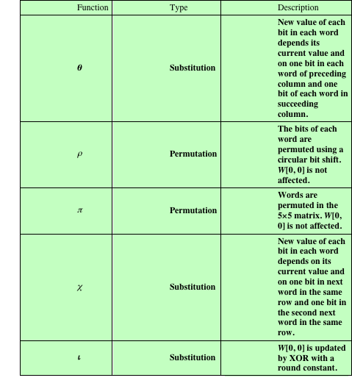
Table 11.6
Step Functions
in SHA-3
Notes:
Table 11.6 summarizes the operation of the five steps. The steps have a simple
description leading to a specification that is compact and in which no trapdoor
can be hidden. The operations on lanes in the specification are limited to bitwise
Boolean operations (XOR, AND, NOT) and rotations. There is no need for table
lookups, arithmetic operations, or data-dependent rotations. Thus, SHA-3 is easily
and efficiently implemented in either hardware or software.

Slide 37
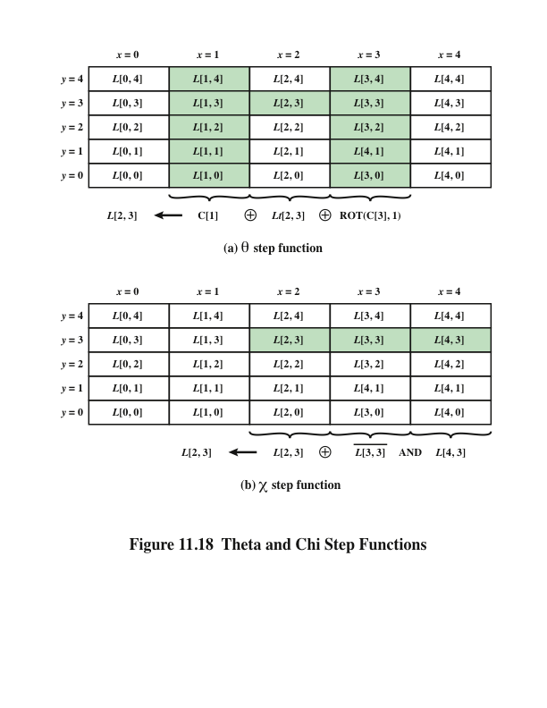
Notes:
Figure 11.18.a illustrates the operation on L [3, 2]. The same operation is performed
on all of the other lanes in the matrix.

Slide 38
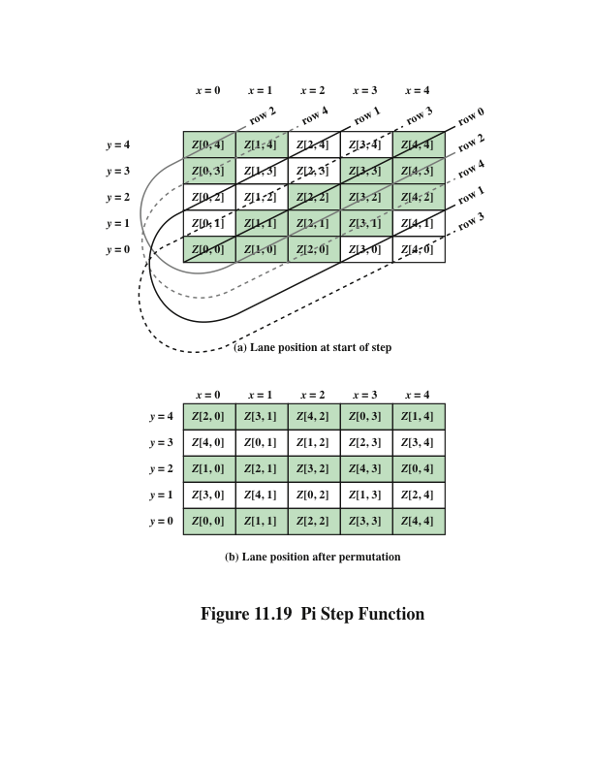
Notes:
Figure 11.19 Pi Step Function

Slide 39
Summary
Applications of cryptographic hash functions
Message authentication
Digital signatures
Other applications
Requirements and security
Security requirements for cryptographic hash functions
Brute-force attacks
Cryptanalysis
Hash functions based on cipher block chaining
Secure hash algorithm (SHA)
SHA-512 logic
SHA-512 round function
SHA-3
The sponge construction
The SHA-3 Iteration Function f
Notes:
Chapter 11 summary.

Slide 41
Hash函数
Hash函数强调单向性和抗冲突特性
Hash函数的用途总结下先
给明文增加结构特征以保护密文
产生MAC码（HMAC）
数字签名
从口令衍生密钥
挑战-应答认证协议中
也用来产生随机数

Slide 42
散列函数 h=H(x)
函数参数
输入：可以任意长度
输出：必须固定长度n比特，一般n=128、160bits
函数特性
单向性质：给定h，要找x使H(x)＝h是困难的
弱抗碰撞特性：
对于给定的y，找x，使H(x)＝H(y)是困难的
强抗碰撞特性（生日攻击）：
找x和y，使H(x)＝H(y)是困难的
* 如果碰撞则意味着数字签名容易被伪造/欺骗

Slide 43
Hash函数设计考虑
奇偶校验
异或XOR（或者累加）
只能检出奇数个比特错误
CRC
常用在帧校验
仍有很高的比率不能检出传输比特错误
* 不能满足单向性和抗冲突
复杂的密码学用散列函数
MD2/MD5
SHA/SHA1

Slide 44
找碰撞：生日攻击
最多尝试2^{n}＋1个报文，必有至少一对碰撞
问：平均尝试多少个报文，可以以1/2的概率找到一对碰撞？
~ 2^{n/2}
类比问题（生日问题）
最多找365+1个人，则必有至少两个人生日相同
问：平均找多少个人，能以1/2的概率找到两人生日相同？
23

Slide 45
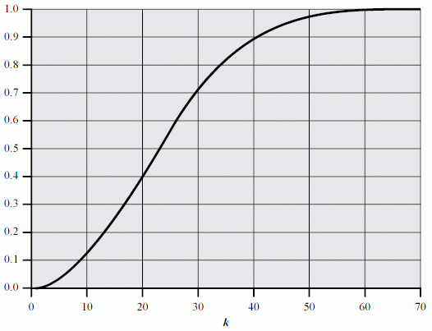
The Birthday Paradox

Slide 46
分组链接技术
一种Hash函数设计方法(基于某种加密算法)
by Rabin
H₀=初始值
H_{i}=E（M_{i}，H_{i-1}）
G=H_{n}
推荐使用MD5或SHA1

Slide 47
对Hash的攻击
穷举攻击（输出为n位的Hash函数）
抗弱碰撞性的能力为 2^{n}
抗强碰撞性的能力为 2^{n/2}
对MD5的密码分析
已有重大进展，可以在数小时至数分钟内产生一对冲突（攻击强抗碰撞特性）

Slide 48
小结
加密可以抵抗窃听，而认证是为了保证消息(进一步身份)的真实性。
如果加密时使用合适的方法（），也可以把认证特性加入进去，但是把认证和加密分离具有更好的灵活性。
认证码的产生须要密钥。为了效率，可以使用Hash函数。从概念上MAC码可以这样产生：
Hash（Message||Key）

Slide 50
MD5
近几年对散列算法的分析就是从MD5上获得突破的，MD5的强抗碰撞特性被打破。但是MD5是目前仍广泛使用的散列算法，而且看起来强抗碰撞特性的丢失对实用影响不大。
MD5算法是很多其他散列算法的前身，包括SHA-1。MD5算法将逐渐被代替，如SHA-1、WHIRLPOOL、RIPEMD-160。
新型散列算法的设计工作正在积极实施中。

Slide 51
MD系列
作者
Ronald Rivest
http://theory.lcs.mit.edu/~rivest/
MD2、MD4、MD5
MD2/4/5 RFC1319/1320/1321
http://www.ietf.org/rfc/rfc1321.txt
应用
曾经是最广泛的摘要算法
但是太短(128bits)
而SHA有160bits

Slide 52
MD5 Detail
输入 任意长
输出 128bits
过程
填充在Y[L]
报文填充1～512bits，使之≡448mod512
填充64bits长度值
填充后报文被划分成512bits分组
初始MD寄存器(IV)（小数在前little endian/intel）
A＝67452301 B＝EFCDAB89
C＝98BADCFE D＝10325476
分组处理 …

Slide 53
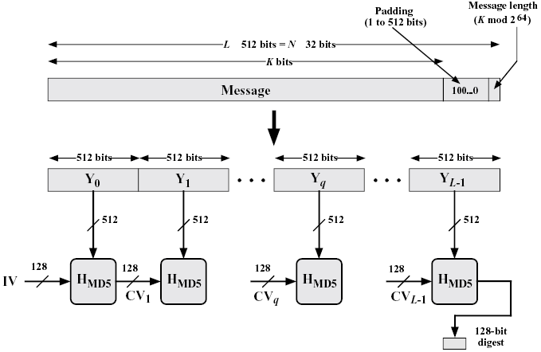
MD5 Overview
ABCD初值

Slide 54
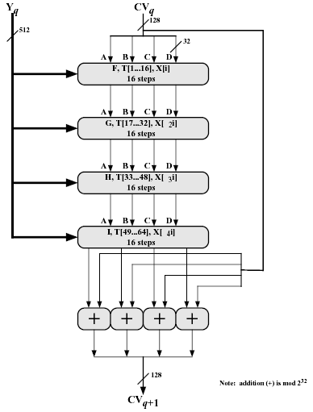
MD5 1 Loop
输入
128b＋512b(128*4)
输出
128b
过程
FGHI布尔函数
T[]是常量表
X[k]为512b分组中的
第k个32b字

Slide 55
T[i] = 2³²×abs(sin(i))
T[1] = D76AA478
T[2] = E8C7B756
T[3] = 242070DB
T[4] = C1BDCEEE
T[5] = F57COFAF
T[6] = 4787C62A
T[7] = A8304613
T[8] = FD469501
T[9] = 698098D8
T[10] = 8B44F7AF
T[11] = FFFF5BB1
T[12] = 895CD7BE
T[13] = 6B901122
T[14] = FD987193
T[15] = A679438E
T[16] = 49B40821
T[17] = F61E2562
T[18] = C040B340
T[19] = 265E5A51
T[20] = E9B6C7AA
T[21] = D62F105D
T[22] = 02441453
T[23] = D8A1E681
T[24] = E7D3FBC8
T[25] = 21E1CDE6
T[26] = C33707D6
T[27] = F4D50D87
T[28] = 455A14ED
T[29] = A9E3E905
T[30] = FCEFA3F8
T[31] = 676F02D9
T[32] = 8D2A4C8A
T[33] = FFFA3942
T[34] = 8771F681
T[35] = 699D6122
T[36] = FDE5380C
T[37] = A4BEEA44
T[38] = 4BDECFA9
T[39] = F6BB4B60
T[40] = BEBFBC70
T[41] = 289B7EC6
T[42] = EAA127FA
T[43] = D4EF3085
T[44] = 04881D05
T[45] = D9D4D039
T[46] = E6DB99E5
T[47] = 1FA27CF8
T[48] = C4AC5665
T[49] = F4292244
T[50] = 432AFF97
T[51] = AB9423A7
T[52] = FC93A039
T[53] = 655B59C3
T[54] = 8F0CCC92
T[55] = FFEFF47D
T[56] = 85845DD1
T[57] = 6FA87E4F
T[58] = FE2CE6E0
T[59] = A3014314
T[60] = 4E0811A1
T[61] = F7537E82
T[62] = BD3AF235
T[63] = 2AD7D2BB
T[64] = EB86D391

Slide 56
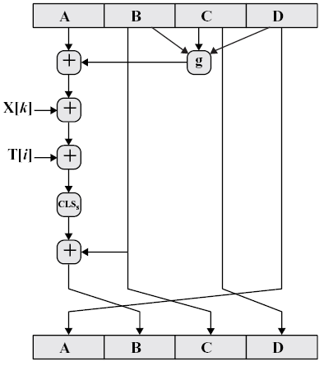
MD5 1/4 Loop
四个函数真値表
b c d F G H I
0 0 0 0 0 0 1
0 0 1 1 0 1 0
0 1 0 0 1 1 0
0 1 1 1 0 0 1
1 0 0 0 0 1 1
1 0 1 0 1 0 1
1 1 0 1 1 0 0
1 1 1 1 1 1 0

Slide 57
MD5强度
特性
散列码(128b)的每一个比特是输入的每一个比特的函数
找两个冲突报文的计算量得2^64(生日攻击)
找个给定报文冲突的计算量得2^128
攻击进展
单轮攻击已经可能
(Berson 92、Dobbertin 96)
WANG

Slide 58
MD4 - MD5的前驱
MD4 - MD2的后继
1990/1992 rfc 1320
设计
安全
快速
简单紧凑
Little endian (intel cpu)
MD5改进
增加复杂度了以更安全，也更慢些
增加了轮数、g的变化、累加

Slide 59
SHA-1
SHA：Secure Hash Algorithm
作者 NIST
1993 FIPS PUB 180 SHA {SHA-0}
1995 FIPS PUB 180-1 SHA-1修正版
2001 FIPS PUB 180-2 SHA-2
包括SHA-256/384/512
相关FIPS
http://csrc.nist.gov/publications/fips/
CSRC http://csrc.nist.gov/
AES、PKI、IPSec、＋
基于MD4，类似MD5

Slide 60
SHA-1 Detail
输入 任意报文(<2^64)
输出 160bits
过程
填充报文、长度成512bits分组
初始化寄存器ABCDE
E = C3D2E1F0
分组处理 …

Slide 61
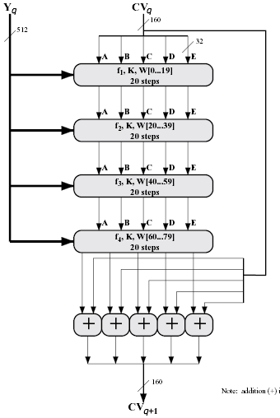
SHA-1 1 Block
512bits/32=16words
扩展至W[80]字
每1/4用20字

Slide 62
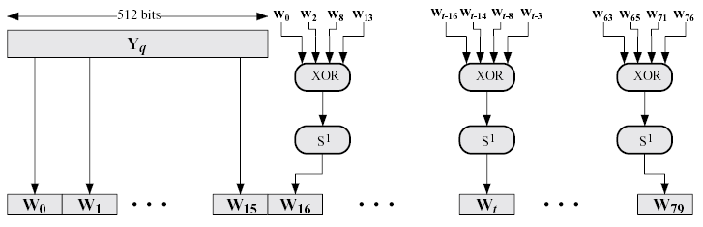
分组 512bits → 80×32bits
（从16个字扩展为80个字）
W0…15=512bits/32 Wt=S1(Wt-16 xor Wt-14 xor Wt-8 xor Wt-3)

Slide 63
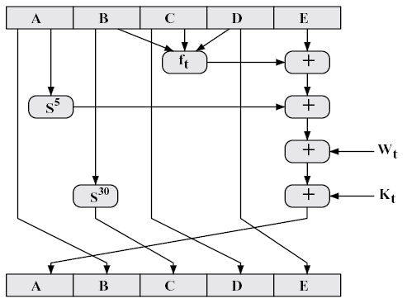
SHA-1 1 Loop
Si 循环左移ibits
K1(00-19)=5A827999
K2(20-39)=6ED9EBA1
K3(40-59)=8F1BBCDC
K4(60-79)=CA62C1D6
(分别是2^30×:
√2、√3、√5、√10)

Slide 64
SHA f_{0…79}
B C D f1(0..19)f2(20..39)f3(40..59)f4(60..79)
0 0 0 0 0 0 0
0 0 1 1 1 0 1
0 1 0 0 1 0 1
0 1 1 1 0 1 0
1 0 0 0 1 0 1
1 0 1 0 0 1 0
1 1 0 1 0 1 0
1 1 1 1 1 1 1

Slide 65
比较SHA-1/ MD5
散列值长度
MD5 128bits SHA-1 160bits
安全性
SHA看来好些，但是SHA的设计原则没有公开
速度
SHA-1慢些 （openssl speed md5/sha-1:）
type 16 bytes 64 bytes 256 bytes 1024 bytes 8192 bytes
md5 5425.31k 19457.48k 55891.45k 104857.60k 143211.40k
sha-1 5104.58k 16008.41k 37925.33k 57421.81k 68241.68k
其他
雷同，但
SHA-1使用big endian

Slide 66
SHA-256/384/512
FIPS 180-2 (draft 2001)
Algorithm MessageSize
BlockSize
WordSize
MDSize
Security
SHA-1 <2⁶⁴ 512 32 160 80
SHA-256 <2⁶⁴ 512 32 256 128
SHA-384 <2¹²⁸ 1024 64 384 192
SHA-512 <2¹²⁸ 1024 64 512 256
Security refto birthday attack

Slide 67
SHA-512
输出512位，以1024位分组处理
寄存器初始值
a = 6A09E667F3BCC908
b = BB67AE8584CAA73B
c = 3C6EF372FE94F82B
d = A54FF53A5F1D36F1
e = 510E527FADE682D1
f = 9B05688C2B3E6C1F
g = 1F83D9ABFB41BD6B
h = 5BE0CD19137E2179
Notes:
目前，MD5和SHA-1仍是最常用的散列算法。但是更长的散列算法如SHA-256/512等正在成为趋势。

Slide 68
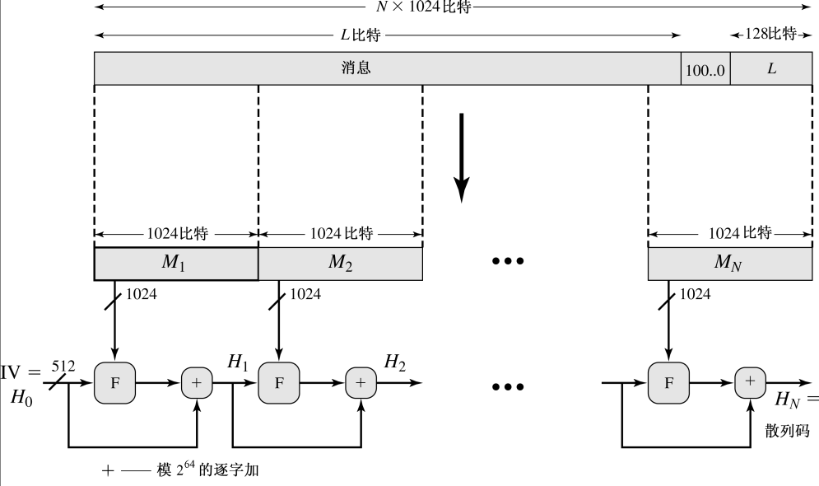
SHA-512 Overview

Slide 69
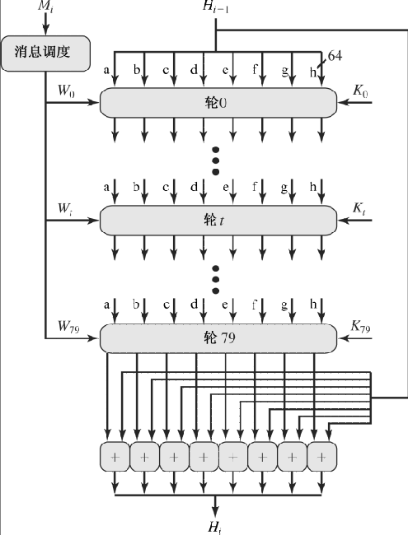
SHA-512 Round

Slide 70
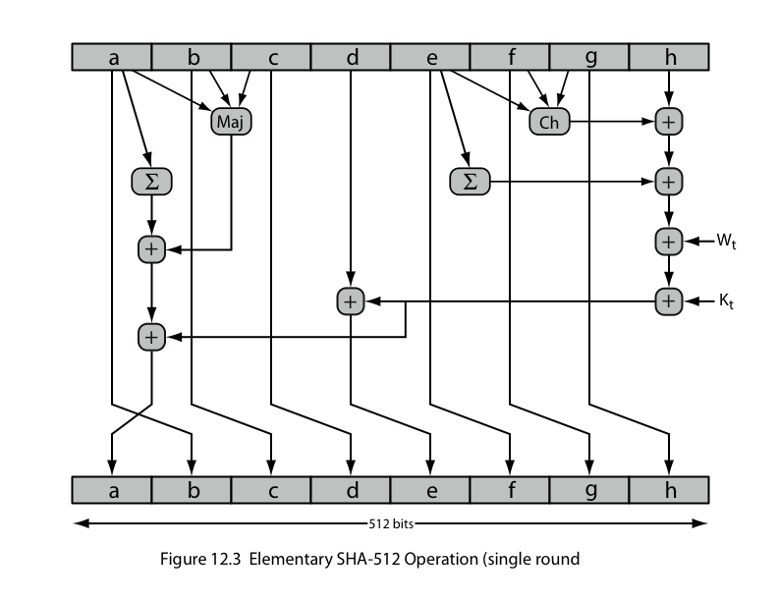
SHA-512 Round Function

Slide 71
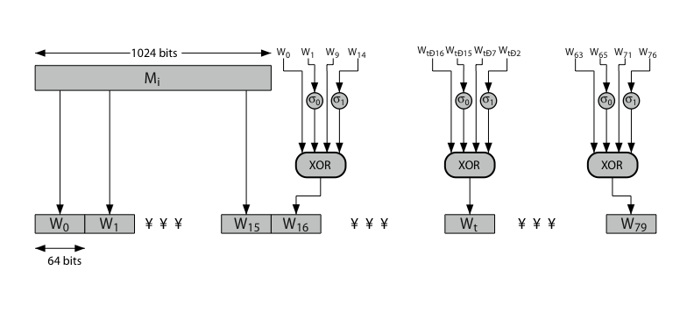
SHA-512 Round Function

Slide 72
SHA-512实现
SHA-256/384/512 implementation
http://freshmeat.net/projects/sha2/
Support for the SHA-256, SHA-384, and SHA-512 hash algorithms was added to the Sun provider. ---JDK 1.4.2
在OpenSSL-0.9.8d中还不支持。

Slide 73
Whirlpool
借鉴了AES内部的设计
和AES/Rijndael有相同的设计者
NESSIE认可的两个Hash算法(和SHA-2)
https://www.cosic.esat.kuleuven.be/nessie/
http://paginas.terra.com.br/informatica/paulobarreto/WhirlpoolPage.html
特性
每一分组512位/64字节
输出 512位

Slide 74
基于分组密码的散列函数的缺点
不利于随机化
因为加密是可逆的，
分组密码存在规则性
分组密码通常很慢
分组密码分组长度小于散列值长度
通常64位或128位 vs. 128/160/256/384/512
Whirlpool的考虑

Slide 75
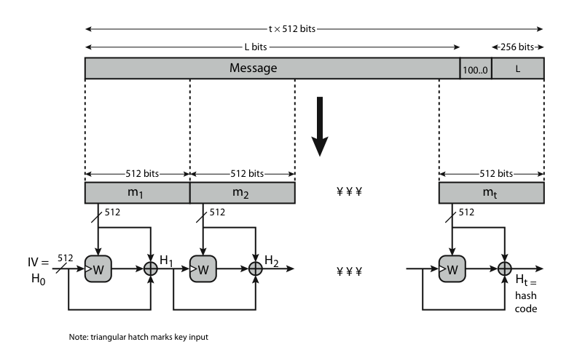
Whirlpool Overview

Slide 76
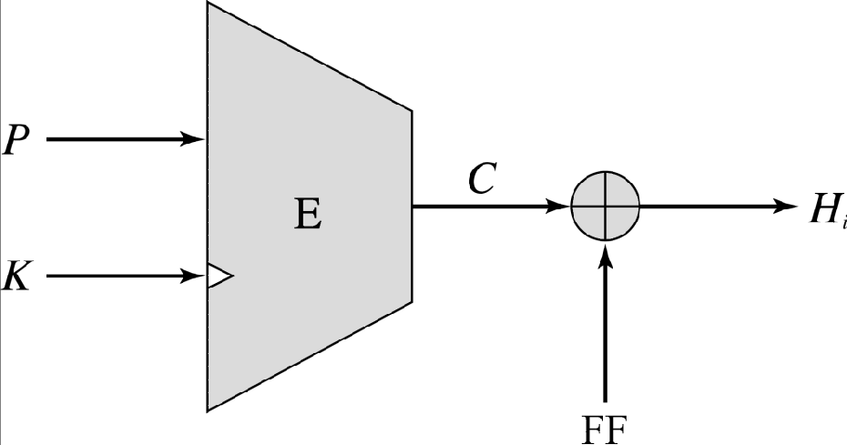
通用循环散列结构[Merkle]
Whirlpool
K ← H_{i-1}
FF← P⊕H_{i-1}

Slide 77
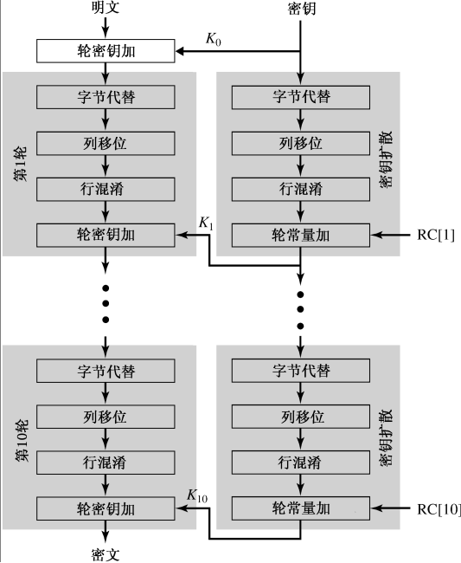
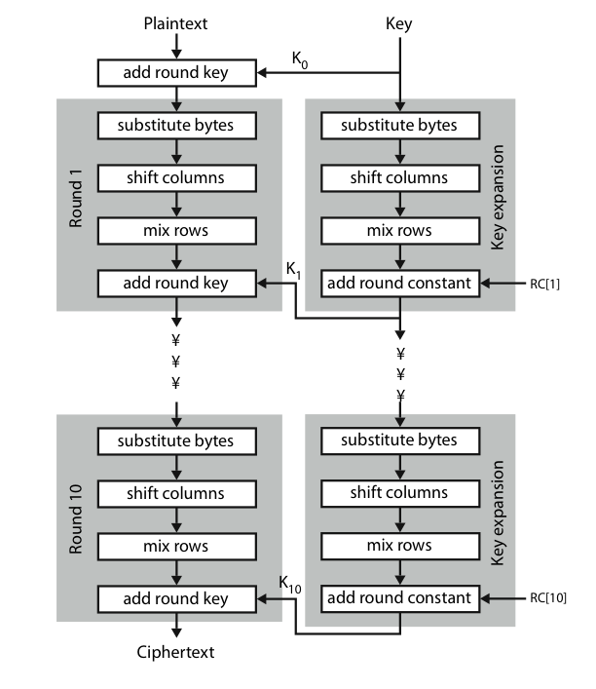
Whirlpool 轮次

Slide 78
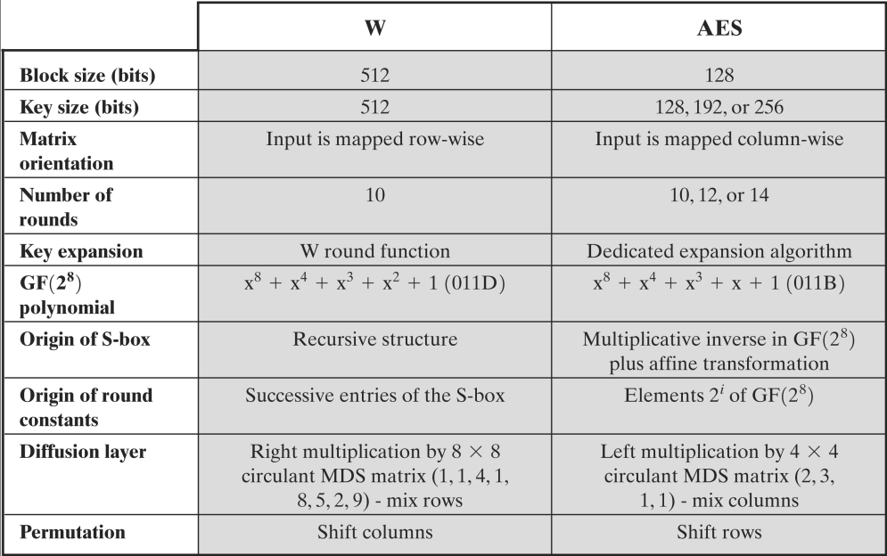
和AES比较

Slide 79
Whirlpool的安全性
较新而缺少经验和结论
所需硬件资源比SHA-12多，但同时也较快

Slide 80
Whirlpool实现
参考实现
http://planeta.terra.com.br/informatica/paulobarreto/whirlpool.zip
Notes:
还不普及

