Slide 1
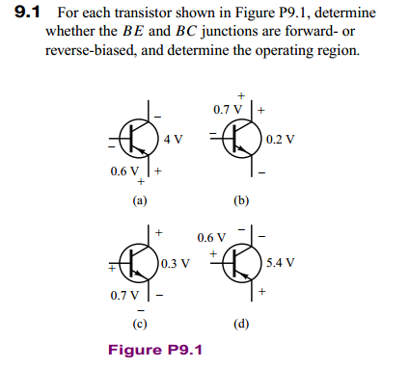
Solution: (a)PNP VBE=-0.6v VCE=-4v VBC=VBE-VCE=3.6v BE: forward BC: reverse
operating region: Active (放大区)
(b)NPN VBC=-0.7v VCE=0.2v VBE=VBC+VCE=-0.5v BE: reverse BC: reverse
operating region: Cutoff (截止区)
(c)NPN VBE=0.7v VCE=0.3v VBC=VBE-VCE=-0.4v BE: forward BC: forward
operating region: Saturation (饱和区)
(d)PNP VBC=0.6v VCE=-5.4v VBE=VBC+VCE=-4.8v BE: forward BC: reverse
operating region: Active (放大区)

Slide 2
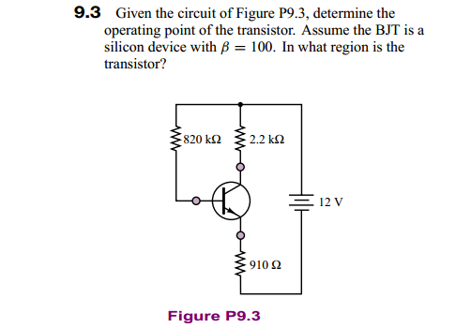
BE: forward BC: reverse operating region: Active (放大区)

Slide 3
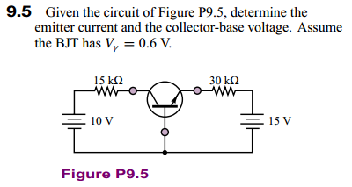
BE: reverse BC: reverse operating region: Cutoff (截止区)
the base current is very small, and essentially no collector current flows.
将BE级15V电压反向，求放大区

Slide 4
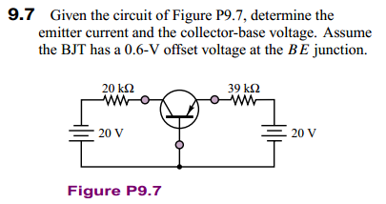
PNP三极管

Slide 5
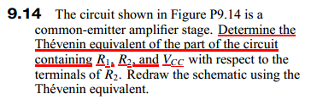
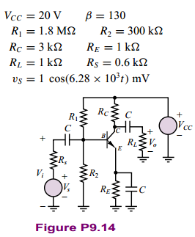

Slide 6
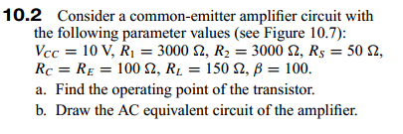
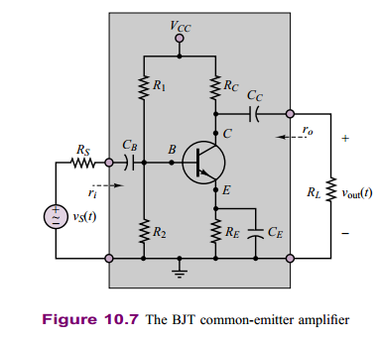

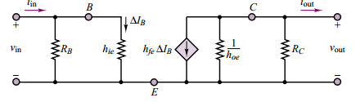

Slide 7

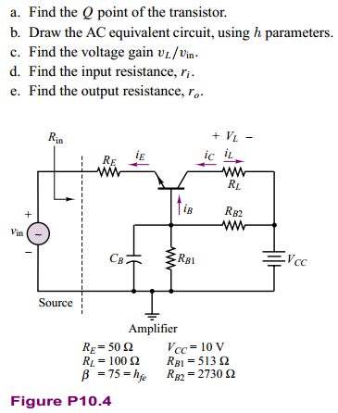

Slide 8
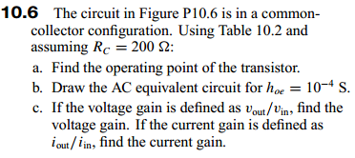
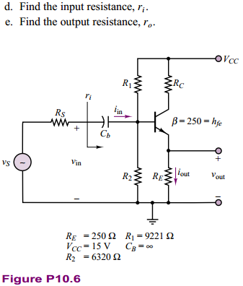

Slide 9
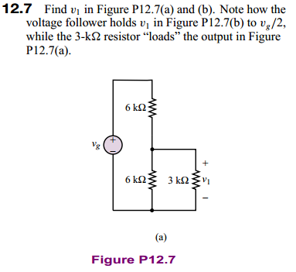
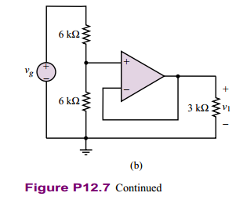
虚短：
虚断：

Slide 10
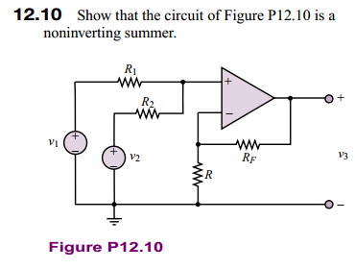
由虚短：
由虚断：

Slide 11
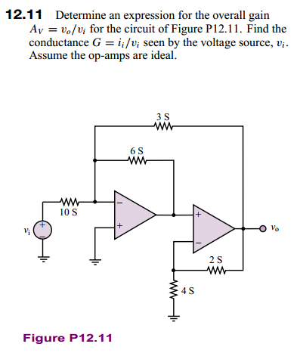
由虚断有：
i1
i2
ii
由虚短有：

