Slide 1
Digital Circuits and Logic Design
Shaoyong Zheng (郑少勇)
Assistant Professor
School of Information Science and Technology
Office: Room 635-A
Email: zhengshaoy@mail.sysu.edu.cn

Slide 2

Digital Circuits
Digital circuits
Represent signal by discrete bands of analog level rather than by a continuous range

Slide 3
Logic Design
Logic Design
A process by which an abstract form of desired circuit behavior is turned into a design implementation in terms of logic gate.
Logic Gate
An idealized or physical device implementing a Boolean function, that is, it performs a logical operation on one or more logical inputs, and produces a single logical output

Slide 4


Logic Design
Gate
Logic Gate??

Slide 5
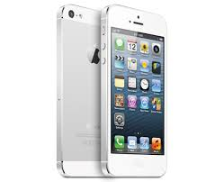
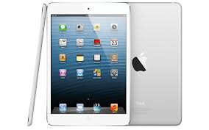

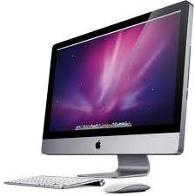
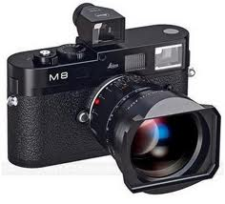
Digital System
Digital system
A system that implements functions using digital logics

Slide 6
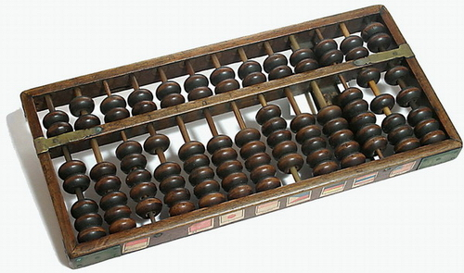
Digital System
History
1642 Mechanical Adder
1671 Mechanical Multiplier/Divider
1847 Boolean Algebra (George Boole)
1938 Commutative Algebra(Claude Shannon)

Slide 7
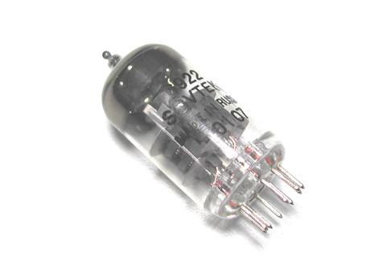
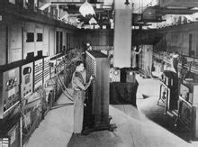
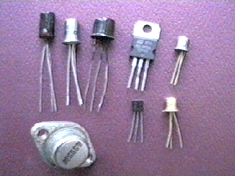
Digital System
History
1906 Vacuum Tube
1946 First computer ENIAC
1947 Transistor

Slide 8


Digital System
History
1960 Integrated circuit
1971 Microprocessor(Intel)
1970’s LSI(Large Scale Integrated Circuits)
1980’s VLSI(Very Large Scale Integrated Circuits)

Slide 9
Digital Circuits
Digital Circuits
Digital Circuits
Combinational Logic Circuits
Sequential Logic Circuits
组合逻辑电路
时序逻辑电路

Slide 10
Digital Circuits
Digital Circuits
Digital Circuits
Discrete Component Circuit
Integrated Circuit
分立元件电路
集成电路

Slide 11
Aims
Course Intended Learning Outcomes
Perform number and code conversion and arithmetic operations among various number systems
Apply different methods to simplify combinational logic functions and sequential machines
Analyze and design combinational and synchronous sequential circuits
Recognize electrical characteristics of different logic families
Apply basic theories to practical work

Slide 12
Contents of the Course
Chapter 1 Introductory Concepts
Chapter 2 Number Systems, Operations, and Codes
Chapter 3 Logic Gates (逻辑门)
Chapter 4 Boolean Algebra and Logic Simplification
Chapter 5 Combinational Logic (组合逻辑) Analysis
Chapter 6 Functions of Combinational Logic

Slide 13
Contents of the Course
Chapter 7 Latches, Flip-Flops, and Timers
(锁存器，触发器，定时器)
Chapter 8 Counters (计数器)
Chapter 9 Shift Registers (移位寄存器)
Chapter 10 Memory and Storage
Chapter 11 Signal Interfacing and Processing
Chapter 12 Integrated Circuit Technologies

Slide 14
Course Schedule
Week 1: Chapter 1
Week 2: Chapter 2
Week 3: Chapter 3
Week 4: Chapter 4
Week 5: Chapter 5
Week 6: Chapter 6
Week 7: Chapter 6
Week 8: Chapter 7
Week 9: Chapter 7
Week 10: Chapter 8
Week 11: Chapter 8
Week 12: Chapter 9
Week 13: Chapter 10
Week 14: Chapter 11
Week 15: Chapter 12
Week 16: Revision
Week 17: Q&A
Week 18: Final Exam

Slide 15
Reference
Text Book
Thomas L. Floyd. Digital Fundamentals (10th Edition).
电子工业出版社.2005.
Reference Books
龚之春. 数字电路，电子科技大学出版社.1999.
杨颂华，冯毛官，孙万蓉等. 数字电子技术基础(第2版)，
西安电子科技大学出版社.2009

Slide 16

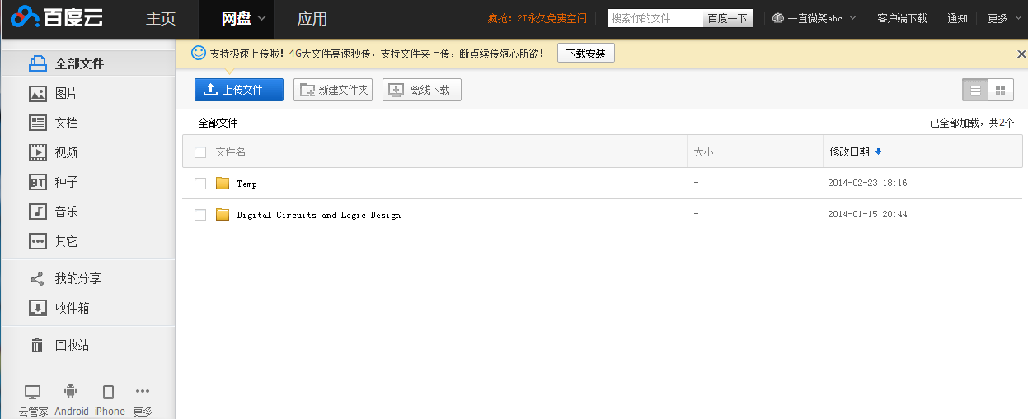
Reference
Course Material
百度云网盘
ID: sysuzsy@gmail.com
Password: syzheng
Folder: Digital Circuits and Logic Design

Slide 17
Assessment
Final Exam
Duration: 2 hours
70% final score
Course Work
15 homework assignments
20% final score
Attendance
10% final score

Slide 18
Importance of Course
Importance of course
Basic course for
Computer Science
Electronic Engineering
Communication Engineering
Subject of Postgraduate Entrance Examination for
Electronic Engineering
Communication Engineering

Slide 19
Importance of Course
Necessary for Computer Science?
SYSU
Computer Science
Information Security
Computer Science
Network Engineering

Slide 20
Importance of Course
Necessary for Computer Science?
Digital Circuits
Software
Hardware

Slide 21
Personal Information
Educational Background
Doctor of Philosophy 2009.1 ~ 2011.7
Department of Electronic Engineering City University of Hong Kong
Master of Philosophy 2007.8 ~ 2008.12
Department of Electronic Engineering City University of Hong Kong
Master of Science 2004.9 ~ 2006.2
Department of Electronic Engineering City University of Hong Kong

Slide 22
Personal Information
Professional Experiences
Assistant Professor 2012.10 ~ now
Department of Electronics and Communication Engineering
Sun Yat-sen University
Visiting Assistant Professor 2013.7-2013.8
Department of Electronic Engineering City University of Hong Kong
Research Fellow 2011.8-2012.10
Department of Electronic Engineering City University of Hong Kong
Research Assistant 2006.8-2008.12
Department of Electronic Engineering City University of Hong Kong

Slide 23
Personal Information
Research Interests
Evolutionary Algorithm
RF and Microwave circuits
Millimeter wave components
Passive Microwave components optimization
Publications
Published more than 30 papers in journals and conference proceedings including
10 IEEE Transactions
7 IEEE/IET Letters

Slide 24
Personal Information
Professional Activities
Member of IEEE
IEEE Microwave Theory and Techniques Society
IEEE Industrial Electronics Society
IEEE Antennas and Propagation Society
Active Peer Reviewer
IEEE Transactions on Microwave Theory and Techniques
IEEE Microwave and Wireless Components Letters
Progress in Electromagnetics Research
Journal of Electromagnetic Waves and Applications

Slide 25
Assignment
Assignment 1 (Due on 3 March 2014)
What to expect from this course
Suggestion for this course
…

