Slide 1
Digital Circuits and Logic Design
Chapter 10
Memory and Storage

Slide 2
After this lecture, you should be able to:
Identify different types of memory
Describe operations of different types of memory
Describe methods to expand the memory

Slide 3
Memory Units
Memory and Storage
Computers and other types of systems require the permanent or semi-permanent storage of large amounts of binary data.
Microprocessor-based systems rely on storage devices and memories for their operation because of the necessity for storing programs and for retaining a data during processing.
In computer terminology, memory usually refers to RAM and ROM and storage refers to hard disk, floppy disk, and CD-ROM.

Slide 4
Memory Units
Memory
Memory is the portion of a system for storing binary data in large quantities.
Semiconductor memories consists of arrays of storage elements that are either latches or capacitors.
Units of binary data: bits, bytes, nibbles, and words.
The basic semiconductor memory array
Each storage element in a memory can retain either a 1 or 0
and is called a cell .

Slide 5
Memory Units
Memory Units
Memories store data in units from one to eight bits.
The most common unit is the byte, which by definition is 8 bits.
Computer memories are organized into multiples of bytes called words.
Generally, a word is defined as the number of bits handled as one entity by a computer.
By this definition, a word is equal to the internal register size (usually 16, 32, or 64 bits).

Slide 6
Memory Units
Memory Units
The location of a unit of data in a memory is called the address. In PCs, a byte is the smallest unit of data that can be accessed.
In a 2-dimensional array, a byte is accessed by supplying a row number. For example the blue byte is located in row 7.
The capacity of a memory is the total number of data units that can be stored.

Slide 7
Memory Units
Memory Units
In a 2-dimensional array, a byte is accessed by supplying a row number. For example the blue byte is located in row 7.

Slide 8
Memory Addressing
Memory Addressing
A 3-dimensional array is arranged as rows and columns. Each byte has a unique row and column address.
Question
How many bytes are shown?
What is the location of the blue byte?
a) 64 B
b) Row 2, column 8

Slide 9
Memory Addressing
Memory Addressing
In order to read or write to a specific memory location, a binary code is placed on the address bus.
Internal decoders decode the address to determine the specific location.
Data units go into the memory during a write operation and come out of the memory during a read operation on a set of lines called the data bus.
The data bus is bidirectional, which means that data can go in either direction (into the memory or out of the memory).

Slide 10
Memory Addressing
Memory Addressing
The address bus is a group of conductors with a common function.
Its size determines the number of locations that can be accessed.
A 32 bit address bus can access 2³² locations, which is approximately 4G.

Slide 11
Memory Addressing
Memory Addressing
In addition to the address bus and data bus, semiconductor memories have read and write control signals and chip select signals. Depending on the type of memory, other signals may be required.
Read Enable (RE) and Write Enable (WE) signals are sent from the CPU to memory to control data transfer to or from memory.
Chip Select (CS) or Chip Enable (CE) is used as part of address decoding. All other inputs are ignored if the Chip Select is not active.
Output Enable (OE) is active during a read operation, otherwise it is inactive. It connects the memory to the data bus.

Slide 12
Operations
Read and Write Operations
The two main memory operations are called read and write. A simplified write operation is shown in which new data overwrites the original data. Data moves to the memory.
Address register
Data register
Address decoder
Byte organized memory array
Address bus
The address is placed on the address bus.
Data is placed on the data bus.
A write command is issued.
Data bus
Write

Slide 13
Operations
Read and Write Operations
The read operation is actually a “copy” operation, as the original data is not changed. The data bus is a “two-way” path.
Data moves from the memory during a read operation.
Address register
Data register
Address decoder
Byte organized memory array
Address bus
Data bus
The address is placed on the address bus.
A read command is issued.
A copy of the data is placed in the data bus and shifted into the data register.
Read

Slide 14
RAM
Semiconductor Memory
The two major categories of semiconductor memories are:
RAM
ROM
RAM (Random-access memory) is a type of memory in which all address are accessible in an equal amount of time and can be selected in any order for a read or write operation.
ROM (Read-only memory) is a type of memory in which data are stored permanently or semipermanently.

Slide 15
RAM
Random Access Memory
RAMs are read/write memories in which data can be written into or read from any selected address in any sequence.
When a data unit is written into a given address in the RAM, the data unit previously stored at that address is replaced by the new data unit.
When a data unit is read from a given address in the RAM, the data unit remains stored and is not destroyed by the read operation.
A RAM is typically used for short-term data storage because it cannot retain stored data when power is turned off.

Slide 16
RAM
Random Access Memory
RAM is for temporary data storage. It is read/write memory and can store data only when power is applied, hence it is volatile.
Two categories are static RAM (SRAM) and dynamic RAM (DRAM).
Bits stored in a semiconductor latch or flip-flop
Bits stored as charge on a capacitor

Slide 17
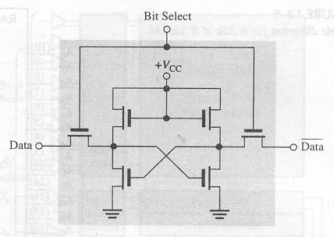
RAM
Static RAM
All SRAMs are characterized by flip-flop storage cells that are typically implemented in integrated circuits with several MOS FET (metal–oxide–semiconductor field-effect transistor ).
The following figure shows a basic SRAM flip-flop storage cell. The cell is selected by an active level on the Bit Select line and a data bit (1 or 0) is written into the cell by placing it on the data and the complement of data lines.

Slide 18
RAM
Static RAM
The storage cells in a SRAM are organized in rows and columns. All the cells in a row share the same Row Select line. Each set of Data and the complement of Data lines go to each cell in a given column and are connected to a single data line that serves as both an input and output through the data input and data output buffers.

Slide 19
RAM
Asynchronous Static RAM
The basic organization of an asynchronous SRAM
Memory array
Address lines
Row
decoder
256 rows x
128 columns x
8 bits
Eight
input buffers
Output data
I/O₀
Input data control
Column I/O
I/O₇
Column decoder
CS
Address lines
WE
OE

Slide 20
RAM
Asynchronous Static RAM
Read cycle sequence:
A valid address is put on the address bus
Chip select is LOW
Output enable is LOW
Data is placed on the data bus
Write cycle sequence:
A valid address is put on the address bus
Chip select is LOW
Write enable is LOW
Data is placed on the data bus

Slide 21
RAM
Static RAM
Tristate
High (1)
Low (0)
HIGH-Z (open)
Advantages
Faster
More complex
Disadvantages
Take up more space
More expensive

Slide 22
RAM
Cache Memory
The cache controller guesses which area of slow dynamic memory the CPU will need next and moves it to the cache memory.
Major applications of SRAMs
L1 cache (first level cache)
Usually integrated into the processor chip
Has a very limited storage
L2 cache (second level cache)
A separate memory chip or set of chips external to the processor
Has a larger storage capacity

Slide 23
RAM
Dynamic RAM (DRAM)
Dynamic RAMs (DRAMs) store a data bit in a small capacitor rather than in a latch.
Advantage
- Simple
- Allow very large memory arrays to be constructed on a chip at
a lower cost per bit than in static memories
Disadvantage
- The storage capacitor cannot hold its charge over an extended
period of time and will lose the stored data bit.
- To refresh requires additional memory circuitry and
complicates the operation of the DRAM.

Slide 24
RAM
Dynamic RAM (DRAM)

Slide 25
RAM
Dynamic RAM (DRAM)
Multiplexed address lines:
Addresses
RAS
CAS
Row address is latched when RAS is LOW
Column address is latched when CAS is LOW
Read and Write Cycles
For a read cycle, the R/W input is High.
For a write cycle, the R/W input is Low.

Slide 26
RAM
Dynamic RAM (DRAM)
Fast page mode allows successive read or write operations from a series of columns address that are all on the same row.
RAS
CAS
R/W
Addresses
D_{OUT}

Slide 27
RAM
Dynamic RAM (DRAM)
Refresh mode
- Burst refresh
- Distributed refresh
Refresh operation
- RAS only refresh
- CAS before RAS refresh
Other types of DRAMs have been developed to speed access and make the processor more efficient
- FPM DRAM
- EDO DRAM
- BEDO DRAM
- SDRAM

Slide 28
ROM
Read-Only Memory (ROM)
A ROM contains permanently or semipermanently stored data, which can be read from the memory but either cannot be changed at all or cannot be changed without specialized equipment.
A ROM stores data that are used repeatedly in system applications, such as tables, conversions, or programmed instruction for system initialization and operation.
ROMs retain stored data when the power is off and are therefore nonvolatile memories.

Slide 29
ROM
Read-Only Memory (ROM)
The ROM family is all considered non-volatile, because it retains data with power removed. It includes various members that can be either permanent memory or erasable.

Slide 30
ROM
Read-Only Memory (ROM)
A ROM symbol is shown with typical inputs and outputs. The triangles on the outputs indicate it is a tri-stated device.
Address input lines
A₀
Data output lines
A₁
A₂
O₀
A₃
O₁
A₄
O₂
A₅
O₃
A₆
A₇
E₀
E₁

Slide 31
ROM
Read-Only Memory (ROM)
To read a value from the ROM, an address is placed on the address bus, the chip is enabled, and a short time later (called the access time), data appears on the data bus.
Address transition
Address input lines
Valid address on input lines
t_{a}
Data outputs
Valid data on output lines
Data output transition
Chip select

Slide 32
ROM
The mask ROM
The mask ROM is the type in which the data are permanently stored in the memory during the manufacturing process.
The mask ROM is usually referred to simply as a ROM.
It is permanently programmed during the manufacturing process to provide widely used standard functions, such as popular conversions, or to provide user-specified functions.
Once the memory is programmed, it cannot be changed.

Slide 33
ROM
PROMS
PROMs are programmable ROM, in which a fused link is burned open during the programming process. Once the PROM is programmed, it cannot be reversed.
PROMs come from the manufacture unprogrammed and are custom programmed in the programmed in the field to meet the user’s needs.
PROMs use some type of fusing process to store bits, in which a memory link is burned open or left intact to represent a 0 or a 1.
The fusing process is irreversible; once a PROM is programmed, it cannot be changed.

Slide 34
ROM
EPROMS
An EPROM is an erasable PROM. Unlike an ordinary PROM, an EPROM can be reprogrammed if an existing program in the memory array is erased first.
An EPROM uses an NMOSFET array with an isolated-gate structure. The isolated transistor gate has no electrical connections and can store an electrical charge for indefinite periods of time.

Slide 35
ROM
UV EPROMS
The UV EPROM is electrically programmable by the user, but the stored data must be erased by exposure to ultraviolet light over a period of several minutes.
EEPROMS
An electrically erasable PROM can be both erased and programmed with electrical pulses.
Since it can be both electrically written into and electrically erased, the EEPROM can be rapidly programmed and erased in circuit for reprogramming.

Slide 36
Flash
Flash Memory
Flash memories are high density read/write memories that are nonvolatile. They have the ability to retain charge for years with no applied power.
The ideal memory has high storage capacity, nonvolatility, in-system read and write capability, comparatively fast operation, and cost effectiveness.
The traditional memory technologies such as ROM, PROM, EPROM, EEPROM, SRAM and DRAM individually exhibit one or more of these characteristics, but no single technology has all of them except the flash memory.

Slide 37
Flash
Flash Memory
The flash memory cell can be read by applying a positive voltage to the control gate.
If the cell is storing a 1, the positive voltage is sufficient to turn on the transistor;
if it is storing a 0, the transistor is off.
logic 0 is stored
logic 1 is stored

Slide 38
Flash
Flash Memory
Flash memories arranged in arrays with an active load.
When a specific row and column is selected during a read operation, the active load has current.

Slide 39
Flash
Flash Memory
Drawback
Once a bit has been set to 0, it can be reset to a 1 only by erasing an entire block of memory.
Flash memory has a large but finite number of read/write cycles.

Slide 40
Memory expansion
Memory Expansion
Available memory can be expanded to increase the word length (number of bits in each address), or the word capacity (number of different addresses) or both.
Memory expansion is accomplished by adding an appropriate number of memory chips to the address, data, and control buses.

Slide 41
Memory expansion
Memory Expansion
Memory can be expanded in either word length or word capacity or both.
To expand word length:
The data bus size is larger, but the number of address is the same.

Slide 42
Memory expansion
Memory Expansion
To expand word capacity, need to add an address line

Slide 43
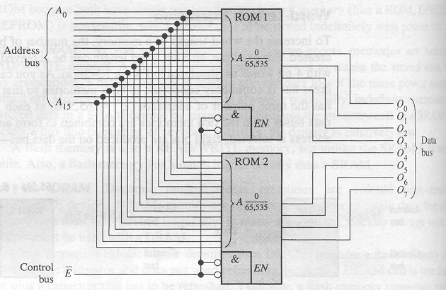
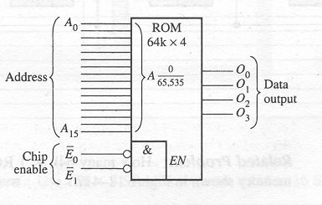
Memory expansion
Memory Expansion
Expand the 64K×4 ROMs to form a 64K×8 ROM.

Slide 44
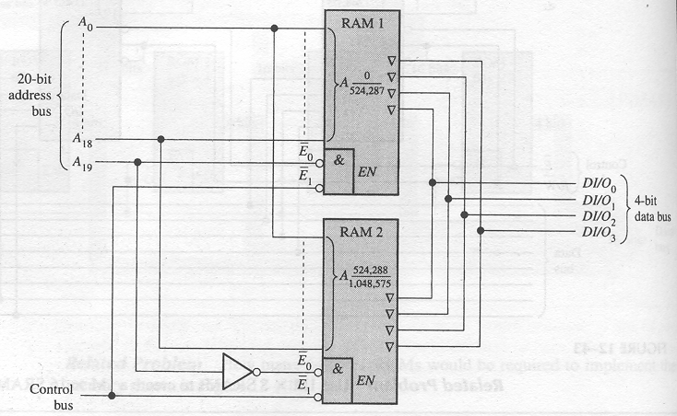
Memory expansion
Memory Expansion
Use 512K×4 RAMs to implement a 1M×4 memory.

Slide 45
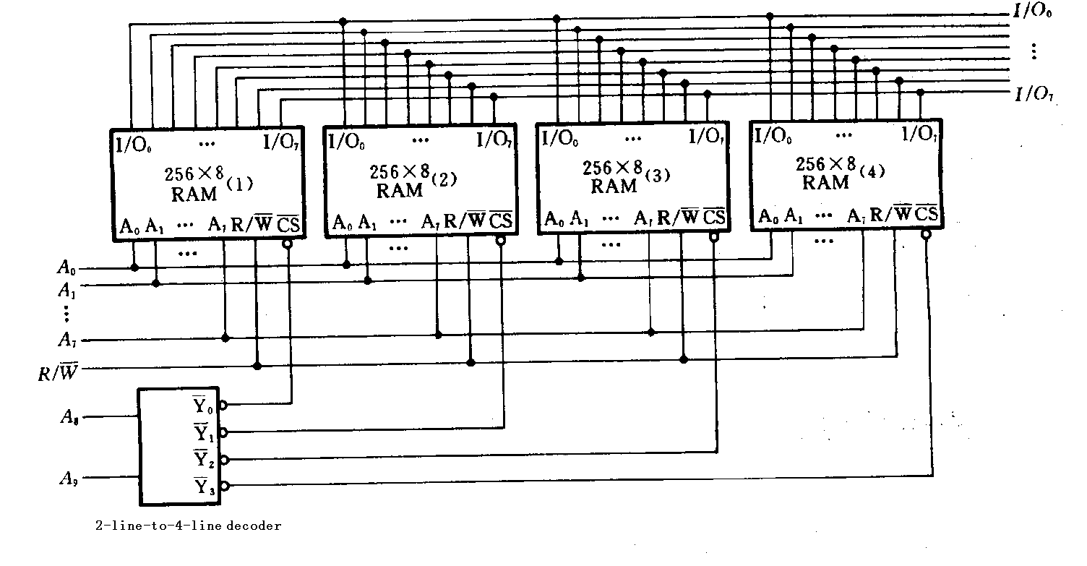
Memory expansion
Memory Expansion
Use 256×8 RAMs to implement a 1024×8 memory.

Slide 46
Memory Module
SIMMs and DIMMs
SIMMs (single in-line memory modules) and DIMMs (dual in-line memory modules) are plug-in circuit boards containing the ICs and I/O brought out on edge connectors.
SIMMs have a 32-bit data path with I/O on only one side whereas DIMMs have a 64-bit data path with I/O on both sides of the board.
SIMM or DIMM
Socket on system board

Slide 47
Memory
FIFO Memory
FIFO memory (first in-first out) is basically an arrangement of shift registers.
It is used in applications where two systems communicate at different rates.

Slide 48
Memory
LIFO Memory
LIFO memory (last in-first out)
In microprocessors, a portion of RAM is devoted to this type of memory, which is called the stack.
Stacks are very useful for temporary storage of internal registers, so that the processor can be interrupted but can easily return to a given task.
Top-of-stack
Stack pointer

Slide 49
Memory
CCD Memory
CCD memory (charge-coupled device memory)
High density is the main advantage
Operation
- Consist of long rows of semiconductor capacitors
- Data are entered into a channel serially by depositing a small
charge for a 0 and a large charge for a 1 on the capacitors.
- Refreshment is done by shifting the charge packets serially
through a refresh circuit.
Used in modern cameras to capture video images in the form of light-induced charge.

Slide 50
Magnetic Hard Drive
Magnetic Hard Drive
The magnetic hard drive is the backbone of computer mass storage and is applied to other devices such as digital video recorders.
Capacities of hard drives have increased exponentially, with 1 TB (1 trillion bytes!) drives available today.
Platters are arranged in tracks (circular shapes) and sectors (pie shaped).
Files are listed in a File Allocation Table, (FAT) that keeps track of file names, locations, size, and more.

Slide 51
Magnetic Hard Drive
Magnetic Hard Drive Performance
Seek time
- the average time for the read/write head to the desire track
Latency time
- the time it takes for the desired sector to spin under the head
once the head is position over the desired tack
Access time
- the sum of the average seek time and the average latency
period for the disk drive

Slide 52
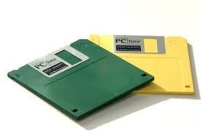
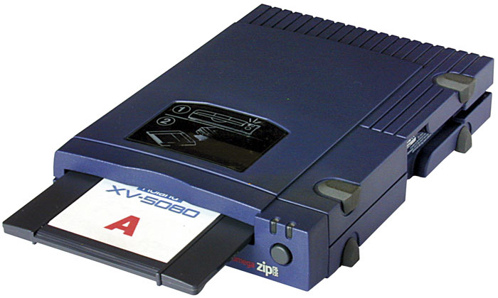
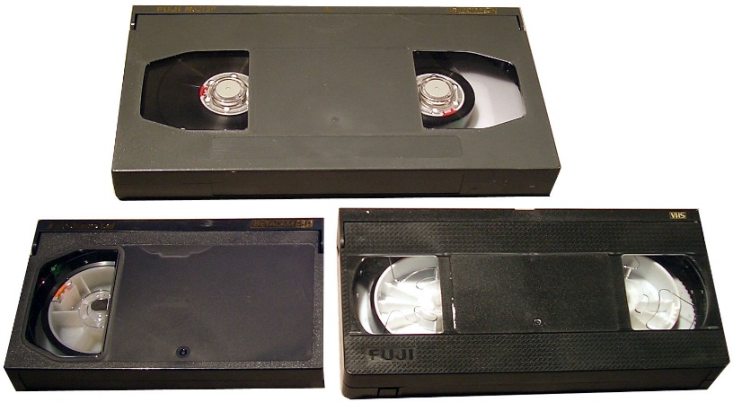
Magnetic Hard Drive
Magnetic Hard Drive
Zip
Floppy Disk
REV
Magnetic Tape

Slide 53

Optical Storage
Optical Storage
The compact disk (CD) uses a laser to burn tiny pits into the media. Surrounding the pits are flat areas called lands. The CD can be read using a low-power IR laser that detects the difference between pits and lands.
Binary data is encoded with a special method called negative non-return to zero encoding. A change from a pit to a land or a land to a pit represents a binary one, whereas no change represents a zero. A standard 120 mm CD can hold approximately 700 MB of data.

Slide 54
Quiz
1. Static RAM is
a. nonvolatile read only memory
b. nonvolatile read/write memory
c. volatile read only memory
d. volatile read/write memory
2. A nonvolatile memory is one that
a. requires a clock
b. must be refreshed regularly
c. retains data without power applied
d. all of the above

Slide 55
Quiz
3. The advantage of dynamic RAM over static RAM is that
a. it is much faster
b. it does not require refreshing
c. it is simpler and cheaper
d. all of the above
4. The first step in a read or write operation for a random access memory is to
a. place a valid address on the address bus
b. enable the memory
c. send or obtain the data
d. start a refresh cycle

Slide 56
Quiz
5. The output enable signal (OE) on a RAM is active
a. only during a write operation
b. only during a read operation
c. both of the above
d. none of the above
6. When data is read from RAM, the memory location is
a. cleared after the read operation
b. set to all 1’s after the read operation
c. unchanged
d. destroyed

Slide 57
Quiz
7. An EPROM has a window to allow UV light to enter under certain conditions. The purpose of this is to
a. refresh the data
b. read the data
c. program the IC
d. erase the data

Slide 58
Quiz
8. The small triangles on the logic diagram indicate that these outputs are
a. not used
b. tri-stated
c. inverted
d. grounded
Address input lines
A₀
Data output lines
A₁
A₂
O₀
A₃
O₁
A₄
O₂
A₅
O₃
A₆
A₇
E₀
E₁

Slide 59
Quiz
9. Using two ICs as shown will expand
a. the word size
b. the number of words available
c. both of the above
d. none of the above

Slide 60
Quiz
10. On a hard drive. information about file names, locations, and file size are kept in a special location called the
a. file location list
b. file allocation table
c. disk directory
d. stack

Slide 61
Assignment
Assignment 11 (Due on 18 May 2014)
PP.452
2,9,14,18,23

