Slide 1
Digital Circuits and Logic Design
Chapter 11
Signal Interfacing and Processing

Slide 2
After this lecture, you should be able to:
Identify different ADC and DAC methods
Describe the function of DSP

Slide 3
Interfacing
Interfacing
Many quantities are analog in nature; that is, they are continuous quantities.
Physical quantities such as temperature, pressure, time,
velocity, and sound are examples of analog quantities.
Most of modern electronic devices and systems are digital system.
Interfacing is the process of making two or more devices or systems compatible with each other so that they function together as required.

Slide 4
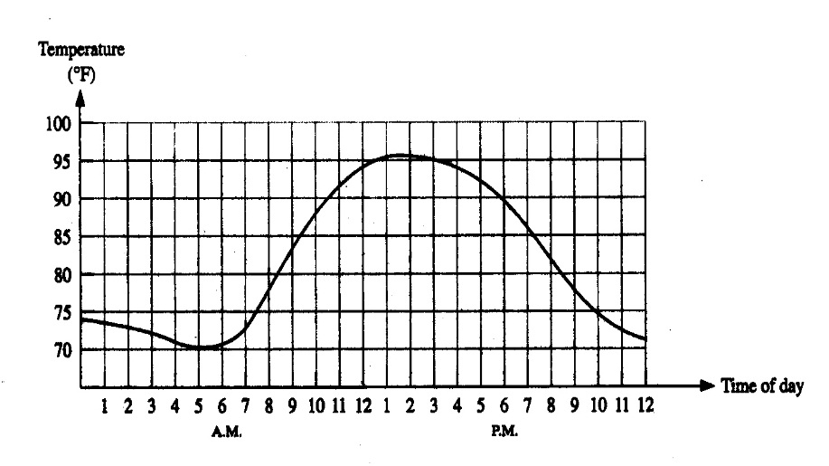
Interfacing
ADC: analog-to-digital conversion/converter
ADC
Analog values
Digital codes
0011
0100
0101

Slide 5
Interfacing
DAC: digital-to-analog conversion/converter
DAC
Digital Codes
Analog values
0011,
0100,
0101

Slide 6

Interfacing
Control
On/off
Play
Record
Analog value
Analog value
Digital code
0
1
0 1
ADC
DSP
DAC
Amp.
Amp.
In the play mode
In the record mode
Tape Driver
Magnetic read
/write head

Slide 7
Sampling
Sampling
Most input signals to an electronic system start out as analog signals. For processing, the signal is normally converted to a digital signal by sampling the input.
Before sampling, the analog input must be filtered with a low-pass anti-aliasing filter. The filter eliminates frequencies that exceed a certain limit that is determined by the sampling rate.

Slide 8
Anti-aliasing Filter
Anti-aliasing Filter
The sampling theorem:
In order to recover a signal, the sampling rate must be greater than twice the highest frequency in the signal.
Stated as an equation, f_{sample} > 2f_{a(max)}
where f_{sample} = sampling frequency
f_{a(max)} = highest harmonic in the analog signal
If the signal is sampled less than this, the recovery process will produce frequencies that are entirely different than in the original signal. These “masquerading” signals are called aliases.

Slide 9
Anti-aliasing Filter
Anti-aliasing Filter
The anti-aliasing filter is a low-pass filter that limits high frequencies in the input signal to only those that meet the requirements of the sampling theorem.
Filtered analog frequency spectrum
Unfiltered analog frequency spectrum
Sampling frequency spectrum
f
f_{c}
f_{sample}
Overlap causes aliasing error
The filter’s cutoff frequency, f_{c}, should be less than ½ f_{sample}.

Slide 10

Anti-aliasing Filter
Anti-aliasing Filter
Most signals have higher frequency harmonic and noise.
For most ADCs, the sampling and filter cutoff frequencies are selected to be able to reconstruct the desired signal without including unnecessary harmonics and noise.
An example of a reasonable sampling rate is in a digital audio CD. For audio CDs, sampling is done at 44.1 kHz because audio frequencies above 20 kHz are not detectable by the ear.
Question
What cutoff frequency should an anti-aliasing filter have for a digital audio CD?
Less than 22.05 kHz.

Slide 11
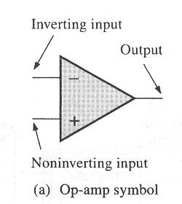
ADC
The Operational Amplifier
An op-amp is a linear amplifier that has one output and two inputs (inverting and noninverting ).
The ideal op-amp has a very high voltage gain and a very high input impedance as well as a very low output impedance.

Slide 12
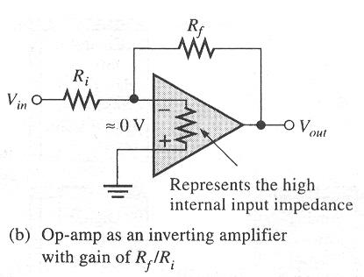
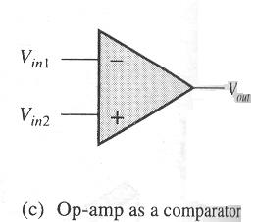
ADC
The Operational Amplifier
Comparator
Inverting amplifier

Slide 13
ADC
Analog-to-Digital Conversion
To process naturally occurring analog quantities with a digital system, the analog signal is converted to digital form after the anti-aliasing filter.
The first step in converting a signal to digital form is to use a sample-and-hold circuit. This circuit samples the input signal at a rate determined by a clock signal and holds the level on a capacitor until the next clock pulse.
A positive half-wave from 0-10 V is shown in blue. The sample-and-hold circuit produces the staircase representation shown in red.
10 V
0 V

Slide 14
ADC
Analog-to-Digital Conversion
The second step is to quantize these staircase levels to binary coded form using an analog-to-digital converter (ADC). The digital values can then be processed by a digital signal processor or computer.
Example
What is the maximum unsigned binary value for the waveform?
10 V = 1010₂ V. The table lists the quantized binary values for all of the steps.
Peak = 10 V
10 V
0 V

Slide 15
ADC
Analog-to-Digital Conversion Method
The Flash ADC
The flash ADC uses a series high-speed comparators that compare the input with reference voltages. Flash ADCs are fast but require 2^{n} – 1 comparators to convert an analog input to an n-bit binary number.
Question
How many comparators are needed by a 10-bit flash ADC?
1023

Slide 16
ADC
Analog-to-Digital Conversion Method
The dual-slope ADC
1. The dual-slope ADC integrates the input voltage for a fixed time while the counter counts to n.
2. Control logic switches to the V_{REF} input.
3. A fixed-slope ramp starts from –V as the counter counts. When it reaches 0 V, the counter output is latched.
-V
HIGH
HIGH

Slide 17
ADC
Analog-to-Digital Conversion Method
The successive approximation ADC
1. Starting with the MSB, each bit in the successive approximation register (SAR) is activated and tested by the digital-to-analog converter (DAC).
V_{out}
2. After each test, the DAC produces an output voltage that represents the bit.
DAC
D₀
D₁
Parallel binary output
3. The comparator compares this voltage with the input signal. If the input is larger, the bit is retained; otherwise it is reset (0).
Comparator
D₂
Input signal
D₃
(MSB)
(LSB)
SAR
Serialbinary output
CLK
The method is fast and has a fixed conversion time for all inputs.

Slide 18
ADC
Analog-to-Digital Conversion Method
An integrated circuit successive approximation ADC is the ADC804. This popular ADC is an 8-bit converter that completes a conversion in 64 clock periods (100 μs).
The completion is signaled by the INTR line going LOW.

Slide 19
ADC
Analog-to-Digital Conversion Method
The sigma-delta ADC
With sigma-delta conversion, the difference between two samples of the analog input signal integrated and quantized. The density of 1s at the output is proportional to the input signal.

Slide 20
ADC
Analog-to-Digital Conversion Method
One option for the sigma-delta method is to count the one-bit quantized output for a set interval. The output of the counter is latched with the parallel binary code.
Sigma-delta ADCs can have high resolution and have advantages for rejecting noise signals (such as 60 Hz power line interference).
They are available in ICs with internal programmable amplifiers.
For these reasons, they are widely used in instrumentation applications.

Slide 21
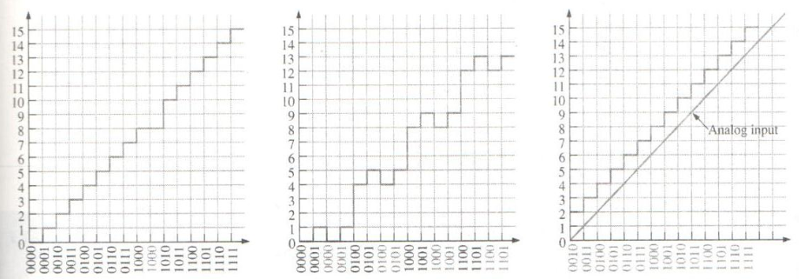
ADC
ADC Errors
Missing code
Incorrect codes
Offset

Slide 22
DAC
Digital-to-Analog Conversion Method
Binary-weighted-input DAC
The binary-weighted-input DAC is a basic DAC in which the input current in each resistor is proportional to the column weight in the binary numbering system. It requires very accurate resistors and identical HIGH level voltages for accuracy.
LSB
8R
The MSB is represented by the largest current, so it has the smallest resistor.
To simplify analysis, assume all current goes through R_{f} and none into the op-amp.
D₀
R_{f}
4R
D₁
2R
V_{out}
D₂
Analog output
D₃
R
MSB

Slide 23
DAC
Digital-to-Analog Conversion Method
Example
A certain binary-weighted-input DAC has a binary input of 1101. If a HIGH = +3.0 V and a LOW = 0 V, what is V_{out}?
120 kΩ
R_{f}
+3.0 V
60 kΩ
10 kΩ
0 V
30 kΩ
V_{out}
+3.0 V
15 kΩ
+3.0 V
V_{out} = I_{out} R_{f} = (−0.325 mA)(10 kΩ) =
−3.25 V

Slide 24
DAC
Digital-to-Analog Conversion Method
R-2R ladder:
The R-2R ladder requires only two values of resistors.
The output is proportional to the binary weight of inputs that are HIGH.
Each input that is HIGH contributes to the output:
where V_{S} = input HIGH level voltage
n = number of bits
i = bit number
Inputs
D₀
D₁
D₂
D₃
For accuracy, the resistors must be precise ratios, which is easily done in integrated circuits.
R₁
R₃
R₅
R₇
R_{f} = 2R
2R
2R
2R
2R
R₂
R₄
R₆
R₈
2R
R
R
R
V_{out}

Slide 25
DAC
Digital-to-Analog Conversion Method
Example
An R-2R ladder has a binary input of 1011. If a HIGH = +5.0 V and a LOW = 0 V, what is V_{out}?
D₀
D₁
D₂
D₃
+5.0 V
+5.0 V
0 V
+5.0 V
R₁
R₃
R₅
R₇
R_{f} = 50 kΩ
50 kΩ
50 kΩ
50 kΩ
50 kΩ
R₂
R₄
R₆
R₈
50 kΩ
25 kΩ
25 kΩ
25 kΩ
V_{out}
Apply to all inputs that are HIGH, then sum the results.
Applying superposition, V_{out} =
−3.43 V

Slide 26
DAC
Performance Characteristics of DACs
Resolution
The reciprocal of the number of discrete steps in the output
Accuracy
A comparison of the actual output of a DAC with the expected output
Expressed as a percentage of a full-scale, or maximum, output voltage
Linearity
A linear error is a deviation from the ideal straight-line output of a DAC.
An offset error is the amount of output voltage when the input ones are
all zeros

Slide 27
DAC
Performance Characteristics of DACs
Monotonicity
A DAC is monotonic if it does not take any reverse steps when it is
sequenced over its entire range of input bits.
Settling time
It is normally defined as the time it takes a DAC to settle within ±1/2
LSB of its final value when a change occurs in the input code.

Slide 28
DAC
Reconstruction Filter
After converting a digital signal to analog, it is passed through a low-pass “reconstruction filter” to smooth the stair steps in the output.
The cutoff frequency of the reconstruction filter is often set to the same limit as the anti-aliasing filter, to block higher harmonics due to the digitizing process.
Reconstruction Filter
Output of the DAC
Final analog output

Slide 29
DSP
Digital Signal Processing
A digital signal processor (DSP) is optimized for speed and working in real time (as events happen). It is basically a specialized microprocessor with a reduced instruction set.
After filtering and converting the analog signal to digital, the DSP takes over. It may enhance the signal in some predetermined way (reducing noise or echoes, improving images, encrypting the signal, etc.). The signal can then be converted back to analog form if desired.

Slide 30
DSP
Digital Signal Processing
Because speed is important in DSP applications, assembly language is frequently used because in general it executes faster.
A general block diagram of the TMS320C6000 series DSP

Slide 31
Quiz
1. If an anti-aliasing filter is not used in digitizing a signal the recovery process
a. is slowed
b. may include alias signals
c. will have less noise
d. all of the above
2. An anti-aliasing filter should have
a. f_{c} more than 2 times the Nyquist frequency
b. f_{c} equal to the Nyquist frequency
c. f_{c} more than ½ f_{sample}
d. f_{c} less than ½ f_{sample}

Slide 32
Quiz
3. The number of comparators required in a 10-bit flash ADC is
a. 255
b. 511
c. 1023
d. 4095

Slide 33
Quiz
4. The block diagram is for a successive-approximation ADC.
The top block is
a. an SAR
b. a DAC
c. an ADC
d. a comparator
V_{out}
D₀
D₁
Parallel binary output
D₂
Input signal
D₃
(MSB)
(LSB)
Serialbinary output
CLK

Slide 34
Quiz
5. The ADC804 integrated circuit signals a completed conversion by
a. INTR goes LOW
b. CS goes LOW
c. RD goes LOW
d. CLK R goes HIGH

Slide 35
Quiz
6. A sigma-delta circuit is a form of
a. DSP
b. DAC
c. ADC
d. SAR
7. The circuit shown is a
a. DSP
b. DAC
c. ADC
d. SAR
8R
R_{f}
4R
2R
V_{out}
R

Slide 36
Quiz
8. For the circuit shown, the input on the far left is for the
a. analog input
b. clock
c. LSB
d. MSB
9. A reconstruction filter
a. is a low-pass filter
b. can have the same response as an anti-aliasing filter
c. smoothes the output from a DAC
d. all of the above
Inputs
R₁
R₃
R₅
R₇
R_{f} = 2R
2R
2R
2R
2R
R₂
R₄
R₆
R₈
2R
R
R
R
V_{out}

Slide 37
Quiz
10. A DSP is a specialized microprocessor that
a. has a very large instruction set
b. is deigned to be very fast
c. has internal anti-aliasing and reconstruction filters
d. all of the above

Slide 38
Assignment
Assignment 12 (Due on 9 June 2014)
PP.487
1,10,17,24

