Slide 1
Digital Circuits and Logic Design
Chapter 2
Number Systems, Operations, and Codes

Slide 2
After this lecture, you should be able to:
Identify different number systems
Perform number conversion and arithmetic operations among various number systems
Describe the methods to detect error

Slide 3

Number Systems
Number Systems (数制)
Decimal Numbers (十进制)
Binary Numbers (二进制)
Hexadecimal Numbers (十六进制)
Octal Numbers (八进制)

Slide 4
Decimal Numbers
Decimal Numbers
The sum of the products of each digit times the column value for that digit.
The number 9240 can be expressed as
(9 x 10³) + (2 x 10²) + (4 x 10¹) + (0 x 10⁰)
or 9 x 1,000 + 2 x 100 + 4 x 10 + 0 x 1
Example
Express the number 480.52 as the sum of values of each digit.
480.52 = (4 x 10²) + (8 x 10¹) + (0 x 10⁰) + (5 x 10⁻¹) +(2 x 10⁻²)

Slide 5
Binary Numbers
Binary Numbers
Binary has a radix of two and uses the digits 0 and 1 to represent quantities.
The column weights of binary numbers are powers of two that increase from right to left beginning with 2⁰ =1:
…2⁵ 2⁴ 2³ 2² 2¹ 2⁰
For fractional binary numbers, the column weights are negative powers of two that decrease from left to right:
2² 2¹ 2⁰. 2⁻¹ 2⁻² 2⁻³ 2⁻⁴ …

Slide 6
Binary Numbers
0 0 0 0 0
1 0 0 0 1
2 0 0 1 0
3 0 0 1 1
4 0 1 0 0
5 0 1 0 1
6 0 1 1 0
7 0 1 1 1
8 1 0 0 0
9 1 0 0 1
10 1 0 1 0
11 1 0 1 1
12 1 1 0 0
13 1 1 0 1
14 1 1 1 0
15 1 1 1 1
Binary Numbers
A binary counting sequence for numbers from zero to fifteen is shown.
Digital counters frequently have this same pattern of digits:

Slide 7
Hexadecimal Numbers
Decimal
Hexadecimal
Binary
0 1 2 3 4 5 6 7 8 9 10 11 12 13 1415
0 1 2 3 4 5 6 7 8 9 A B C D E F
0000 0001 0010 0011 0100 0101 0110 0111 1000 1001 1010 1011 1100 1101 1110 1111
Hexadecimal Numbers
Hexadecimal uses sixteen characters to represent numbers: the numbers 0 through 9 and the alphabetic characters A through F.
Large binary number can easily be converted to hexadecimal by grouping bits 4 at a time and writing the equivalent hexadecimal character.
Example
Express 1001 0110 0000 1110₂ in hexadecimal:
Group the binary number by 4-bits starting from the right. Thus, 960E

Slide 8
Hexadecimal Numbers
Decimal
Hexadecimal
Binary
0 1 2 3 4 5 6 7 8 9 10 11 12 13 1415
0 1 2 3 4 5 6 7 8 9 A B C D E F
0000 0001 0010 0011 0100 0101 0110 0111 1000 1001 1010 1011 1100 1101 1110 1111
Hexadecimal Numbers
Hexadecimal is a weighted number system. The column weights are powers of 16, which increase from right to left.
{
16³ 16² 16¹ 16⁰
.
Column weights
4096 256 16 1
.
Example
Express 1A2F₁₆ in decimal.
Start by writing the column weights:
4096 256 16 1
1 A 2 F₁₆
1(4096) + 10(256) +2(16) +15(1) =
6703₁₀

Slide 9
Octal Numbers
Decimal
Octal
Binary
0 1 2 3 4 5 6 7 8 9 10 11 12 13 1415
0 1 2 3 4 5 6 7 10 1112 13 14 15 16 17
0000 0001 0010 0011 0100 0101 0110 0111 1000 1001 1010 1011 1100 1101 1110 1111
Octal Numbers
Octal uses eight characters the numbers 0 through 7 to represent numbers. There is no 8 or 9 character in octal.
Binary number can easily be converted to octal by grouping bits 3 at a time and writing the equivalent octal character for each group.
Example
Express 1 001 011 000 001 110₂ in octal:
Group the binary number by 3-bits starting from the right. Thus, 113016₈

Slide 10
Octal Numbers
Decimal
Octal
Binary
0 1 2 3 4 5 6 7 8 9 10 11 12 13 1415
0 1 2 3 4 5 6 7 10 1112 13 14 15 16 17
0000 0001 0010 0011 0100 0101 0110 0111 1000 1001 1010 1011 1100 1101 1110 1111
Octal Numbers
Octal is also a weighted number system. The column weights are powers of 8, which increase from right to left.
{
8³ 8² 8¹ 8⁰
.
Column weights
512 64 8 1
.
Example
Express 3702₈ in decimal.
Start by writing the column weights:
512 64 8 1
3 7 0 2₈
3(512) + 7(64) +0(8) +2(1) =
1986₁₀

Slide 11
Binary Numbers
Binary Conversions(二进制转换)
The decimal equivalent of a binary number can be determined by adding the column values of all of the bits that are 1 and discarding all of the bits that are 0.
Example
Convert the binary number 100101.01 to decimal.
Start by writing the column weights; then add the weights that correspond to each 1 in the number.
2⁵ 2⁴ 2³ 2² 2¹ 2⁰. 2⁻¹ 2⁻²
32 16 8 4 2 1 . ½ ¼
1 0 0 1 0 1. 0 1
32 +4 +1 +¼ =
37¼

Slide 12
Binary Numbers
Binary Conversions
Convert a decimal whole number to binary by reversing the procedure. Write the decimal weight of each column and place 1’s in the columns that sum to the decimal number.
Example
Convert the decimal number 49 to binary.
The column weights double in each position to the right. Write down column weights until the last number is larger than the one you want to convert.
2⁶ 2⁵ 2⁴ 2³ 2² 2¹ 2⁰.
64 32 16 8 4 2 1.
0 1 1 0 0 0 1.

Slide 13
Binary Numbers
Binary Conversions
Convert a decimal fraction to binary by repeatedly multiplying the fractional results of successive multiplications by 2. The carries form the binary number.
Convert the decimal fraction 0.188 to binary by repeatedly multiplying the fractional results by 2.
Example
0.188 x 2 = 0.376 carry = 0
MSB
0.376 x 2 = 0.752 carry = 0
0.752 x 2 = 1.504 carry = 1
0.504 x 2 = 1.008 carry = 1
0.008 x 2 = 0.016 carry = 0
Answer = .00110 (for five significant digits)

Slide 14
Binary Numbers
Binary Conversions
You can convert decimal to any other base by repeatedly dividing by the base. For binary, repeatedly divide by 2:
Convert the decimal number 49 to binary by repeatedly dividing by 2.
Example
You can do this by “reverse division” and the answer will read from left to right. Put quotients to the left and remainders on top.
Answer:
1
1
0
0
0
1
remainder
0
1
3
6
12
24
49 2
Continue until the last quotient is 0
Decimal number
base
Quotient

Slide 15
Operations
Binary Addition(二进制加法)
The rules for binary addition are
0 + 0 = 0 Sum = 0, carry = 0
0 + 1 = 0 Sum = 1, carry = 0
1 + 0 = 0 Sum = 1, carry = 0
1 + 1 = 10 Sum = 0, carry = 1
When an input carry = 1 due to a previous result, the rules are
1 + 0 + 0 = 01 Sum = 1, carry = 0
1 + 0 + 1 = 10 Sum = 0, carry = 1
1 + 1 + 0 = 10 Sum = 0, carry = 1
1 + 1 + 1 = 10 Sum = 1, carry = 1

Slide 16
Operations
Binary Addition
Add the binary numbers 00111 and 10101 and show the equivalent decimal addition.
Example
0
1
1
1
00111 7
10101 21
1
1
1
0
0
=
28

Slide 17
Operations
Binary Substraction (二进制减法)
The rules for binary subtraction are
0 − 0 = 0
1 − 1 = 0
1 − 0 = 1
10 − 1 = 1 with a borrow of 1
Subtract the binary number 00111 from 10101 and show the equivalent decimal subtraction.
Example
/¹
/¹
/¹
10101 21
00111 7
0
1
1
1
0
=
14

Slide 18
Operations
Binary Multiplication (二进制乘法)
The rules for binary subtraction are
0 × 0 = 0
0 × 1 = 0
1 × 0 = 0
1 × 1 = 1
Example
111 × 101
111 7
× 101 × 5
111 35
000
+ 111
100011

Slide 19
Operations
1’s Complement (反码)
For example, the 1’s complement of 11001010 is
00110101
In digital circuits, the 1’s complement is formed by using inverters:
1 1 0 0 1 0 1 0
0 0 1 1 0 1 0 1

Slide 20
Operations
2’s Complement(补码)
The 2’s complement of a binary number is found by adding 1 to the Least Significant Bit (最低有效位) of the 1’s complement.
Recall that the 1’s complement of 11001010 is
00110101 (1’s complement)
To form the 2’s complement, add 1:
+1
1 1 0 0 1 0 1 0
00110110 (2’s complement)
1
0 0 1 1 0 1 0 1
0 0 1 1 0 1 1 0

Slide 21
Number Systems
Signed Binary Numbers (带符号二进制数)
There are several ways to represent signed binary numbers. In all cases, the Most Significant Bit (最高有效位) in a signed number is the sign bit, that tells you if the number is positive or negative.
Computers use a modified 2’s complement for signed numbers. Positive numbers are stored in true form (with a 0 for the sign bit) and negative numbers are stored in complement form (with a 1 for the sign bit).
For example, the positive number 58 is written using 8-bits as 00111010 (true form).
Sign bit
Magnitude bits (幅度位)

Slide 22
Number Systems
Signed Binary Numbers
Negative numbers are written as the 2’s complement of the corresponding positive number.
The negative number −58 is written as:
−58 = 11000110 (complement form)
Sign bit
Magnitude bits
An easy way to read a signed number that uses this notation is to assign the sign bit a column weight of −128 (for an 8-bit number). Then add the column weights for the 1’s.
Assuming that the sign bit = −128, show that 11000110 = −58 as a 2’s complement signed number:
Example
Column weights: −128 64 32 16 8 4 2 1.
1 1 0 0 0 1 1 0
−128 +64 +4 +2 = −58

Slide 23
Number Systems
Floating Point Numbers(浮点数)
Floating point notation is capable of representing very large or small numbers by using a form of scientific notation. A 32-bit single precision number is illustrated.
S E (8 bits) F (23 bits)
Sign bit
Biased exponent (+127)
Magnitude with MSB dropped
Example
Express the speed of light, c, in single precision floating point notation. (c = 0.2998 x 10⁹)
In binary, c = 0001 0001 1101 1110 1001 0101 1100 0000₂.
In scientific notation, c = 1.001 1101 1110 1001 0101 1100 0000 x 2²⁸.
S = 0 because the number is positive. E = 28 + 127 = 155₁₀ = 1001 1011₂. F is the next 23 bits after the first 1 is dropped.
In floating point notation, c =
0 10011011 001 1101 1110 1001 0101 1100

Slide 24
Arithmetic Operations
Arithmetic Operations(算术运算)
Using the signed number notation with negative numbers in 2’s complement form simplifies addition and subtraction of signed numbers.
Rules for addition: Add the two signed numbers. Discard any final carries. The result is in signed form.
Examples:
00011110 = +30
00001111 = +15
00001110 = +14
11101111 = −17
11111111 = −1
11111000 = −8
00101101
= +45
11111101
= −3
1
11110111
= −9
Discard carry

Slide 25
Arithmetic Operations
Arithmetic Operations
Note that if the number of bits required for the answer is exceeded, overflow will occur. This occurs only if both numbers have the same sign. The overflow will be indicated by an incorrect sign bit.
Two examples are:
01000000 = +128
01000001 = +129
10000001 = −127
10000001 = −127
10000001
= −126
Discard carry
100000010
= +2
Wrong! The answer is incorrect and the sign bit has changed.

Slide 26
Arithmetic Operations
Arithmetic Operations
Rules for subtraction: 2’s complement the subtrahend(减数) and add the numbers. Discard any final carries. The result is in signed form.
Repeat the examples done previously, but subtract:
00011110
00001111
(+30)
–(+15)
00001110
11101111
11111111
11111000
(+14)
–(−17)
(−1)
–(−8)
−
−
−
2’s complement subtrahend and add:
00011110 = +30
11110001 = −15
00001110 = +14
00010001 = +17
11111111 = −1
00001000 = +8
1
00001111
= +15
00011111
= +31
1
00000111
= +7
Discard carry
Discard carry

Slide 27
Arithmetic Operations
Arithmetic Operations
Rules for multiplication:
Determine if the signs of the multiplicand and multipliers are the same or different
Change any negative number to true form
Generate the partial products
Add each partial product to the sum of the previous products to get the final product
If the sign bit was negative, take the 2’s complement of the product. Otherwise, leave the product in the true form

Slide 28
Arithmetic Operations
Arithmetic Operations
Rules for division:
Determine if the signs of the dividend and divisor are the same or different. Initialize the quotient to zero
Subtract the divisor from the dividend using 2’s complement addition to get the first partial remainder and add 1 to the quotient
Continue to partial subtraction until there is a zero or negative result. Count the number of times that the divisor is subtracted and obtain the quotient

Slide 29
BCD
Decimal
Binary
BCD
0 1 2 3 4 5 6 7 8 9 10 11 12 13 1415
0000 0001 0010 0011 0100 0101 0110 0111 1000 1001 1010 1011 1100 1101 1110 1111
0000 0001 0010 0011 0100 0101 0110 0111 1000 1001 0000 0001 0010 0011 0100 0101
BCD
Binary coded decimal (BCD) is a weighted code that is commonly used in digital systems when it is necessary to show decimal numbers such as in clock displays.
The table illustrates the difference between straight binary and BCD. BCD represents each decimal digit with a 4-bit code. Notice that the codes 1010 through 1111 are not used in BCD.
0001 0001 0001 0001 0001 0001

Slide 30
BCD
BCD
Think of BCD in terms of column weights in groups of four bits. For an 8-bit BCD number, the column weights are: 80 40 20 10 8 4 2 1.
Question:
What are the column weights for the BCD number 1000 0011 0101 1001?
8000 4000 2000 1000 800 400 200 100 80 40 20 10 8 4 2 1
Note that you could add the column weights where there is a 1 to obtain the decimal number. For this case:
8000 + 200 +100 + 40 + 10 + 8 +1 = 8359₁₀

Slide 31
BCD
BCD Addition
Step 1: Add the BCD numbers using the rules for binary addition
Step 2: If a 4-bit sum is equal or less than 9, it is a valid BCD number
Step 3: If a 4-bit sum is greater than 9 or a carry out is generated
Add 6 (0110) to skip the six invalid states and return the code
to 8421. If a carry results when 6 is added, simply add the
carry to the next 4-bit group.
Example
0 0 0 1 0 1 1 0 16
+ 0 0 0 1 0 1 0 1 + 15
0 0 1 0 1 0 1 1 31
+ 0 1 1 0
0 0 1 1 0 0 0 1
0 0 0 1 0 1 1 0
+ 0 0 0 1 0 1 0 1

Slide 32
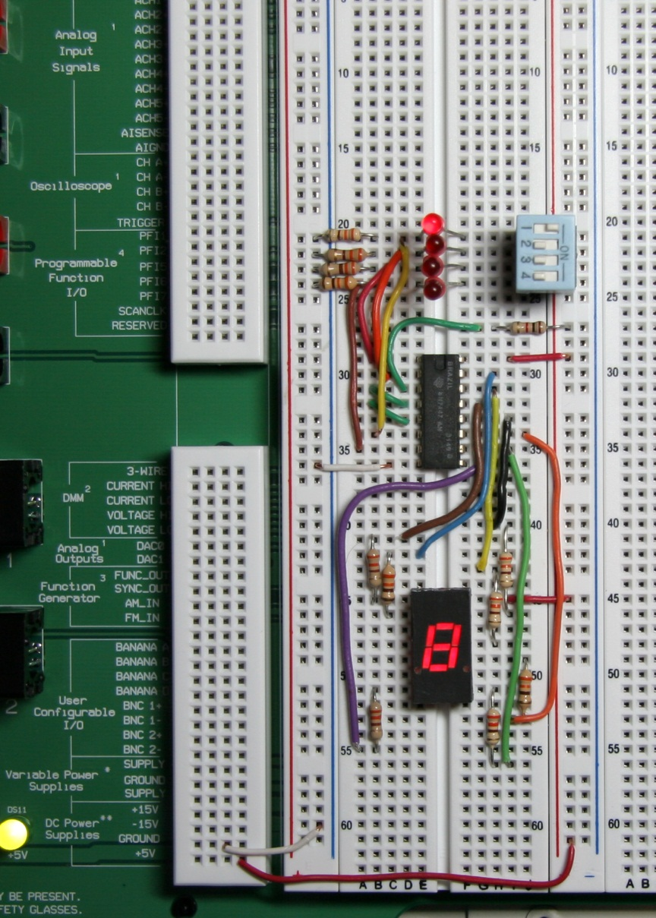
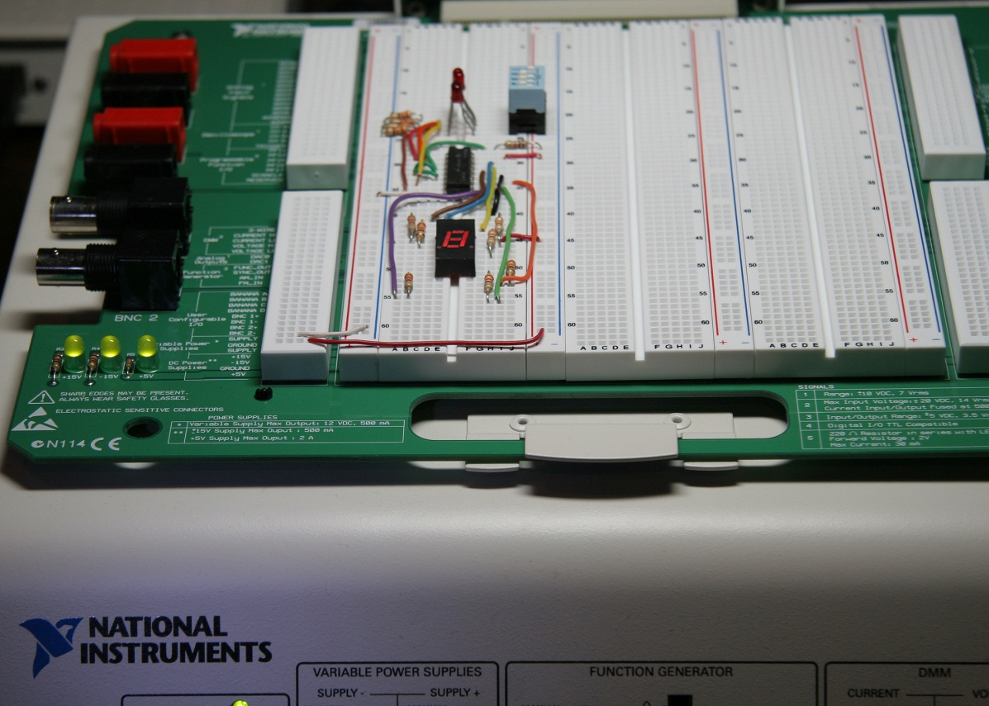
BCD
BCD
A lab experiment in which BCD is converted to decimal is shown.

Slide 33
Gray Code
Decimal
Binary
Gray code
0 1 2 3 4 5 6 7 8 9 10 11 12 13 1415
0000 0001 0010 0011 0100 0101 0110 0111 1000 1001 1010 1011 1100 1101 1110 1111
0000 0001 0011 0010 0110 0111 0101 0100 1100 1101 1111 1110 1010 1011 1001 1000
Gray Code(格雷码)
Gray code is an unweighted code that has a single bit change between one code word and the next in a sequence.
Gray code is used to avoid problems in systems where an error can occur if more than one bit changes at a time.

Slide 34
Gray Code
Gray Code(格雷码)
Binary-to-Gray Code Conversion
The left most in the Gray code is the same as the
corresponding most significant bit in the binary number
Going from left to right, add each adjacent pair of binary code
bits to get the next Gray code. (Discard carries)
Example
1 0 1 1 0 Binary
1 0 1 1 0 Binary
1 1 1 0 1 Gray

Slide 35
Gray Code
Gray Code(格雷码)
Gray-to-Binary Code Conversion
The left most in the Binary code is the same as the
corresponding most significant bit in the Gray number
Add each binary code bit generated to the Gray code bit in the next adjacent position. (Discard carries)
Example
1 1 0 1 1 Gray code
1 1 0 1 1 Gray
1 0 0 1 0 Binary

Slide 36
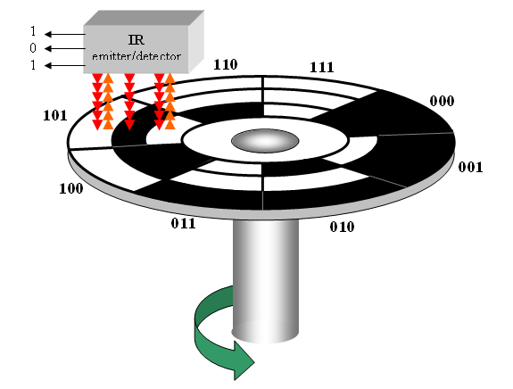
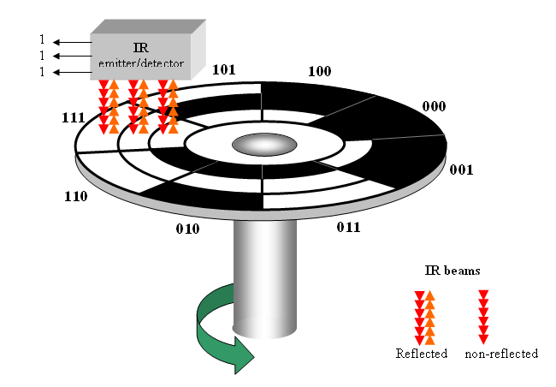
Gray Code
Gray Code
A shaft encoder (轴角编码器) is a typical application. Three IR (红外) emitter/detectors are used to encode the position of the shaft. The encoder on the left uses binary and can have three bits change together, creating a potential error. The encoder on the right uses gray code and only 1-bit changes, eliminating potential errors.
Binary sequence
Gray code sequence

Slide 37
ASC II
ASC II
ASCII is a code for alphanumeric characters and control characters. In its original form, ASCII encoded 128 characters and symbols using 7-bits. The first 32 characters are control characters, that are based on obsolete teletype requirements, so these characters are generally assigned to other functions in modern usage.
In 1981, IBM introduced extended ASCII, which is an 8-bit code and increased the character set to 256. Other extended sets (such as Unicode) have been introduced to handle characters in languages other than English.

Slide 38
Error Detection
Parity Method(校验方法)
The parity method is a method of error detection for simple transmission errors involving one bit (or an odd number of bits). A parity bit is an “extra” bit attached to a group of bits to force the number of 1’s to be either even (even parity) or odd (odd parity).
The ASCII character for “a” is 1100001 and for “A” is 1000001. What is the correct bit to append to make both of these have odd parity?
Example
The ASCII “a” has an odd number of bits that are equal to 1; therefore the parity bit is 0. The ASCII “A” has an even number of bits that are equal to 1; therefore the parity bit is 1.

Slide 39
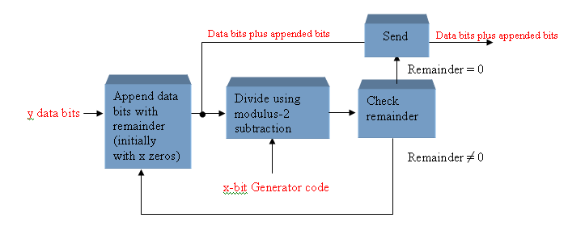
Error Detection
Cyclic Redundancy Check(循环冗余校验)
The cyclic redundancy check (CRC) is an error detection method that can detect multiple errors in larger blocks of data. At the sending end, a checksum (校验) is appended to a block of data. At the receiving end, the check sum is generated and compared to the sent checksum. If the check sums are the same, no error is detected.

Slide 40
Error Detection
Cyclic Redundancy Check(循环冗余校验)
Example
Determine the transmitted CRC for the following byte of data (D) and generator code (G). Verify that the remainder is 0.
D: 11010011 G:1010
The appended data (D’) is D’: 110100110000
Divide the appended data by the generator code (1010) using the modulo=2 operating until all bits have been used
Remainder=0100

Slide 41
Error Detection
Cyclic Redundancy Check(循环冗余校验)
Example
Since the remainder is not 0, append the data with the four remainder bits (0100), then divide by the generator code (1010).
The appended data (D’’) is D’’: 110100110100
Remainder=0
The appended transmitted CRC(D’’) is
D’’: 110100110100

Slide 42
Error Detection
Cyclic Redundancy Check(循环冗余校验)
Example
The received data (D’) is D’: 100100110100
Check whether there is an error?
Remainder=0100
The remainder is not 0, therefor an error is indicated.

Slide 43
Quiz
1. For the binary number 1000, the weight of the column with the 1 is
a. 4
b. 6
c. 8
d. 10
2. The 2’s complement of 1000 is
a. 0111
b. 1000
c. 1001
d. 1010

Slide 44
Quiz
3. The fractional binary number 0.11 has a decimal value of
a. ¼
b. ½
c. ¾
d. none of the above
4. The hexadecimal number 2C has a decimal equivalent value of
a. 14
b. 44
c. 64
d. none of the above

Slide 45
Quiz
5. Assume that a floating point number is represented in binary. If the sign bit is 1, the
a. number is negative
b. number is positive
c. exponent is negative
d. exponent is positive
6. When two positive signed numbers are added, the result may be larger that the size of the original numbers, creating overflow. This condition is indicated by
a. a change in the sign bit
b. a carry out of the sign position
c. a zero result
d. no change in the sign bit

Slide 46
Quiz
7. The number 1010 in BCD is
a. equal to decimal eight
b. equal to decimal ten
c. equal to decimal twelve
d. invalid
8. An example of an unweighted code is
a. binary
b. decimal
c. BCD
d. Gray code

Slide 47
Quiz
9. An example of an alphanumeric code is
a. hexadecimal
b. ASCII
c. BCD
d. CRC
10. An example of an error detection method for transmitted data is the
a. parity check
b. CRC
c. both of the above
d. none of the above

Slide 48
Assignment
Assignment 2 (Due on 17 March 2014)
PP.59
6.(a),6.(b)
12.(a),16.(a)
24.(a) ,28.(a)
40.(a) ,44.(a)
50.(a),56.(a),58

