Slide 1
Digital Circuits and Logic Design
Chapter 3
Logic Gates

Slide 2
After this lecture, you should be able to:
Identify different basic logic gates
Show the truth table for the logic gates
Determine the output waveform for the logic gates

Slide 3
Logic Operations
Logic Gates (逻辑门)
The circuit that performs a specified logic operation
Inputs, outputs （输入，输出）: the lines connected to each symbol (gate).
AND and OR gates can have any number of inputs;
NOT gate has only one input.

Slide 4
The Inverter
The inverter(反相器)
Negation indicator (否定指示)
Input
- a 0 is the active or assert input state
Output
- a 0 is the active or assert output state
Polarity indicators (极性指示)
Input
- a Low level is the active or assert input state
Output
- a Low level is the active or assert output state

Slide 5


The Inverter
The inverter
The inverter performs the Boolean NOT operation.
When the input is LOW, the output is HIGH; when the input is HIGH, the output is LOW.
LOW (0) HIGH (1)
HIGH (1) LOW(0)
The NOT operation (complement) is shown with an overbar. Thus, the Boolean expression for an inverter is X = A.

Slide 6
The Inverter
The inverter
Example waveforms:
A
X
A group of inverters can be used to form the 1’s complement of a binary number:
Binary number
1 0 0 0 1 1 0 1
0 1 1 1 0 0 1 0
1’s complement

Slide 7
The And Gate
The And Gate(与门)
The AND gate produces a HIGH output when all inputs are HIGH; otherwise, the output is LOW. For a 2-input gate, the truth table is
A
X
B
0 0
0 1
1 0
1 1
0
0
0
1
A
X
B
The AND operation is usually shown with a dot between the variables but it may be implied (no dot). Thus, the AND operation is written as X = A .B or X = AB.

Slide 8
The And Gate
The And Gate(与门)
Example waveforms:
A
B
X
The AND operation is used in computer programming as a selective mask. If you want to retain certain bits of a binary number but reset the other bits to 0, you could set a mask with 1’s in the position of the retained bits.
Example
If the binary number 10100011 is ANDed with the mask 00001111, what is the result?
00000011

Slide 9
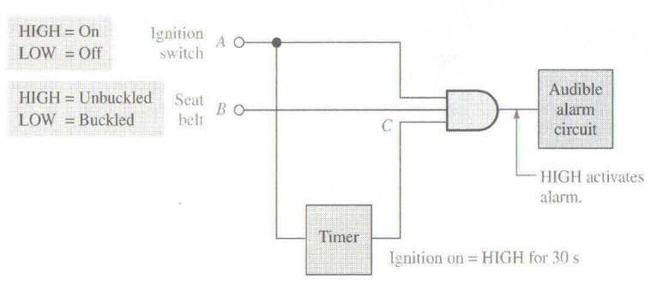
The And Gate
The And Gate(与门)
Example

Slide 10
The Or Gate
The Or Gate(或门)
The OR gate produces a HIGH output if any input is HIGH; if all inputs are LOW, the output is LOW. For a 2-input gate, the truth table is
A
X
A
X
0 0
0 1
1 0
1 1
0
1
1
1
B
B
The OR operation is shown with a plus sign (+) between the variables. Thus, the OR operation is written as X = A + B.

Slide 11
The Or Gate
The Or Gate(或门)
Example waveforms:
A
B
X
The OR operation can be used in computer programming to set certain bits of a binary number to 1.
Example
How to convert the letter to lower case?
The ASCII character for “a” is 01100001 and for “A” is 01000001.
OR an ASCII letter with the 8-bit mask 00100000?

Slide 12
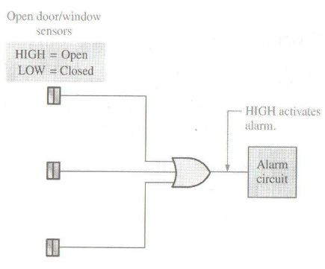
The Or Gate
The Or Gate(或门)
Example

Slide 13
The NAND Gate
The NAND Gate(与非门)
The NAND gate produces a LOW output when all inputs are HIGH; otherwise, the output is HIGH. For a 2-input gate, the truth table is
A
X
B
0 0
0 1
1 0
1 1
1
1
1
0
A
X
B
The NAND operation is shown with a dot between the variables and an overbar covering them. Thus, the NAND operation is written as X = A .B (Alternatively, X = AB.)

Slide 14
The NAND Gate
The NAND Gate(与非门)
Example waveforms:
A
B
X
The NAND gate is particularly useful because it is a “universal” gate – all other basic gates can be constructed from NAND gates.
How to connect a 2-input NAND gate to form a basic inverter?
Question

Slide 15
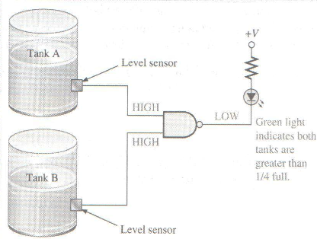
The NAND Gate
The NAND Gate(与非门)
Example

Slide 16
The NOR Gate
The NOR Gate(或非门)
The NOR gate produces a LOW output if any input is HIGH; if all inputs are HIGH, the output is LOW. For a 2-input gate, the truth table is
A
X
B
0 0
0 1
1 0
1 1
1
0
0
0
A
X
B
The NOR operation is shown with a plus sign (+) between the variables and an overbar covering them. Thus, the NOR operation is written as X = A + B.

Slide 17
The NOR Gate
The NOR Gate(或非门)
Example waveforms:
A
B
X
The NOR operation will produce a LOW if any input is HIGH.
Example
When is the LED is ON for the circuit shown?
The LED will be on when any of the four inputs are HIGH.

Slide 18
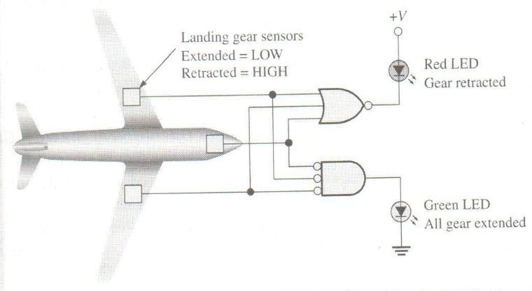
The NOR Gate
The NOR Gate(或非门)
Example

Slide 19
The XOR Gate
The XOR Gate(异或门)
The XOR gate produces a HIGH output only when both inputs are at opposite logic levels. The truth table is
A
X
B
0 0
0 1
1 0
1 1
0
1
1
0
A
X
B
The XOR operation is written as X = AB + AB. Alternatively, it can be written with a circled plus sign between the variables as X = A + B.

Slide 20
The XOR Gate
The XOR Gate(异或门)
Example waveforms:
A
B
X
Notice that the XOR gate will produce a HIGH only when exactly one input is HIGH.
If the A and B waveforms are both inverted for the above waveforms, how is the output affected?
Question
There is no change in the output.

Slide 21
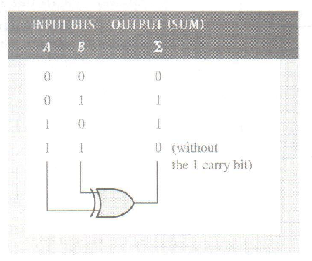
The XOR Gate
The XOR Gate(异或门)
Example

Slide 22
The XNOR Gate
The XNOR Gate(同或门)
The XNOR gate produces a HIGH output only when both inputs are at the same logic level. The truth table is
A
X
B
0 0
0 1
1 0
1 1
1
0
0
1
A
X
B
The XNOR operation shown as X = AB + AB. Alternatively, the XNOR operation can be shown with a circled dot between the variables. Thus, it can be shown as X = A . B.

Slide 23
The XNOR Gate
The XNOR Gate(同或门)
Example waveforms:
A
B
X
Notice that the XNOR gate will produce a HIGH when both inputs are the same. This makes it useful for comparison functions.
If the A waveform is inverted but B remains the same, how is the output affected?
Question
The output will be inverted.

Slide 24
Fixed Function Logic
Fixed Function Logic
Logic families
CMOS
TTL
BiCMOS

Slide 25
Fixed Function Logic
Fixed Function Logic
CMOS (Complementary Metal-Oxide Semiconductor)
- Field-effect transistor (场效应晶体管)
- dominant one
TTL (Transistor-Transistor Logic)
- bipolar junction transistor (双极性晶体管管)
- on the decline
BiCMOS
- a combination of CMOS and TTL

Slide 26
Fixed Function Logic
Fixed Function Logic
Packaging for fixed function logic is shown.
DIP package SOIC package

Slide 27
Fixed Function Logic
Fixed Function Logic
Some common gate configurations and their standard identifier digits are shown.

Slide 28
Fixed Function Logic
Fixed Function Logic
Logic symbols show the gates and associated pin numbers.

Slide 29
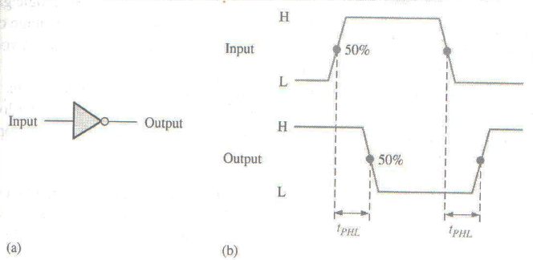
Fixed Function Logic
Performance characteristics and parameters
Propagation Delay Time (t_{p})
- The time interval between the transition of an input pulse and
the occurrence of the resulting transition of the output pulse

Slide 30
Fixed Function Logic
Performance characteristics and parameters
DC Supply Voltage (V_{cc})
- CMOS logic
5V (2V-6V)
3.3V (2V-3.6V)
- Bipolar logic
5V (4.5V-5.5V)
Power Dissipation (P_{D})
- the product of the dc supply voltage and average supply current

Slide 31
Fixed Function Logic
Performance characteristics and parameters
Input and output Logic Levels
- CMOS Logic (5V)
V_{IL_Max}=1.5 V V_{IH_Min}=3.5 V
V_{OL_Max}=0.33 V V_{OH_Min}=4.4 V
- Bipolar Logic
V_{IL_Max}=0.8 V V_{IH_Min}=2 V
V_{OL_Max}=0.4 V V_{OH_Min}=2.4 V
Speed-Power Product (SPP)
- a measure of the performance of a logic circuit taking into
account the propagation delay time and the power dissipation

Slide 32
Fixed Function Logic
Performance characteristics and parameters
Fan-Out and Loading
- Fan-Out (扇出)
The maximum number of inputs of the same series in an IC
family that can be connected to a gate’s output
- Unit Loads (单位负载)

Slide 33
Fixed Function Logic
Data sheets
Data sheets include limits and conditions set by the manufacturer as well as DC and AC characteristics. For example, some maximum ratings for a 74HC00A are:

Slide 34
Programmable Logic
Programmable Logic
A Programmable Logic Device (PLD) can be programmed to implement logic. There are various technologies available for PLDs. Many use an internal array of AND gates to form logic terms. Many PLDs can be programmed multiple times.

Slide 35
Programmable Logic
Programmable Logic
In general, the required logic for a PLD is developed with the aid of a computer. The logic can be entered using a Hardware Description Language (HDL).
HDL
Basic idea is a programming language to describe hardware
Initial purpose was to allow abstract design and simulation
Design could be verified then implemented in hardware
Now Synthesis tools allow direct implementation from HDL code.
Large improvement in designer productivity

Slide 36
HDL
HDL
HDL allows write-run-debug cycle for hardware development.
Similar to programming software
Much, much faster than design-implement-debug
Combined with modern Field Programmable Gate Array chips large, complex circuits (100000s of gates) can be implemented.
HDL
Verilog HDL
VHDL

Slide 37
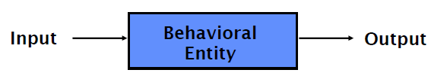
VHDL
VHDL
Very Hard Difficult Language??
Very High Speed Integrated Circuits Description Language
Every VHDL design description consists of at least one entity / architecture pair, or one entity with multiple architectures.
The entity section is used to declare I/O ports of the circuit. The architecture portion describes the circuit’s behavior.
A behavioral model is similar to a “black box”.
Standardized design libraries are included before entity declaration.

Slide 38
VHDL
VHDL
entity NandGate is
port(A, B: in bit;
LED: out bit);
end entity NandGate;
architecture GateBehavior of NandGate is
signal A, B: bit;
begin
X <= A nand B;
LED <= X;
end architecture GateBehavior;

Slide 39
Quiz
The truth table for a 2-input AND gate is
a.
0 0
0 1
1 0
1 1
0
1
1
0
b.
0 0
0 1
1 0
1 1
1
0
0
0
0 0
0 1
1 0
1 1
0
0
0
1
0 0
0 1
1 0
1 1
0
1
1
1
c.
d.

Slide 40
Quiz
The truth table for a 2-input NOR gate is
a.
0 0
0 1
1 0
1 1
0
1
1
0
b.
0 0
0 1
1 0
1 1
1
0
0
0
0 0
0 1
1 0
1 1
0
0
0
1
0 0
0 1
1 0
1 1
0
1
1
1
c.
d.

Slide 41
Quiz
The truth table for a 2-input XOR gate is
a.
0 0
0 1
1 0
1 1
0
1
1
0
b.
0 0
0 1
1 0
1 1
1
0
0
0
0 0
0 1
1 0
1 1
0
0
0
1
0 0
0 1
1 0
1 1
0
1
1
1
c.
d.

Slide 42
Quiz
A
X
4. The symbol is for a(n)
B
a. OR gate
b. AND gate
c. NOR gate
d. XOR gate
A
X
5. The symbol is for a(n)
B
a. OR gate
b. AND gate
c. NOR gate
d. XOR gate

Slide 43
Quiz
6. A logic gate that produces a HIGH output only when all of its inputs are HIGH is a(n)
a. OR gate
b. AND gate
c. NOR gate
d. NAND gate
7. The expression X = A + B means
a. A OR B
b. A AND B
c. A XOR B
d. A XNOR B

Slide 44
Quiz
8. A 2-input gate produces the output shown. (X represents the output.) This is a(n)
a. OR gate
b. AND gate
c. NOR gate
d. NAND gate
A
B
X

Slide 45
Quiz
9. A 2-input gate produces a HIGH output only when the inputs agree. This type of gate is a(n)
a. OR gate
b. AND gate
c. NOR gate
d. XNOR gate
10. The required logic for a PLD can be specified in an Hardware Description Language by
a. text entry
b. schematic entry
c. state diagrams
d. all of the above

Slide 46
Assignment
Assignment 3 (Due on 17 March 2014)
PP.102
2,6,10,16,20,24

