Slide 1
Digital Circuits and Logic Design
Chapter 4
Boolean Algebra and Logic Simplification

Slide 2
After this lecture, you should be able to:
Identify different Boolean operations and expression
Conduct Boolean analysis of Logic Circuits
Simplify the logic circuit

Slide 3
Boolean Operations and Expressions
Boolean algebra (布尔代数)
Boolean algebra (布尔代数） is the mathematics of digital systems.
In Boolean algebra, a variable is a symbol used to represent an action, a condition, or data. A single variable can only have a value of 1 or 0.
The complement represents the inverse of a variable and is indicated with an overbar. Thus, the complement of A is A.

Slide 4
Boolean Operations and Expressions
Boolean Addition
Boolean Addition
- a sum of literals (a variable or the complement of a variable)
- produced by an OR gate
A sum term is equal to 1 when one or more of the literals in the term are 1.
A sum term is equal to 0 only if each of the literals is 0.
Example
Determine the values of A, B, and C that make the sum term of the expression A + B + C = 0?
Each literal must = 0; therefore A = 1, B = 0 and C = 1.

Slide 5
Boolean Operations and Expressions
Boolean Multiplication
Boolean Multiplication
- the product of literals
- produced by an AND gate
A product term is equal to 1 only if each of the literals in the term is 1.
A product term is equal to 0 when one or more of the literals are 0.
Example
What are the values of the A, B and C if the product term of A.B.C = 1?
Each literal must = 1; therefore A = 1, B = 0 and C = 0.

Slide 6
Laws of Boolean Algebra
Laws of Boolean Algebra
Commutative laws (交换律)
A+B=B+A; AB=BA
Associative laws (结合律）
A+(B+C)=(A+B)+C
A(BC)=(AB)C
Distributive Law (分配律）
A(B+C)=AB+AC

Slide 7
Laws of Boolean Algebra
Commutative Law (交换律）
For addition, the commutative law states
In terms of the result, the order in which variables are ORed makes no difference.
A + B = B + A
For multiplication, the commutative law states
In terms of the result, the order in which variables are ANDed makes no difference.
AB = BA

Slide 8
Laws of Boolean Algebra
Associative laws (结合律）
The associative laws are also applied to addition and multiplication. For addition, the associative law states
When ORing more than two variables, the result is the same regardless of the grouping of the variables.
A + (B +C) = (A + B) + C
For multiplication, the associative law states
When ANDing more than two variables, the result is the same regardless of the grouping of the variables.
A(BC) = (AB)C

Slide 9
Laws of Boolean Algebra
Distributive laws (分配律）
The distributive law is the factoring law. A common variable can be factored from an expression just as in ordinary algebra. That is
AB + AC = A(B+ C)
The distributive law can be illustrated with equivalent circuits:
A(B+ C)
AB + AC

Slide 10
Rules of Boolean Algebra
Rules of Boolean Algebra
1. A+0=A
A variable ORed with 0 is always equal to the variable.
2. A+1=1
A variable ORed with 1 is always equal to 1.
3. A·0=0
A variable ANDed with 0 is always equal to 0.
4. A·1=A
A variable ANDed with 1 is always equal to the variable.

Slide 11
Rules of Boolean Algebra
Rules of Boolean Algebra
5. A+A=A
A variable ORed with itself is always equal to the variable.
6. A·A=A
A variable ANDed with itself is always equal to the variable.
1
7.
A variable ORed with its complement is always equal to 1.
0
8.
A variable ANDed with its complement is always equal to 0.

Slide 12
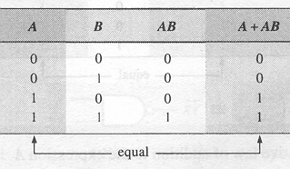
Rules of Boolean Algebra
Rules of Boolean Algebra
9.
The double complement of a variable is always equal to the variable.
A
10. A+AB=
A

Slide 13
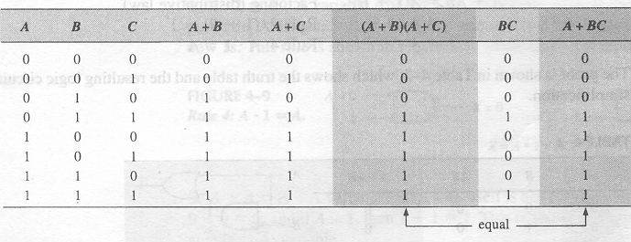
Rules of Boolean Algebra
Rules of Boolean Algebra
11. (A+B)(A+C)=A+BC
12.

Slide 14
Basic Theorems
Venn diagrams (文氏图)
Rules of Boolean algebra can be illustrated with Venn diagrams. The variable A is shown as an area.
The rule A + AB = A can be illustrated easily with a diagram. Add an overlapping area to represent the variable B.
The overlap region between A and B represents AB.
=
The diagram visually shows that A + AB = A.

Slide 15
Basic Theorems
Venn diagrams
A + AB = A + B
Example
Illustrate the rule with a Venn diagram.
A is represented by the blue area and B by the red circle.
The intersection represents AB.
A
Notice that A + AB = A + B

Slide 16
Basic Theorems
Venn diagrams
Example
Prove the rule (A + B)(A + C) = A + BC
(A + B)(A + C) = AA + AC + AB + BC
= A + AC + AB + BC
= A(1 + C + B) + BC
= A . 1 + BC
= A + BC

Slide 17
Basic Theorems
Venn diagrams
Three areas represent the variables A, B, and C.
The area representing A + B is shown in yellow.
The area representing A + C is shown in red.
The overlap of red and yellow is shown in orange.
The overlapping area between B and C represents BC.
ORing with A gives the same area as before.
=
(A + B)(A + C)
A + BC

Slide 18
Basic Theorems
DeMorgan’s 1st Theorem （狄摩根定理）
The complement of a product of variables is equal to the sum of the complemented variables.
AB = A + B
Applying DeMorgan’s first theorem to gates:

Slide 19
Basic Theorems
DeMorgan’s 2nd Theorem
The complement of a sum of variables is equal to the product of the complemented variables.
A + B = A . B
Applying DeMorgan’s second theorem to gates:

Slide 20
Basic Theorems
DeMorgan’s Theorem
For a given expression X, if
0←1，1←0，•←+，+←•,
A←A, A←A
then got.
⇒ X →
Procedure:
Step 1: Replace OR with AND, AND with OR;
Step 2: Complement each literal.

Slide 21
Boolean Analysis
Boolean Analysis
Combinational logic circuits can be analyzed by writing the expression for each gate and combining the expressions according to the rules for Boolean algebra.
Example
Apply Boolean algebra to derive the expression for X.
Write the expression for each gate:
(A + B )
C (A + B )
X= C (A + B )+ D
Applying DeMorgan’s theorem and the distribution law:
X = C (A B) + D = A B C + D

Slide 22
Boolean Analysis of Logic Circuits
SOP and POS forms
Boolean expressions can be written in the
sum-of-products form (SOP) (乘积项之和)
product-of-sums form (POS) (和项之乘积)
An expression is in SOP form when two or more product terms are summed as in the following examples:
A B C + A B A B C + C D C D + E
An expression is in POS form when two or more sum terms are multiplied as in the following examples:
(A + B)(A + C) (A + B + C)(B + D) (A + B)C

Slide 23
Boolean Analysis of Logic Circuits
SOP Standard form
In SOP standard form, every variable in the domain must appear in each term.
This form is useful for constructing truth tables or for implementing logic in PLDs.

Slide 24
Boolean Analysis of Logic Circuits
SOP Standard form
Procedure of converting a SOP to a standard SOP form:
Multiply each nonstandard product term by a term made up of
the sum of a missing variable and its complement
Get the standard SOP form by using the distributive rules
Example
Convert X = A B + A B C to standard form.
The first term does not include the variable C. Therefore, multiply it by the (C + C), which = 1:
X = A B (C + C) + A B C
= A B C + A B C + A B C

Slide 25
Boolean Analysis of Logic Circuits
POS Standard form
In POS standard form, every variable in the domain must appear in each sum term of the expression.
Procedure of converting a POS to a standard POS form:
Add nonstandard sum term by a term made up of the product of
a missing variable and its complement.
Get the standard POS form by applying rule 12,
which states that (A + B)(A + C) = A + BC.

Slide 26
Boolean Analysis of Logic Circuits
POS Standard form
Example
Convert X = (A + B)(A + B + C) to standard form.
The first sum term does not include the variable C. Therefore, add C C and expand the result
X = (A + B + C C)(A + B + C)
= (A +B + C )(A + B + C)(A + B + C)

Slide 27
Boolean Analysis
Constructing the truth table from a logic expression
(1) Determine the number of the input and output variables, and the number of the input variable possible combinations.
(2) Draw the truth table frame according to the input and output variables
(3) List all of the input variable combinations of 1s and 0s in a binary sequence (按序）.
(4) Fill the truth table. If the input variable combinations make the output 1, then place a 1 in the corresponding output column, otherwise place a 0.

Slide 28
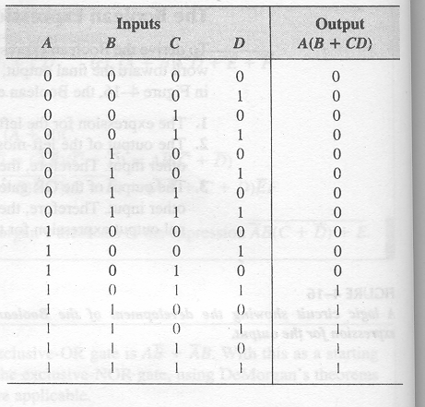
Boolean Analysis
Constructing the truth table from a logic expression
Example
X=A(B+CD)

Slide 29
Boolean Expressions and Truth Table
Determining SOP from a truth table
List the binary values of the input variables for which the output is 1.
Convert each binary value to the corresponding product term by replacing each 1 with the corresponding variable and each 0 with the complement.
Get the logic expression by summing all the combinations.

Slide 30
Boolean Expressions and Truth Table
Determining POS from a truth table
List the binary values of the input variables for which the output is 0.
Convert each binary value to the corresponding sum term by replacing each 0 with the corresponding variable and each 1 with the complement.
Get the logic expression by multiplying all the combinations.

Slide 31
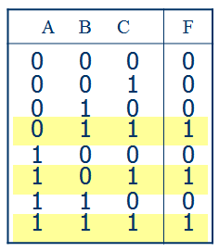
Boolean Expressions and Truth Table
Determining logic expression from a truth table
Example
List the binary values where the outputs are “1”
Convert each binary value to the corresponding product
Summing all the combinations

Slide 32
Simplification Methods
Simplification Methods
When design a circuit by a Boolean expression, have to reduce the expression to the simplest form (for a SOP term, the fewest sums and the fewest variables per sum) to make the circuit simple and easy to be implemented.
Simplification Methods
Boolean Algebra
Karnaugh Map

Slide 33
Simplification Using Boolean Algebra
Simplification Using Boolean Algebra
The approach is to use the basic laws, rules and theorems of Boolean algebra to process and simplify an expression.
This method depends on a thorough knowledge of Boolean algebra and considerable practice in its application.
The effectiveness of algebraic simplification depends on the familiarity with all the laws, rules, and theorems of Boolean algebra and on the ability to apply them.

Slide 34
Simplification Using Boolean Algebra
Example
Y=ABC+ABD+ABC+CD+BD
Y=ABC+ABC+CD+B(AD+D)
= ABC+ABC+CD+B(A+D)
= ABC+ABC+CD+BA+BD
=AB +ABC+CD+BD
=B(A+AC)+CD+BD
=B(A+C)+CD+BD
=BA+BC+CD+BD
=BA+B(C+D)+CD
=BA+BCD+CD
=BA+B+CD
=B(A+1)+CD
=B+CD

Slide 35
The Karnaugh Map
The Karnaugh Map（卡诺图）
The Karnaugh map (K-map) is a tool for simplifying combinational logic with 3 or 4 variables.
For 3 variables, 8 cells(单元) are required (2³).
The map shown is for three variables labeled A, B, and C.
Each cell represents one possible product term.
Each cell differs from an adjacent cell by only one variable.

Slide 36
The Karnaugh Map
The Karnaugh Map
Cells are usually labeled using 0’s and 1’s to represent the variable and its complement.
The numbers are entered in gray code, to force adjacent cells to be different by only one variable.
Gray code
Ones are read as the true variable and zeros are read as the complemented variable.

Slide 37
The Karnaugh Map
The Karnaugh Map
Alternatively, cells can be labeled with the variable letters. This makes it simple to read, but it takes more time preparing the map.
C C
Example
Read the terms for the yellow cells.
AB
AB
AB
AB
The cells are ABC and ABC.

Slide 38
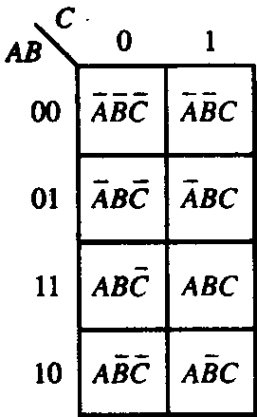
The Karnaugh Map
The Karnaugh Map
The 3-variable K-map
BC
A
00 01 11 10
0 1
ABC
ABC
ABC
ABC
ABC
ABC
ABC
ABC

Slide 39
The Karnaugh Map
The Karnaugh Map
CD
AB
00 01 11 10
The 4-variable K-map is an array of sixteen cells. Binary values of A and B are along the left side and C and D are across the top.
00 01 11 10
ABCD
ABCD
ABCD
ABCD
ABCD
ABCD
ABCD
ABCD
ABCD
ABCD
ABCD
ABCD
ABCD
ABCD
ABCD
ABCD

Slide 40
The Karnaugh Map
Cell Adjacency (逻辑相邻性)
Each cell is adjacent to the cells that are immediately next to it on any of its four sides, but not adjacent to its corner cells （四边相邻，但对角不相邻).

Slide 41
The Karnaugh Map
Cell Adjacency
The cell is adjacent to its four sides. Also the cells in the top row are adjacent to the corresponding cells in the bottom row (最上一行与最下一行也逻辑相邻), the cells in the outer left column are adjacent to the corresponding cells in the outer right column (最左行与最右行也逻辑相邻) .

Slide 42
K-map SOP Minimization
Mapping a Standard SOP Expression
For an SOP expression in standard form
A 1 is placed on the K-map for each product term in the expression.
A 0 is placed for the cells that aren’t included in the expression.
Usually, the 0s are left off the map.
(表达式中含有的最小项在卡诺图中填入1，不含有的填入0，通常，0会被省略，而不填入图中）

Slide 43
Rules of Combining Minterms
Rules of Combining Minterms
（1）According to the characteristic of minterm, When the sum of 2 adjacent minterms(cells) is formed, the different variable can be removed.
BC
AC
A
00 01 11 10
1 1
0 1
1 1
1 1
AB

Slide 44
Rules of Combining Minterms
Rules of Combining Minterms
（2）When the sum of 4 adjacent CELLS is formed, the 2 different variables can be removed, and only the same variables are left.
BC
A
00 01 11 10
0 1
1 1
1 1

Slide 45
Rules of Combining Minterms
Rules of Combining Minterms
BC
CD
AB
A
00 01 11 10
00 01 11 10
00 01 11 10
1
1
0 1
1 1 1 1
1
1
Y= BD

Slide 46
Rules of Combining Minterms
Rules of Combining Minterms
（3）When the sum of 8 adjacent CELLS is formed, the 3 different variable can be removed, and only the same variables are left.
CD
AB
00 01 11 10
00 01 11 10
1 1
1 1
1 1
1 1

Slide 47
Rules of Combining Minterms
Rules of Combining Minterms
CD
CD
AB
AB
00 01 11 10
00 01 11 10
00 01 11 10
00 01 11 10
1 1 1 1
1 1 1 1
1 1 1 1
1 1 1 1
Y=A

Slide 48
Rules of Combining Minterms
Rules of Combining Minterms
Example
Group the 1’s on the map and read the minimum logic.
1. Group the 1’s into two overlapping groups as indicated.
Read each group by eliminating any variable that changes across a boundary.
B changes across this boundary
The vertical group is read AC.
The horizontal group is read AB.
C changes across this boundary
X = AC +AB

Slide 49
Boolean Analysis of Logic Circuits
Rules of Combining Minterms
Example
Group the 1’s on the map and read the minimum logic.
C changes across outer boundary
1. Group the 1’s into two separate groups as indicated.
Read each group by eliminating any variable that changes across a boundary.
B changes
The upper (yellow) group is read as AD.
B changes
The lower (green) group is read as AD.
C changes
X
X = AD +AD

Slide 50
Procedure of Simplification
Procedure of Simplification
Step 1. If the expression isn’t in SOP form, convert it by clearing the round-brackets or by applying Demorgan’s Theorem..
Step 2. Draw the necessary ¾-variable K-map.
Step 3. Map the expression.

Slide 51
Procedure of Simplification
Procedure of Simplification
Step 4. Grouping the 1s.
1. A group must contain either 1,2,4,8, or 16 (2^{n}) cells, and it must be rectangular (矩形圈）
CD
AB
00 01 11 10
00 01 11 10
1 1
1 1

Slide 52
Procedure of Simplification
Procedure of Simplification
2. Always include the largest possible number of 1s in a group. The larger a group, the simpler the resulting term will be (圈要尽量地大）.
3. Each 1 on the map must be included in at least one group. The 1s already in a map can be included in another group according to A+A=A（每个最小项都至少被圈1次）.
4. Each group must include at least 1 new cell that isn’t included by other groups. Otherwise, the product will be redundant （每个圈中至少有一个新项）.

Slide 53
Procedure of Simplification
Procedure of Simplification
Step 5. Determining the product term for each group. Each group of cells containing 1s creates one product term composed of all variables that occur in only one form(either uncomplemented or complemented) within the group. （写出每个圈的表达式）
Variables that occur both uncomplemented and complemented within the group are canceled .
Step 6. Summing the resulting product terms. （将每个圈的表达式相加）

Slide 54
Procedure of Simplification
Example
CD
BD
AB
00 01 11 10
Notice：
1.Check whether there is any redundant group（冗余项）.
2.The sum form may be not unique.
00 01 11 10
1 1 1
CD
BCD
1 1
1 1 1 1
A
BC
1 1 1 1

Slide 55
Procedure of Simplification
Don’t Care Conditions (无关项，约束项）
Sometimes a situation arises in which some input variable combinations are not allowed, or never appear.
In the 8421 BCD code, there are six invalid combinations: 1010,1011,1100,1101,1110,1111.
Since these unallowed states will never occur in an application involving the BCD code, they can be treated as “don’t care” terms with respect to their effect on the output. That is, for these “don’t care” terms either a 1 or 0 may be assigned to the output; it really doesn’t matter since they will never occur.

Slide 56
Procedure of Simplification
Expression of Don’t Care Conditions
Express them with an X/φ in the corresponding cells on the K-map. The “don’t care” terms can be used to advantage on the K-map.
When grouping the 1s, the Xs can be treated as 1s to make a larger grouping or as 0s if they can’t be used to advantage.

Slide 57
Procedure of Simplification
Example
The truth table of some logic function is shown as the following, and AB=0. Write down its minimum SOP term.
Truth table
B
A
B
Y
0
1
A
0
0
0
0
0
1
0
1
1
1
1
×
1
0
1
1
1
×

Slide 58
Procedure of Simplification
Example
(1) The “don’t care” conditions are not used
B
(2) The “don’t care” conditions are used
0
1
A
0
0
1
1
1
×

Slide 59
The Karnaugh Map
The Karnaugh Map
The 5-variable K-map can be constructed using two 5-variable K-maps
CD
CD
AB
AB
00 01 11 10
00 01 11 10
00 01 11 10
00 01 11 10
A=0
A=1

Slide 60
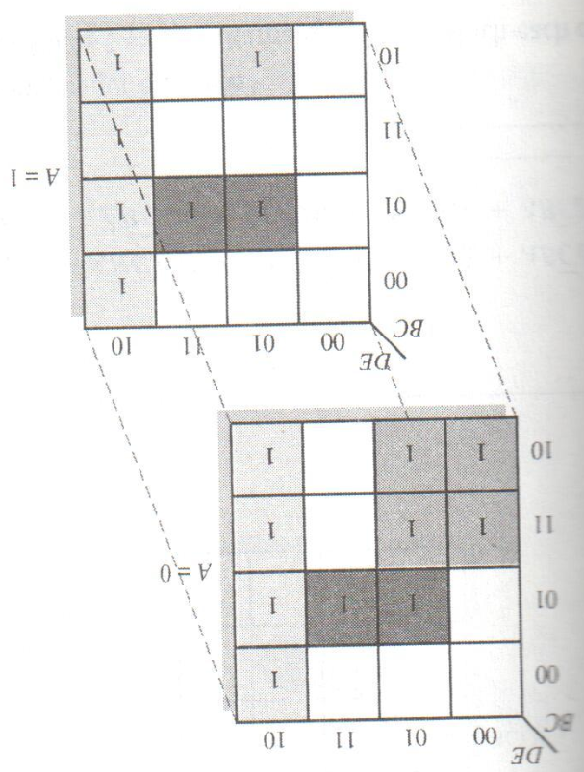
The Karnaugh Map
Cell Adjacency (逻辑相邻性)
A=0 map is placed on top of the A=1 map
Each cell in the A=0 map is adjacent to the cell directly below it in the A=1 map

Slide 61
Logic Simplification
Logic Simplification
The Quine-McClusky Method (奎因－麦克拉斯基算法)
- more than four or five variables
- being easily implemented with a computer
- not efficient in term of processing time and memory usage
Espresso Algorithm
- more efficient in terms of reducing memory usage and
computation time
- no restrictions to the number of variables, output
functions

Slide 62
Quiz
1. The associative law for addition is normally written as
a. A + B = B + A
b. (A + B) + C = A + (B + C)
c. AB = BA
d. A + AB = A
2. The Boolean equation AB + AC = A(B+ C) illustrates
a. the distribution law
b. the commutative law
c. the associative law
d. DeMorgan’s theorem

Slide 63
Quiz
3. The Boolean expression A . 1 is equal to
a. A
b. B
c. 0
d. 1
4. The Boolean expression A + 1 is equal to
a. A
b. B
c. 0
d. 1

Slide 64
Quiz
5. The Boolean equation AB + AC = A(B+ C) illustrates
a. the distribution law
b. the commutative law
c. the associative law
d. DeMorgan’s theorem
6. A Boolean expression that is in standard SOP form is
a. the minimum logic expression
b. contains only one product term
c. has every variable in the domain in every term
d. none of the above

Slide 65
Quiz
7. Adjacent cells on a Karnaugh map differ from each other by
a. one variable
b. two variables
c. three variables
d. answer depends on the size of the map
8. The minimum expression that can be read from the Karnaugh map shown is
a. X = A
b. X = A
c. X = B
d. X = B

Slide 66
Quiz
9. The minimum expression that can be read from the Karnaugh map shown is
a. X = A
b. X = A
c. X = B
d. X = B

Slide 67
Assignment
Assignment 4 (Due on 24 March 2014)
PP.155
10(d,e),16(a,b),20(b),22,24(a),34(b),44(c,e)

