Slide 1
Digital Circuits and Logic Design
Chapter 5
Combinational Logic Analysis

Slide 2
After this lecture, you should be able to:
Identify different basic combinational logic circuits
Develop the logic circuit according to given conditions
Implement the logic circuit using universal logic element
Perform the conversion between waveform and circuit

Slide 3
Combinational Logic Circuits
Combinational Logic
A type of digital logic which is implemented by Boolean circuits, where the output is a pure function of the present input only.
The output level is at all times dependent on the combination of input levels and with no storage involved.
(输出只与当前输入有关，无存贮功能)

Slide 4
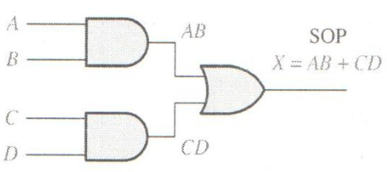
Basic Combinational Logic Circuits
And-OR Logic
For a 4-input AND-OR logic circuit, the output X is HIGH if both input A and input B or input C and input D are HIGH.
The Boolean expression is
X = AB + CD

Slide 5
Basic Combinational Logic Circuits
And-OR Logic
In Sum-of-Products (SOP) form, basic combinational circuits can be directly implemented with AND-OR combinations if the necessary complement terms are available.

Slide 6
Basic Combinational Logic Circuits
And-OR Logic
An example of an SOP implementation is shown. The SOP expression is an AND-OR combination of the input variables and the appropriate complements.
A
B
ABC
C
X = ABC
+ DE
SOP
D
E
DE

Slide 7
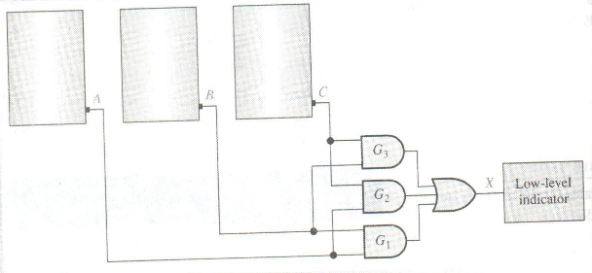
Basic Combinational Logic Circuits
And-OR Logic
Example
Design a circuit that monitors the chemical level in each tank and indicates when the level in any two of the tanks drops below the specified point.
A HIGH voltage will be produced when the level of chemical in the tank drops below a specified point.

Slide 8
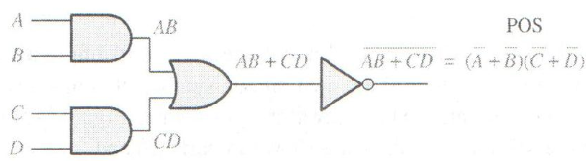
Basic Combinational Logic Circuits
And-OR-Invert Logic
When the output of a SOP form is inverted, the circuit is called an AND-OR-Invert circuit.
For a 4-input AND-OR logic circuit, the output X is LOW if both input A and input B or input C and input D are HIGH.
The Boolean expression is
X = AB + CD= (A+B)(C+D)

Slide 9
Basic Combinational Logic Circuits
And-OR-Invert Logic
The AOI configuration lends itself to product-of-sums (POS) implementation.
An example of an AOI implementation is shown. The output expression can be changed to a POS expression by applying DeMorgan’s theorem twice.
A
B
ABC
C
X = ABC
+ DE
X = ABC
+ DE
AOI
D
X = (ABC)(DE)
DeMorgan
E
DE
X = (A + B + C)(D + E)
POS

Slide 10
Basic Combinational Logic Circuits
Exclusive-OR Logic
The truth table for an exclusive-OR gate is
Notice that the output is HIGH whenever A and B disagree.
The Boolean expression is
X = AB + AB
The circuit can be drawn as
A
Symbols:
Distinctive shape Rectangular outline
X
B

Slide 11
Basic Combinational Logic Circuits
Exclusive-NOR Logic
The truth table for an exclusive-NOR gate is
Notice that the output is HIGH whenever A and B agree.
The Boolean expression is
X = AB + AB
The circuit can be drawn as
Symbols:
A
X
Distinctive shape Rectangular outline
B

Slide 12
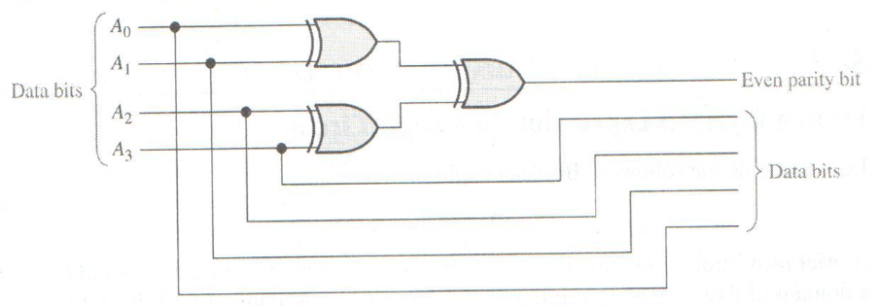
Basic Combinational Logic Circuits
Exclusive-OR Logic
Example
To implement an even parity code generator
A parity bit will be added to the original code to make the total number of 1’s in code even.

Slide 13
Combinational Logic Circuits
Combinational Logic Circuits
Example
For each circuit, determine if the LED should be on or off.
(a) (b) (c)
Circuit (a): XOR, inputs agree, output is LOW, LED is ON.
Circuit (b): XNOR, inputs disagree, output is LOW, LED is ON.
Circuit (c): XOR, inputs disagree, output is HIGH, LED is OFF.

Slide 14
Combinational Logic Circuits
Boolean Expression Implementation
Implementing a SOP expression is done by first forming the AND terms; then the terms are ORed together.
Show the circuit that will implement the Boolean expression X = ABC + ABD + BDE.
Example
Start by forming the terms using three 3-input AND gates.
Then combine the three terms using a 3-input OR gate.
A
B
C
A
X = ABC + ABD + BDE
B
D
B
D
E

Slide 15
Combinational Logic Circuits
Truth Table Implementation
Write the SOP expression from the truth table
Implement the logic circuit according to obtained SOP
Input A | Input B | Input C | Output X
0 | 0 | 0 | 0
0 | 0 | 1 | 0
0 | 1 | 0 | 0
0 | 1 | 1 | 1
1 | 0 | 0 | 1
1 | 0 | 1 | 0
1 | 1 | 0 | 0
1 | 1 | 1 | 0
Example

Slide 16
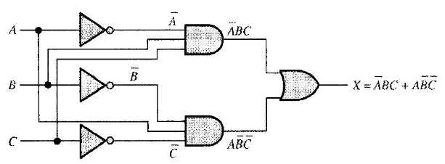
Combinational Logic Circuits
Truth Table Implementation
Example

Slide 17
Combinational Logic Circuits
Karnaugh Map Implementation
For basic combinational logic circuits, the Karnaugh map can be read and the circuit drawn as a minimum SOP.
Example
A Karnaugh map is drawn from a truth table. Read the minimum SOP expression and draw the circuit.
B changes across this boundary
1. Group the 1’s into two overlapping groups as indicated.
Read each group by eliminating any variable that changes across a boundary.
C changes across this boundary
The vertical group is read A C.
The horizontal group is read AB.

Slide 18
Combinational Logic Circuits
Karnaugh Map Implementation
Example
Circuit:
A
C
X =
A
C
+
A
B
A
B
The result is shown as a sum of products.
It is a simple matter to implement this form using only NAND gates.

Slide 19
Combinational Logic Circuits
NAND Logic
Example
Convert the circuit in the previous example to one that uses only NAND gates.
Recall from Boolean algebra that double inversion cancels. By adding inverting bubbles to above circuit, it is easily converted to NAND gates:
A
C
X =
A
C
+
A
B
A
B

Slide 20
Combinational Logic Circuits
Universal Logic
NAND gates are sometimes called universal gates because they can be used to produce the other basic Boolean functions.
A
A
A
AB
B
Inverter
AND gate
A
A
A + B
A + B
B
B
OR gate
NOR gate

Slide 21
Combinational Logic Circuits
Universal Logic
NOR gates are also universal gates and can form all of the basic gates.
A
A
A
A + B
B
Inverter
OR gate
A
A
AB
AB
B
B
AND gate
NAND gate

Slide 22
Combinational Logic Circuits
NAND Logic
Recall from DeMorgan’s theorem that AB = A + B. By using equivalent symbols, it is simpler to read the logic of SOP forms. The earlier example shows the idea:
A
C
X =
A
C
+
A
B
A
B
The logic is easy to read if you (mentally) cancel the two connected bubbles on a line.

Slide 23
Combinational Logic Circuits
Dual Symbols (双重符号)
A NAND symbol and the equivalent negative-OR symbol can reflect the same operation.
The NAND symbol and the negative-OR symbol are called dual symbols
Every connection between a gate output and a gate input is either bubble-to-bubble or nonbubble-to-nonbubble.
A bubble output should not be connected to a nonbubble input or vice versa in a logic diagram.

Slide 24
Combinational Logic Circuits
NOR Logic
Alternatively, DeMorgan’s theorem can be written as A + B = A B. By using equivalent symbols, it is simpler to read the logic of POS forms. For example,
A
B
X =
(A + B)(A + C)
A
C
Again, the logic is easy to read if you cancel the two connected bubbles on a line.

Slide 25
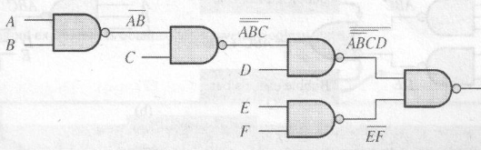
Combinational Logic Circuits
Dual Symbols
Example

Slide 26
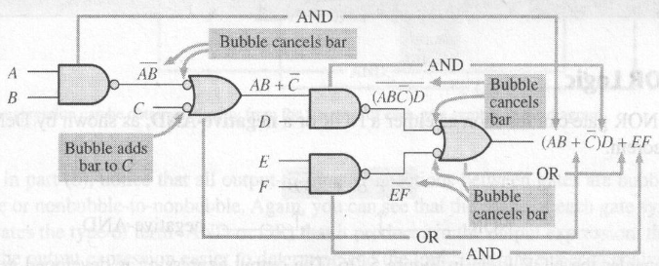
Combinational Logic Circuits
Dual Symbols
Example

Slide 27
Combinational Logic Circuits
Pulsed Waveforms
For combinational circuits with pulsed inputs, the output can be predicted by developing intermediate outputs and combining the result. For example, the circuit shown can be analyzed at the outputs of the OR gates:
A
A
G₁
B
B
G₃
C
C
D
G₂
D
G₁
G₂
G₃

Slide 28
Combinational Logic Circuits
Pulsed Waveforms
Develop the truth table for the circuit and enter 0’s and 1’s on the waveforms, and read the output from the table.
Inputs
Output
A B C D
X
0 0 0 0
0
0 0 0 1
1
A
0 0 1 0
1
G₁
0 0 1 1
1
B
0 1 0 0
0
G₃
C
0 1 0 1
1
G₂
0 1 1 0
1
D
0 1 1 1
1
1 0 0 0
0
A
0 1 0 1 0 1 0 1 0 1
1 0 0 1
0
B
0 1 1 0 0 1 1 0 0 0
1 0 1 0
0
1 0 1 1
0
C
0 0 0 1 1 1 1 0 0 0
1 1 0 0
0
1 1 0 1
1
D
0 0 0 0 0 0 0 1 1 0
1 1 1 0
1
G₃
0 0 0 0 1 1 1 0 1 0
1 1 1 1
1

Slide 29
Quiz
1. Assume an AOI expression is AB + CD. The equivalent POS expression is
a. (A + B)(C + D)
b. (A + B)(C + D)
c. (A + B)(C + D)
d. none of the above
2. The truth table shown is for
a. a NAND gate
b. a NOR gate
c. an exclusive-OR gate
d. an exclusive-NOR gate

Slide 30
Quiz
3. An LED that should be ON is
a. LED-1
b. LED-2
c. neither
d. both

Slide 31
Quiz
4. To implement the SOP expression , the type of gate that is needed is a
a. 3-input AND gate
b. 3-input NAND gate
c. 3-input OR gate
d. 3-input NOR gate
X = ABC + ABD + BDE
A
B
C
A
B
D
B
D
E

Slide 32
Quiz
5. Reading the Karnaugh map, the logic expression is
a. A C + A B
b. A B + A C
c. A B + B C
d. A B + A C

Slide 33
Quiz
6. The circuit shown will have identical logic out if all gates are changed to
a. AND gates
b. OR gates
c. NAND gates
d. NOR gates
A
B
C
D

Slide 34
Quiz
7. The two types of gates which are called universal gates are
a. AND/OR
b. NAND/NOR
c. AND/NAND
d. OR/NOR

Slide 35
Quiz
8. The circuit shown is equivalent to an
a. AND gate
b. XOR gate
c. OR gate
d. none of the above
A
B

Slide 36
Quiz
9. The circuit shown is equivalent to
a. an AND gate
b. an XOR gate
c. an OR gate
d. none of the above
A
B

Slide 37
Quiz
10. During the first three intervals for the pulsed circuit shown, the output of
a. G₁ is LOW and G₂ is LOW
b. G₁ is LOW and G₂ is HIGH
c. G₁ is HIGH and G₂ is LOW
d. G₁ is HIGH and G₂ is HIGH
A
A
G₁
B
B
G₃
C
C
D
G₂
D

Slide 38
Assignment
Assignment 5 (Due on 31 Mar 2014)
PP.189
2,6(a,f),10(h),12(a),14,20,22

