Slide 1
Digital Circuits and Logic Design
Chapter 6
Functions of Combinational Logic Analysis

Slide 2
After this lecture, you should be able to:
Identify different combinational logic circuits
Implement different combinational logic circuit using conventional Integrate Circuits

Slide 3
Adder
Half-Adder (半加器)
Basic rules of binary addition are performed by a half adder, which has two binary inputs (A and B) and two binary outputs (Carry out and Sum).
The inputs and outputs can be summarized on a truth table.
The logic symbol and equivalent circuit are:
Σ
Σ
A
Σ
A
C_{out}
B
C_{out}
B

Slide 4
Adder
Full-Adder(全加器)
The 1-bit full-adder accepts two input bits and an input carry (低位的进位）and generates a sum output and an output carry.
The difference between a full-adder and a half-adder is that the full-adder accepts an input carry.
The truth table summarizes the operation.

Slide 5
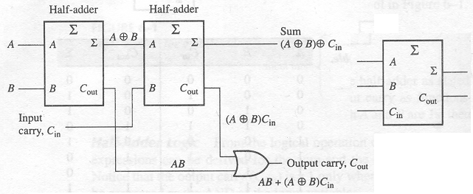
Adder
Full-Adder
A full-adder can be constructed from two half adders as shown:

Slide 6
Adder
Full-Adder
Σ
Σ
1
Σ
Σ
0
Sum
1
A
A
Example
B
0
1
0
C_{out}
B
C_{out}
For the given inputs, determine the intermediate and final outputs of the full adder.
1
C_{out}
1
The first half-adder has inputs of 1 and 0; therefore the Sum =1 and the Carry out = 0.
The second half-adder has inputs of 1 and 1; therefore the Sum = 0 and the Carry out = 1.
The OR gate has inputs of 1 and 0, therefore the final carry out = 1.

Slide 7
Adder
Full-Adder
Notice that the result from the previous example can be read directly on the truth table for a full adder.
Σ
Σ
1
Σ
Σ
0
Sum
1
A
A
B
0
1
0
C_{out}
B
C_{out}
1
C_{out}
1

Slide 8
Adder
Parallel Adders (并行加法器)
Full adders are combined into parallel adders that can add binary numbers with multiple bits. A 4-bit adder is shown.
A₄ B₄
A₃ B₃
A₂ B₂
A₁ B₁
C₀
A
B
C_{in}
A
B
C_{in}
A
B
C_{in}
A
B
C_{in}
C_{out}
Σ
C_{out}
Σ
C_{out}
Σ
C_{out}
Σ
C₄
C₃
C₂
C₁
Σ₄
Σ₃
Σ₂
Σ₁

Slide 9
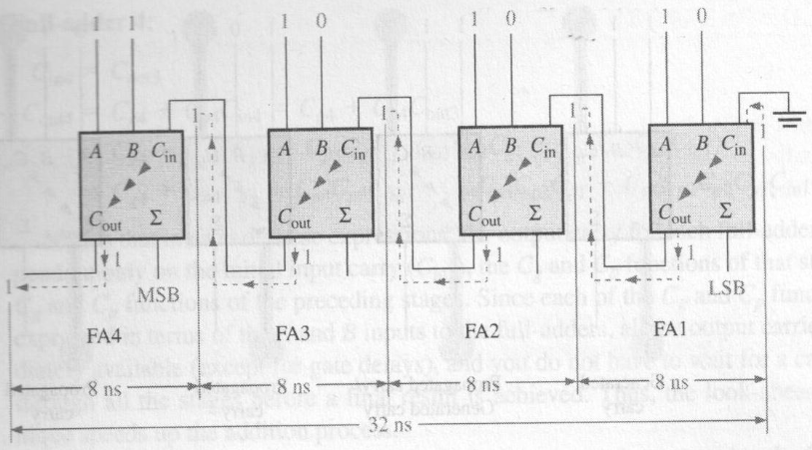
Adder
The Ripple Carry Adder (异步进位加法器)
The sum and the output carry of any stage cannot be produced until the input carry occurs

Slide 10
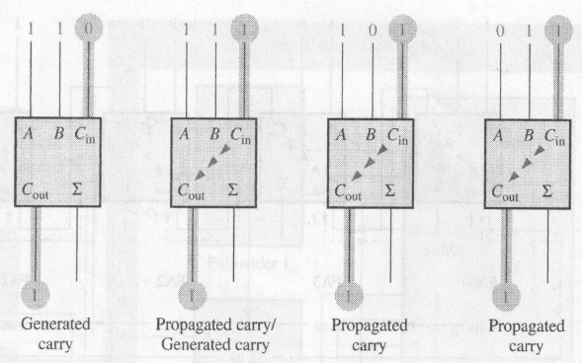
Adder
The Look-Ahead Carry Adder (超前进位加法器)
Anticipates the output carry of each stage and the inputs Produces the output carry by either carry generation or carry propagation.

Slide 11
Adder
The Look-Ahead Carry Adder
Carry generation (C_{g})
A carry is generated only when both input bits are 1s
Carry propagation (C_{p})
An input carry may be propagated by the full-adder when either or both of the input bits are 1s
Output carry (C_{out})

Slide 12
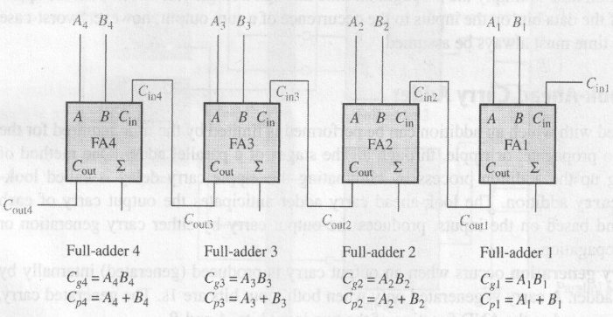
Adder
The Look-Ahead Carry Adder
4-bit parallel adder

Slide 13
Adder
Parallel Adders
The 74LS283 is a example of 4-bit adder
Σ
1
2
3
4
1
2
3
4
Binary number A
4-bit sum
1
2
3
4
Binary number B
Input carry
C₀
C₄
Output carry

Slide 14
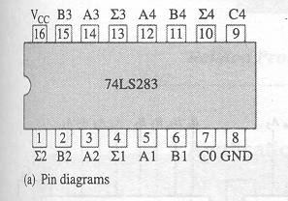
Adder
Parallel Adders
74LS283
Features look-ahead carry, which adds logic to minimize the output carry delay
The maximum delay to the output carry is 17 ns

Slide 15
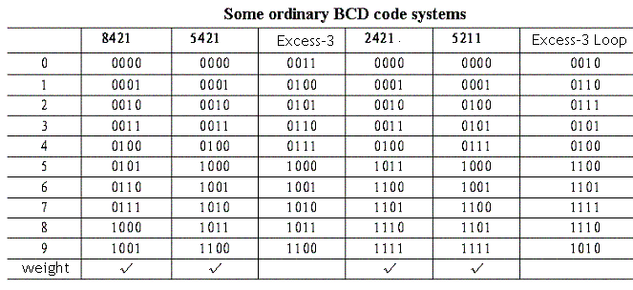
Adder Applications
Convert 8421 BCD code to Excess-3

Slide 16
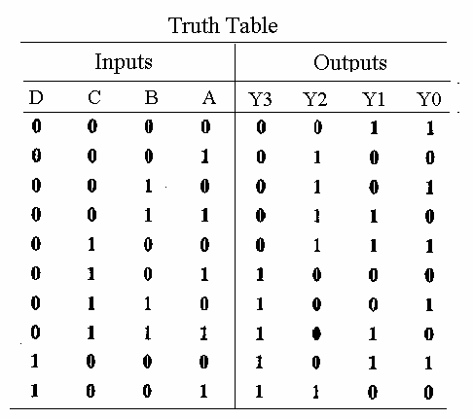
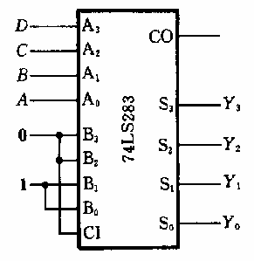
Adder Application
Convert 8421 BCD code to Excess-3
Y₃Y₂Y₁Y₀=DCBA+0011

Slide 17
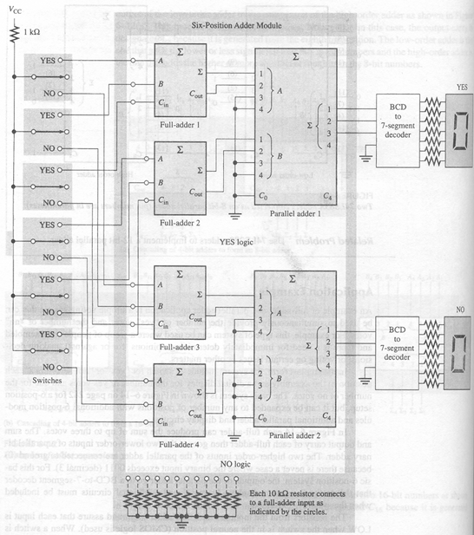
Adder Application
A voting system

Slide 18
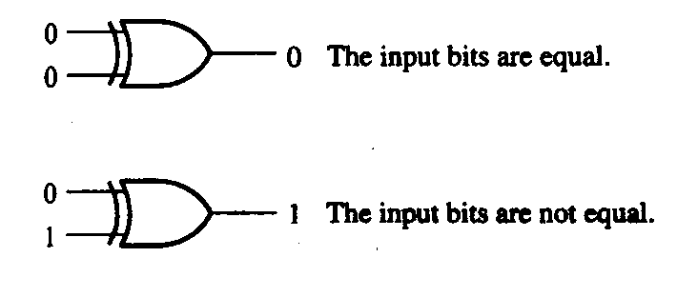
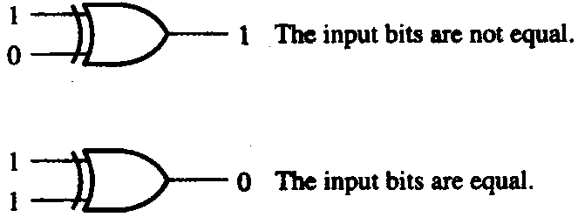
Comparators
Comparators (比较器)
The function of a comparator is to compare the magnitudes of two binary numbers to determine the relationship between them.
In the simplest form, a comparator can test for equality using XNOR gates.

Slide 19
Comparators
Comparators
Example
How could you test two 4-bit numbers for equality?
AND the outputs of four XNOR gates.
A₁
B₁
A₂
B₂
Output
A₃
B₃
A₄
B₄

Slide 20
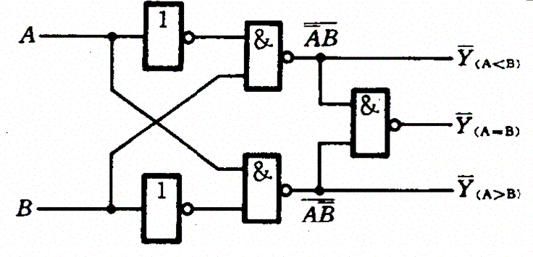
Comparators
Comparators
In addition to the equality output, many integrated circuit comparators provide the inequality outputs.

Slide 21
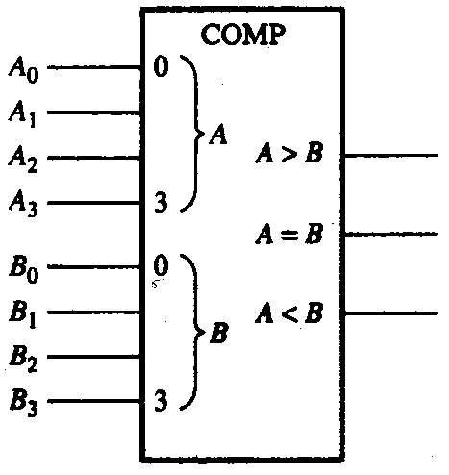
Comparators
Comparators
Logic symbol for 4-bit comparator with inequality indication
Y_{(A>B)}
Y_{(A=B)}
Y_{(A<B)}

Slide 22
Comparators
Comparators
IC comparators provide outputs to indicate which of the numbers is larger or if they are equal. The bits are numbered starting at 0, rather than 1 as in the case of adders. Cascading inputs are provided to expand the comparator to larger numbers.
COMP
A₀
0
A₁
A
A₂
A₃
3
Cascading inputs
A > B
A > B
A = B
A = B
Outputs
A < B
A < B
B₀
0
B₁
A
The IC shown is the 4-bit 74LS85.
B₂
B₃
3

Slide 23
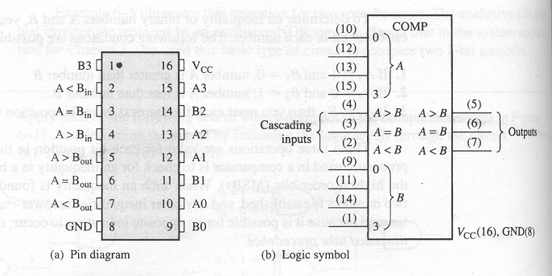
Comparators
Comparators
74HC85 4-bit comparator

Slide 24
Comparators
Comparators
IC comparators can be expanded using the cascading inputs as shown. The lowest order comparator has a HIGH on the A = B input.
LSBs
MSBs
A₀
COMP
A₄
COMP
A₁
0
A₅
0
A₂
A
A₆
A
A₃
A₇
3
3
A > B
A > B
A > B
A > B
+5.0 V
A = B
A = B
A = B
A = B
Outputs
B₀
A < B
A < B
B₄
A < B
A < B
0
0
B₁
A
B₅
A
B₂
B₆
B₃
3
B₇
3

Slide 25
Decoders
Decoders (译码器)
The basic function of a decoder is to detect the presence of a specified combination of bits (code) on its inputs and to indicate the presence of that code by a specified output level.
In its general form, a decoder has n input lines to handle n bits and from one to 2^{n} output lines.
Two simple decoders that detect the presence of the binary code 0011 are shown.
A₀
A₀
A₁
X
A₁
X
A₂
A₂
A₃
A₃
Active HIGH decoder for 0011
Active LOW decoder for 0011

Slide 26
Decoders
Decoders
Question
Assume the output of the decoder shown is a logic 1. What are the inputs to the decoder?

Slide 27
Decoders
Decoders
IC decoders have multiple outputs to decode any combination of inputs. For example the binary-to-decimal decoder shown here has 16 outputs – one for each combination of binary inputs.
Question
For the input shown, what is the output?

Slide 28
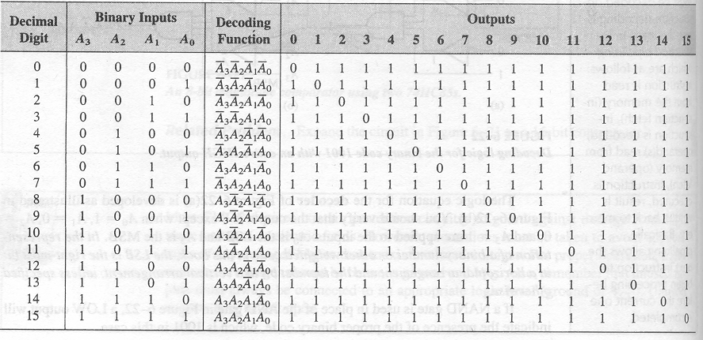
Decoders
The 4-bit decoder
In order to decode all possible combinations of four bits, sixteen decoding gates are required.
Truth table for a 4-line-to-16-line decoder(4线-16线译码器）

Slide 29
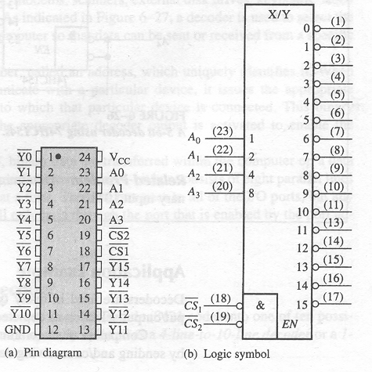
Decoders
The 4-bit decoder
74HC154
There is an enable function (EN,使能端) provided on this device, which is implemented with a NOR gate.
A LOW level on each chip select input is required in order to make the enable gate output (EN) HIGH.

Slide 30
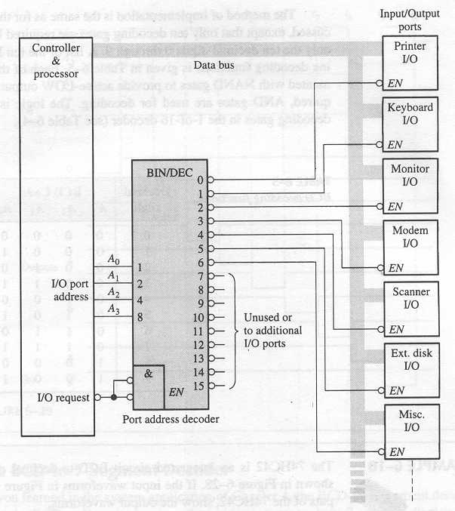
Decoders
The 4-bit decoder application
A simplified computer I/O port system with a port address decoder with only four address lines shown.

Slide 31
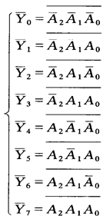
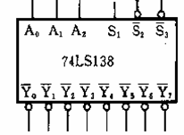
Decoders
The 3-bit decoder
74LS138

Slide 32
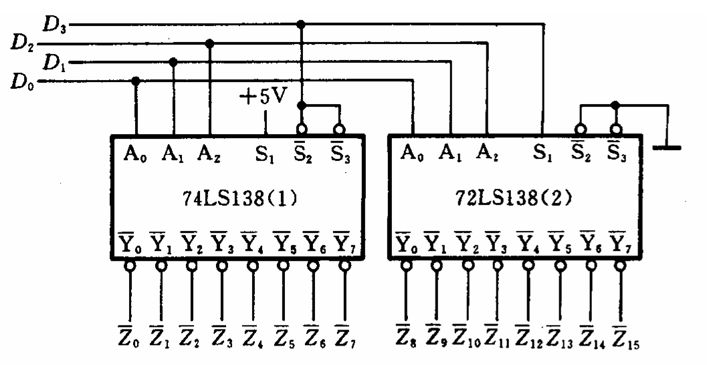
Decoders
The 4-bit decoder
74LS138

Slide 33
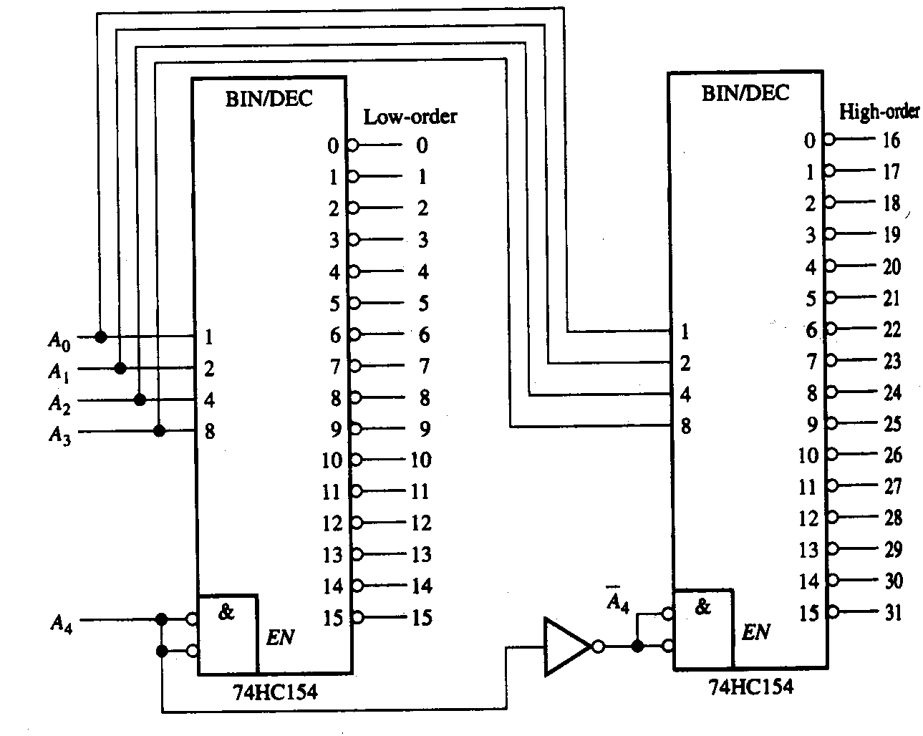
Decoders
The 5-bit decoders
74HC154

Slide 34
Decoders
Decoders
BCD-to-decimal decoders accept a binary coded decimal input and activate one of ten possible decimal digit indications.
A₀
A₁
A₂
A₃
Example
Assume the inputs to the 74HC42 decoder are the sequence 0101, 0110, 0011, and 0010. Describe the output.
All lines are HIGH except for one active output, which is LOW. The active outputs are 5, 6, 3, and 2 in that order.

Slide 35
Decoders
BCD Decoders/Driver
Another useful decoder is the 74LS47. This is a BCD-to-seven segment display with active LOW outputs.
V_{CC}
The a-g outputs are designed for much higher current than most devices (hence the word driver in the name).
BCD/7-seg
BI/RBO
BI/RBO
BCD inputs
Outputs to seven segment device
LT
LT
RBI
RBI
74LS47
GND

Slide 36
Decoders
LED
f g
a b
a b c d e f g
LED
+
+
+
+
+
a
Common-cathode
共阴极
f
b
•
g
+
e
d
c
•
•
Common-anode
共阳极
e d
c •
a b c d e f g

Slide 37
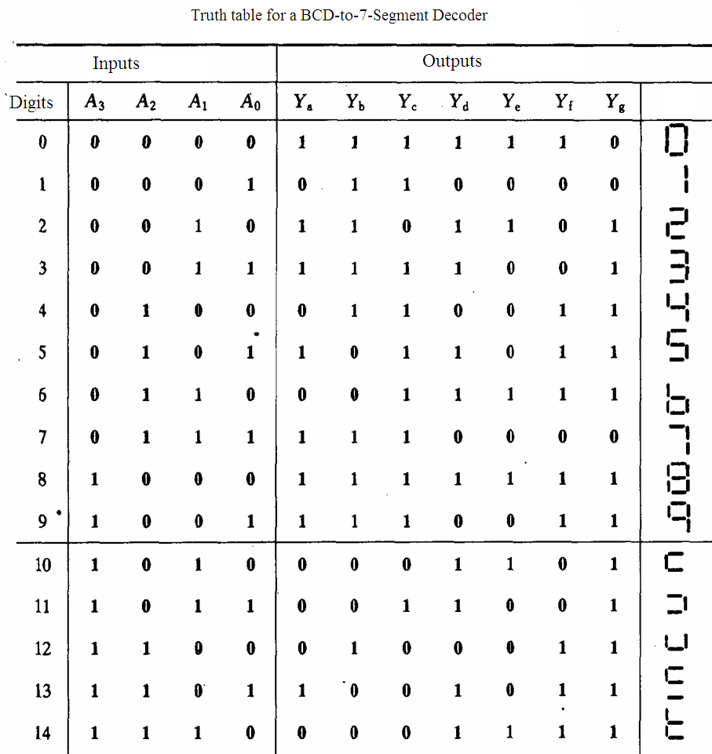
Decoders
LED
f g
a b
a
f
b
g
e
d
c
•
e d
c •

Slide 38
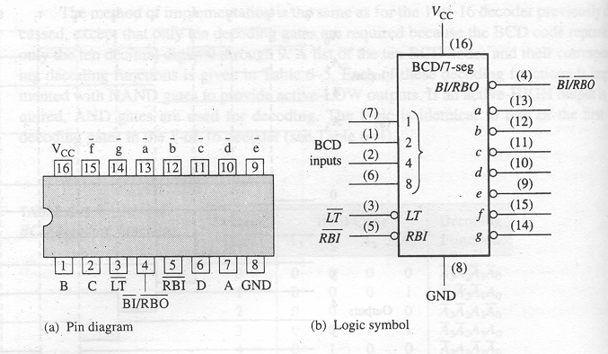
Decoders
74LS47

Slide 39
Decoders
74LS47
Lamp test (灯测试信号)
When LT=0 and BI/RBO=1,all of the 7 segments in the
display are turned on.
Used to verify that no segments are burned out.
BI/RBO (Blanking Input/Ripple Blanking Output)
(灭灯输入端/灭零输出端)
When used as a BI, all segment outputs are HIGH.
When BI is LOW, overrides all other inputs.
RBI (Ripple Blanking input) (灭零输入端)

Slide 40
Decoders
74LS47
The 74LS47 features leading zero suppression, which blanks unnecessary leading zeros but keeps significant zeros as illustrated here. The BI/RBO output is connected to the RBI input of the next decoder.
Blanked
Blanked
Depending on the display type, current limiting resistors may be required.

Slide 41
Decoders
74LS47
Trailing zero suppression blanks unnecessary trailing zeros to the right of the decimal point as illustrated here. The RBI input is connected to the BI/RBO output of the following decoder.
Decimal point
Blanked
Blanked

Slide 42
Decoders
74LS47
Notice the current limiting resistors, required to prevent overdriving the LED display.

Slide 43
Encoders
Encoders (编码器)
An encoder accepts an active logic level on one of its inputs and converts it to a coded output, such as BCD or binary.
The decimal to BCD is an encoder with an input for each of the ten decimal digits and four outputs that represent the BCD code for the active digit. The basic logic diagram is shown. There is no zero input because the outputs are all LOW when the input is zero.
1
A₀
2
3
A₁
4
5
A₂
6
7
8
A₃
9

Slide 44
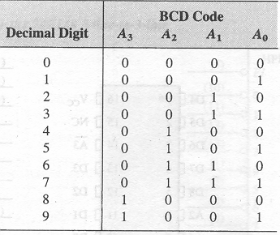
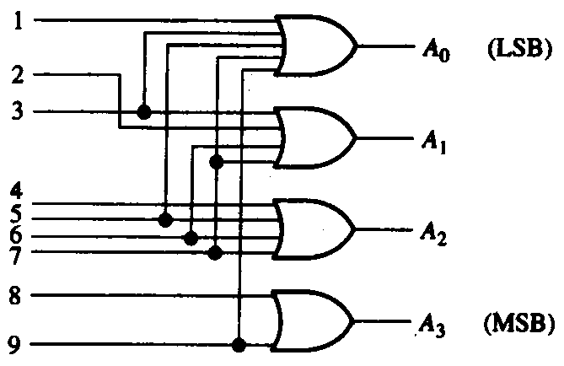
Encoders
The Decimal-to-BCD Encoder
Function Table Logic Diagram

Slide 45
Encoders
The Decimal-to-BCD Encoder
Truth table
inputs
outputs
I₀
I₁
I₂
I₃
I₄
I₅
I₆
I₇
Y₂
Y₁
Y₀
1 0 0 0 0 0 0 0
0
0
0
0 1 0 0 0 0 0 0
0
0
1
0 0 1 0 0 0 0 0
0
1
0
0 0 0 1 0 0 0 0
0
1
1
0 0 0 0 1 0 0 0
1
0
0
0 0 0 0 0 1 0 0
1
0
1
0 0 0 0 0 0 1 1
1
1
0
0 0 0 0 0 0 0 1
1
1
1

Slide 46
Encoders
The Decimal-to-BCD Encoder
Example
Show how the decimal-to-BCD encoder converts the decimal number 3 into a BCD 0011.
The top two OR gates have ones as indicated with the red lines. Thus the output is 0111.
1
0
1
A₀
2
0
1
3
1
A₁
4
0
5
0
0
A₂
6
0
0
7
8
0
0
0
A₃
9

Slide 47
Encoders
The Decimal-to-BCD Priority Encoder
The 74HC147 is an example of an IC encoder. It is has ten active-LOW inputs and converts the active input to an active-LOW BCD output.
V_{CC}
This device is offers additional flexibility in that it is a priority encoder. This means that if more than one input is active, the one with the highest order decimal digit will be active.
HPRI/BCD
Decimal input
BCD output
74HC147
GND

Slide 48
Encoders
V_{CC}
Encoders
Keyboard encoder
HPRI/BCD
BCD complement of key press
74HC147
The zero line is not needed by the encoder, but may be used by other circuits to detect a key press.

Slide 49
Code Converters
Code converters (代码转换器)
There are various code converters that change one code to another. Two examples are the four bit binary-to-Gray converter and the Gray-to-binary converter.
Example
Show the conversion of binary 0111 to Gray and back.
0
1
LSB
1
0
LSB
0
1
1
0
1
1
1
1
0
0
0
MSB
0
MSB
Binary-to-Gray Gray-to-Binary

Slide 50
Code Converters
Code converters
Binary-to-Gray Code Conversion
The left most in the Gray code is the same as the
corresponding most significant bit in the binary number
Going from left to right, add each adjacent pair of binary code
bits to get the next Gray code. (Discard carries)
Gray-to-Binary Code Conversion
The left most in the Binary code is the same as the
corresponding most significant bit in the Gray number
Add each binary code bit generated to the Gray code bit in the next adjacent position. (Discard carries)

Slide 51
Multiplexers
Multiplexers (数据选择器)
A multiplexer (MUX) selects one data line from two or more input lines and routes data from the selected line to the output. The particular data line that is selected is determined by the select inputs.
D₀
D₁
Y
D₂
D₃
Data Select
Switch

Slide 52
Multiplexers
Multiplexers
Example
Two select lines are shown here to choose any of the four data inputs.
S₀
0
Which data line is selected if S₁S₀ = 10?
Data
select
1
S₁
D₂
D₀
Data
output
Data
inputs
D₁
D₂
D₃

Slide 53
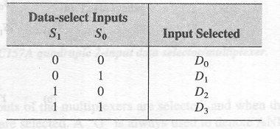
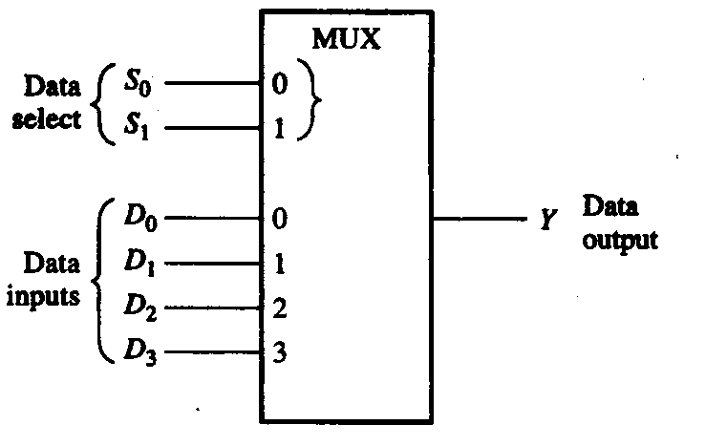
Multiplexers
4-input Multiplexers

Slide 54
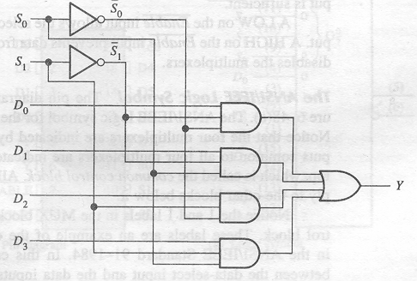
Multiplexers
4-input Multiplexers

Slide 55
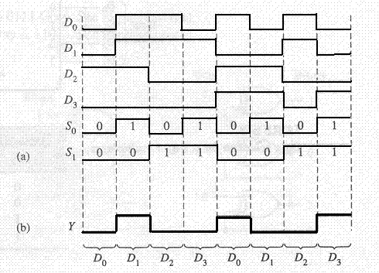
Multiplexers
4-input Multiplexers
Example

Slide 56
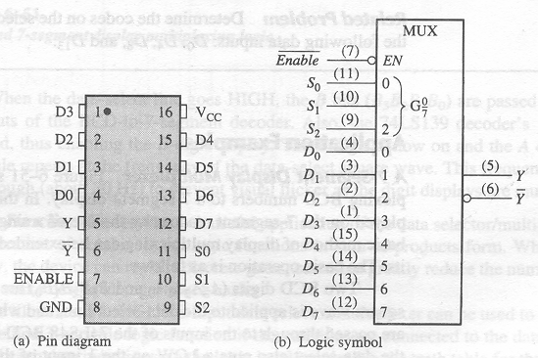
Multiplexers
8-input Multiplexers
74LS151

Slide 57
Applications of Multiplexers
Generate Combinational Logic Functions
A useful application of the multiplexer is in the generation of combinational logic functions in SOP form.
When used in this way, that the device replaces discrete gates, can often greatly reduce the number of ICs and can make design changes much easier.
A 4/8-input multiplexer can be used to implement any specified 2/3-variable logic function if the variables are connected to the data-select inputs and each data input is set to the logic level.

Slide 58
Applications of Multiplexers
Generate Combinational Logic Functions
Procedure:
Step 1: Convert the logic expressions to the similar form of the needed multiplexer.
Step 2: Compare the converted expression and the expression of the multiplexer, and determine the relationship between the variables and the data-select,
Step 3: Determine the logic level or expression of the data-input.
Step 4: Construct the circuit.

Slide 59

Applications of Multiplexers
Generate Combinational Logic Functions
Example
Generate the following function by using a 1-of-4 multiplexer.
（1） Y =D₀(A₁A₀）+D₁ (A₁A₀）+ D₂ (A₁A₀）+D₃ (A₁A₀）

Slide 60
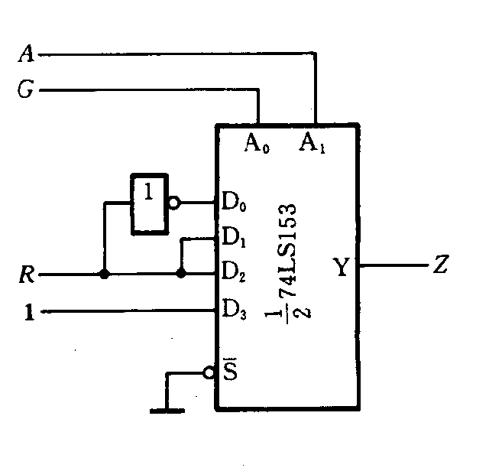
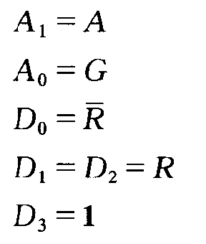
Applications of Multiplexers
Generate Combinational Logic Functions
Example
(2)
(3)
Notice:
enable pin

Slide 61
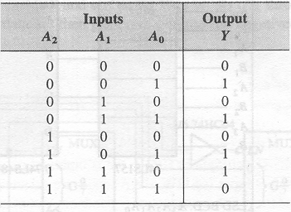
Applications of Multiplexers
Generate Combinational Logic Functions
Example
Implement the logic function by using 1-of-8 multiplexer.

Slide 62
Applications of Multiplexers
Generate Combinational Logic Functions
Example

Slide 63
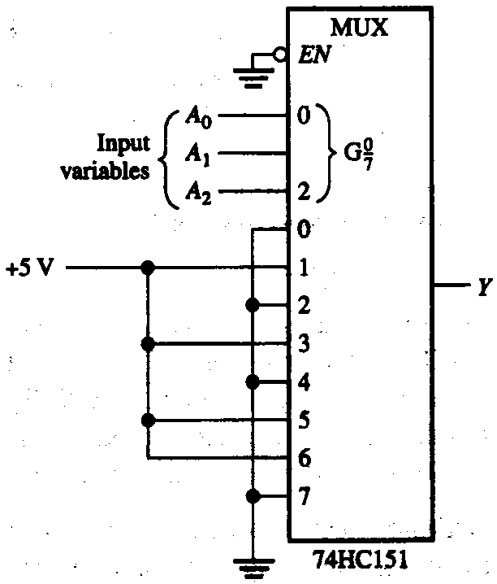
Applications of Multiplexers
Generate Combinational Logic Functions
Example

Slide 64
Demultiplexers
Demultiplexers (分配器)
A demultiplexer (DEMUX) performs the opposite function from a MUX. It switches data from one input line to two or more data lines depending on the select inputs.
Y₀
Data Input
Y₁
Data
Outputs
Y₂
Y₃
Data Select

Slide 65
Demultiplexers
Demultiplexers
The 74LS138 was introduced previously as a decoder but can also serve as a DEMUX. When connected as a DEMUX, data is applied to one of the enable inputs, and routed to the selected output line depending on the select variables.
Data select lines
Data outputs
Enable
inputs
74LS138

Slide 66
Demultiplexers
A
0
A
1
Demultiplexers
A
Determine the outputs, given the inputs shown.
2
Example
G
1
G
LOW
2A
The output logic is opposite to the input because of the active-LOW convention. (Red shows the selected line).
G
LOW
2B
Y
0
Y
1
Data select lines
Y
2
Y
Data outputs
3
Y
Enable
inputs
4
Y
5
Y
6
Y
74LS138
7

Slide 67
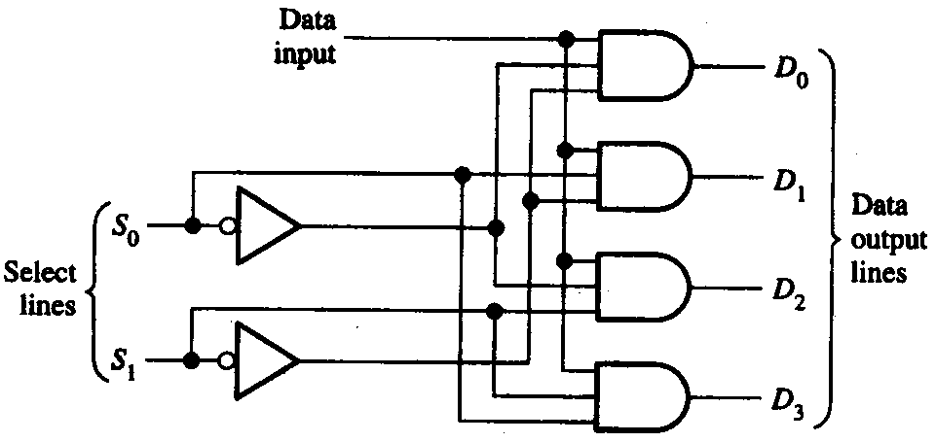
Demultiplexers
1-line-to-4-line Demultiplexer

Slide 68
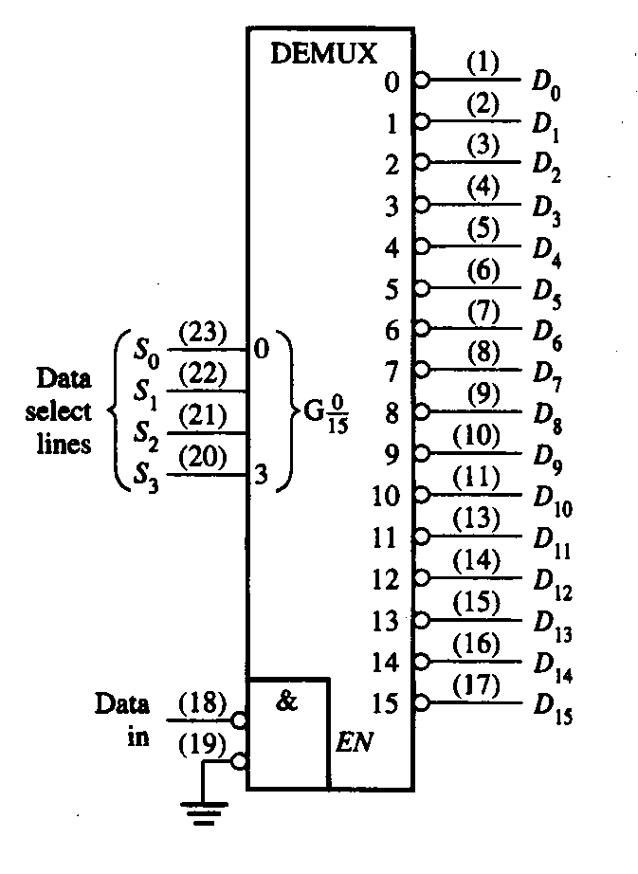
Demultiplexers
4-line-to-16-line Demultiplexer
74HC154

Slide 69
Parity Generator
Parity Generator/Checker (奇偶发生器/校验器)
Parity is an error detection method that uses an extra bit appended to a group of bits to force them to be either odd or even.
In even parity, the total number of ones is even; in odd parity the total number of ones is odd.
Example
The ASCII letter S is 1010011. Show the parity bit for the letter S with odd and even parity.
S with odd parity =
11010011
S with even parity =
01010011

Slide 70
Parity Generator
Parity Generator/Checker
Checker: The 74LS280 can test codes with up to 9 bits. The even output will normally be HIGH if the data lines have even parity; otherwise it will be LOW.
The odd output will normally be HIGH if the data lines have odd parity; otherwise it will be LOW.
Data inputs
Generator: To generate even parity, the parity bit is taken from the odd parity output. To generate odd parity, the output is taken from the even parity output.
74LS280

Slide 71
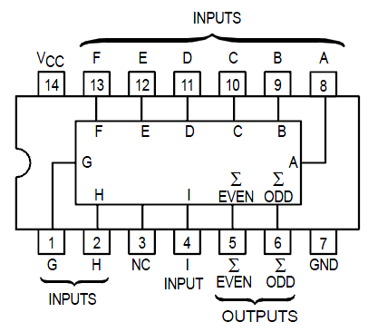
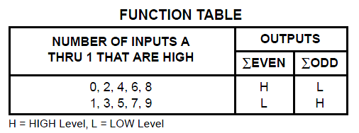
Parity Generator
Parity Generator/Checker

Slide 72
Quiz
1. For the full-adder shown, assume the input bits are as shown with A = 0, B = 0, C_{in} = 1. The Sum and C_{out} will be
a. Sum = 0 C_{out} = 0
b. Sum = 0 C_{out} = 1
c. Sum = 1 C_{out} = 0
d. Sum = 1 C_{out} = 1
Σ
Σ
Σ
Σ
Sum
0
A
A
0
B
C_{out}
B
C_{out}
1
C_{out}

Slide 73
Quiz
2. The output will be LOW if
a. A < B
b. A > B
c. both a and b are
correct
d. A = B
A₁
B₁
A₂
B₂
Output
A₃
B₃
A₄
B₄

Slide 74
Quiz
3. If you expand two 4-bit comparators to accept two 8-bit numbers, the output of the least significant comparator is
a. equal to the final output
b. connected to the cascading inputs of the most
significant comparator
c. connected to the output of the most significant
comparator
d. not used

Slide 75
Quiz
4. Assume you want to decode the binary number 0011 with an active-LOW decoder. The missing gate should be
a. an AND gate
b. an OR gate
c. a NAND gate
d. a NOR gate
A₀
A₁
?
X
A₂
A₃

Slide 76
Quiz
5. Assume you want to decode the binary number 0011 with an active-HIGH decoder. The missing gate should be
a. an AND gate
b. an OR gate
c. a NAND gate
d. a NOR gate
A₀
A₁
?
X
A₂
A₃

Slide 77
Quiz
6. The 74138 is a 3-to-8 decoder. Together, two of these ICs can be used to form one 4-to-16 decoder. To do this, connect
a. one decoder to the LSBs of the input; the other decoder to the MSBs of the input
b. all chip select lines to ground
c. all chip select lines to their active levels
d. one chip select line on each decoder to the input MSB

Slide 78
Quiz
7. The decimal-to-binary encoder shown does not have a zero input. This is because
a. when zero is the input,
all lines should be LOW
b. zero is not important
c. zero will produce
illegal logic levels
d. another encoder is used
for zero
1
A₀
2
3
A₁
4
5
A₂
6
7
8
A₃
9

Slide 79
Quiz
8. If the data select lines of the MUX are S₁S₀ = 11, the output will be
a. LOW
b. HIGH
c. equal to D₀
d. equal to D₃
Data
select
S₀
S₁
D₀
Data
output
Data
inputs
D₁
D₂
D₃

Slide 80
Quiz
9. The 74138 decoder can also be used as
a. an encoder
b. a DEMUX
c. a MUX
d. none of the above
10. The 74LS280 can generate even or odd parity. It can also be used as
a. an adder
b. a parity tester
c. a MUX
d. an encoder

Slide 81
Assignment
Assignment 6 (Due on 14 April 2014)
PP.248
2(a,b),8,10,12,14,22,24,30,31,33

