Slide 1
Digital Circuits and Logic Design
Chapter 7
Latches, Flip-flops, and Timers

Slide 2
After this lecture, you should be able to:
Describe operation characteristics of Flip-Flops
Describe applications of Flip-Flops
Implement one-shot and astable multivibrator using 555 timer

Slide 3
Flip-flops
Flip-Flops Characteristics
Propagation delay time is specified for the rising and falling outputs. It is measured between the 50% level of the clock to the 50% level of the output transition.
50% point on triggering edge
CLK
CLK
50% point
Q
50% point on LOW-to-HIGH transition of Q
Q
50% point on HIGH-to- LOW transition of Q
t_{PLH}
t_{PHL}
The typical propagation delay time for the 74AHC family (CMOS) is 4 ns. Even faster logic is available for specialized applications.

Slide 4
Flip-flops
Flip-Flops Characteristics
Another propagation delay time specification is the time required for an asynchronous input to cause a change in the output. Again it is measured from the 50% levels. The 74AHC family has specified delay times under 5 ns.
PRE
50% point
CLR
50% point
Q
50% point
Q
50% point
t_{PHL}
t_{PLH}

Slide 5
Flip-flops
Flip-Flops Characteristics
Set-up time and hold time are times required before and after the clock transition that data must be present to be reliably clocked into the flip-flop.
Setup time is the minimum time for the data to be present before the clock.
D
CLK
Set-up time, t_{s}
Hold time is the minimum time for the data to remain after the clock.
D
CLK
Hold time, t_{H}

Slide 6
Flip-flops
Flip-Flops Characteristics
Maximum clock frequency
The highest rate at which a flip-flop can be reliably triggered
Minimum pulse widths
Specified by the manufacture for the clock, preset and clear inputs
for various inputs
Power dissipation
The power dissipation is the product of the supply voltage and the average current required.

Slide 7
Flip-flops
Flip-Flops Applications
Output lines
Principal flip-flop applications are for temporary data storage, as frequency dividers, and in counters
Q₀
Typically, for data storage applications, a group of flip-flops are connected to parallel data lines and clocked together. Data is stored until the next clock pulse.
Q₁
Q₂
Parallel data input lines
Q₃
Clock
Clear

Slide 8
Flip-flops
Flip-Flops Applications
For frequency division, it is simple to use a flip-flop in the toggle mode or to chain a series of toggle flip flops to continue to divide by two.
HIGH
HIGH
One flip-flop will divide f_{in} by 2, two flip-flops will divide f_{in} by 4 (and so on). A side benefit of frequency division is that the output has an exact 50% duty cycle.
J
Q_{A}
J
Q_{B}
f_{out}
f_{in}
CLK
CLK
K
K
f_{in}
Waveforms:
f_{out}

Slide 9
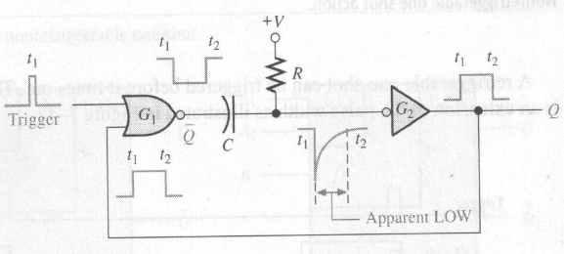
Flip-flops
One-Shots (单稳态)
The one-shot or monostable multivibrator is a device with only one stable state. When triggered, it goes to its unstable state for a predetermined length of time, then returns to its stable state.

Slide 10
Flip-flops
One-Shots
+V
R_{EXT}
C_{EXT}
For most one-shots, the length of time in the unstable state (t_{W}) is determined by an external RC circuit.
Q
CX
RX/CX
Trigger
Q
Trigger
Q
t_{W}

Slide 11
Flip-flops
One-Shots
Nonretriggerable (不可重复触发) one-shots do not respond to any triggers that occur during the unstable state.
Retriggerable one-shots respond to any trigger, even if it occurs in the unstable state. If it occurs during the unstable state, the state is extended by an amount equal to the pulse width.
Retriggerable (可重复触发) one-shot:
Trigger
Retriggers
Q
t_{W}

Slide 12
Flip-flops
One-Shots
An application for a retriggerable one-shot is a power failure detection circuit. Triggers are derived from the ac power source, and continue to retrigger the one shot. In the event of a power failure, the one-shot is not triggered and an alarm can be initiated.
Triggers derived from ac
Missing trigger due to power failure
Q
Retriggers
Retriggers
Power failure indication
t_{W}
t_{W}
t_{W}

Slide 13
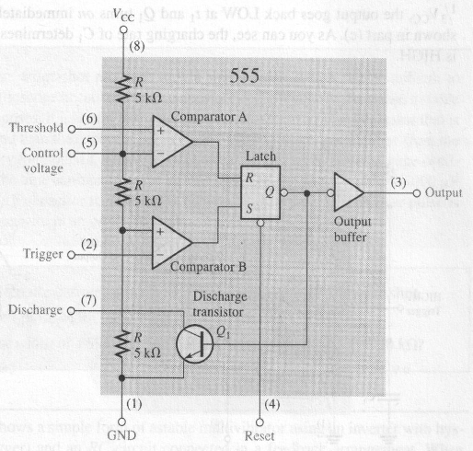
The 555 timer
The 555 timer

Slide 14
The 555 timer
The 555 timer
The 555 timer can be configured in various ways, including as a one-shot. A basic one shot is shown. The pulse width is determined by R₁C₁ and is approximately t_{W} = 1.1R₁C₁.
+V_{CC}
R₁
RESET
V_{CC}
DISCH
The trigger is a negative-going pulse.
THRES
OUT
t_{W} = 1.1R₁C₁
TRIG
CONT
GND
C₁

Slide 15
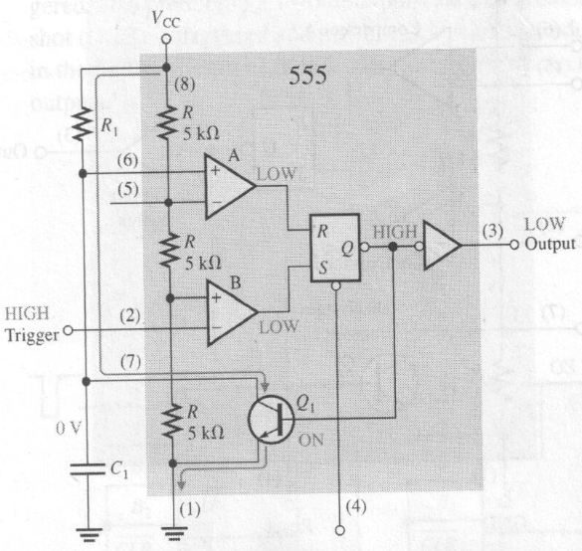
The 555 timer
The 555 timer

Slide 16
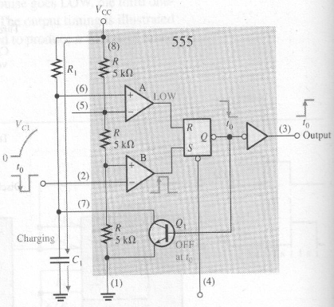
The 555 timer
The 555 timer

Slide 17
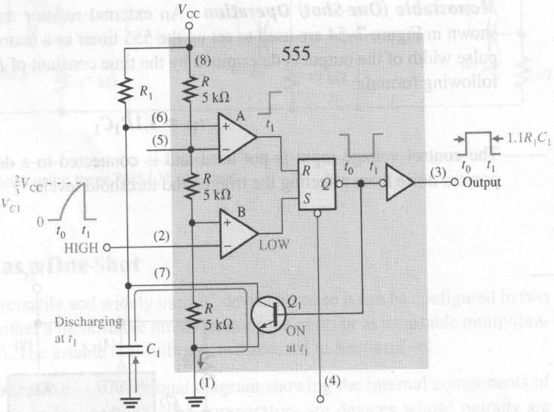
The 555 timer
The 555 timer
t = RCln([(V₁-V₀)/(V₁-V_{t})])

Slide 18
The 555 timer
The 555 timer
Example
Determine the pulse width for the circuit shown.
24.2 ms
t_{W} = 1.1R₁C₁ = 1.1(10 kΩ)(2.2 μF) =
+V_{CC}
+15 V
R₁
10 kΩ
RESET
V_{CC}
DISCH
THRES
OUT
t_{W} = 1.1R₁C₁
TRIG
CONT
C₁
GND
2.2 μF

Slide 19
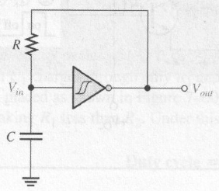
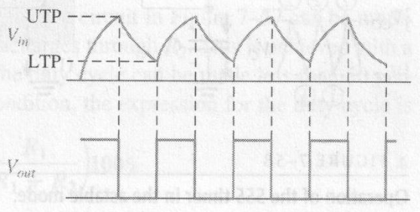
The 555 timer
Astable Multivibrator
Schmitt Trigger (施密特触发)
A special threshold circuit that produces hysteresis (磁滞)
Prevent erratic switching between states
Allow reliable triggering to occur even when the input is changing slowly

Slide 20
The 555 timer
The 555 timer
The 555 can be configured as a basic astable multivibrator with the circuit shown. In this circuit C₁ charges through R₁ and R₂ and discharges through only R₂. The output frequency is given by:
+V_{CC}
R₁
RESET
V_{CC}
DISCH
The frequency and duty cycle are set by these components.
R₂
THRES
OUT
TRIG
CONT
C₁
GND

Slide 21
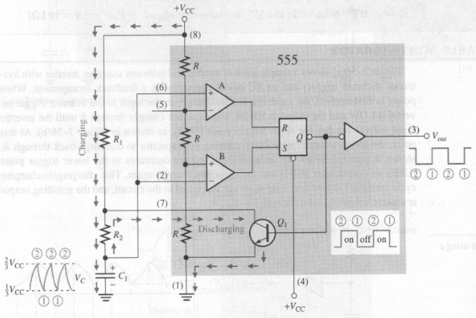
The 555 timer
The 555 timer

Slide 22
The 555 timer
The 555 timer
The time that the output is HIGH(t_{H}) is how long it takes C₁ to charge from 1/3 V_{CC} to 2/3 V_{CC}
The time that the output is LOW(t_{L}) is how long it takes C₁ to discharge from 2/3 V_{CC} to 1/3 V_{CC}
The period T is
Duty cycle

Slide 23
The 555 timer
The 555 timer
Given the components, the frequency can be read from the chart. Alternatively, the chart can be used to pick components for a desired frequency.
+V_{CC}
R₁
RESET
V_{CC}
DISCH
C₁ (μF)
R₂
THRES
OUT
TRIG
CONT
C₁
GND
f (Hz)

Slide 24
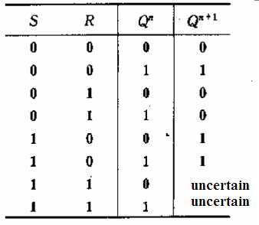
Logic Expression
Logic Expression
S-R flip-flop
Truth-table
Logic Expression
（特性方程）

Slide 25
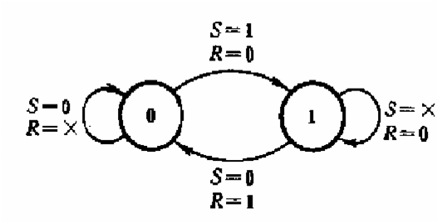
Logic Expression
Logic Expression
S-R flip-flop
Truth-table
State Diagram (状态转换图）

Slide 26
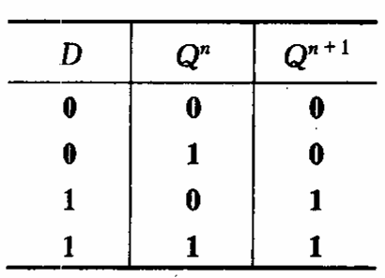
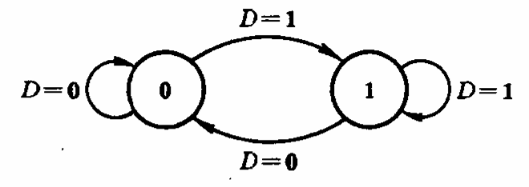
Logic Expression
Logic Expression
D flip-flop
Truth-table
Logic Expression
Q^{n+1}=D
State Diagram

Slide 27
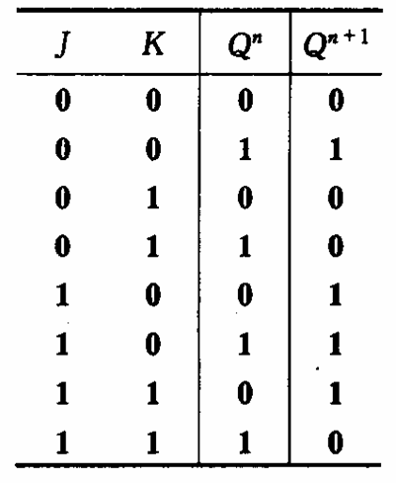
Logic Expression
Logic Expression
J-K flip-flop
Truth-table
Logic Expression

Slide 28
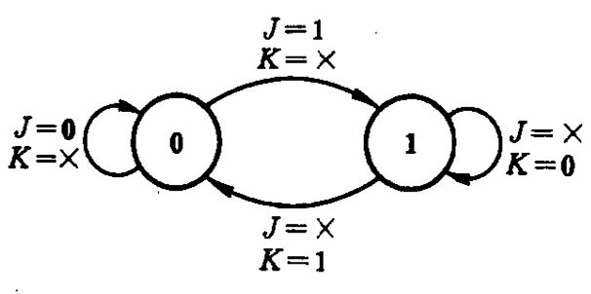
Logic Expression
Logic Expression
J-K flip-flop
Truth-table
State Diagram

Slide 29
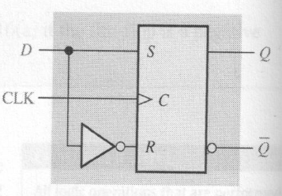
Logic Expression
Implement D FF using S-R FF
S-R flip-flop
D flip-flop

Slide 30
Logic Expression
Implement J-K FF using D FF
Toggle mode
D flip-flop
J-K flip-flop
D
Q
CLK
CLK
Q

Slide 31
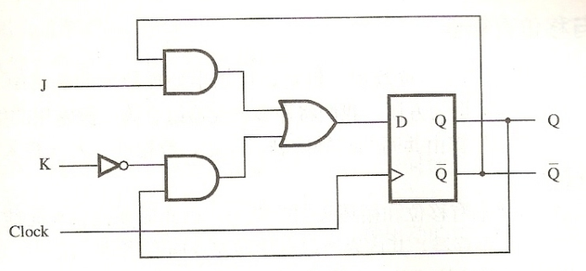
Logic Expression
Implement J-K FF using D FF
D flip-flop
J-K flip-flop

Slide 32
Quiz
1. The output of a D latch will not change if
a. the output is LOW
b. Enable is not active
c. D is LOW
d. all of the above
2. The D flip-flop shown will
a. set on the next clock pulse
b. reset on the next clock pulse
c. latch on the next clock pulse
d. toggle on the next clock pulse
D
Q
CLK
CLK
Q

Slide 33
Quiz
3. For the J-K flip-flop shown, the number of inputs that are asynchronous is
a. 1
b. 2
c. 3
d. 4
PRE
Q
J
CLK
K
Q
CLR

Slide 34
Quiz
4. Assume the output is initially HIGH on a leading edge triggered J-K flip flop. For the inputs shown, the output will go from HIGH to LOW on which clock pulse?
a. 1
b. 2
c. 3
d. 4
CLK
J
K
1 2 3 4

Slide 35
Quiz
5. The time interval illustrated is called
a. t_{PHL}
b. t_{PLH}
c. set-up time
d. hold time
6. The time interval illustrated is called
a. t_{PHL}
b. t_{PLH}
c. set-up time
d. hold time
50% point on triggering edge
CLK
Q
50% point on LOW-to-HIGH transition of Q
?
D
CLK
?

Slide 36
Quiz
7. The application illustrated is a
a. astable multivibrator
b. data storage device
c. frequency multiplier
d. frequency divider
HIGH
HIGH
Q_{A}
Q_{B}
f_{out}
J
J
f_{in}
CLK
CLK
K
K

Slide 37
Quiz
8. The application illustrated is a
a. astable multivibrator
b. data storage device
c. frequency multiplier
d. frequency divider
Output lines
Q₀
Q₁
Q₂
Parallel data input lines
Q₃
Clock
Clear

Slide 38
Quiz
9. A retriggerable one-shot with an active HIGH output has a pulse width of 20 ms and is triggered from a 60 Hz line. The output will be a
a. series of 16.7 ms pulses
b. series of 20 ms pulses
c. constant LOW
d. constant HIGH
10. The circuit illustrated is a
a. astable multivibrator
b. monostable multivibrator
c. frequency multiplier
d. frequency divider
+V_{CC}
R₁
RESET
V_{CC}
DISCH
R₂
THRES
OUT
TRIG
CONT
C₁
GND

Slide 39
Assignment
Assignment 8 (Due on 28 April 2014)
PP.303
22,24,25,28,30

