Slide 1
Digital Circuits and Logic Design
Chapter 8
Counters

Slide 2
After this lecture, you should be able to:
Analyze the sequential logics
Identify different types of counters
Implement different types of counters
Design the sequential logics

Slide 3
Sequential Logic
Sequential Logic
The digital electronic logic is classified as the combinational logic and the sequential logic.
Sequential Logic
Memory Section
Combinational Logic Section

Slide 4
Sequential Logic
Sequential Logic
The sequential logic is classified as the asynchronous one and synchronous one (异步时序电路和同步时序电路）.
Synchronous
Events that have a fixed time relationship with each other
Asynchronous
Refers to events that do not have a fixed time relationship
with each other and, generally, do not occur at the same time.

Slide 5
Sequential Logic
Logic Diagram
Combinational Logic
x₁
x_{i}
y₁
y_{j}
Y = F[X,Q]
Output Exp.
Z = G[X,Q]
Excitation Exp.
Memory
Q^{n+1} = H[Z,Q^{n}]
State Exp.
q₁
q_{l}
z₁
z_{k}

Slide 6
Sequential Logic
Analysis of the Sequential Logic
Procedure:
Write down the clock and excitation expressions for each FF.
Get their state expressions by replacing the logic expression for the FF with its excitation expression.
3. Write down the output expression.
4. Assume the present state, and analyze the next state, and draw its state diagram/state sequence table or its timing diagram.
5. Determine the logic function of the logic diagram.

Slide 7
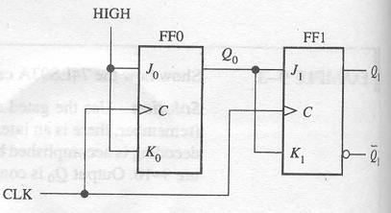
Counters
Analysis of the Sequential Logic
Example
What’s the function of the following logic diagram?

Slide 8
Counters
Analysis of the Sequential Logic
Example
Write down the clock and excitation expressions for each FF.
2. Get their state expressions by replacing the logic expression for the FF with its excitation expression.

Slide 9
Counters
Analysis of the Sequential Logic
Example
3.Write down the output expression.
4. Assume the present state, and analyze the next state, and draw its state diagram/state sequence table or its timing diagram .

Slide 10
Counters
Analysis of the Sequential Logic
Example
CP | Q₁ | Q₀
0 | 0 | 0
1 | 0 | 1
2 | 1 | 0
3 | 1 | 1
4 | 0 | 0
State Sequence Table

Slide 11
Counters
Analysis of the Sequential Logic
Example
State Sequence Table
State Diagram
CP | Q₁ | Q₀
0 | 0 | 0
1 | 0 | 1
2 | 1 | 0
3 | 1 | 1
4 | 0 | 0
Q₁Q₀
00
01
11
10

Slide 12
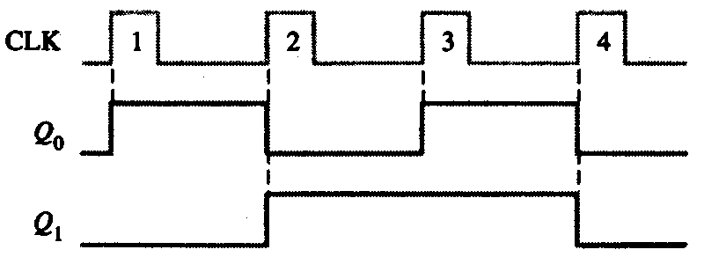
Counters
Analysis of the Sequential Logic
Example
Timing Diagram

Slide 13
Counters
Analysis of the Sequential Logic
Example
A 2-bit synchronous binary counter
00
01
11
10

Slide 14
Counters
Synchronous Counters
In a synchronous counter all flip-flops are clocked together with a common clock pulse.
The binary count sequence follows a pattern of 0’s and 1’s.
0 0 0
0 0 1
0 1 0
0 1 1
1 0 0
1 0 1
1 1 0
1 1 1
LSB changes on every number.
The next bit changes on every other number.
The next bit changes on every fourth number.

Slide 15
Counters
Counting in Binary
A counter can form the same pattern of 0’s and 1’s with logic levels. The first stage in the counter represents the least significant bit – notice that these waveforms follow the same pattern as counting in binary.
LSB
MSB

Slide 16
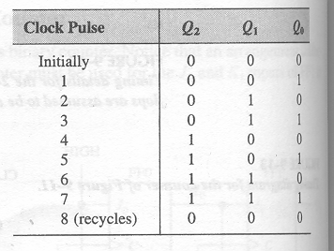
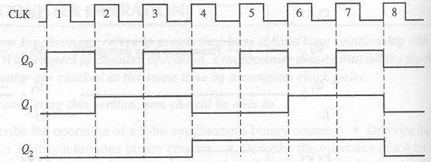
Latches
3-Bit Synchronous Binary Counter
Example
HIGH
Q₀
Q₀
Q₁
Q₀Q₁
Q₂
J₀
J₁
J₂
C
C
C
K₀
K₁
K₂
CLK

Slide 17
Counters
4-bit Synchronous Binary Counter
Q₀
Q₁
Q₂
Q₃

Slide 18
Counters
BCD Decade Counter
With some additional logic, a binary counter can be converted to a BCD synchronous decade counter. After reaching the count 1001, the counter recycles to 0000.
This gate detects 1001, and causes FF3 to toggle on the next clock pulse. FF0 toggles on every clock pulse. Thus, the count starts over at 0000.
Q₃
Q₀

Slide 19
Counters
BCD Decade Counter
Waveforms for the decade counter:
CLK
Q₀
Q₁
Q₂
Q₃

Slide 20
Counters
A 4-bit Synchronous Binary Counter
The 74LS163 is a 4-bit IC synchronous counter with additional features over a basic counter. It has parallel load, a CLR input, two chip enables, and a ripple count output that signals when the count has reached the terminal count.
Data inputs
D₀
D₁
D₂
D₃
CLR
LOAD
ENT
RCO
ENP
CLK
Q₀
Q₁
Q₂
Q₃
Data outputs

Slide 21
Counters
CLR
LOAD
D₀
Data inputs
D₁
D₂
D₃
CLK
ENP
ENT
Q₀
Q₁
Q₂
Q₃
RCO
12 13 14 15 0 1 2
Count Inhibit
Clear Preset

Slide 22
Counters
Up/Down Synchronous Counters
An up/down counter is capable of progressing in either direction depending on a control input.
UP
Q₀.UP
HIGH
FF0
FF1
FF2
Q₂
J₀
Q₀
J₁
Q₁
J₂
UP/DOWN
C
C
C
Q₀
Q₁
Q₂
K₀
K₁
K₂
DOWN
Q₀.DOWN
CLK

Slide 23
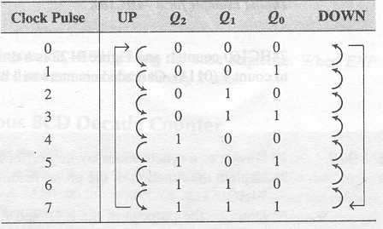
Counters
Up/Down Synchronous Counters
State Diagram
Up sequence
Q₂Q₁Q₀
000
001
010
011
111
110
101
100
Down sequence

Slide 24
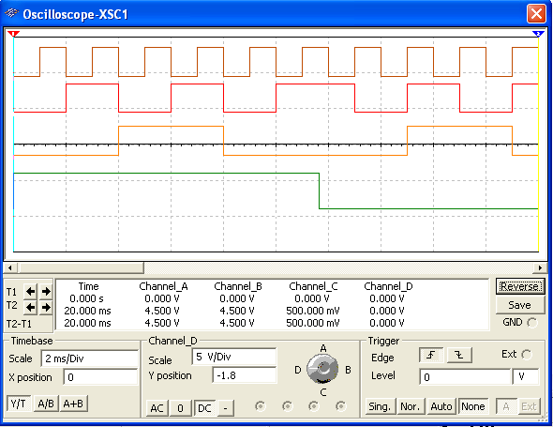
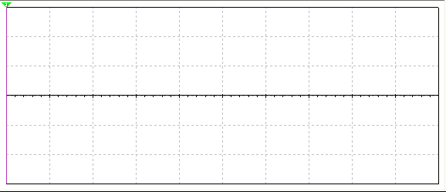
Counters
Up/Down Synchronous Counters
Q₀
Q₁
Q₂
UP/DOWN
Count up
Count down

Slide 25
Counters
Up/Down Synchronous Counters
D₀
D₁
D₂
D₃
Data inputs
The 74HC190 is a high speed CMOS synchronous up/down decade counter with parallel load capability. It also has a active LOW ripple clock output (RCO) and a MAX/MIN output when the terminal count is reached.
74HC190
CTEN
MAX/MIN
D/U
CTR DIV 10
LOAD
CLK
C
RCO
Q₀
Q₁
Q₂
Q₃
Data outputs
D₀
D₁
D₂
D₃
Data inputs
The 74HC191 has the same inputs and outputs but is a synchronous up/down binary counter.
74HC191
CTEN
MAX/MIN
D/U
CTR DIV 16
LOAD
CLK
C
RCO
Q₀
Q₁
Q₂
Q₃
Data outputs

Slide 26
Sequential Logics Design
Sequential Logics Design
Procedure:
1. Convert the given problem to a logic problem. Assume the input, output and state variables.
2. Get its state diagram.
3. Get its state sequence table.
4. According to the number of the states, draw a corresponding number-variable K-map.

Slide 27
Sequential Logics Design
Sequential Logics Design
Procedure:
5. Get the state expressions using K-map.
6. Choose the needed flip-flop.
7.Get the excitation expressions according to the state expressions and logic expression for the corresponding flip-flop.
8. Sketch the logic diagram.

Slide 28
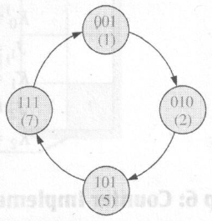
Sequential Logics Design
Sequential Logics Design
Example
Design a counter with the binary count sequence shown in the state diagram shown below using J-K flip-flops

Slide 29
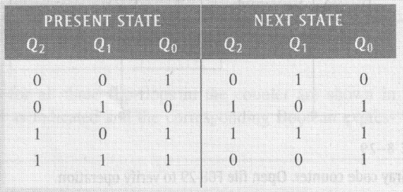
Sequential Logics Design
Sequential Logics Design
Example

Slide 30
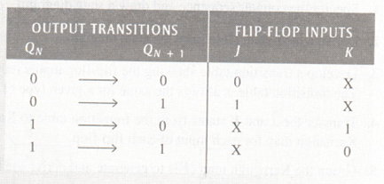
Sequential Logics Design
Sequential Logics Design
Example

Slide 31
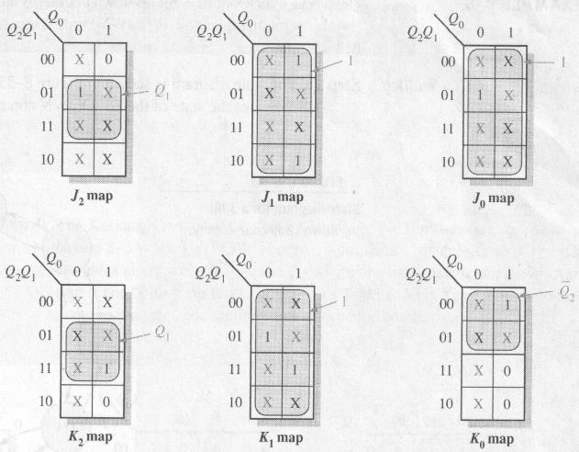
Sequential Logics Design
Sequential Logics Design
Example

Slide 32
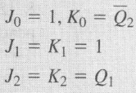
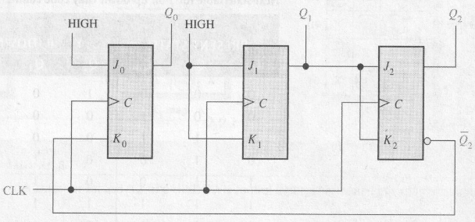
Sequential Logics Design
Sequential Logics Design
Example

Slide 33
Counters
Cascaded counters
Cascading is a method of achieving higher-modulus counters. For synchronous IC counters, the next counter is enabled only when the terminal count of the previous stage is reached.
HIGH
Counter 1
Counter 2
f_{out}
CTEN
TC
CTEN
TC
CTR DIV 16
CTR DIV 16
CLK
C
Q₀
Q₂
Q₁
Q₃
C
Q₀
Q₂
Q₁
Q₃
f_{in}
Example
What is the modulus of the cascaded DIV 16 counters?
If f_{in} =100 kHz, what is f_{out}?
a) Each counter divides the frequency by 16. Thus the modulus is 16² = 256.
b) The output frequency is 100 kHz/256 = 391 Hz

Slide 34
Counters
Counter Decoding
Decoding is the detection of a binary number and can be done with an AND gate.
Question
What number is decoded by this gate?

Slide 35
Counters
Resetting the Count with a Decoder
The divide-by-60 counter also uses partial decoding to clear the tens count when a 6 was detected.
The divide characteristic illustrated here is a good way to obtain a lower frequency using a counter.
For example, the 60 Hz power line can be converted to 1 Hz.

Slide 36
Counters
Counter Decoding
Example
Show how to decode state 5 with an active LOW output.
Notice that a NAND gate was used to give the active LOW output.

Slide 37
Counters
Three bit Asynchronous Counter
In an asynchronous counter, the clock is applied only to the first stage. Subsequent stages derive the clock from the previous stage.
The three-bit asynchronous counter shown is typical. It uses J-K flip-flops in the toggle mode.
HIGH
J₀
Q₀
J₁
Q₁
J₂
Q₂
CLK
C
C
C
Q₀
Q₁
K₀
K₁
K₂

Slide 38
Counters
Three bit Asynchronous Counter
Notice that the Q₀ output is triggered on the leading edge of the clock signal. The following stage is triggered from Q₀. The leading edge of Q₀ is equivalent to the trailing edge of Q₀. The resulting sequence is that of an 3-bit binary up counter.
CLK
Q₀
Q₁
Q₂

Slide 39
Counters
Three bit Asynchronous Counter
Asynchronous counters are sometimes called ripple counters, because the stages do not all change together.
For certain applications requiring high clock rates, this is a major disadvantage.
Notice how delays are cumulative as each stage in a counter is clocked later than the previous stage.
CLK
Q₀
Q₁
Q₂
Q₀ is delayed by 1 propagation delay, Q₂ by 2 delays and Q₃ by 3 delays.

Slide 40
Counters
Asynchronous Decade Counter
This counter uses partial decoding to recycle the count sequence to zero after the 1001 state. The flip-flops are trailing-edge triggered, so clocks are derived from the Q outputs. Other truncated sequences can be obtained using a similar technique.
CLR
HIGH
Q₀
Q₁
Q₂
Q₃
J₀
J₁
J₂
J₃
CLK
C
C
C
C
K₀
K₁
K₂
K₃

Slide 41
Counters
Asynchronous Decade Counter
When Q₁ and Q₃ are HIGH together, the counter is cleared by a “glitch” on the CLR line.
CLK
Q₀
Q₁
Glitch
Q₂
Q₃
CLR
Glitch

Slide 42
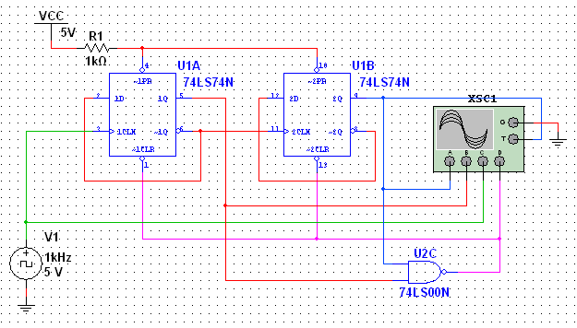
Counters
Asynchronous Counter Using D Flip-flops
D flip-flops can be set to toggle and used as asynchronous counters by connecting Q back to D.

Slide 43
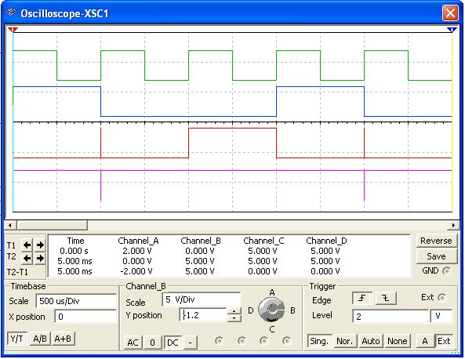
Counters
Asynchronous Counter Using D Flip-flops
CLK
LSB
MSB
CLR
Note that it is momentarily in state 3 which causes it to clear.
The sequence is 0 – 2 – 1 – (CLR) (repeat)…

Slide 44
Counters
74LS93A Asynchronous Counter
The 74LS93A has one independent toggle J-K flip-flop driven by CLK A and three toggle J-K flip-flops that form an asynchronous counter driven by CLK B.
The counter can be extended to form a 4-bit counter by connecting Q₀ to the CLK B input. Two inputs are provided that clear the count.
CLK B
J₀
J₁
J₂
J₃
CLK A
C
C
C
C
K₀
K₁
K₂
K₃
All J and K inputs are connected internally HIGH
RO (1)
RO (2)
Q₀
Q₁
Q₂
Q₃

Slide 45
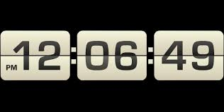
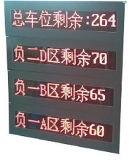
Counters
Applications
A Digital Clock
Parking Control

Slide 46
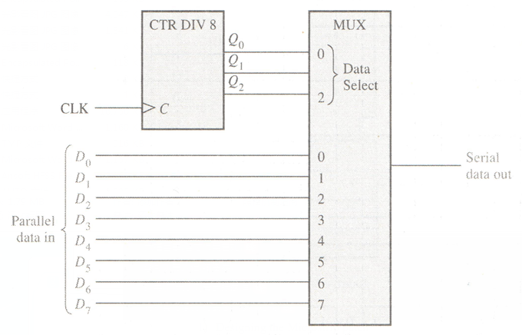
Counters
Applications
Parallel to Serial Data Conversion

Slide 47
Assignment
Assignment 9 (Due on 5 May 2014)
PP.355
2,4(a,e),6,9,12,16,18,22(a),24(a),26,

