Slide 1
Digital Circuits and Logic Design
Chapter 8
Counters

Slide 2
After this lecture, you should be able to:
Analyze the sequential logics
Design the sequential logics

Slide 3
Analysis of the Sequential Logic
Analysis of the Sequential Logic
Procedure:
Write down the clock and excitation expressions for each FF.
Get their state expressions by replacing the logic expression for the FF with its excitation expression.
3. Write down the output expression.
4. Assume the present state, and analyze the next state, and draw its state diagram/state sequence table or its timing diagram.
5. Determine the logic function of the logic diagram.

Slide 4
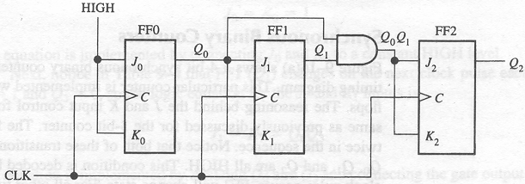
Analysis of the Sequential Logic
Analysis of the Sequential Logic

Slide 5
Analysis of the Sequential Logic
Analysis of the Sequential Logic
Write down the clock and excitation expressions for each FF.
2. Get their state expressions by replacing the logic expression for the FF with its excitation expression.

Slide 6
Counters
Analysis of the Sequential Logic
3.Write down the output expression.
4. Assume the present state, and analyze the next state, and draw its state diagram/state sequence table or its timing diagram .

Slide 7
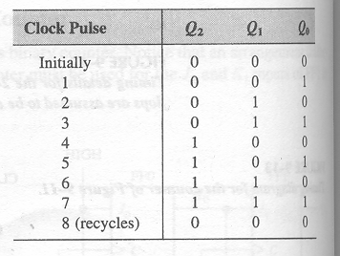
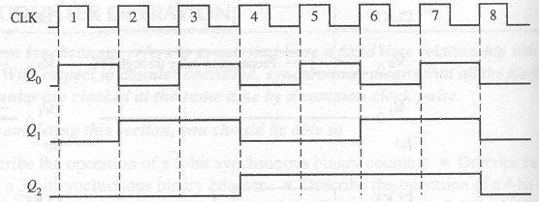
Analysis of the Sequential Logic
Analysis of the Sequential Logic
5. Determine the logic function of the logic diagram.
A 3-bit synchronous binary counter

Slide 8
Sequential Logics Design
Sequential Logics Design
Procedure:
1. Convert the given problem to a logic problem. Assume the input, output and state variables.
2. Get its state diagram.
3. Get its state sequence table.
4. According to the number of the states, draw a corresponding number-variable K-map.

Slide 9
Sequential Logics Design
Sequential Logics Design
Procedure:
5. Get the state expressions using K-map.
6. Choose the needed flip-flop.
7.Get the excitation expressions according to the state expressions and logic expression for the corresponding flip-flop.
8. Sketch the logic diagram.

Slide 10
Sequential Logic Circuits Design
Sequential Logic Circuits Design
Design a logic diagram that can check the series data.
When there are three or more than three HIGH inputs in series, the output is 1.
Otherwise , the output is 0.

Slide 11
Sequential Logic Circuits Design
Sequential Logic Circuits Design
Step 1: Analyze the problem, assume the input/output variables, and get its state diagram/state sequence table.
Assume:
X: the input variable;
Y: the output variable;
States: S0 – the input is 0;
S1 – there is only one HIGH input.
S2 – there is two HIGH inputs in series.
S3 – there is three or more than three HIGH inputs in series.

Slide 12
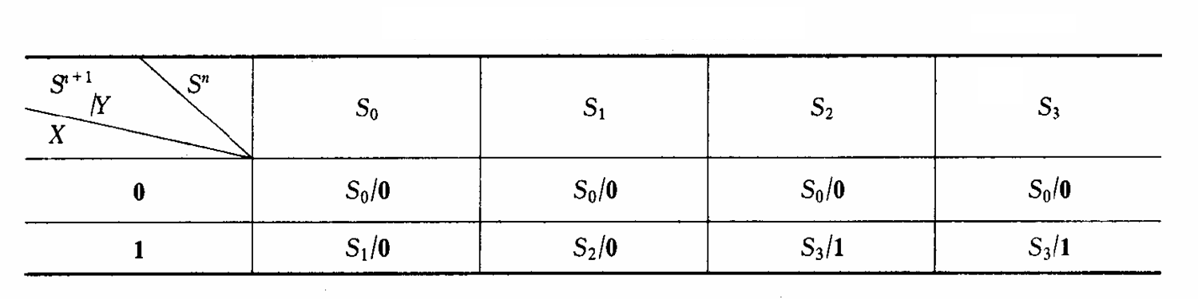
Sequential Logic Circuits Design
Sequential Logic Circuits Design
Step 2: State sequence table
Equivalent States
The input

Slide 13
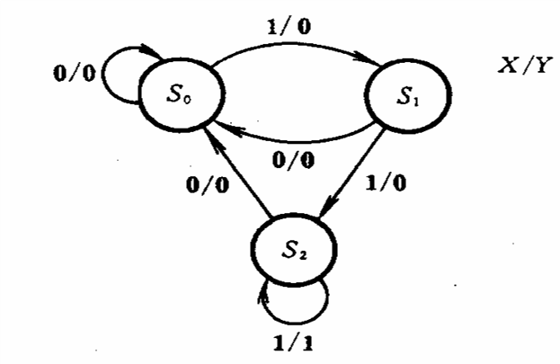
Sequential Logic Circuits Design
Sequential Logic Circuits Design
3 states: 2 flip-fops (3 <=2²)

Slide 14
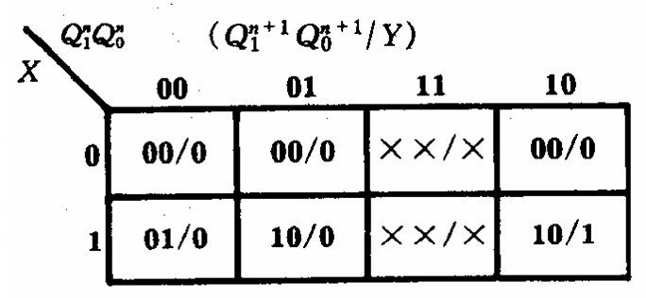
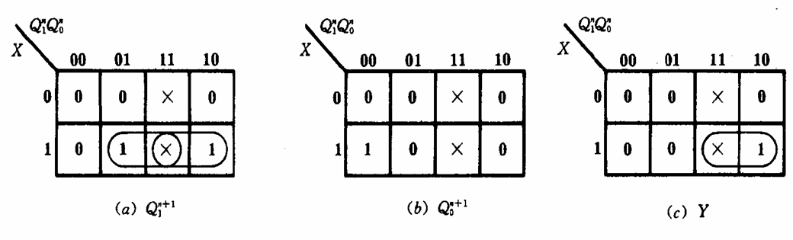
Sequential Logic Circuits Design
Sequential Logic Circuits Design
Step 3: K-map

Slide 15
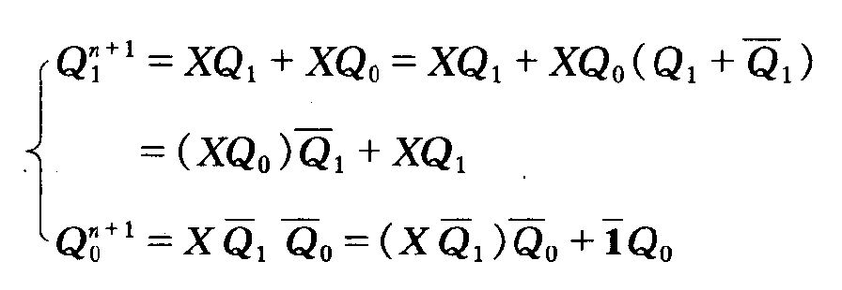
Sequential Logic Circuits Design
Sequential Logic Circuits Design
Step 4: State expressions
Step 5: Output expression
Y=X • Q₁

Slide 16
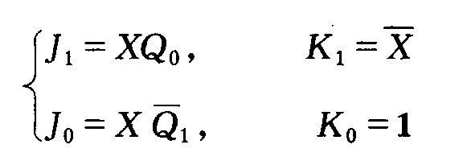
Sequential Logic Circuits Design
Sequential Logic Circuits Design
Step 6: Choose the flip-flop: J-K flip-flop.
Step 7: Get the excitation expressions.

Slide 17
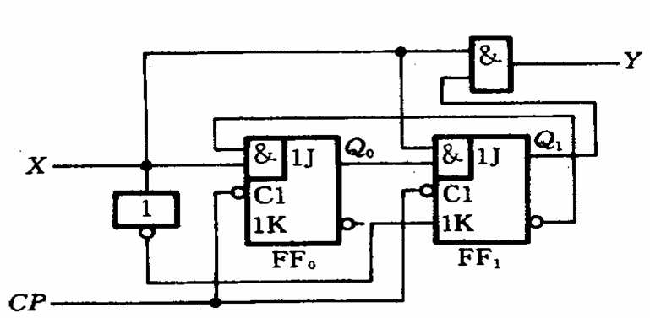
Sequential Logic Circuits Design
Sequential Logic Circuits Design
Step 8: Construct the logic diagram.
Y=X • Q₁

Slide 18
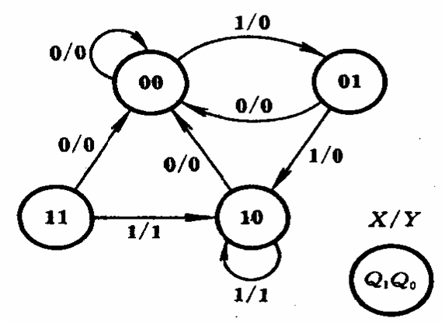
Sequential Logic Circuits Design
Sequential Logic Circuits Design
Step 9: Check whether the diagram startup automatically.
It can startup automatically.

Slide 19
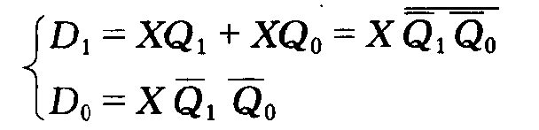
Sequential Logic Circuits Design
Sequential Logic Circuits Design
Implement the above logic function using D flip-flop.
Y=X • Q₁

Slide 20
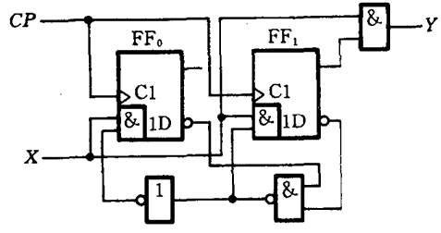
Sequential Logic Circuits Design
Sequential Logic Circuits Design
Implement the above logic function using D flip-flop.
Y=X • Q₁

Slide 21
Counters
Counters
The counter can be classified as the following categories:
Modulus-2 counter
Modulus-10 counter
Modulus-60 counter
Modulus-M counter

Slide 22
States
States
Valid states (used states)
- states used by the diagram in normal operation.
Invalid states (unused states)
- states which aren’t used by the diagram in normal operation.
Valid Cycle
- Cycle that includes the valid states.
Invalid Cycle
- Cycle that includes the invalid states.

Slide 23
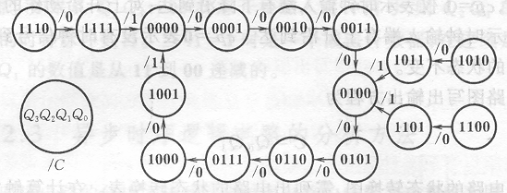
States
States
Valid Cycle
Invalid Cycle
Invalid States
Valid States

Slide 24
States
Self-startup check
Startup automatically
- If a logic diagram doesn’t have invalid cycle, it can startup automatically.
Self-startup check
- Check if all the invalid states can enter the valid cycle automatically.

Slide 25
Logic Symbols
Logic Symbols
Dependency notation allows the logical operation of a device to be determined from its logic symbol.
CTR DIV 16
Common control block
CLR
5CT = 0
D₀
D₁
D₂
D₃
LOAD
M1
M2
RCO
ENT
G3
CLR
ENP
G4
LOAD
CLK
C5/2,3,4
ENT
CTR DIV 16
RCO
ENP
D₀
Q₀
CLK
C
D₁
Q₁
D₂
Q₂
D₃
Q₃
Q₀
Q₁
Q₂
Q₃

Slide 26
Logic Symbols
Logic Symbols
Common Control Block
Individual Elements
Input: D₀,D₁,D₂ and D₃ Output: Q₀,Q₁,Q₂ and Q₃
Qualifying Symbol
CTR DIV 16
Control Dependency (C)
C5/2,3,4+
Mode Dependency (M)
M1,M2
And Dependency (G)
G3,G4

Slide 27
Quiz
1. The counter shown below is an example of
a. an asynchronous counter
b. a BCD counter
c. a synchronous counter
d. none of the above
HIGH
J₀
Q₀
J₁
Q₁
J₂
Q₂
CLK
C
C
C
Q₀
Q₁
K₀
K₁
K₂

Slide 28
Quiz
The Q₀ output of the counter shown
a. is present before Q₁ or Q₂
b. changes on every clock pulse
c. has a higher frequency than Q₁ or Q₂
d. all of the above
HIGH
J₀
Q₀
J₁
Q₁
J₂
Q₂
CLK
C
C
C
Q₀
Q₁
K₀
K₁
K₂

Slide 29
Quiz
3. To cause a D flip-flop to toggle, connect the
a. clock to the D input
b. Q output to the D input
c. Q output to the D input
d. clock to the preset input

Slide 30
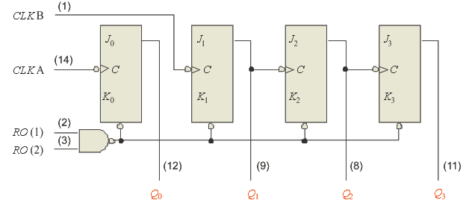
Quiz
4. The 7493A asynchronous counter diagram is shown (J’s and K’s are HIGH.) To make the count have a modulus of 16, connect
a. Q₀ to RO(1) and RO(2) to
b. Q₃ to RO(1) and RO(2)
c. CLK A and CLK B together
d. Q₀ to CLK B

Slide 31
Quiz
5. Assume Q₀ is LOW. The next clock pulse will cause
a. FF1 and FF2 to both toggle
b. FF1 and FF2 to both latch
c. FF1 to latch; FF2 to toggle
d. FF1 to toggle; FF2 to latch

Slide 32
Quiz
6. A 4-bit binary counter has a terminal count of
a. 4
b. 10
c. 15
d. 16
Assume the clock for a 4-bit binary counter is 80 kHz.
The output frequency of the fourth stage (Q₃) is
a. 5 kHz
b. 10 kHz
c. 20 kHz
d. 320 kHz

Slide 33
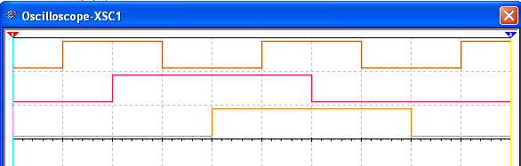
Quiz
8. A 3-bit count sequence is shown for a counter (Q₂ is the MSB). The sequence is
a. 0-1-2-3-4-5-6-7-0 (repeat)
b. 0-1-3-2-6-7-5-4-0 (repeat)
c. 0-2-4-6-1-3-5-7-0 (repeat)
d. 0-4-6-2-3-7-5-1-0 (repeat)

Slide 34
Quiz
9. FF2 represents the MSB. The counts that are being decoded by the 3-input AND gates are
a. 2 and 3
b. 3 and 6
c. 2 and 5
d. 5 and 6

Slide 35
Quiz
10. Assume the input frequency (f_{in}) is 256 Hz. The output frequency (f_{out}) will be
a. 16 Hz
b. 1 kHz
c. 65 kHz
d. none of the above
HIGH
Counter 1
Counter 2
f_{out}
CTEN
TC
CTEN
TC
CTR DIV 16
CTR DIV 16
CLK
C
Q₀
Q₂
Q₁
Q₃
C
Q₀
Q₂
Q₁
Q₃
f_{in}

