Slide 1
Digital Circuits and Logic Design
Chapter 9
Shift Register

Slide 2
After this lecture, you should be able to:
Identify different basic shift register operations
Implement different basic shift registers
Describe applications of shift registers

Slide 3
Shift Register
Basic Shift Register Functions
Shift registers are a type of sequential logic circuits closely related to digital counters.
Shift registers consist of an arrangement of FF and are important in application involving the storage and transfer of data in a digital system.
It can store and shift data (1s and 0s)entered into it from an external source.

Slide 4
Shift Register
Basic Shift Register Functions
A register is a digital circuit with two basic functions: data storage and data movement.
The storage capacity of a register is the total number of bits (1s and 0s) of digital data it can retain.
Each state (FF) in a shift register represents one bit of storage capacity; therefore, the number of states in a register determines its storage capacity.

Slide 5
Shift Register
Basic Shift Register Operations
A shift register is an arrangement of flip-flops with important applications in storage and movement of data. Some basic data movements are illustrated here.
Data in
Data in
Data out
Data out
Data in
Data out
Serial in/shift right/serial out
Serial in/shift left/serial out
Parallel in/serial out
Data in
Data in
Data out
Data out
Serial in/parallel out
Parallel in/parallel out
Rotate right
Rotate left

Slide 6
Shift Register
Serial-in/Serial out Shift Register
The serial in/serial out shift register accepts data serially- that is, one bit at a time on a single line.
It produces the stored information on its output also in serial form.
1
1
1
1
1
1
CLK
CLK
CLK
CLK
CLK

Slide 7
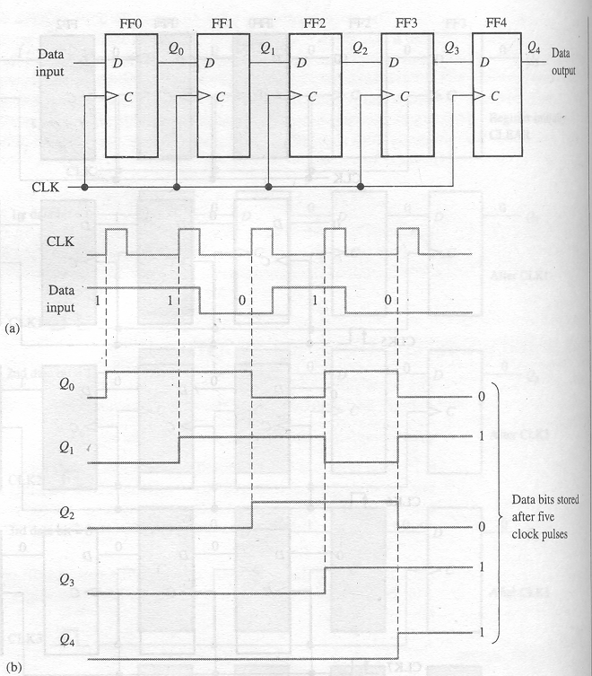
Shift Register
Serial-in/Serial out Shift Register

Slide 8
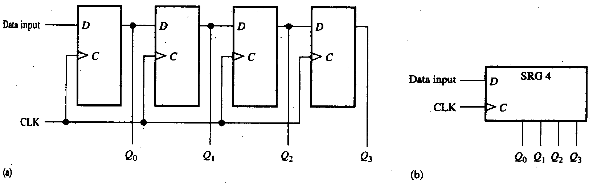
Shift Register
Serial-in/Parallel out Shift Register
4-bit serial in/parallel out shift register and its logic symbol

Slide 9
Shift Register
The 74HC164A Shift Register
The 74HC164A is a CMOS 8-bit serial in/parallel out shift register. V_{CC} can be from +2.0 V to +6.0 V.
CLR
CLK
Serial inputs
A
B
Q₀
Q₁
Q₂
Q₃
Q₄
Q₅
Q₆
Q₇
One of the two serial data inputs may be used as an active HIGH enable to gate the other input. If no enable is needed, the other serial input can be connected to V_{CC}.
The 74HC164A has an active LOW asynchronous clear. Data is entered on the leading-edge of the clock.

Slide 10
Shift Register
Waveforms for the 74HC164A
Sample waveforms for the 74HC164A are shown. Notice that B acts as an active HIGH enable for the data on A as discussed.
CLR
A
Serial inputs
B
CLK
Q₀
Q₁
As with CMOS devices, unused inputs should always be connected to a logic level; unused outputs should be left open.
Q₂
Q₃
Outputs
Q₄
Q₅
Q₆
Q₇
Clear
Clear

Slide 11
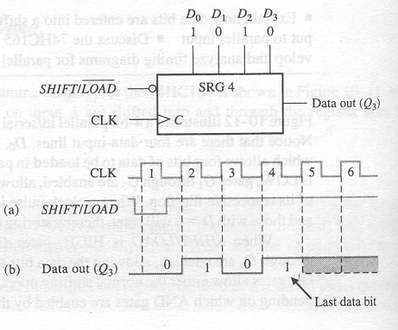
Shift Register
Parallel in/Serial out Shift Register

Slide 12
Shift Register
Parallel in/Serial out Shift Register
Shift registers can be used to convert parallel data to serial form. A logic diagram for this type of register is shown:
D₀
D₁
D₂
D₃
SHIFT/LOAD
Serial data out
Q₀
Q₁
Q₂
Q₃
CLK

Slide 13
Shift Register
The 74HC165 Shift Register
The 74HC165 is a CMOS 8-bit parallel in/serial out shift register. The logic symbol is shown:
D₀
D₁
D₂
D₃
D₄
D₅
D₆
D₇
SH/LD
Q₇
SER
CLK INH
CLK
Q₇
The clock (CLK) and clock inhibit (CLK INH) lines are connected to a common OR gate, so either of these inputs can be used as an active-LOW clock enable with the other as the clock input.

Slide 14
Shift Register
The 74HC165 Shift Register
Data is loaded asynchronously when SH/LD is LOW and moved through the register synchronously when SH/LD is HIGH and a rising clock pulse occurs.
D₀
D₁
D₂
D₃
D₄
D₅
D₆
D₇
SH/LD
Q₇
SER
CLK INH
CLK
Q₇
The 74HC165 can also be operated as serial in/serial out.
Data can be entered serially on the SER input.

Slide 15
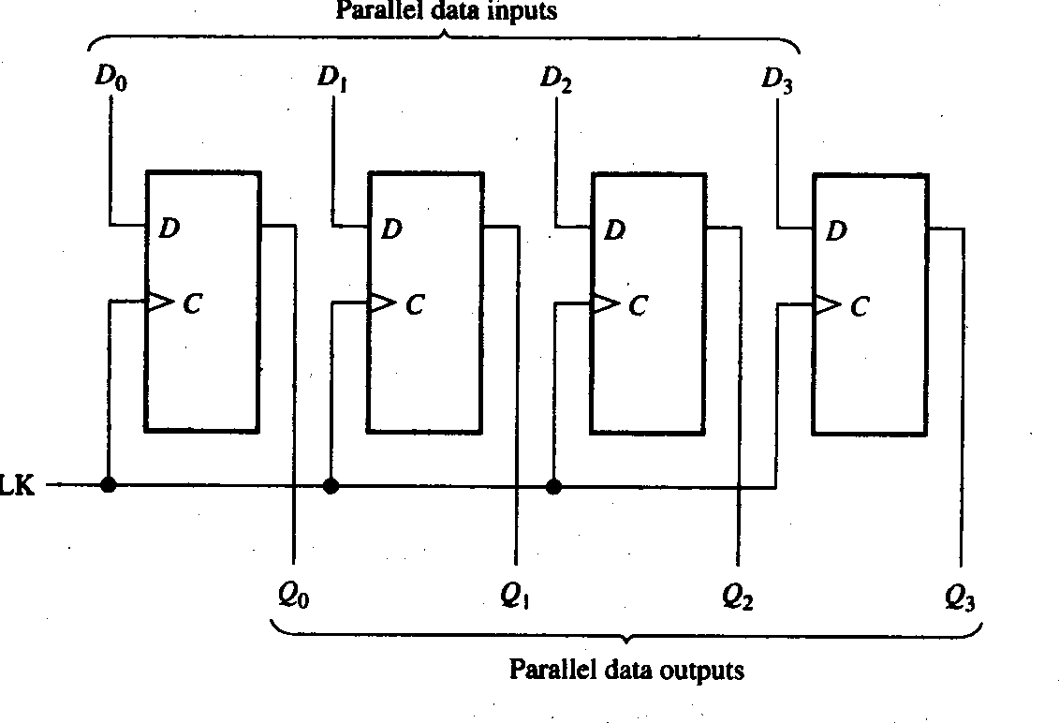
Shift Register
Parallel in/Parallel out Shift Register

Slide 16
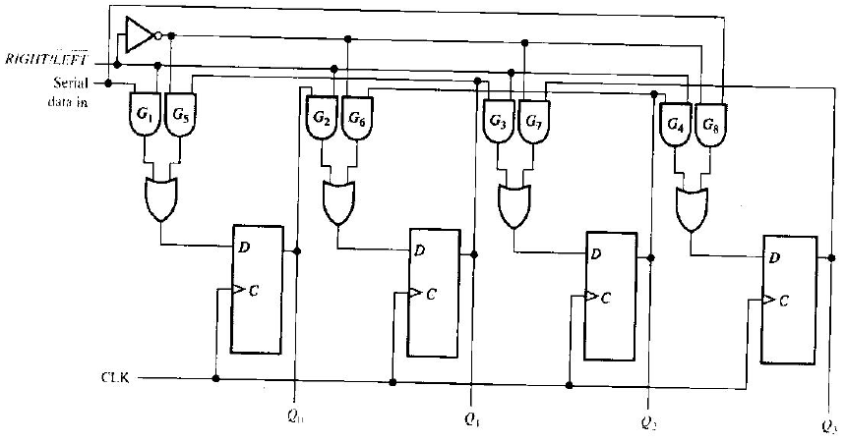
Shift Register
Bidirectional Shift Register

Slide 17
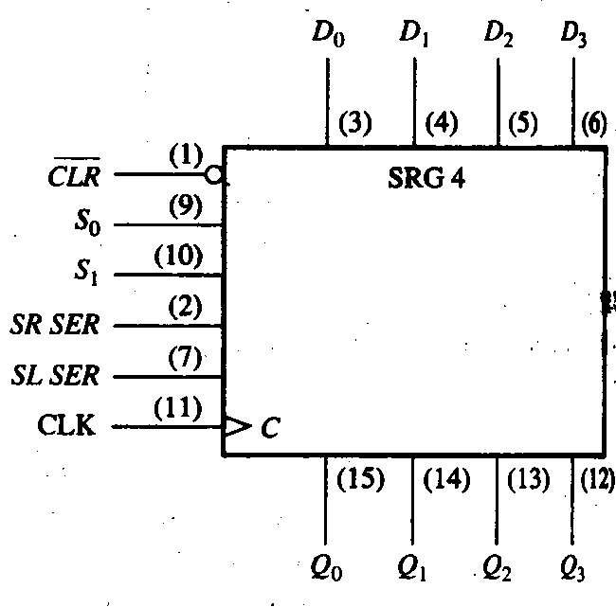
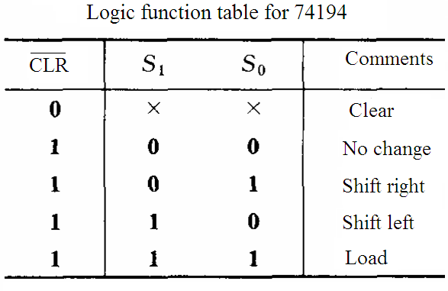
Shift Register
Bidirectional Shift Register
Bidirectional shift registers can shift the data in either direction using a RIGHT/LEFT input.

Slide 18
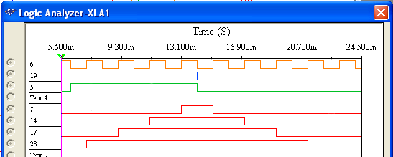
Shift Register
Bidirectional Shift Register
Bidirectional shift registers can shift the data in either direction using a RIGHT/LEFT input.
CLK
RIGHT/LEFT
Shift left
Shift right
Serial data in
Q₀
Q₁
Q₂
Q₃

Slide 19
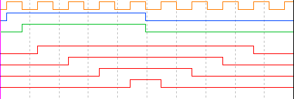
Shift Register
Bidirectional Shift Register
Question
How will the pattern change if the RIGHT/LEFT control signal is inverted?
CLK
RIGHT/LEFT
Shift left
Shift right
Shift right
Shift left
Serial data in
Q₀
Q₁
Q₂
Q₃

Slide 20
Shift Register
Universal Shift Register
A universal shift register has both serial and parallel input and output capability.
The 74HC194 is an example of a 4-bit bidirectional universal shift register.
D₀
D₁
D₂
D₃
CLR
S₀
S₁
SR SER
SL SER
CLK
Q₀
Q₁
Q₂
Q₃

Slide 21
Shift Register
Universal Shift Register

Slide 22
Shift Register Counters
Shift Register Counters
A shift register counter is basically a shift register with the serial output connected back to the serial input to produce special sequences.
There are two most common types of shift register counters:
Johnson counter
Ring counter

Slide 23
Shift Register Counters
Johnson Counter
In a Johnson counter, the complement of the output of the last flip-flop is connected back to the input of the first flip-flop.

Slide 24
Shift Register Counters
Johnson Counter
Redrawing the same Johnson counter (without the clock shown) illustrates why it is sometimes called as a “twisted-ring” counter.

Slide 25
Shift Register Counters
Johnson Counter
The Johnson counter is useful when you need a sequence that changes by only one bit at a time but it has a limited number of states (2n, where n = number of stages).
The first five counts for a 4-bit Johnson counter that is initially cleared are: CLK Q₀ Q₁ Q₂ Q₃
0
1
2
3
4
5
6
7
0 0 0 0
1 0 0 0
1 1 0 0
1 1 1 0
1 1 1 1
0 1 1 1
0 0 1 1
0 0 0 1

Slide 26
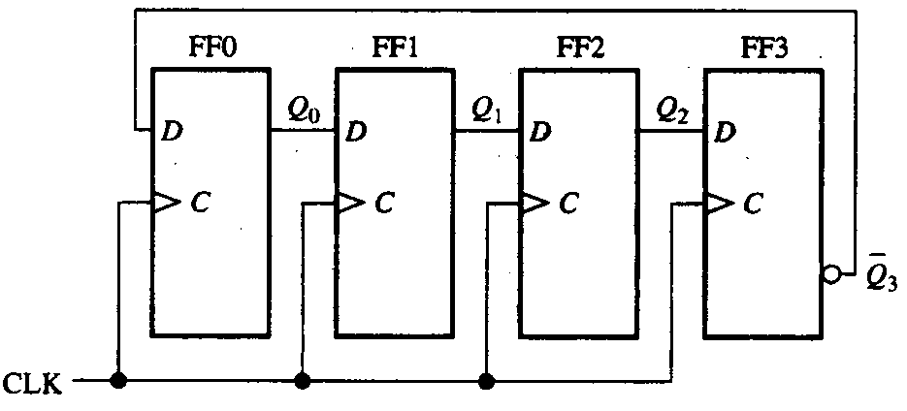
Shift Register Counters
Johnson Counter
4-bit Johnson counter

Slide 27
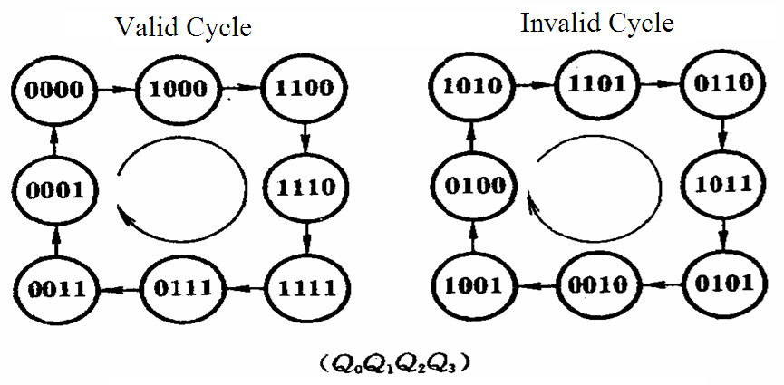
Shift Register Counters
Johnson Counter
State Diagram
It Can’t startup automatically.
Modulus-2n

Slide 28
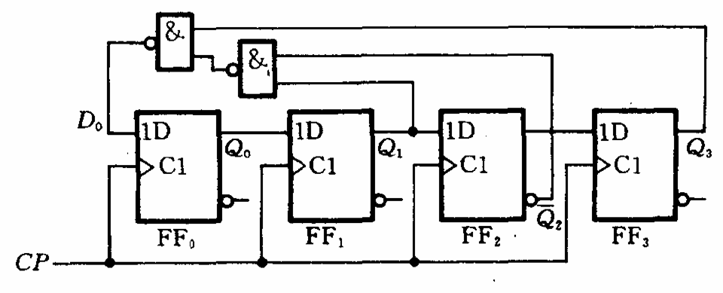
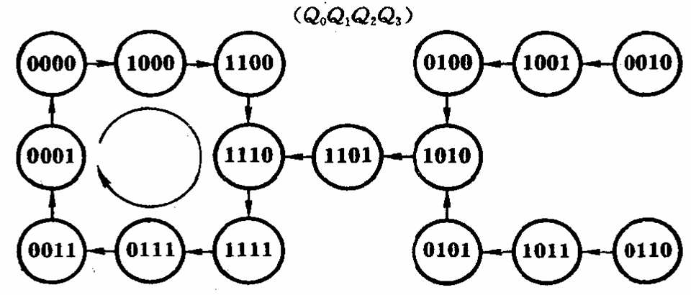
Shift Register Counters
Johnson Counter

Slide 29
Shift Register Counters
Ring Counter
The ring counter can also be implemented with either D flip-flops or J-K flip-flops.

Slide 30
Shift Register Counters
Ring Counter
Redrawing the Ring counter (without the clock shown) shows why it is a “ring”.
The disadvantage to this counter is that it must be preloaded with the desired pattern (usually a single 0 or 1) and it has even fewer states than a Johnson counter (n, where n = number of flip-flops).
On the other hand, it has the advantage of being self-decoding with a unique output for each state.

Slide 31
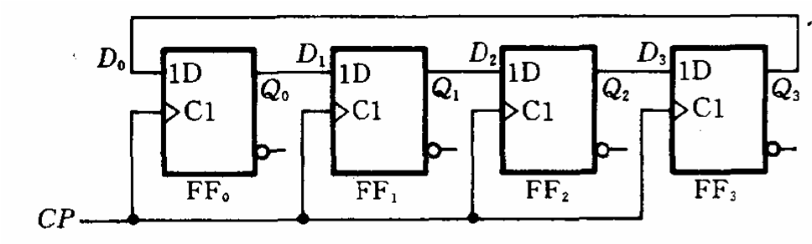
Shift Register Counters
Ring Counter
4-bit Ring counter

Slide 32
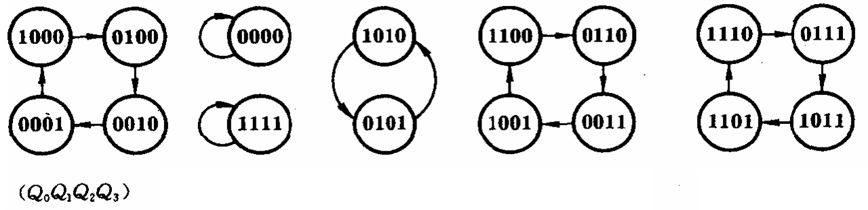
Shift Register Counters
Ring Counter
It Can’t startup automatically.
State Diagram
Modulus-n
Valid Cycle

Slide 33
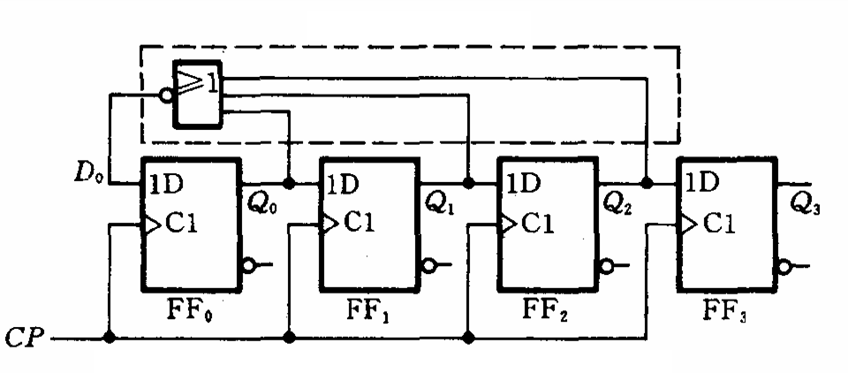
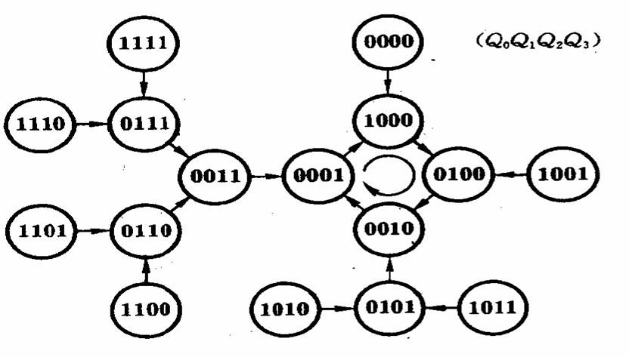
Shift Register Counters
Ring Counter

Slide 34
Shift Register Counters
Ring Counter
A common pattern for a ring counter is to load it with a single 1 or a single 0. The waveforms shown here are for an 8-bit ring counter with a single 1.

Slide 35
Applications
Shift Register Applications
Shift registers can be used to delay a digital signal by a predetermined amount.
Example
An 8-bit serial in/serial out shift register has a 40 MHz clock. What is the total delay through the register?
The delay for each clock is 1/40 MHz = 25 ns
25 ns
The total delay is 8 x 25 ns = 200 ns
= 200 ns

Slide 36
Applications
Shift Register Applications
A UART (Universal Asynchronous Receiver Transmitter) is a serial-to-parallel converter and a parallel to serial converter.
Data bus
CLK
CLK
Serial data out
Serial data in
Start
Bit (0)
Stop Bits (1)

Slide 37
Applications
Shift Register Applications
The keyboard encoder is an example of where a ring counter is used in a small system to encode a key press.
Two 74HC195 shift registers are connected as an 8-bit ring counter preloaded with a single 0. As the 0 circulate in the ring counter, it “scans” the keyboard looking for any row that has a key closure. When one is found, a corresponding column line is connected to that row line. The combination of the unique column and row lines identifies the key.

Slide 38
Applications

Slide 39
Quiz
1. The shift register that would be used to delay serial data by
4 clock periods is
a. c.
b. d.

Slide 40
Quiz
2. The circuit shown is a
a. serial-in/serial-out shift register
b. serial-in/parallel-out shift register
c. parallel-in/serial-out shift register
d. parallel-in/parallel-out shift register

Slide 41
Quiz
3. If the SHIFT/LOAD line is HIGH, data
a. is loaded from D₀, D₁, D₂ and D₃ immediately
b. is loaded from D₀, D₁, D₂ and D₃ on the next CLK
c. shifted from left to right on the next CLK
d. shifted from right to left on the next CLK

Slide 42
Quiz
4. A 4-bit parallel-in/parallel-out shift register will store data for
a. 1 clock period
b. 2 clock periods
c. 3 clock periods
d. 4 clock periods

Slide 43
Quiz
5. The 74HC164 (shown) has two serial inputs. If data is placed on the A input, the B input
a. could serve as an active LOW enable
b. could serve as an active HIGH enable
c. should be connected to ground
d. should be left open
CLR
CLK
Serial inputs
A
B
Q₀
Q₁
Q₂
Q₃
Q₄
Q₅
Q₆
Q₇

Slide 44
Quiz
6. An advantage of a ring counter over a Johnson counter is that the ring counter
a. has more possible states for a given number of flip-flops
b. is cleared after each cycle
c. allows only one bit to change at a time
is self-decoding
7. A possible sequence for a 4-bit ring counter is
a. … 1111, 1110, 1101 …
b. … 0000, 0001, 0010 …
c. … 0001, 0011, 0111 …
d. … 1000, 0100, 0010 …

Slide 45
Quiz
8. The circuit shown is a
a. serial-in/parallel-out shift register
b. serial-in/serial-out shift register
c. ring counter
d. Johnson counter

Slide 46
Quiz
9. Assume serial data is applied to the 8-bit shift register
shown. The clock frequency is 20 MHz. The first data bit
will show up at the output in
a. 50 ns
b. 200 ns
c. 400 ns
d. 800 ns

Slide 47
Quiz
10. For transmission, data from a UART is sent in
a. asynchronous serial form
b. synchronous parallel form
c. can be either of the above
d. none of the above

Slide 48
Assignment
Assignment 10 (Due on 19 May 2014)
PP.355
3,4,14

