Slide 1
Review: Linear Programming and Reduction I

Slide 2
Linear programming problem: given a set of variables, assign real values to them so as to
satisfy a set of linear equations and/or linear inequalities involving these variables, and
maximize or minimize a given linear objective function.

Slide 3
LP formulation
Objective function
Constraints
max x₁ + 6x₂
x₁ ≤ 200
x₂ ≤ 300
x₁ + x₂ ≤ 400
x₁ , x₂ ≥ 0
A linear equation in x₁ and x₂ defines a line in the two-dimensional (2D) plane, and a linear inequality designates a half-space, the region on one side of the line.

Slide 4
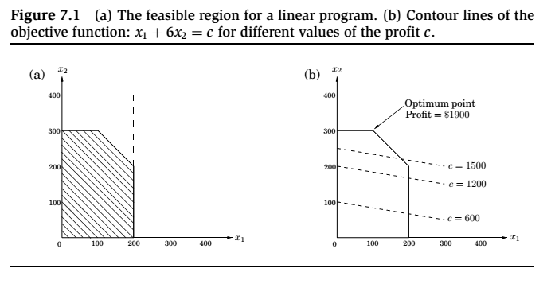
Thus the set of all feasible solutions of this linear program, that is, the points (x₁ , x₂) which satisfy all constraints, is the intersection of five half-spaces. It is a convex polygon.

Slide 5
The optimal solution
We want to find the point in this polygon at which the objective function – the profit – is maximized.
The points with a profit of c dollars lie on the line x₁ + 6x₂ = c, which has a slope of -1/6.
As c increases, this “profit line” moves parallel to itself, up and to the right. Since the goal is to maximize c , we must move the line as far up as possible, while still touching the feasible region.
The optimum solution will be the very last feasible point that the profit line sees and must therefore be a vertex of the polygon.

Slide 6
Solving linear programs
Linear programs (LPs) can be solved by the simplex method, devised by George Dantzig in 1947.
This algorithm starts at a vertex, and repeatedly looks for an adjacent vertex (connected by an edge of the feasible region) of better objective value.
In this way it does hill-climbing on the vertices of the polygon, walking from neighbor to neighbor so as to steadily increase profit along the way.

Slide 7
Solving linear programs, cont.
Upon reaching a vertex that has no better neighbor, simplex declares it to be optimal and halts.
Why does this local test imply global optimality? By simple geometry – think of the profit line passing through this vertex. Since all the vertex’s neighbors lie below the line, the rest of the feasible polygon must also lie below this line.

Slide 8
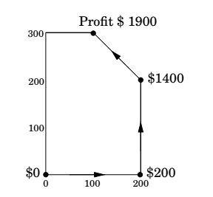

Slide 9
LP Formulation: More Product
max x1 + 6x2 + 13x3
x1 ≤ 200
x2 ≤ 300
x1 + x2 + x3 ≤ 400
x2 + 3x3 ≤ 600
x1 , x2 , x3 ≥ 0

Slide 10
The space of solutions is now three-dimensional.
Each linear equation defines a 3D plane, and each inequality a half-space on one side of the plane. The feasible region is an intersection of seven half-spaces, a polyhedron.
A profit of c corresponds to the plane x₁ + 6x₂ + 13x₃ = c, as c increases, the profit-plane moves parallel to itself, further and further into the positive orthant until it no longer touches the feasible region.

Slide 11
The point of final contact is the optimal vertex: (0, 300, 100), with total profit $3100.
How would the simplex algorithm behave on this modified problem? A possible trajectory:
(0,0,0)
$0
(200,0,0)
$200
→
(200,200,0)
$1400
→
(200,0,200)
$2800
→
(0,300,100)
$3100
→

Slide 12
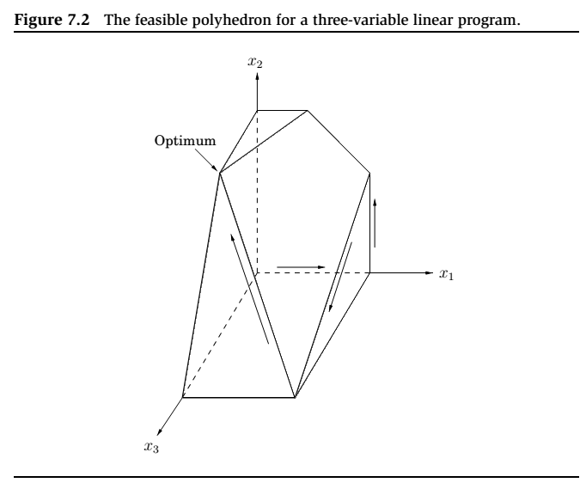

Slide 13
optimum
Here is why you should believe that (0, 300, 100), with a total profit of $3100, is the optimum:
Recall
max x1 + 6x2 + 13x3
x1 ≤ 200
x2 ≤ 300
x1 + x2 + x3 ≤ 400 x2 + 3x3 ≤ 600
x1 , x2 , x3 ≥ 0
Add the second inequality to the third, and add to them the fourth multiplied by 4.
The result is the inequality
x1 + 6x2 + 13x3 ≤ 3100.

Slide 14
Integer linear programming
The optimum solution might turn out to be fractional .
There are other LPs which need to end up with an integer solution of reasonable quality.
In general, there is a tension in linear programming between the ease of obtaining fractional solutions and the desirability of integer ones.
Finding the optimum integer solution of an LP is an important but very hard problem, called integer linear programming.

Slide 15
Reductions
We want to solve Problem P.
We already have an algorithm that solves Problem Q.
If any subroutine for Q can also be used to solve P, we say P reduces to Q. Often, P is solvable by a single call to Q’s subroutine, which means any instance x of P can be transformed into an instance y of Q such that P(x) can be deduced from Q(y).

Slide 16
Variants of linear programming
A general linear program has many degrees of freedom:
It can be either a maximization or a minimization problem.
Its constraints can be equations and/or inequalities.
The variables are often restricted to be nonnegative, but they can also be unrestricted in sign.
We will now show that these various LP options can all be reduced to one another via simple transformations.

Slide 17
Standard form
Therefore, we can reduce any LP (maximization or minimization, with both inequalities and equations, and with both nonnegative and unrestricted variables) into an LP of a much more constrained kind that we call the standard form:
the variables are all nonnegative,
the constraints are all equations,
and the objective function is to be minimized.
max x1 + 6x2 |  | min −x1 − 6x2
x1 ≤ 200 |  | x1 + s1 = 200
x2 ≤ 300 | ⇒ | x2 + s2 = 300
x1 + x2 ≤ 400 |  | x1 + x2 + s3 = 400
x1 , x2 , x3 ≥ 0 |  | x1 , x2 , s1 , s2 , s3 ≥ 0

Slide 18
Flows in networks

Slide 19
Shipping oil
We have a network of pipelines along which oil can be sent. The goal is to ship as much oil as possible from the source s and the sink t.
Each pipeline has a maximum capacity it can handle, and there are no opportunities for storing oil en route.

Slide 20
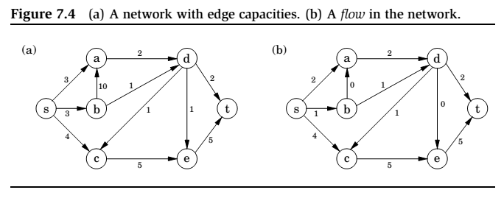
A Flow in Network

Slide 21
Maximizing flow
The networks consist of a directed graph G = (V , E ); two special nodes s, t ∈ V , which are, respectively, a source and sink of G ; and capacities ce > 0 on the edges.
We would like to send as much oil as possible from s to t without exceeding the capacities of any of the edges.
A particular shipping scheme is called a flow and consists of a variable fe for each edge e of the network, satisfying the following two properties:
1. It doesn’t violate edge capacities: 0 ≤ fe ≤ ce for all e ∈ E .
2. For all nodes u except s and t, the amount of folw entering u equals the amount leaving
(w,u )∈E
fwu = fuz
(u,z )∈E
In other words, flow is conserved.

Slide 22
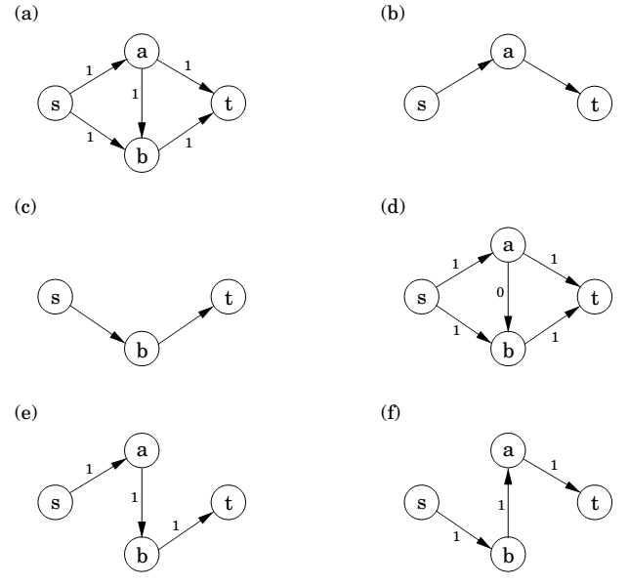
Max-flow algorithm: example

Slide 23
Maximizing flow (cont’d)
The size of a flow is the total quantity sent from s to t and, by the conservation principle, is equal to the quantity leaving s :
size(f ) =
fsu (s,u)∈E
In short, our goal is to assign values to {f_{e} | e ∈ E } that will satisfy a set of linear constraints and maximize a linear objective function.
But this is a linear program! The maximum-flow problem reduces to linear programming.

Slide 24
A closer look at the algorithm
All we know so far of the simplex algorithm is the vague geometric intuition that it keeps making local moves on the surface of a convex feasible region, successively improving the objective function until it finally reaches the optimal solution.
The behavior of simplex has an elementary interpretation:
Start with zero flow.
Repeat: choose an appropriate path from s to t, and increase flow along the edges of this path as much as possible.

Slide 25
A closer look at the algorithm (cont’d)
There is just one complication.
What if we choose a path that blocks all other paths?
Simplex gets around this problem by also allowing paths to cancel existing flow.
To summarize, in each iteration simplex looks for an s -t path whose edges (u, v ) can be of two types:
(u, v ) is in the original network, and is not yet at full capacity.
The reverse edge (v, u) is in the original network, and there is some flow along it.
If the current flow is f , then in the first case, edge (u, v ) can handle up to cuv − fuv additional units of flow, and in the second case, up to fvu additional units (canceling all or part of the existing flow on (v, u)).

Slide 26
A closer look at the algorithm (cont’d)
These flow-increasing opportunities can be captured in a residual network G^{f} = (V , E ^{f} ), which has exactly the two types of edges listed, with residual capacities c^{f} :
cuv − fuv if (u, v ) ∈ E and fuv < cuv
fvu
if (v, u) ∈ E and fvu > 0.
Thus we can equivalently think of simplex as choosing an s -t path in the residual network.
By simulating the behavior of simplex, we get a direct algorithm for solving max-flow.
It proceeds in iterations, each time explicitly constructing G^{f} , finding a suitable s -t path in G^{f} by using, say, a linear-time breadth-first search, and halting if there is no longer any such path along which flow can be increased.

Slide 27
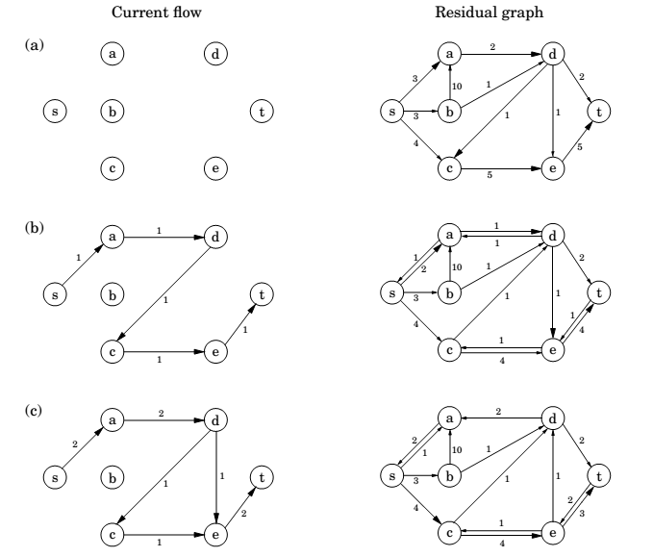

Slide 28
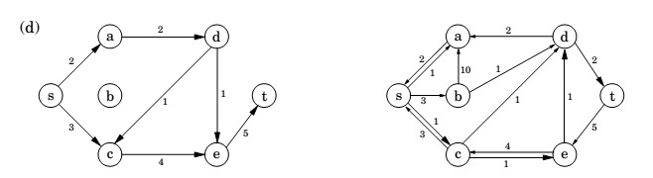
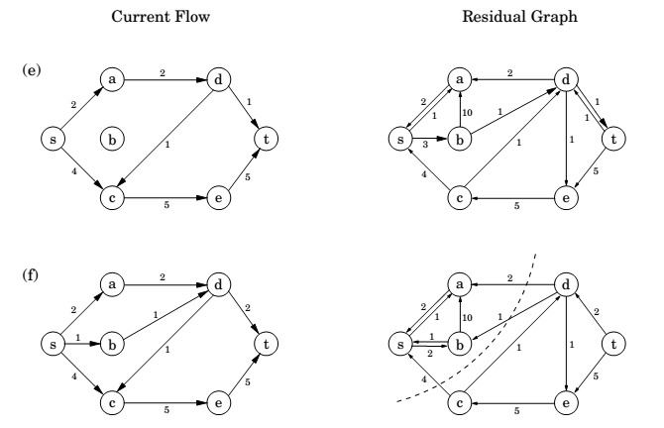

Slide 29
Cuts
A truly remarkable fact:
not only does simplex correctly compute a maximum flow, but it also generates a short proof of the optimality of this flow!
An (s, t)-cut partitions the vertices into two disjoint groups L and R such that s ∈ L and t ∈ R . Its capacity is the total capacity of the edges from L to R , and as argued previously, is an upper bound on any flow:
Pick any flow f and any (s, t)-cut (L, R ),
then size(f ) ≤ capacity(L, R ).

Slide 30
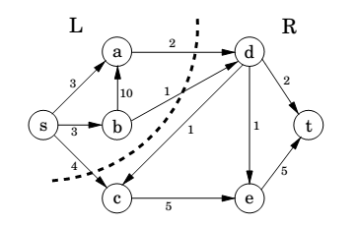
Cut

Slide 31
A certificate of optimality
Theorem (Max-flow min-cut)
The size of the maximum flow in a network equals the capacity of the smallest (s, t)-cut.
Proof.
Suppose f is the final flow when the algorithm terminates.
We know that node t is no longer reachable from s in the residual network G^{f} . Let L be the nodes that are reachable from s in G^{f} , and let R = V \ L be the rest of the nodes. We claim that
size(f ) = capacity(L, R )
To see this, observe that by the way L is defined, any edge going from L to R must be at full capacity (in the current flow f ), and any edge from R to L must have zero flow.
Therefore the net flow across (L, R ) is exactly the capacity of the cut.

Slide 32
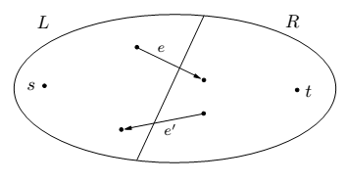
Max-flow min-cut

Slide 33
Efficiency
Each iteration of our maximum-flow algorithm is efficient, requiring O(|E |) time if a DFS or BFS is used to find an s -t path.
But how many iterations are there?
Suppose all edges in the original network have integer capacities ≤ C .
Then on each iteration of the algorithm, the flow is always an integer and increases by an integer amount. Therefore, since the maximum flow is at most C |E |, the number of iterations is at most this much.
If paths are chosen in a sensible manner – in particular, by using a BFS, which finds the path with the fewest edges – then the number of iterations is at most O(|V | · |E |), no matter what the capacities are.
This latter bound gives an overall running time of O(|V | · |E |²) for maximum flow.

Slide 34
Bipartite matching

Slide 35
The problem
A graph with nodes on the left representing boys and nodes on the right representing girls.
There is an edge between a boy and girl if they like each other.
Is it possible to choose couples so that everyone has exactly one partner, and it is someone they like?
In graph-theoretic jargon, is there a perfect matching?

Slide 36
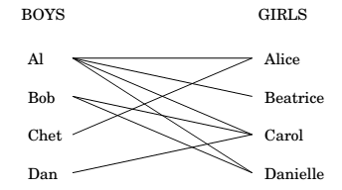
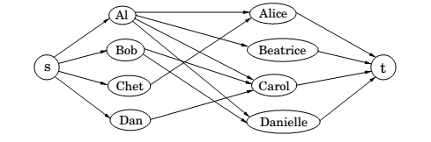
Bipartite matching

Slide 37
LP formulation
This matchmaking game can be reduced to the maximum-flow problem, and thereby to linear programming!
Create a new source node s with outgoing edges to all the boys;
a new sink node t, with incoming edges from all the girls;
and direct all the edges in the original bipartite graph from boy to girl.
Finally, give every edge a capacity of 1.

Slide 38
LP formulation
Then there is a perfect matching if and only if this network has a flow whose size equals the number of couples.
The maximum-flow problem has the following property: if all edge capacities are integers, then the optimal flow found by our algorithm is integral.
We can see this directly from the algorithm, which in such cases would increment the flow by an integer amount on each iteration.

Slide 39
Duality

Slide 40
Recall:
max x₁ + 6x₂
x₁ ≤ 200
x₂ ≤ 300
x₁ + x₂ ≤ 400
x₁ , x₂ ≥ 0
Simplex declares the optimum solution to be (x₁,x₂) = (100,300), with objective value 1900.
Can this answer be checked somehow?
We take the ﬁrst inequality and add it to six times the second inequality:
x₁ + 6x₂ ≤ 2000.
Multiplying the three inequalities by 0, 5, and 1, respectively, and adding them up yields
x₁ + 6x₂ ≤ 1900.

Slide 41
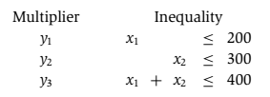
Let’s investigate the issue by describing what we expect of these three
multipliers, call them y_{1,} y₂ ,y₃.
These y_{i}’s must be nonnegative, for otherwise they are unqualiﬁed to multiply inequalities. After the multiplication and addition steps, we get the bound:
(y₁ + y₃)x₁ + (y₂ + y₃)x₂ ≤ 200y₁ + 300y₂ + 400y_{3.}
We want the left-hand side to look like our objective function x₁ + 6x₂ so that the right-hand side is an upper bound on the optimum solution.

Slide 42



We can easily ﬁnd y’s that satisfy the inequalities on the right by simply making them large enough, for example
(y1, y2, y3) = (5, 3, 6). But these particular multipliers would tell us that the optimum solution of the LP is at most
200 · 5 + 300 · 3 + 400 · 6 = 4300,
a bound that is far too loose to be of interest.
What we want is a bound that is as tight as possible, so we should minimize 200y₁ + 300y₂ + 400y₃
subject to the preceding inequalities.
And this is a new linear program!

Slide 43
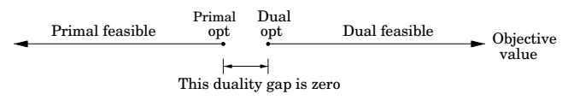
The dual program
min 200 y₁ + 300 y₂ + 400 y₃
y₁ + y₃ ≥ 1
y₂ + y₃ ≥ 6
y₁, y₂, y₃ ≥ 0
By design, any feasible value of this dual LP is an upper bound on the original primal LP. So if we somehow ﬁnd a pair of primal and dual feasible values that are equal, then they must both be optimal. Here is just such a pair:
Primal: (x₁, x₂) = (100, 300);
Dual: (y₁, y₂, y₃ ) = (0, 5, 1).
They both have value 1900, and therefore they certify each other’s optimality.

Slide 44

A generic primal LP in matrix-vector form and its dual
Primal LP: Dual LP:
max c^{T}x min y^{T}b
Ax $≤$ b y^{T} A $≥$ c^{T}
x $≥$ 0 y $≥0$
Theorem (Duality)
If a linear program has a bounded optimum, then so does its dual, and the two optimum values coincide.

Slide 45
Zero-sum games

Slide 46
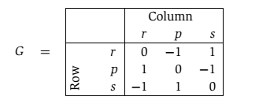
Rock-paper-scissors game
We can represent various conflict situations in life by matrix games.
The schoolyard rock-paper-scissors game is specified by the
payoﬀ matrix G: the Row player vs. the Column player

Slide 47
Mixed strategy
We play this game repeatedly.
If Row always makes the same move, Column will quickly catch on and will always play the countermove, winning every time. Therefore Row should mix things up: we can model this by allowing Row to have a mixed strategy, in which on each turn she plays r with probability x₁, p with probability x₂, and s with probability x₃.
This strategy is speciﬁed by the vector x = (x₁,x₂,x₃), positive numbers that add up to 1.
Similarly, Column’s mixed strategy is some y = (y₁,y₂,y₃).
i,j

Slide 48
Mixed strategy (cont.)
On any given round of the game, there is an x_{i}y_{j} chance that Row
and Column will play the ith and jth moves, respectively.
Therefore the expected (average) payoﬀ is
Row wants to maximize this, while Column wants to minimize it.

Slide 49


Completely random strategy
Suppose Row plays the “completely random” strategy x = (1/3,1/3,1/3).
If Column plays r, then the average payoﬀ will be
This is also true if Column plays p, or s.
And since the payoﬀ of any mixed strategy (y₁, y₂, y₃) is just a weighted
average of the individual payoﬀs for playing r, p, and s, it must also be zero.

Slide 50
Completely random strategy (cont’d)
Thus by playing the “completely random” strategy, Row forces an expected payoﬀ of zero, no matter what Column does.
This means that Column cannot hope for a negative expected payoﬀ
(remember that he wants the payoﬀ to be as small as possible).
Symmetrically, if Column plays the completely random strategy, he also forces an expected payoﬀ of zero, and thus Row cannot hope for a positive expected payoﬀ.
The best each player can do is to play completely randomly, with an expected payoﬀ of zero.

Slide 51
Two scenarios
1. First Row announces her strategy, and then Column picks his.
2. First Column announces his strategy, and then Row chooses hers.
We’ve seen that the average payoﬀ is the same (zero) in either case if both parties play optimally.
But this might well be due to the high level of symmetry in rock-paper-scissors.
In general games, we’d expect the ﬁrst option to favor Column, since he knows Row’s strategy and can fully exploit it while choosing his own.

Slide 52
Two scenarios (cont.)
In general games, we’d expect the ﬁrst option to favor Column, since he knows Row’s strategy and can fully exploit it while choosing his own.
Likewise, we’d expect the second option to favor Row.
Amazingly, this is not the case: if both play optimally, then it doesn’t hurt a player to announce his or her strategy in advance!
What’s more, this remarkable property is a consequence of and in fact –equivalent to – linear programming duality.

Slide 53
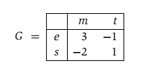
Presidential election
There are two candidates for oﬃce, and the moves they make correspond to campaign issues on which they can focus (the initials stand for economy, society, morality, and tax cut).
The payoﬀ entries of G are millions of votes lost by Column.

Slide 54
Pure strategy
Suppose Row announces that she will play the mixed strategy
x = (1/2,1/2). What should Column do?
Move m will incur an expected loss of 1/2, while t will incur an expected loss of 0. The best response of Column is therefore the pure strategy y = (0,1).
More generally, once Row’s strategy x = (x₁, x₂) is ﬁxed, there is always a pure strategy that is optimal for Column:
either move m, with payoﬀ 3x₁ − 2x₂, or t, with payoﬀ −x₁ + x₂, whichever is smaller.

Slide 55
Pure strategy (cont.)
Therefore, if Row is forced to announce x before Column plays, she knows that his best response will achieve an expected payoﬀ of min{3x₁ − 2x₂,−x₁ + x₂}. She should choose x defensively to maximize her payoﬀ against this best response:
Pick (x₁,x₂) that maximizes min{3x₁ − 2x₂, −x₁ + x₂}.

Slide 56
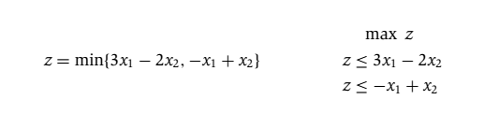
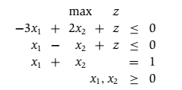
LP formulation
Row needs to choose x₁ and x₂ to maximize this z.

Slide 57
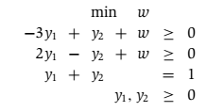
LP formulation (cont’d)
Symmetrically, if Column has to announce his strategy ﬁrst, his best bet is to choose the mixed strategy y that minimizes his loss under Row’s best response:
Pick (y₁, y₂) that minimizes max{3y₁ − y₂, −2y₁ + y₂}.
In LP form:
These two LPs are dual to each other (see Figure 7.11)! Hence, they have the same optimum, call it V.

Slide 58
Value of the game
By solving an LP, Row (the maximizer) can determine a strategy for herself that guarantees an expected outcome of at least V no matter what Column does.
And by solving the dual LP, Column (the minimizer) can guarantee an expected outcome of at most V, no matter what Row does.
It follows that this is the uniquely deﬁned optimal play:
a priori it wasn’t even certain that such a play existed.
V is known as the value of the game
In our example, it is 1/7 and is realized when Row plays her optimum mixed strategy (3/7,4/7) and Column plays his optimum mixed strategy (2/7,5/7).

Slide 59

Min-max theorem of games
This is surprising, because the left-hand side, in which Row has to announce her strategy ﬁrst, should presumably be better for Column than the right-hand side, in which he has to go ﬁrst.
Duality equalizes the two.

