Slide 1
3. Expression表达式
Mathematical expression算术表达式
Logic expression逻辑表达式
Evaluation expression赋值表达式
Statement and function语句和函数

Slide 2
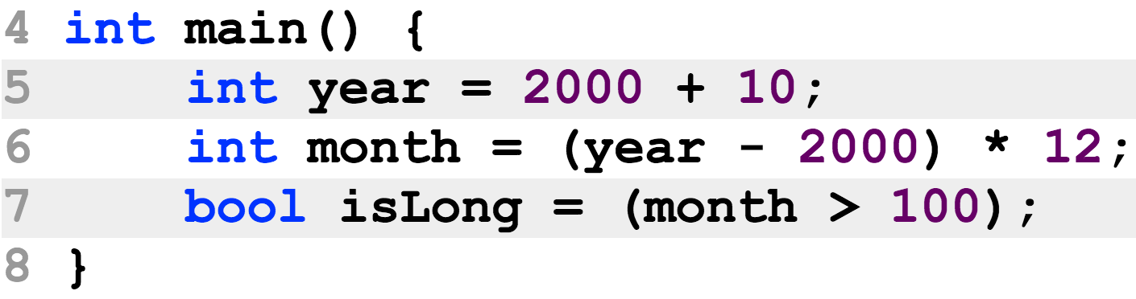



什么是表达式 expression
C++中，表达式就是标示符和操作符组成的描述功能的语法成分
算术表达式:
赋值表达式:
逻辑表达式:

Slide 3
Math expression算数运算表达式
如何把书面表达式转换为C++中的算术表达式
注意：要在适当的地方补乘号 * 和括号 ()
(3 + 4 * x) / 5 – 10 * (y - 5) * (a + b + c) / x + 9 * (4 / x + (9 + x) / y)

Slide 4
Math expression
There is two types of divisions 除法有两种方式
Floating-point division 浮点数(实数)除法
When at least one operand is a double (real) value
The result is a real value
7.0 / 2 results in 3.5
7 / 2.0 results in 3.5
7.0 / 2.0 results in 3.5
Integer division 整数除法(两操作数都是整数时)
When both operands are not real values
The result is an integer value 结果为整数，尾数被去掉
7 / 2 results in 3

Slide 5
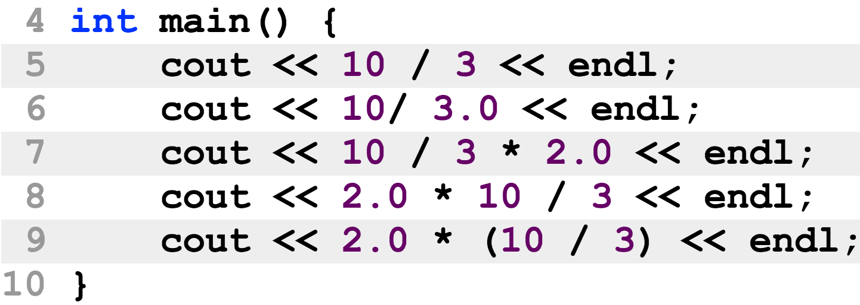
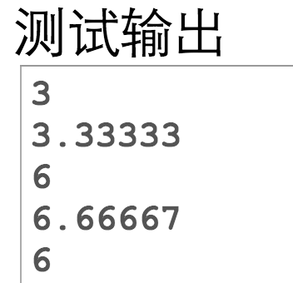
Math expression
There is two types of divisions

Slide 6
Math expression
There is two types of almost every math operation 所有算术运算都分两种
计算机的算术指令分为整数指令和浮点数指令
An operation is a floating-point operation if one or both of the operands are real numbers.
An operation is an integer operation if both operands are not floating-point numbers.
If operands are characters or boolean values, they will be converted to integer before calculation.

Slide 7
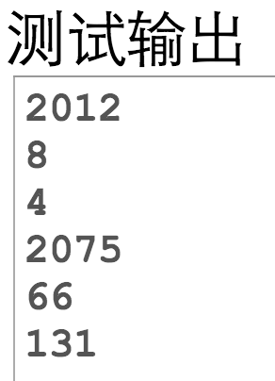
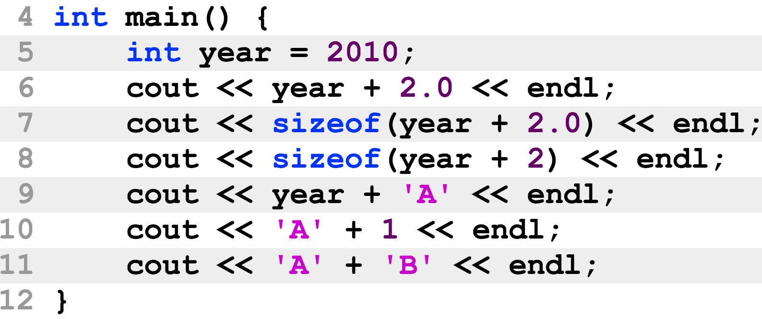
Math expression
There is two types of almost every math operation

Slide 8
Math expression
Remainder operator (%) 求余只能用于整数
Both operations must be integer values
To determine if a number is dividable by another number
12 % 5 == 0 // 12 is dividable by 5
14 % 7 == 0 // 14 is dividable by 7
12 % 2 == 0 // 12 is even
13 % 2 == 1 // 13 is odd
Usually applied to positive numbers, the remainder is negative only if the dividend is negative
-7 % 3 == -1 -26 % -8 == -2 20 % -13 == 7

Slide 9
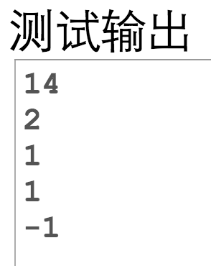
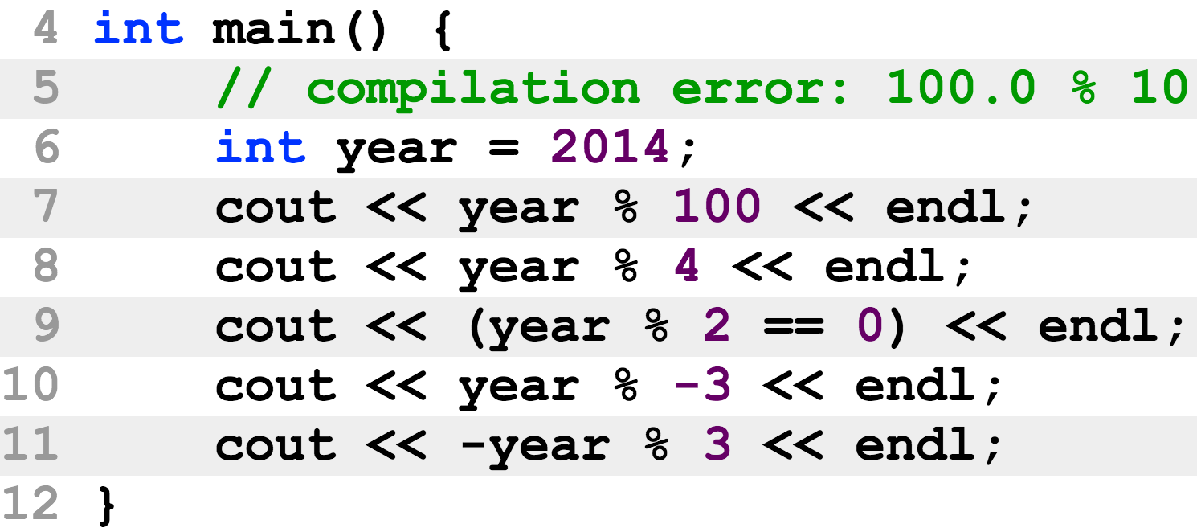
Math expression
Remainder operator (%)
Why line 9 requires a pair of ( ) ?

Slide 10
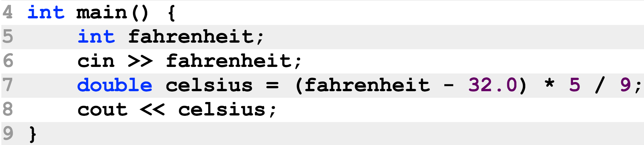
Math expression
Every expression has a value 每个表达式都有一个值
中间表达式也有值
所有这些值在程序运行的时候才能计算
Anonymous variable 匿名变量
They are used to store intermediate values
How many anonymous variables are there in line 7?
What are their types, respectively?

Slide 11
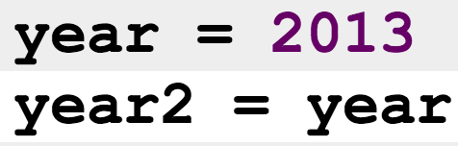
Evaluation expression 赋值表达式
Simple evaluation
Compound evaluation
celsuis is evaluated the value of the anonymous variable, which is the result of the right-side math expression

Slide 12
Evaluation expression
运算符的结合律 associativity
算数运算符的结合律尊续数学定义
同种运算符或优先级相同的运算符左结合
赋值运算符右结合
age1 = age2 = age3 = 18
age3 = 18 会先运算(执行)
然后它的值(即age3)会作为接着执行的赋值操作符的右操作数，即 age2 = age3
同样地，最后执行的是 age1 = age2
最后结果: 3个变量均被赋值为18

Slide 13
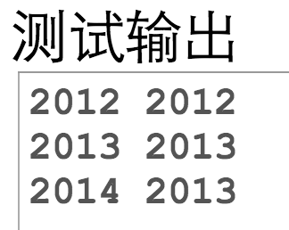
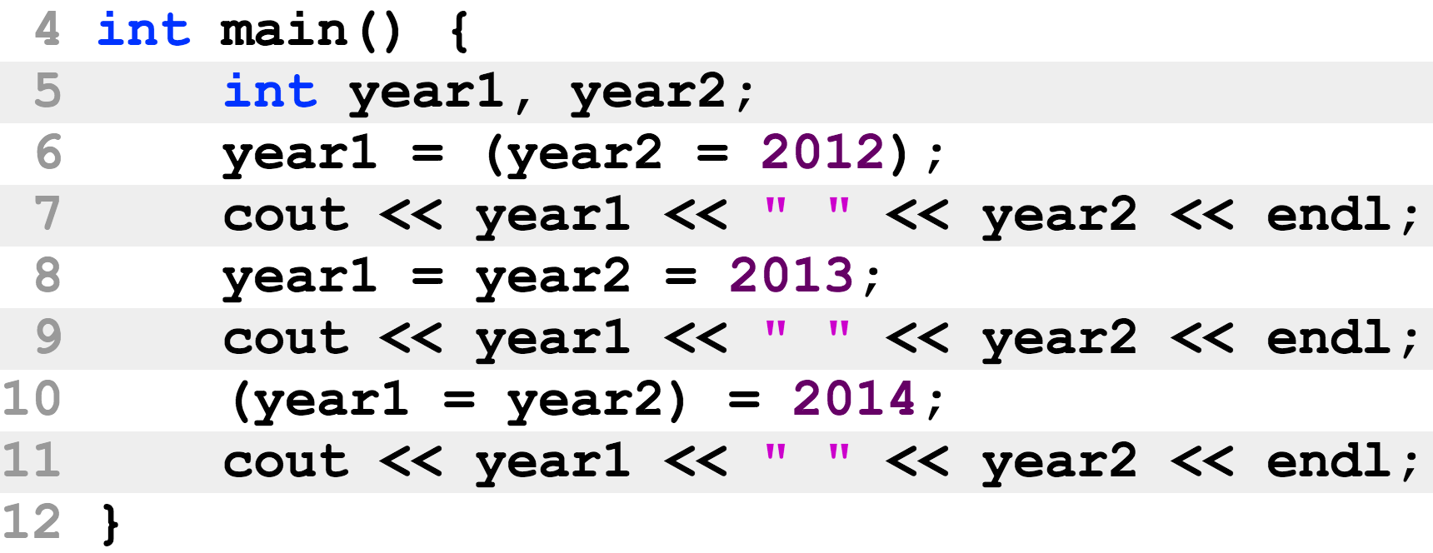
Evaluation expression
An evaluation expression also has a return “value”
It is the left operand itself
The evaluation operator is right-associative

Slide 14
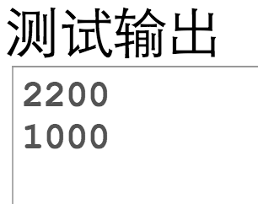
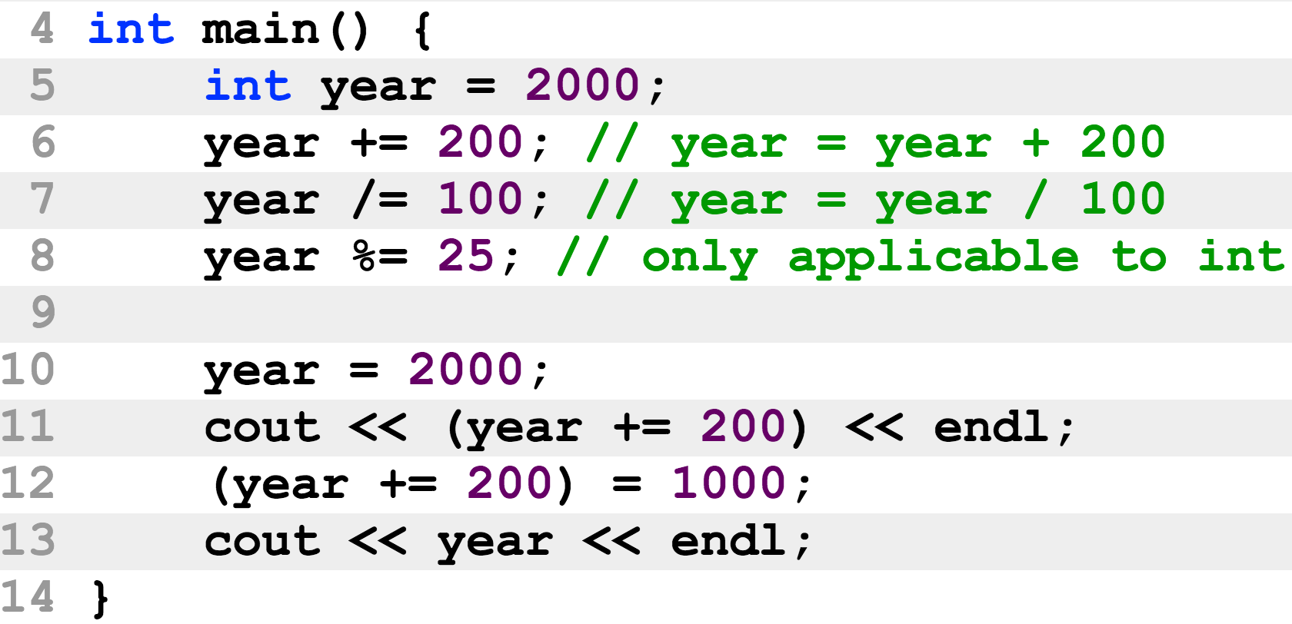
Evaluation expression
Short-hand operators 快捷运算符

Slide 15
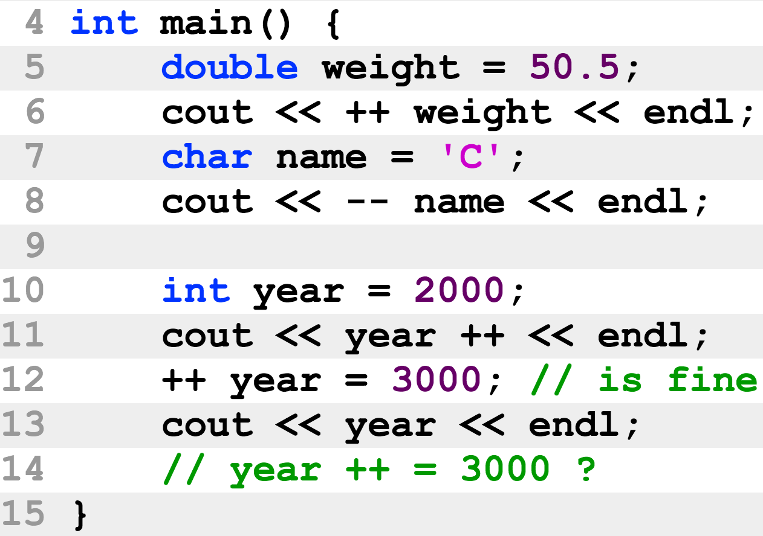
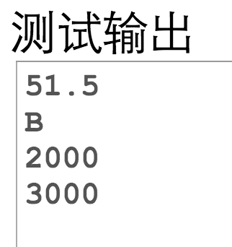
Evaluation expression
Increment / decrement (增量/减量) operators

Slide 16
Evaluation expression
Increment /decrement operators
Operator | Name | Description
++ var | Preincrement | Increments var by 1 and evaluates to the new value in var after the increment.
var ++ | Postincrement | Evaluates to the original value in var and increments var by 1.
-- var | Predecrement | Decrements var by 1 and evaluates to the new value in var after the decrement.
var -- | Postdecrement | Evaluates to the original value in var and decrements var by 1.

Slide 17
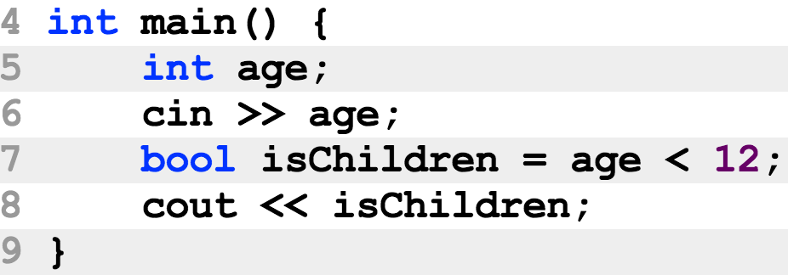
Logical expression逻辑表达式
逻辑表达式: 返回值为bool的表达式
逻辑操作符包含
==
!=
>
>=
<
<=

Slide 18
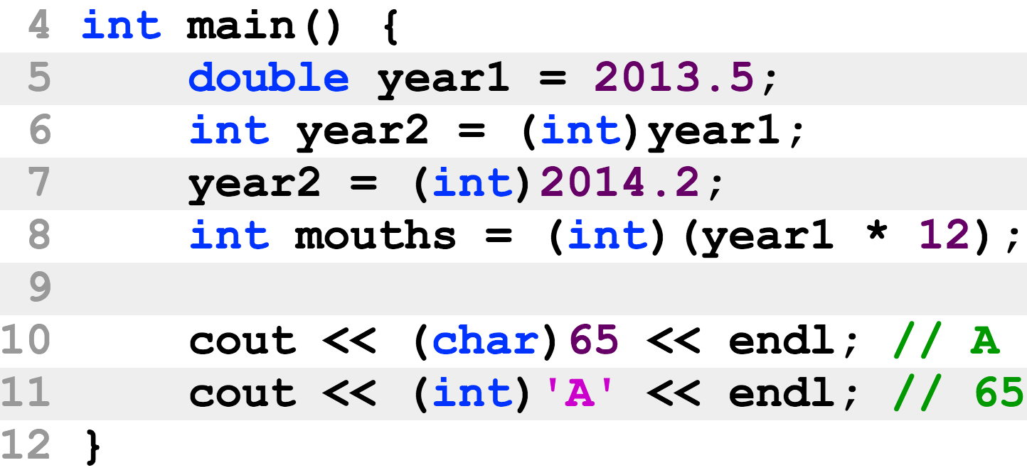
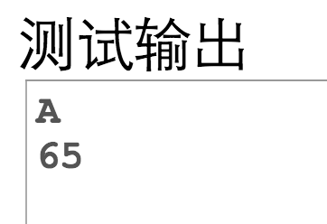
Output / input (I/O) expression 输出/输入表达式
输出输入的实际功能由右操作数确定
Explicit conversion 显式转换

Slide 19
C语言的语法结构
自然语言的语法(作为对比)
语法成分：主、谓、宾、定、补、状、表
语法规则：
主＋谓：Your program crashs
主＋联系动词＋表：You are a programmer
主＋谓＋宾：You got a bug
主＋谓＋宾＋间宾：She gave you a book
主＋谓＋宾＋宾补：You will find programming interesting
其它：并列句，主/宾/表/定/状语从句，同位语/that-/which-从句

Slide 20
C语言的语法结构
C语言的语法
语法成分：程序(program)，函数(function)，语句(statement),表达式(expression), …
语法规则 (syntax,grammar)：
程序 = 函数 函数 函数 …
函数 = 函数头 { 语句 语句 语句 … }
语句 = 表达式 ; 或 if 语句 或 …
表达式 = 定义变量(definition) 或 赋值(evaluation) 或 函数调用(function call) 或 运算(operation)
运算表达式 = 一元(binary)运算如 -10) 或 二元(unary)运算 (如 3 * 2 或 cout << “Hello”)

Slide 21
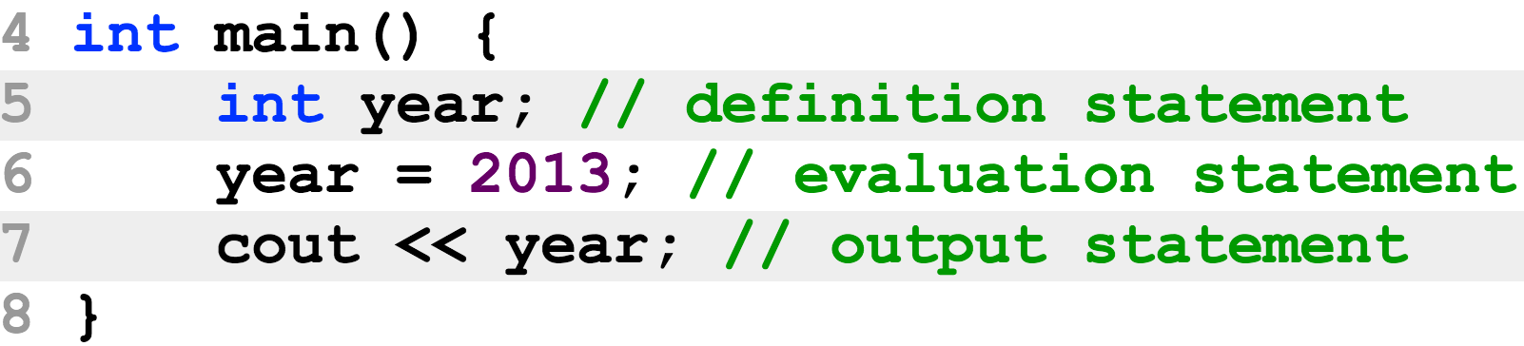
Statement 语句
Expression has a value
Statement has no value
Statement consists of expression

Slide 22
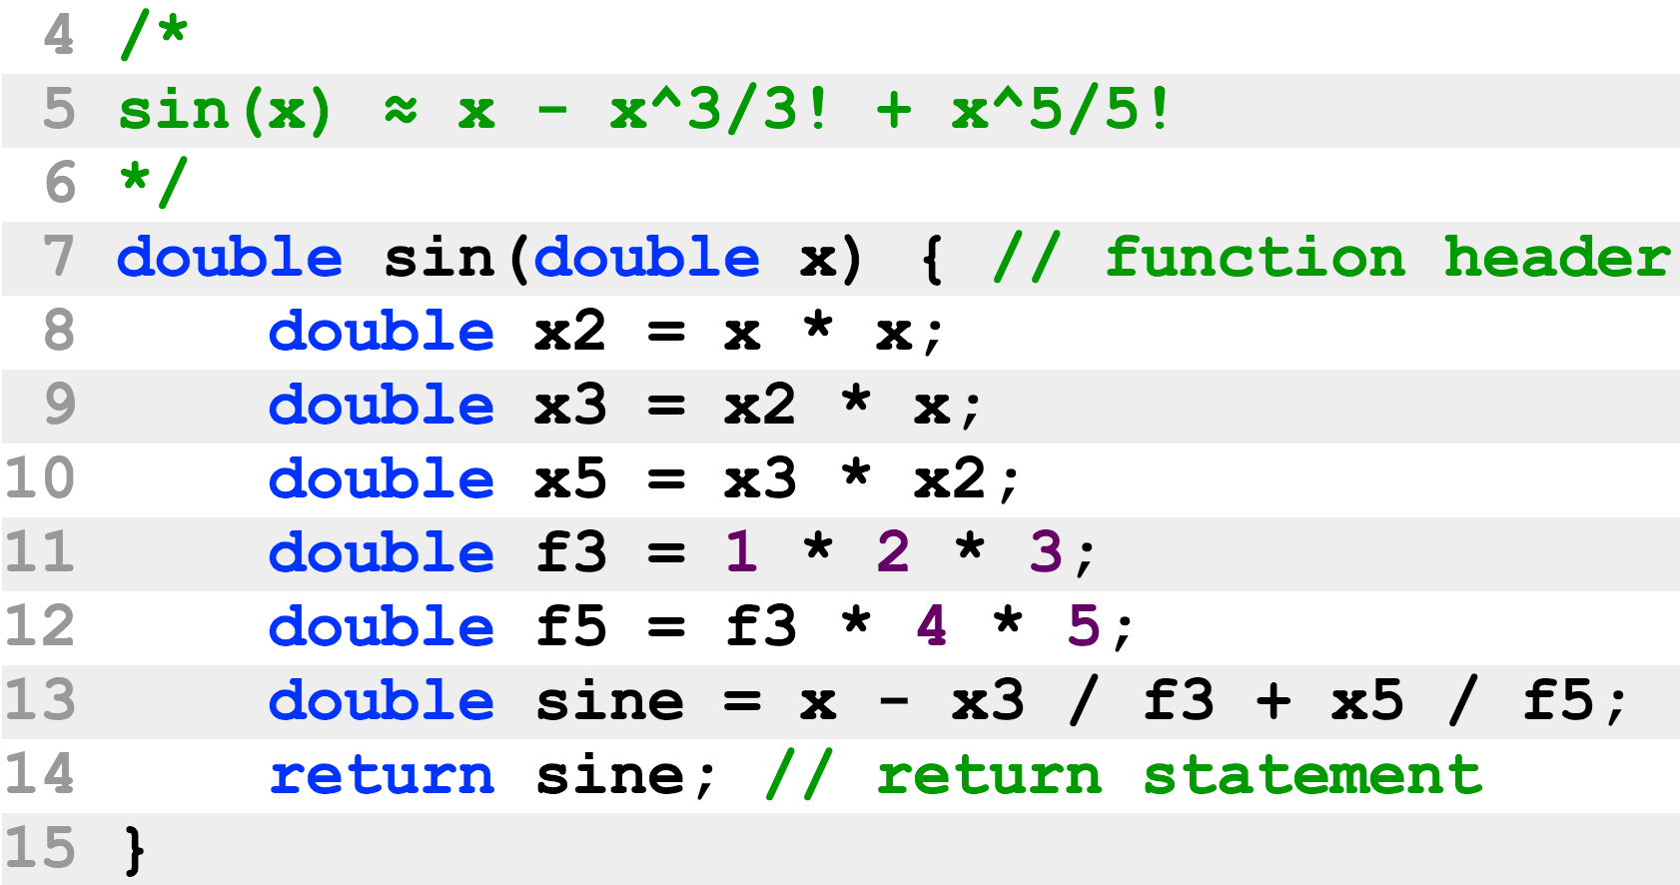
Function 函数
Define a function 声明函数
Define the return type, name, the type and the name of each parameter, and body

Slide 23
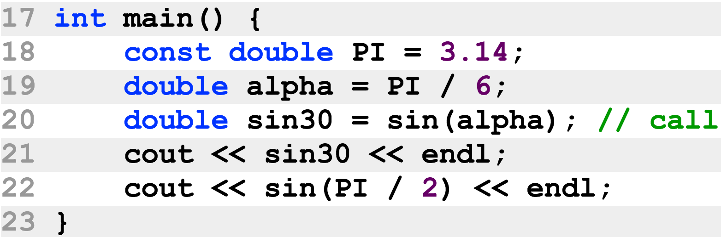
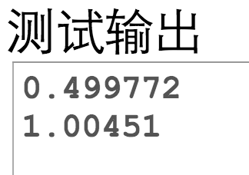
Function
Call a function
The caller (调用者) function hands over the execution to the callee (被调用者) function, and obtain its return value
A function must be defined before it is called

Slide 24

Function
Parameter 形式参数
Each parameter is defined with a type
Argument 实际参数
An argument is a value that is sent from the caller to the callee
Its type must be the same as (or can be converted to) that of the parameter

Slide 25
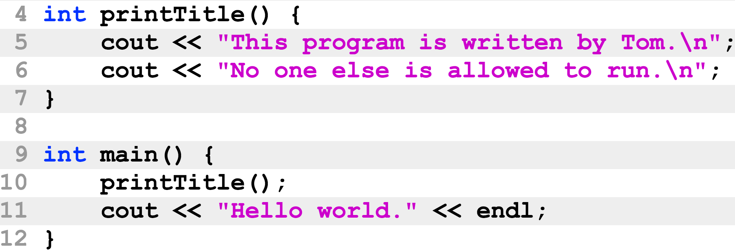
Function
Function can be used for non-computational tasks, such as I/O tasks
Line 4: A program can have no parameter
Line 7: A program can return nothing
Line 11: The returned value might not be used

Slide 26
其它
作业提交网站
https://cse.sysu.edu.cn/cpp3
参考资料
http://cse.sysu.edu.cn/file
上课用的课件 (每星期上课前更新)
cpp_book.pdf (清华大学 C++, 钱能)
ThinkingInCpp.pdf (Thinking in C++, Bruce Eckle)

