Slide 1
4. Selection statements
Boolean expression
Short-circuit operation
Bit-wise operation
If-else statement
Switch statement
Conditional expression
Formatted output 格式化输出

Slide 2
Boolean expression
A boolean expression is an expression that returns a boolean value.
Operands for of boolean expressions: ==, >, etc
More operands: logical operators: &&, ||, etc
Logical operator: both the operand(s) and the result are logical values
&& (and logical and): the result is true when both operands are true
|| (or logical or): the result is false if one of both operands are true
! (not, a unary operator 一元操作符号)

Slide 3
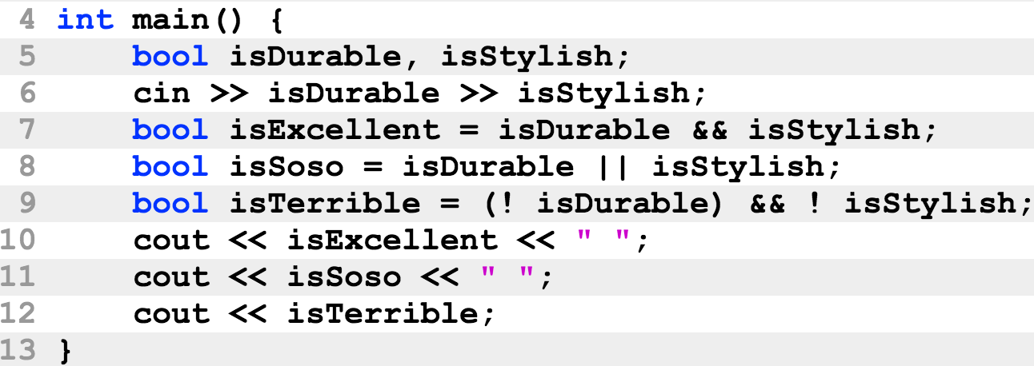
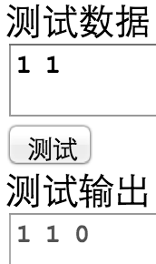
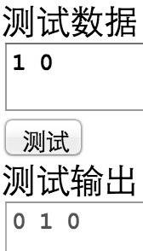
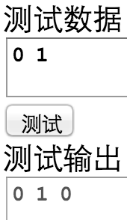
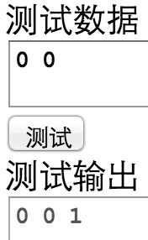
Boolean expression

Slide 4
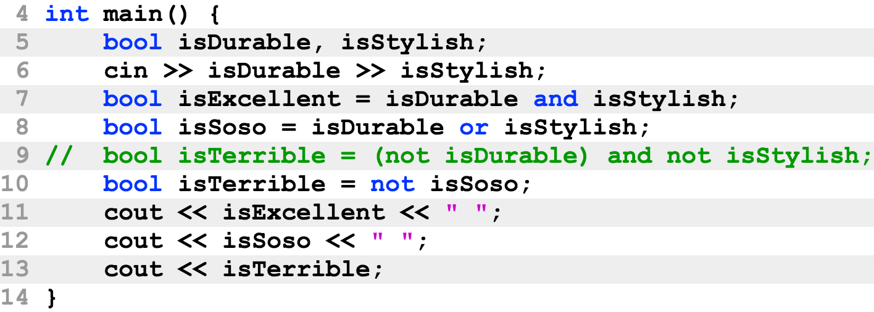
Boolean expression
Morgan’s law
not (x and y) == (not x) or (not y)
not (x or y) == (not x) and (not y)

Slide 5
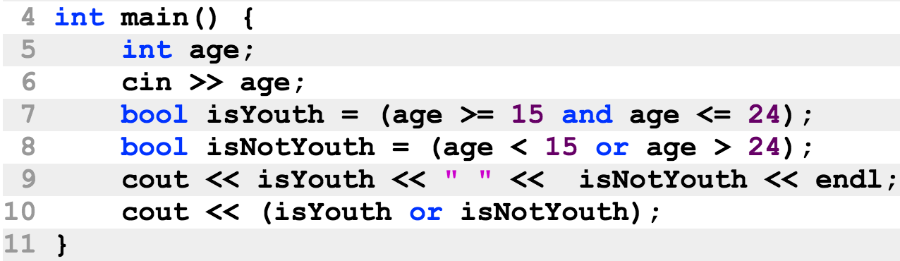
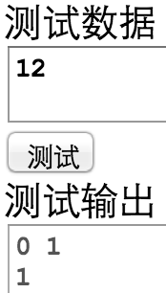
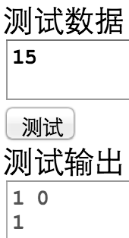
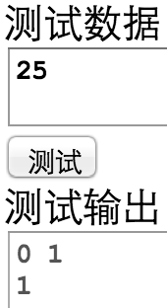
Boolean expression

Slide 6
Short-circuit operation
&& or || can be short-circuit 短路
Example: (x > 0) && (x % 2 == 0) (x > 0) || (x % 2 == 0)
The left-sides are evaluated before the right-side
For &&, if the left-side is false, the result must be false regardless of the right-side.
For ||, if the left-side is true, the result must be true regardless of the right-side.
C++ remove unnecessary computation to improve performance
The right-side in the cases above are not evaluated.

Slide 7
Short-circuit operation
The side-effect of short-circuit operations
The right-side may or may not be evaluated depending on the left-side
Example 1: (x > 0) && ((y += 10) > 0)
y is increased by 10 only if x is greater than 0
Example 2: (x > 0) || isPrime(x)
isPrime is called only if x is less than or equal to 0

Slide 8
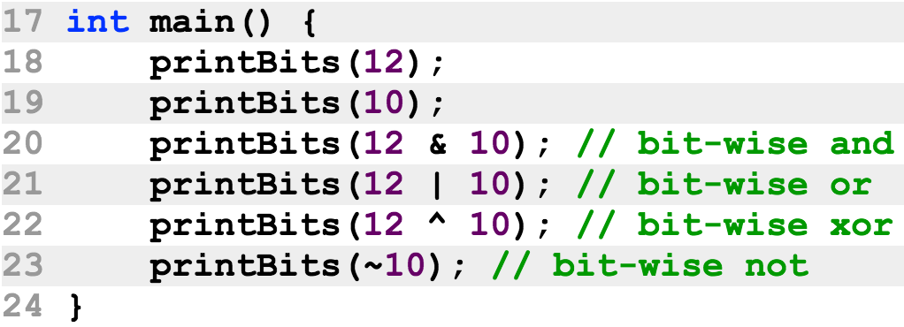
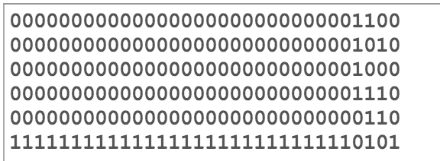
Bit-wise operations
Bit-wise operations are on integers
They regard an integer as an array of bits
They perform logical operations on this bits

Slide 9
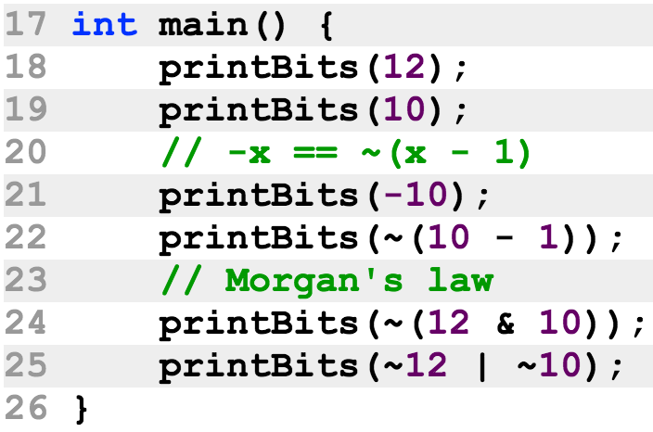
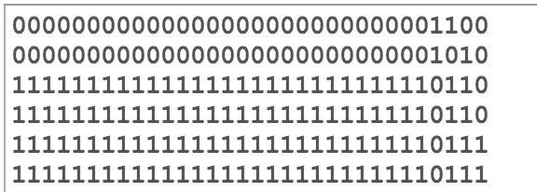
Bit-wise operations

Slide 10
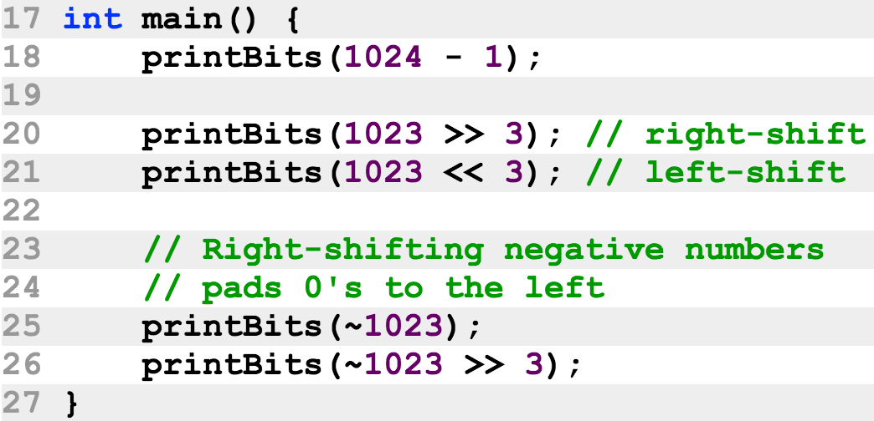
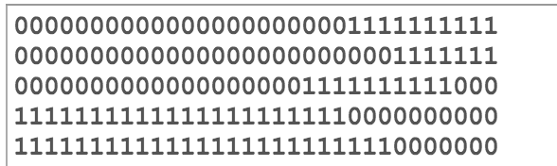
Bit-wise operations
Left/right shift operator

Slide 11
The if-else statement
Statements provide different language functionalities:
Definition statement
Input/output statement
Evaluation statement
Function call statement
If-else statement
Switch statement
For-loop statement
While-loop statement

Slide 12
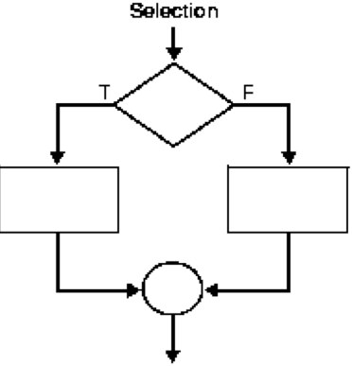
The if-else statement
Structural programming 结构化程序设计：
Sequential statement 顺序语句
Selection (branching) statement 选择(分支)语句

Slide 13
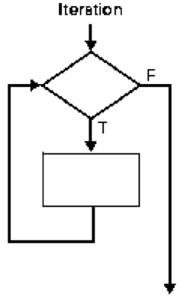
The if-else statement
Structural programming 结构化程序设计：
Sequential statement 顺序语句
Selection (branching) statement 选择(分支)语
Loop (iteration) statement 循环语句

Slide 14
The if-else statement
Structural programming 结构化程序设计：
Sequential statement 顺序语句
Definition statement
Input/output statement
Evaluation statement
Function call statement
Selection (branching) statement 选择(分支)语
If-else statement
Switch statement
Loop (iteration) statement 循环语句
For-loop statement
While-loop statement

Slide 15
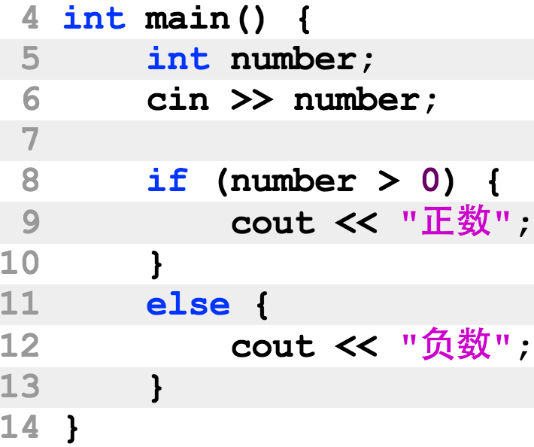
The if-else statement
Syntax: if (condition) block else block
Please pay attention to the indentation

Slide 16
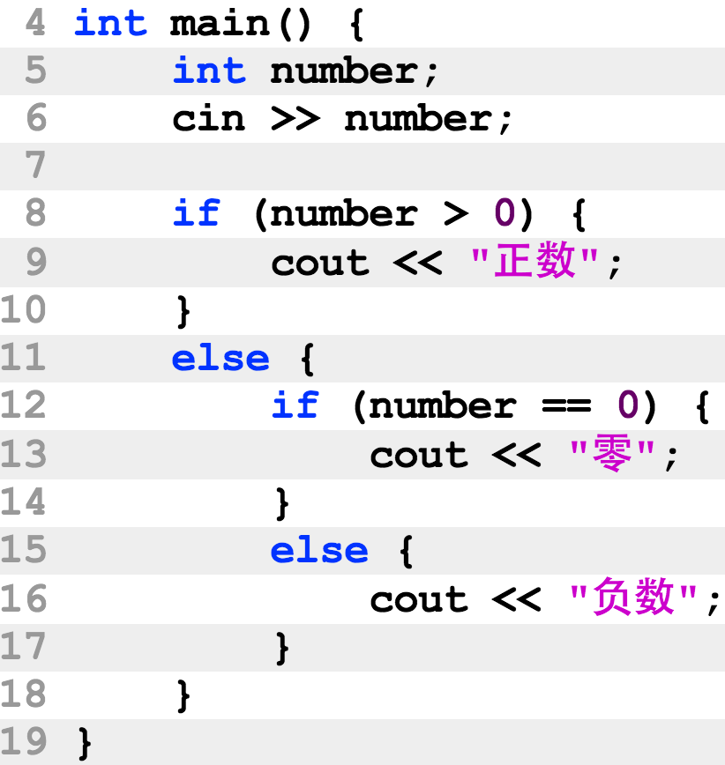
The if-else statement
Any statement can be inside the if-block and the else-block, including anther if-else statement

Slide 17
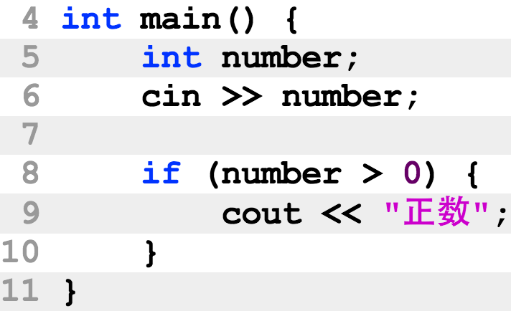
The if-else statement
The else-block is optional

Slide 18
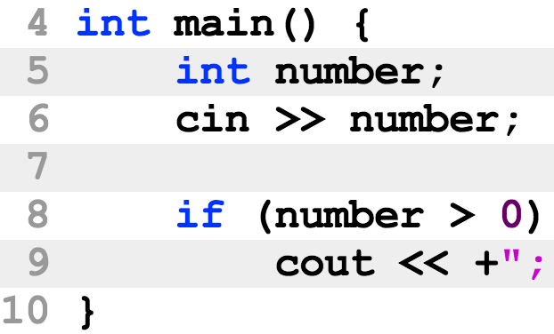
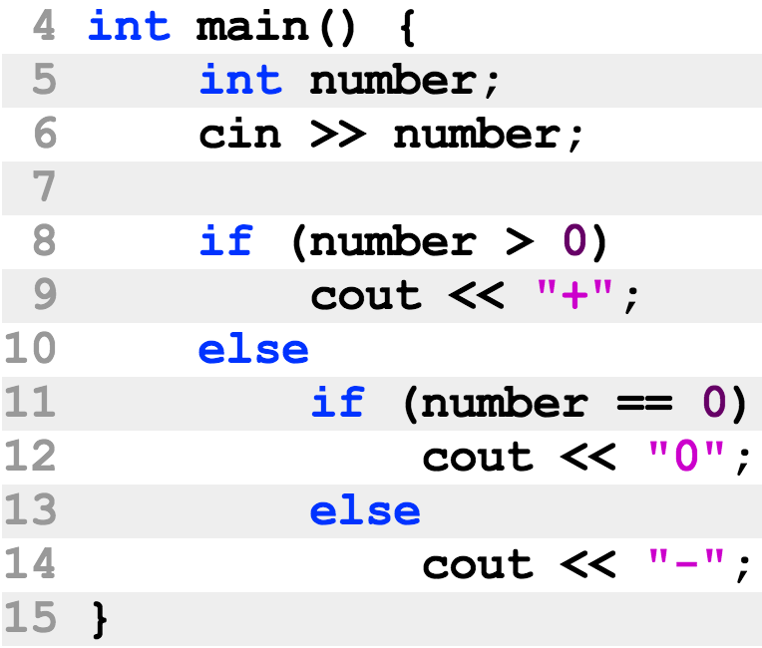
The if-else statement
When the if-block or the else-block contains a single statement, the { and } mark can be omitted.

Slide 19
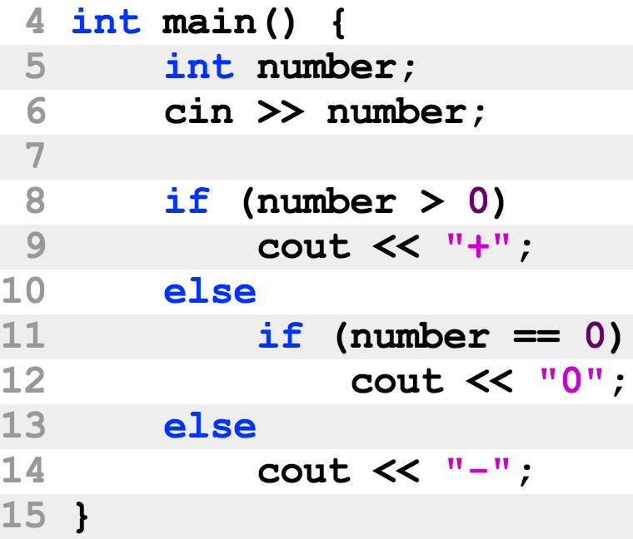
The if-else statement
It is a good practice to always have { and } in complicated if-else statements.
The two programs are actually the same
Each else-block associates with the most immediate if-block
The left example has a wrong indentation.

Slide 20
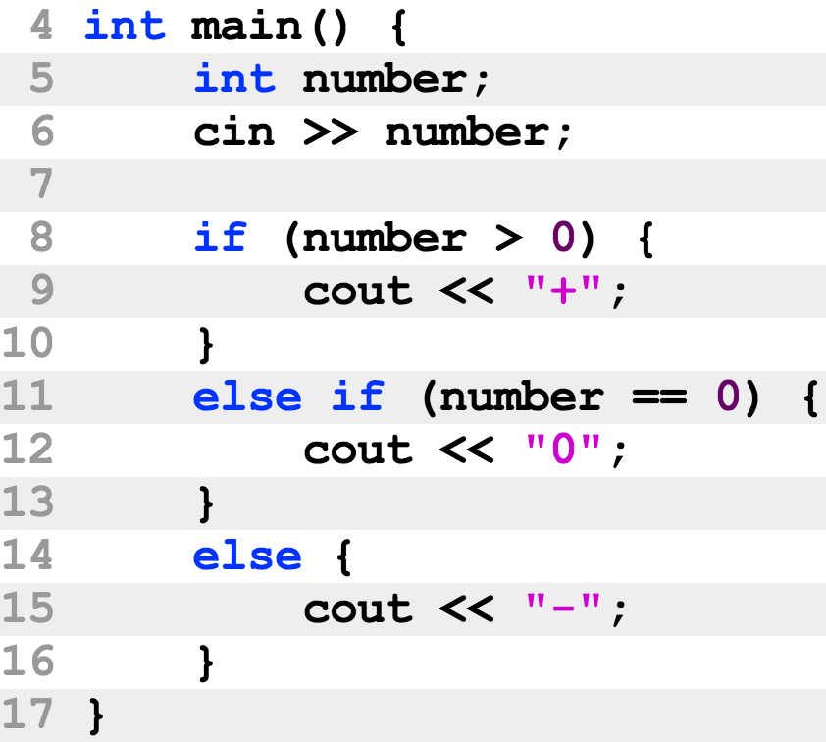
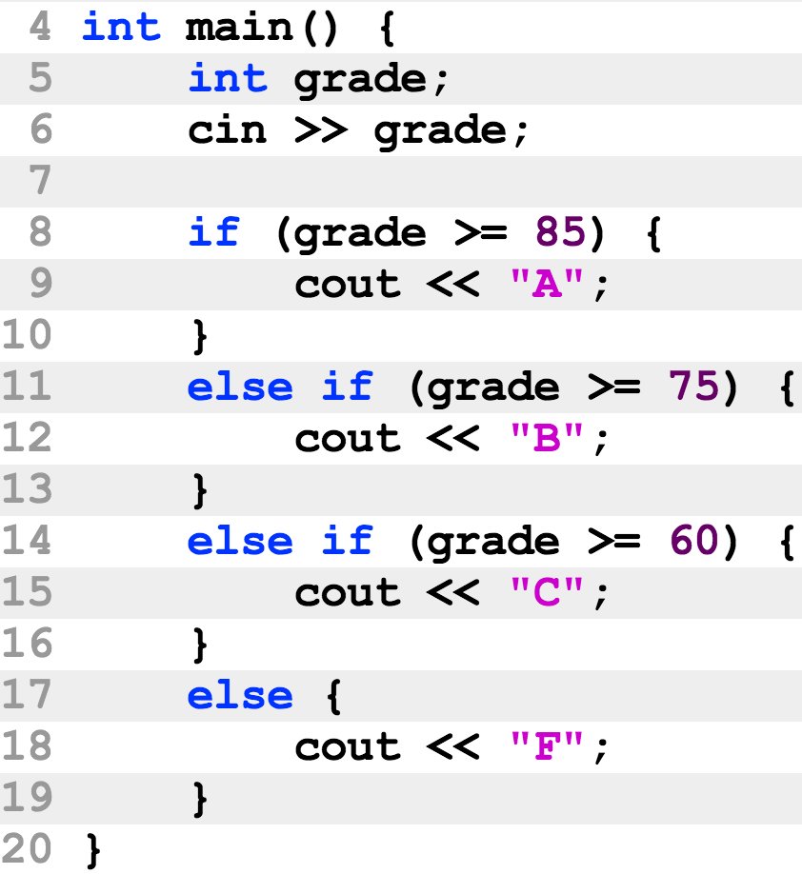
The if-else statement
Cascade if-else statements
Widely used to reduce indentation

Slide 21
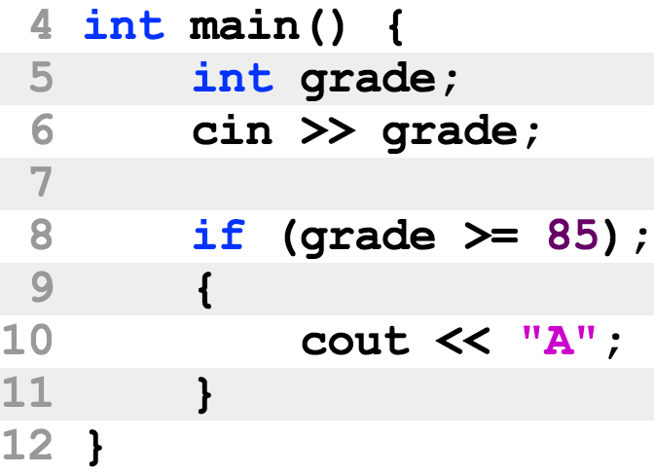
The if-else statement
Example of error 1
The if-statement ends at line 8 with an empty statement
Lines 9-11 is a block, which can appear alone

Slide 22
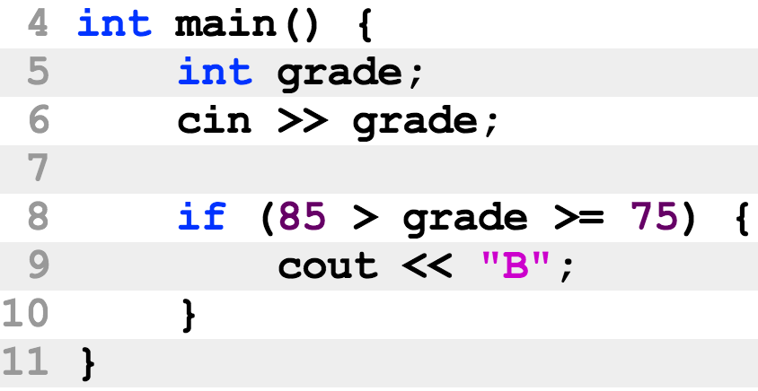
The if-else statement
Example of error 2
The boolean expression at line 8 is always false
85 > grade is either true or false
true >= 75 is false
false >= 75 is false either

Slide 23
Switch statement
结构：switch (int expression) block
In the switch block there can be case labels in addition to statements.
A case label starts with keyword case and an integer literal. Case标号后跟整数常量
Statements inside the switch block
runs sequentially
starting from the case label that matchs the int expression. 仅执行匹配case后的语句

Slide 24
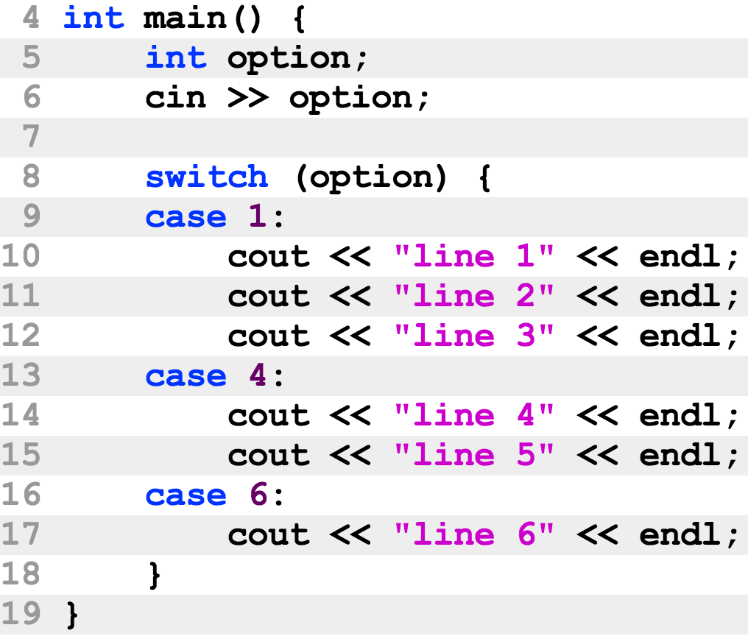
Switch statement
What will you see if the input is 4 ?(3 lines)
What if it is 5 ?(nothing)

Slide 25
Switch statement
An optional break statement inside a switch block
A special statement
The program will stop executing the other statements inside the switch block
The statements following the switch statement will be executed

Slide 26
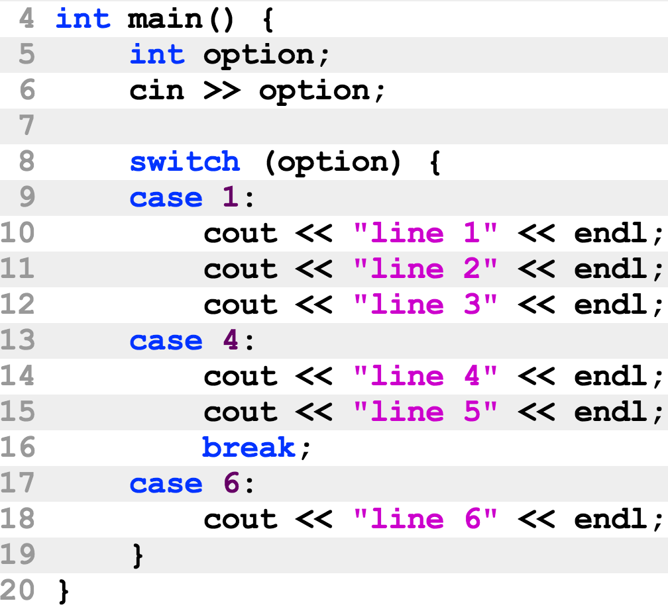
Switch statement
What will you see if the input is 1 ?(5 lines)

Slide 27
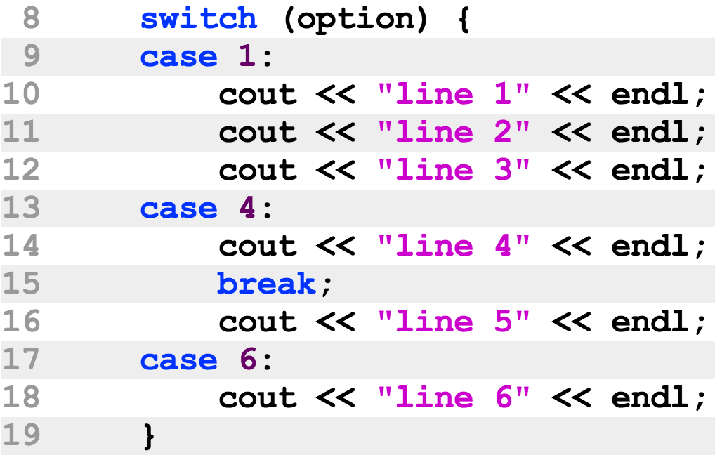
Switch statement
A logical error: line 16 will never run
A logical error means the error is grammatically correct and it may not be discovered by the compiler. 逻辑错误：语法上正确的错误

Slide 28
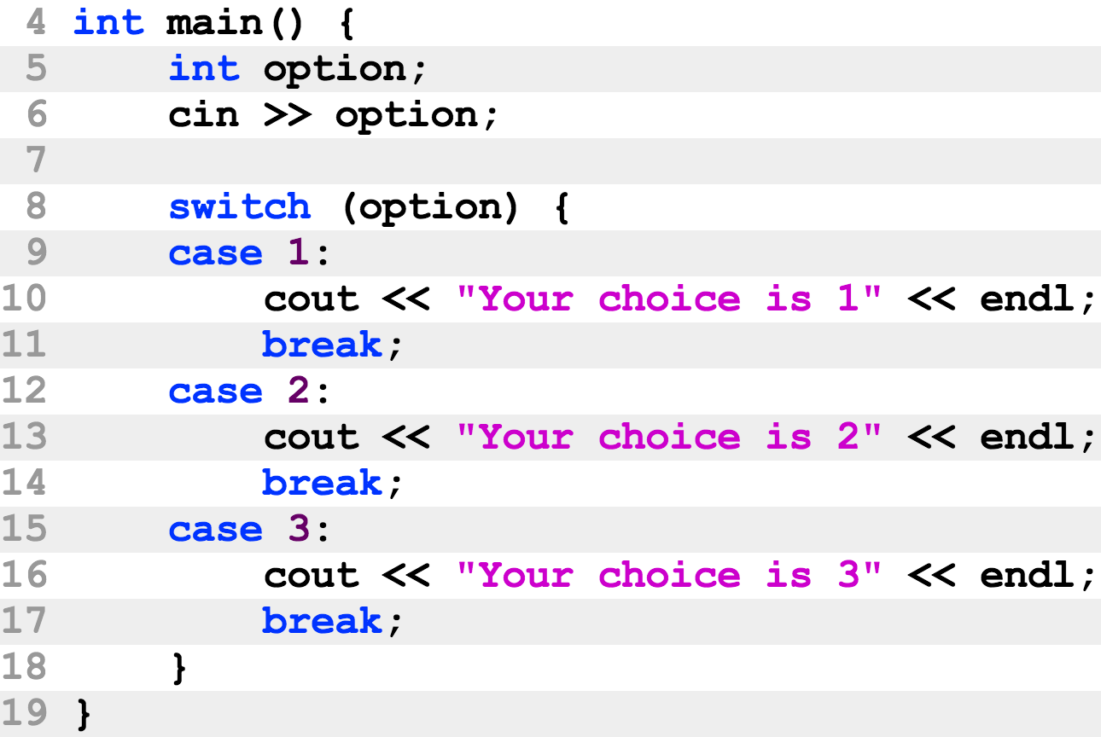
Switch statement
Most common usage: one break in each case.
The following program prints no more than one line.

Slide 29
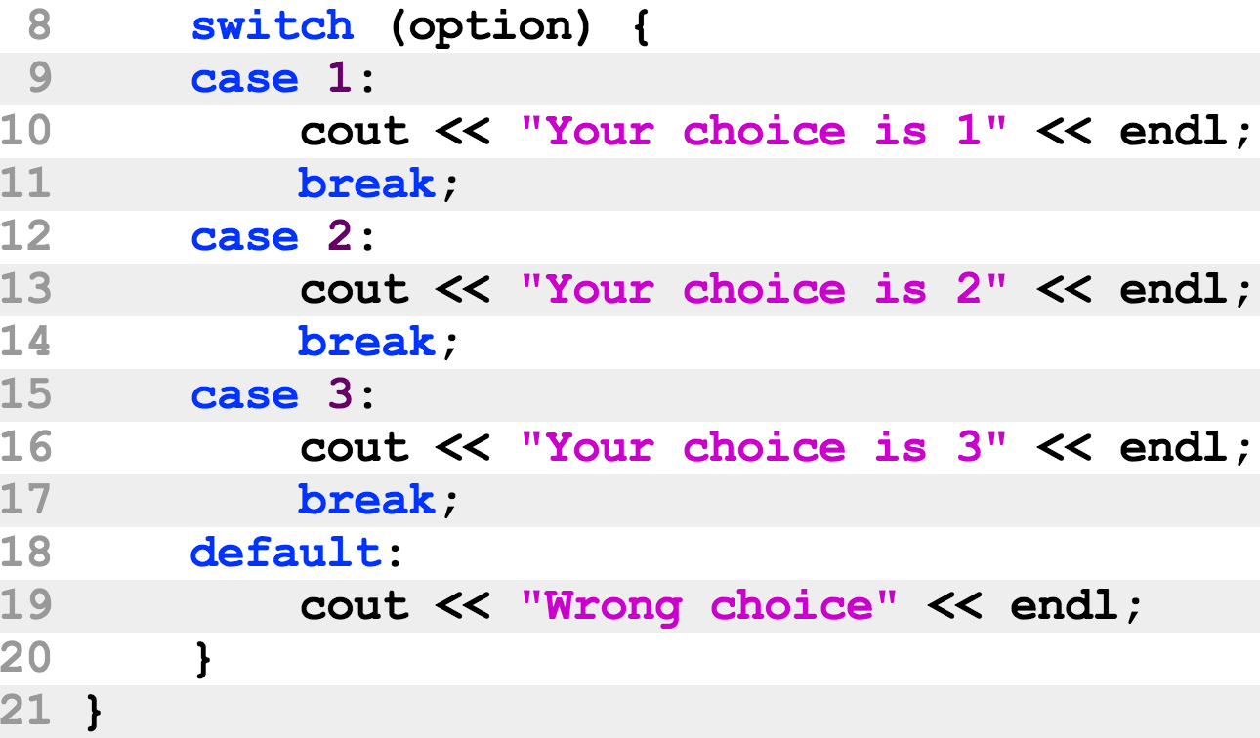
Switch statement
The default label
You will see “Wrong choice” when your input is not 1, 2, or 3.
default must be the last label
default matches when no case label matches

Slide 30
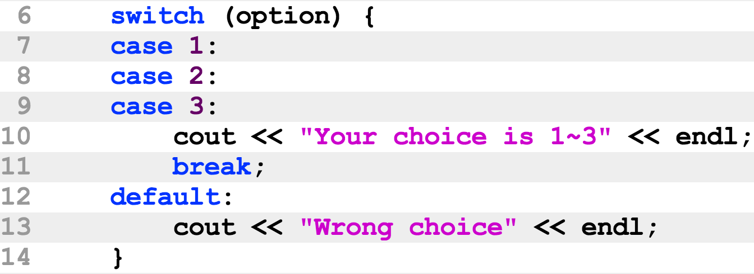
Switch statement
Multiple cases share the same piece of code

Slide 31
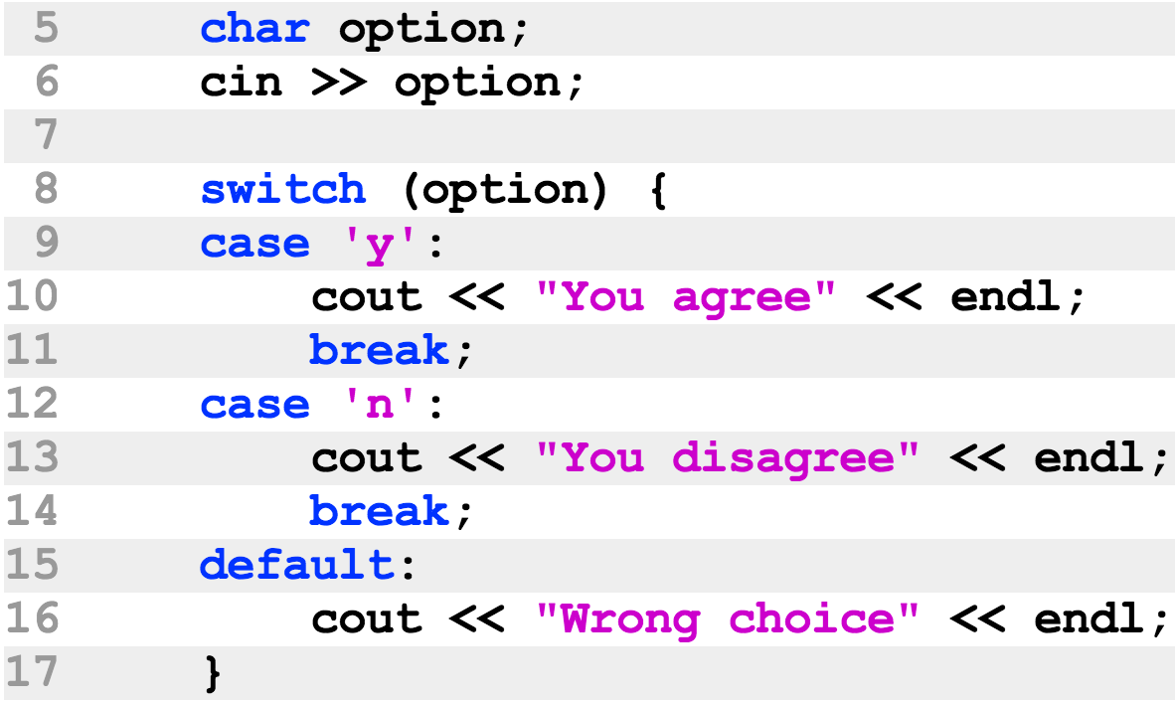
Switch statement
The expression following key-word switch can be other integer types:
long, short, char and bool

Slide 32
Switch statement
Comparing the switch statement and the if-else statement
if-else语句表达能力更强
它的条件可以任意地复杂，而while语句自能做整数的匹配：
整数范围的条件或浮点数比较的条件只能使用if-else
任何switch可以翻译成if-else，但反过来则不一定可以
switch语句更快
它使用hash算法实现，不须逐个case比较，可以直接调到匹配的case后面执行
switch语句更适合于具有大量case的情况

Slide 33
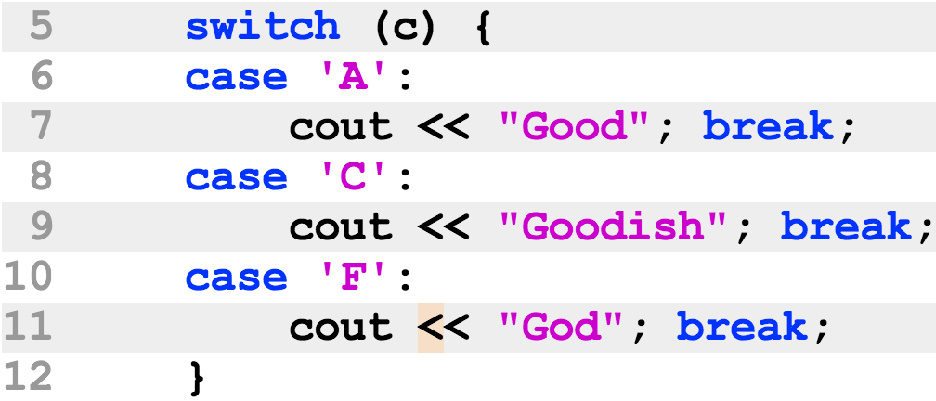
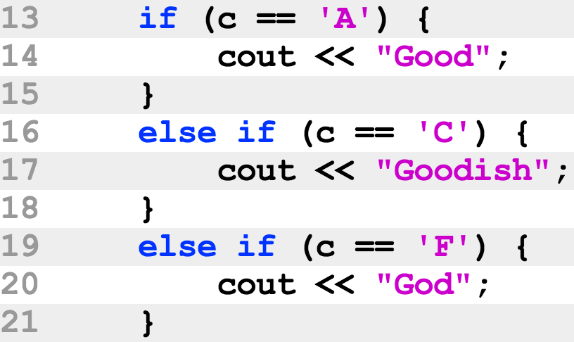
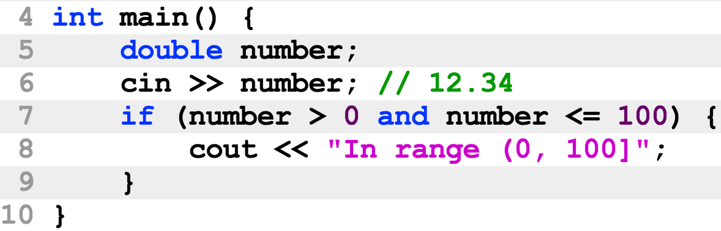
Switch statement
任何switch可以翻译成if-else
但反过来则不一定可以

Slide 34
Conditional operator ( ? : )
一个三元操作符
第一个操作数是bool类型，第二和第三操作数类型必须相同
当第一个操作数为真，返回值为第二操作数，否则为第三操作数

Slide 35
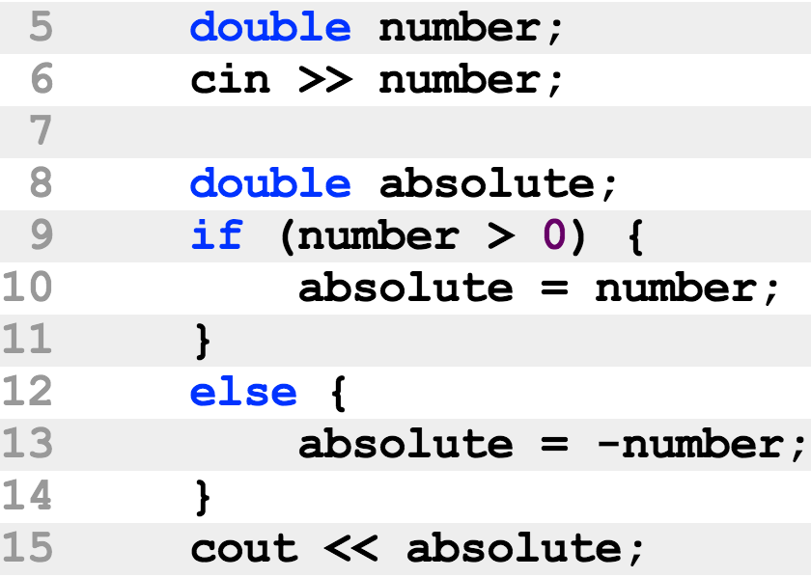
Conditional operator ( ? : )
一个三元操作符
例子：可简化if-else语句

Slide 36
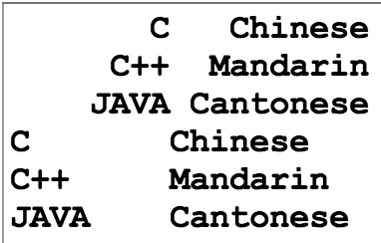
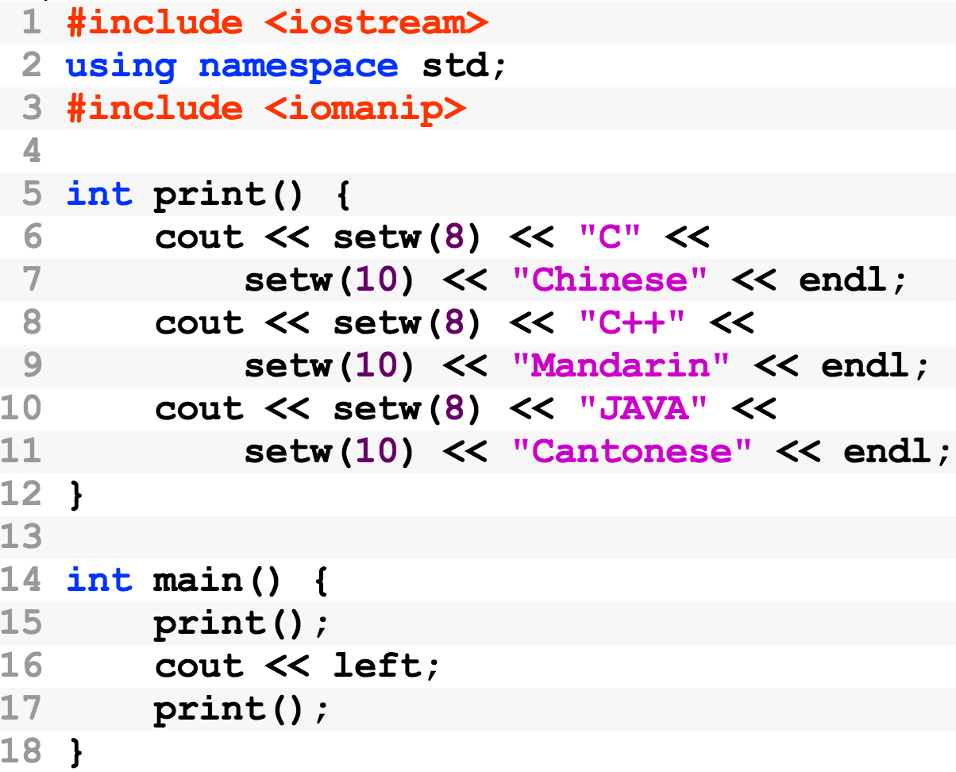
Formatting output
Examples

Slide 37
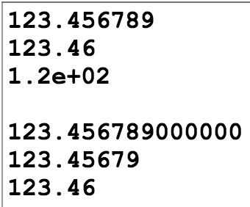
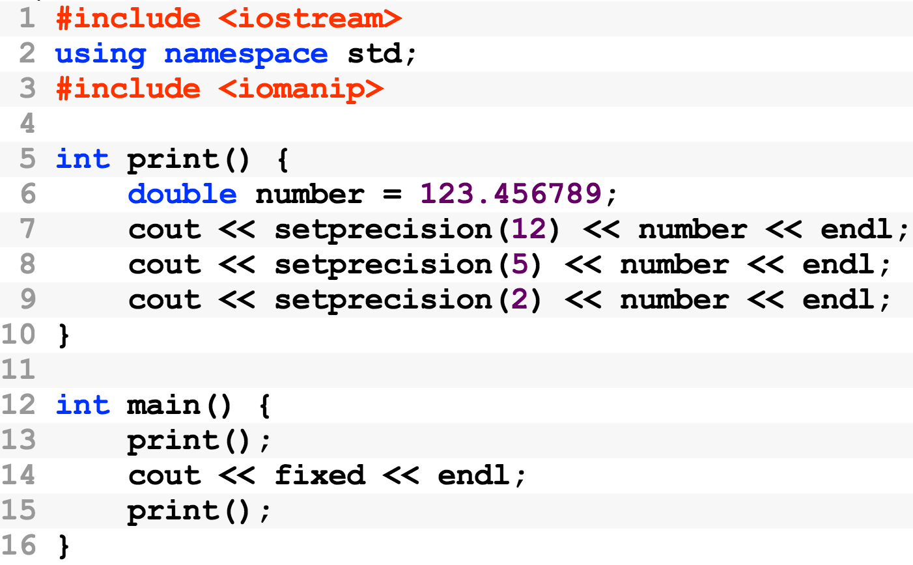
Formatting output
Examples

Slide 38
其它
作业提交网站
https://cse.sysu.edu.cn/cpp3
参考资料
http://cse.sysu.edu.cn/file
上课用的课件 (每星期上课前更新)
cpp_book.pdf (清华大学 C++, 钱能)
ThinkingInCpp.pdf (Thinking in C++, Bruce Eckle)

