Slide 1
Homework 2
Adder & Subtractor
Practice

Slide 2
Adder & Subtractor Practice
Coding Part
Adder (A,B: 3 digits)
Subtractor (A-B, A>=B)
Combine adder and subtractor
Report Part
Analyze the results under different number of digits, training epoch, training size, etc
Can we apply the same training approach for multiplication?
Due: 4/30

Slide 3
Flow
Data Representation
Data Generation
Feature Engineering
String Matching

Slide 4
Data Representation
char vocabulary
“0, 1, 2, 3, 4, 5, 6, 7, 8, 9, +/-, ' '”
length of the sequence
one-hot encoding
digital_tokens decoding

Slide 5
Data Generation
Generate some question-answer pairs for training and validating
question
answer

Slide 6
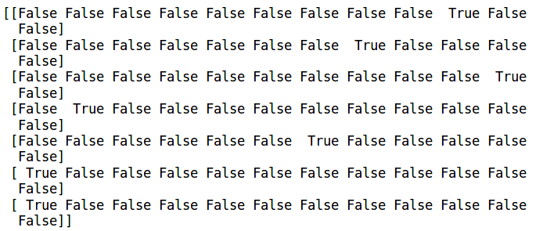
Feature Engineering
Transfer the training sets to one-hot representation.
“' ', +, 0, 1, 2, 3, 4, 5, 6, 7, 8, 9”

Slide 7
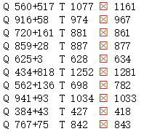
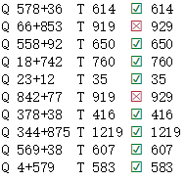
String Matching
When we train our model with the generated datasets, the matching accuracy will gradually increase.
Epoch 1
Epoch 98

Slide 8
Extension Problems
More digits per number ?
More numbers added ?
…...
Sample code :
https://github.com/IKMLab/Adder_practice

