Slide 1

BODY BEATS
BODY BEATS
BODY BEATS

Slide 2

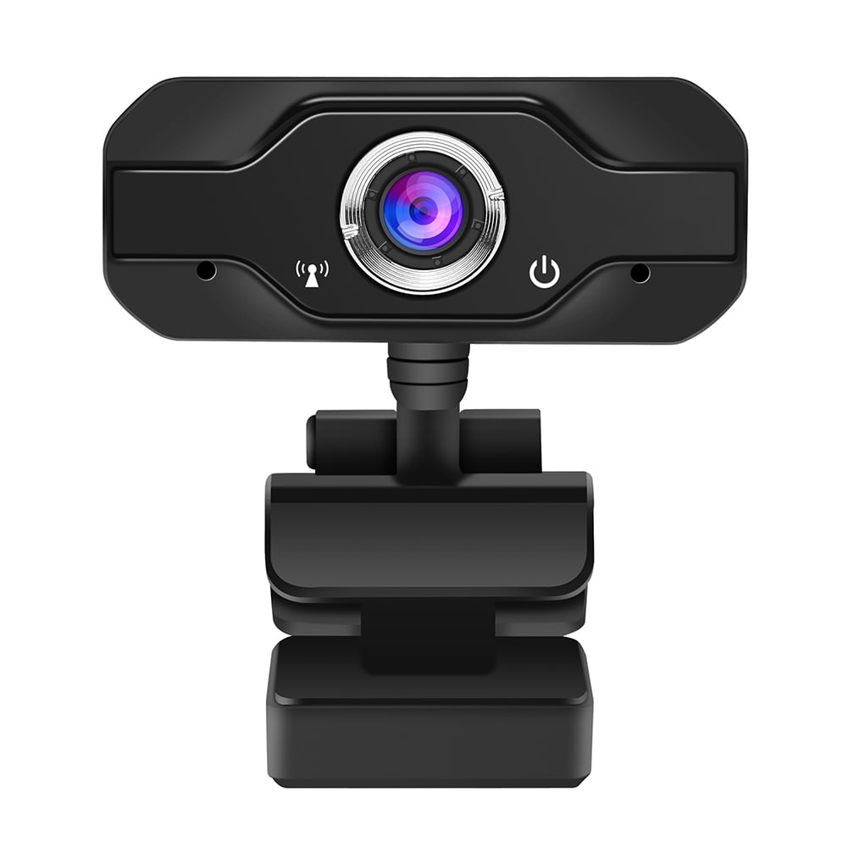


Slide 3

MEDIAPIPE DETECTION
POST LANDMARK 33 POINTS
HAND LANDMARK 21 POINTS
FACE LANDMARK 468 POINTS

Slide 4



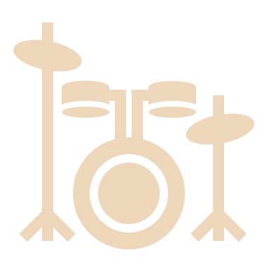


STEP 1 Choose instrument

Slide 6



STEP 2 Try to pose the beats

