Slide 1
Welcome
To
Machine learning
Professor: CVSN ready
By Mohammed Ikram

Slide 2
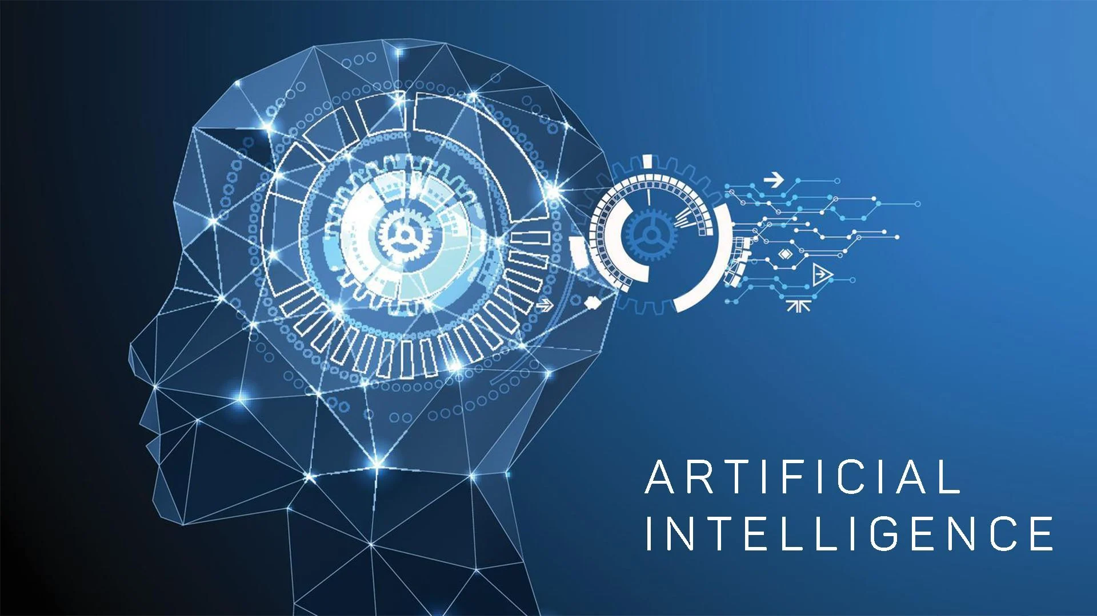
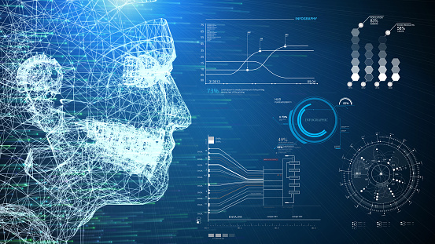
What is Artificial Intelligence
Human Intelligence built in the computer

Slide 3
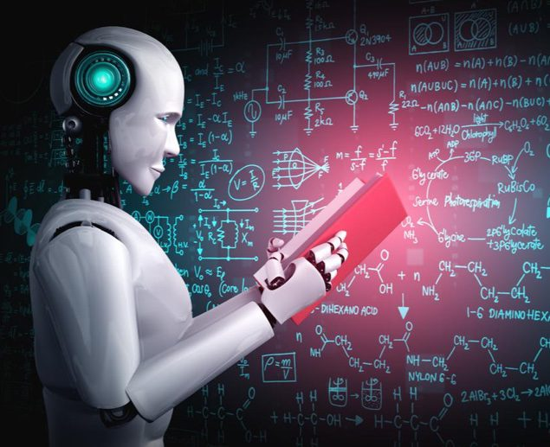
What is machine learning
Machine to learn or work
If we give the input and output to machine level algorithm it will build the model
input
output
Machine level algorithm
=
model
+
to

Slide 4
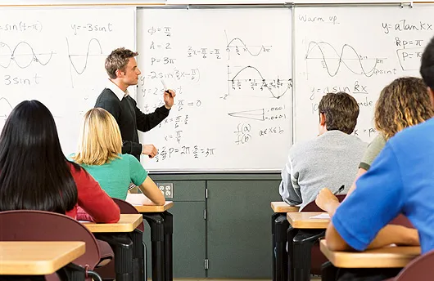


Supervised learning
Learning by other
Its has features and label
Regression and Classification
unsupervised learning
learning by own
clustering and association
reinforcement learning
Getting reward and penalties

Slide 5

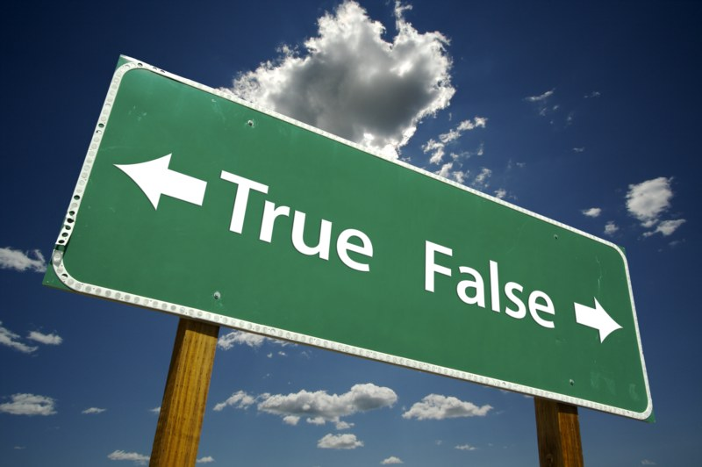
Regression
It is used to predict continuous values
its continuous
Ex: Books
classification
It is used to discrete the data
It is not continuous
Ex: true or false , may or may not

Slide 6


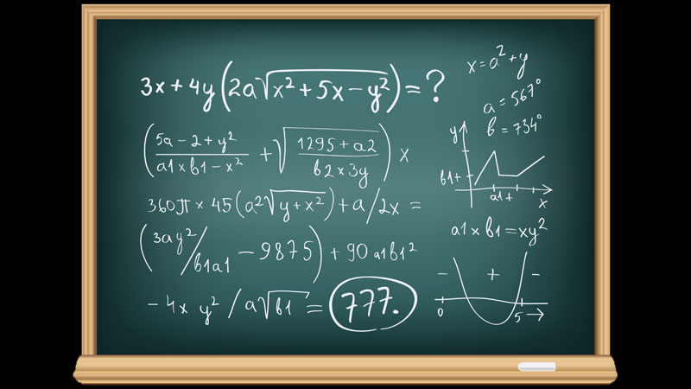
Features
label
Input (features)
model
Output (label)
Function (model)

Slide 7
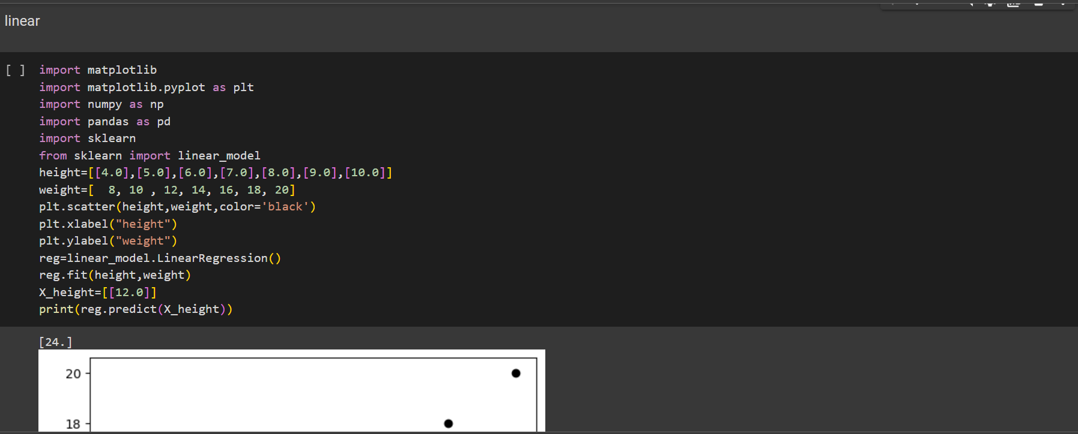
Linear regression

Slide 8
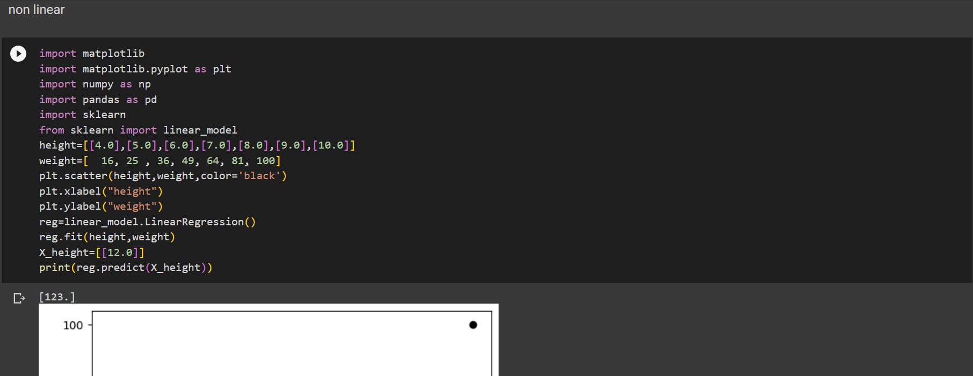
Non Linear

Slide 9
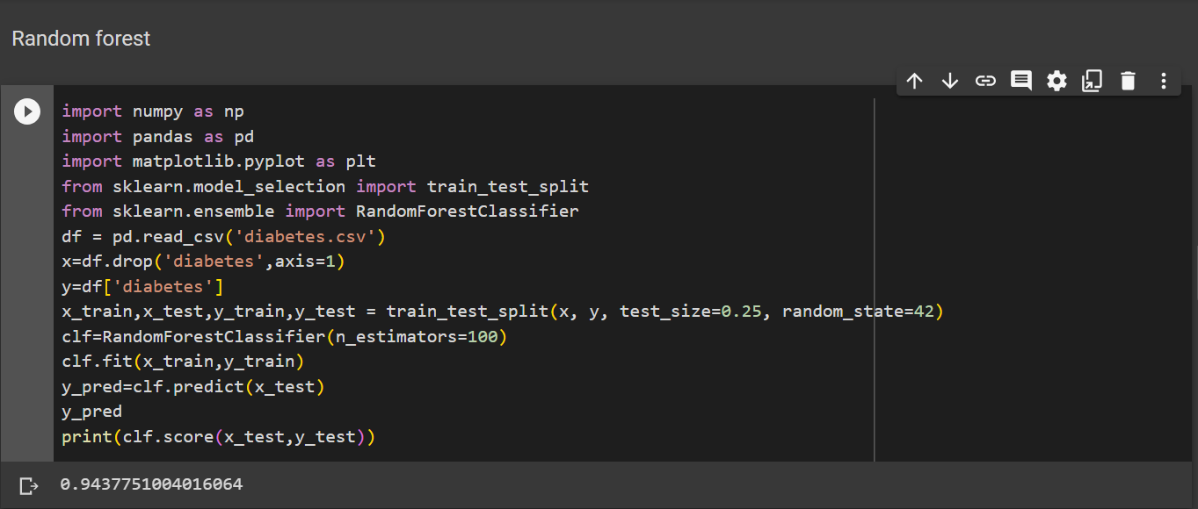
Random Forest

Slide 10
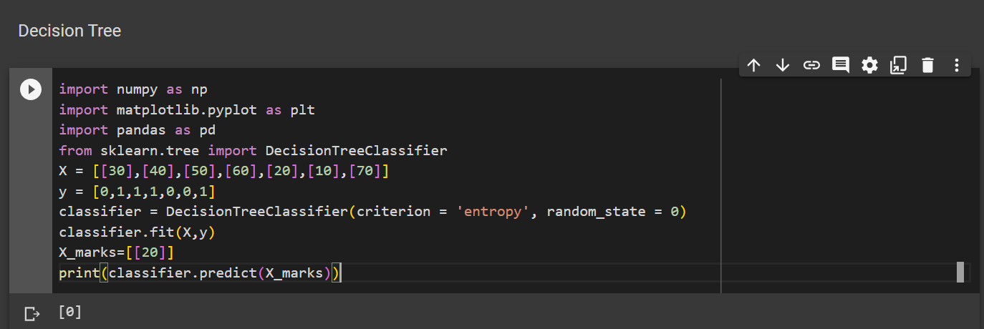
Decision Tree

Slide 11
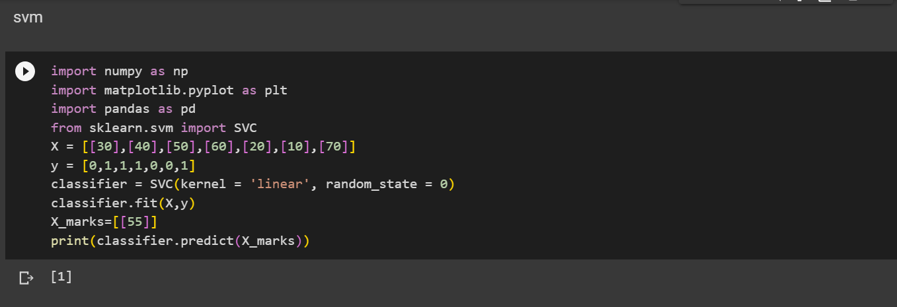
SVM (Support Vector Mission)

Slide 12
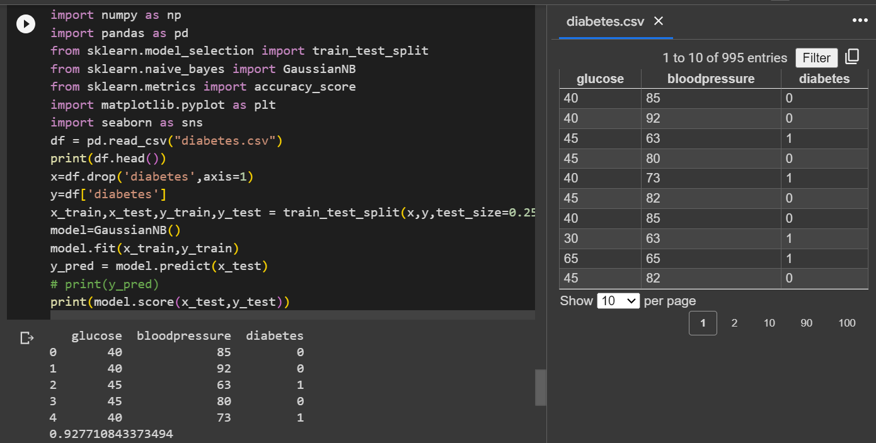
Naive Bayes

